Slide 1
Weekly meeting
12 21 2023
Ty Bottorff

Slide 2
Outline
Myocarditis irAE dataset analysis
Feature vs. clonotype abundance plots
Association between cell type & irAE group
Colitis irAE dataset analysis
Association between cell type & irAE group
Feature analysis by cell type, irAE group
TCR repertoire diversity analysis by cell type, irAE group

Slide 3
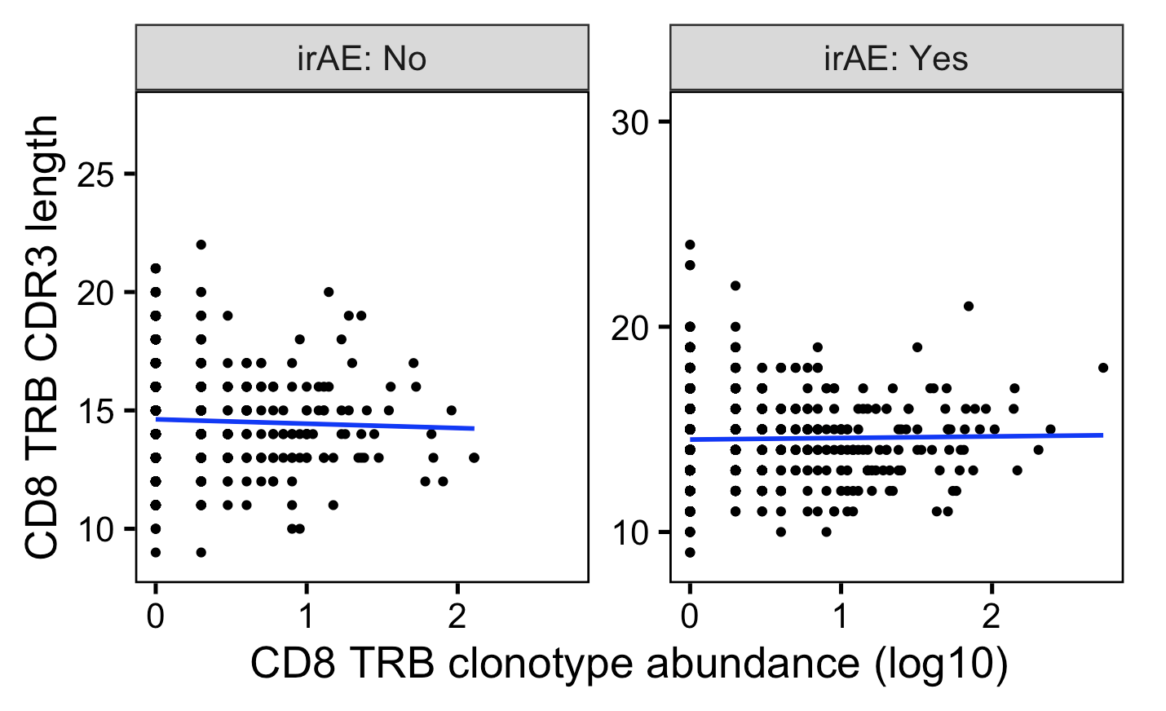
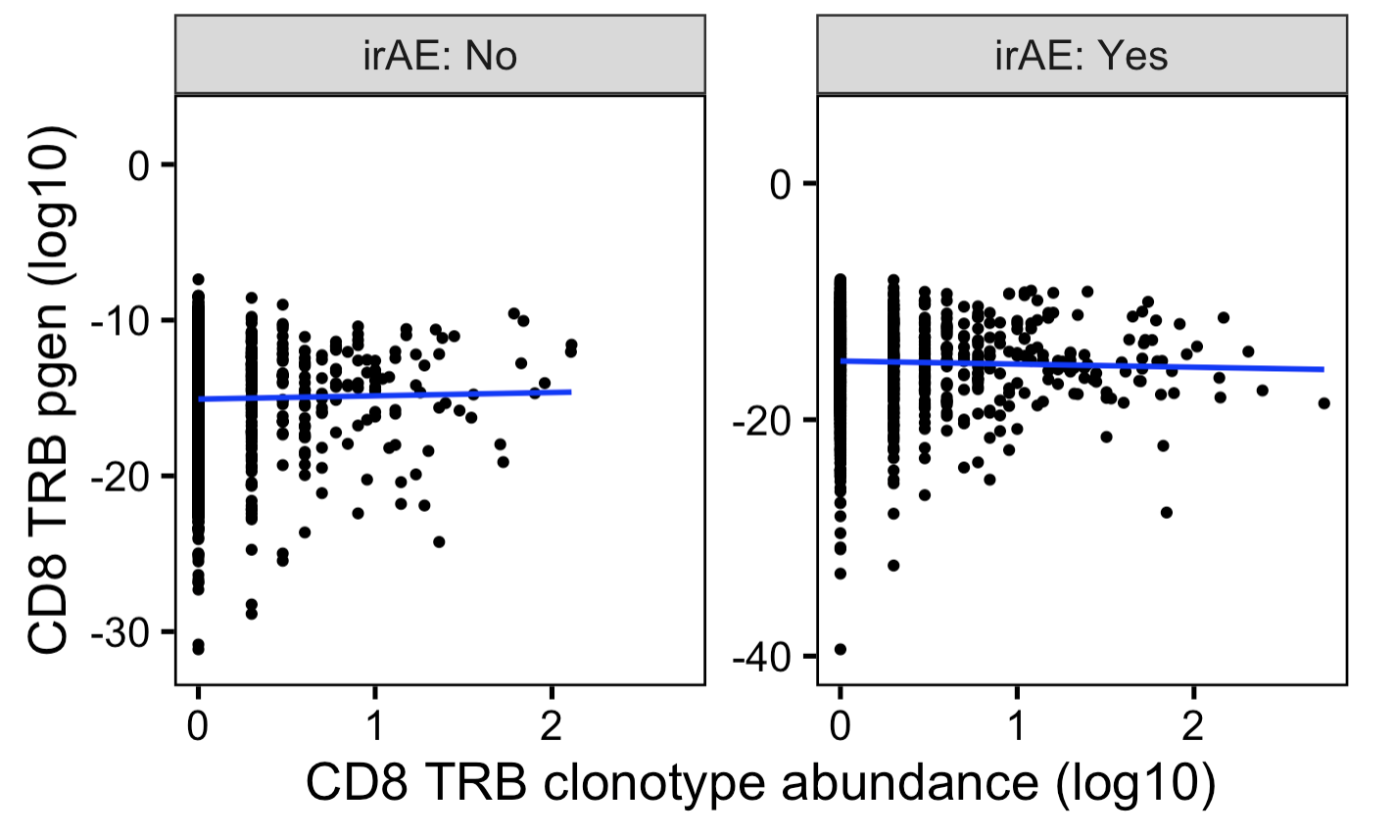
In myocarditis dataset, can see small differences in best fit slopes for feature vs. clonotype abundance plots for yes/no irAE
Unique TCRs
Notes:
Slope differences much bigger if no log10 x-axis scale, but then all squished in x-axis

Slide 4
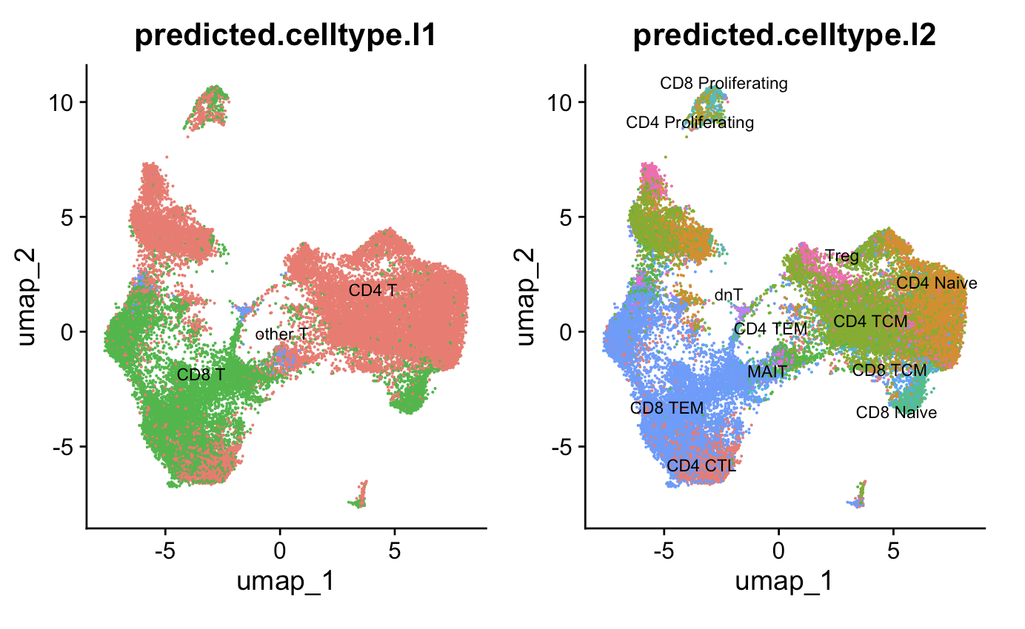
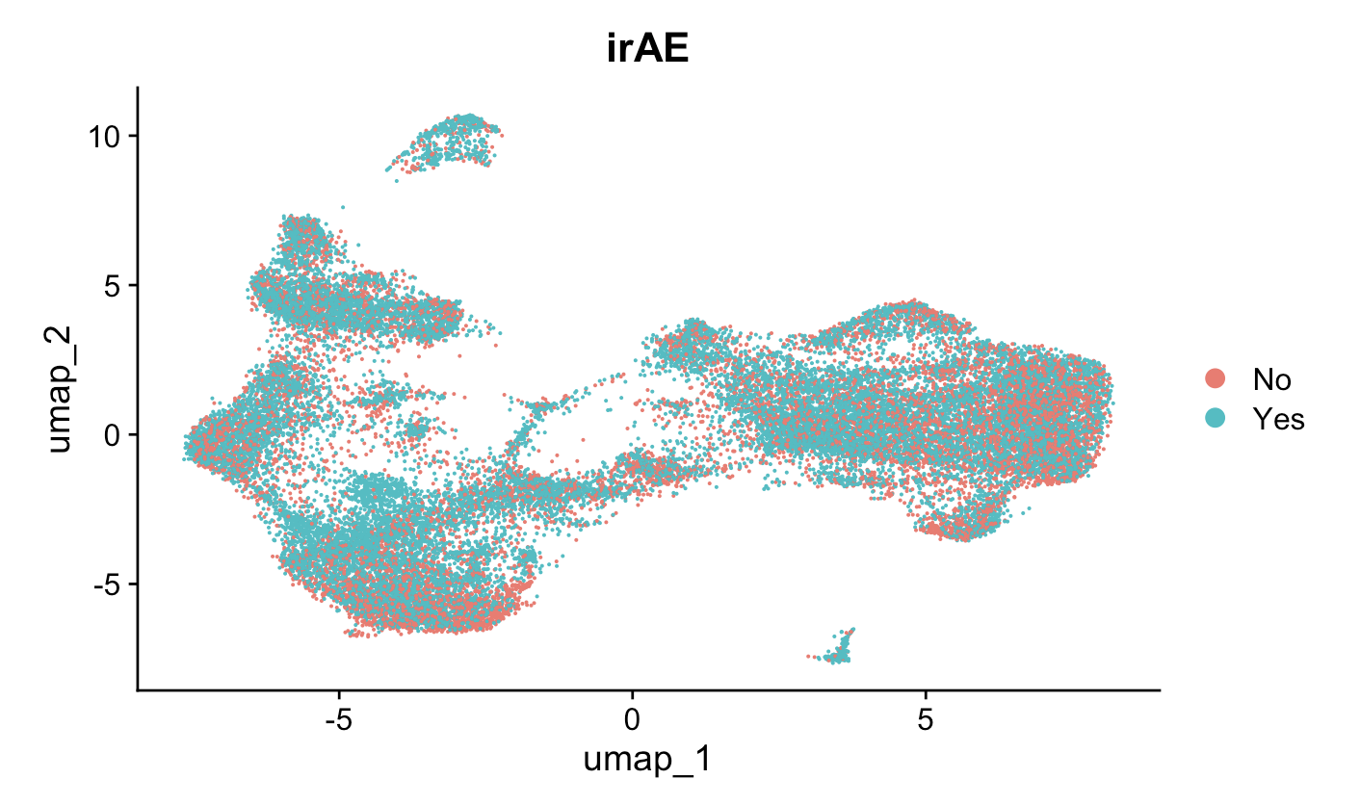
In myocarditis dataset, there is a significant association between cell type (l2) and irAE grouping
irAE
p < 2e-16, Pearson’s Chi-squared test
Notes:
Pearson's Chi-squared test data: contingency_table X-squared = 1185.3, df = 11, p-value < 2.2e-16

Slide 5
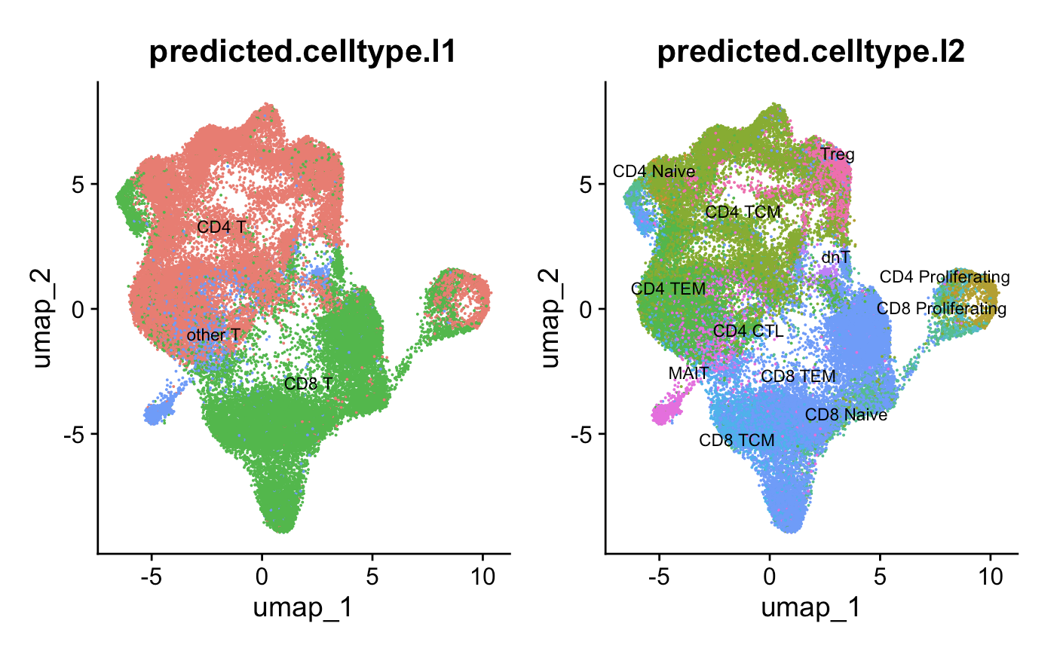
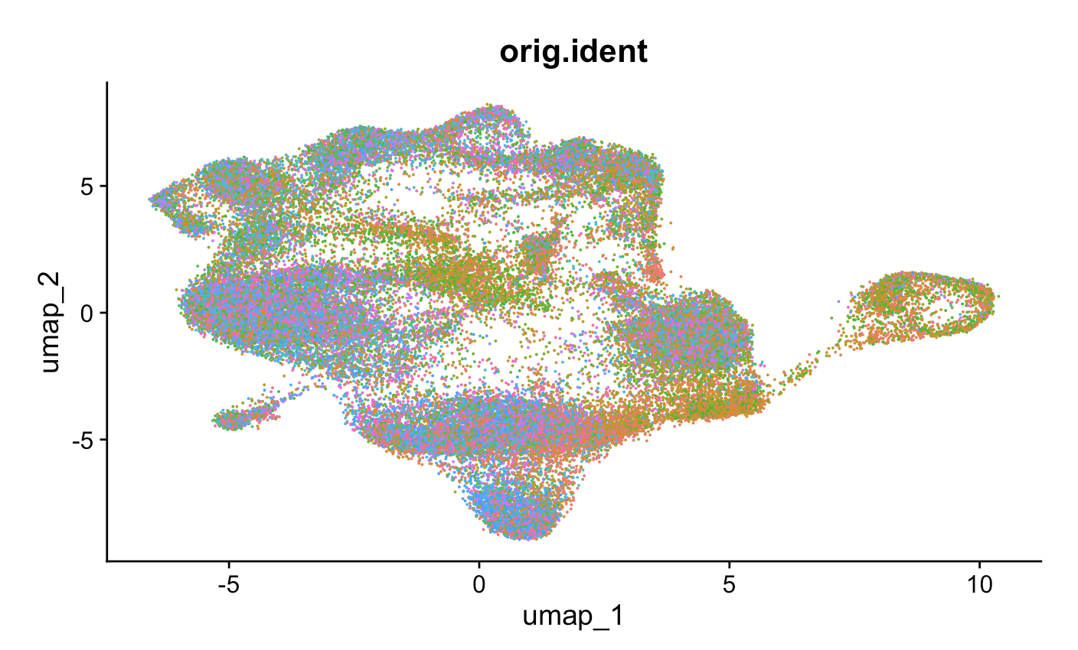
There don’t seem to be significant batch effects (by patient) in colitis dataset
Patient ID

Slide 6
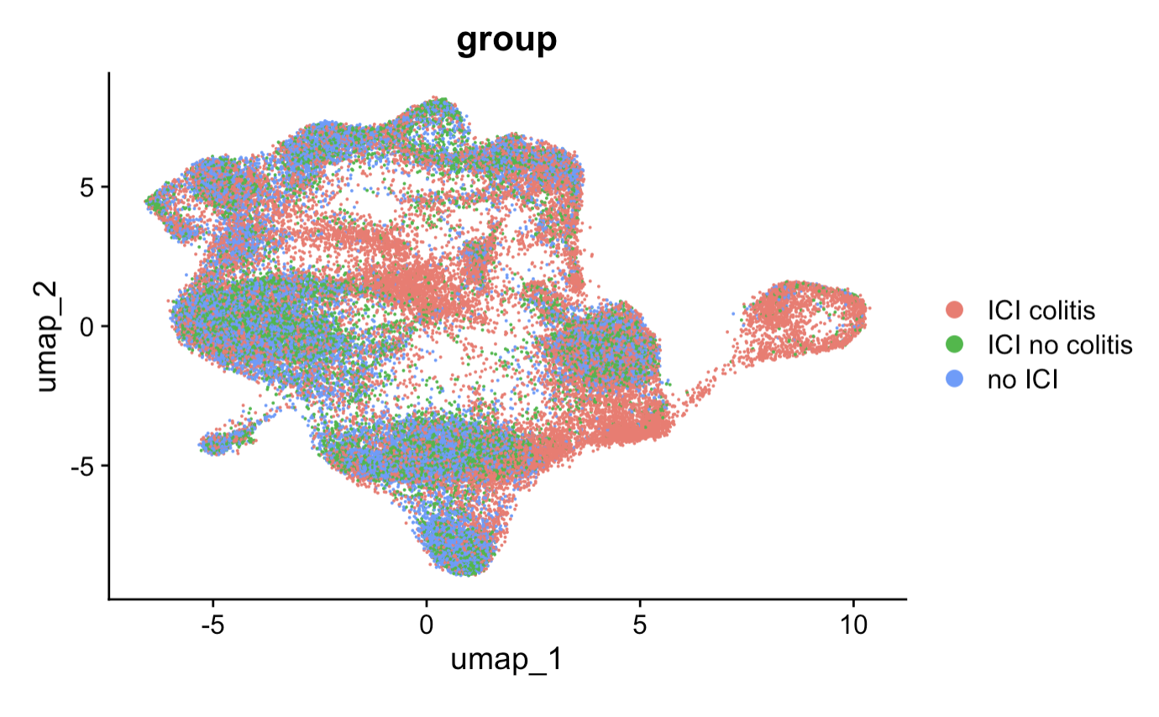
In colitis dataset, there is also a significant association between cell type (l2) and patient grouping
p < 2e-16, Pearson’s Chi-squared test
Notes:
Pearson's Chi-squared test data: contingency_table X-squared = 14158, df = 22, p-value < 2.2e-16

Slide 7
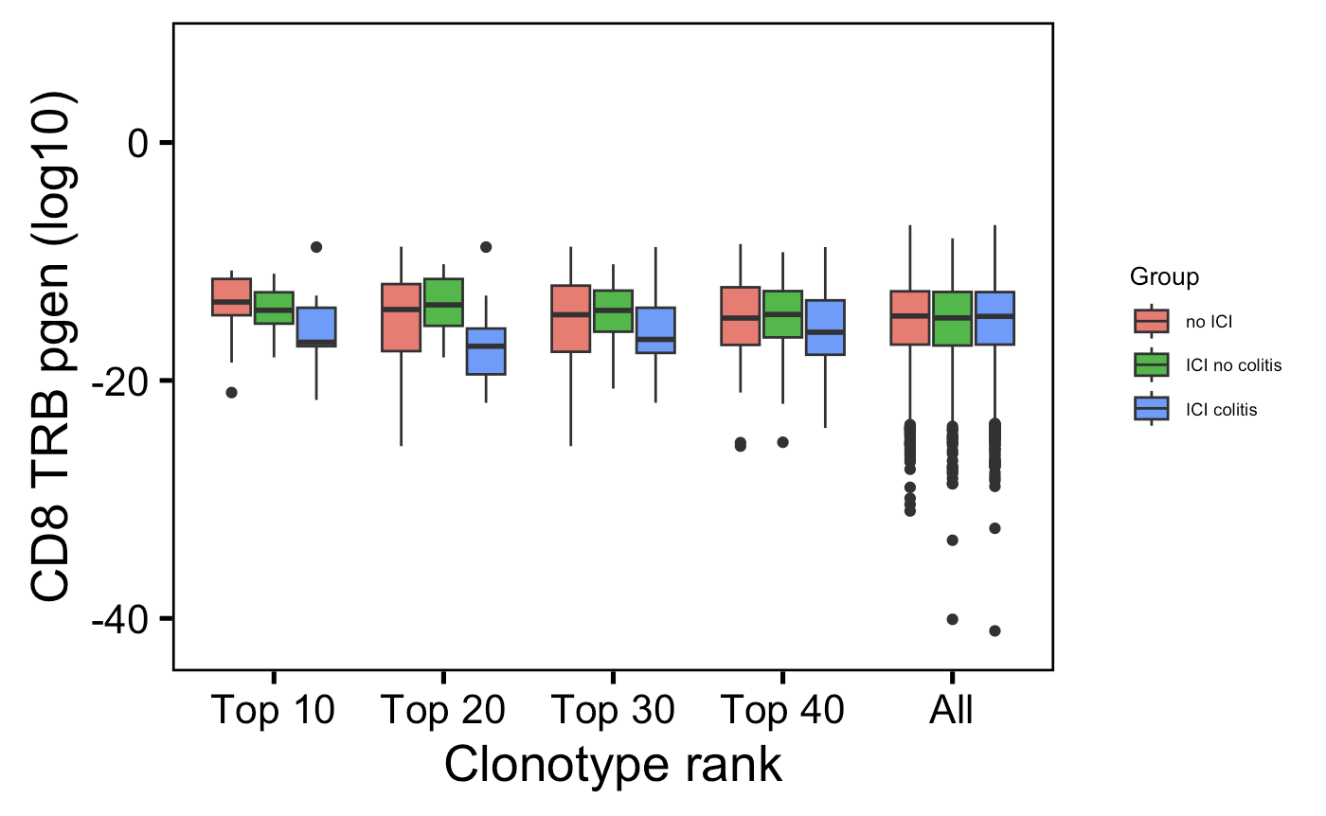
In colitis dataset, CD8 T TRBs are also slightly less germline-like in those developing colitis vs. ICI-no colitis group
**
→
More germline-like
Less germline-like
→
Wilcoxon rank sum test. ****, padj <1e-4; **, padj <1e-2; *; padj <0.05

Slide 8
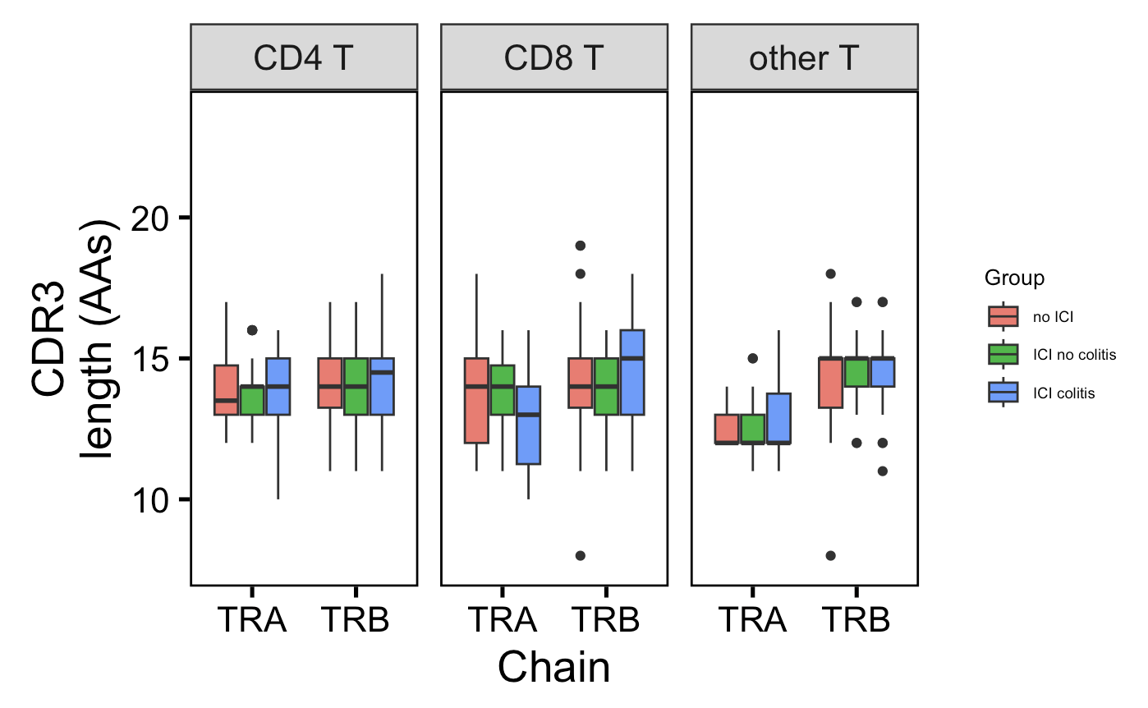
In colitis dataset, there are no junction length differences between patient groups
Unique TCRs from top 30 clonotypes (per chain & cell type) in each patient group

Slide 9
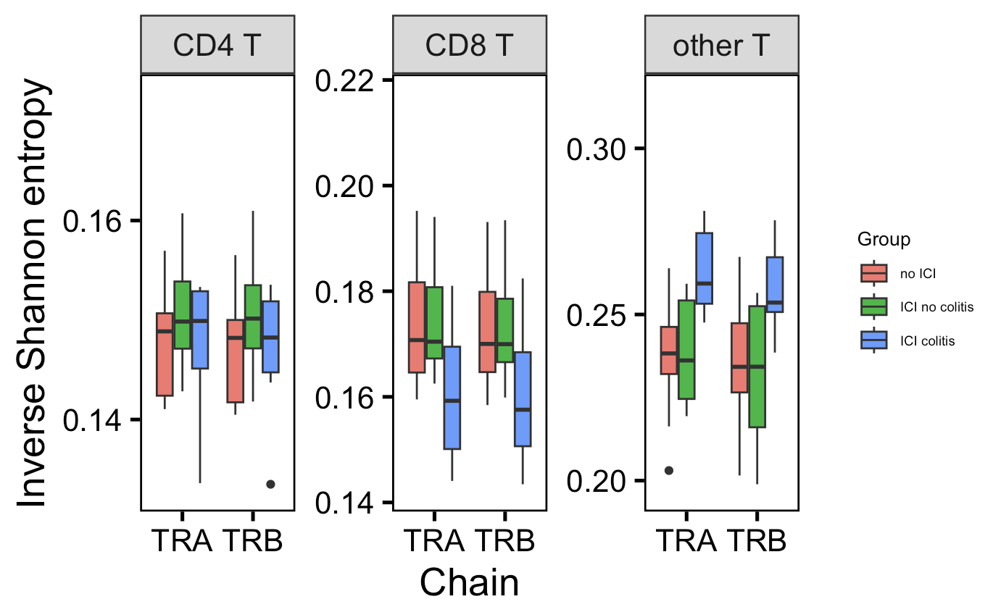
In colitis dataset, CD8 TCR repertoire slightly more polyclonal and other T TCR repertoire more monoclonal in those developing colitis irAE (vs. no ICI)
p =
0.09
p =
0.09
*
*
*
→
More monoclonal
More polyclonal
→
Wilcoxon rank sum test. ****, padj <1e-4; **, padj <1e-2; *; padj <0.05

Slide 10
Conclusions
In both datasets, see cell type (l2) associated with irAE grouping
In both datasets, CD8 TRBs are less germline-like in those developing colitis irAE
Less solid in colitis dataset than in myocarditis dataset
However, do not see longer CD8 TRB CDR3s in colitis dataset as we saw in myocarditis dataset
Uniquely in colitis dataset, see TCR repertoire diversity differences between irAE groups

Slide 11
Next steps
Check V(D)JC gene usage differences by irAE group in colitis dataset
Perhaps an alternative explanation for pgen differences if CDR3 lengths are the same
Vitiligo dataset

Slide 12
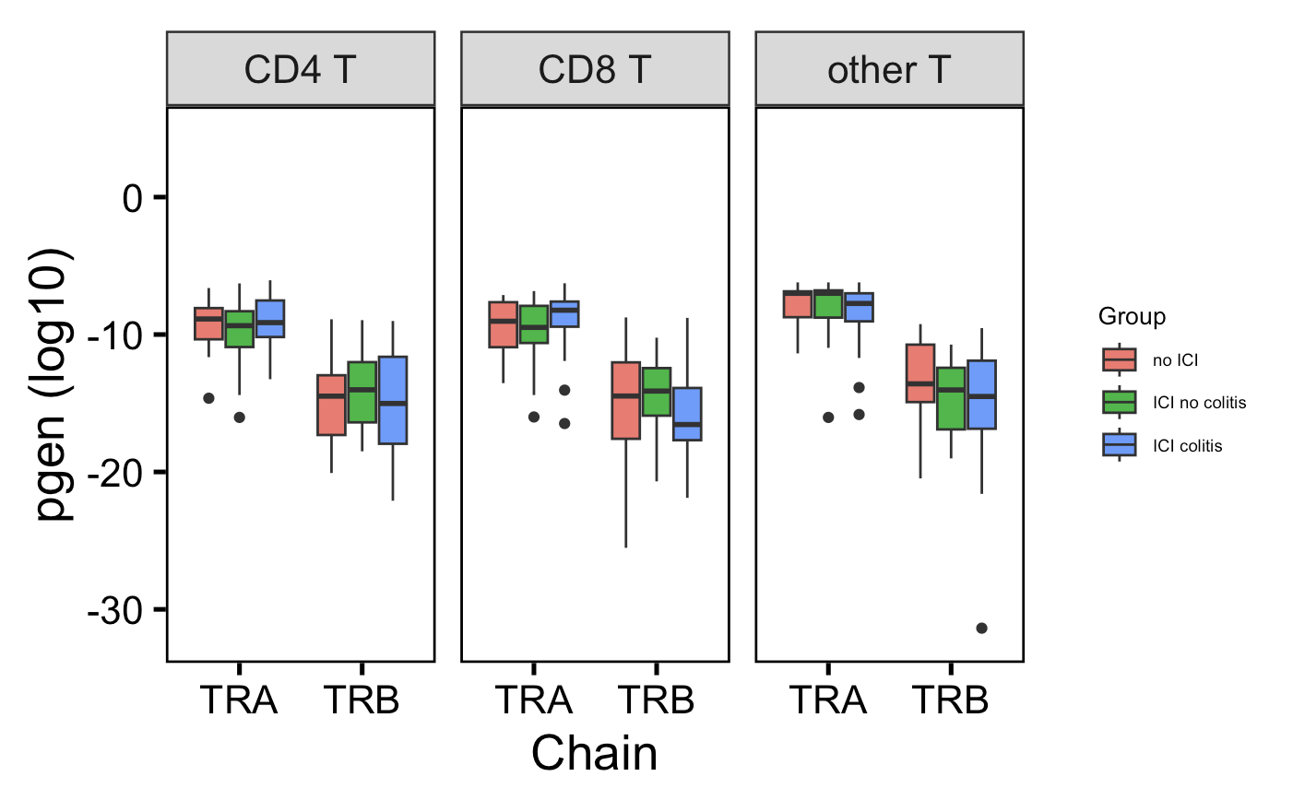
In colitis dataset, CD8 T TRBs are slightly less germline-like in ICI-colitis group vs. ICI-no colitis group
Unique TCRs from top 30 clonotypes (per chain & cell type) in each patient group
→
p = 0.07
More germline-like
Less germline-like
→
Wilcoxon rank sum test. ****, padj <1e-4; **, padj <1e-2; *; padj <0.05

Slide 13
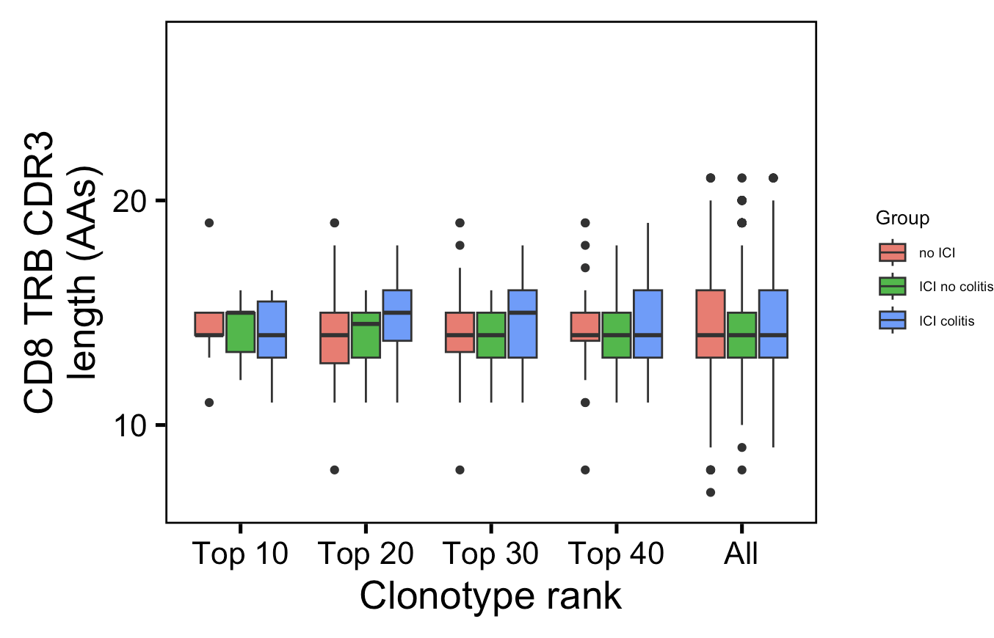
In colitis dataset, there are no CD8 TRB junction length differences between patient groups at any clonotype rank cutoff
Unique TCRs from top 30 clonotypes (per chain & cell type) in each patient group

Slide 14
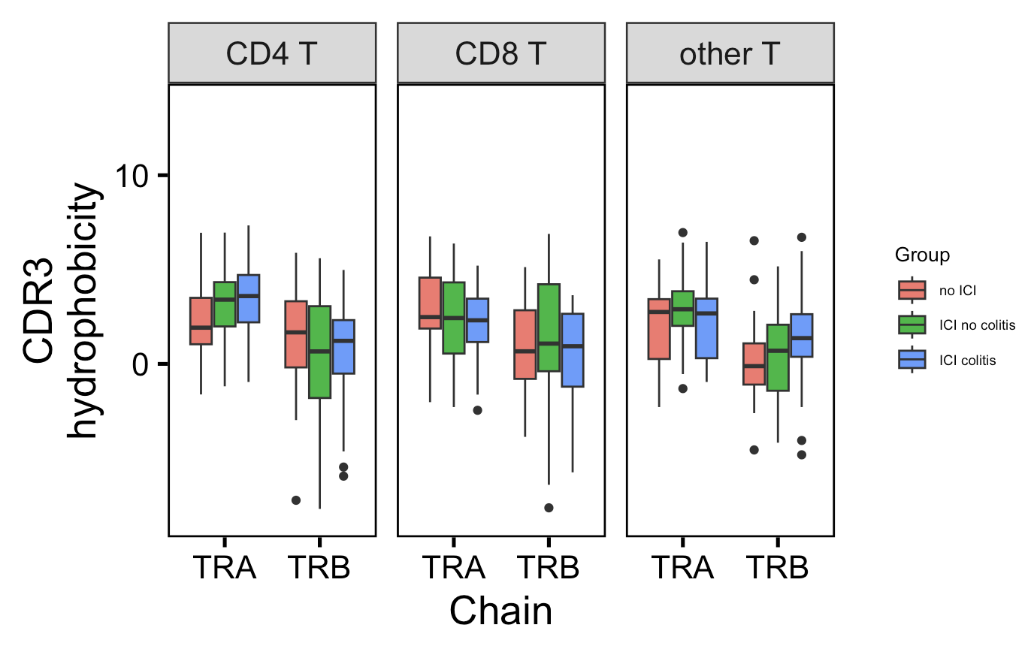
In colitis dataset, there are no junction hydrophobicity differences between patient groups
Unique TCRs from top 30 clonotypes (per chain & cell type) in each patient group

Slide 15
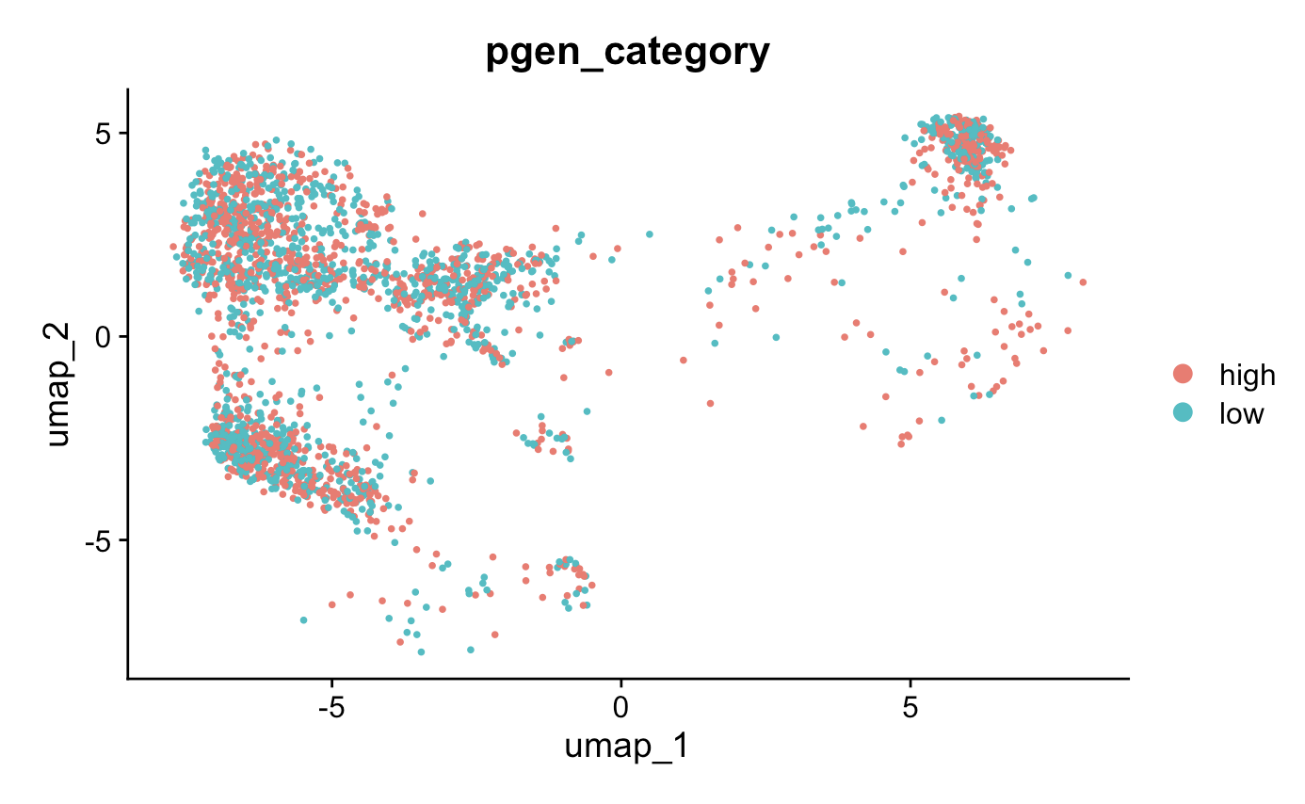
In myocarditis dataset, low and high pgen scores (from CD8 TRBs) do overlap on UMAP, not expecting RNA phenotype differences
Notes:
UMAP is different here because I re-ran code and had been working with a slightly messed up Seurat object but I think it’s ok…

