Slide 1
Weekly meeting
2 15 2024
Ty Bottorff

Slide 2
Outline
Reproduced some of Erin’s ATACseq analysis figures

Slide 3
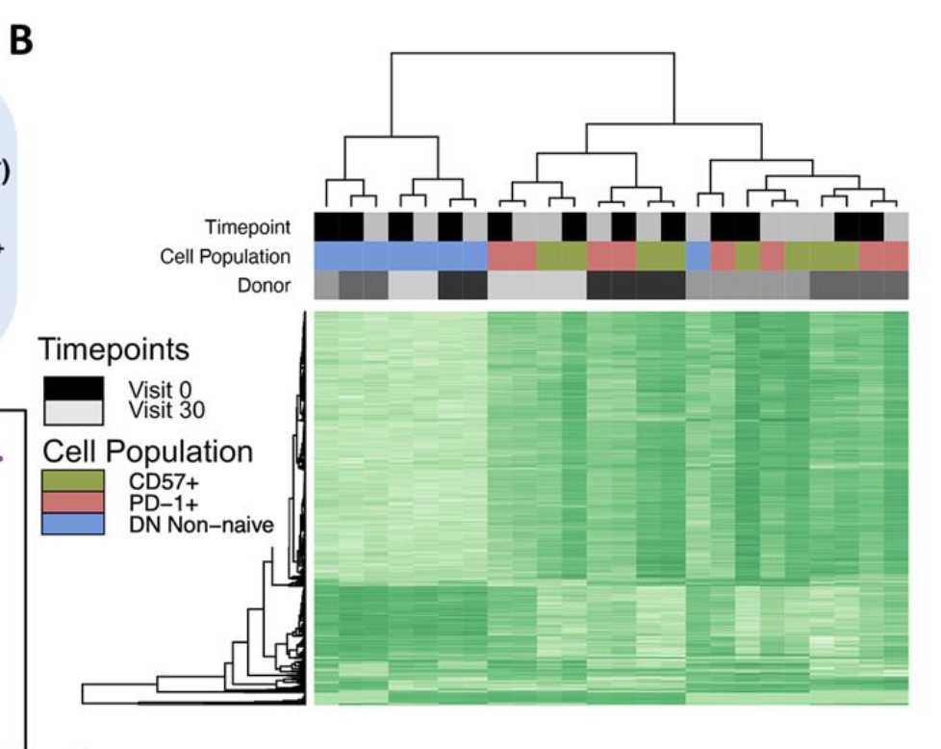
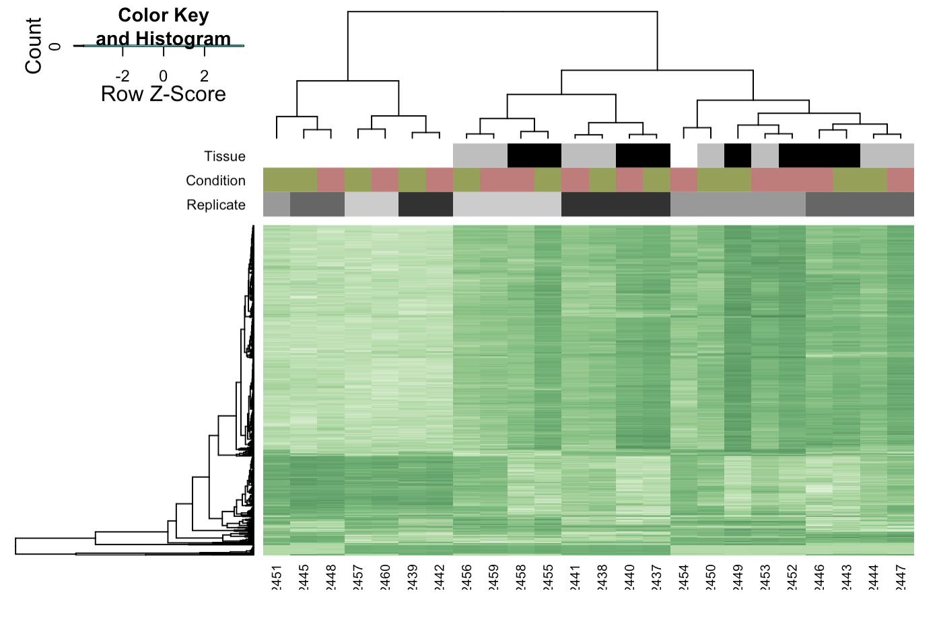
Reproduced Erin’s heatmap clustering of consensus sites (fig 1B)
Erin’s
Ty’s

Slide 4
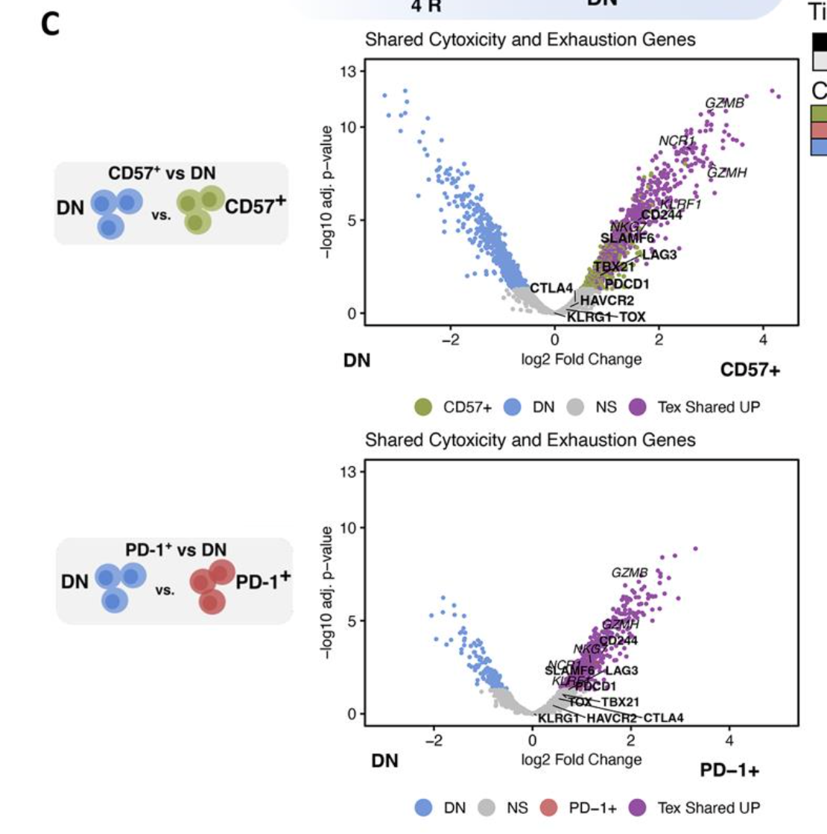
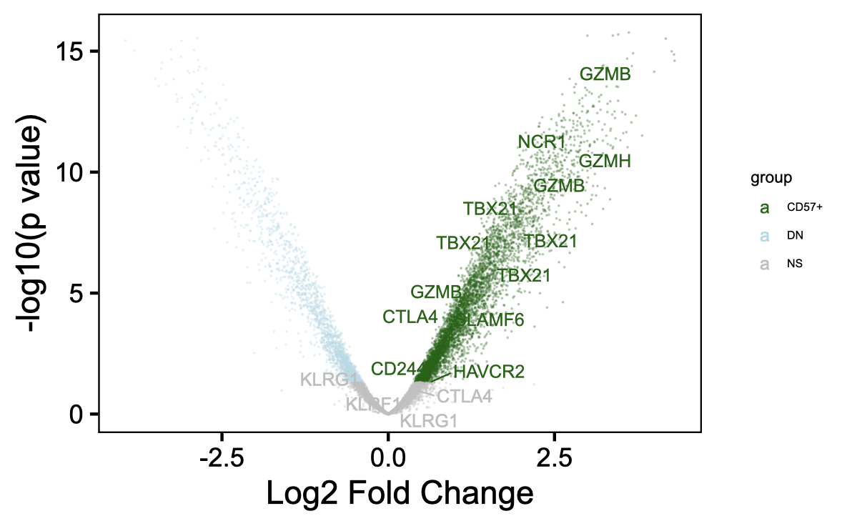
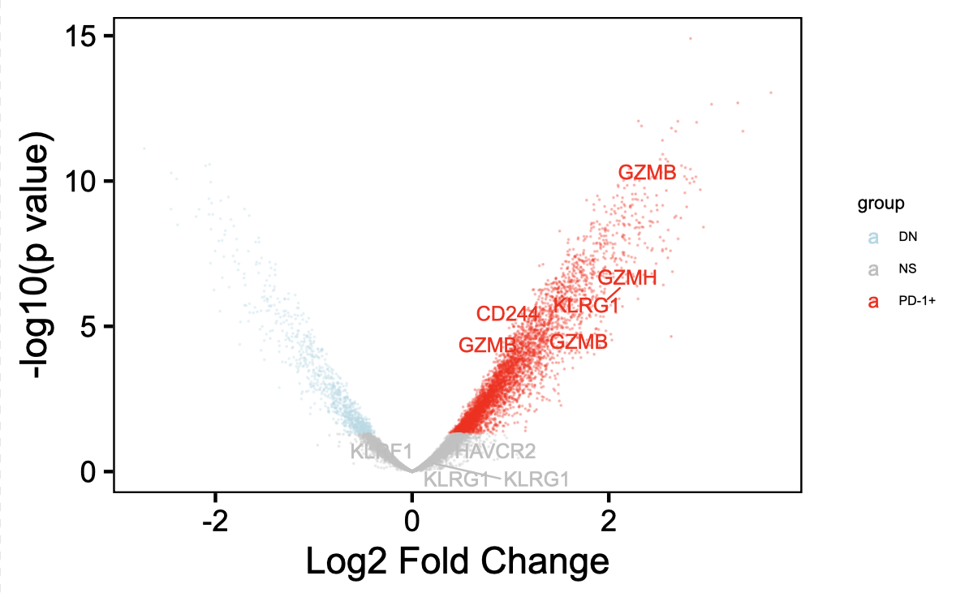
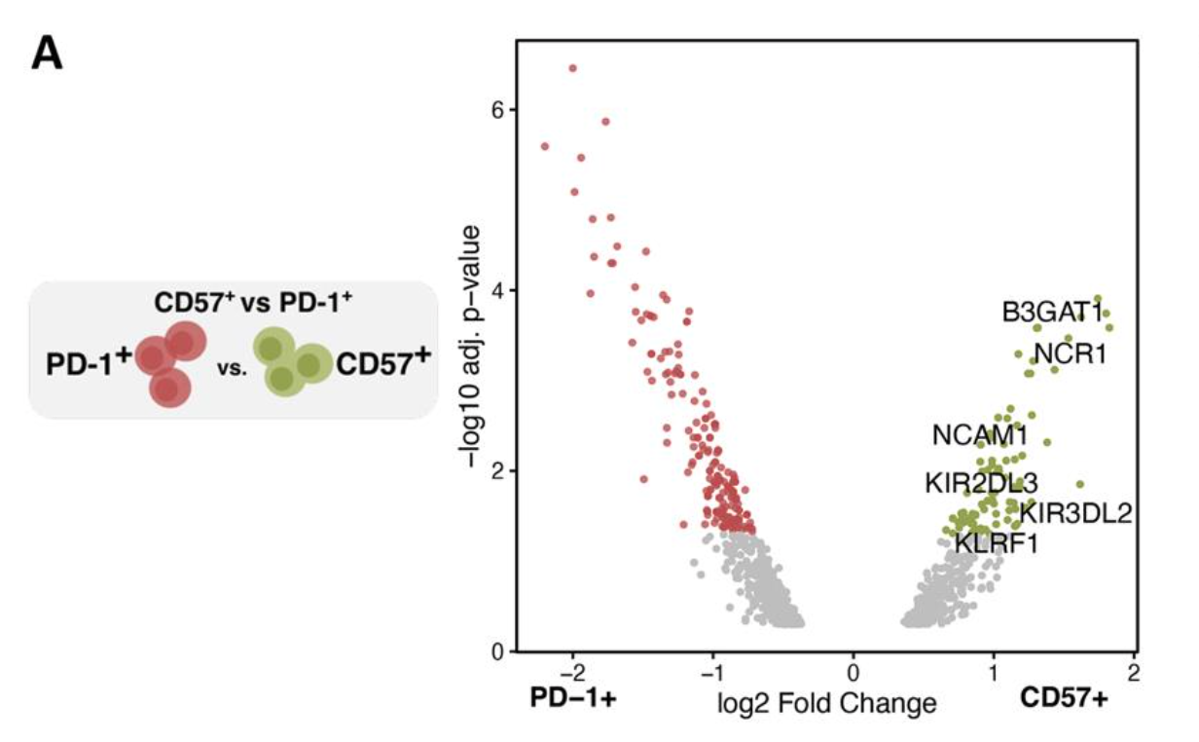
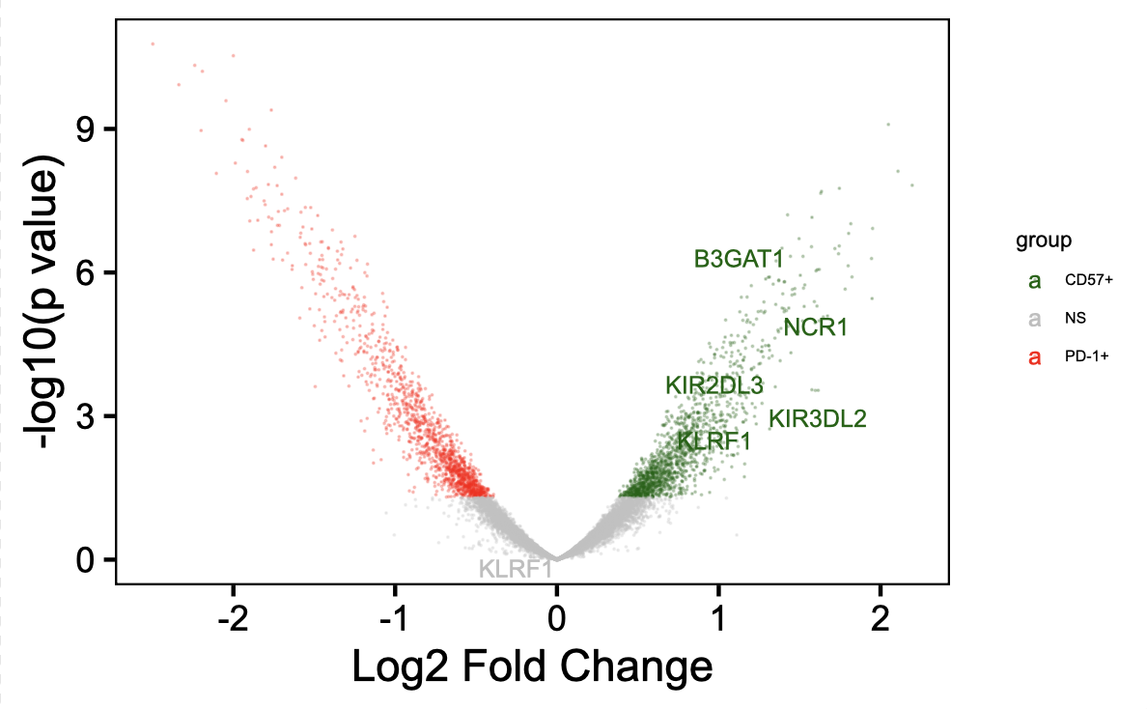
~Reproduced Erin’s volcano plots of differential chromatin accessibility (figs 1C, 2A)
Erin’s
Ty’s
Notes:
Different peak gene annotation method… I used ChIPseeker (annotatePeak(peaks_with_new_seq_level, tssRegion=c(-3000, 3000),TxDb=txdb, annoDb="org.Hs.eg.db"), not sure what Erin used

Slide 5
Next steps

