Slide 1
Weekly meeting
7 25 2024
Ty Bottorff

Slide 2
Outline

Slide 3
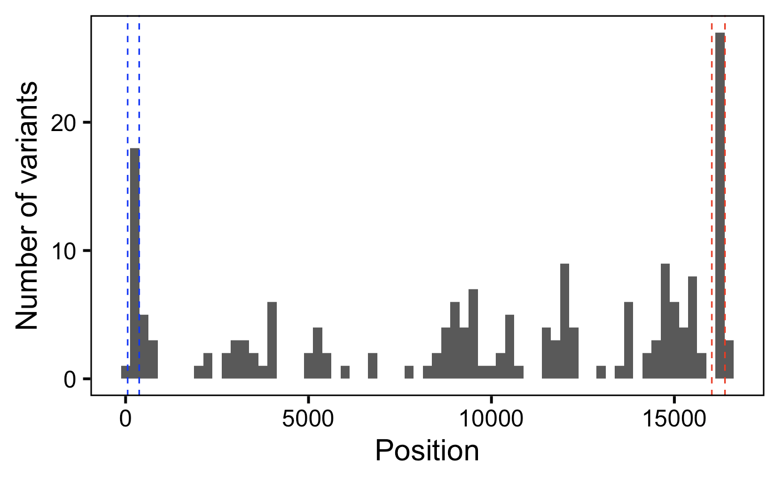
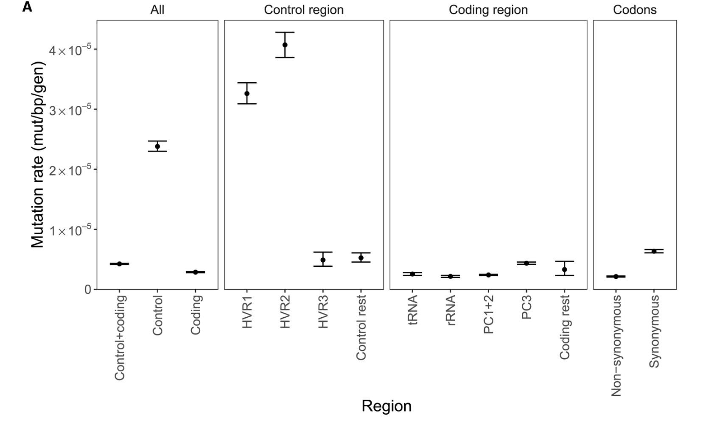
SNV counts in HV1/2 vs. other regions seem to be within order of magnitude of estimated mutation rate fold differences
HV2
HV1
Árnadóttir et al. (2024) Cell

Slide 4
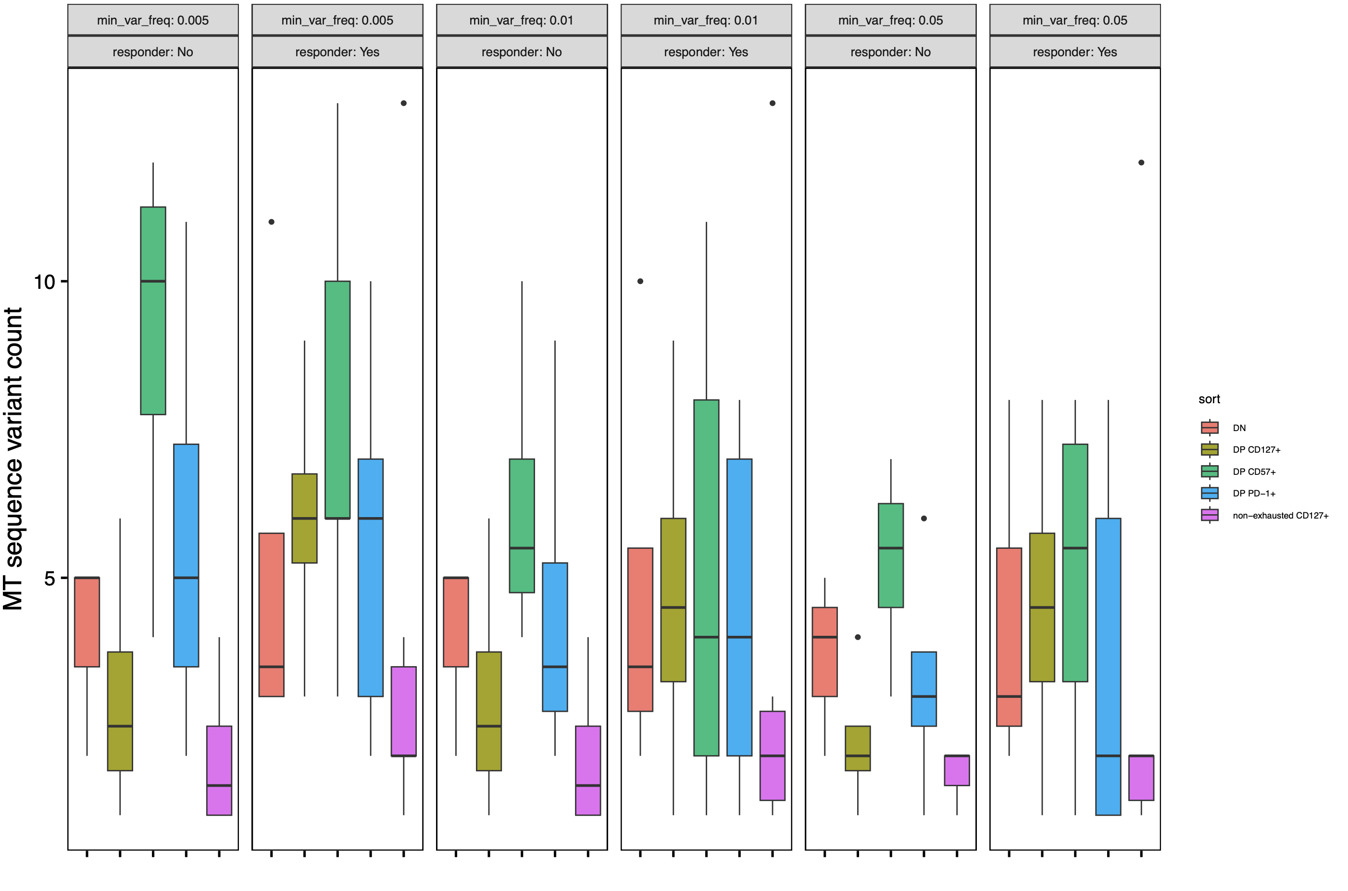
P576: across most min_var_freq params, see more variants in DP CD127⁺ sort and ~fewer variants in DP CD57⁺ in R vs. NR

Slide 5
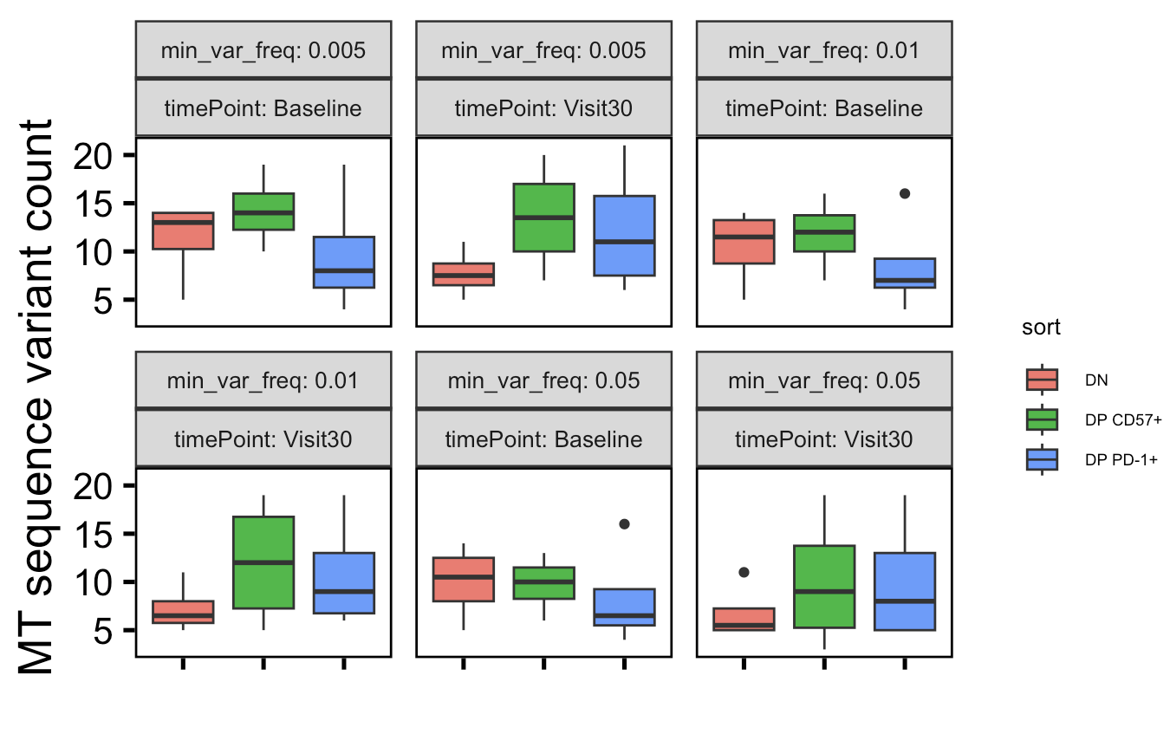
P452: DP CD57⁺ variants already high at baseline, DP PD-1⁺ variants increase over time, DN variants decrease over time…
Notes:
Expectation from Long lab: increased vars over time in PD-1+ and maybe CD57 already high at baseline

Slide 6
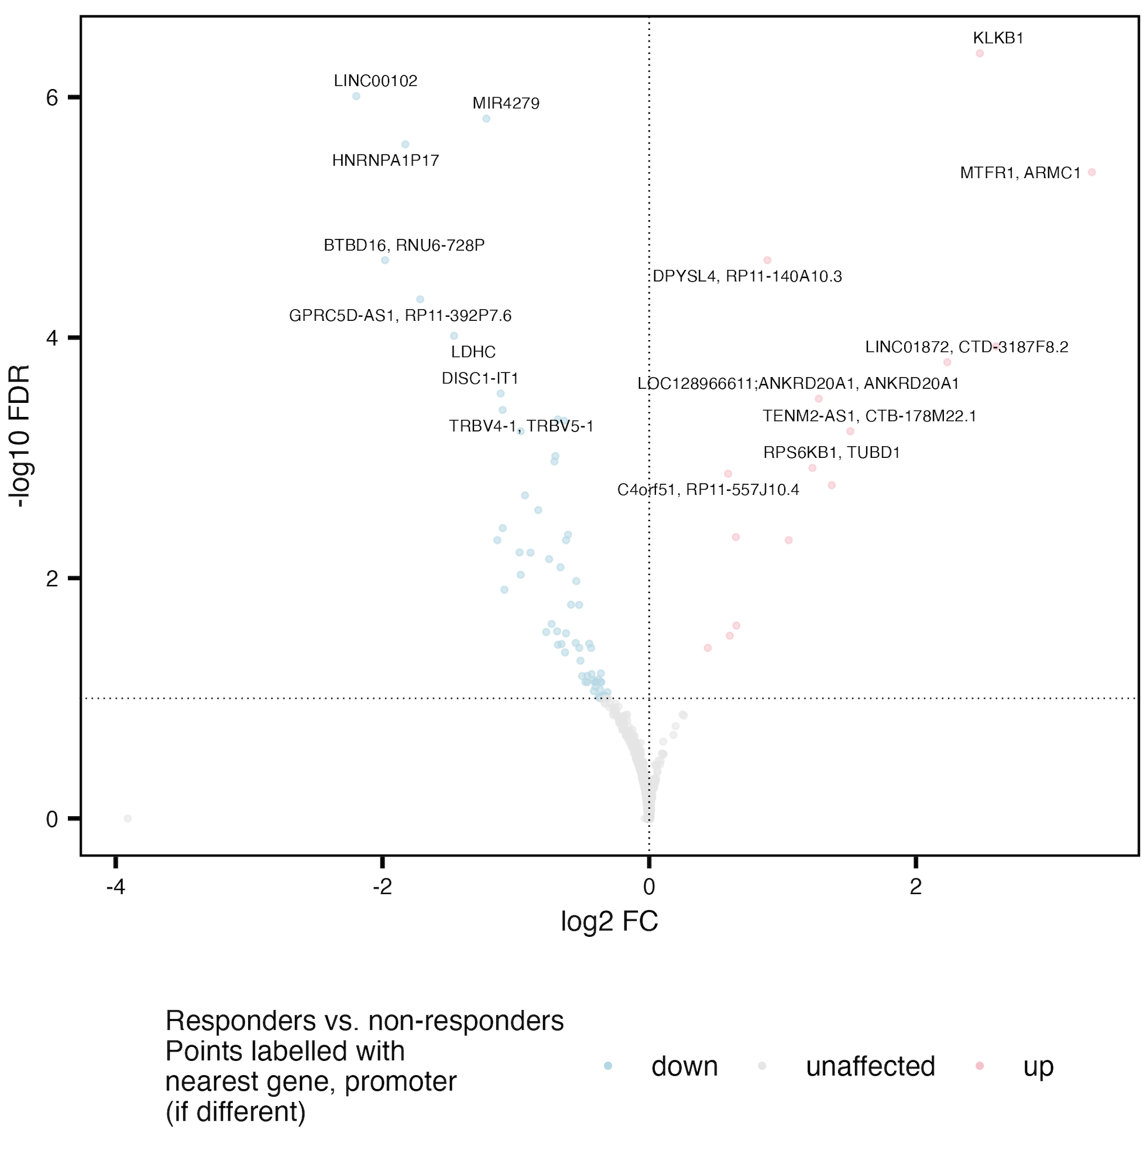
Do see some overlap of R vs. NR DARs in grouped cell sort (right) vs. 1 at a time (below)
C10orf128
F8A1
MIR1184-1
AC007679.3
PPIAP68
C10orf71
DISC1
DISQ
BTBD16
RNU6-728P
MIR4279
Notes:
Plot/analysis made with new covariate regressing out code
Adjusted for donor and responder status effects when comparing cell sorts (no big changes) and donor and sort effects when comparing R vs. NR

Slide 7
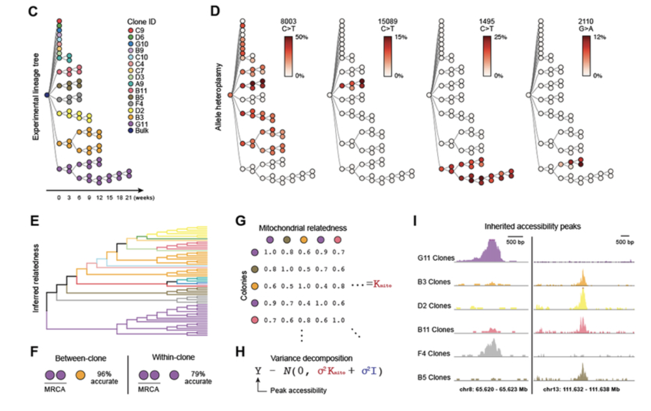
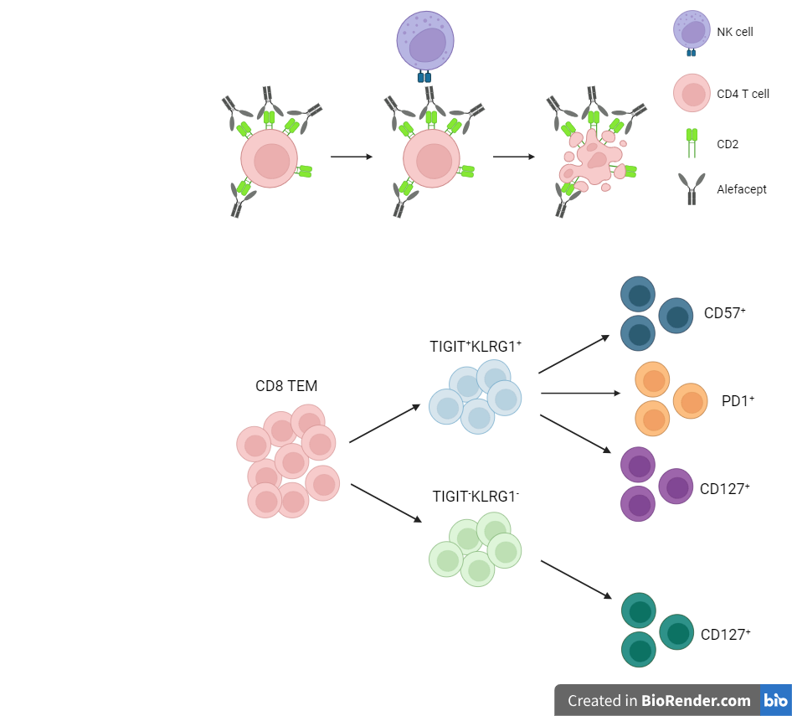
Next experiment ideas
Unique benefits of scATAC/STAMP over bulk
scATACseq: if interested in both MT genome (SNVs) and nuclear genome (> 80% of reads likely)
scSTAMP: sequencing by targeted amplification of multiplex probes, if only interested in MT genome, already applied in human immune cells (Guo et al, 2022, PNAS)
More sequencing of current libraries: would only expect < 20% of additional reads to map to MT genome, so mileage wouldn’t go very far for MT vars specifically, might be of use to re-run variant calling on downsampled P576
Plan: create fig E diagram and color by cell sort
Perhaps would want to change sorting strategy to include parent DP. PD-1⁺ and CD57⁺, or CD127⁺ ever co-expressed?
TIGIT⁺
KLRG1⁺ (DP)
non-naive
CD8s
DP CD57⁺
Ludwig et al. (2020) Cell
DP PD1⁺
DP CD127⁺
non-exhausted (not DP) CD127⁺
TIGIT⁻KLRG1⁻ (DN)

Slide 8
Conclusions

Slide 9
Next steps

