Slide 1
Weekly meeting
8 8 2024
Ty Bottorff

Slide 2
Outline

Slide 3
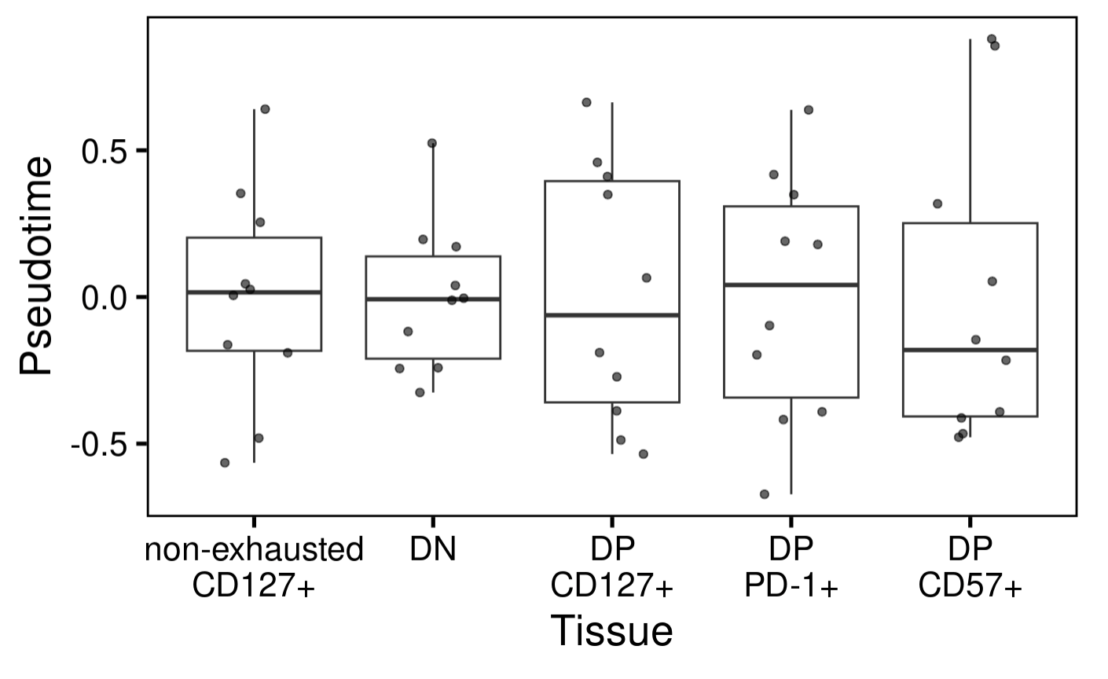
P576 (AbATE): don’t observe pseudotime associating with cell sort
Notes:
Tested for significances already
PhenoPath analyzes the accessibility of genomic regions (peaks) in your ATAC-seq data, modeling how these accessibilities change along a biological trajectory and how this trajectory is influenced by tissue type
PhenoPath models gene expression expression 𝑦 in terms of a latent pathway score (pseudotime) 𝑧. Uniquely, the evolution of genes along the trajectory isn’t common to each gene but can be perturbed by an additional sample-specific covariate 𝛽 (cell sort here)

Slide 4
Conclusions

Slide 5
Next steps

