Slide 1
Weekly meeting
2 15 2024
Ty Bottorff

Slide 2
Outline
Reproduced some of Erin’s ATACseq analysis figures
Compared some different cell typing methods

Slide 3
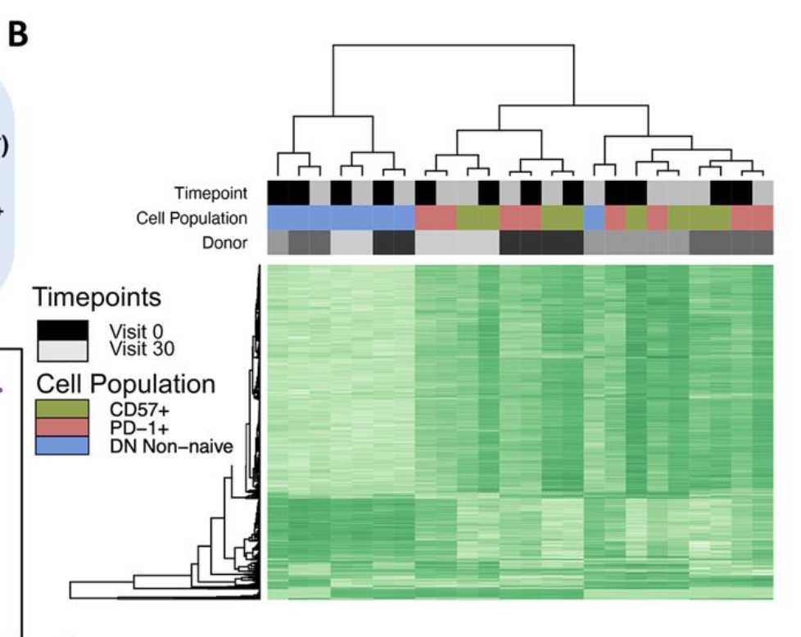
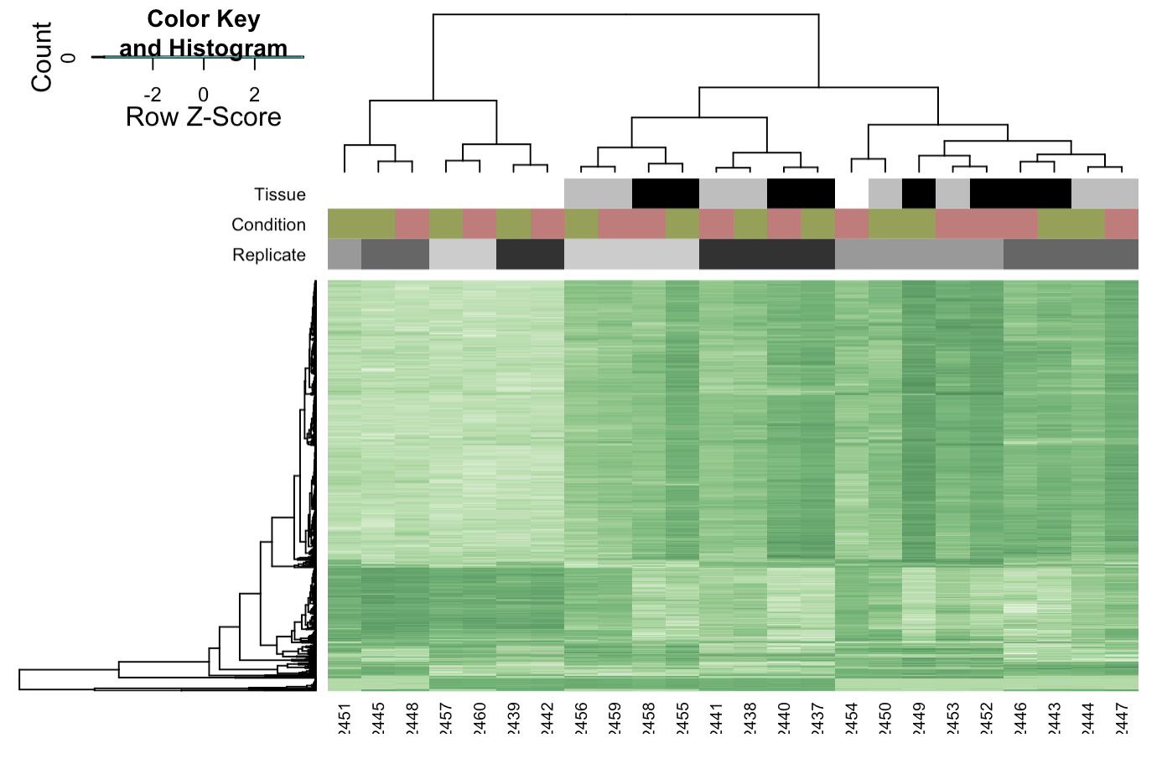
Reproduced Erin’s heatmap clustering of consensus sites (fig 1B)
Erin’s
Ty’s

Slide 4
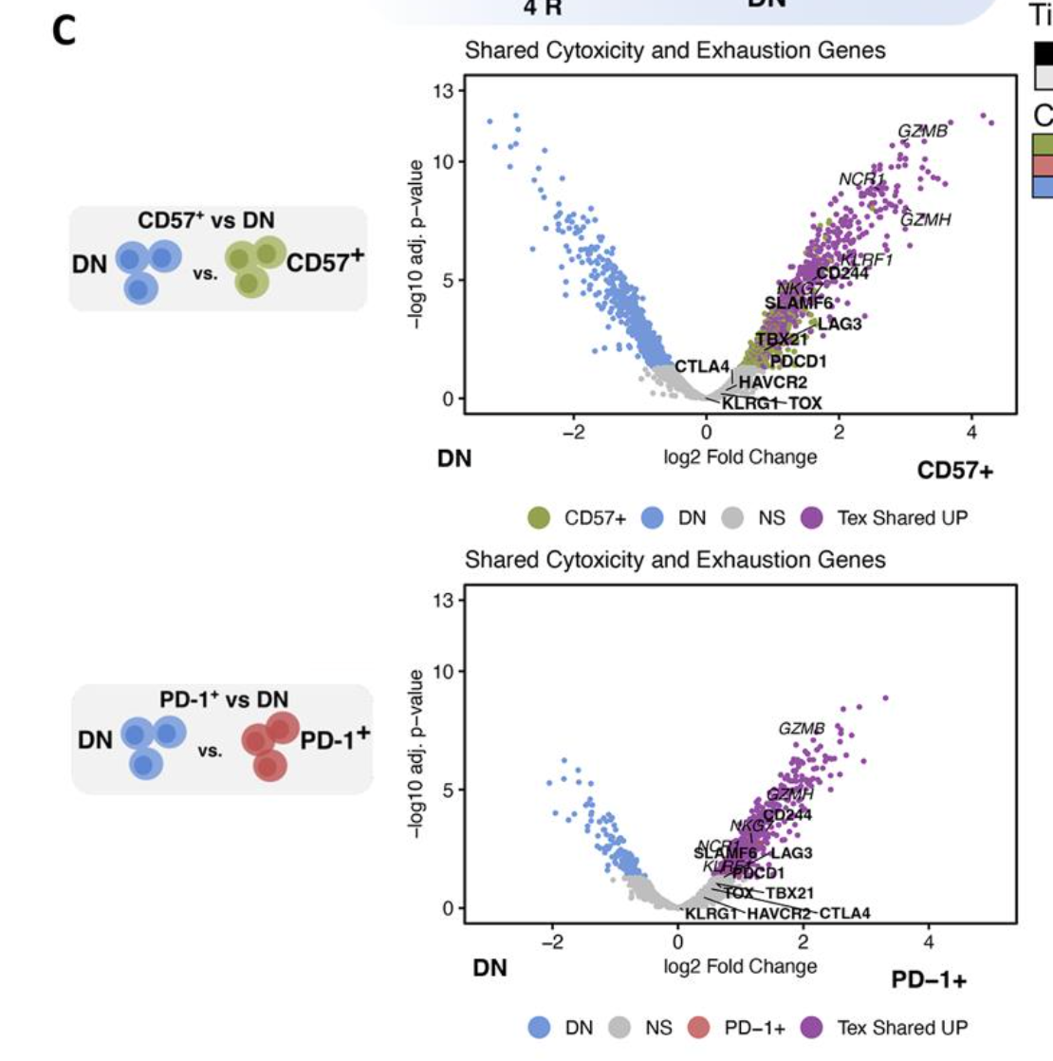
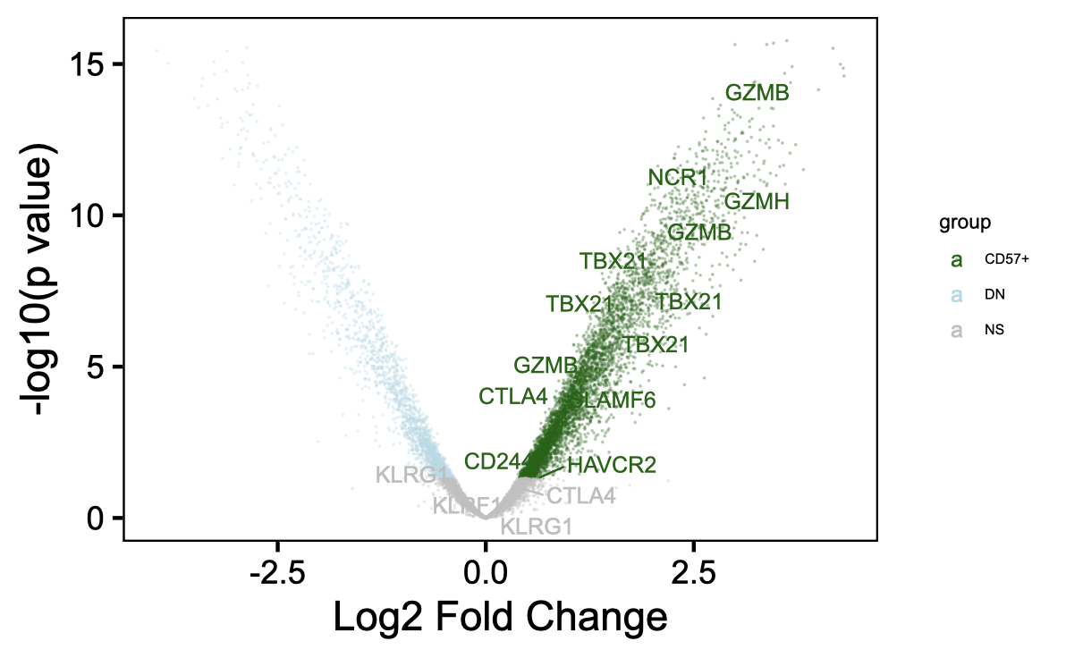
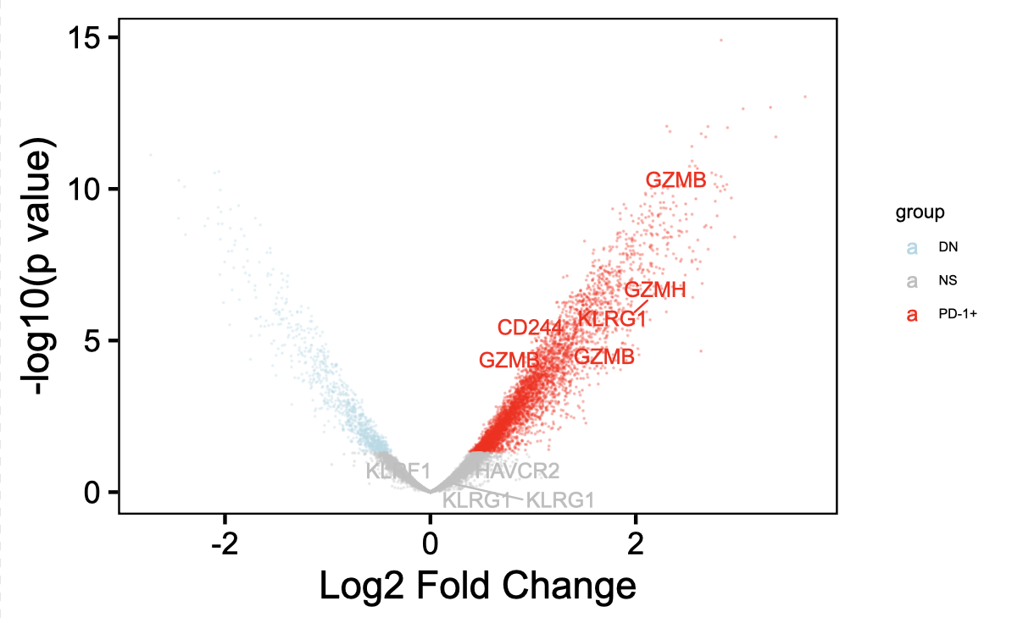
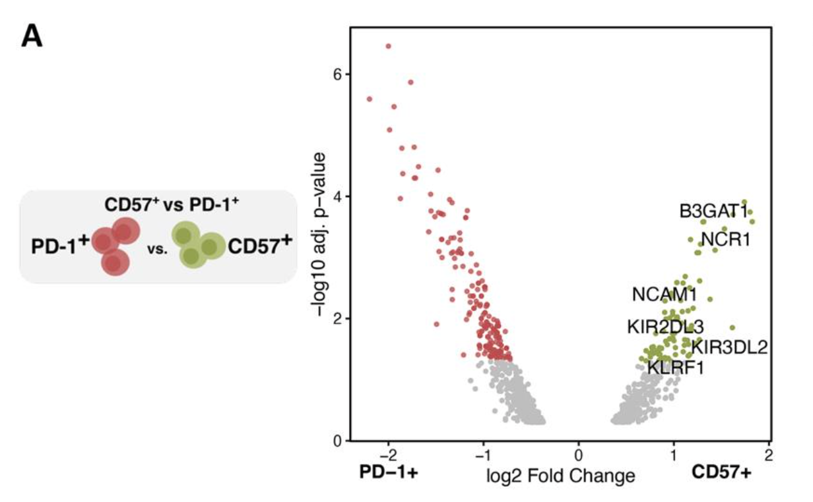
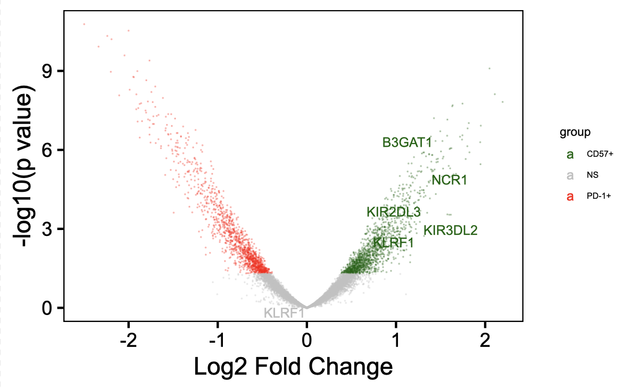
~Reproduced Erin’s volcano plots of differential chromatin accessibility (figs 1C, 2A)
Erin’s
Ty’s
Notes:
Different peak gene annotation method… I used ChIPseeker (annotatePeak(peaks_with_new_seq_level, tssRegion=c(-3000, 3000),TxDb=txdb, annoDb="org.Hs.eg.db"), not sure what Erin used

Slide 5
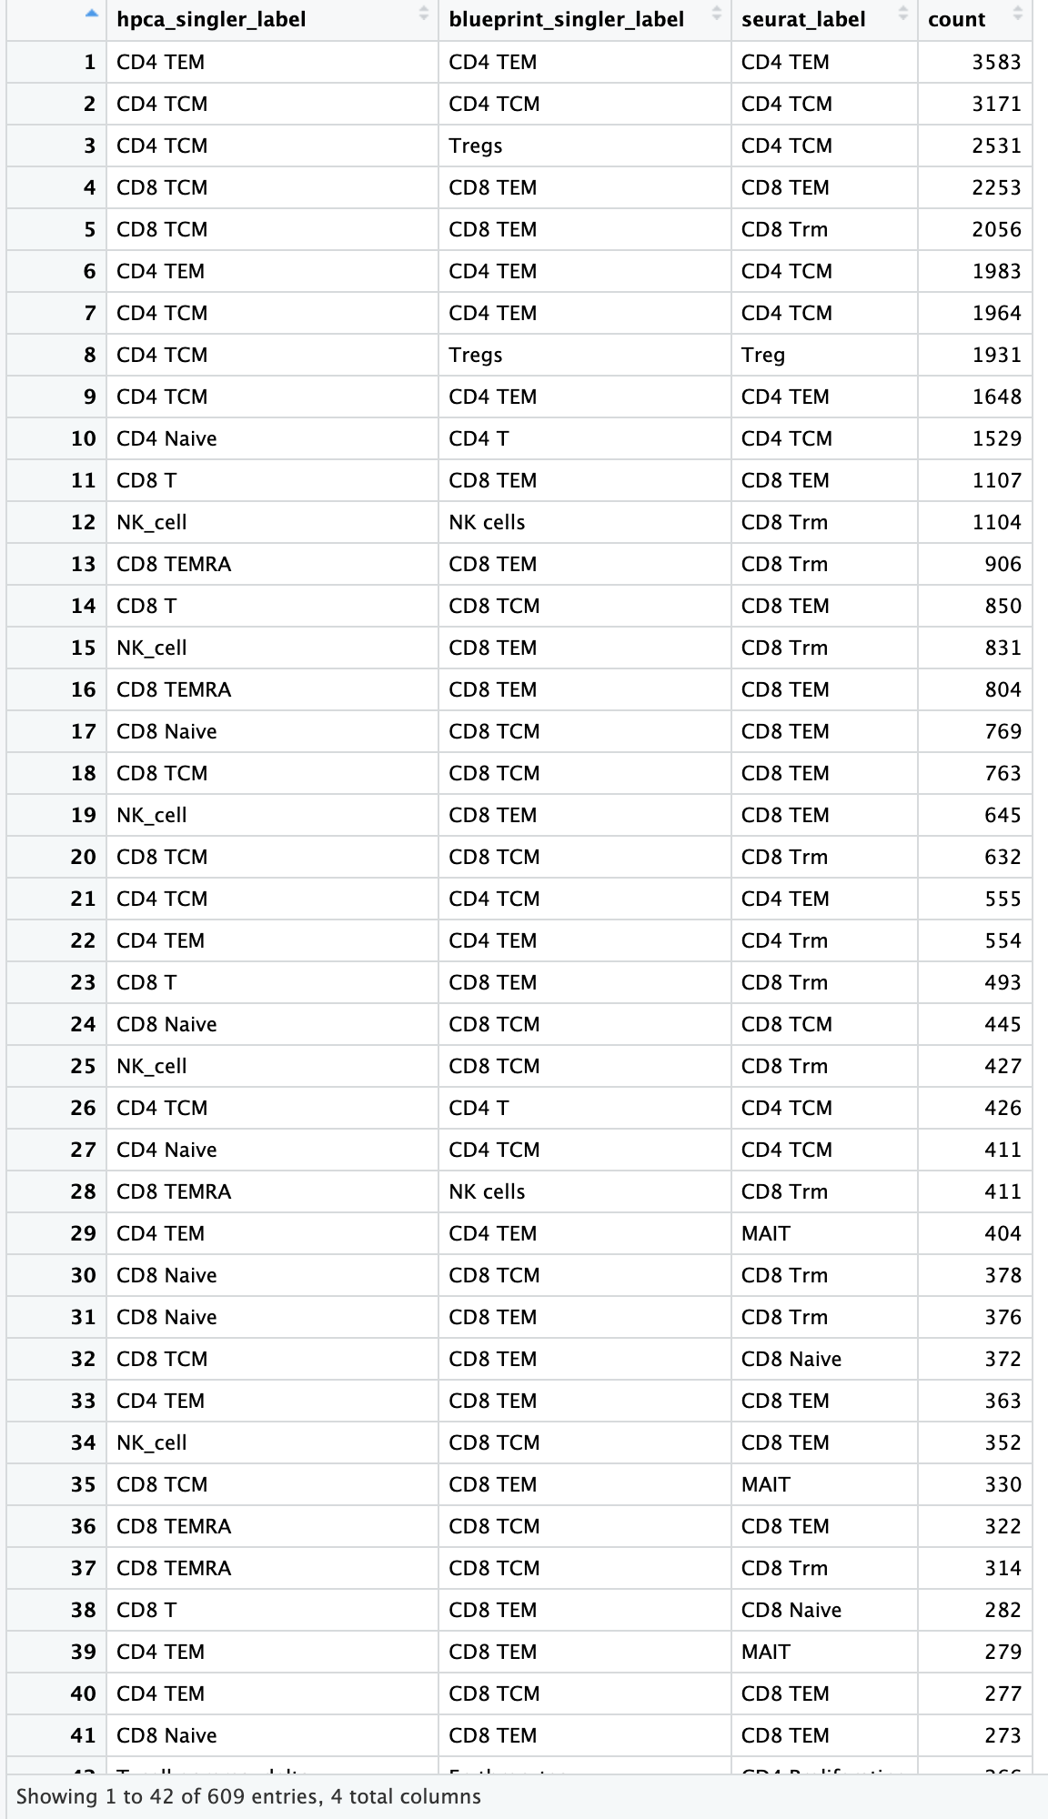
Cell type labels generally agree but there are method/reference differences (colitis dataset)
Notes:
hpca (primary cell atlas, microarray)
713 microarray samples from the Human Primary Cell Atlas
blueprint encode (RNAseq)
259 RNA-seq samples of pure stroma and immune cells
Seurat ref is PBMCs

Slide 6
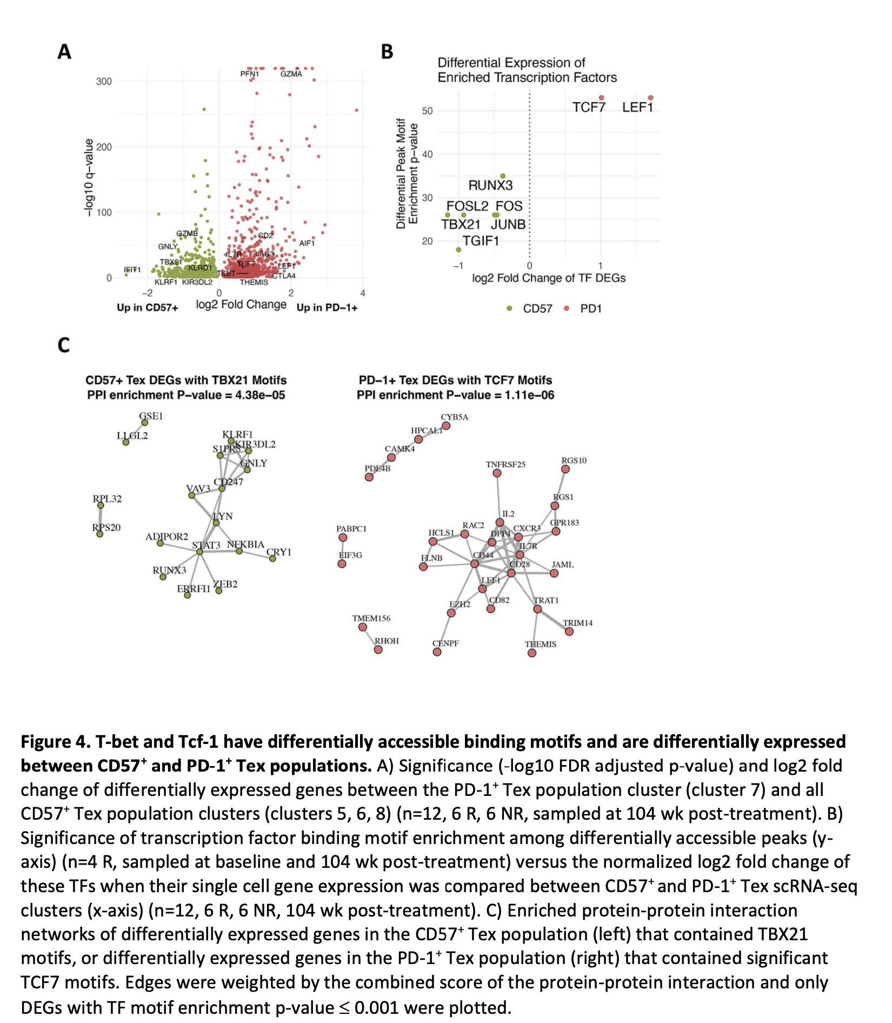
Next steps
More ATACseq practice
Mean signal plots for specific genes (fig 2C)
Incorporate RNAseq data to be able to reproduce fig 4B?
Cell typing
Unicell deconvolve
Not sure how to proceed with many cells called differently cell types by different methods…

