Slide 1
Weekly meeting
4 25 2024
Ty Bottorff

Slide 2
Outline
P576-1 VPs, comparing to P452

Slide 3
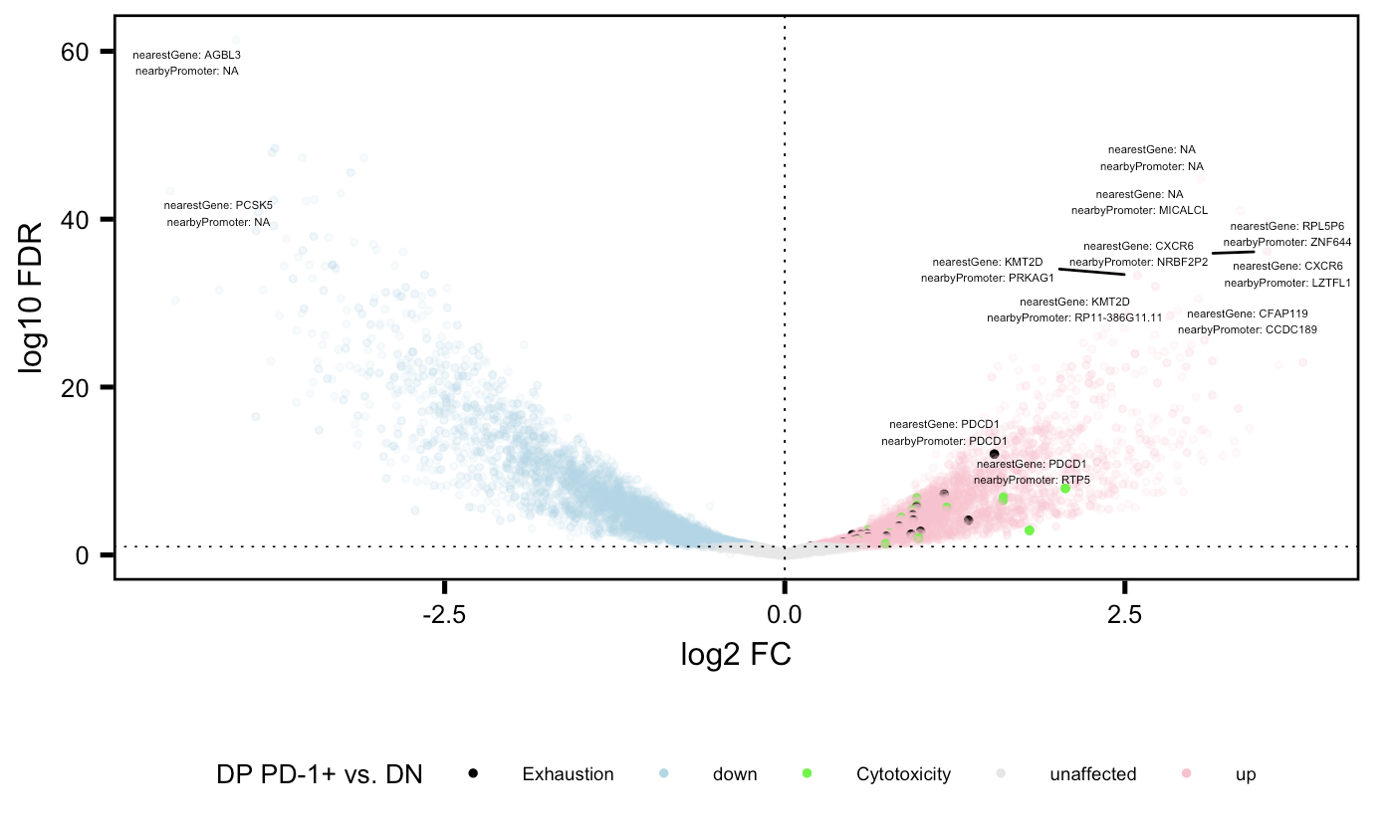
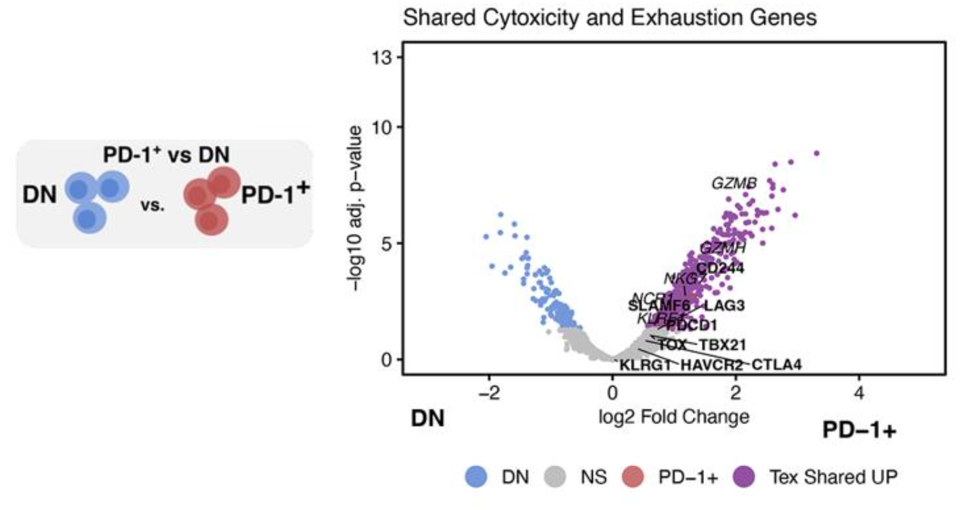
Cytotoxicity and exhaustion genes more accessible in DP PD-1+ relative to DN in both projects
P576
P452 (Erin’s)

Slide 4
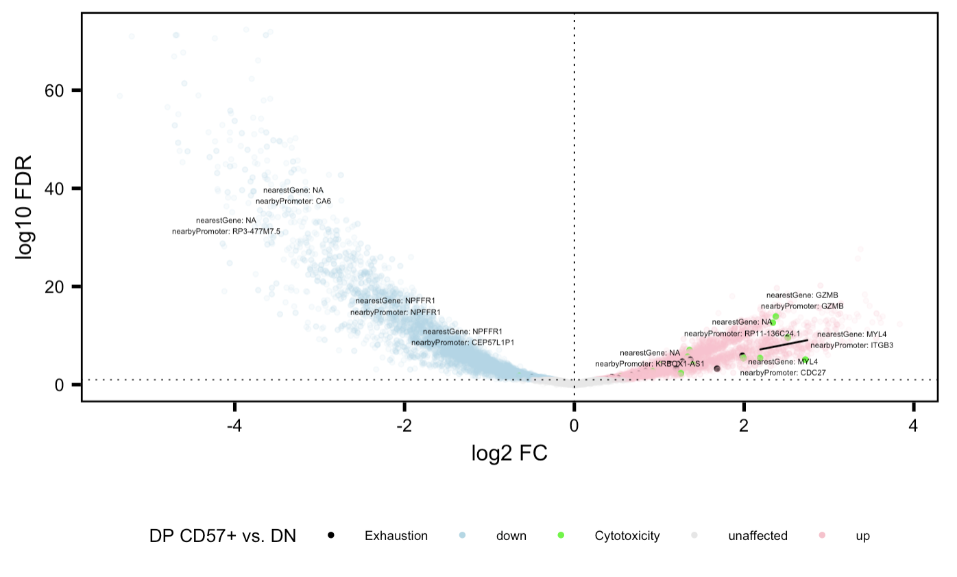
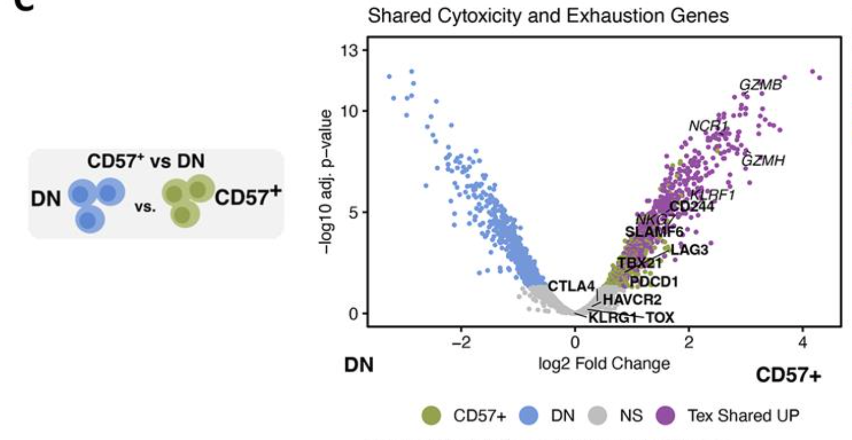
Cytotoxicity and exhaustion genes more accessible in DP CD57+ relative to DN in both projects
P576
P452 (Erin’s)

Slide 5
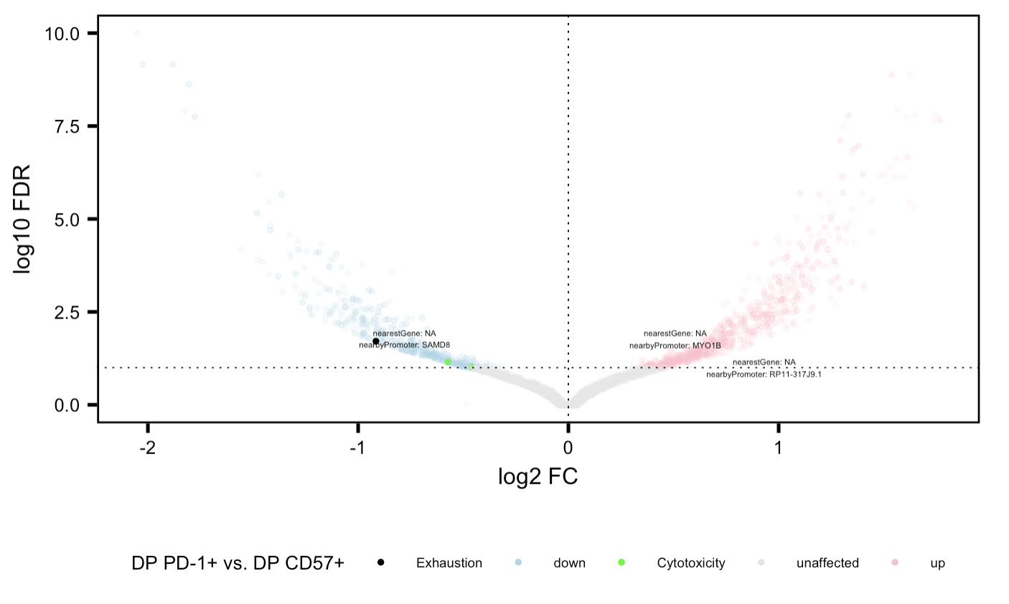
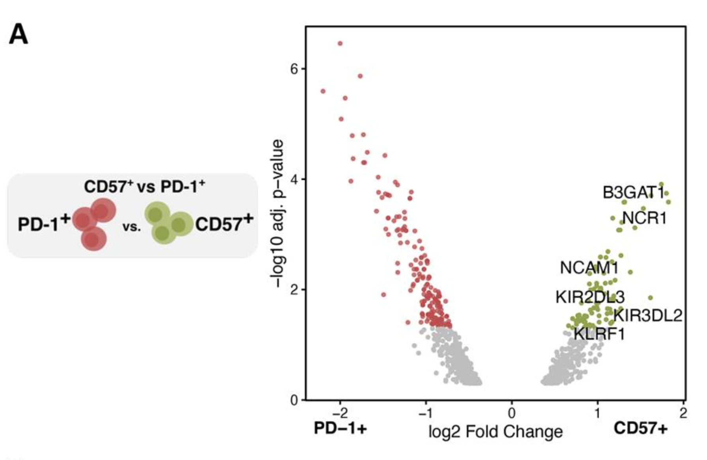
Same genes more accessible in CD57+ relative to PD-1+ in both projects
P576
P452 (Erin’s)

Slide 6
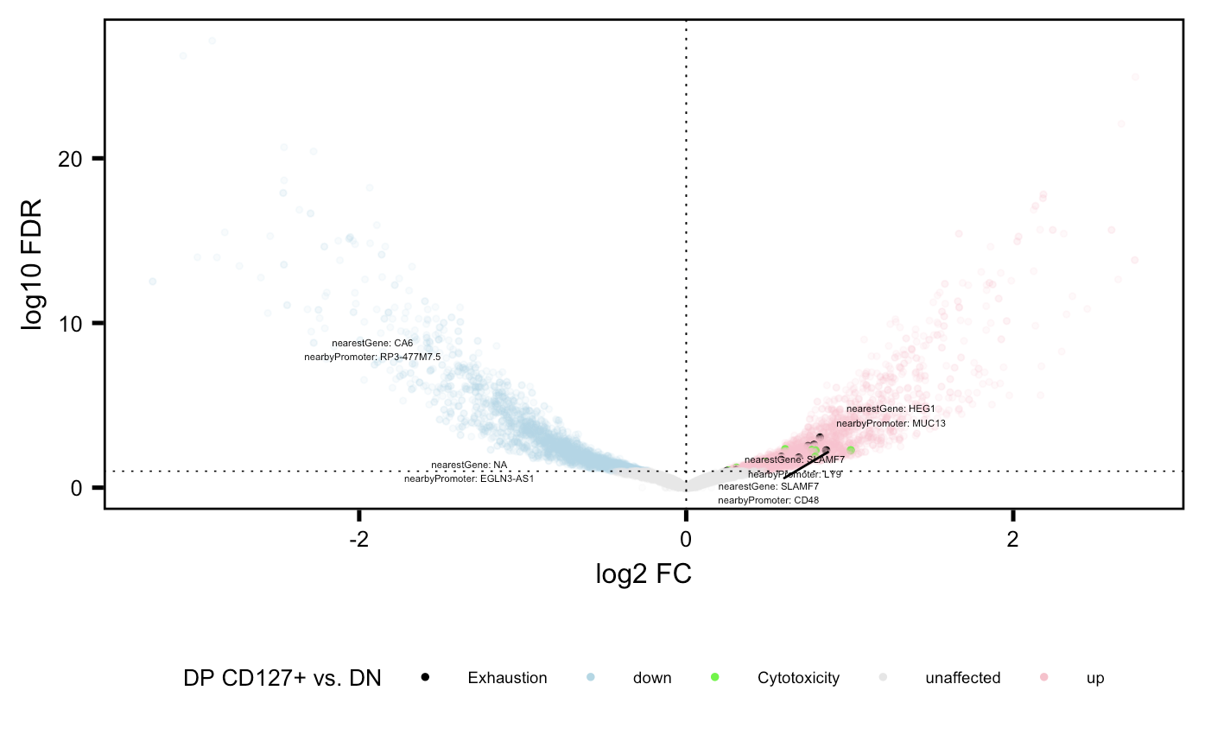
Cytotoxicity and exhaustion genes more accessible in DP CD127+ relative to DN

Slide 7
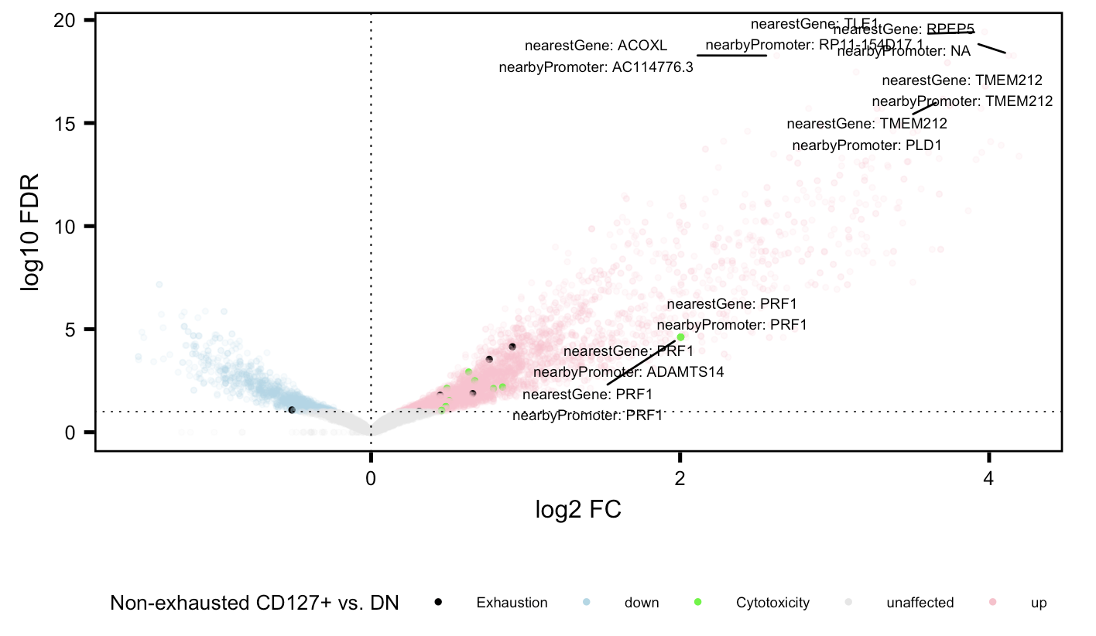
Cytotoxicity (and to a lesser extent exhaustion) genes more accessible in non-exhausted CD127+ relative to DN

Slide 8
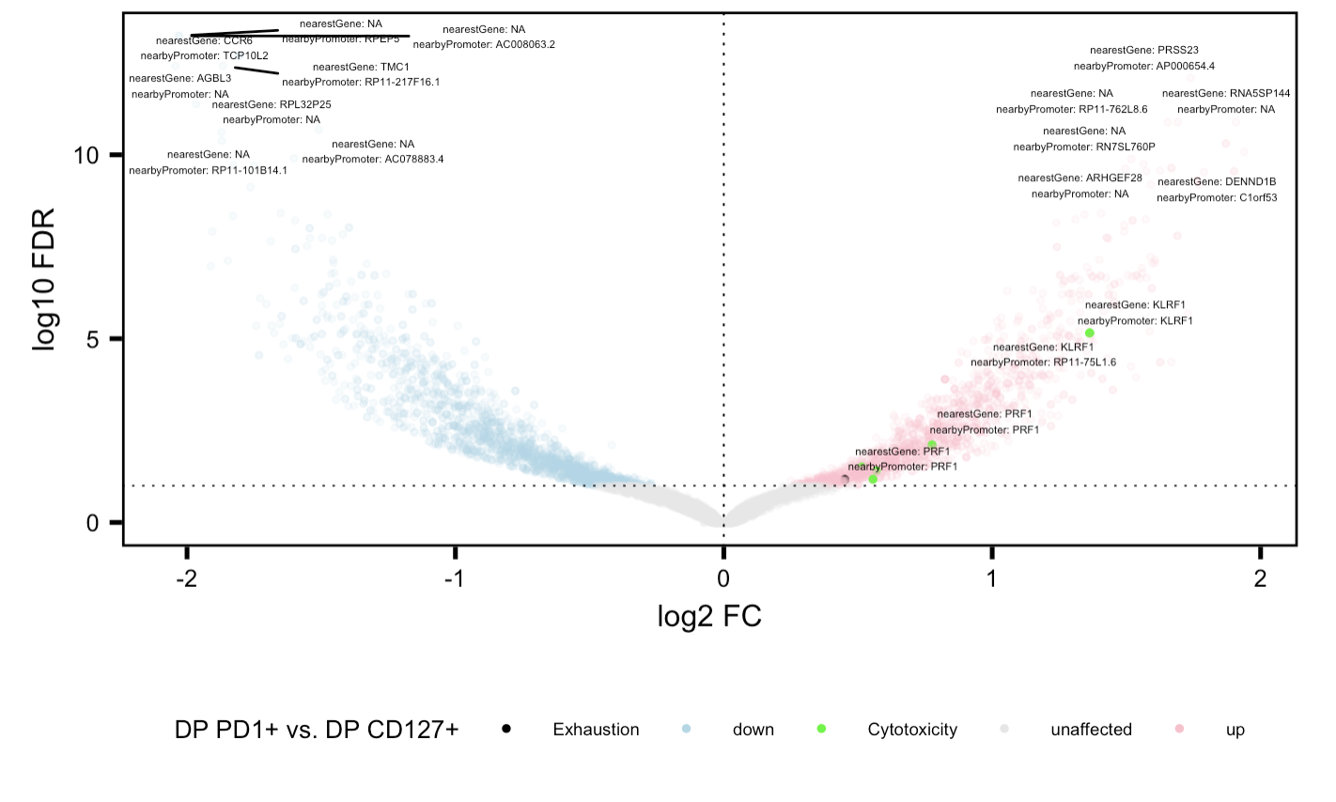
Cytotoxicity genes more accessible in DP PD-1+ relative to DP CD127+

Slide 9
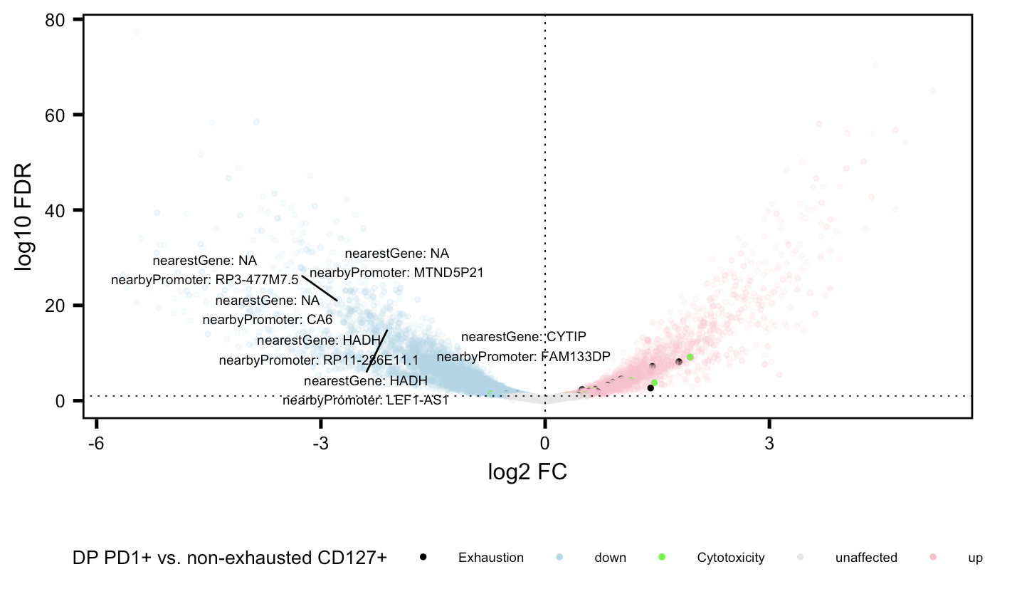
Cytotoxicity and exhaustion genes more accessible in DP PD-1+ relative to non-exhausted CD127+

Slide 10
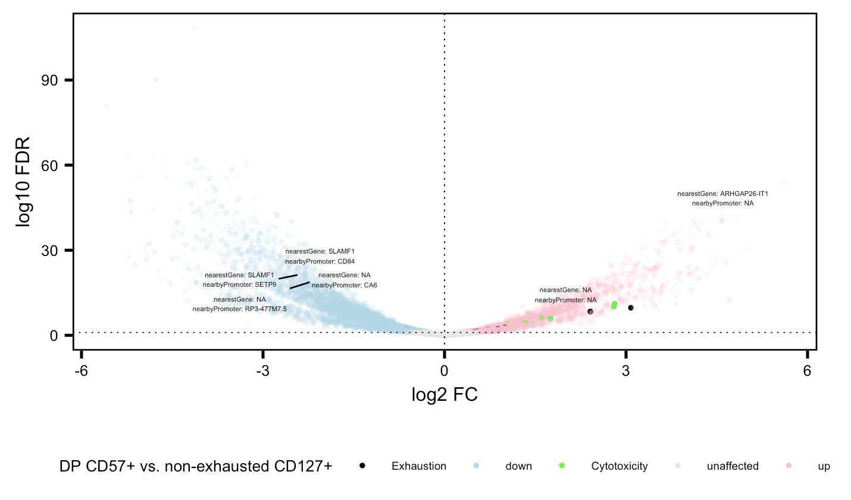
Cytotoxicity and exhaustion genes more accessible in DP CD57+ relative to non-exhausted CD127+

Slide 11
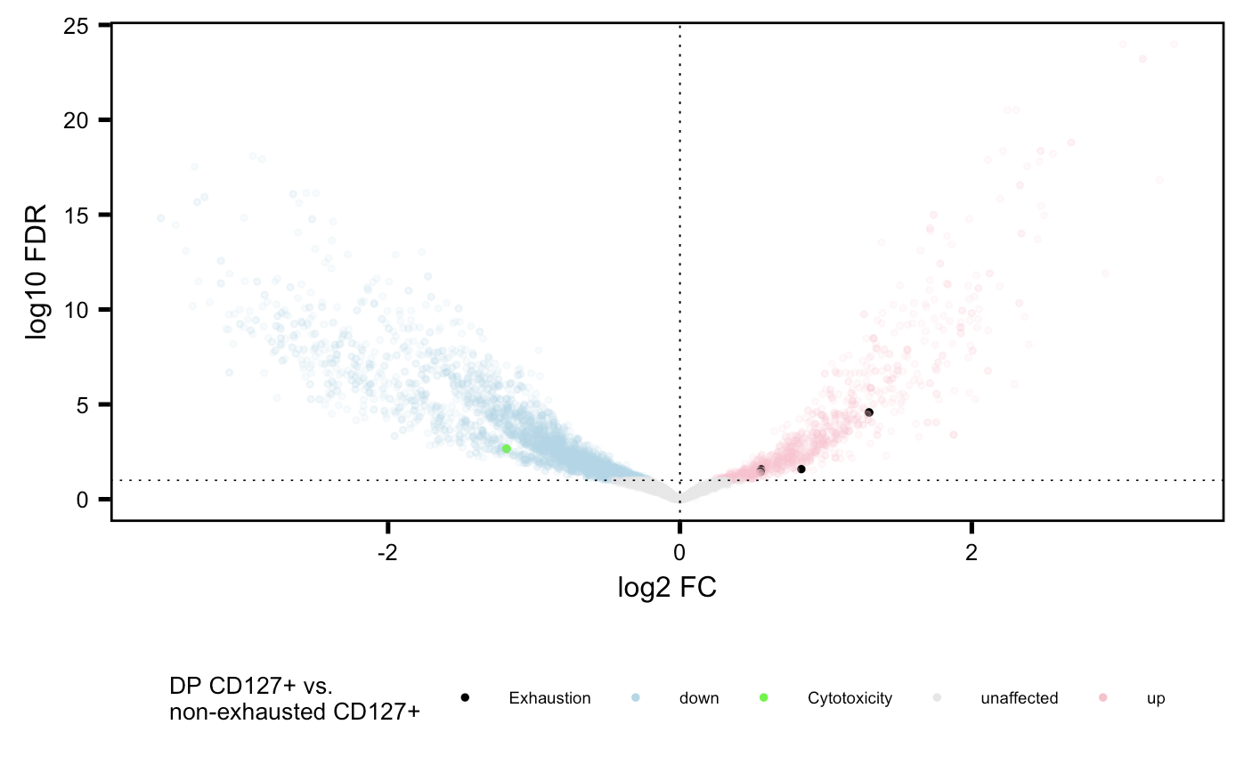
Cytotoxicity genes more accessible in non-exhausted CD127+, exhaustion genes more accessible in DP CD127+

Slide 12
Conclusions
Similar cell sort VP comparisons look similar b/w P576 and P452

Slide 13
Next steps

