Slide 1
Weekly meeting
3 28 2024
Ty Bottorff

Slide 2
Outline

Slide 3
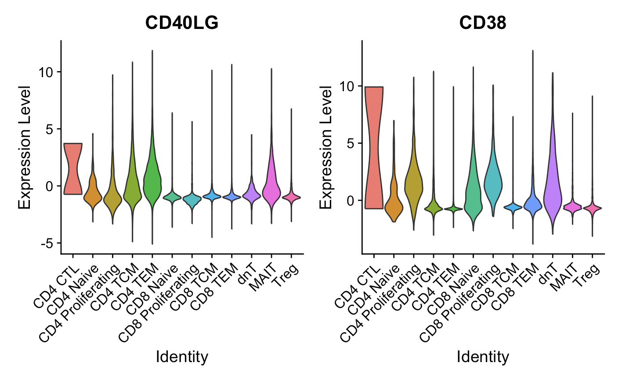
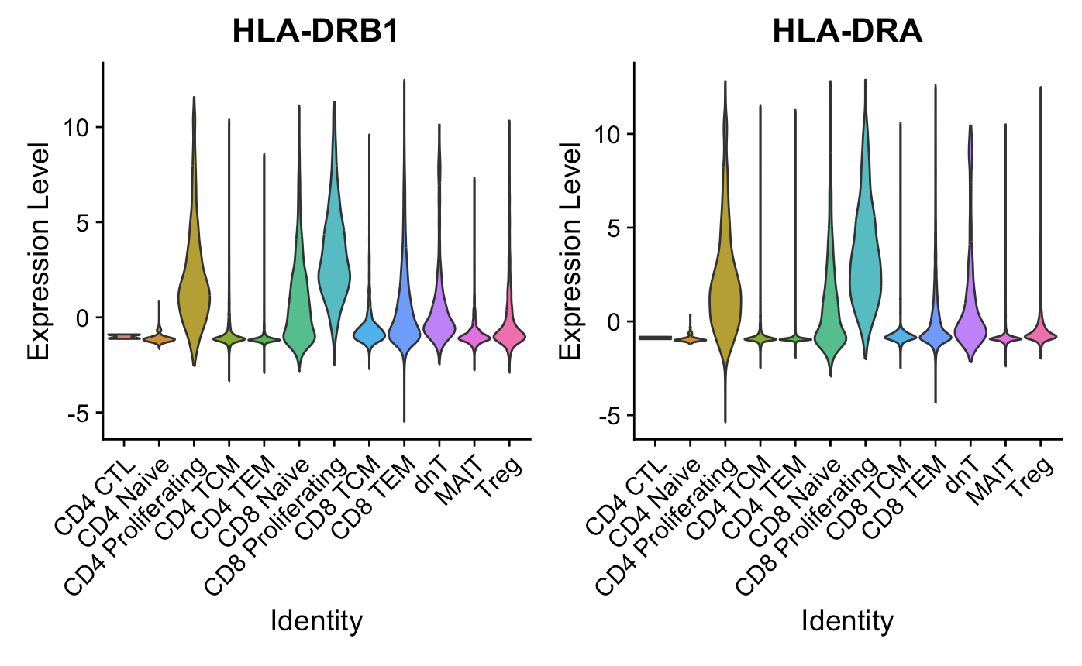
Proliferating cells are ~generally high for activation markers (Luoma (2020), Cell dataset)
CD154
*CD69, CD44, EGR1 different stories
Notes:
CD69, not really higher in proliferating cells, also a marker for Trm though? so...
CD154/CD40LG: kinda high in CD4 prolif but moreso in CD4 CTL/TCM?TEM and MAITs
EGR1, low in everything except MAITs
CD44: lowest in proliferating cells
CD38: yes higher in proliferating cells but really highest in CD4 CTLs, also high in dnTs
HLA-DR: B1 yes higher in proliferating cells (also CD8 naive/TEM), A (yes higher in proliferating cells also in CD8 naive), B5 kinda higher in proliferating cells
HLA-DRB1/DRA are class II, some CD8s can express it but it seems pretty high in CD8 prolif… but they definitely have high CD8A/B…

Slide 4
Conclusions

Slide 5
Next steps

