Slide 1
Weekly meeting
12 28 2023
Ty Bottorff

Slide 2
Outline
Summary of results from myocarditis and colitis datasets, including public/converged subsets

Slide 3
Methods for downsampling, convergence, publicity, normalization
Downsampling
(reproducibly) randomly choose n barcodes per patient, n is # of barcodes in patient with lowest sequencing depth
Convergence (across patients)
CDR3 AA-V gene pairings with > 1 distinct CDR3 nt seq
as expected, see more convergence across patients than within patients
Publicity
clonotypes (CDR3 AA-VJC gene groupings) appearing in > 1 patient
Normalization
divide clonotype counts within patients by patient sequencing depth before choosing top n clonotypes across patients within irAE groups
Notes:
would overlap between public and converged be from common selection events in different people ie common antigens in tumor? unlikely same neoantigen but maybe same TAAs

Slide 4
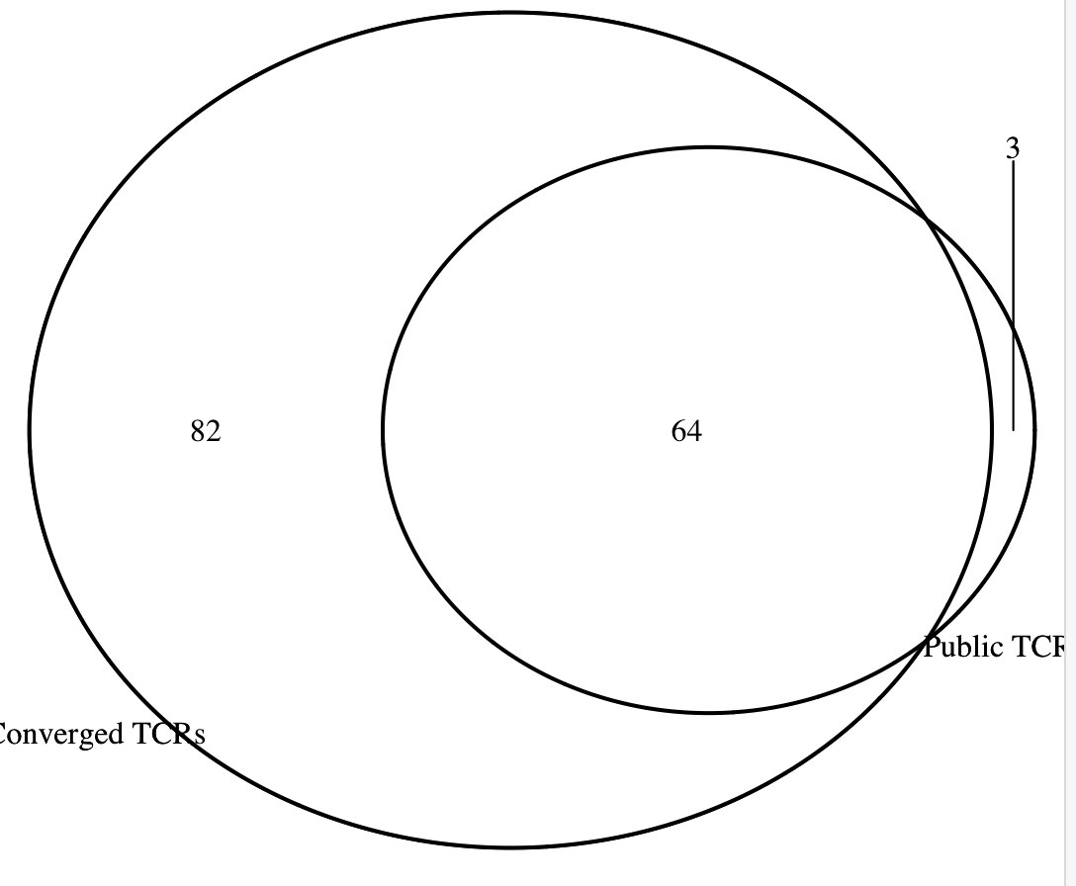
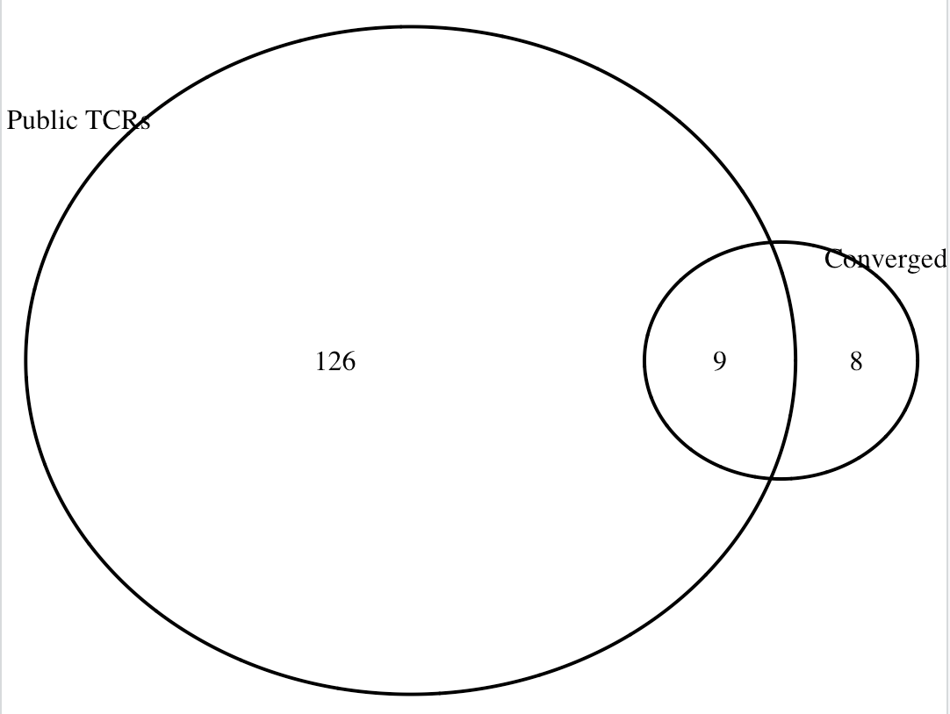
High degree of overlap between public and converged TCRs
Myocarditis dataset
Colitis dataset
If using CDR3 nt instead of AA for publicity call, then much less overlap (also as expected)
Notes:
would overlap between public and converged be from common selection events in different people ie common antigens in tumor? unlikely same neoantigen but maybe same TAAs

Slide 5
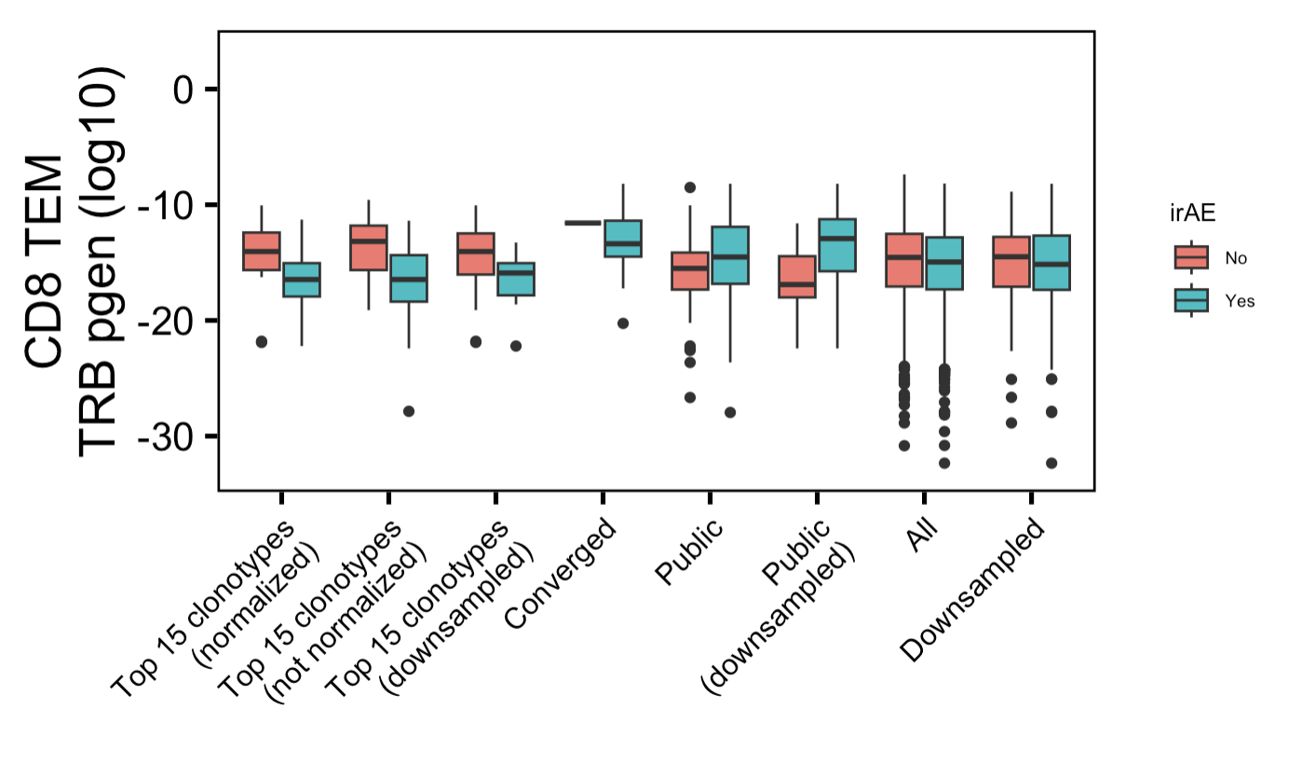
In myocarditis dataset, TRB chains are less germline-like in irAE group only within highly expanded CD8 TEMs (+/- sequence depth normalization)
n =
1,
16
n =
52,
83
n =
8,
20
n =
989,
1286
n =
215,
371
*
*
→
More germline-like
Less germline-like
→
Not
normalized
Normalized
Downsampled
Top 15 clonotypes
Wilcoxon rank sum test. **, padj <1e-2; *; padj <0.05
Notes:
# top 15 (normalized): 0.03
# top 15 (not normalized): 0.02
would overlap between public and converged be from common selection events in different people ie common antigens in tumor? unlikely same neoantigen but maybe same TAAs?

Slide 6
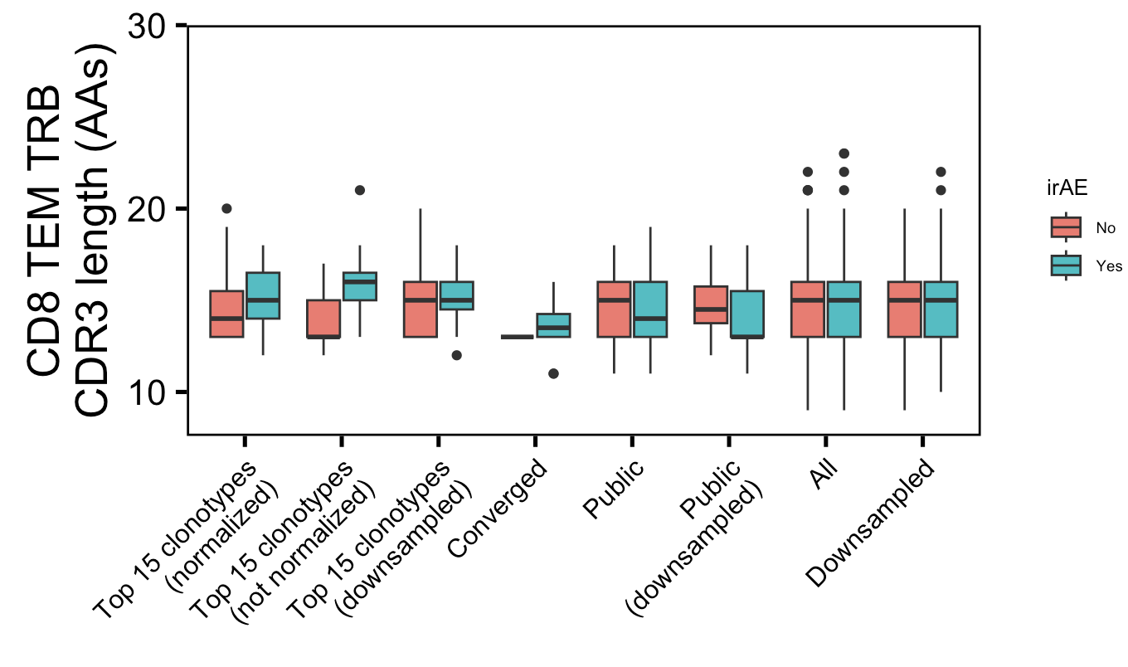
In myocarditis dataset, CD8 TEM TRB junctions are longer in irAE group only within highly expanded T cells (not normalizing for sequence depth or downsampling)
n =
1,
16
n =
52,
83
n =
8,
20
n =
989,
1286
n =
215,
371
*
Not
normalized
Normalized
Downsampled
Top 15 clonotypes
Wilcoxon rank sum test. **, p <1e-2; *; p <0.05
Notes:
# top 15 (not normalized): 0.009
would overlap between public and converged be from common selection events in different people ie common antigens in tumor? unlikely same neoantigen but maybe same TAAs

Slide 7
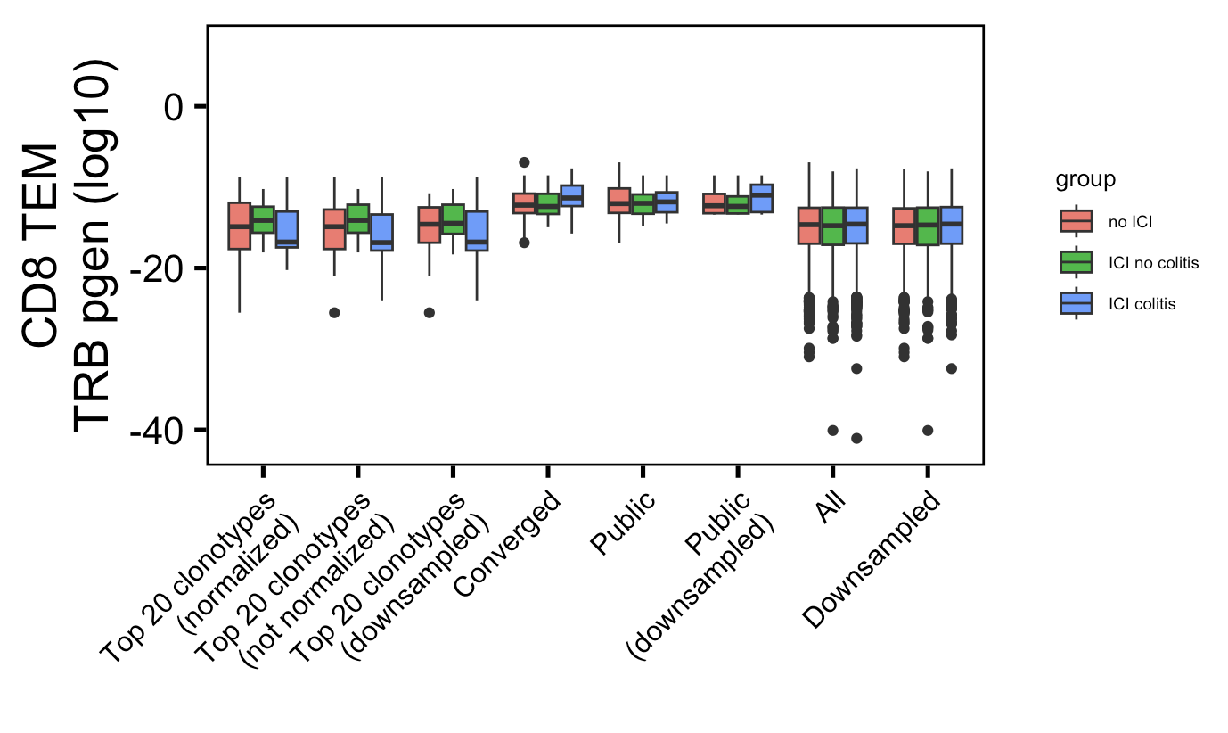
In colitis dataset, CD8 TEM TRB chains are less germline-like in colitis group only within highly expanded T cells (not normalizing for sequence depth or downsampling)
n =
40,
24,
82
n =
20,
18,
29
n =
10,
11,
13
n =
1940,
1292,
3774
n =
1424,
974,
2111
*
→
More germline-like
Less germline-like
→
Not
normalized
Normalized
Downsampled
Top 20 clonotypes
Wilcoxon rank sum test. **, p <1e-2; *; p <0.05
Notes:
p = 0.04 for not normalized top 20 clonotypes, normalized top 20 p = 0.12
would overlap between public and converged be from common selection events in different people ie common antigens in tumor? unlikely same neoantigen but maybe same TAAs

Slide 8
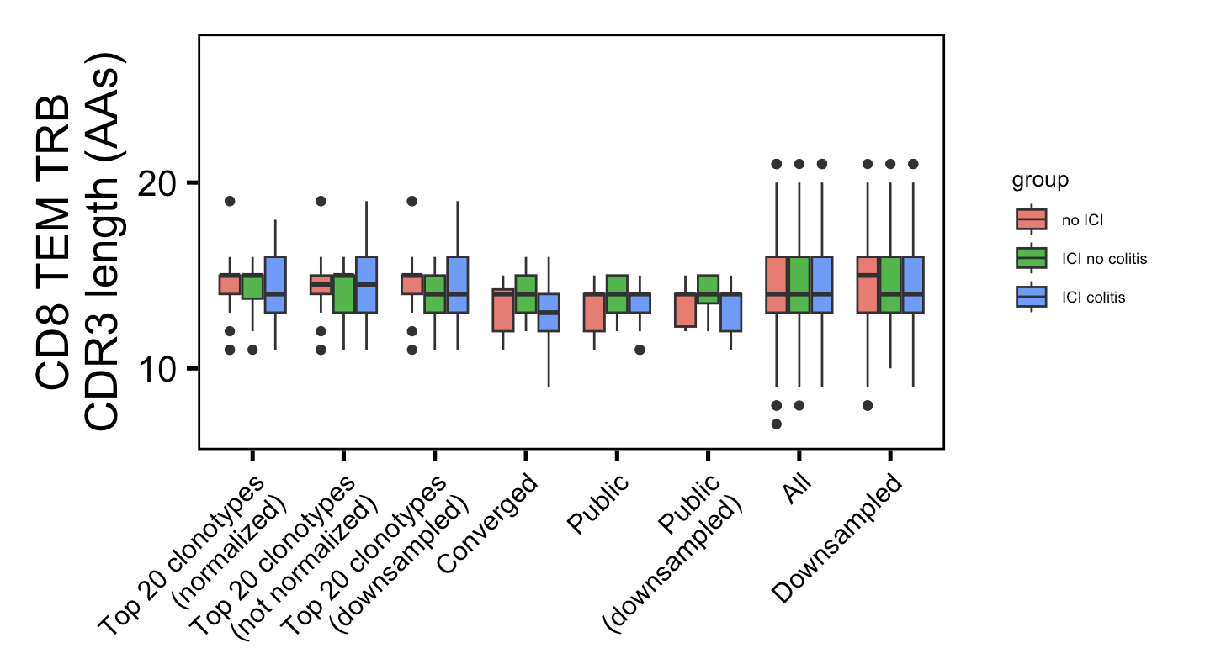
In colitis dataset, see no CD8 TEM TRB CDR3 length differences
n =
40,
24,
82
n =
20,
18,
29
n =
10,
11,
13
n =
1940,
1292,
3774
n =
1424,
974,
2111
Not
normalized
Normalized
Downsampled
Top 20 clonotypes
Notes:
p = 0.04 for not normalized top 20 clonotypes

Slide 9
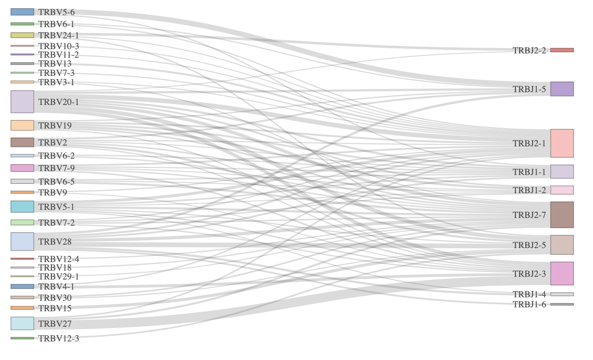
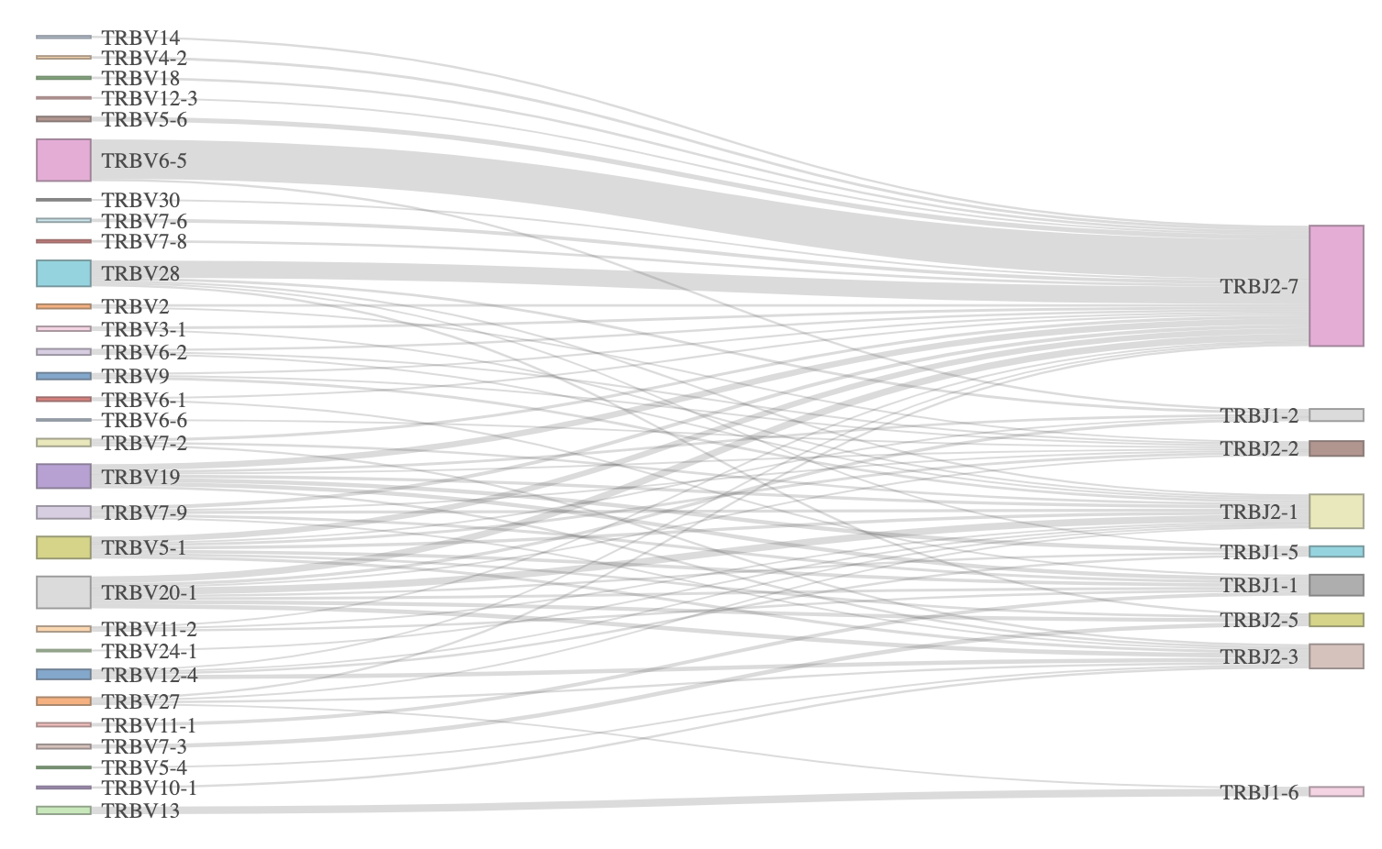
TRB VJ linkages look different in yes vs. no irAE groups, perhaps could also explain pgen differences
Yes irAE
No irAE
Myocarditis dataset
Notes:
Filtered for top 75 most common linkages

Slide 10
Conclusions
In both datasets, CD8 TRBs are less germline-like in those developing colitis irAE
Less solid in colitis dataset than in myocarditis dataset
However, do not see longer CD8 TRB CDR3s in colitis dataset as we saw (weakly) in myocarditis dataset
TRB VJ gene usage differences may be an alternative/additional explanation for pgen differences between irAE groups, although TRA VJ gene usages also look different (data not shown) despite no pgen differences
Don’t see many hits for TCRs in either dataset for neoantigen-specific TCRs (data not shown)
Don’t see many T cells matching neoantigen-specific transcriptional phenotype (data not shown)

Slide 11
Next steps
Practice ATAC-seq analysis for ITN ATAC study, reproducing Erin’s figures after data available 1/17
Notes:
ITN ATAC study - Better defining Tex in teplizumab treated subjects to inform combination treatments

Slide 12
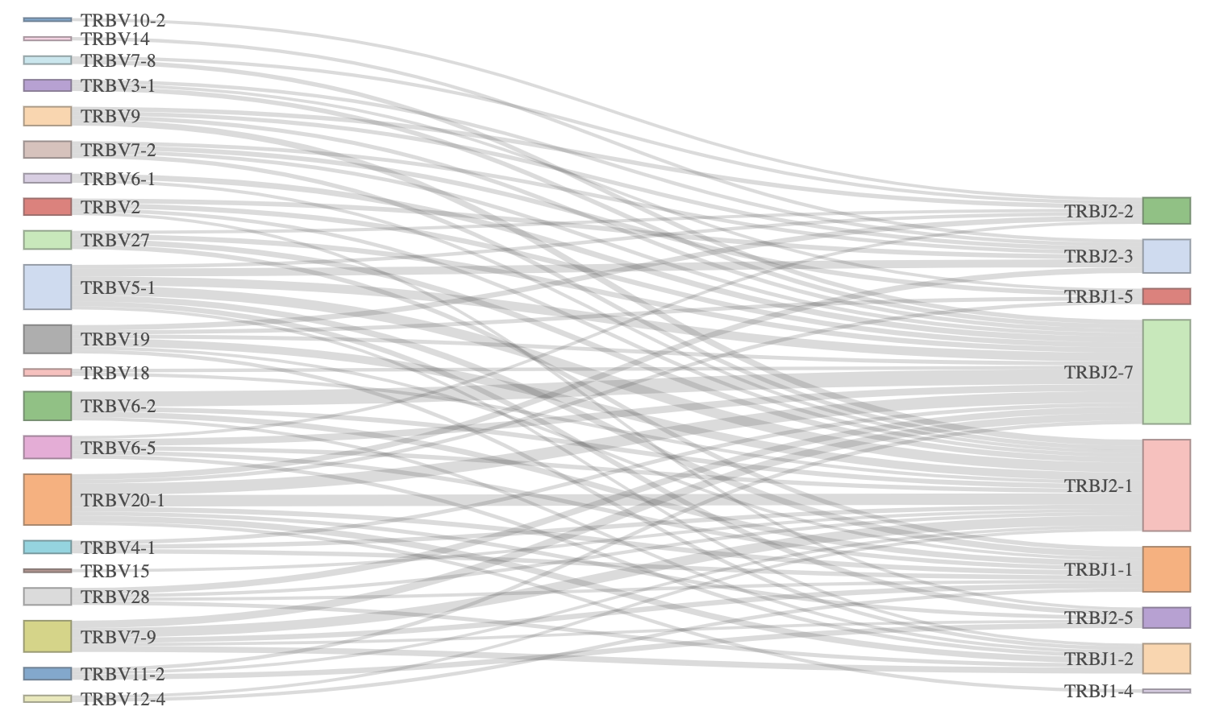
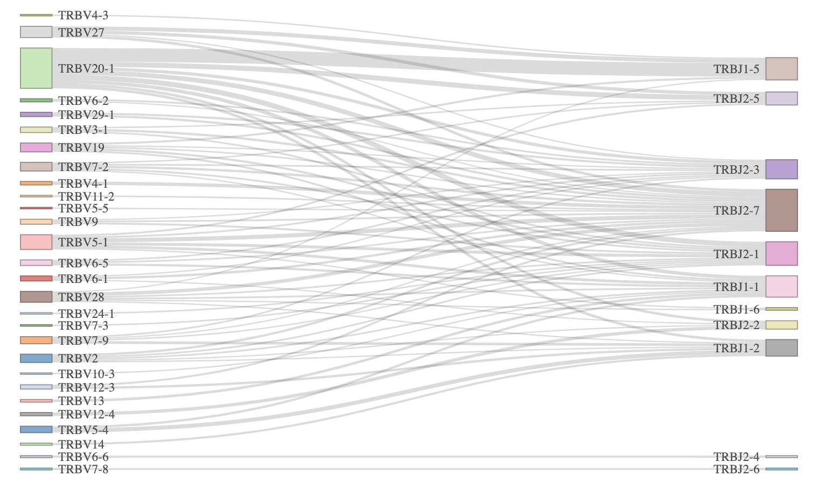
TRB VJ linkages look different in yes vs. no irAE groups, perhaps could also explain pgen differences
Yes irAE
No irAE
Colitis dataset
Notes:
Filtered for top 75 most common linkages

Slide 13
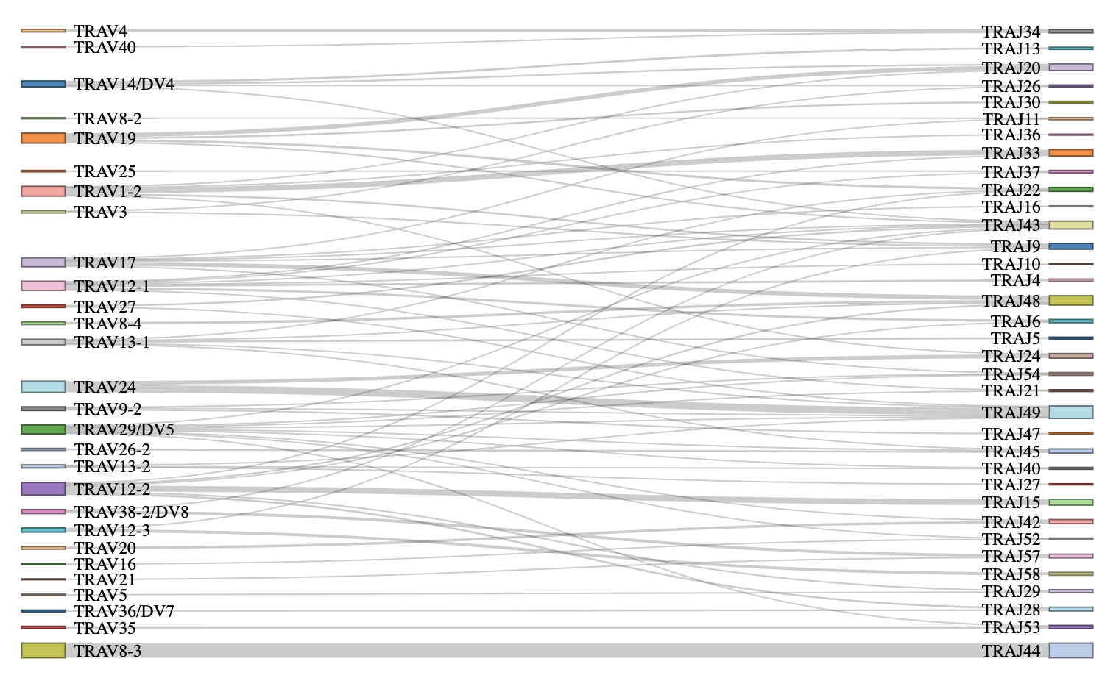
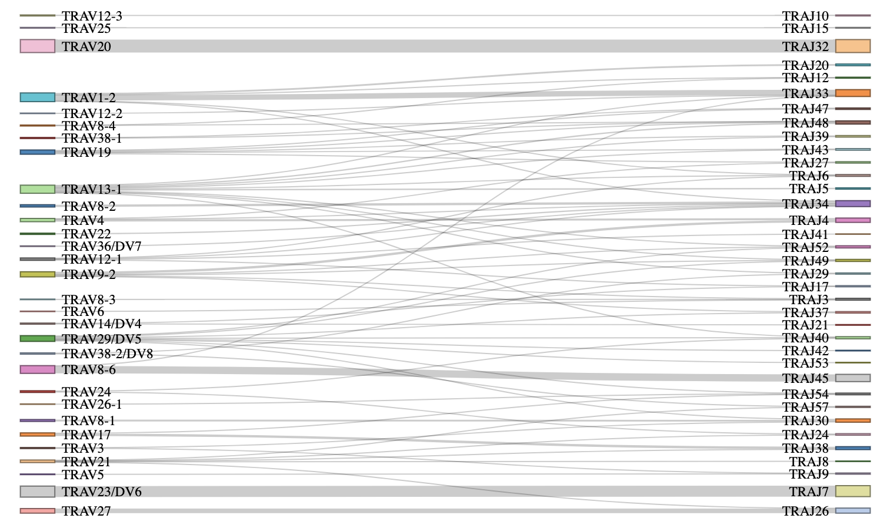
TRA VJ linkages also look different in yes vs. no irAE groups despite no pgen differences
Yes irAE
No irAE
Myocarditis dataset
Notes:
Filtered for top 75 most common linkages

Slide 14
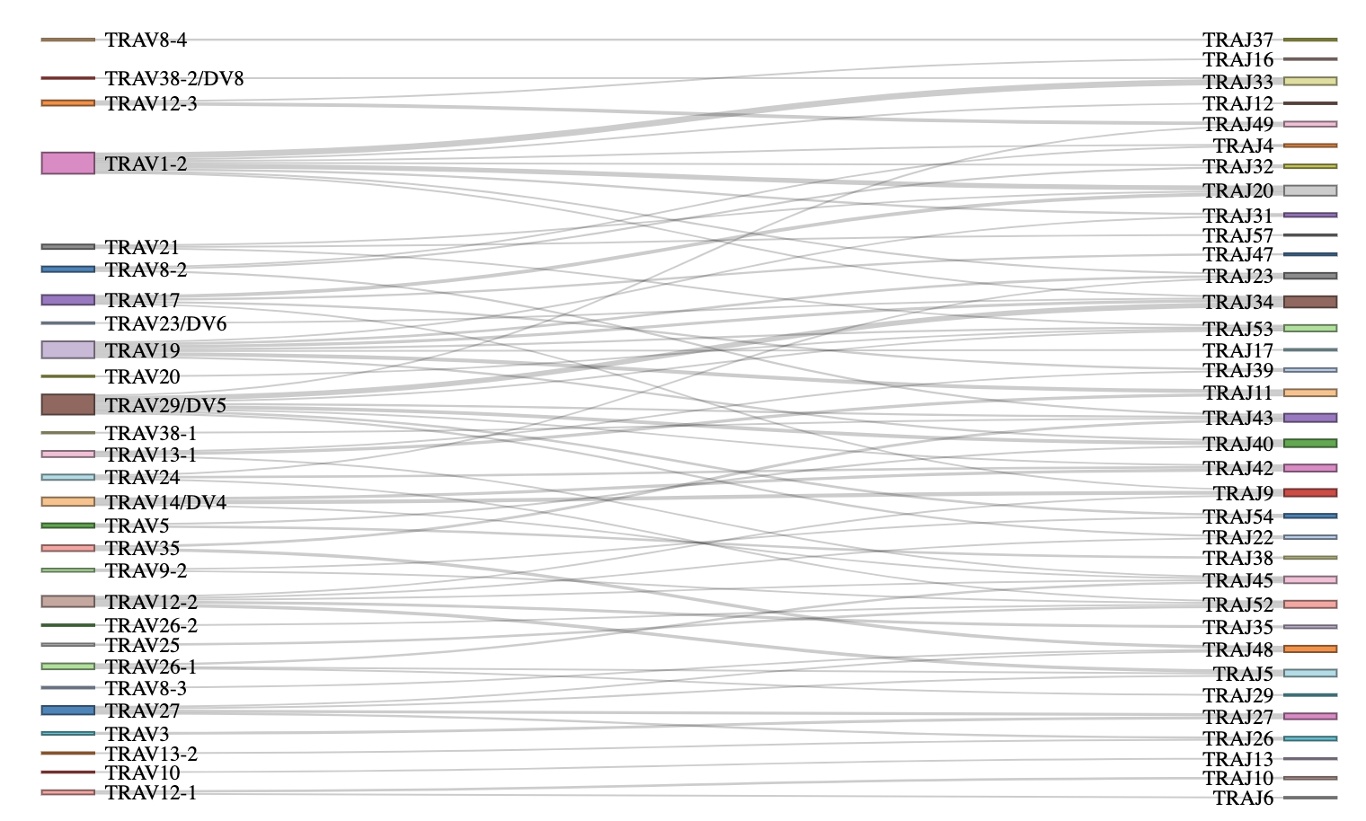
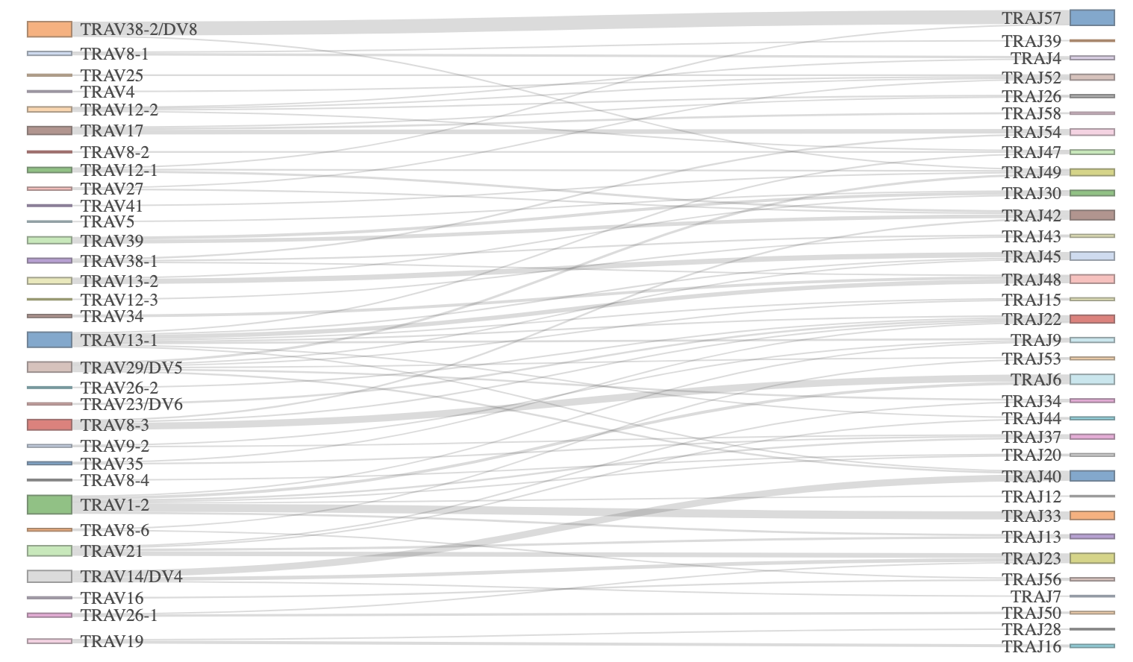
TRA VJ linkages also look different in yes vs. no irAE groups despite no pgen differences
Yes irAE
No irAE
Colitis dataset
Notes:
Filtered for top 75 most common linkages

Slide 15
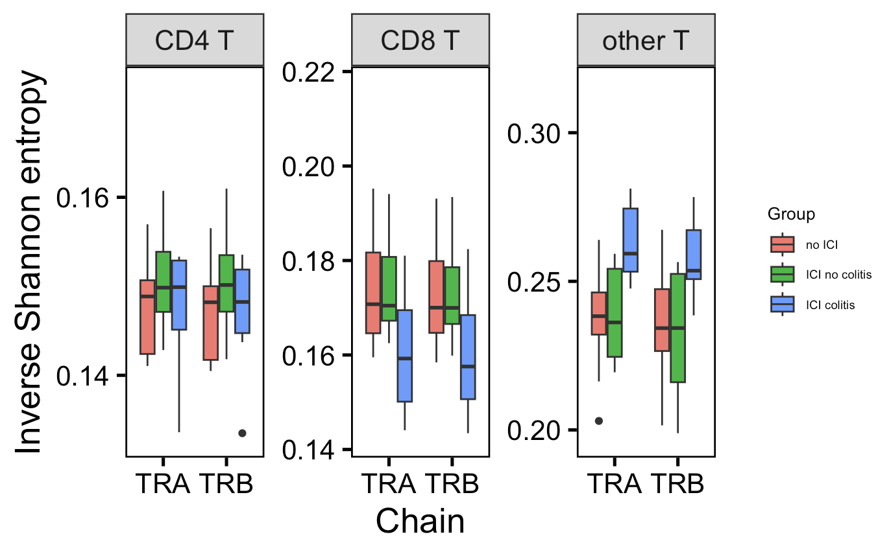
In colitis dataset, CD8 TCR repertoire slightly more polyclonal and other T TCR repertoire more monoclonal in those developing colitis irAE (vs. no ICI)
p =
0.09
p =
0.09
*
*
*
→
More monoclonal
More polyclonal
→
Wilcoxon rank sum test. ****, padj <1e-4; **, padj <1e-2; *; padj <0.05

