Slide 1
Weekly meeting
1 4 2024
Ty Bottorff

Slide 2
Outline

Slide 3
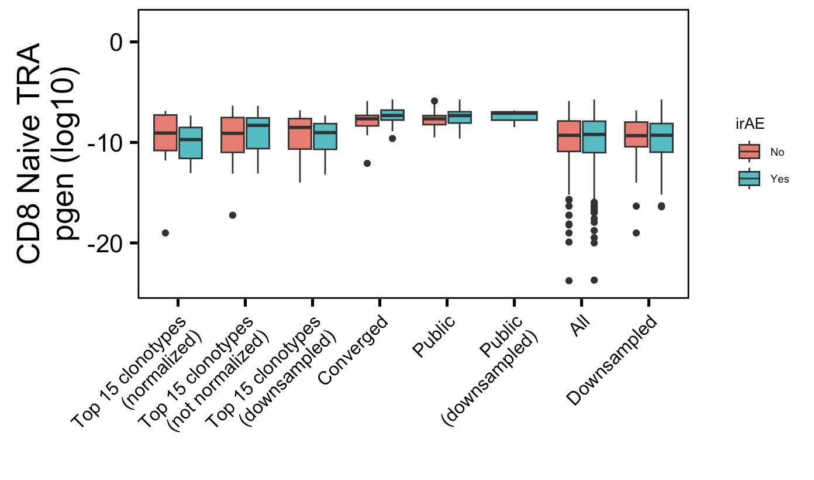
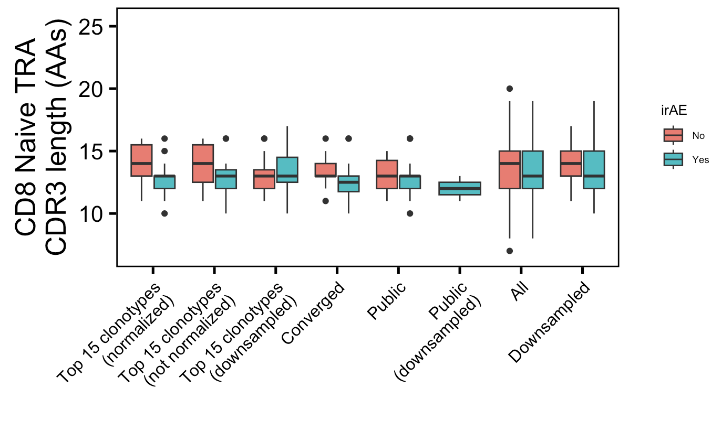
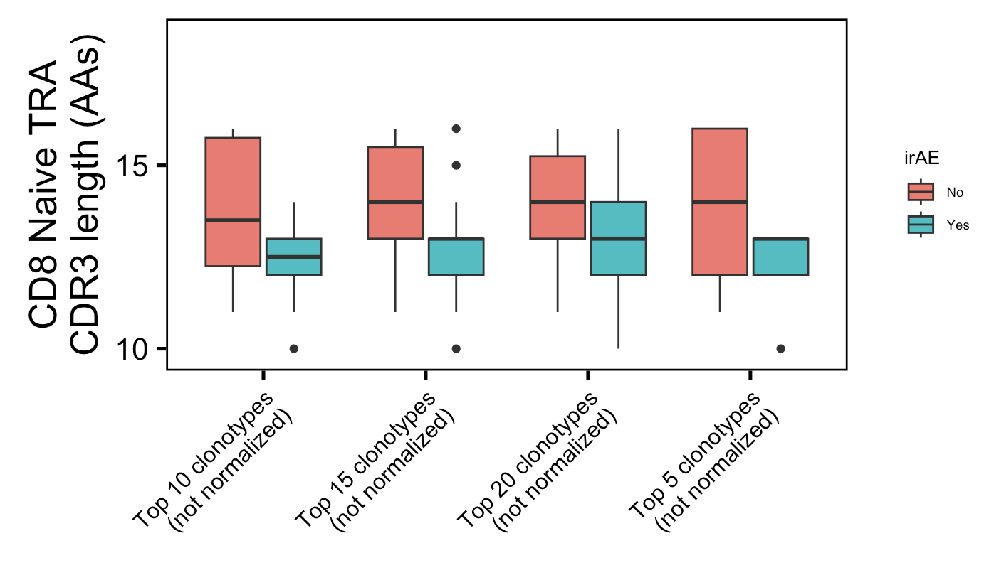
Additional weak conclusion 1 from myocarditis dataset: highly expanded CD8 Naïve TRA CDR3s shorter in irAE patients
*
*
*
Havent adjusted p val yet
Wilcoxon rank sum test. **, p <1e-2; *; p <0.05
Label wrong they’re normalized

Slide 4
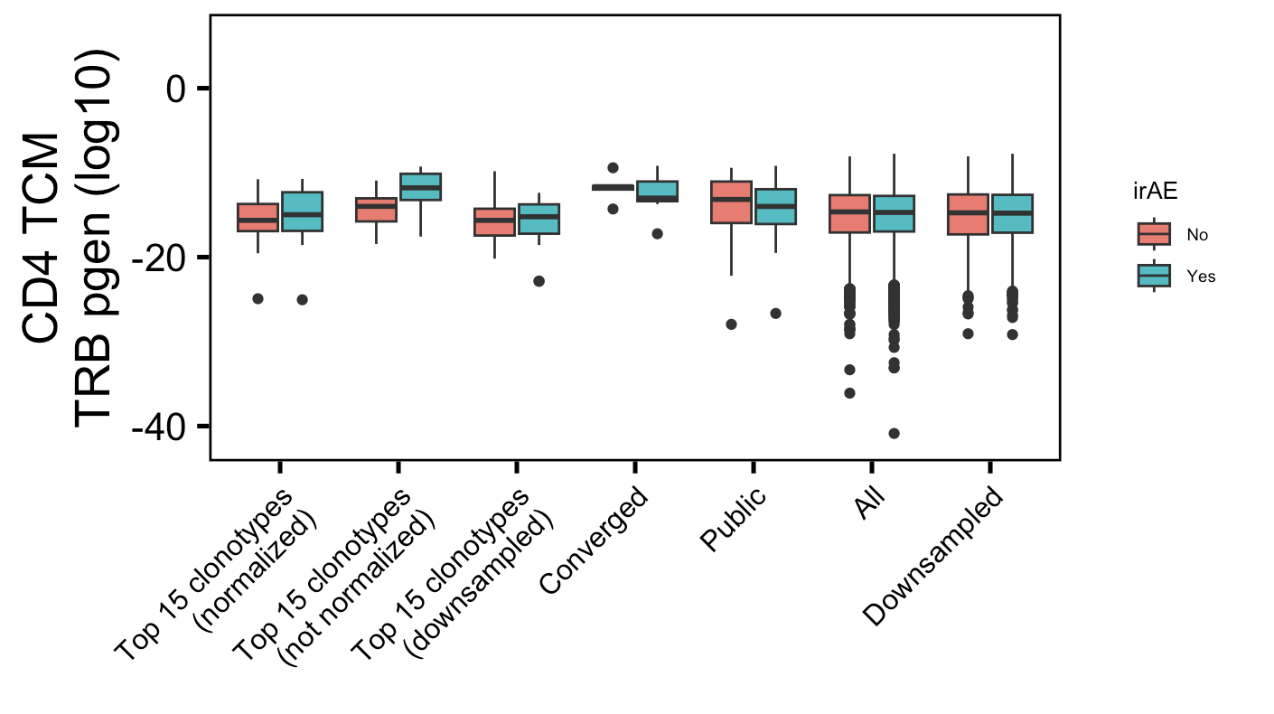
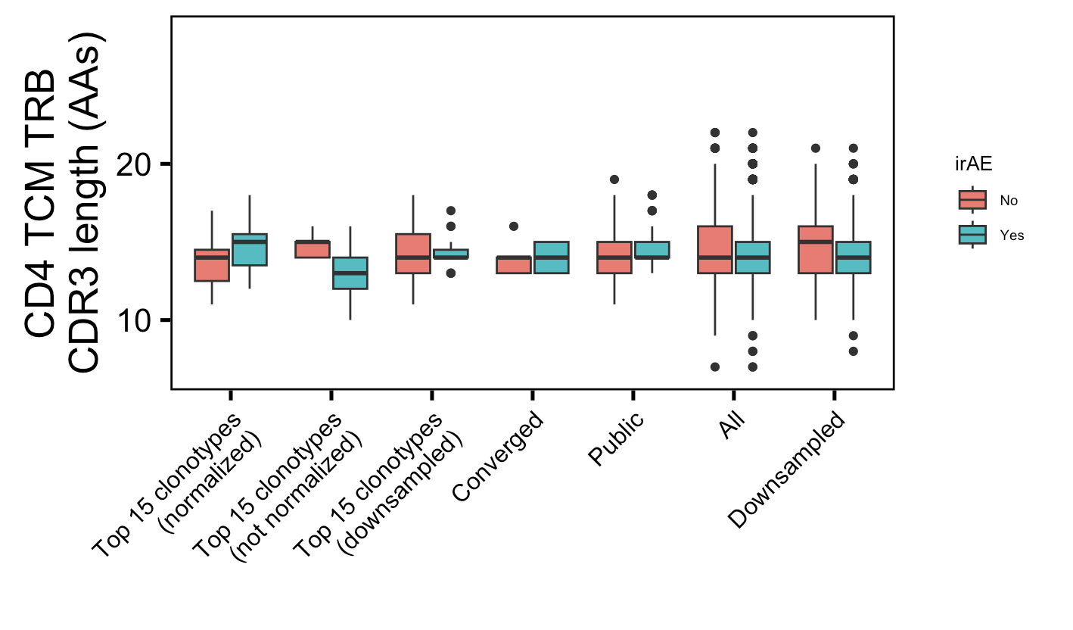
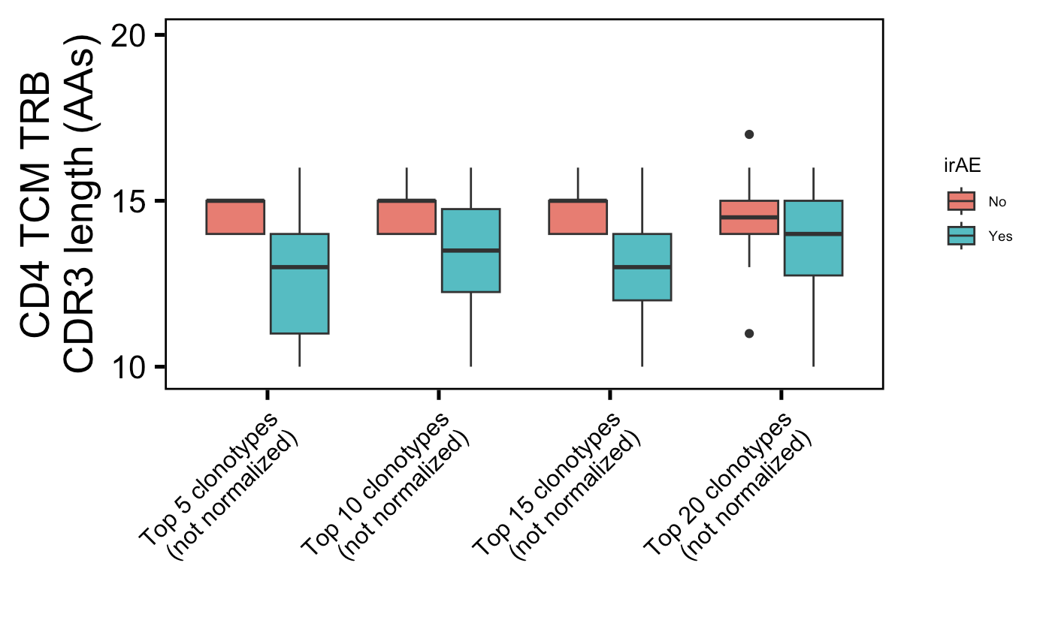
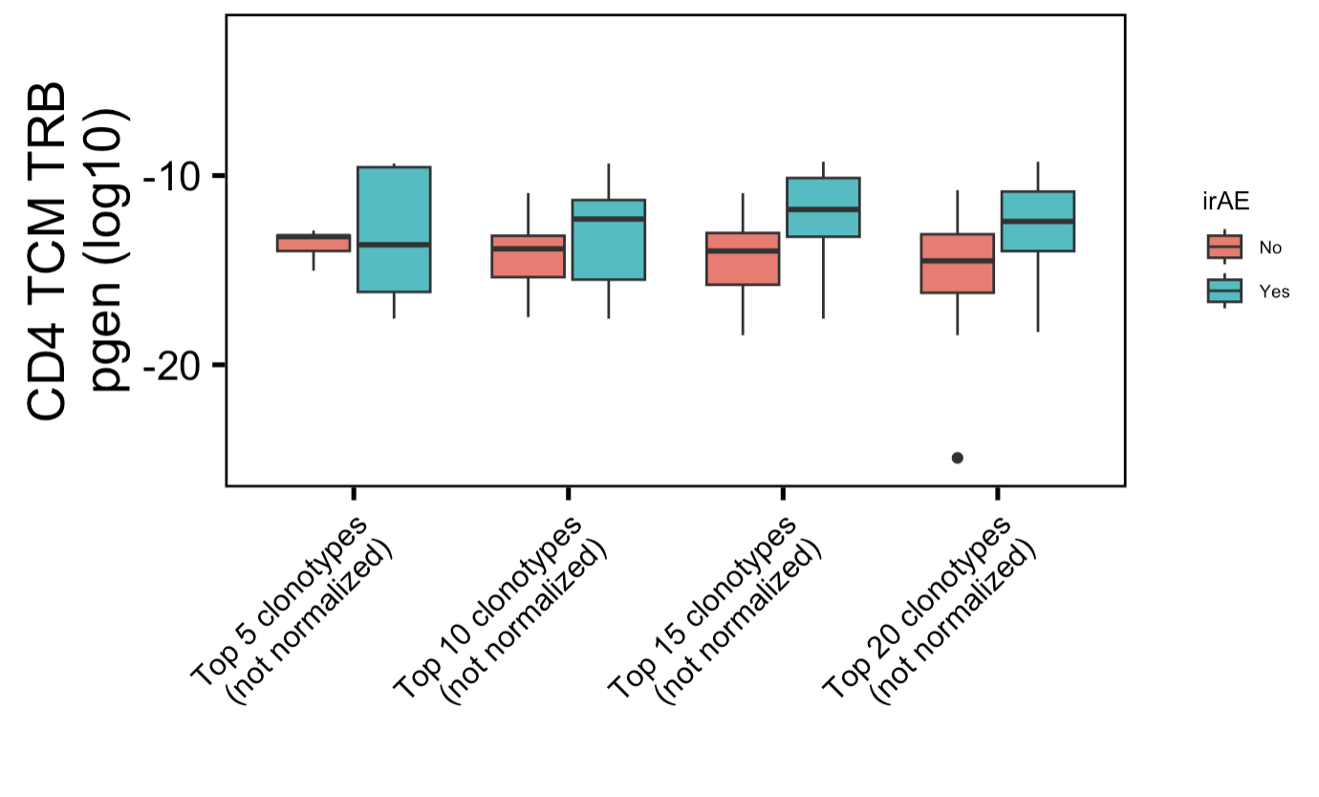
Additional weak conclusion 2 from myocarditis dataset: highly expanded CD4 TCM TRB more germline-like & CDR3s shorter in irAE patients
*
*
*
*
*
Havent adjusted p val yet
Wilcoxon rank sum test. **, p <1e-2; *; p <0.05

Slide 5
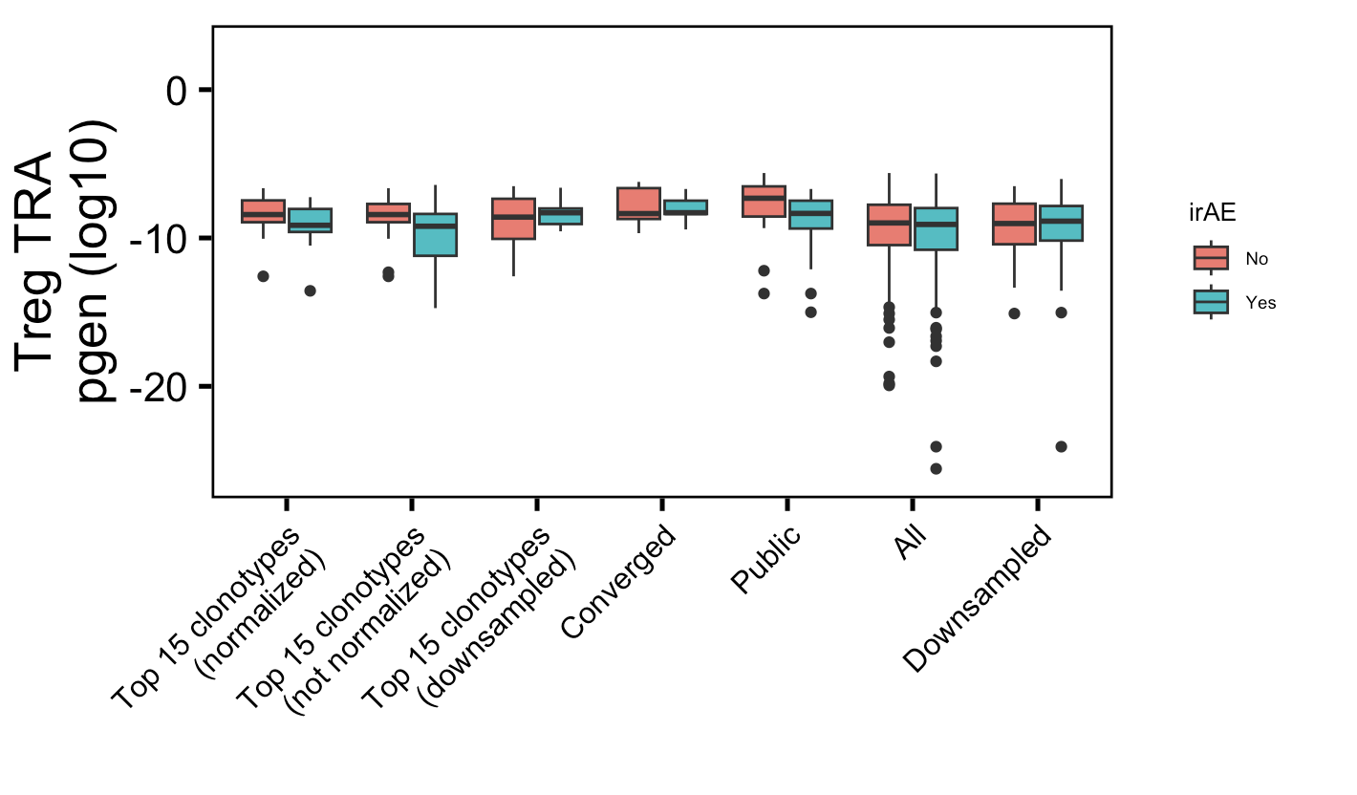
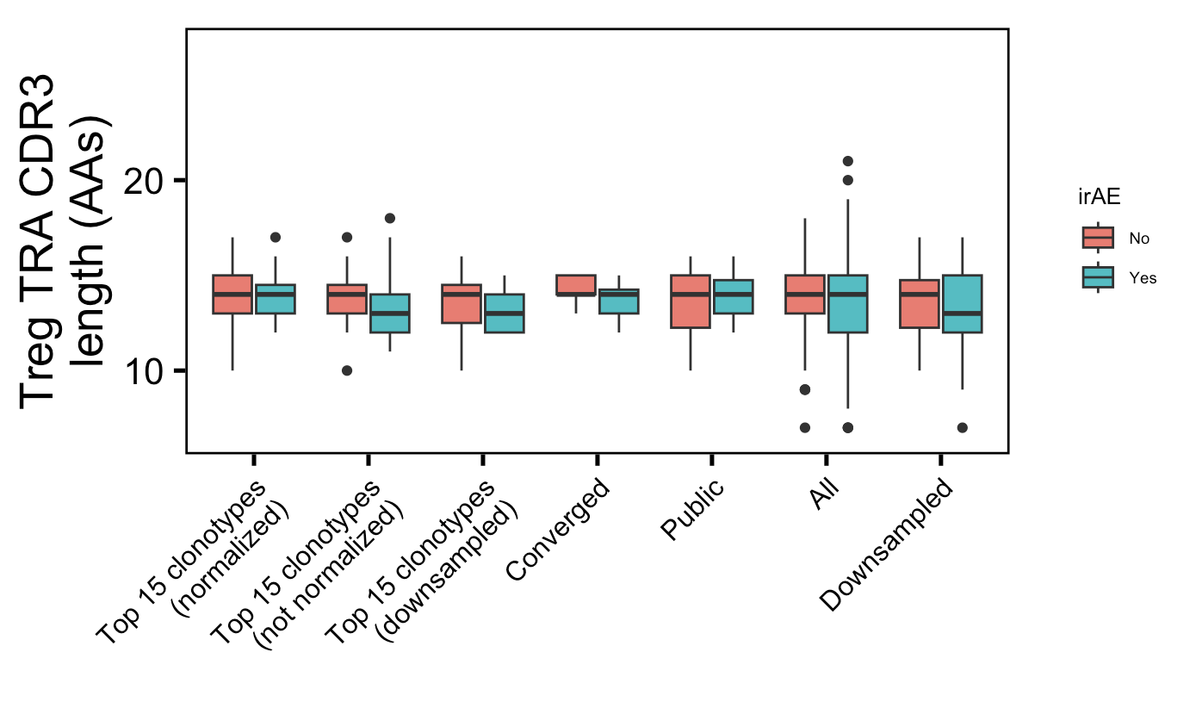
Additional weak conclusion 3 from myocarditis dataset: public Treg TRAs less germline-like in irAE patients
*
Wilcoxon rank sum test. **, p <1e-2; *; p <0.05

Slide 6
Conclusions

Slide 7
Next steps

Slide 8
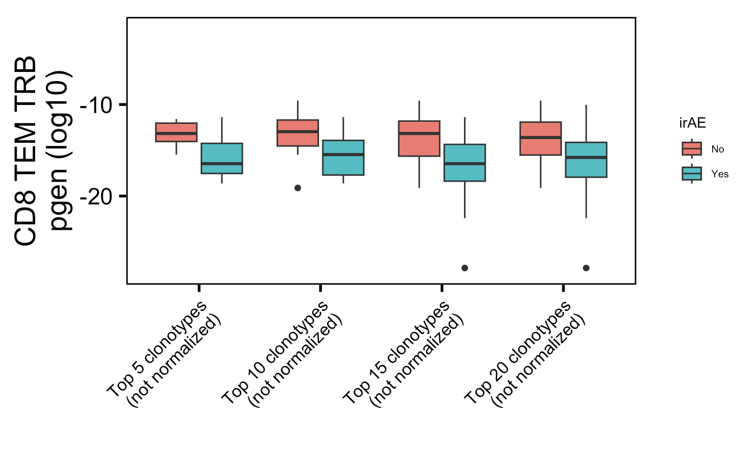
Strongest myocarditis conclusion for comparison
*
*
Havent adjusted p val yet, also show how its not just not normalized (why its not weak)
Wilcoxon rank sum test. **, p <1e-2; *; p <0.05

Slide 9
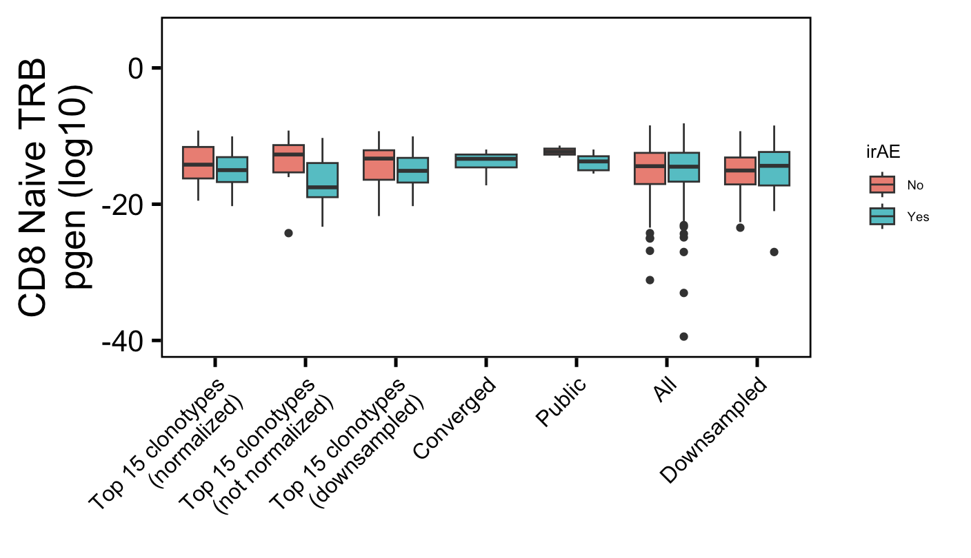
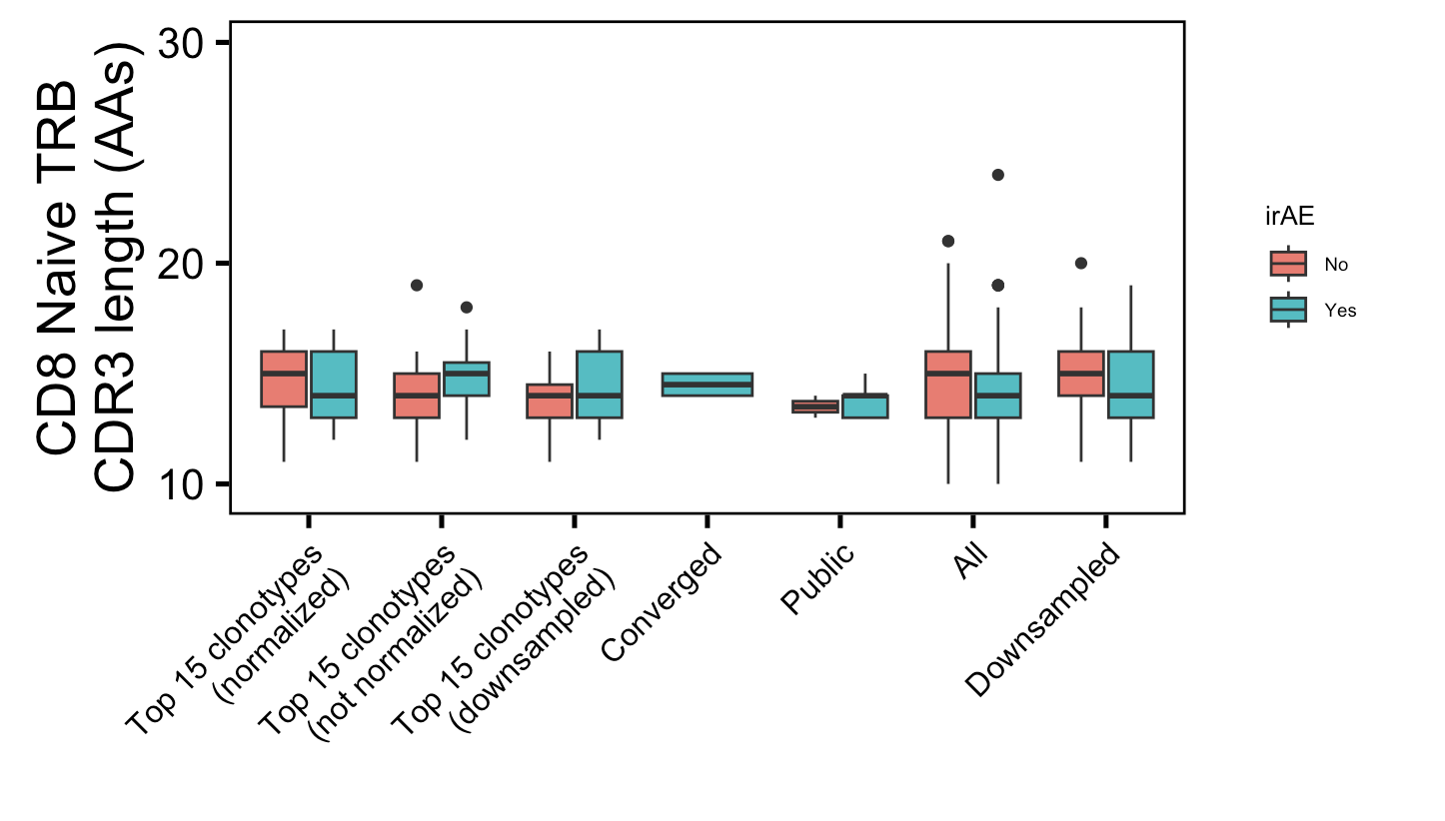
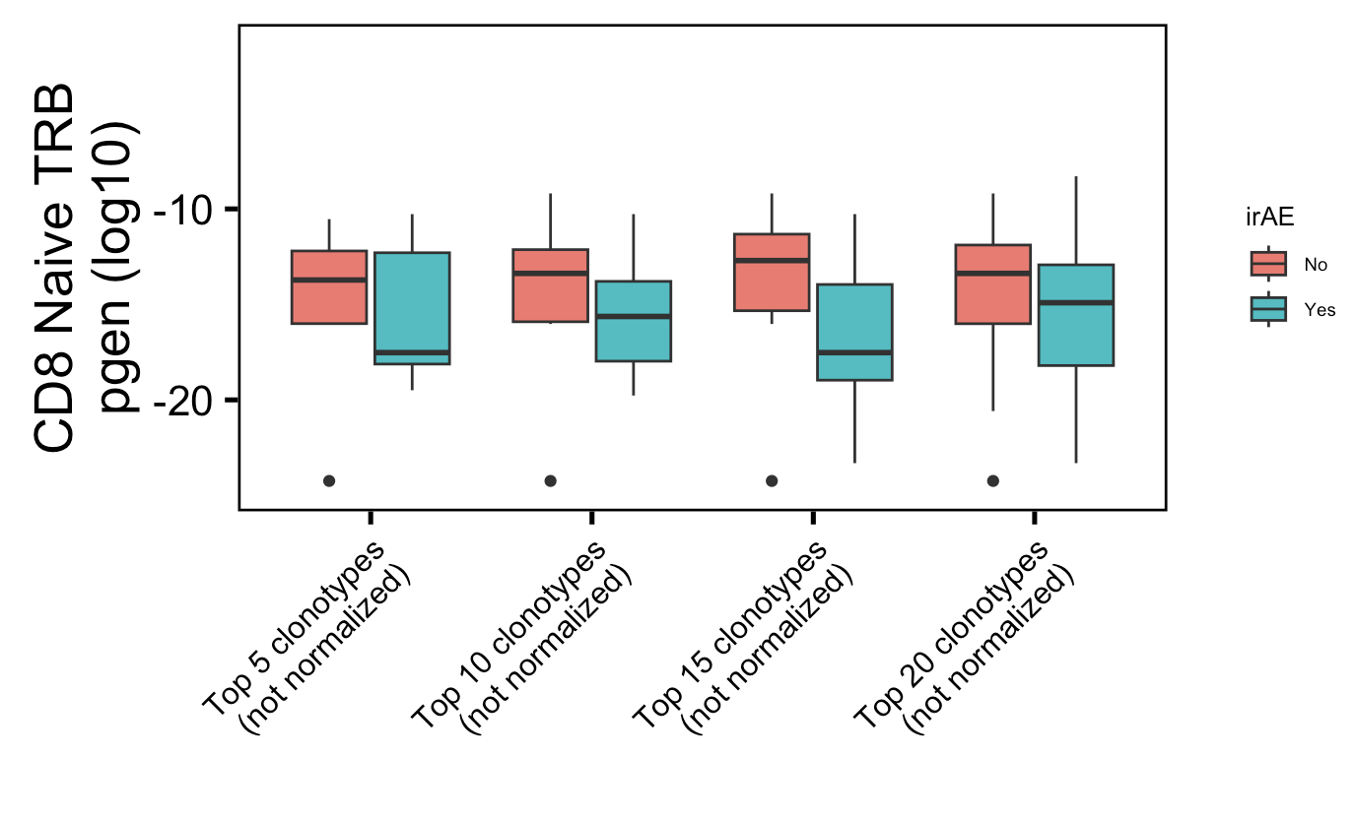
Additional super weak conclusion 1 from myocarditis dataset: highly expanded CD8 Naïve TRBs less germline-like in irAE patients
**
**
Wilcoxon rank sum test. **, p <1e-2; *; p <0.05

Slide 10
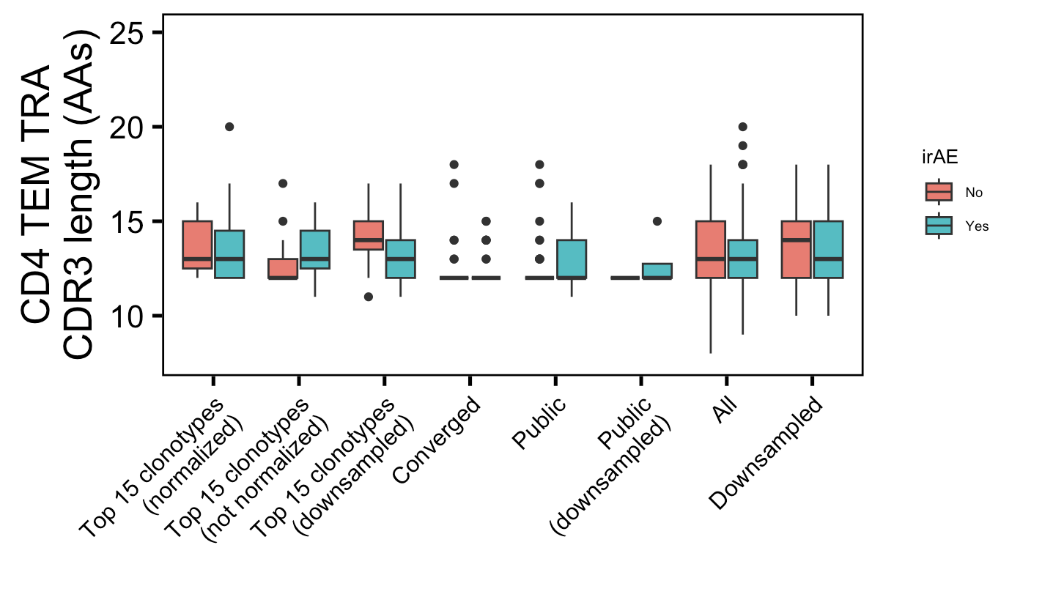
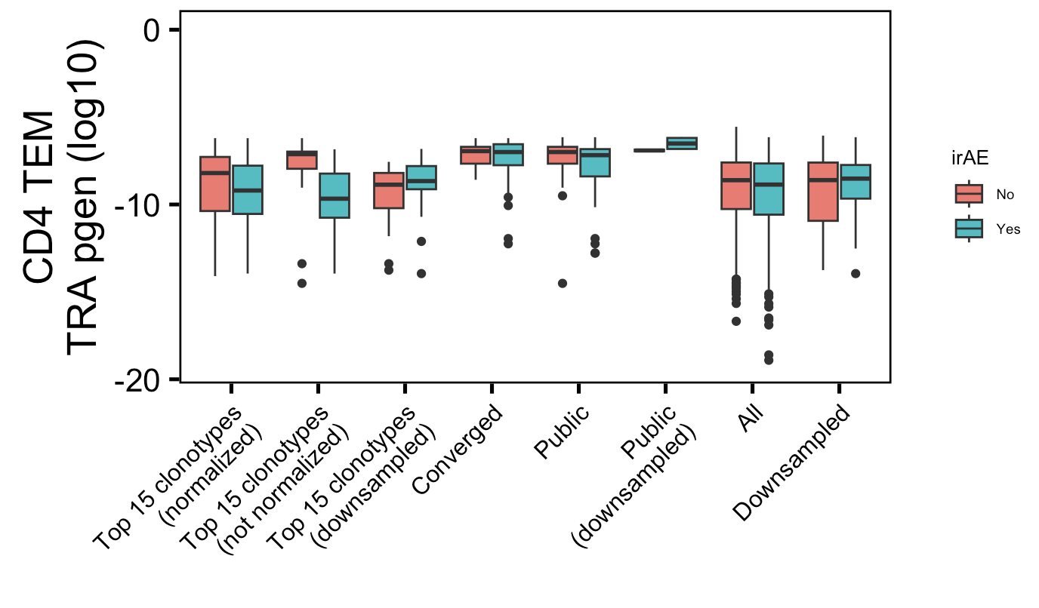
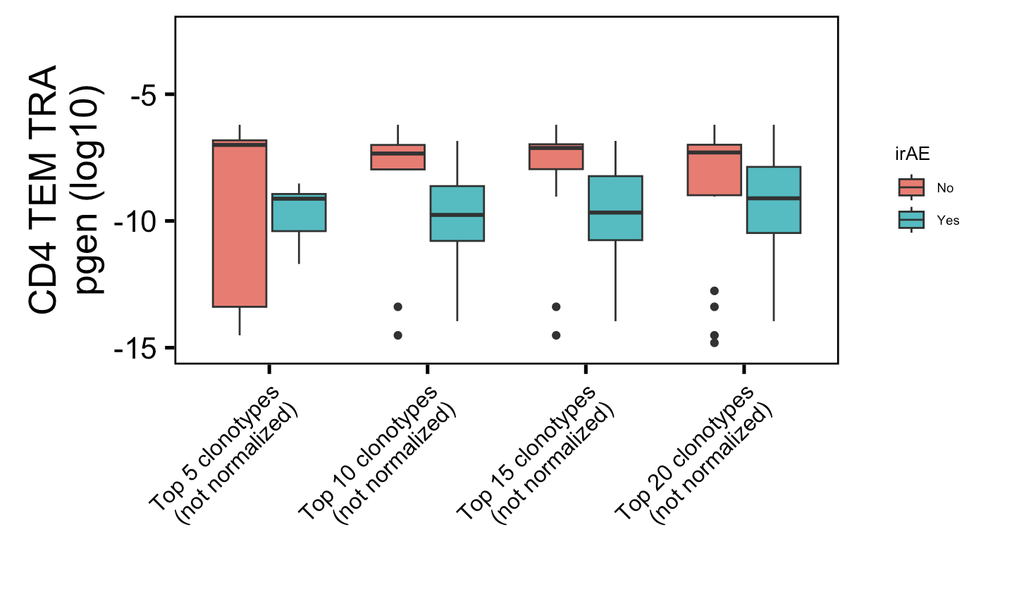
Additional super weak conclusion 2 from myocarditis dataset: highly expanded CD4 TEM TRAs less germline-like in irAE patients
*
*
Wilcoxon rank sum test. **, p <1e-2; *; p <0.05

Slide 11
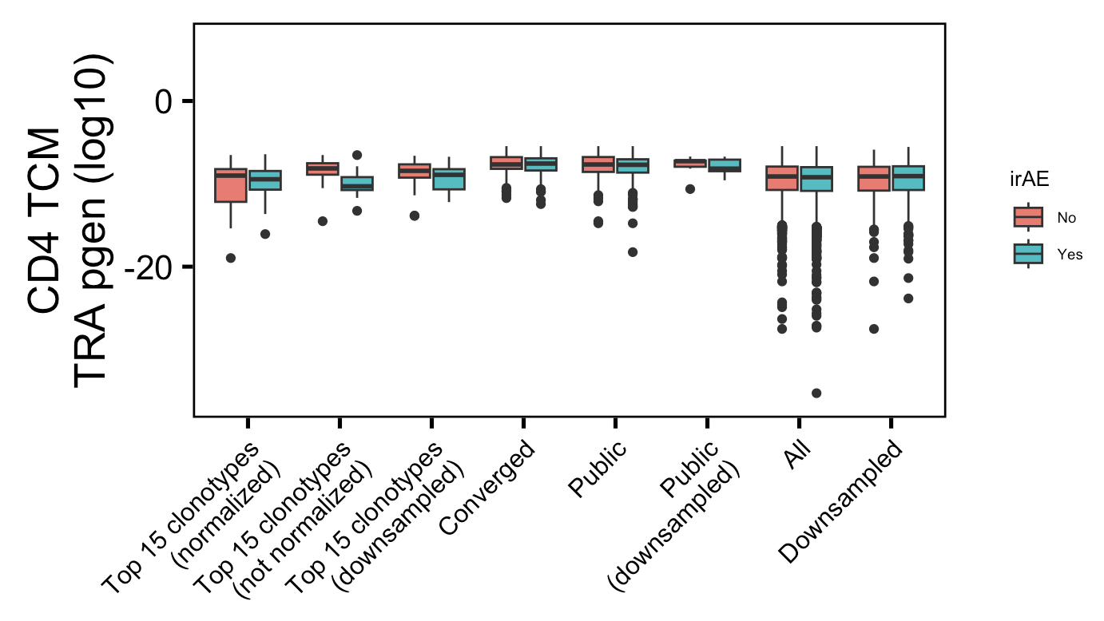
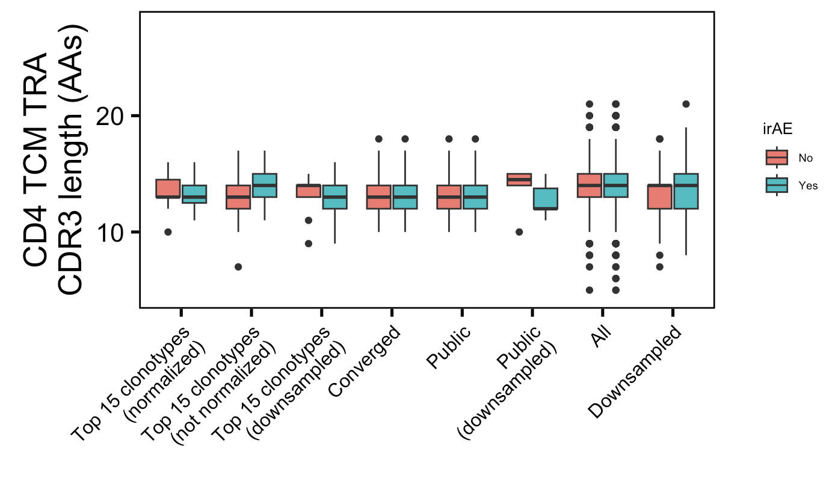
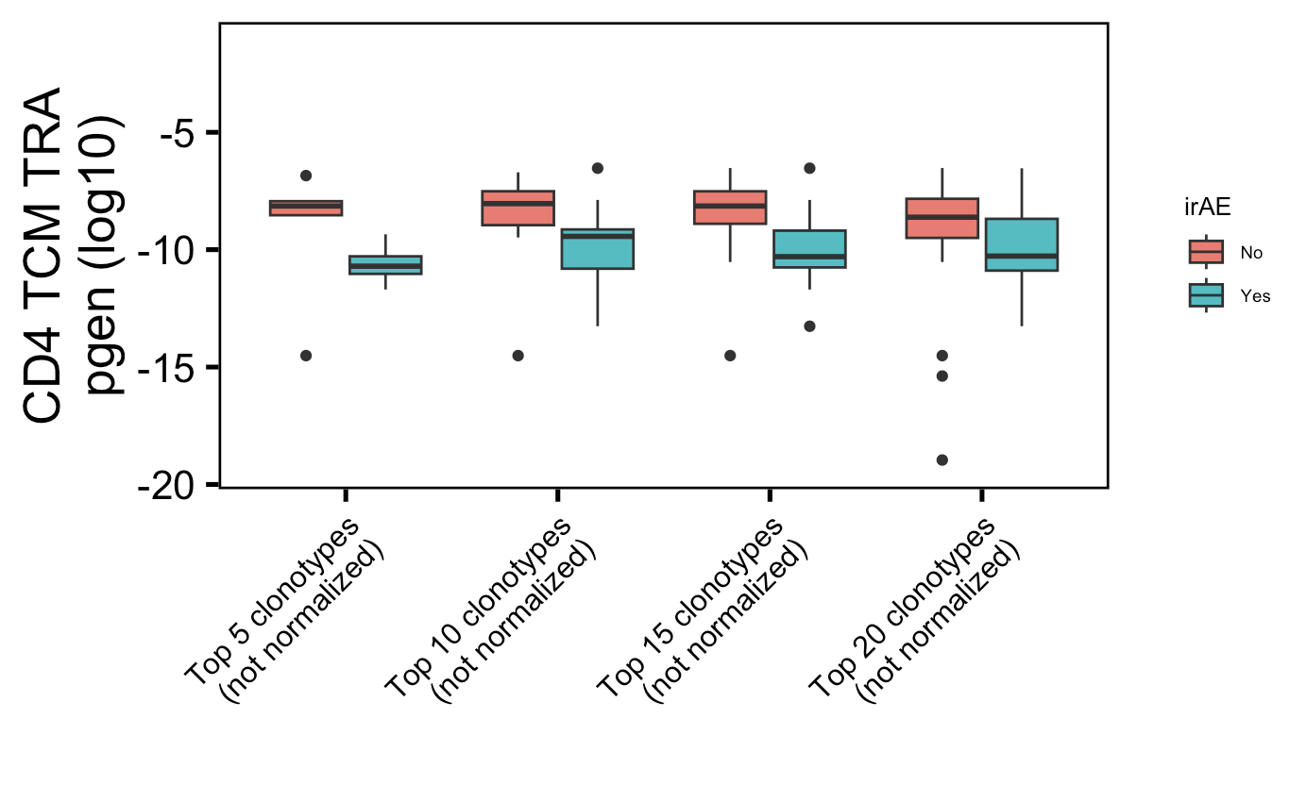
Additional super weak conclusion 3 from myocarditis dataset: highly expanded CD4 TCM TRAs less germline-like in irAE patients
*
*
Wilcoxon rank sum test. **, p <1e-2; *; p <0.05

Slide 12
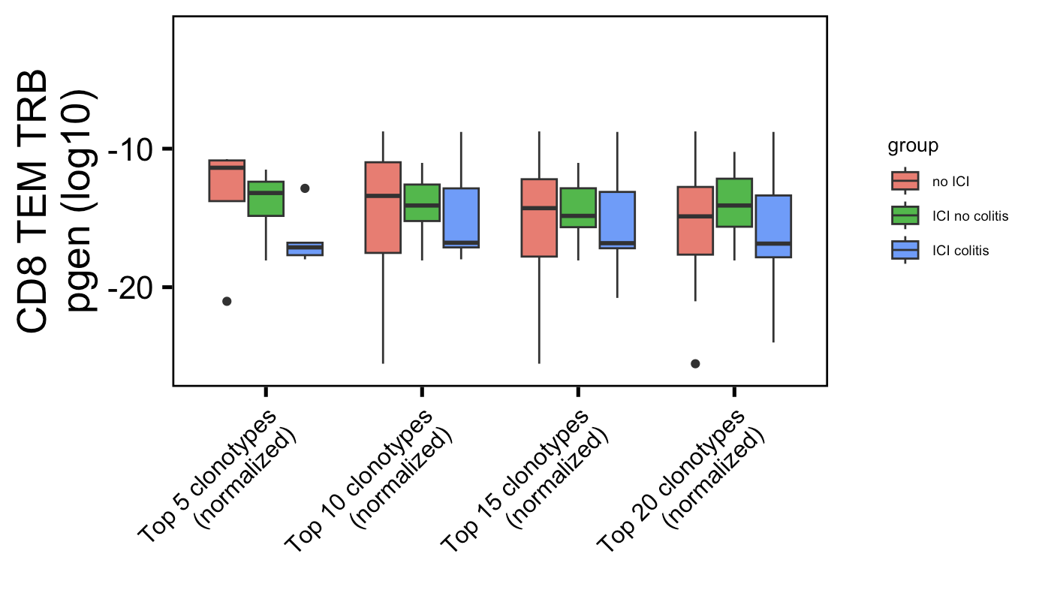
Weak conclusion 1 from colitis dataset (seen last week):
*
Label wrong not normalized
Wilcoxon rank sum test. **, p <1e-2; *; p <0.05

Slide 13
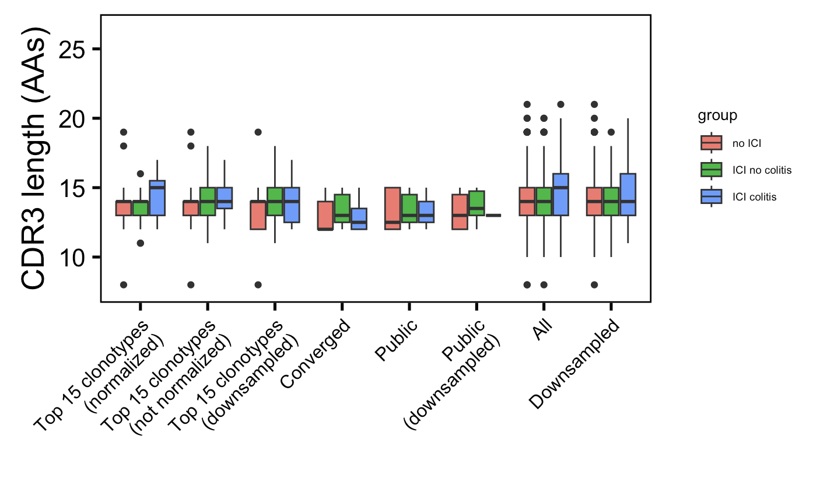
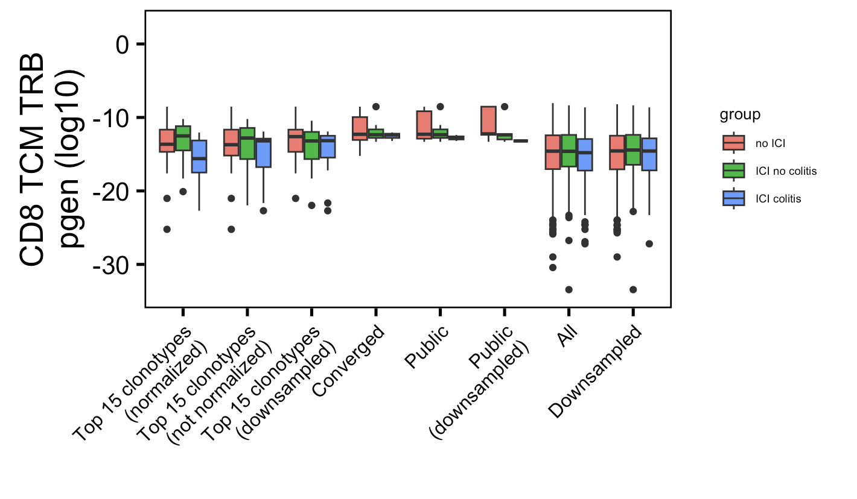
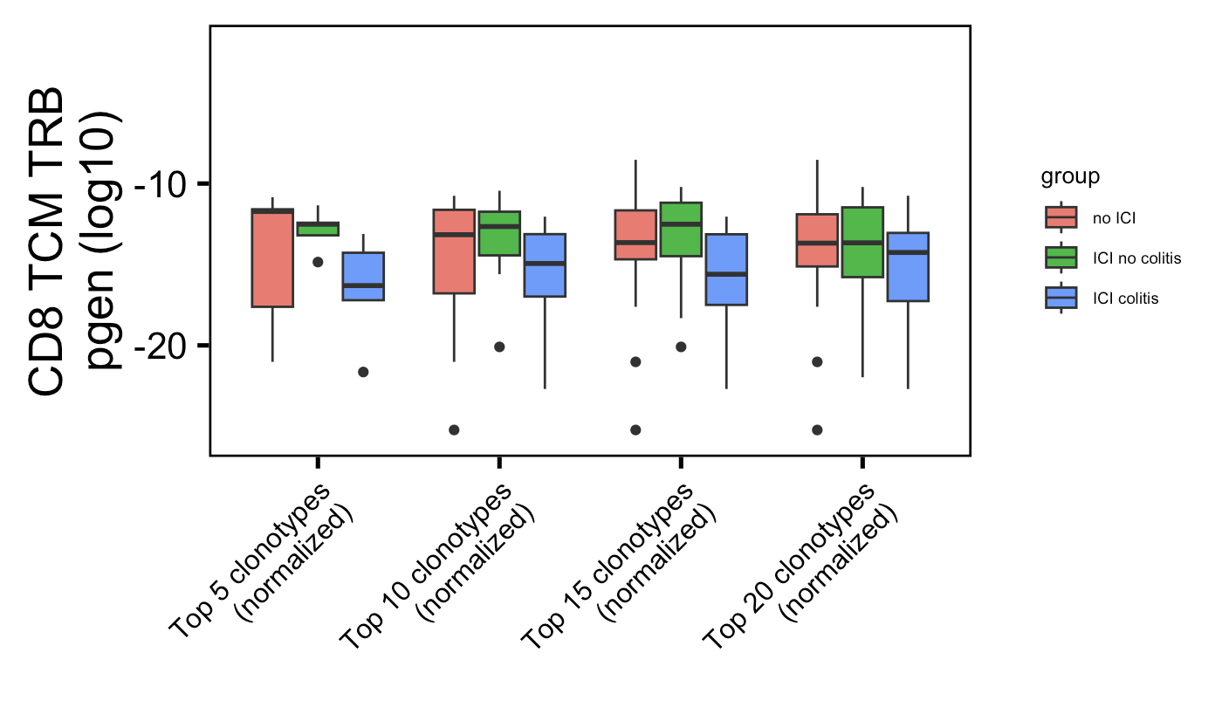
Additional weak conclusion 1 from colitis dataset: highly expanded CD8 TCM TRBs less germline-like in colitis patients (opposite of myocarditis conclusion)
*
*
Wilcoxon rank sum test. **, p <1e-2; *; p <0.05

Slide 14
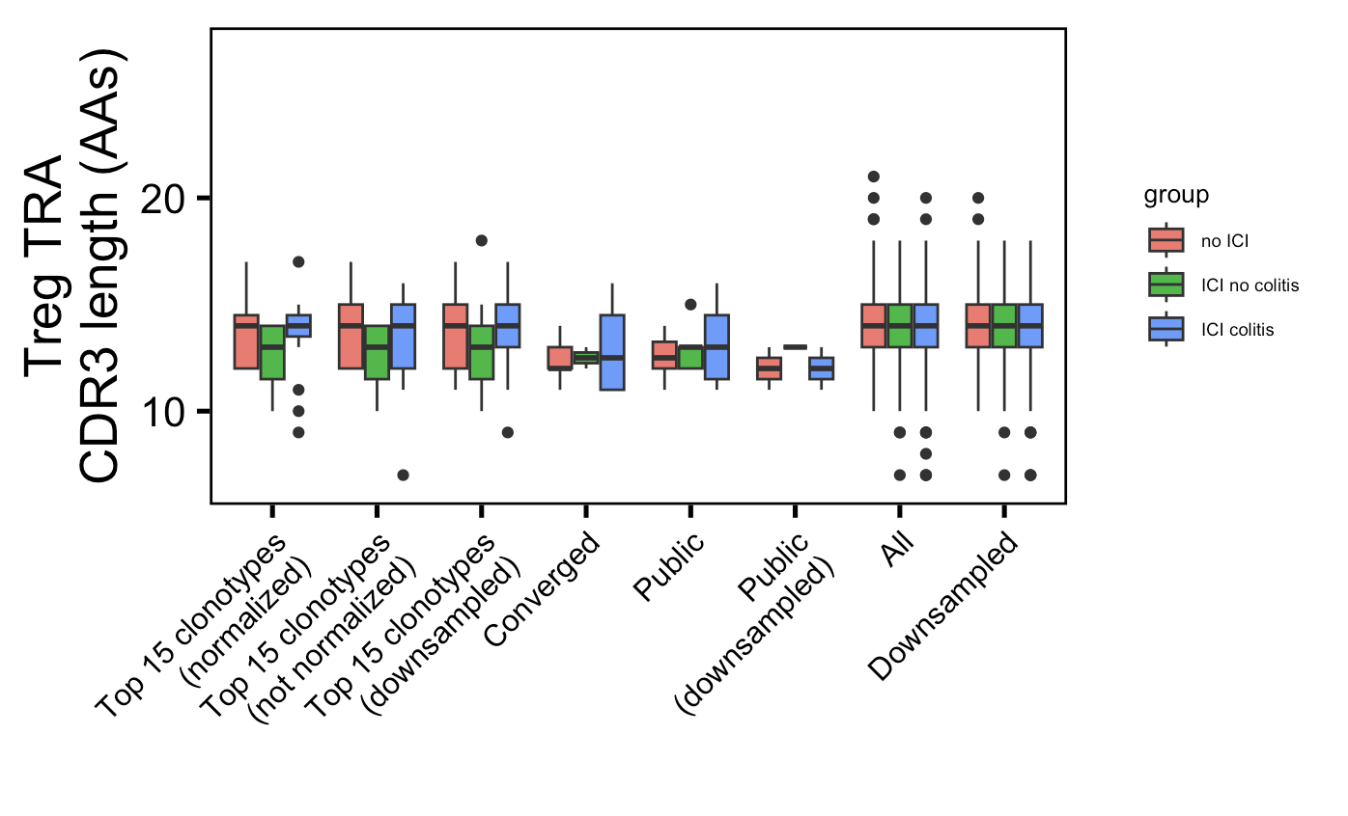
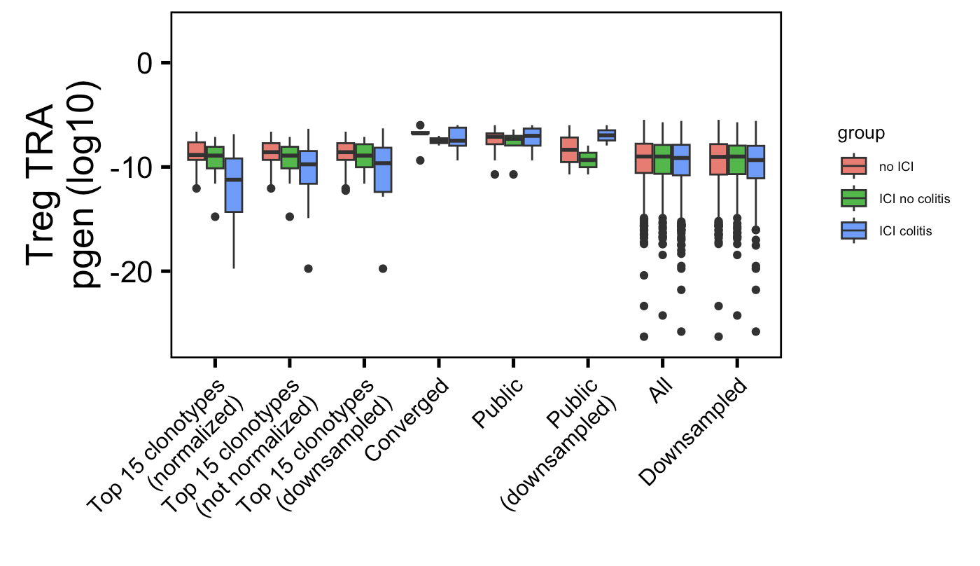
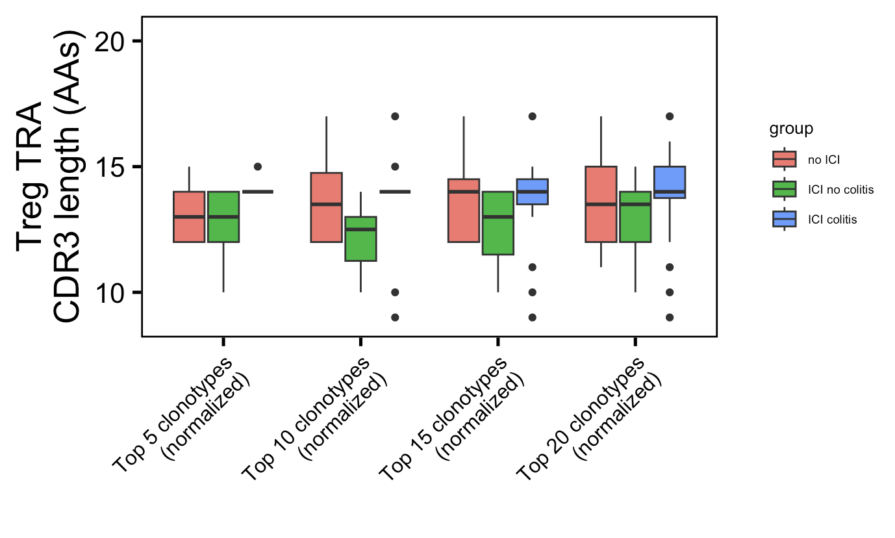
Additional weak conclusion 2 from colitis dataset: highly expanded Treg TRA CDR3s longer in irAE patients
*
*
Wilcoxon rank sum test. **, p <1e-2; *; p <0.05

