Slide 1
Weekly meeting
1 11 2024
Ty Bottorff

Slide 2
Outline
Cleaned up cell type abundance comparisons between irAE groups across both datasets, UMAP contour plot
Looking at feature differences between irAE groups across datasets across different bins of top clonotype %s using heatmaps

Slide 3
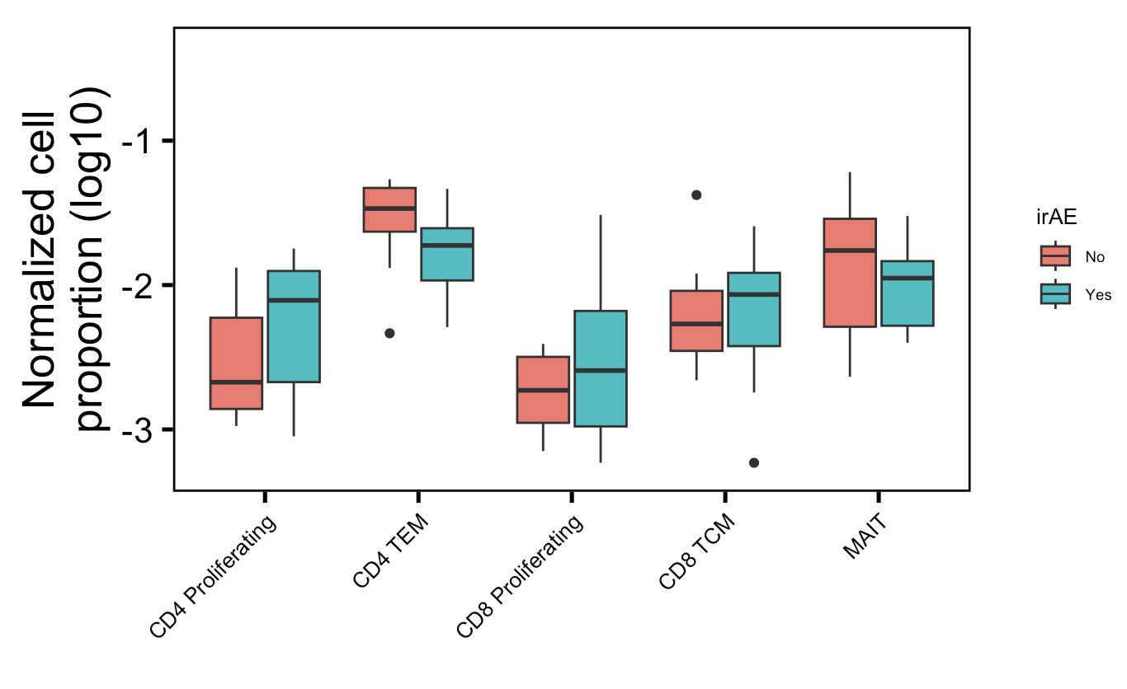
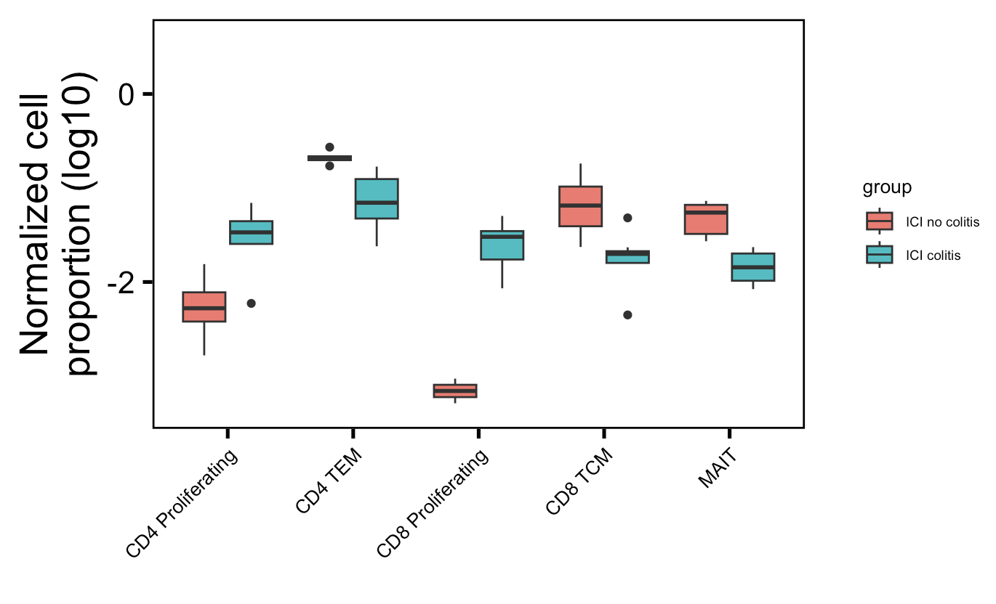
More proliferating T cells (CD4 and CD8), fewer memory T cells (CD4 TEM, CD8 TCM), fewer MAITs in irAE tissue
Myocarditis dataset
Colitis dataset
**
**
*
**
**
None significant even with t test instead of Wilcox rank sum test
Wilcoxon rank sum test. **, p <1e-2; *; p <0.05
Notes:
Fewer Tregs associated with irAEs in literature, don’t see that here though, don’t even see ICI decreasing Tregs…
Wilcox rank sum test doesn’t assume equal variances (t test does)

Slide 4
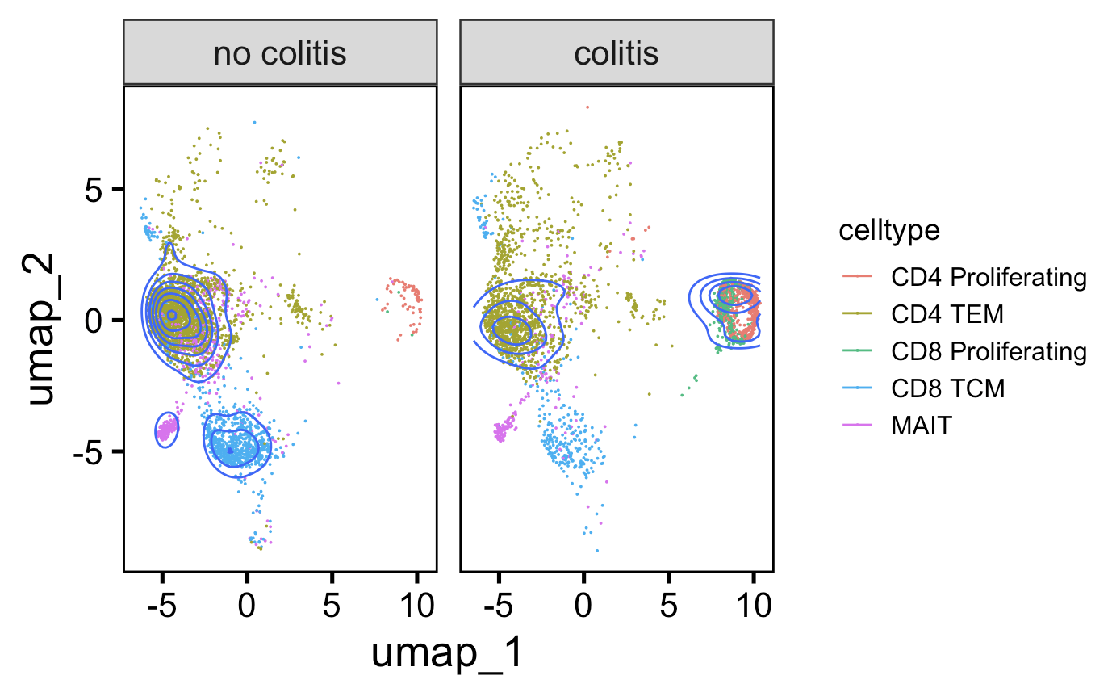
More proliferating T cells, fewer memory T cells (CD4 TEM, CD8 TCM), fewer MAITs in colitis irAE tissue
Downsampled
Notes:
Fewer Tregs associated with irAEs in literature, don’t see that here though, don’t even see ICI decreasing Tregs…

Slide 5
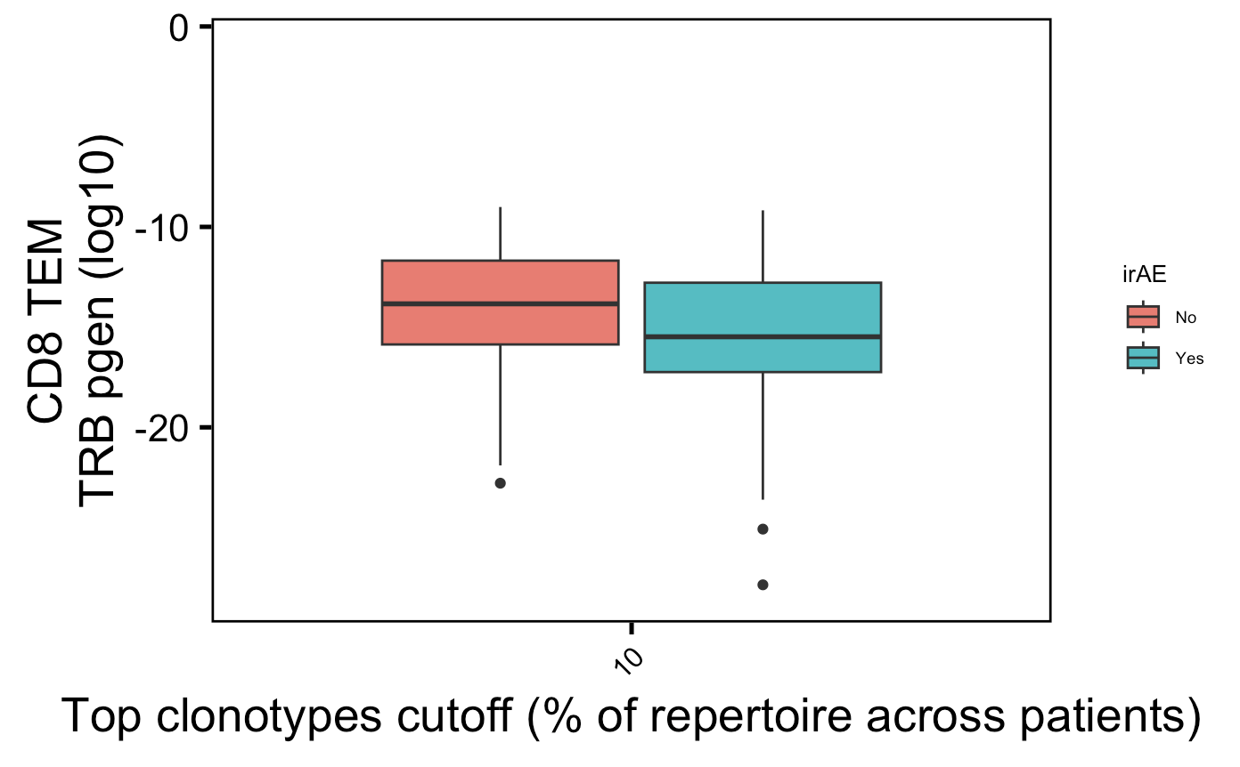
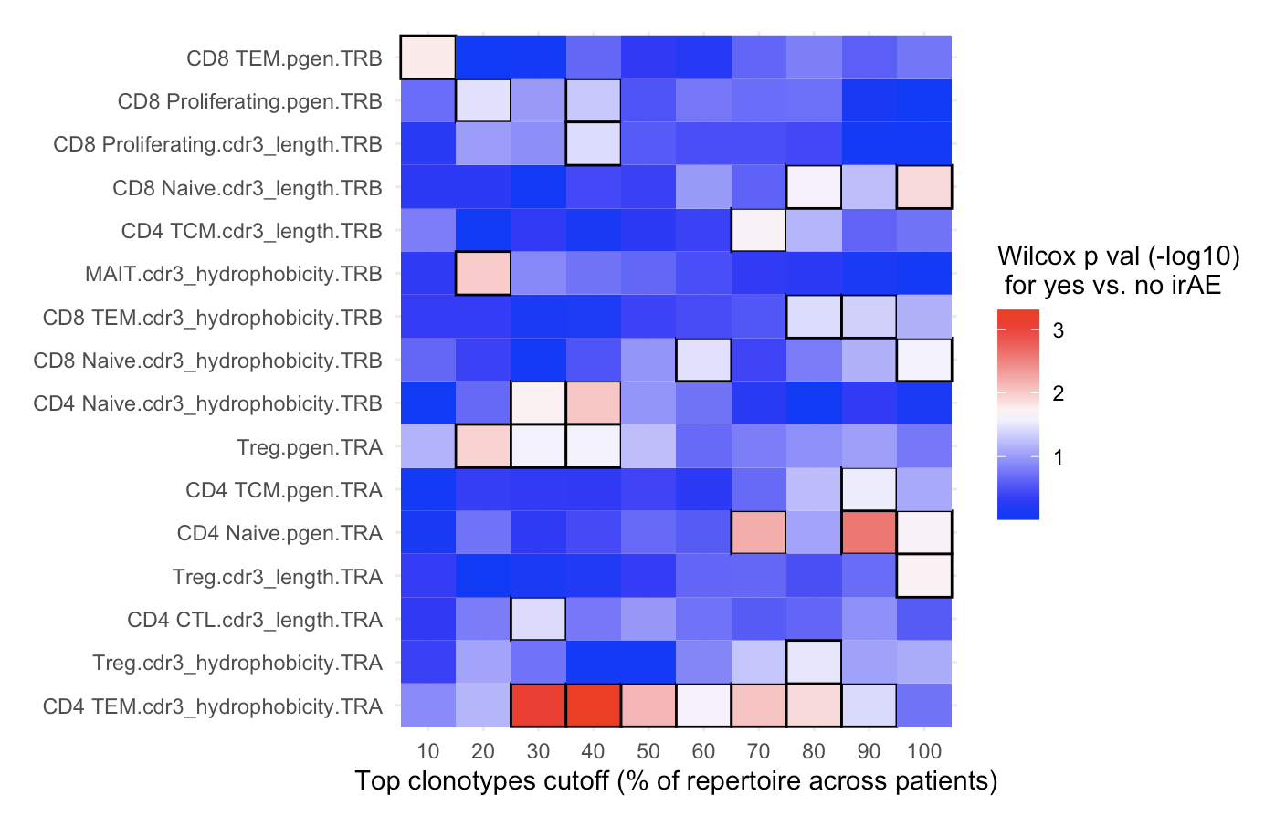
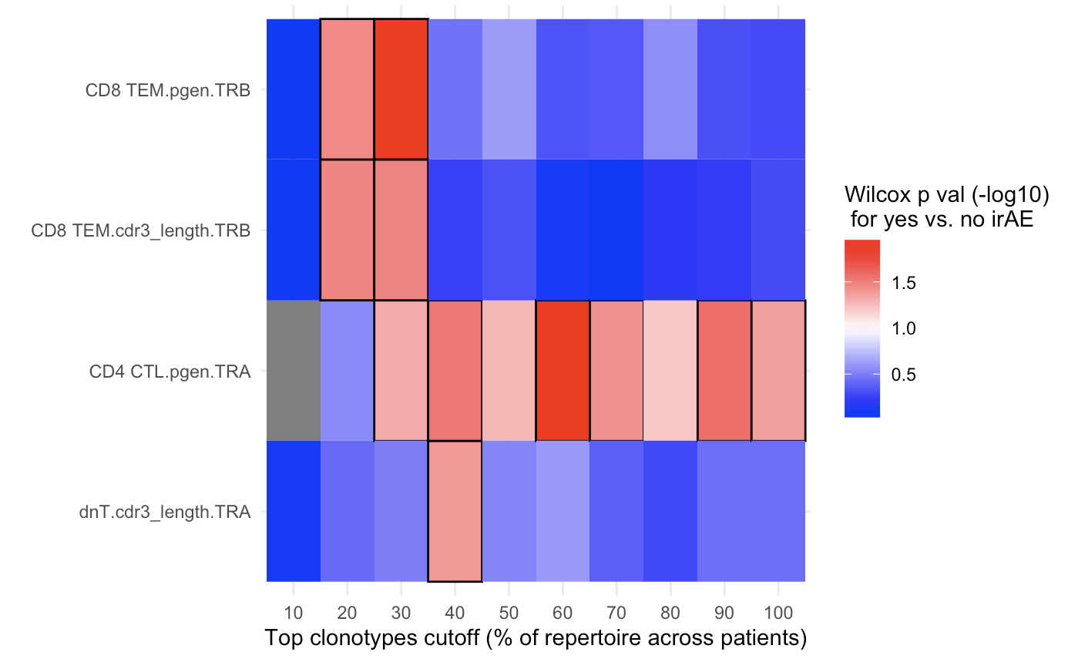
TRB pgen difference between irAE groups in highly expanded CD8 TEMs pops out in summary heatmaps (myocarditis dataset)
Normalized by sequencing depth
Downsampled
Highly expanded ---------- All
Highly expanded ---------- All
Notes:
P = 0.02 for CD8 TEM pgen TRB 10% cutoff

Slide 6
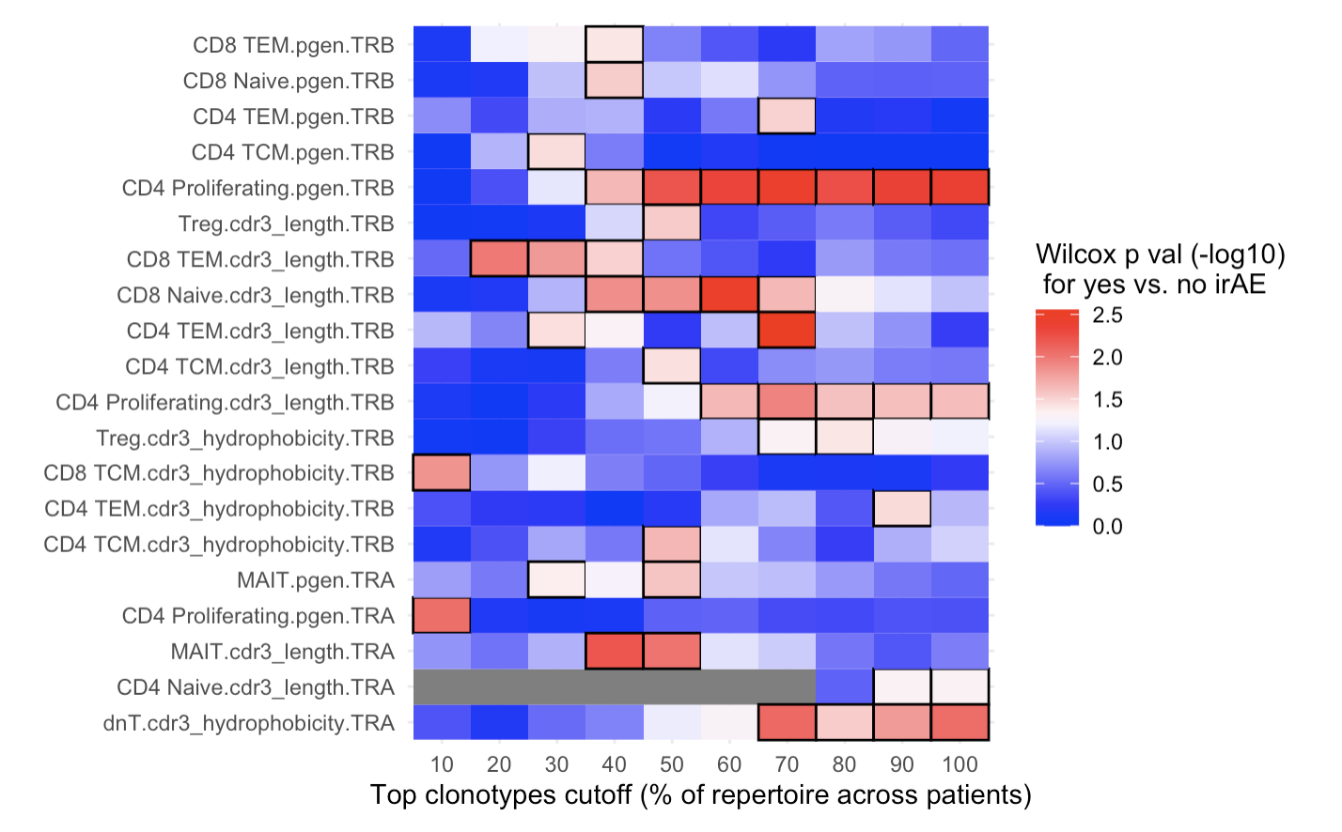
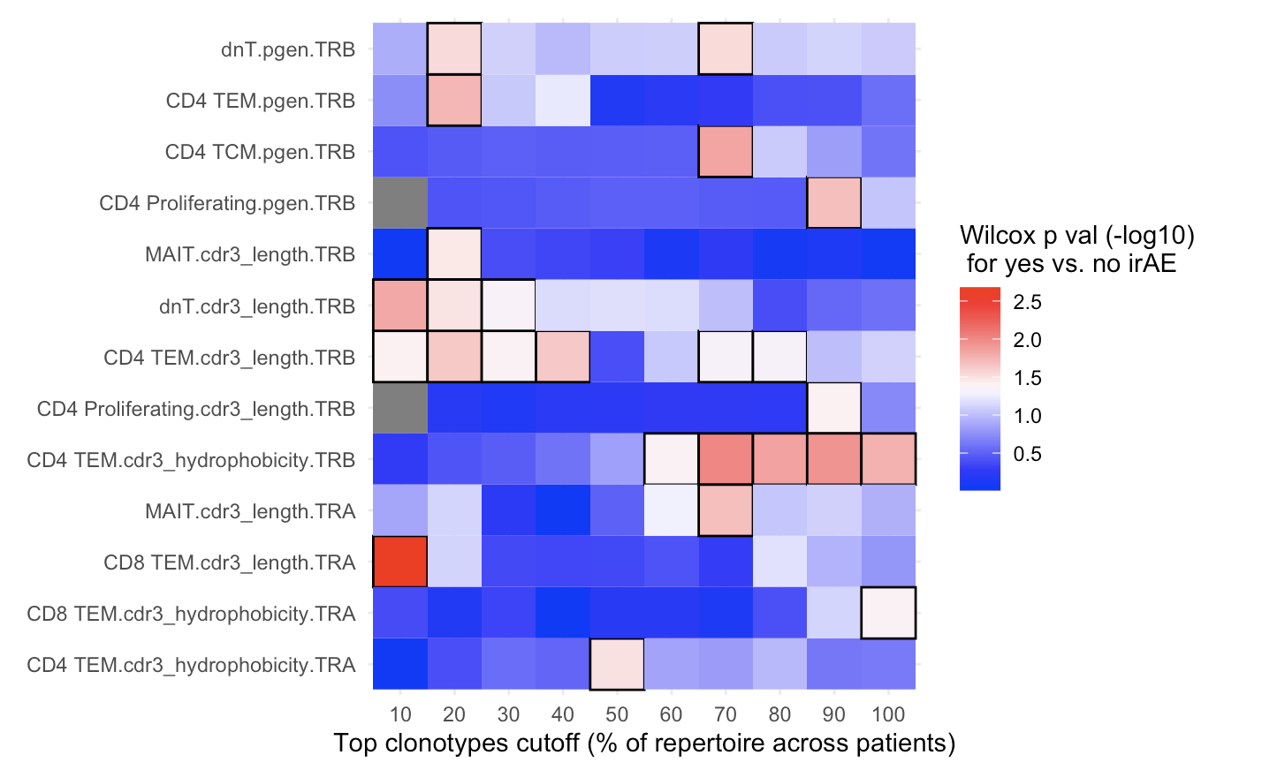
Colitis dataset - CD8 TEM pgen TRB difference at higher cutoff (40%) & only in left heatmap - TRB CDR3 length pops out among highly expanded CD4 TEMs (didn’t see in myocarditis dataset) - CD4 proliferating TRB CDR3 length pops out at all level
Normalized by sequencing depth
Downsampled
Highly expanded ---------- All
Highly expanded ---------- All

Slide 7
Conclusions
More proliferating T cells, fewer memory T cells (CD4 TEM, CD8 TCM), fewer MAITs in colitis irAE tissue

Slide 8
Next steps
Should I use VJ genes for convergence/publicity calling? i.e. clonotype vs. CDR3 publicity
JC prep: use RNAseq to call TCR clonotypes, although only captures top clonotypes
After 1/16 JC focus on ATACseq prep. and 2/1 SI talk prep

Slide 9
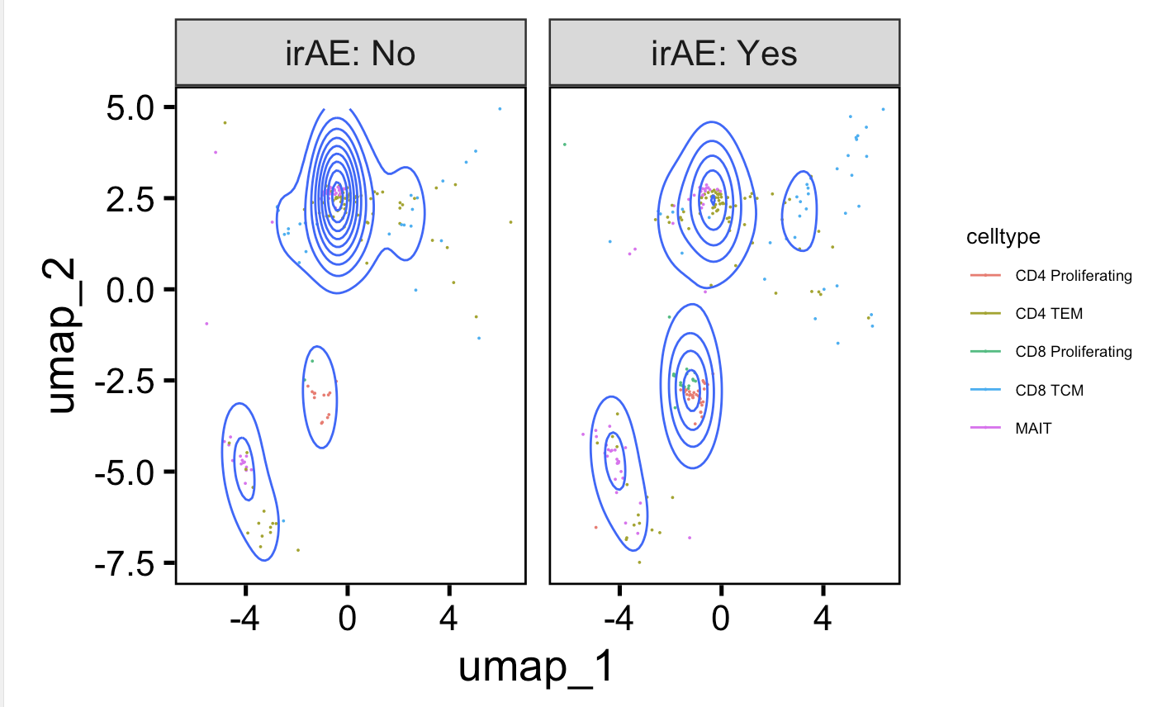
Don’t see cell type abundance differences in downsampled myocarditis UMAP
Notes:
Fewer Tregs associated with irAEs in literature, don’t see that here though, don’t even see ICI decreasing Tregs…

