Slide 1
Weekly meeting
8 15 2024
Ty Bottorff

Slide 2
Outline
MT var analyses from P576 re-seq

Slide 3
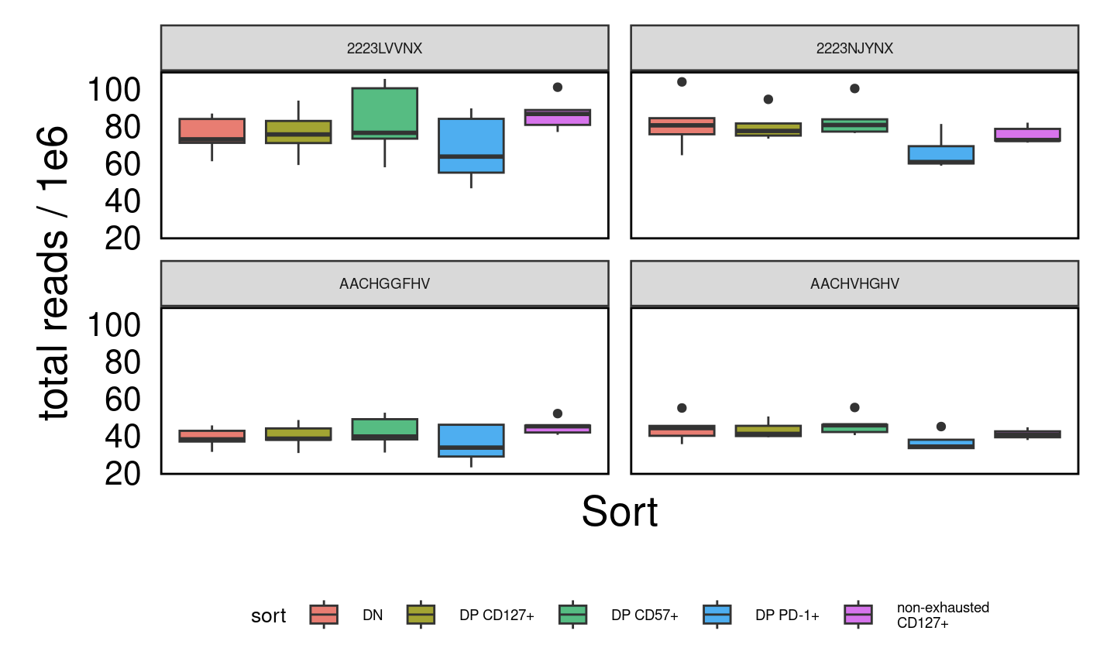
High read counts from re-run (top row)

Slide 4
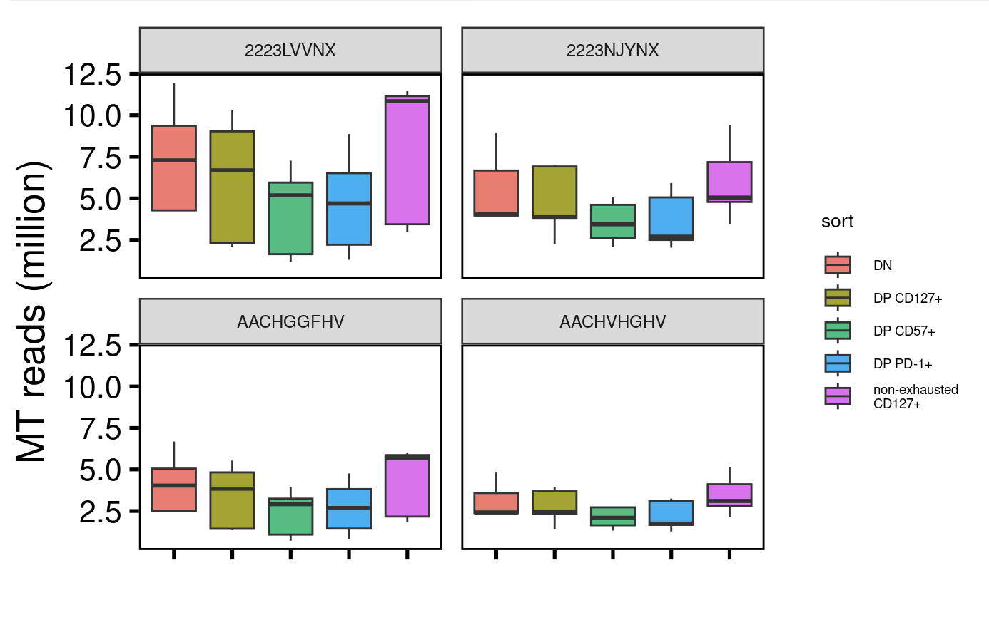
Also gained many MT mapping reads (re-run in top row)

Slide 5
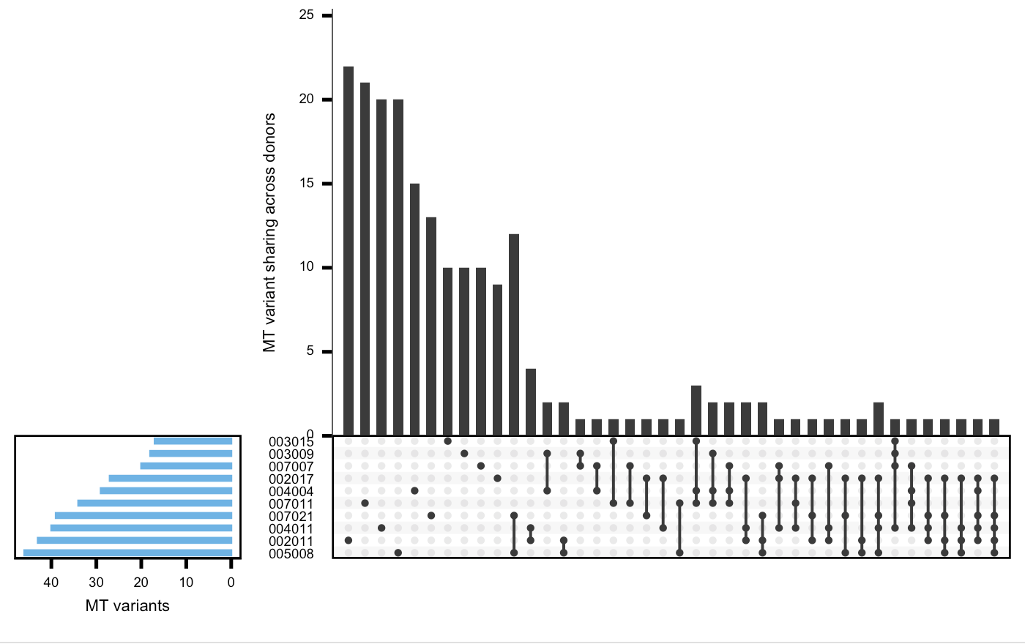
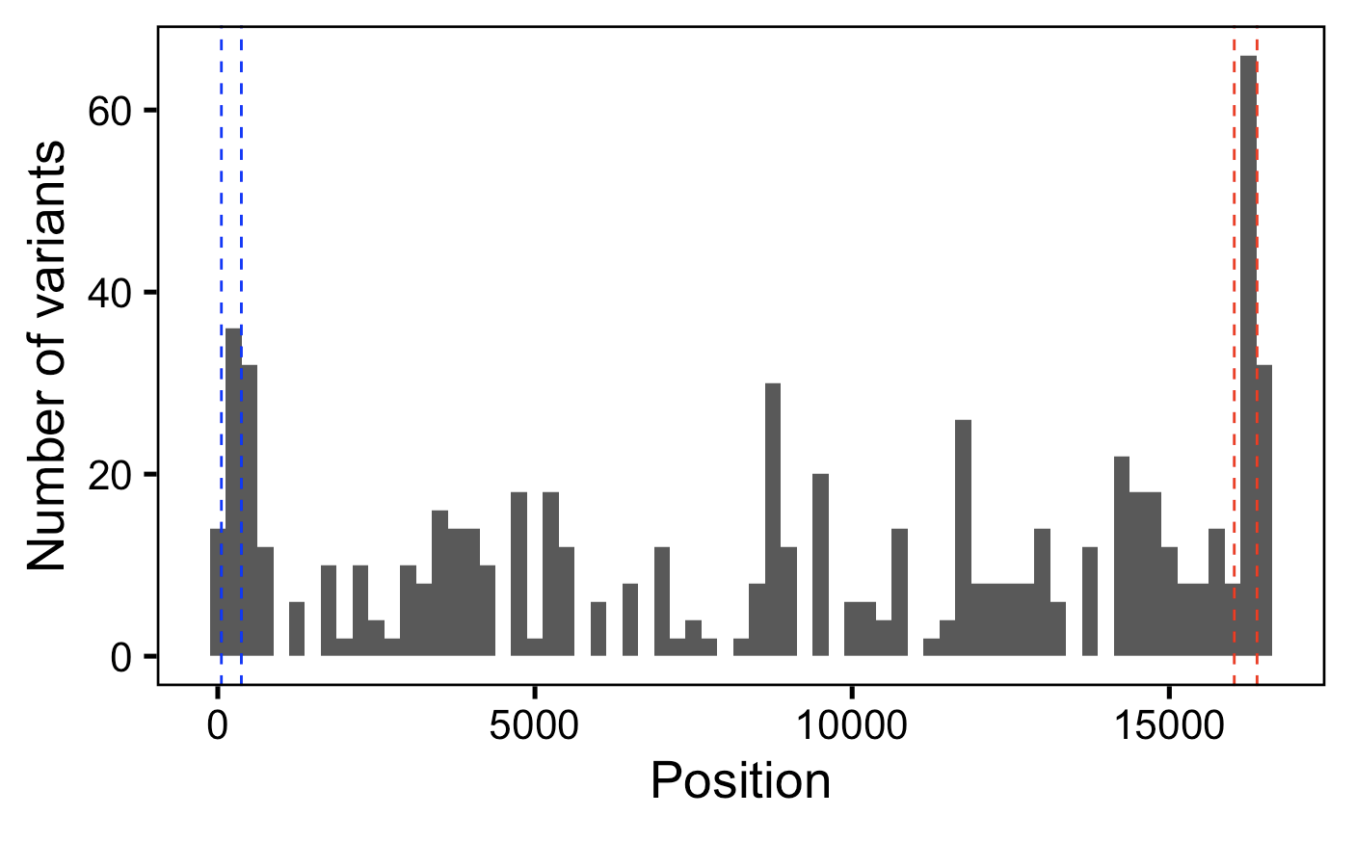
MT var QC looks fine with reseq, observe more MT vars per donor
with more depth, see more public vars
Notes:
I think these are both from 2nd lowest min_var_freq

Slide 6
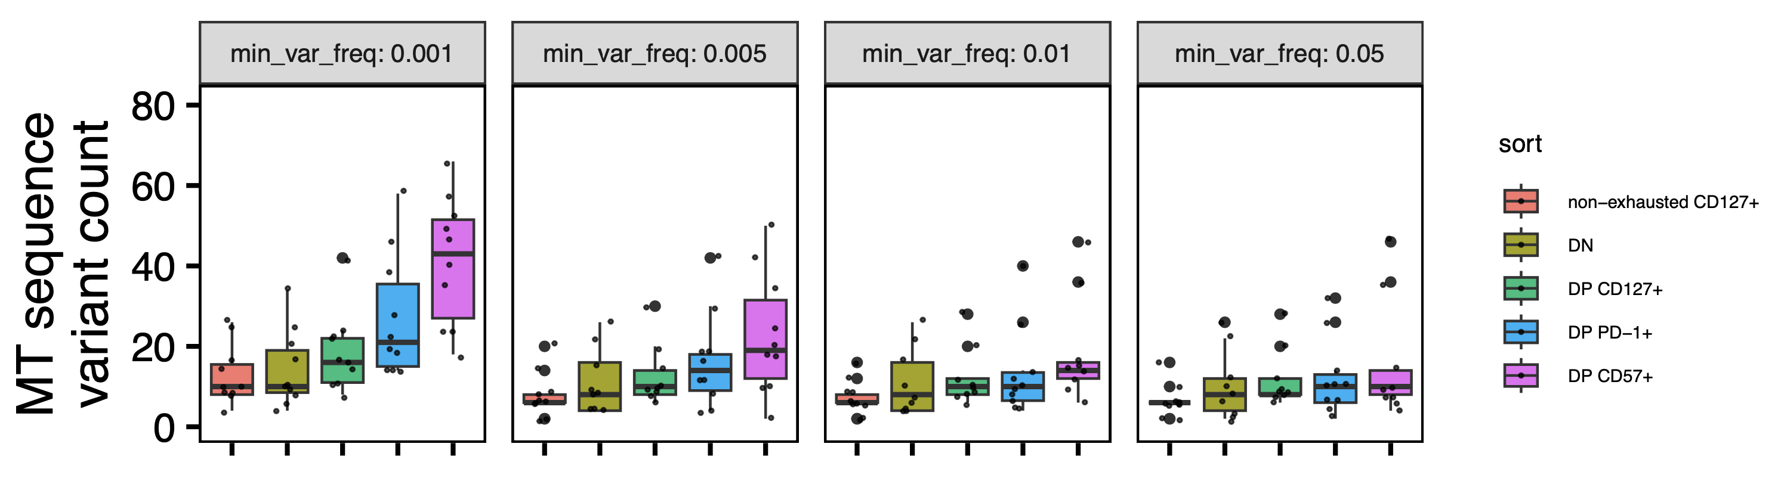
See ~similar results at old 0.5% lower bound for var freq, see padj significance at lower 0.1% bound
**
**
**
*
0.21% is lowest observed var_freq, lowest # of reads supporting a var is 10 (I filtered for > 4, 2 from each strand as done here, they also used min_var_freq == 0.001)
Wilcoxon rank sum test. **, padj <1e-2; *; padj <0.05
Notes:
~issue is that with more seq also get more vars sharing across all sorts within a donor → we remove these, also ~issue is that with more seq uncover more vars even in DN/non-exh…
MT genome is 16 kb
Most seq fragments are ~100 bp (next most ~200 bp)
~8 million MT mapping reads per library
min reads at a pos to call it: 20 (shouldn’t matter, min reads across vars is ~2k), min var reads at pos: 4 (2 from each strand)

Slide 7
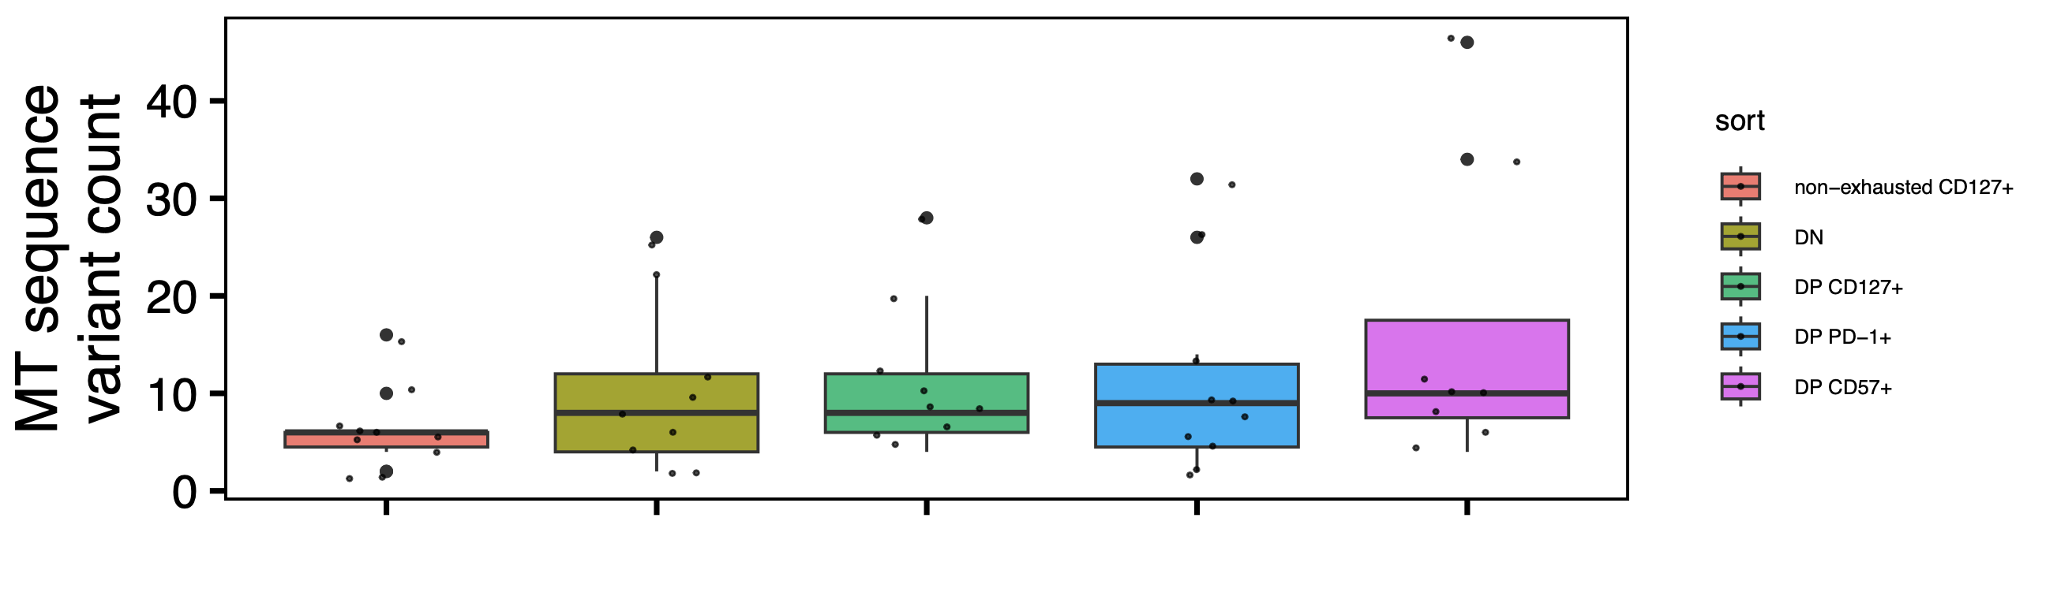
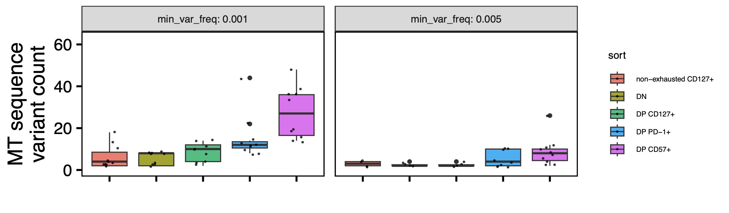
As before, trend mostly driven by low freq vars
Variants > 99% freq
*
**
**
Variants < 5% freq
**
*
**
Wilcoxon rank sum test. **, padj <1e-2; *; padj <0.05

Slide 8
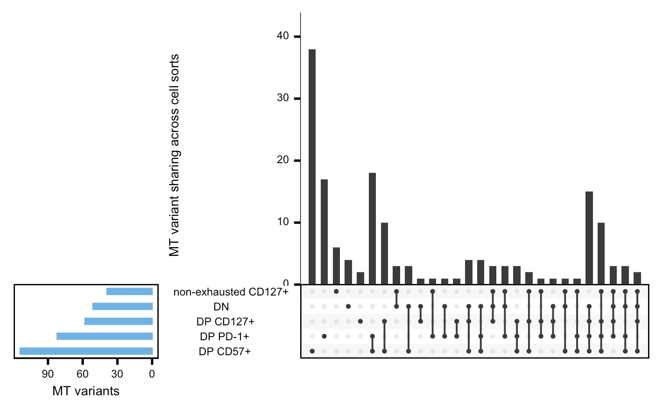
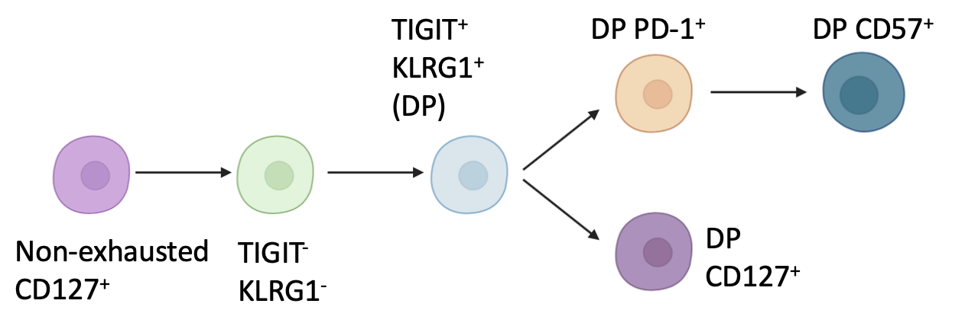
Perhaps MT vars sharing across not non-exhausted CD127⁺ being higher than sharing across non-DN is consistent with non-exhausted CD127⁺ being parent to DN
Notes:
This is also at 2nd lowest min_var_freq

Slide 9
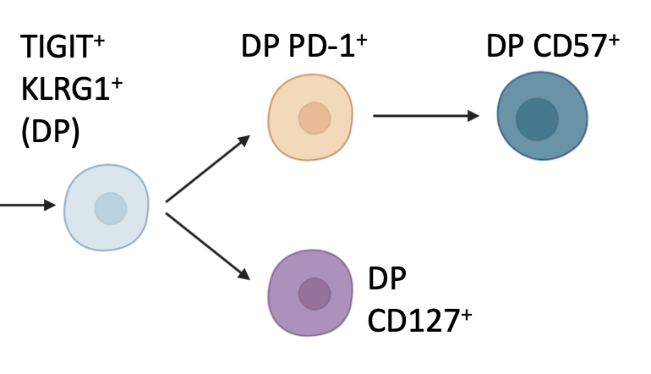
DP PD-1⁺ and DP CD127⁺ share less vars (only 1) than DP CD57⁺ and DP CD127⁺ (10) despite more similar var counts in DP PD-1⁺ and DP CD57⁺, inconsistent with model
Not sure how to interpret this, perhaps it’s due to complications from sharing across > 2 sets vs. 2 sets only
Notes:
This is also at 2nd lowest min_var_freq, and also see same trend with lowest min_var_freq

Slide 10
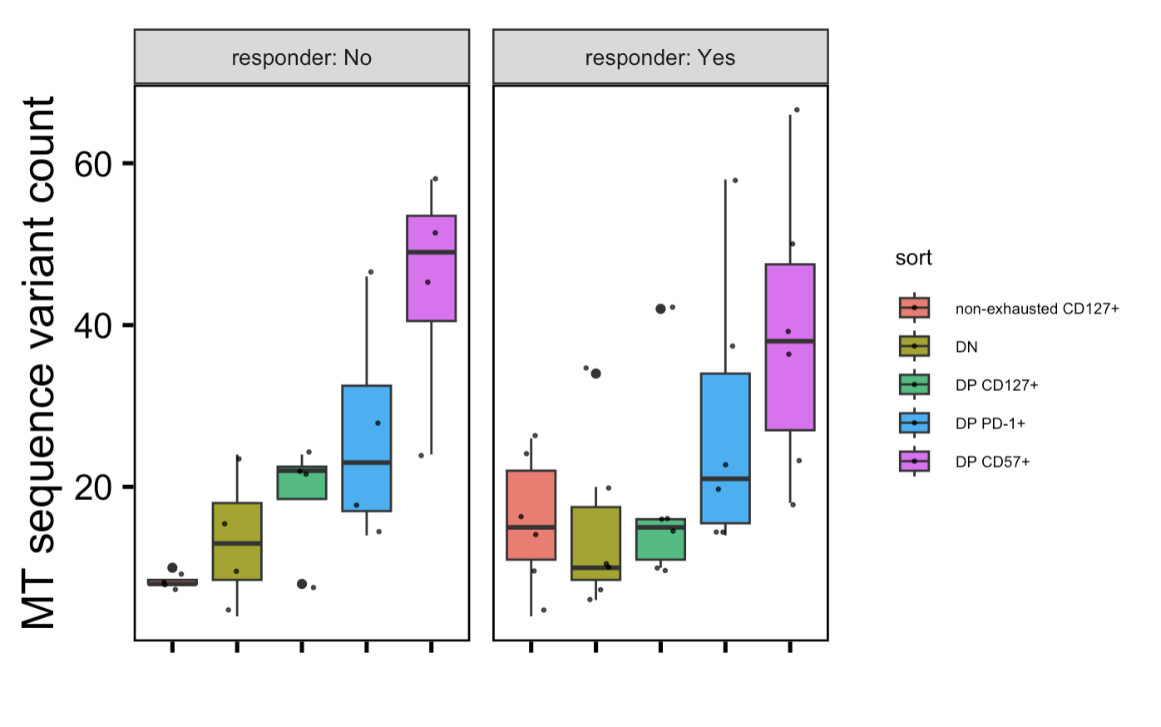
Similar trends b/w R and NR (using lowest min_var_freq here)
No padj differences between R vs. NR within sorts OR sort vs. sort within responder statuses

Slide 11
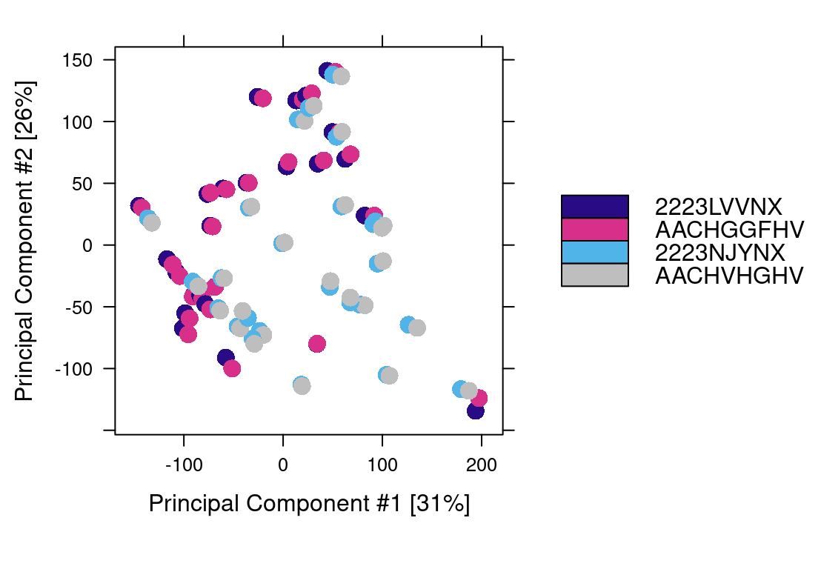
Epigenetics look very similar across seq batches (AA_ fcids vs. 22_ flow cell IDs)

Slide 12
Conclusions
Reseq looks fine at QC and overall epigenetics levels
MT vars
takeaway same as before but stronger confidence (DP CD57⁺ more vars than other sorts especially non-exhausted CD127⁺ and DN)
some evidence for DP PD-1⁺ also having more vars than DN/non-exhausted CD127⁺
some evidence for non-exhausted CD127⁺ being parent to DN

Slide 13
Bifurcation vs. linear path, abstract rewriting, any other authors needed for patient recruitment side?
T cell exhaustion, a state of reduced effector function, results from chronic stimulation from antigens that cannot be fully cleared.
In recent T1D studies, levels of TIGIT+KLRG1+ (DP) PD-1+ and DP CD57+ exhausted CD8s early after treatment have correlated with better response to therapy, consistent with the reduced effector function of these exhausted T cells.
However, levels of DP CD127+ exhausted CD8s may in fact correlate with worse outcome in T1D.
To investigate this heterogeneity in association with response to therapy amongst DP exhausted CD8s and given the epigenetic changes that characterize T cell exhaustion, here we profiled the epigenetic states of different non-naive CD8 populations from PBMCs of 10 T1D patients treated with teplizumab using bulk ATAC-seq.
We found that the epigenetic states of DP CD127+ CD8s were intermediate to that of other DP CD8s (PD-1+ and CD57+) and TIGIT+KLRG1+ CD8s.
We also analyzed mitochondrial-mapping ATAC-seq reads and found that the DP CD8s had more mitochondrial single nucleotide variants than DN CD8s with DP CD57+ specifically having the most variants.
We hypothesize that non-naïve CD8 differentiation flows from DP CD127+ to DP PD-1+ to the more terminal DP CD57+.
no strong evidence for bifurcation vs. linear path…
Notes:
I guess I don't really have any evidence for DP CD127+ splitting off... it could still be parent to other DPs and blocking IL7R doesn't kill cells it would just make it as if they were CD127-...
heterogeneity in association w/ response, does a linear path make sense with this? possibly...

Slide 14
Next steps
Epigenetic analyses from re-seq
Merge alignment bam and peak files by libid across seq runs
Use those merged files in Diffbind analyses, as if we had run everything at once
Homer TF analyses given greater read depth
MT vars: getting biological relevance
Potential rabbit hole: simulate MT dynamics to try and equate MT var counts to # of cell divisions? Would be helpful to know order of magnitude here (i.e. DP CD57+ divided 1X, 10X, or 100X more than nonexh/DN?)
How to choose a sensible lower bound for var freqs? Simulations could perhaps also inform this bound, i.e. how many divisions to see 0.1% freq vars appear vs. 0.5% ones appear?
Notes:
Not super worried about noise driving effects we see because it’s consistent with T1DAL but still

Slide 15
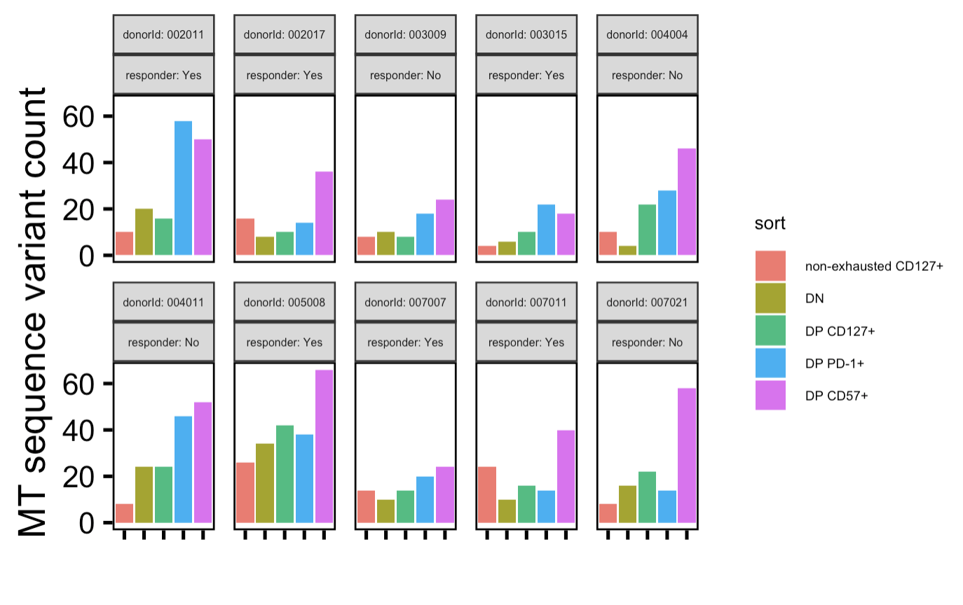
Donor facet

