Slide 1
Weekly meeting
3 28 2024
Ty Bottorff

Slide 2
Outline
Proliferation vs. activation comparison
TCR graphs
Progress on ATACseq Erin vs. Stephan method comparison

Slide 3
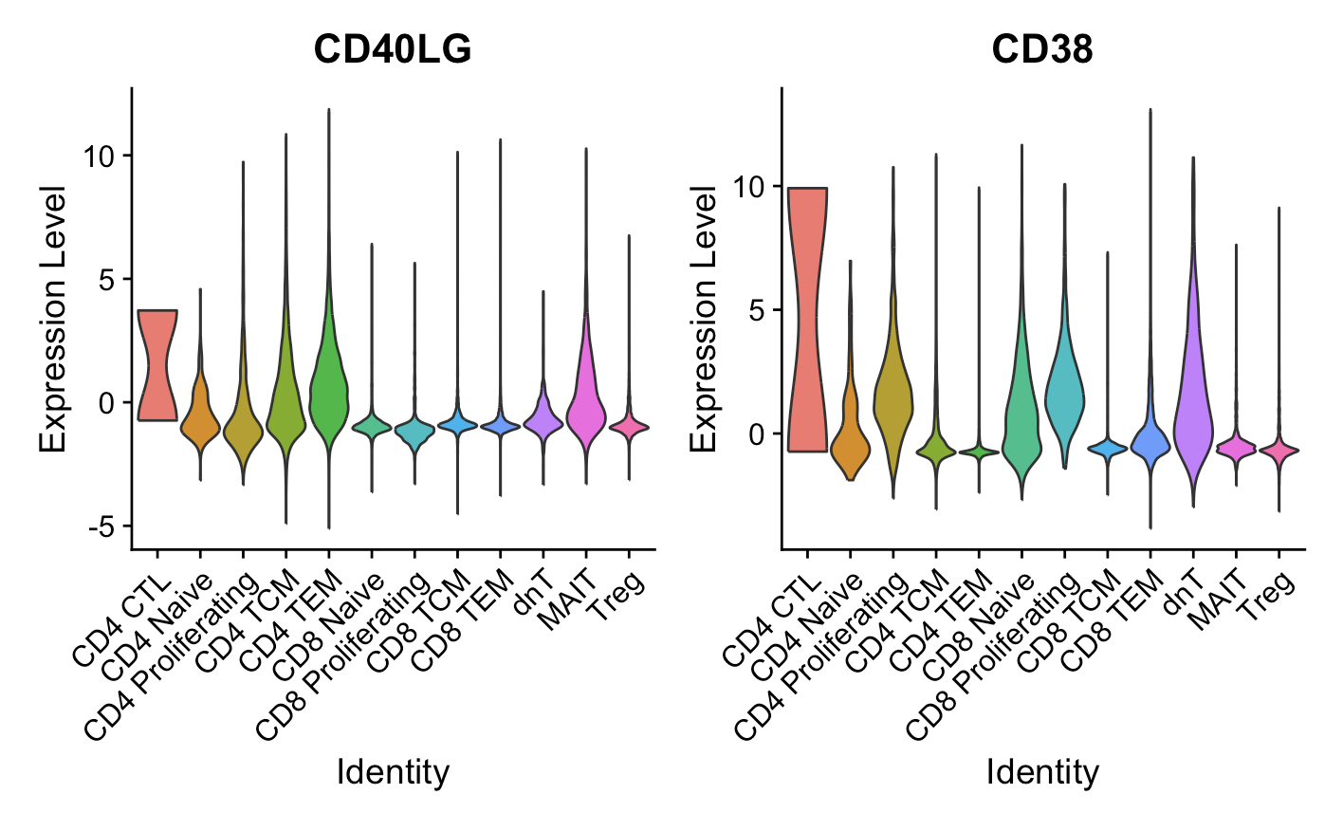
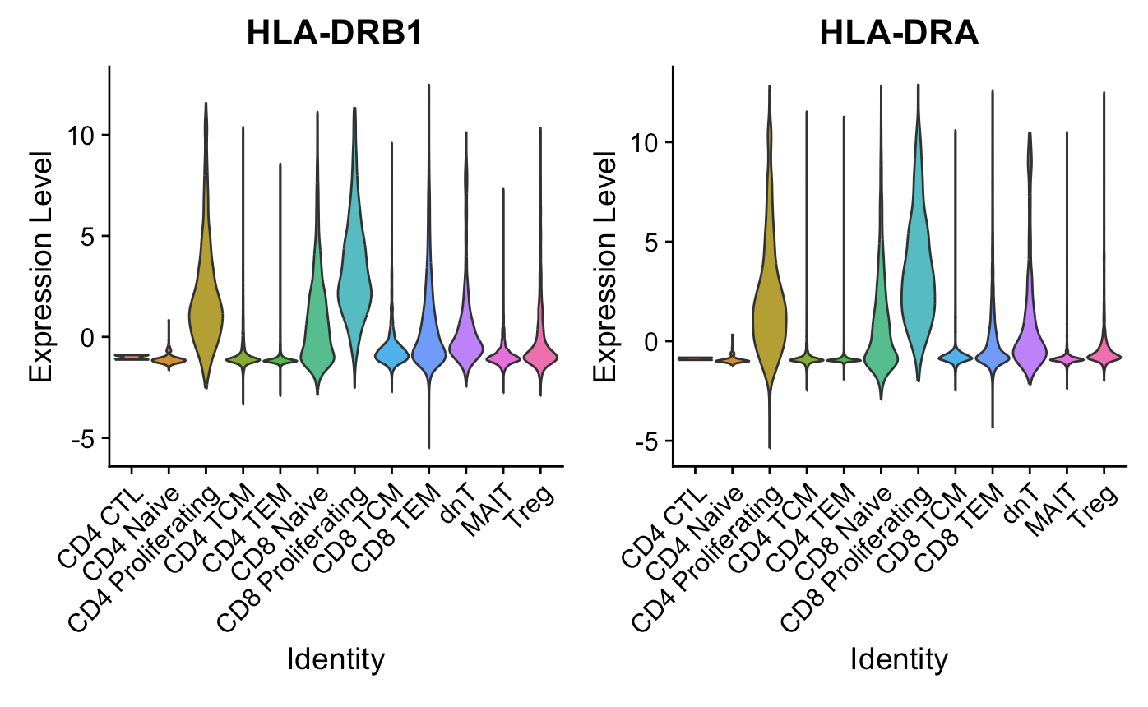
Proliferating cells are ~generally high for activation markers (Luoma (2020), Cell dataset)
CD154
*CD69, CD44, EGR1 different stories
Notes:
CD69, not really higher in proliferating cells, also a marker for Trm though? so...
CD154/CD40LG: kinda high in CD4 prolif but moreso in CD4 CTL/TCM?TEM and MAITs
EGR1, low in everything except MAITs
CD44: lowest in proliferating cells
CD38: yes higher in proliferating cells but really highest in CD4 CTLs, also high in dnTs
HLA-DR: B1 yes higher in proliferating cells (also CD8 naive/TEM), A (yes higher in proliferating cells also in CD8 naive), B5 kinda higher in proliferating cells
HLA-DRB1/DRA are class II, some CD8s can express it but it seems pretty high in CD8 prolif… but they definitely have high CD8A/B…

Slide 4
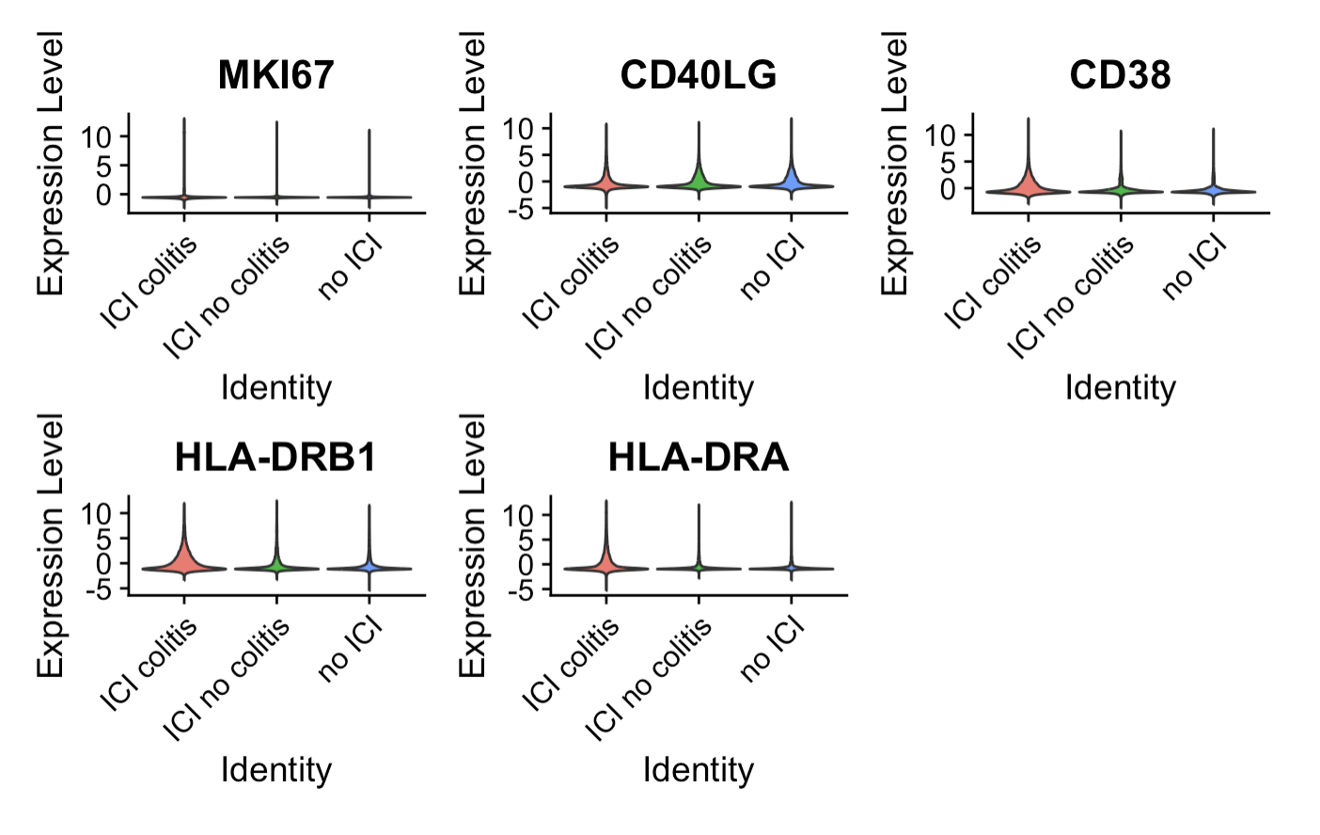
Some activation markers appear higher in ICI colitis tissue (Luoma (2020), Cell dataset), but no significant differences
Notes:
MKI67 probably looks same because there are so few proliferating cells and difference between irAE groups wasn’t even huuge in proliferating cells alone
Did for all T cells, CD4 prolifs, didn’t try for all CD4s but yea not expecting anything…

Slide 5
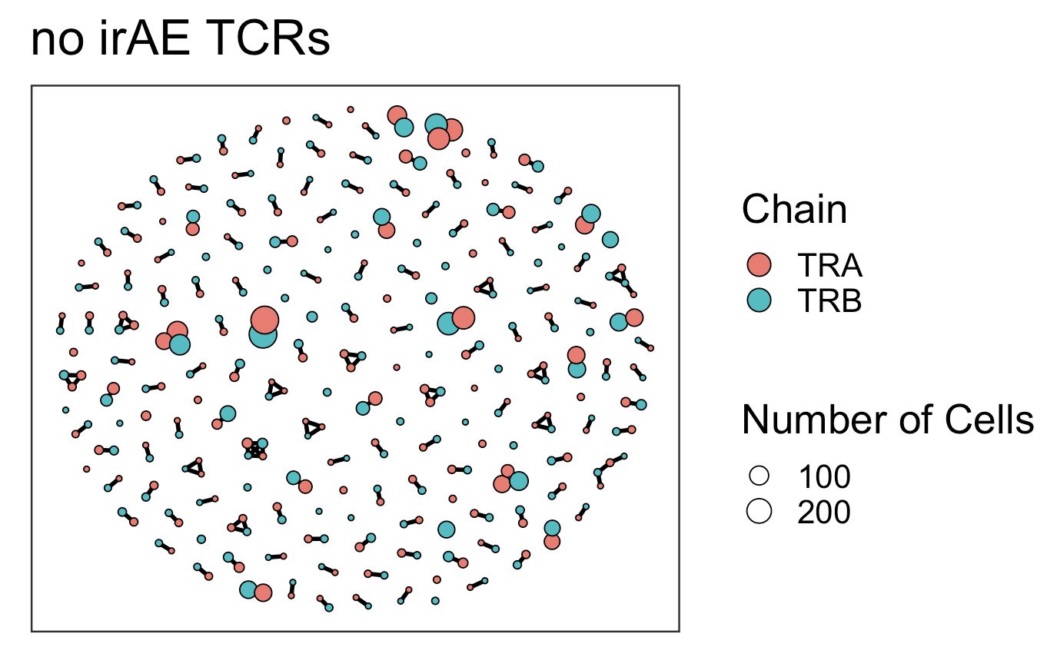
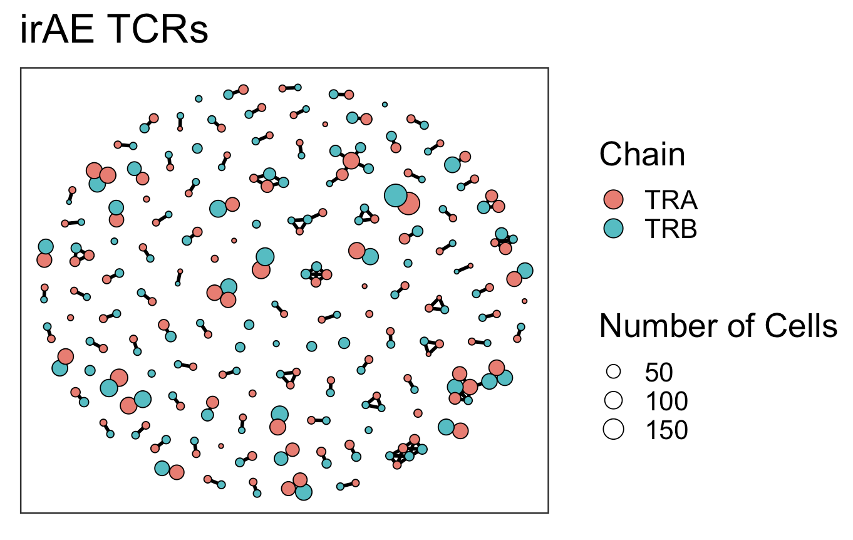
TCR graphs similar between irAE groups (Luoma (2020), Cell dataset), perhaps slightly higher connectivity (2*edges/vertices) in irAE group
Average Connectivity: 1.029762
Number of Edges: 173
Number of Vertices: 336
Average Connectivity: 1.258687
Number of Edges: 163
Number of Vertices: 259
Notes:
average_connectivity = 2 * num_edges / num_vertices
Top 350 clonotypes per patient per chain

Slide 6
Conclusions
Not shown: Erin’s ATACseq, comparing Stephan’s method vs. Erin’s method
Merged alignment files by condition/timepoint
Ran peak caller on merged alignment files
TODO: differentially accessible gene analysis (volcano plot comparison)

Slide 7
Next steps
Worth trying to make activated (CD4) cell type category to compare abundances between irAE groups?
Would need to set thresholds for +/- for markers like CD154, CD38, HLA-DR(A/B1)

