Slide 1
Weekly meeting
3 22 2024
Ty Bottorff

Slide 2
Outline
GSEA analysis for CD4 subsets (up/down in colitis tissue) vs. other CD4s

Slide 3
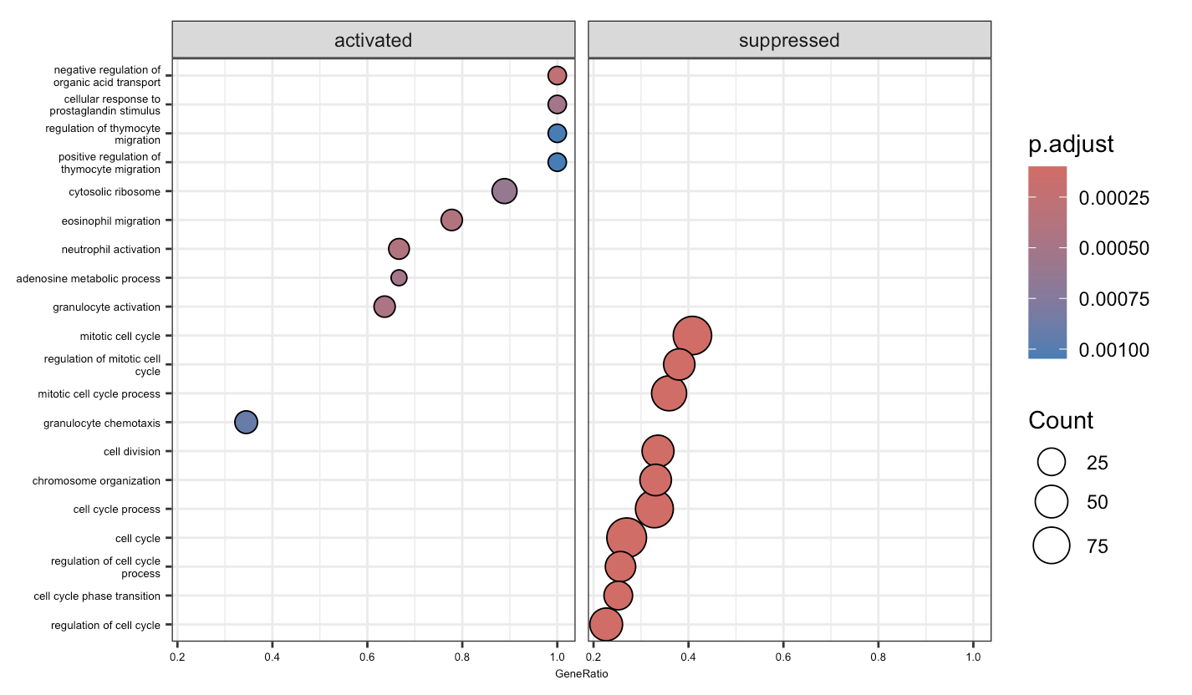
What actually are these CD4 TEMs in Luoma et al. (2020), Cell dataset?
Notes:
GSEA from DEGs from CD4 TEMs vs. other CD4s

Slide 4
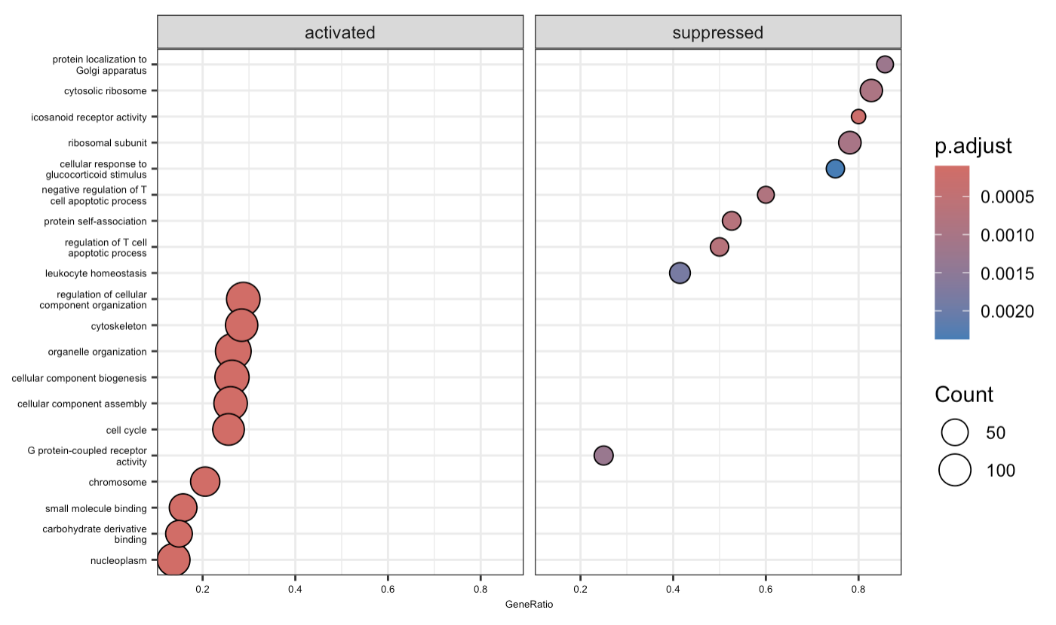
What actually are these CD4 proliferating Ts in Luoma et al. (2020), Cell dataset?
Notes:
GSEA from DEGs from CD4 proliferating vs. other CD4s

Slide 5
Tregs and irAEs
Early expansion of Ki-67+ Tregs associated with irAEs (PMID36693381)
Tregs trend higher in inflammation-prone irAE mouse model, Tregs accrue in human ICB-associated colitis biopsies (PMID36367776)
Lower baseline levels of Tregs associated with irAEs (PMID38233101)
Tregs decreased in frequency in irAE patients (PMID37593676)
Notes:
Explanation for Tregs being higher in irAE: perhaps Treg expansion just follows general immune activation induced by ICB in patients who respond well to ICB and develop irAEs
Explanation for Tregs being lower in irAE: less inhibition of autoreactive T cells

Slide 6
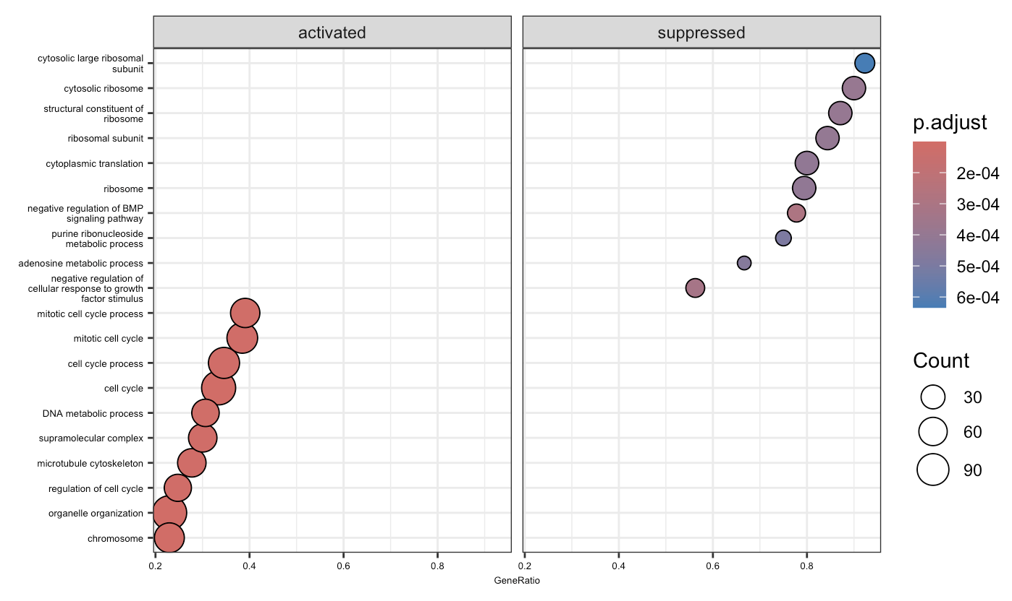
What actually are these memory Tregs in Luoma et al. (2020), Cell dataset?
Notes:
GSEA from DEGs from memory Tregs vs. other CD4s

Slide 7
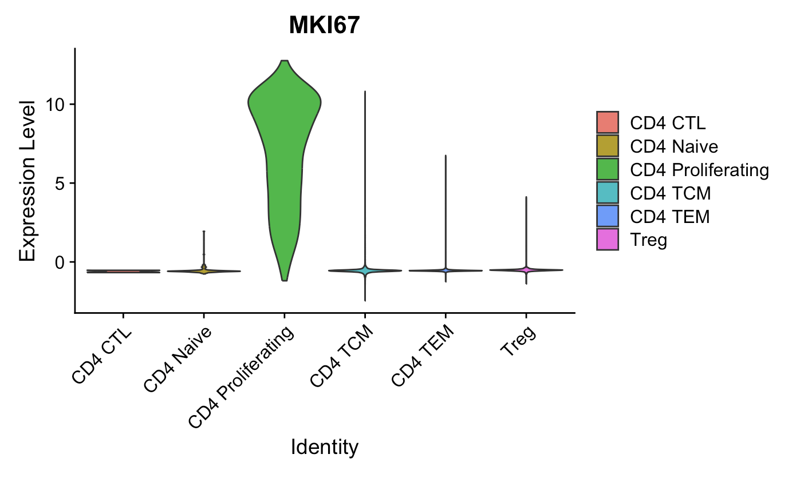
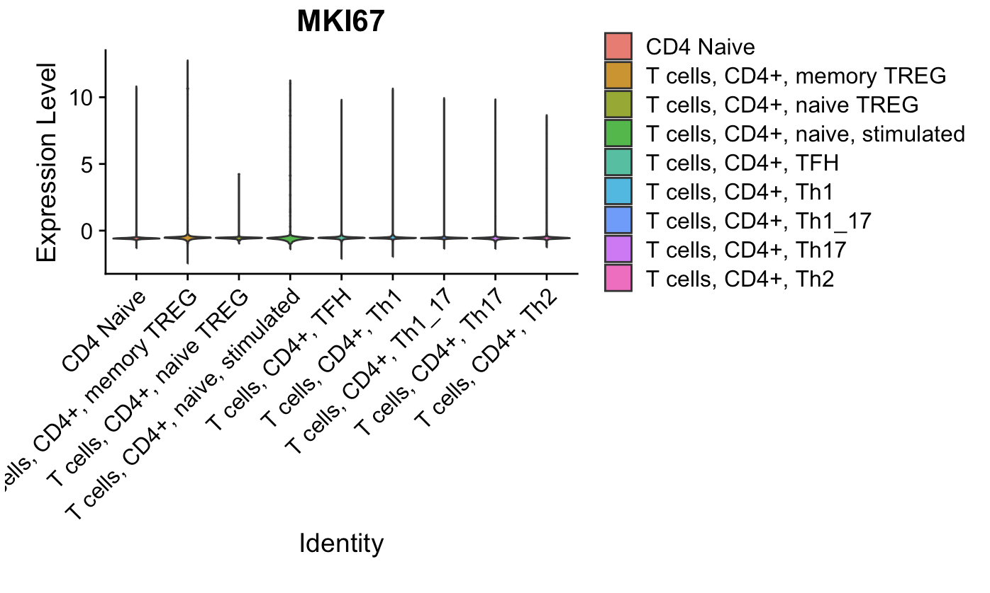
Despite having gene sets associated with cell cycle activated, memory Tregs don’t have high expression of proliferation markers (Luoma et al. (2020), Cell dataset)
Same trends for PCNA, MCM2
Checked a bunch of proliferation genes and memory Tregs << CD4 proliferating

Slide 8
Conclusions
No TCR feature differences between irAE groups within SingleR cell types at highly expanded level, some differences at whole level but nothing consistent across both colitis datasets (data not shown)
GSEA analysis wasn’t too illuminating… memory Tregs are ~proliferative?
Not shown but worked on: ATACseq preparations
Understanding Stephan code for more in depth QC (added library complexity QC code) and updated peaks across samples method vs. Erin’s code
Practiced using samtools/bedtools for merging files, macs2 for peak calling on command line
Initialized git repo

Slide 9
Next steps
New potential datasets, not expecting TCR feature differences within cell type groups here but worth looking into perhaps…
Single-cell transcriptomics identifies pathogenic T-helper 17.1 cells and pro-inflammatory monocytes in immune checkpoint inhibitor-related pneumonitis (J Immunother Cancer. 2022)
scRNA/TCRseq
Bronchoalveolar lavage fluid
Mostly NSCLC
11 patients with ICI-pneumonitis, 6 demographically-matched patients with cancer without ICI-pneumonitis
PD-(L)1 blockade
Main related findings: more proliferative CD8 TEMs/TCMs in severe irAE group
Gut microbiota signatures are associated with toxicity to combined CTLA-4 and PD-1 blockade (Nature Medicine 2021)
PBMCs from pre/on/post ICB
Melanoma
38 irAE, 39 no irAE patients
Combination ICB
Main related findings: more expanded clones in irAE group

