Slide 1
Weekly meeting
1 25 2024
Ty Bottorff

Slide 2
Outline

Slide 3
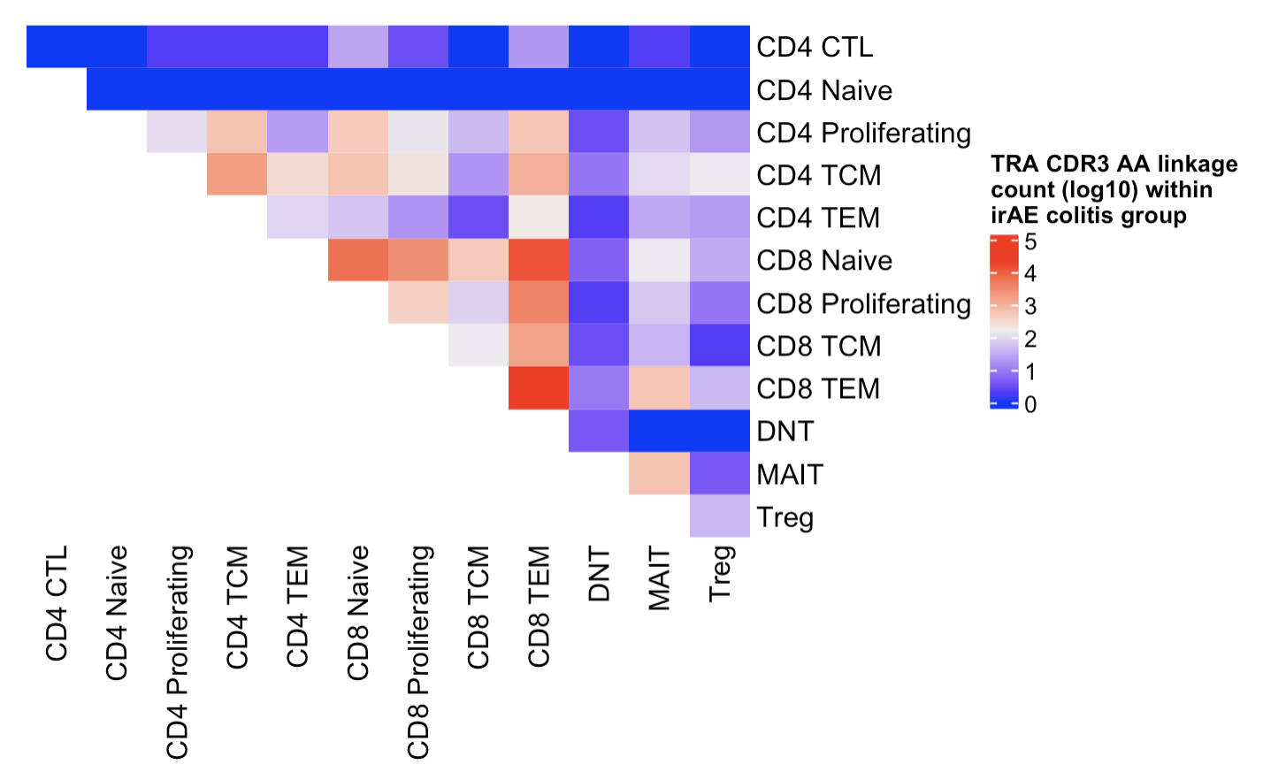
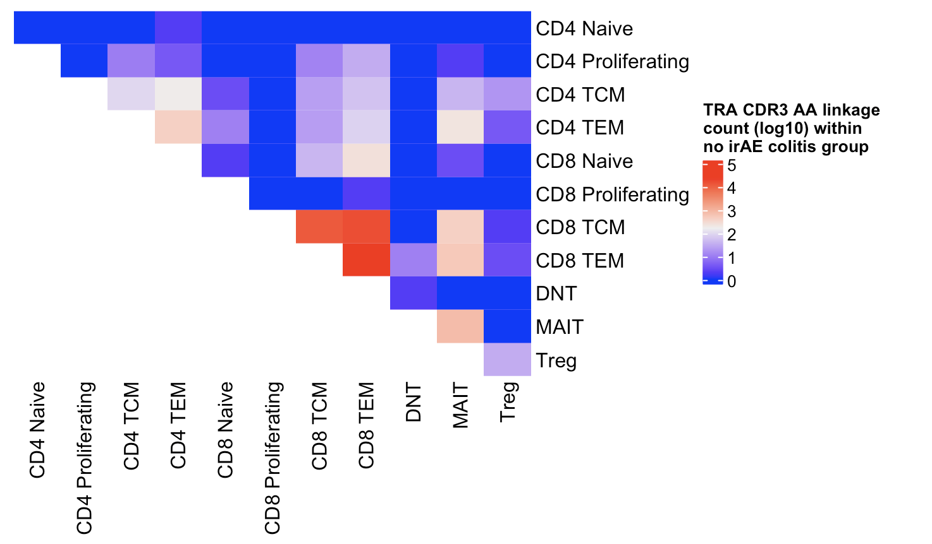
Colitis dataset linkage summary heatmaps (TRA): CDR3 AA linkage sharing seems more common across more cell types within irAE colitis group
Within irAE colitis group
Within no irAE colitis group
Total linkages = 61,623
Total linkages = 61,326
Notes:
Despite similar total linkages between groups, could still be biased by cell types up in irAE being more abundant and introducing more linkages across more other cell types?

Slide 4
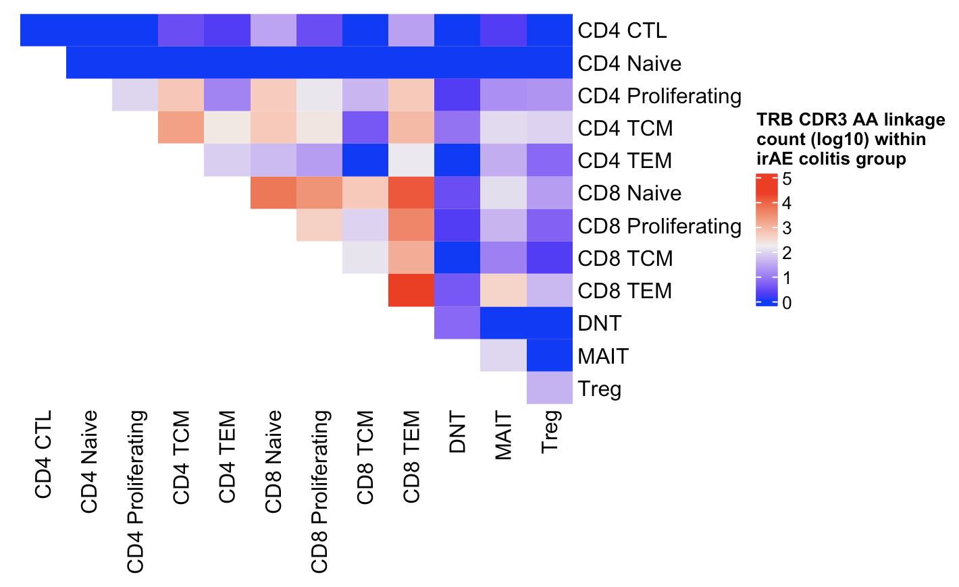
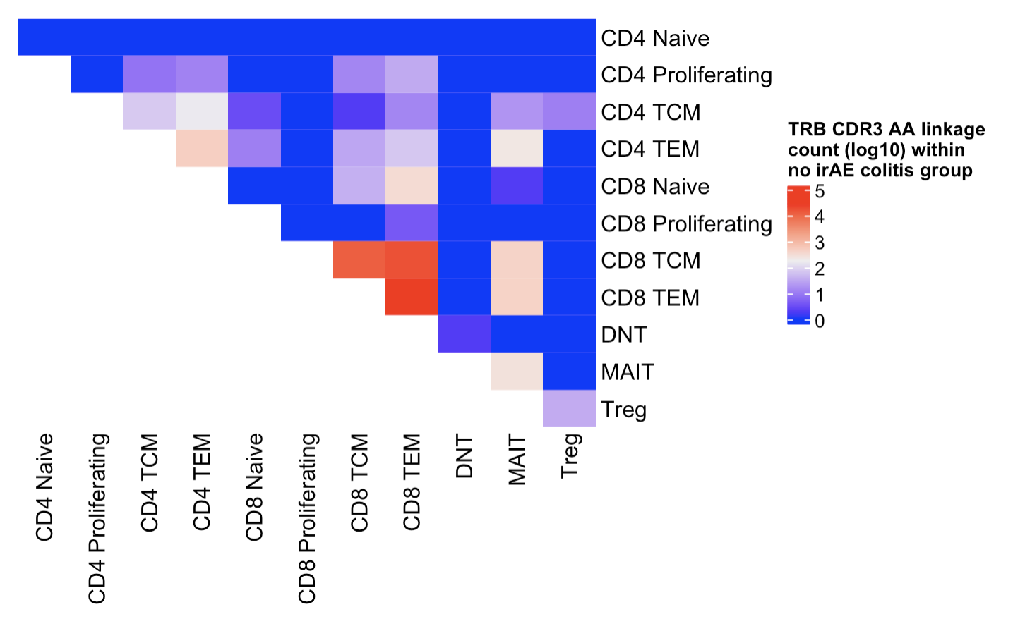
See same trend for TRB in colitis dataset
Within irAE colitis group
Within no irAE colitis group
Total linkages = 63,816
Total linkages = 65,208
Perhaps more diverse cell types are recognizing same antigen in irAE colitis group
Notes:
Despite similar total linkages between groups, could still be biased by cell types up in irAE being more abundant and introducing more linkages across more other cell types?

Slide 5
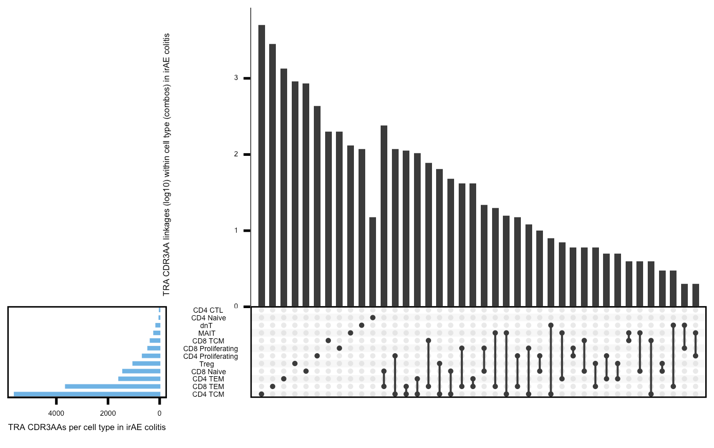
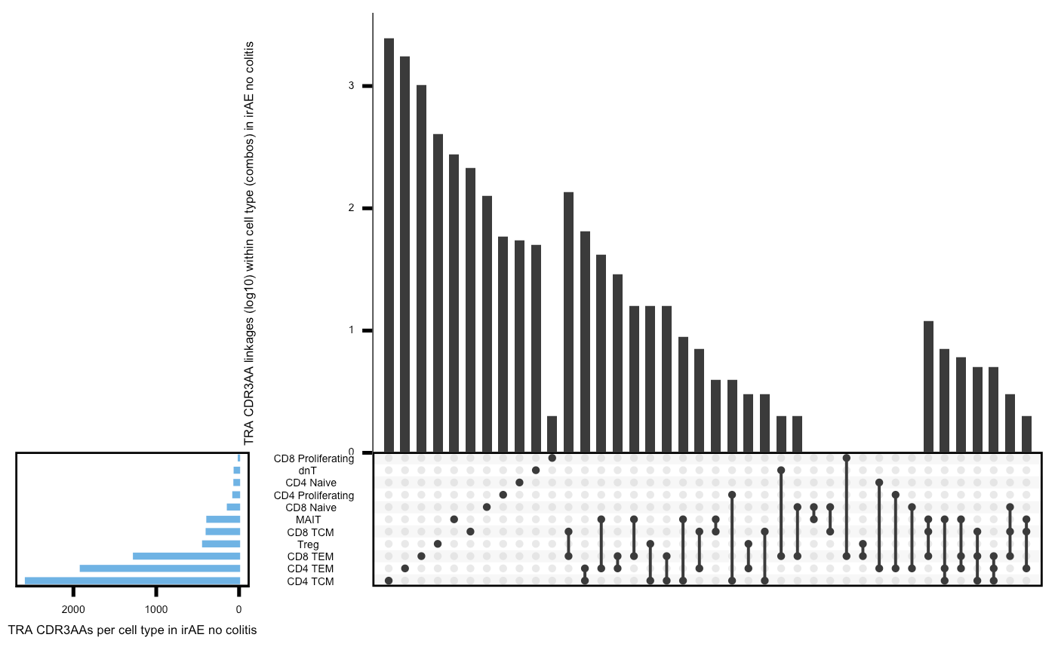
Colitis upset plots (TRA) show same trend but are more biased by set sizes differences
Within irAE colitis group
Within no irAE colitis group

Slide 6
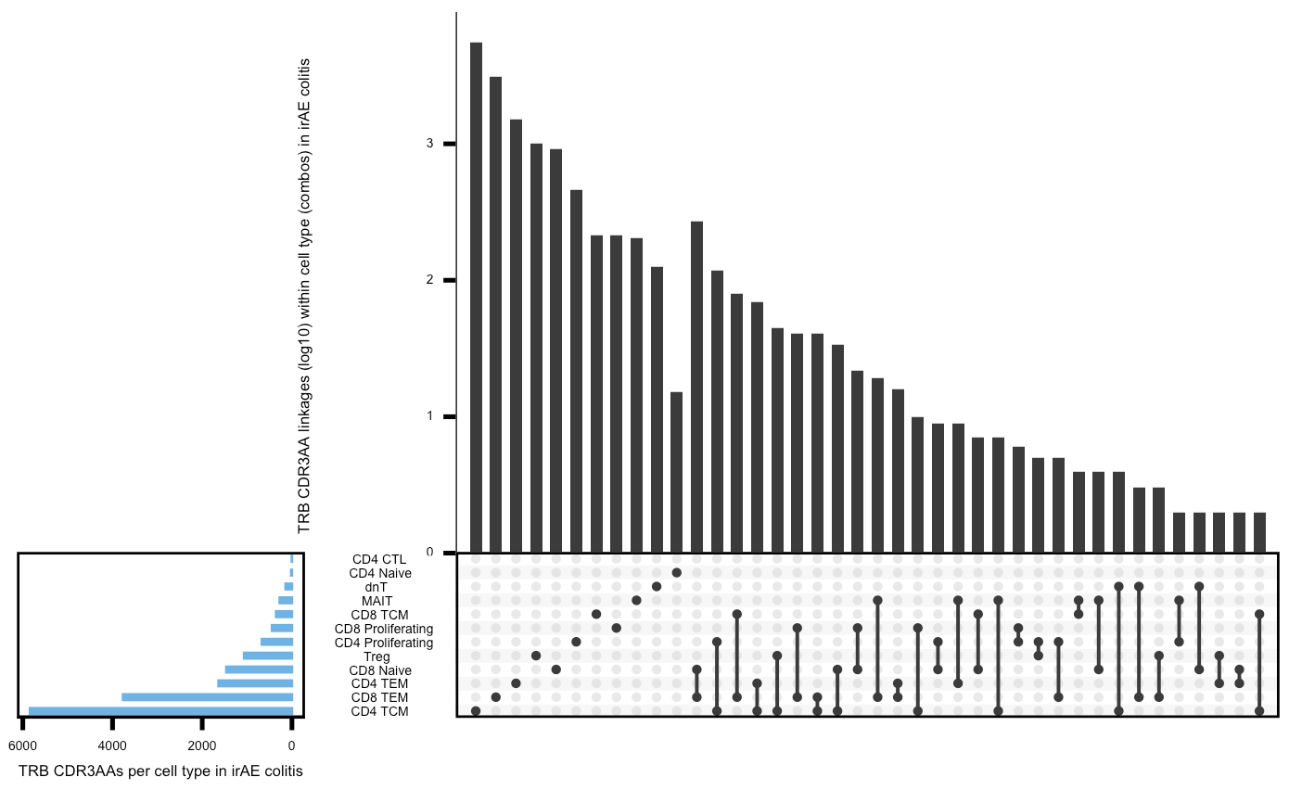
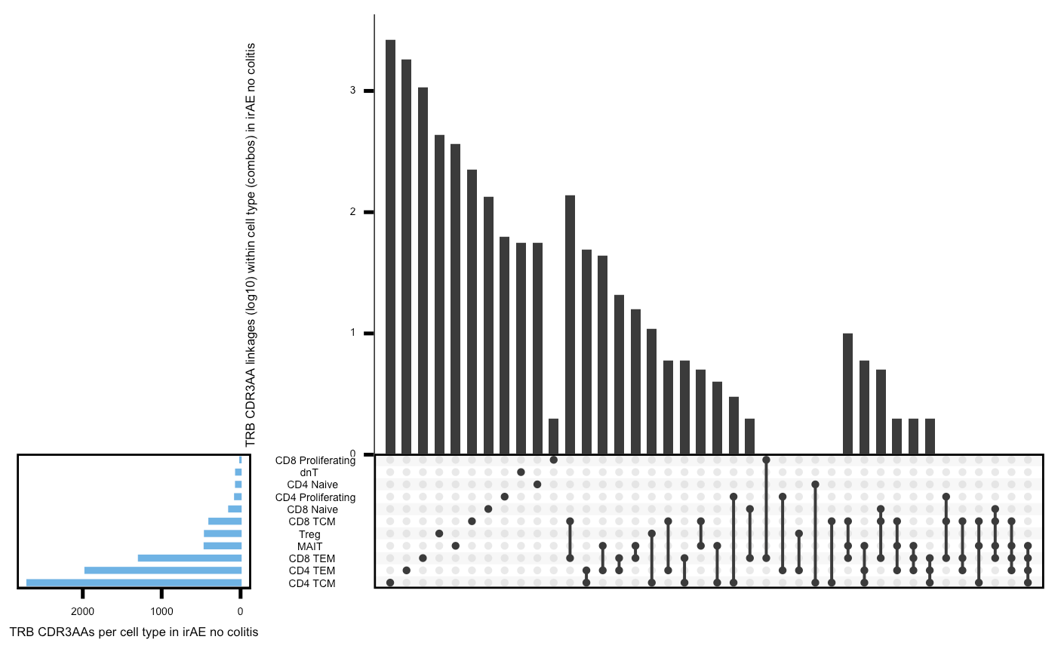
Colitis upset plots (TRB) show same trend but are more biased by set sizes differences
Within irAE colitis group
Within no irAE colitis group

Slide 7
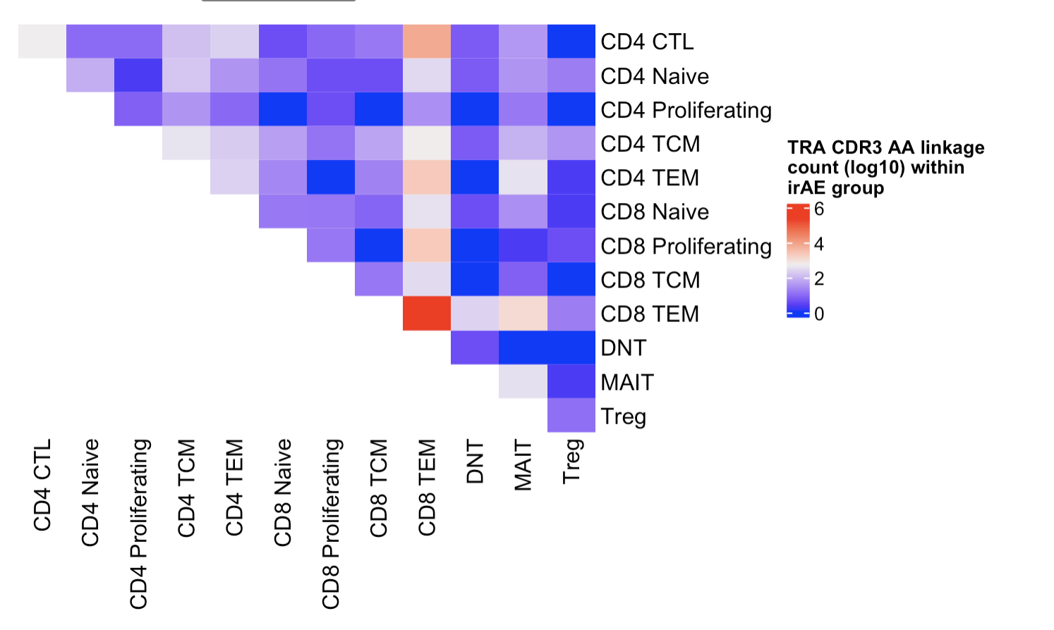
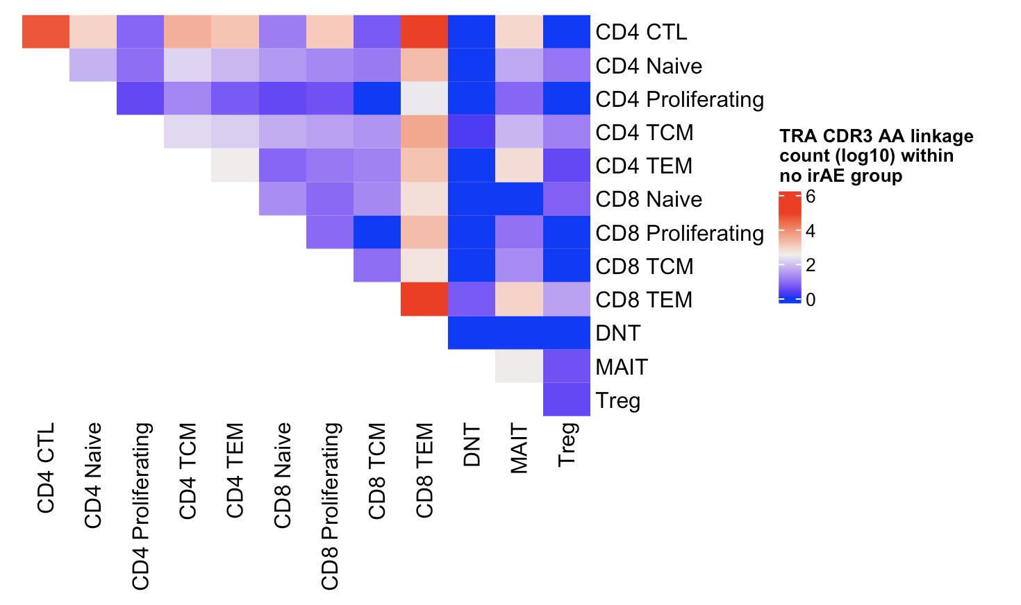
In myocarditis dataset (TRA), don’t see same trend
Within irAE group
Within no irAE group
Total linkages = 298,075
Total linkages = 273,226

Slide 8
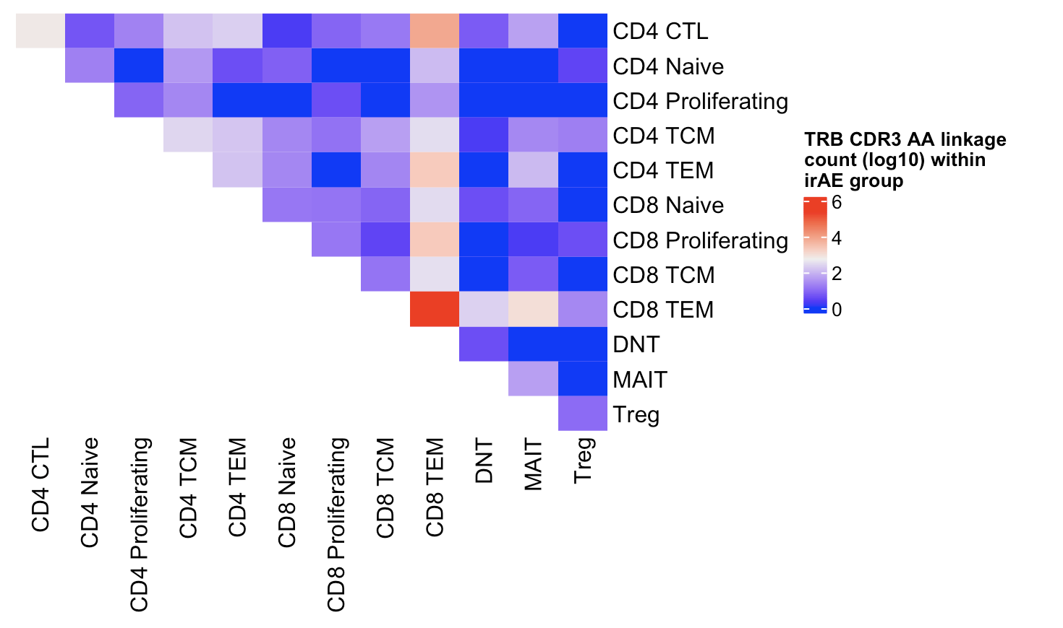
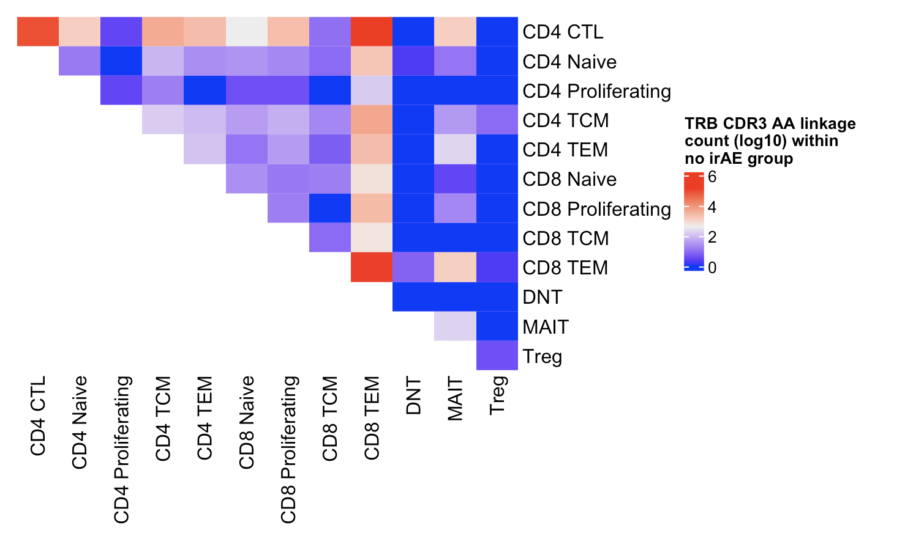
In myocarditis dataset (TRB), don’t see same trend
Within irAE group
Within no irAE group
Total linkages = 300,944
Total linkages = 408,859

Slide 9
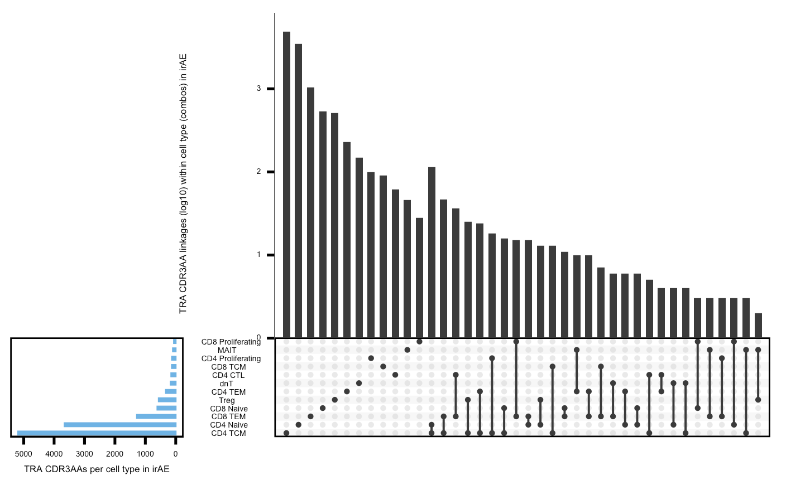
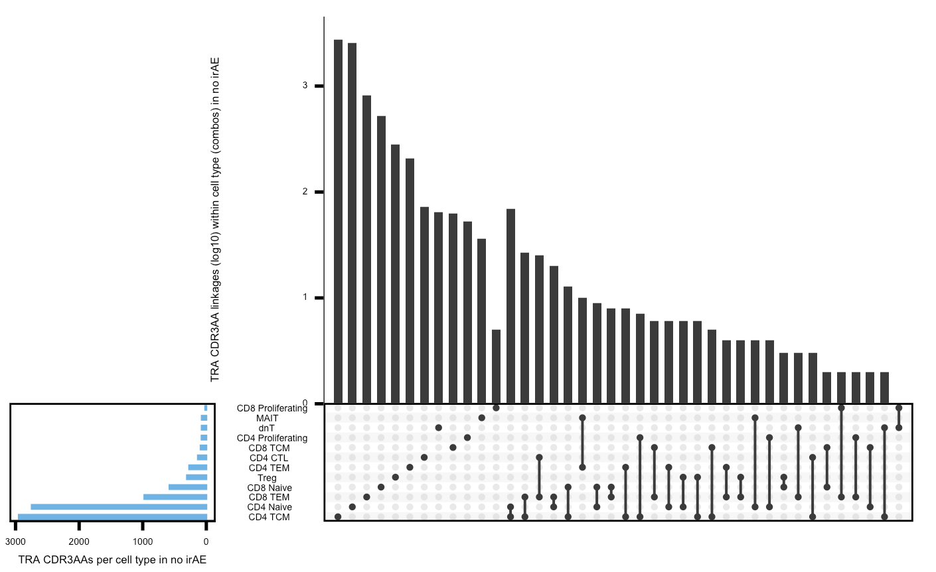
Myocarditis upset plots (TRA) don’t seem very different by irAE group
Within irAE group
Within no irAE group

Slide 10
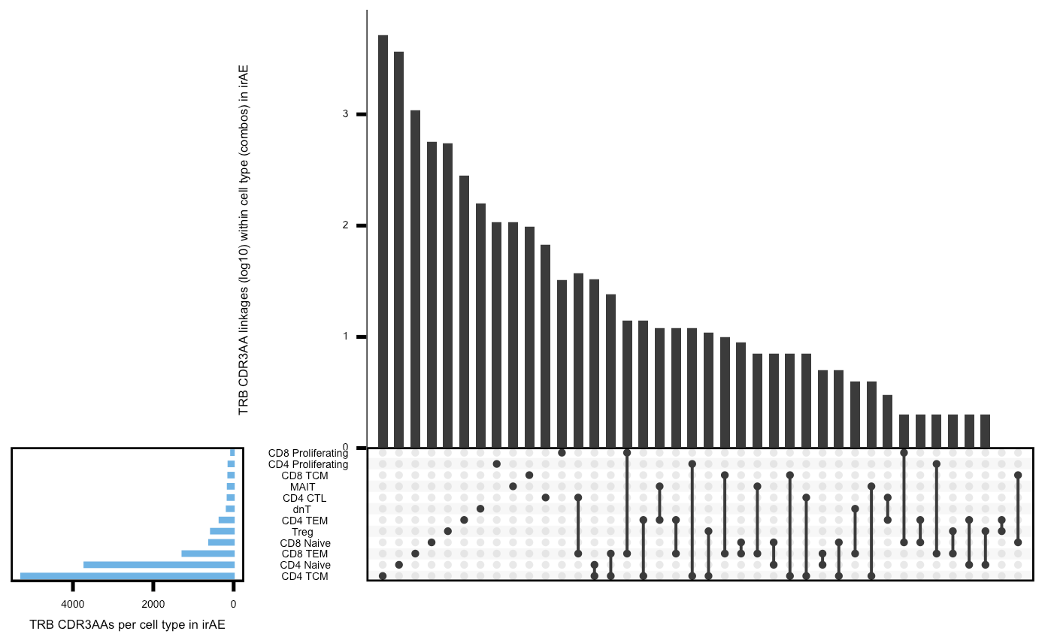
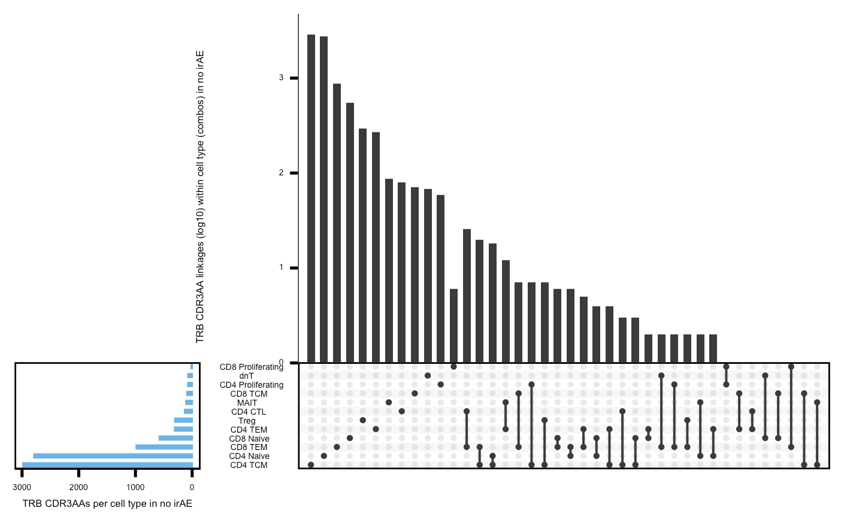
Myocarditis upset plots (TRB) don’t seem very different by irAE group
Within irAE group
Within no irAE group

Slide 11
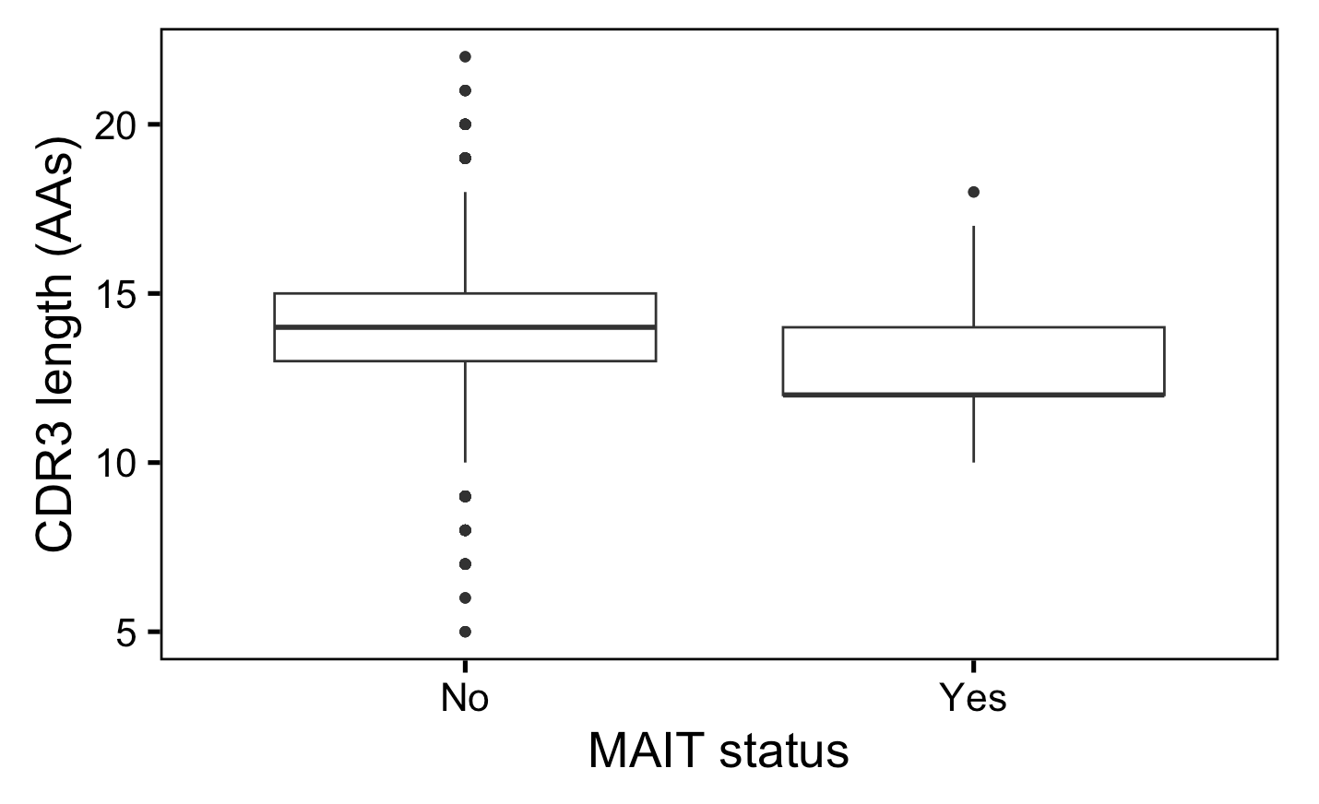
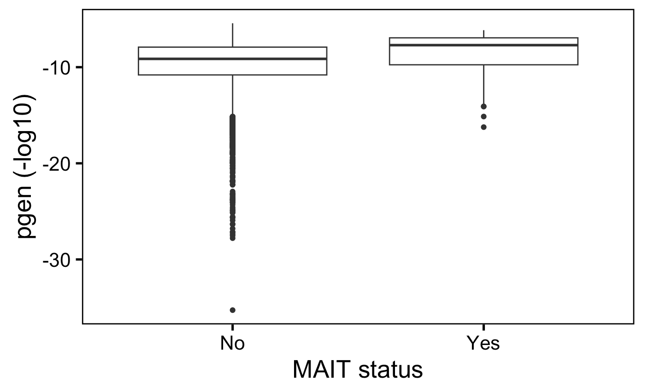
Myocarditis dataset: MAITs (less abundant in irAE colitis tissue) have shorter TRA CDR3s and more germline-like TRA chains vs. other cell types
****
****
Wilcox rank sum test: ****; padj < 1e-4, **; padj <1e-2, *; padj <0.05
Notes:
# pgen (TRA) padj vals
# MAITs: 1.485e-13
# CDR3 length (TRA): padj vals (adjusted within 5 cell types I tested for this feature for TRA)
# MAITs: 8.52e-12

Slide 12
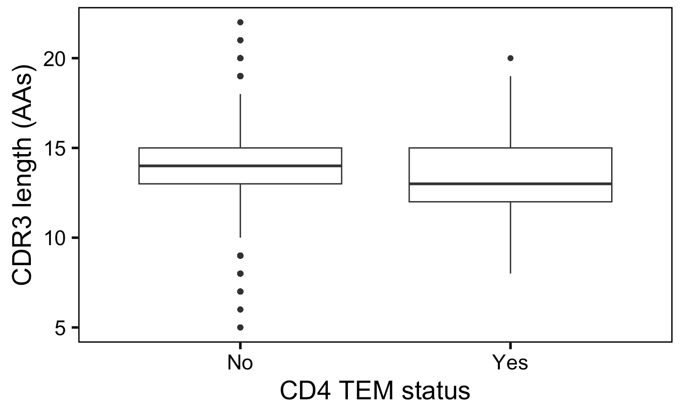
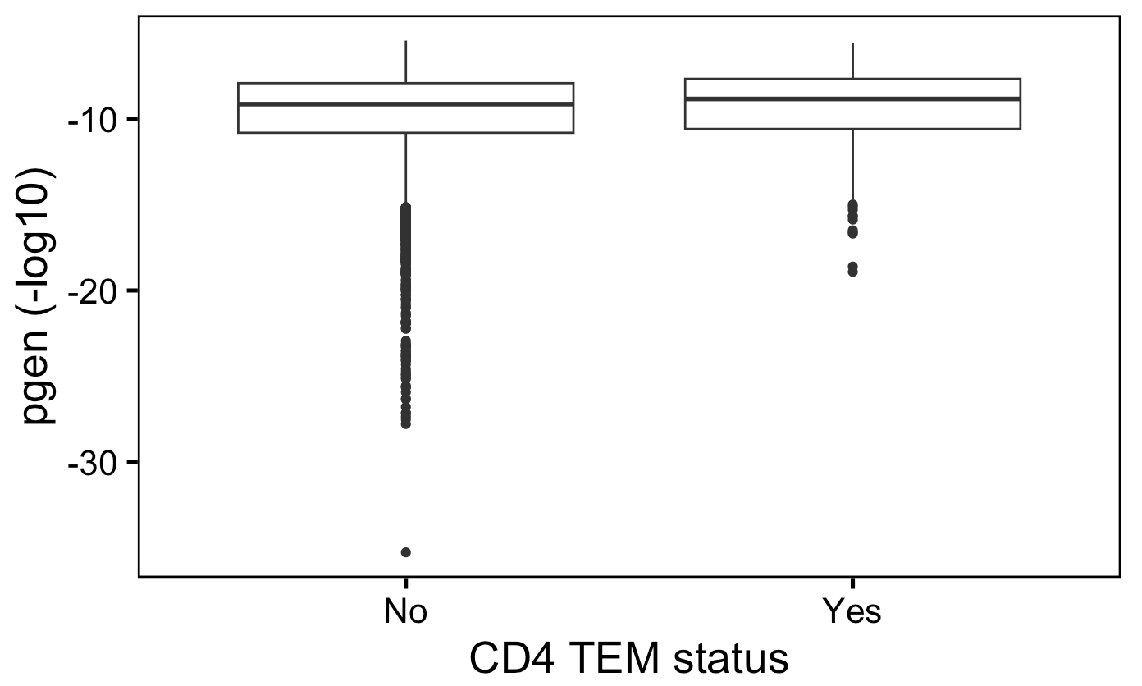
Myocarditis dataset: CD4 TEMs (less abundant in irAE colitis tissue) have shorter TRA CDR3s and more germline-like TRA chains vs. other cell types
**
**
Wilcox rank sum test: ****; padj < 1e-4, **; padj <1e-2, *; padj <0.05
Notes:
# pgen (TRA) padj vals
# CD4 TEM: 4.85e-3
# CDR3 length (TRA): padj vals (adjusted within 5 cell types I tested for this feature for TRA)
# CD4 TEM: 1.6335e-3

Slide 13
Conclusions

Slide 14
Next steps

