Slide 1
Weekly meeting
1 4 2024
Ty Bottorff

Slide 2
Outline

Slide 3
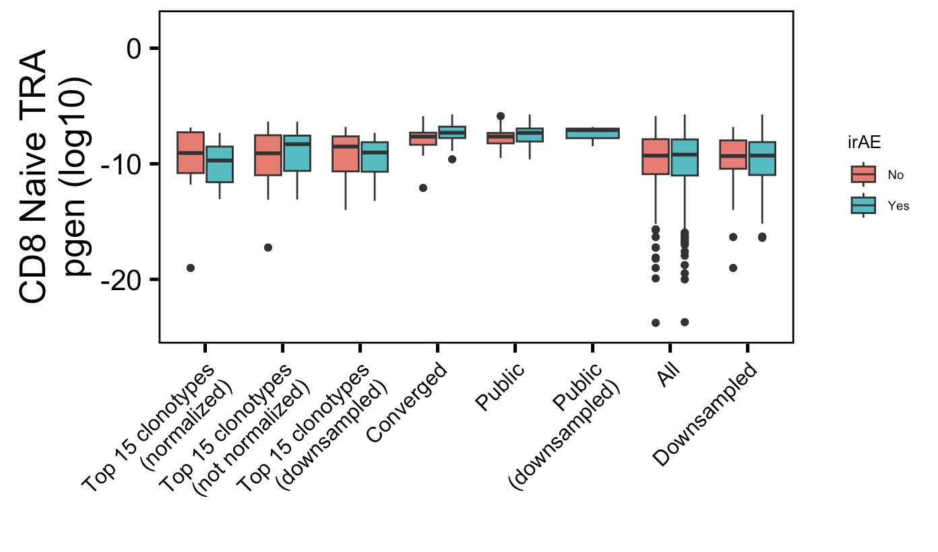
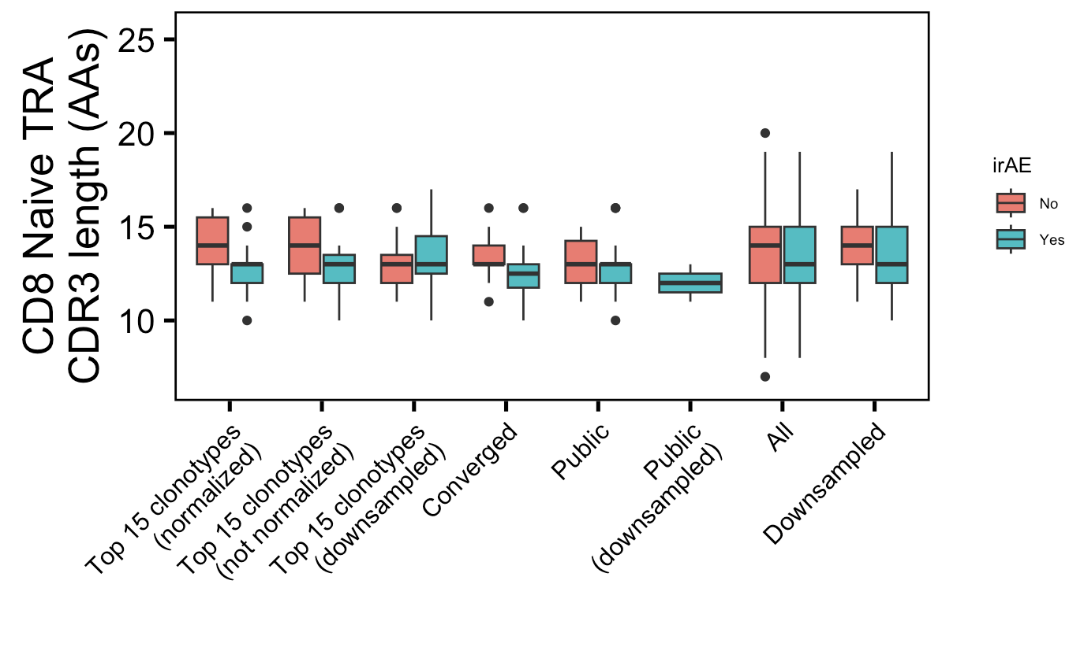
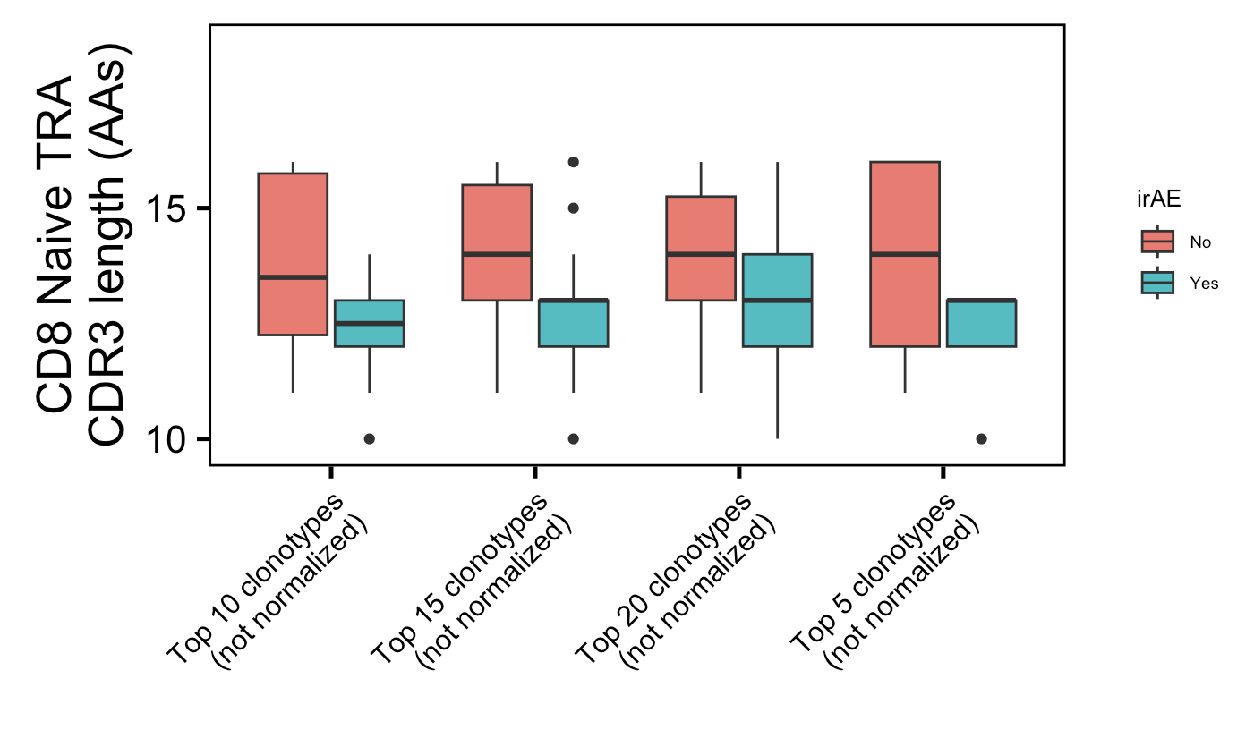
Additional weak conclusion 1 from myocarditis dataset: highly expanded CD8 Naïve TRA CDR3s shorter in irAE patients
*
*
*
Havent adjusted p val yet
Wilcoxon rank sum test. **, p <1e-2; *; p <0.05
Label wrong they’re normalized

Slide 4
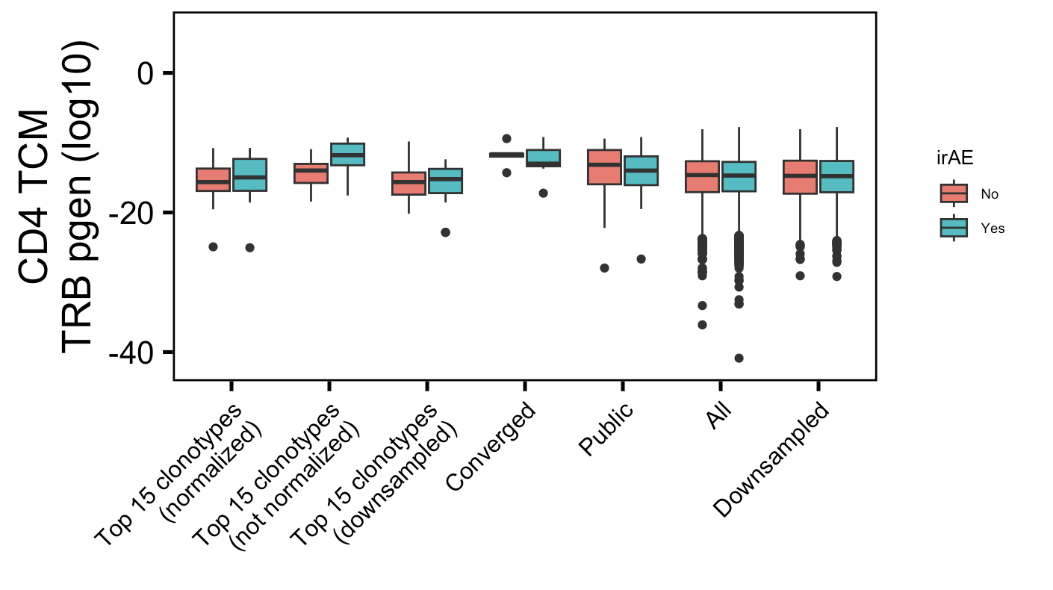
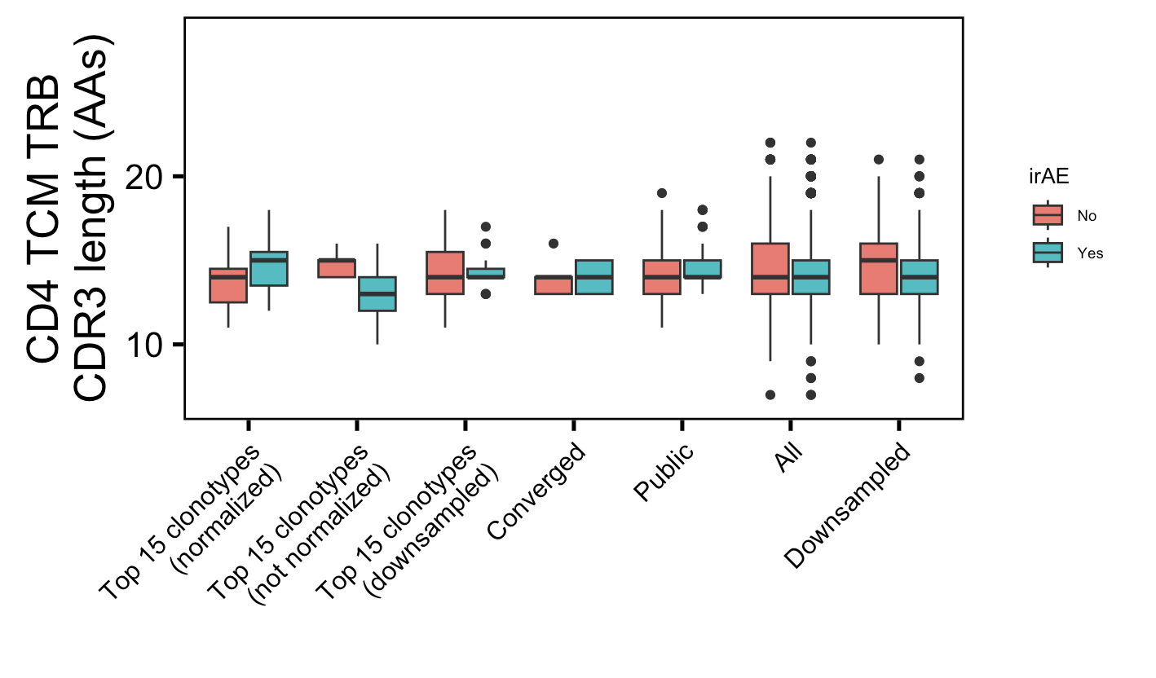
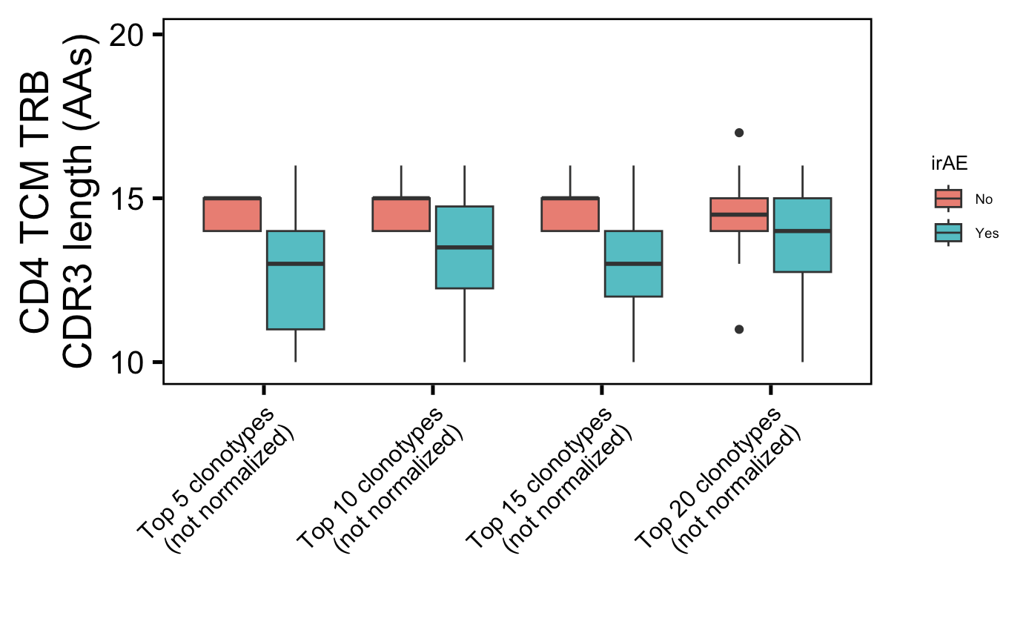
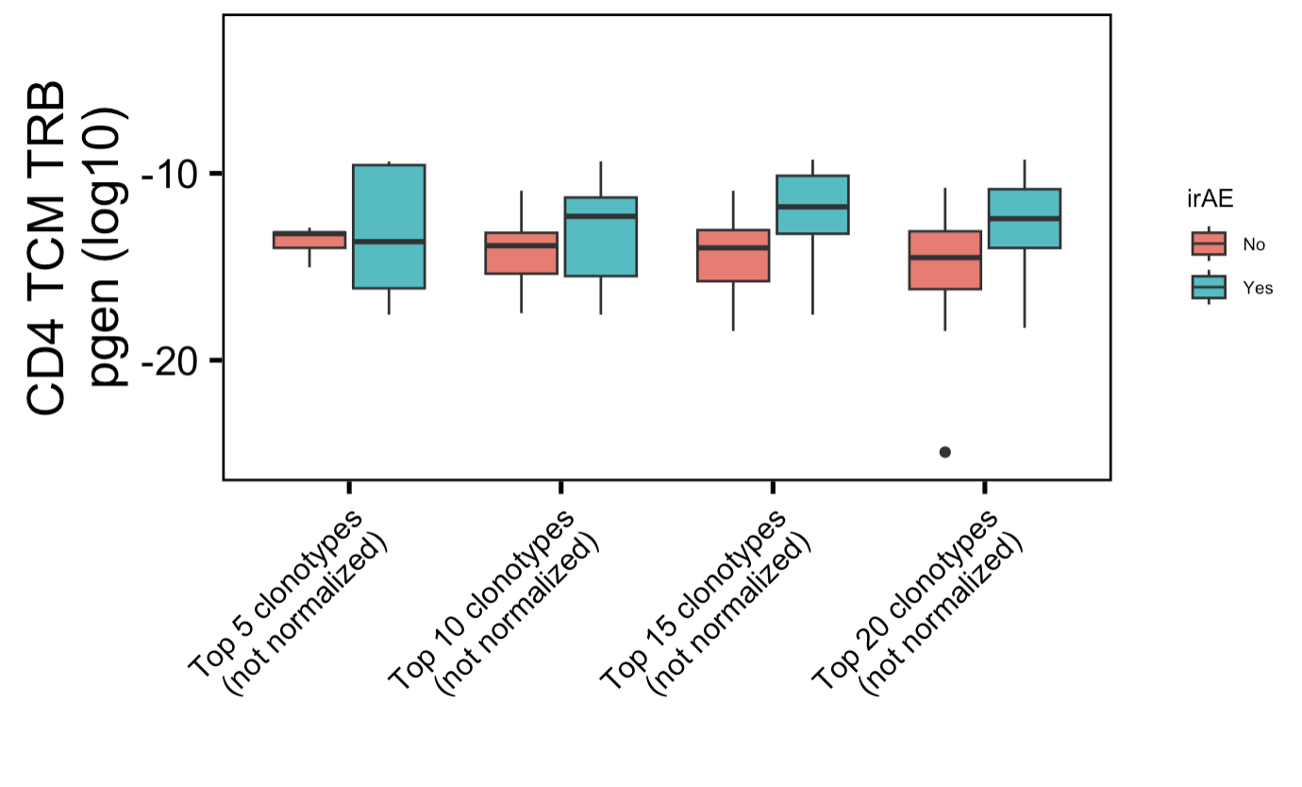
Additional weak conclusion 2 from myocarditis dataset: highly expanded CD4 TCM TRB more germline-like & CDR3s shorter in irAE patients
*
*
*
*
*
Havent adjusted p val yet
Wilcoxon rank sum test. **, p <1e-2; *; p <0.05

Slide 5
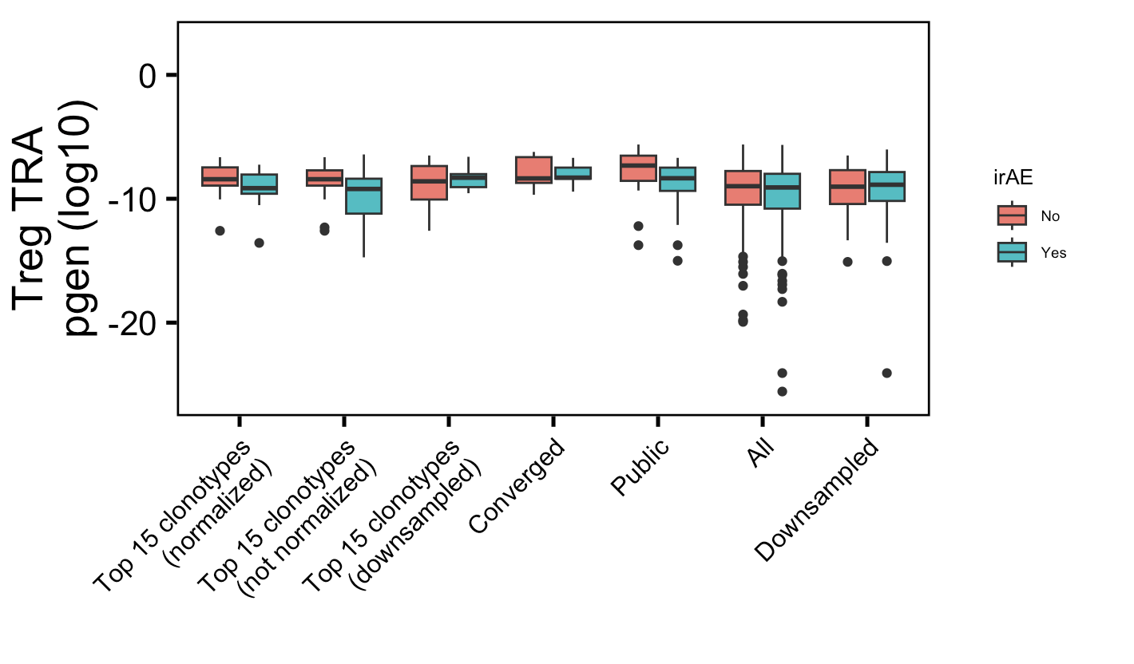
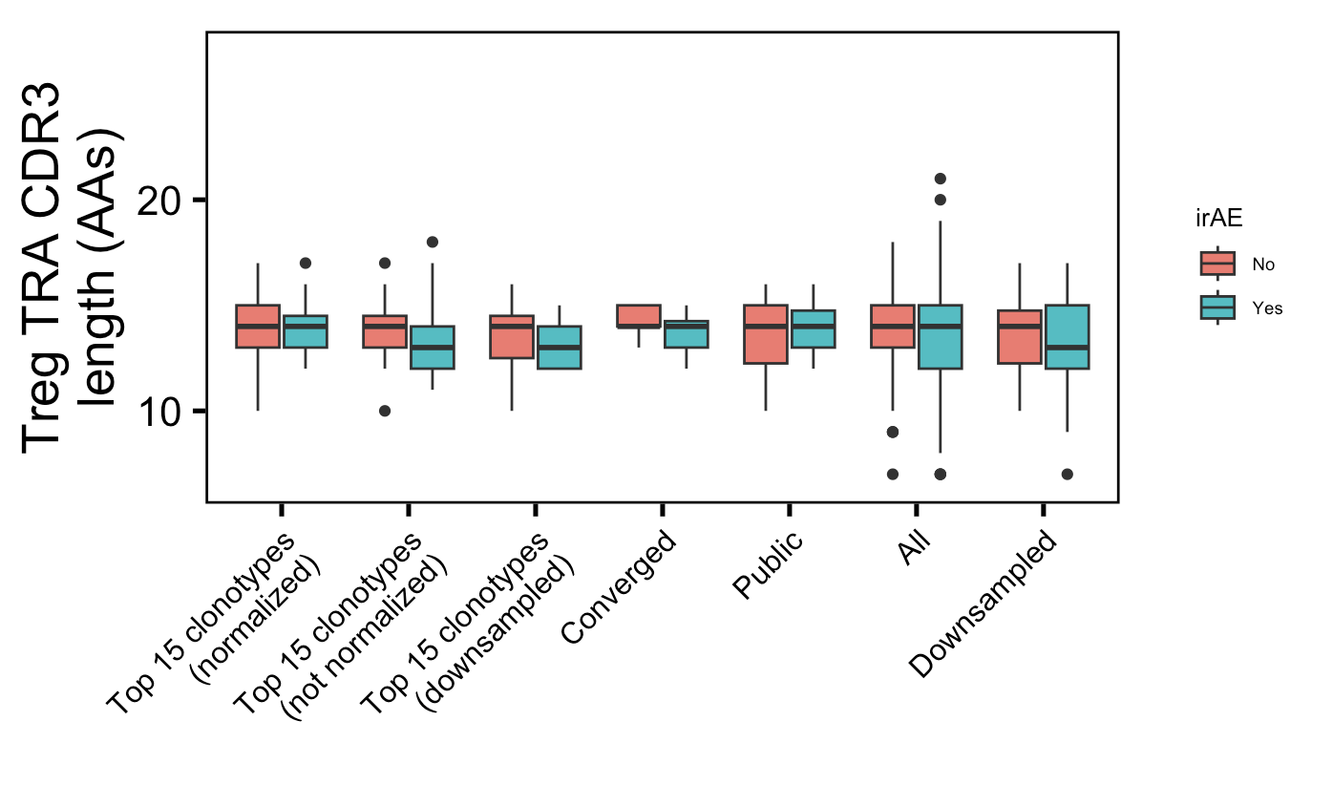
Additional weak conclusion 3 from myocarditis dataset: public Treg TRAs less germline-like in irAE patients
*
Wilcoxon rank sum test. **, p <1e-2; *; p <0.05

Slide 6
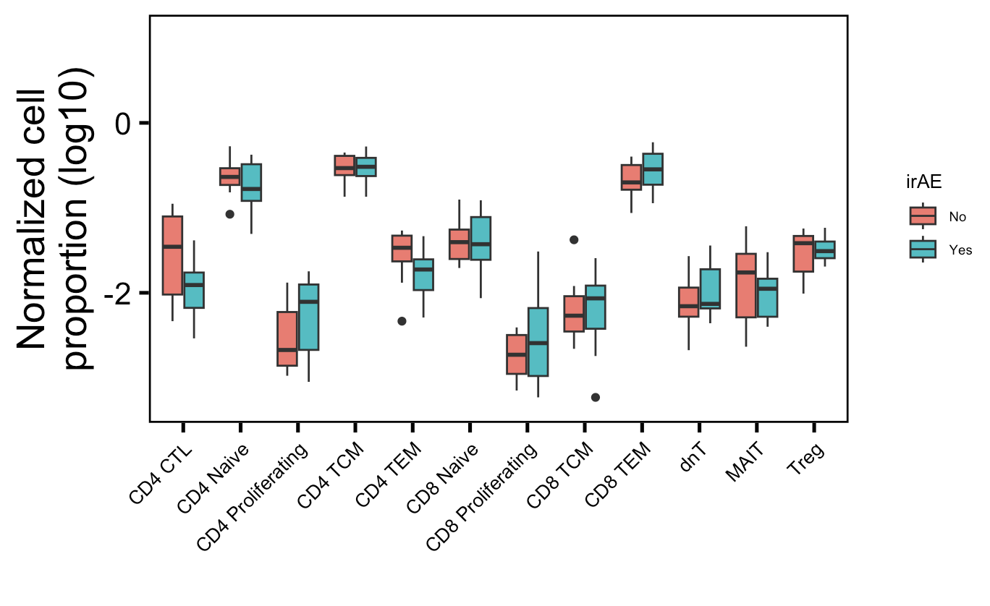
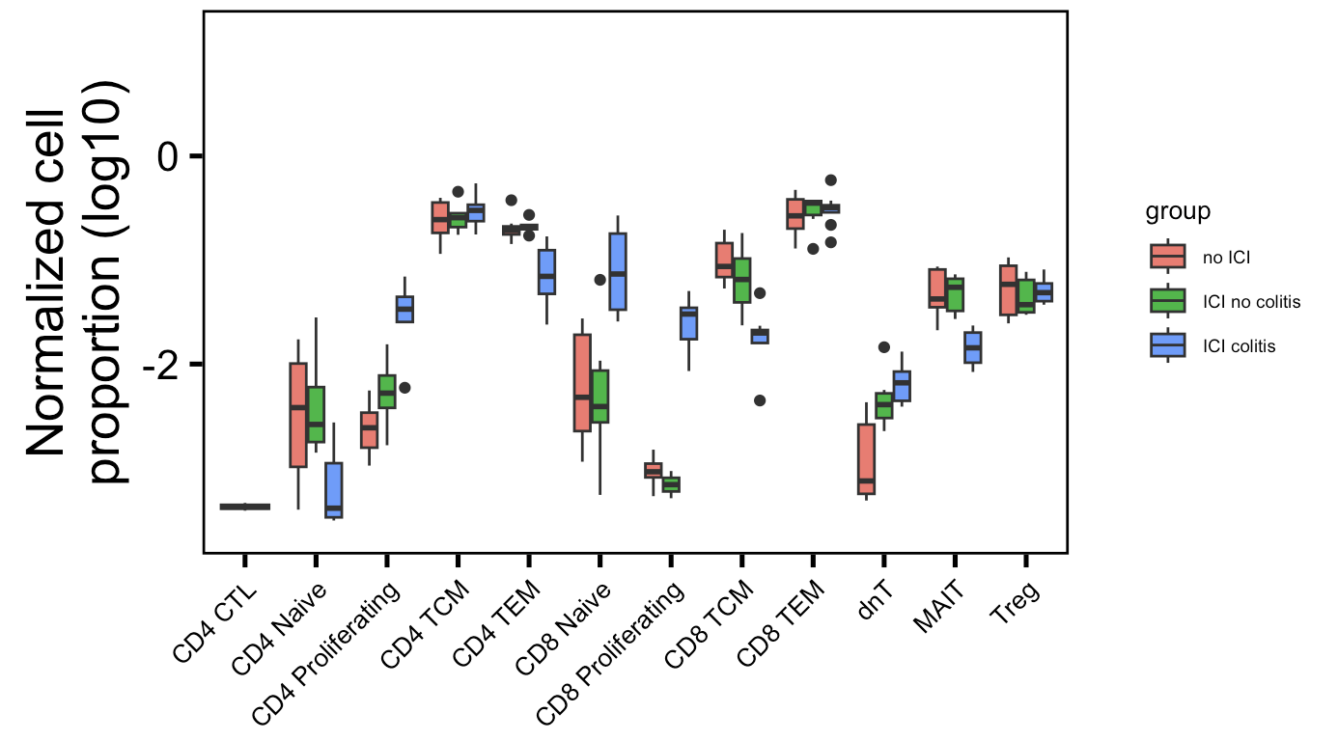
Some cell type normalized abundances in irAE tissue (colitis dataset) are different between irAE groups
Myocarditis dataset
Colitis dataset
**
**
*
*
**
More proliferating T cells (CD4 and CD8), fewer memory T cells (CD4 TEM, CD8 TCM),
fewer MAITs in irAE tissue
Wilcoxon rank sum test. **, p <1e-2; *; p <0.05

Slide 7
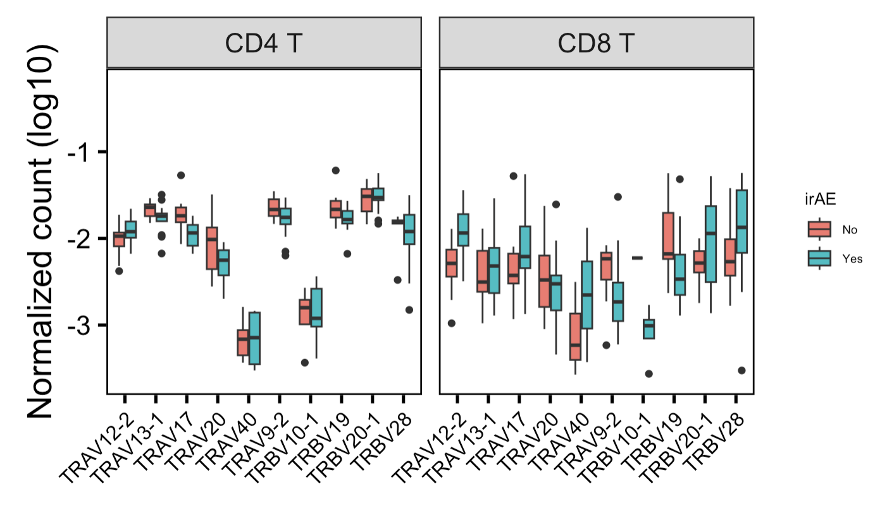
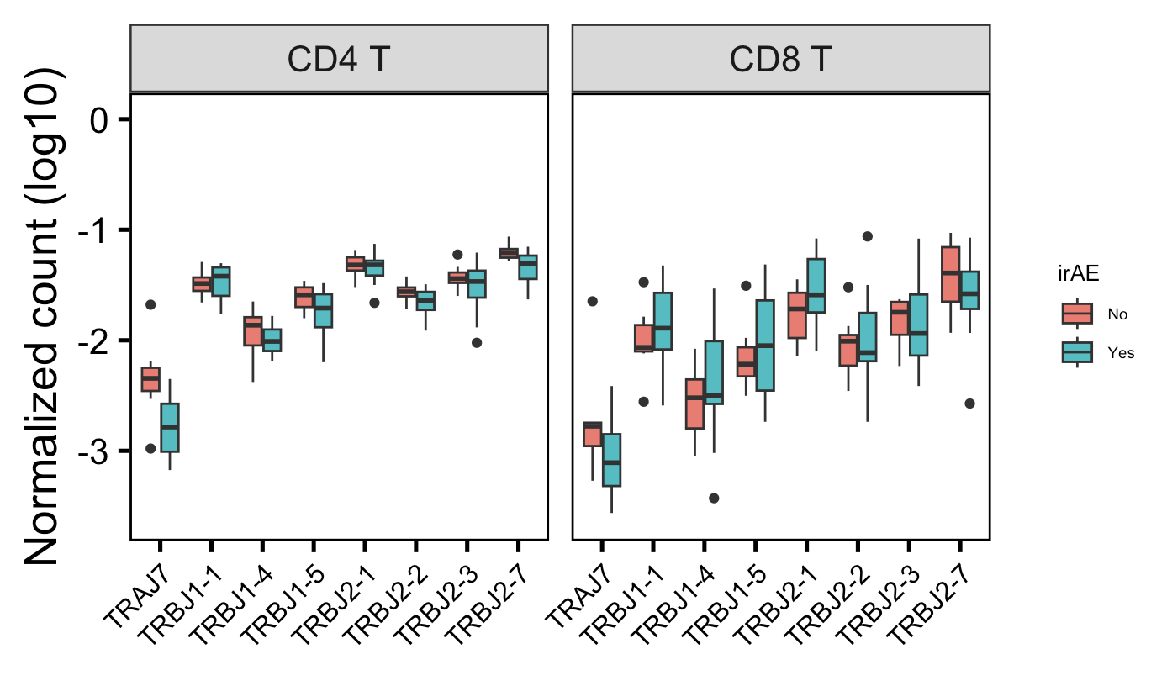
A few VJ genes are more common in different irAE groups in myocarditis dataset
*
*
**
Wilcoxon rank sum test. **, p <1e-2; *; p <0.05
Notes:
# TRAV12-CD8 T: 0.01593
# TRAV17-CD4 T: 0.01052
# TRAJ7-CD4 T: 0.004169

Slide 8
Conclusions

Slide 9
Next steps

Slide 10
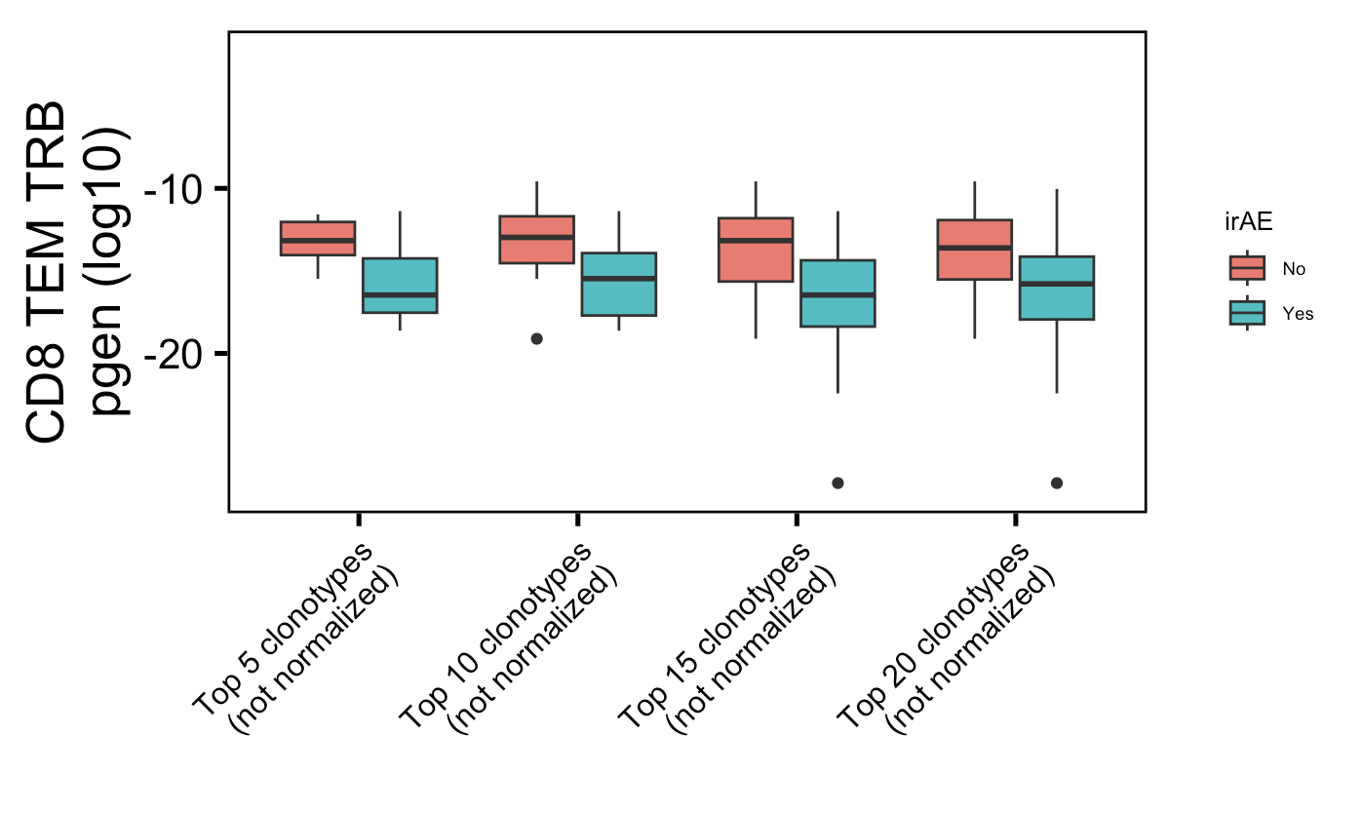
Strongest myocarditis conclusion for comparison
*
*
Havent adjusted p val yet, also show how its not just not normalized (why its not weak)
Wilcoxon rank sum test. **, p <1e-2; *; p <0.05

Slide 11
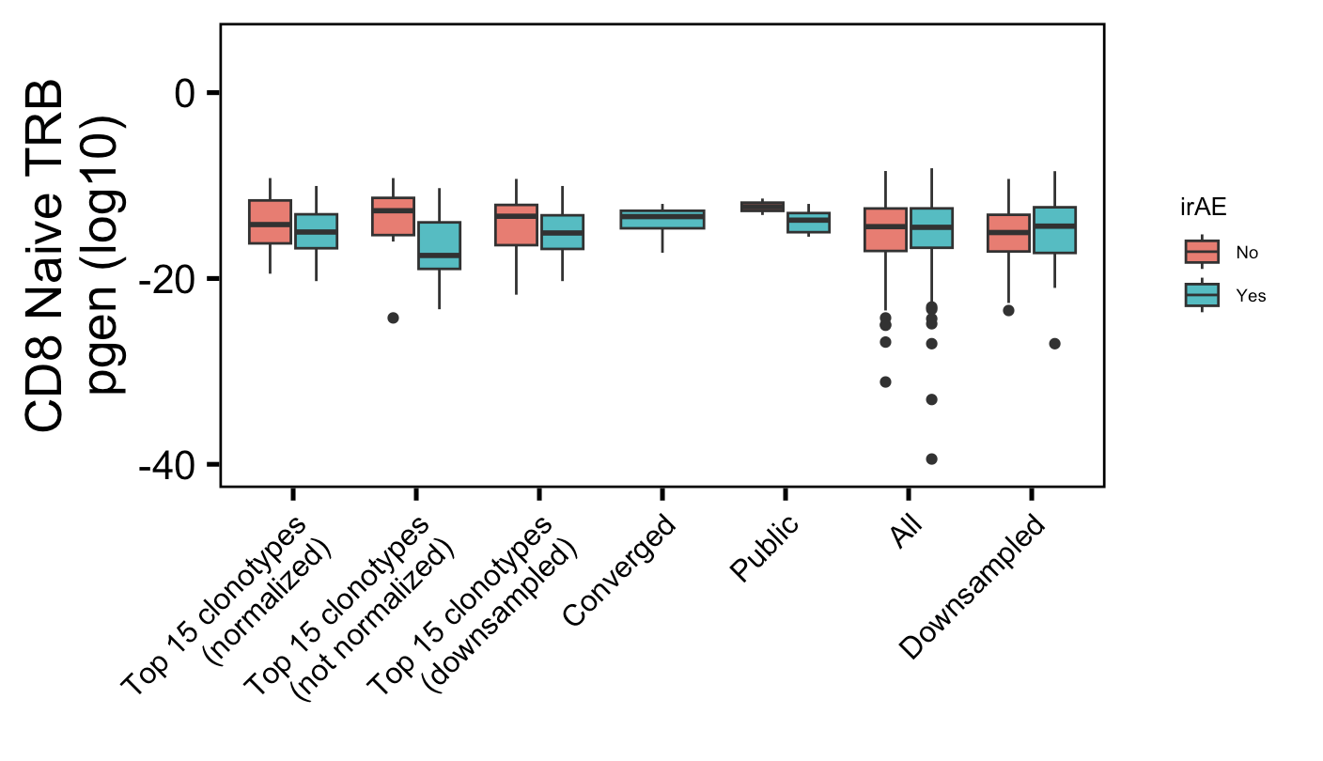
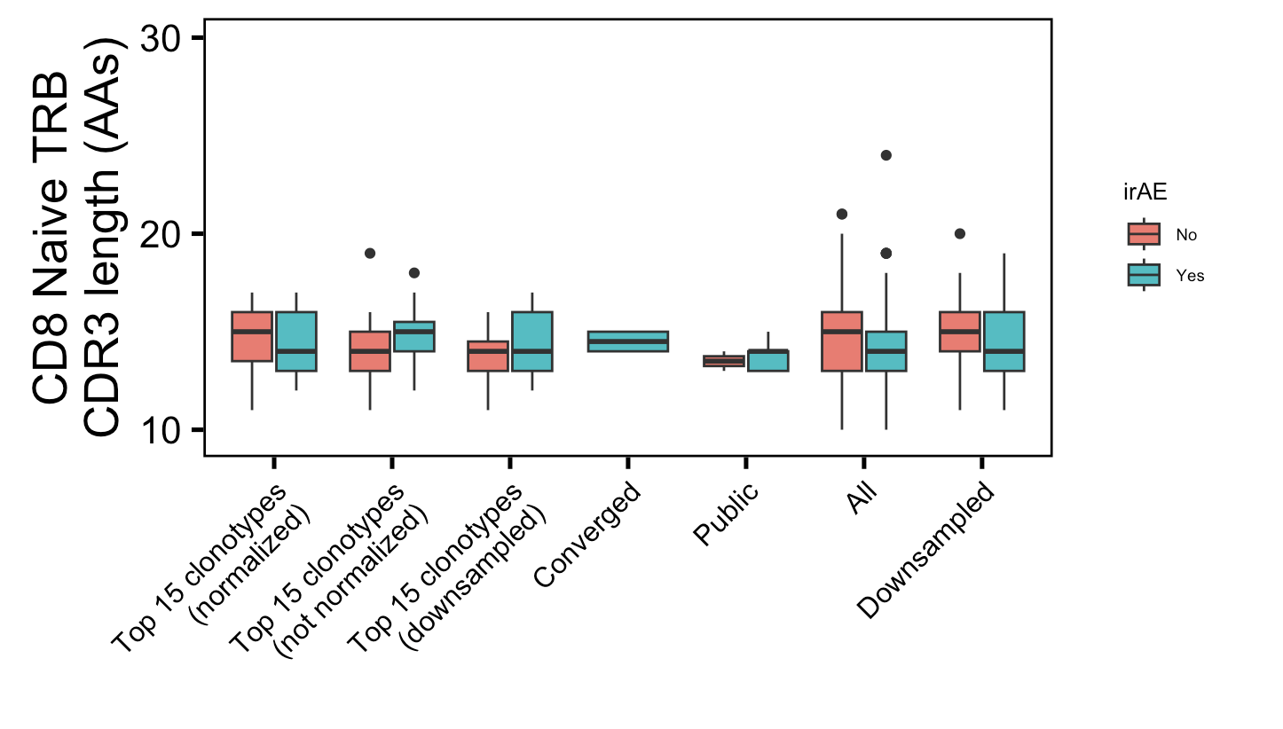
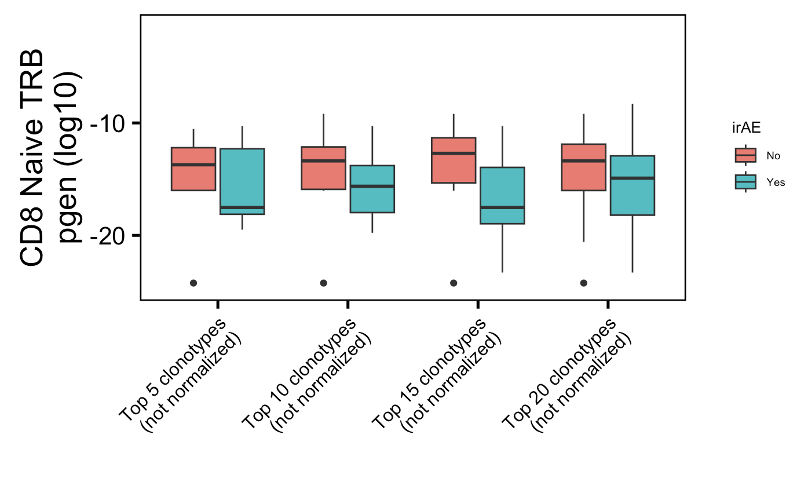
Additional super weak conclusion 1 from myocarditis dataset: highly expanded CD8 Naïve TRBs less germline-like in irAE patients
**
**
Wilcoxon rank sum test. **, p <1e-2; *; p <0.05

Slide 12
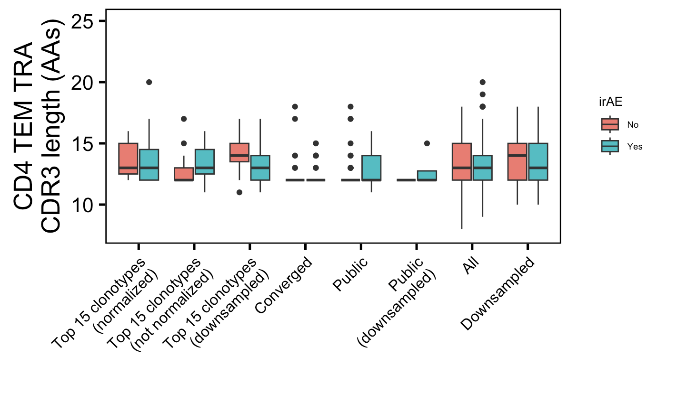
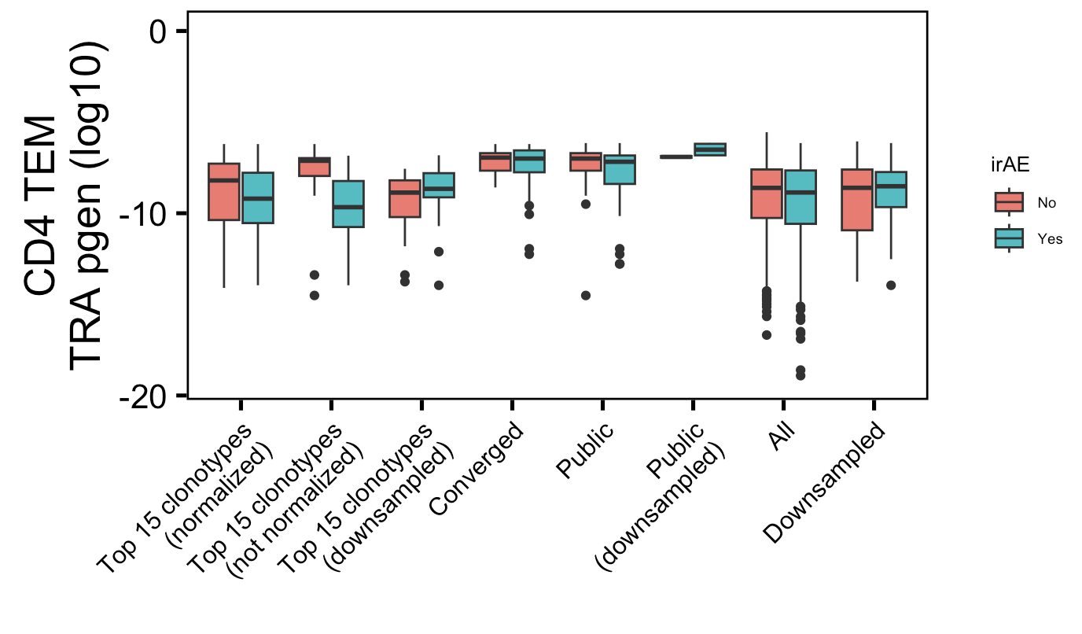
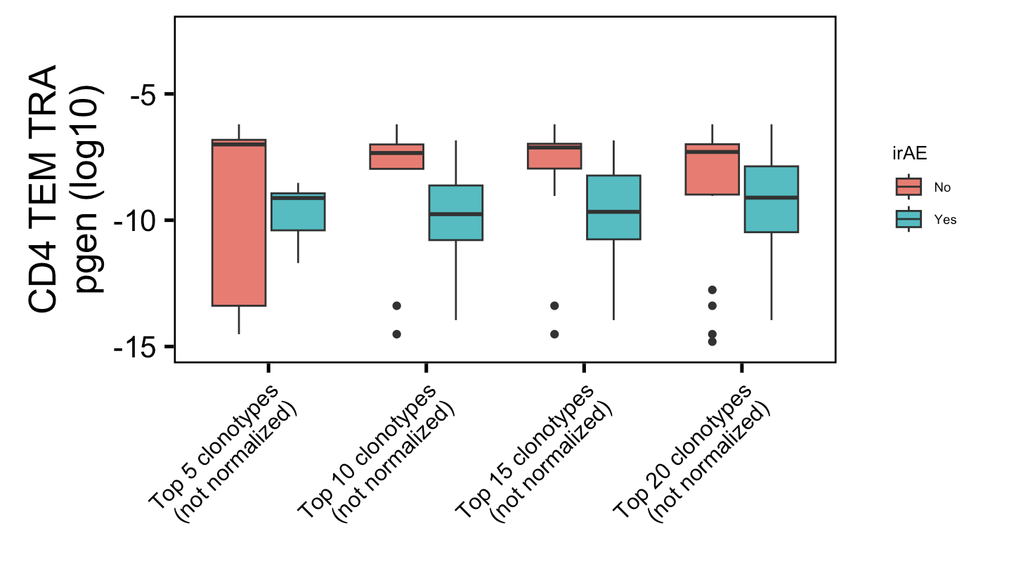
Additional super weak conclusion 2 from myocarditis dataset: highly expanded CD4 TEM TRAs less germline-like in irAE patients
*
*
Wilcoxon rank sum test. **, p <1e-2; *; p <0.05

Slide 13
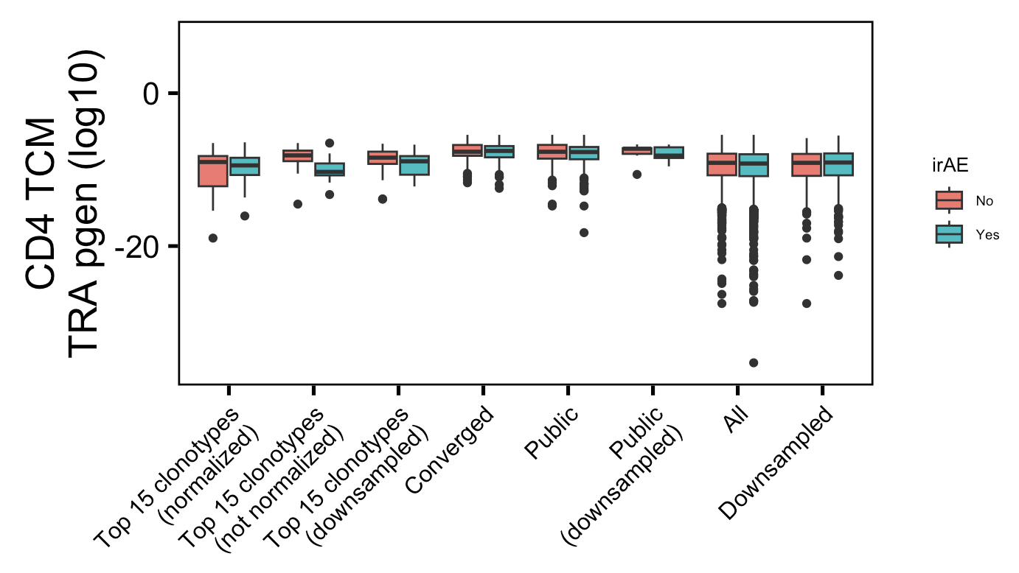
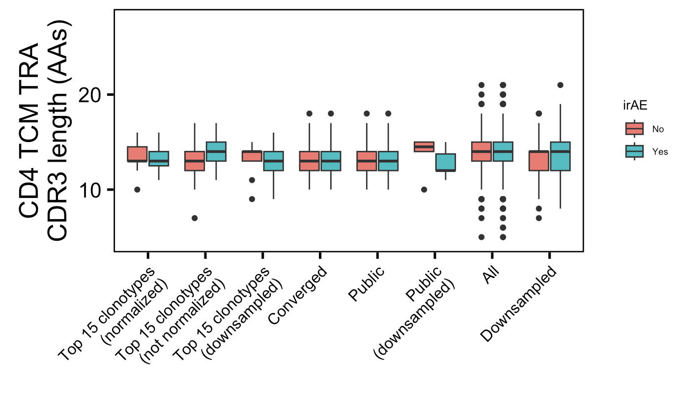
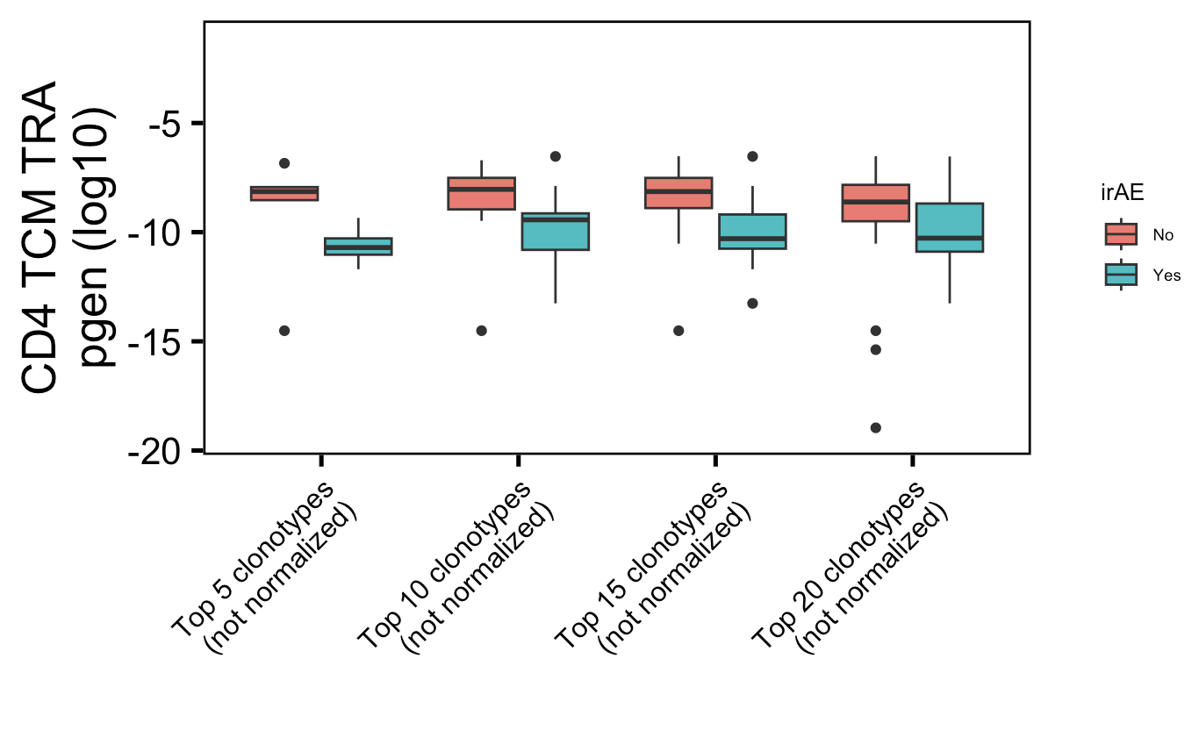
Additional super weak conclusion 3 from myocarditis dataset: highly expanded CD4 TCM TRAs less germline-like in irAE patients
*
*
Wilcoxon rank sum test. **, p <1e-2; *; p <0.05

Slide 14
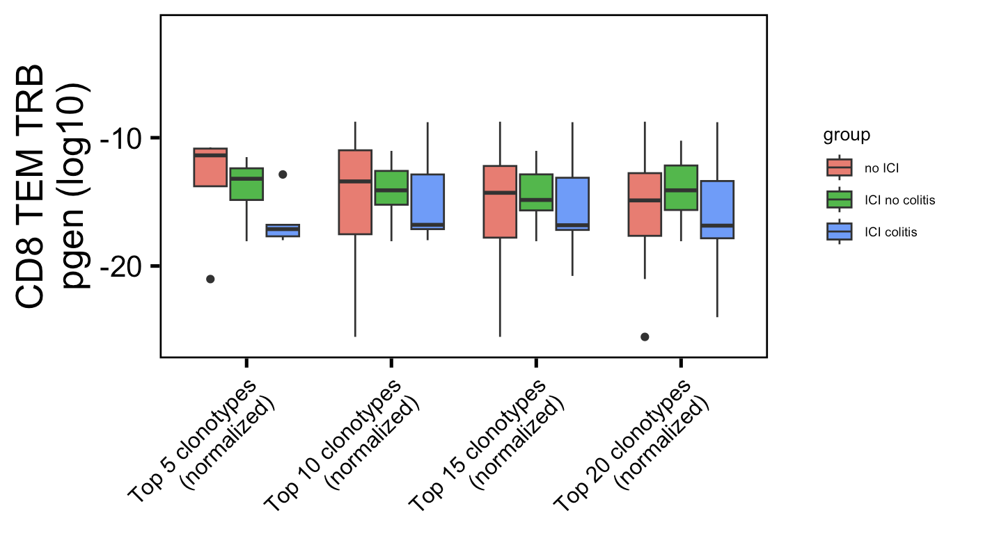
Weak conclusion 1 from colitis dataset (seen last week):
*
Label wrong not normalized
Wilcoxon rank sum test. **, p <1e-2; *; p <0.05

Slide 15
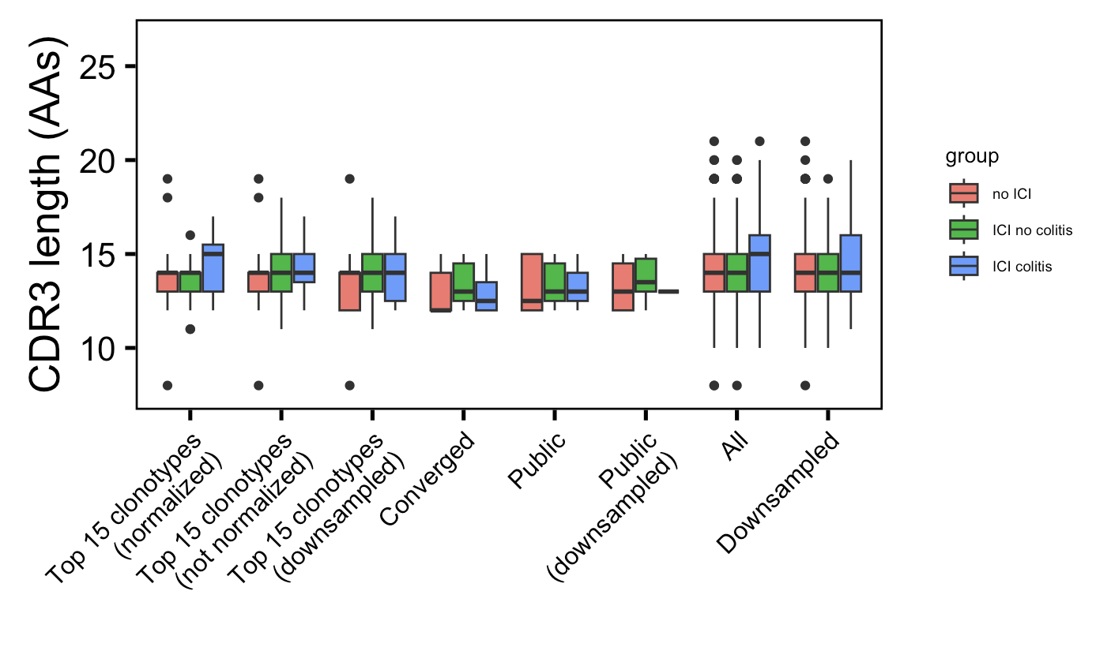
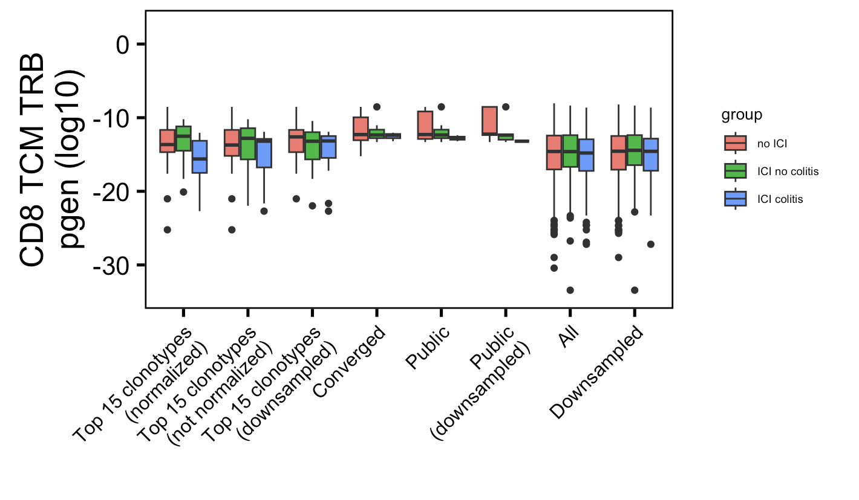
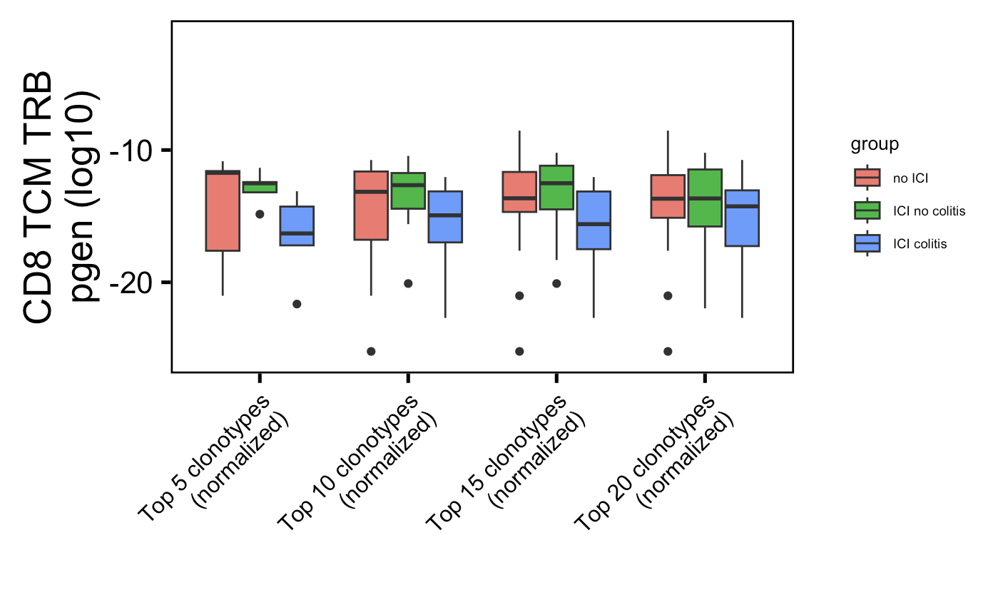
Additional weak conclusion 1 from colitis dataset: highly expanded CD8 TCM TRBs less germline-like in colitis patients (opposite of myocarditis conclusion)
*
*
Wilcoxon rank sum test. **, p <1e-2; *; p <0.05

Slide 16
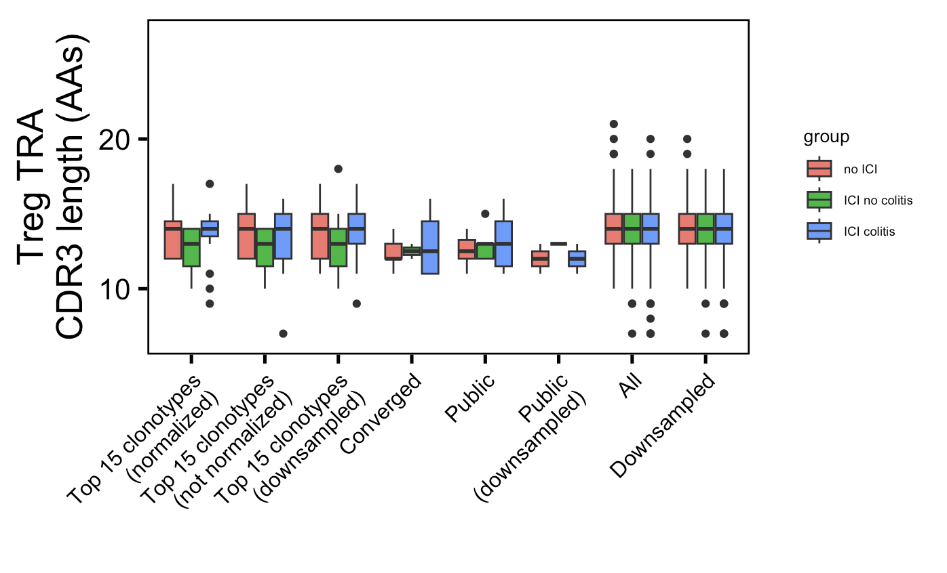
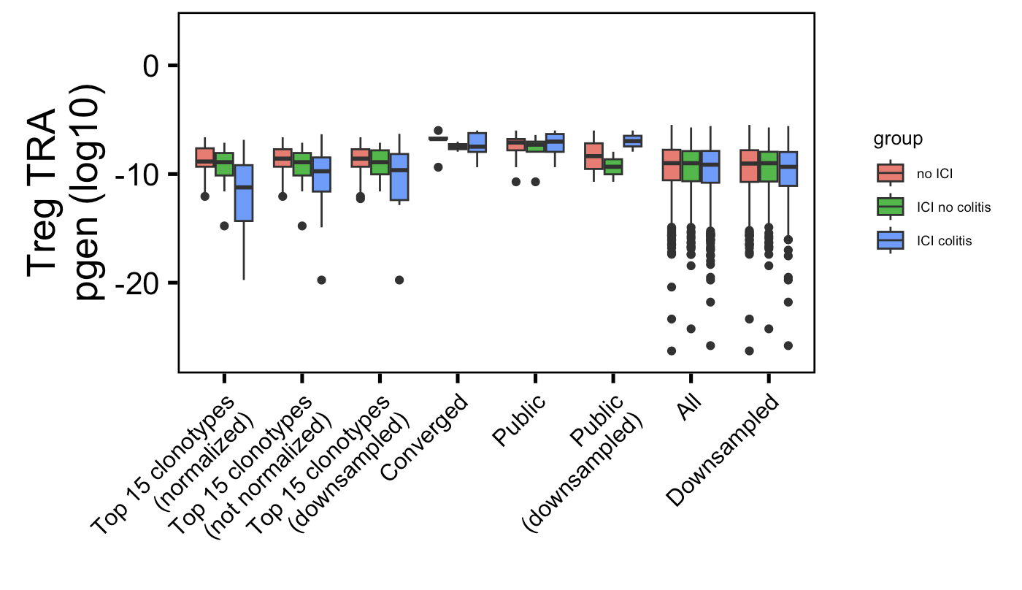
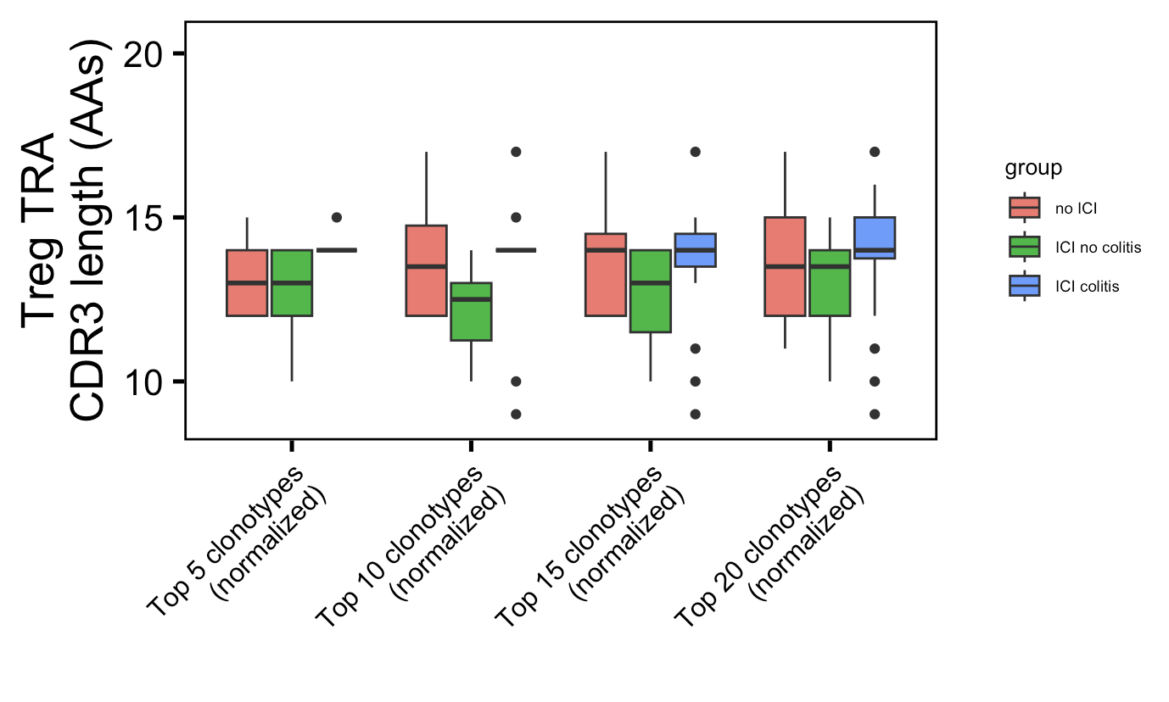
Additional weak conclusion 2 from colitis dataset: highly expanded Treg TRA CDR3s longer in irAE patients
*
*
Wilcoxon rank sum test. **, p <1e-2; *; p <0.05

