Slide 1
Weekly meeting
10 3 2024
Ty Bottorff

Slide 2
Outline
NCI irAE progress on follow ups from last meeting

Slide 3
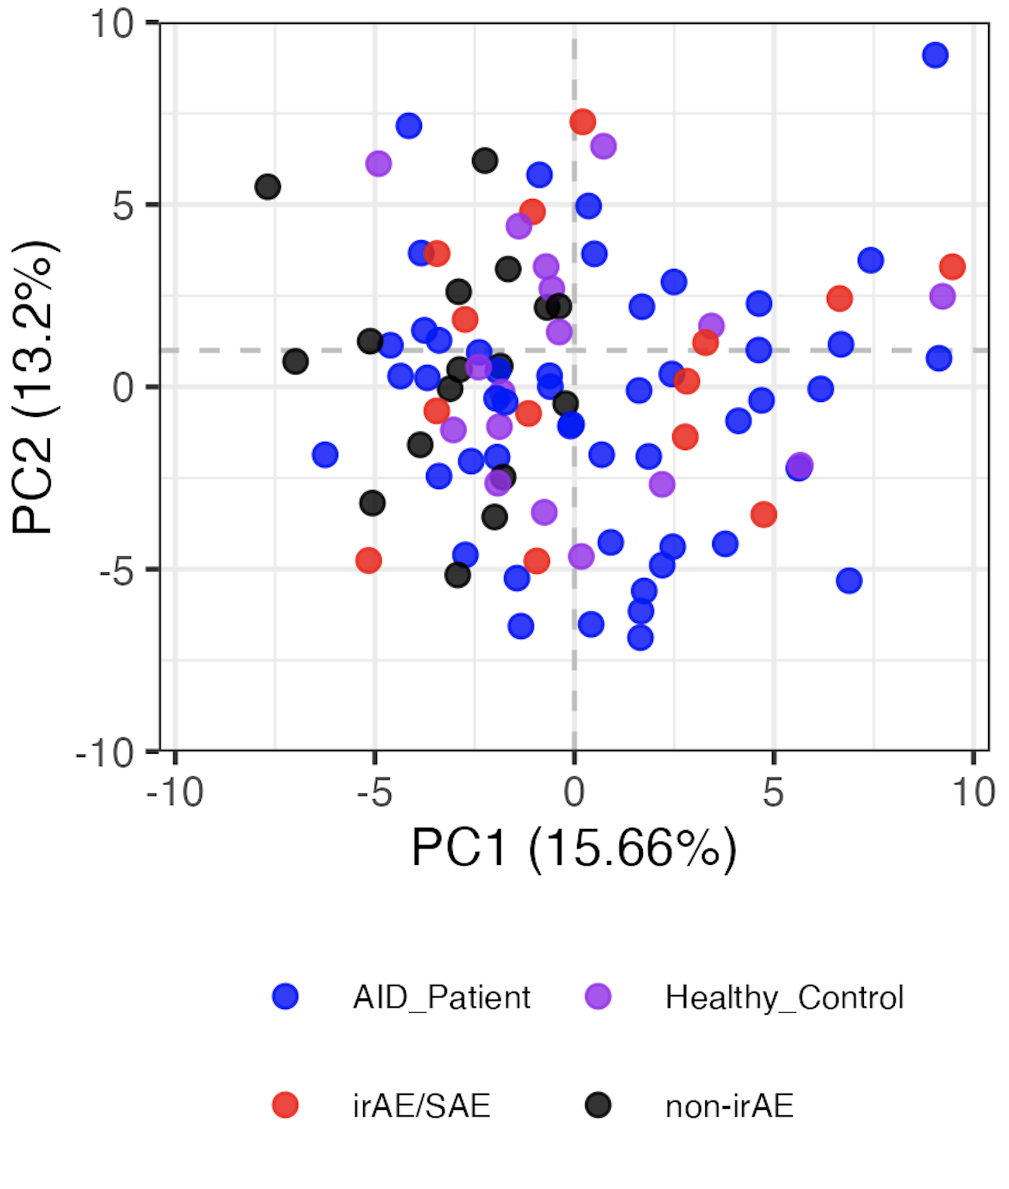
Baseline immunotypes are not distinct by group
Notes:
LOGIT TRANSFORMED FREQS
Including all PD1/PDL1 sorts here but that’s fine I believe (baseline, no ICI yet)

Slide 4
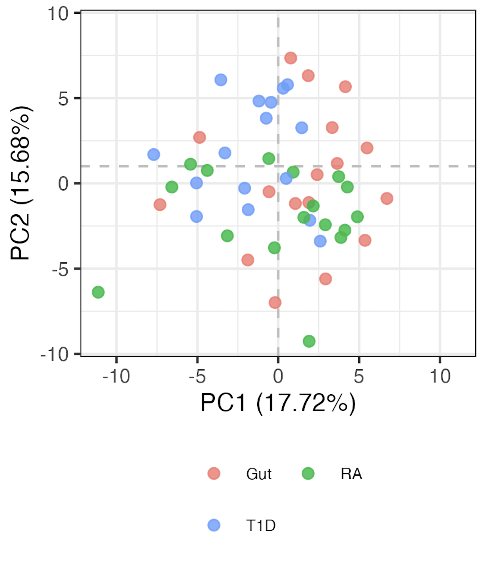
AID subgroup immunotypes are not very distinct either
Notes:
LOGIT TRANSFORMED FREQS

Slide 5
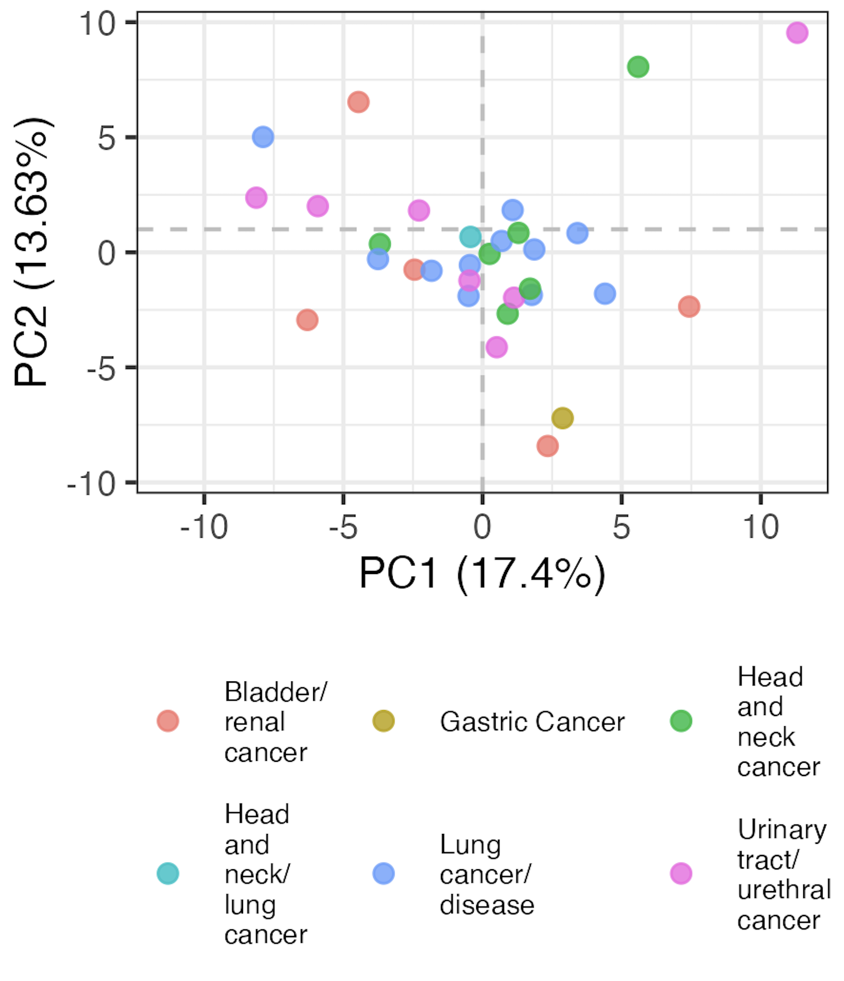
Baseline head, neck, and lung cancer immunotypes are distinct from other cancer subtypes

Slide 6
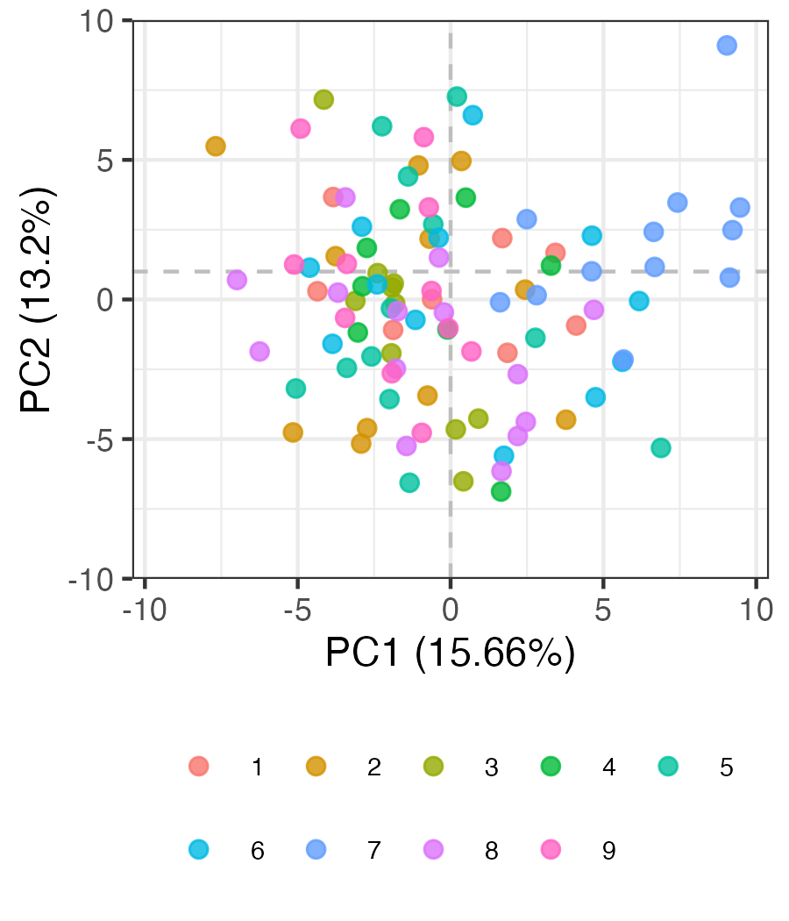
Evidence of batch effects in baseline data
Batch #
Notes:
Batch 7 kind of all clustering together in bottom left…

Slide 7
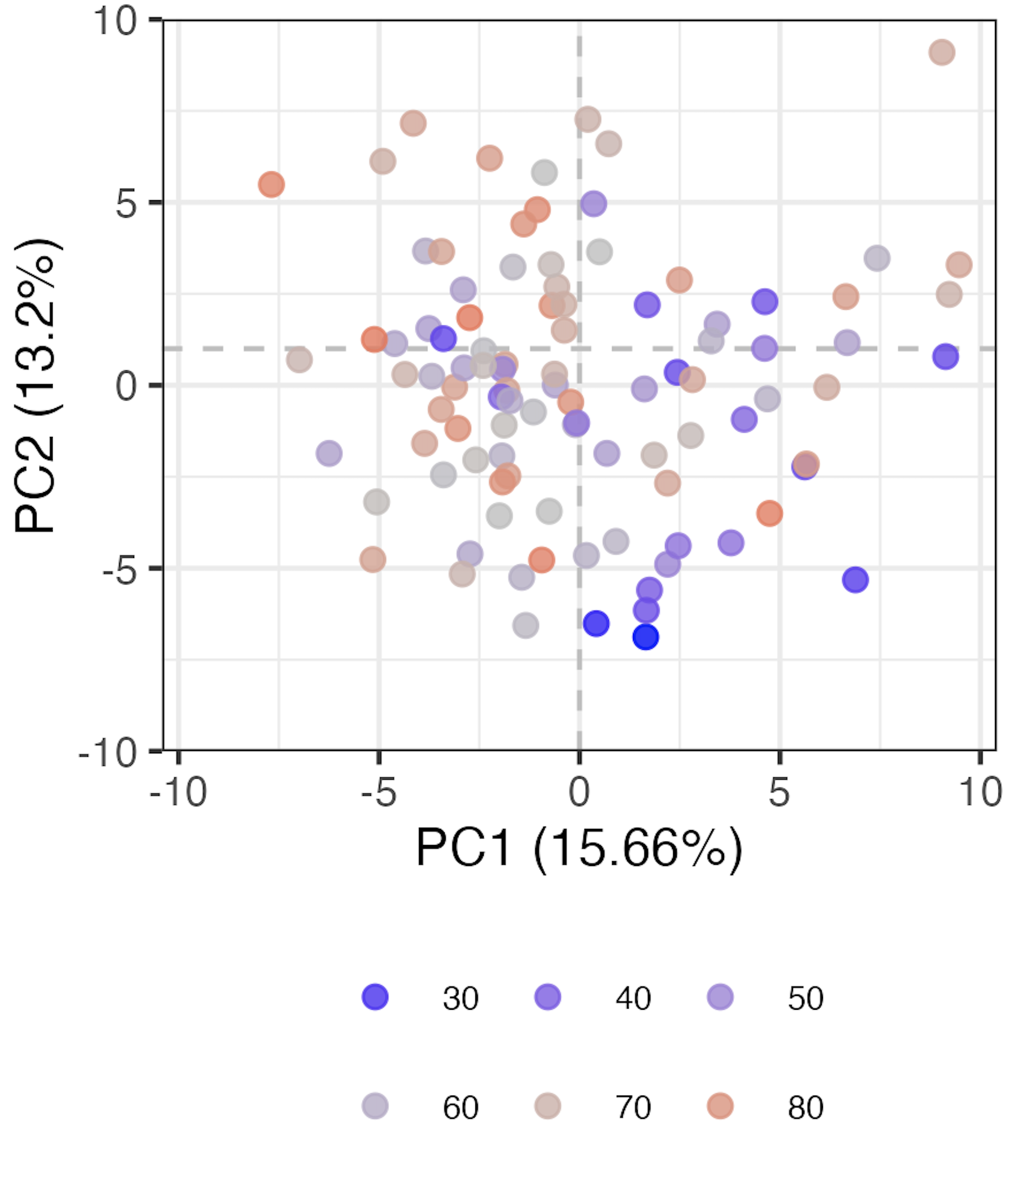
Age contributes to variation (baseline samples)
Age

Slide 8
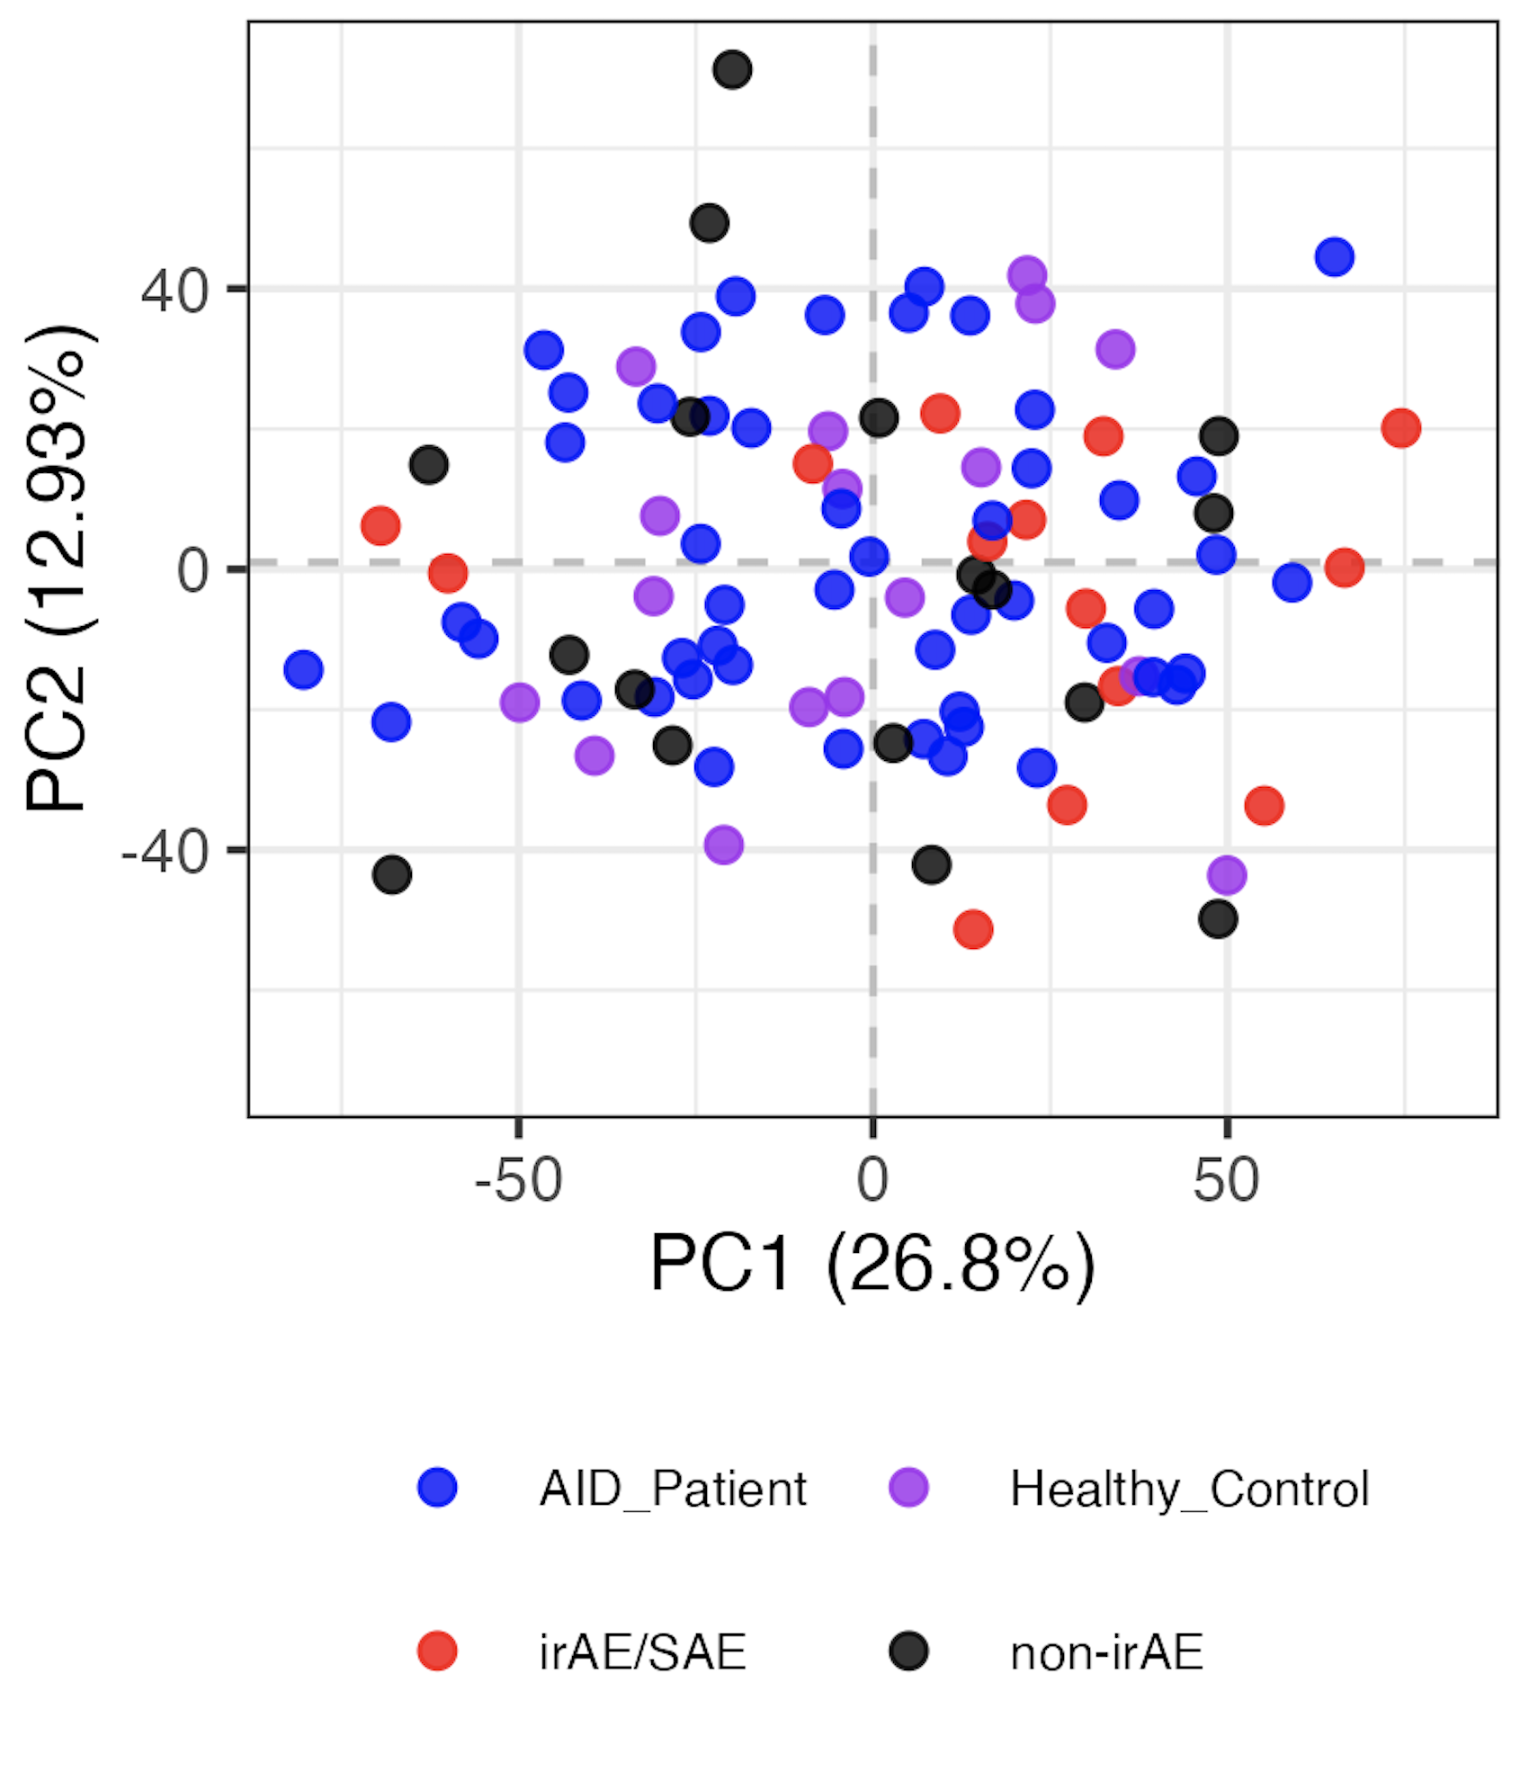
Regressing out age & batch from baseline samples doesn’t reveal distinct immunotypes by group
Confounders regressed out
Notes:
Left is normal logit
Right is residuals from linear models with age and Batch as confounders

Slide 9
Conclusions
NCI irAE project
don’t see effect of previous treatments (radiation, chemoradiation…) on baseline cancer immunotypes (data not shown)
ICA does not appear better at distinguishing unique immunotypes by group (baseline) than PCA (data not shown)
do not see distinct baseline immunotypes by irAE group, even after regressing out age/batch
Notes:
ICA vs. PCA: ICA decomposes data into independent components/sources, separates mixed signals, ICA components are independent not necessarily orthogonal vs. PCA orthogonal PCs i.e. maximally variant

Slide 10
Next steps
ITN update soon?
10/17 SI presentation on T1D project (will send draft by 10/10)
poster info
Josh’s data showing negative association b/w non-exhausted CD127⁺ CD8 frequency & outcome
purine & JAK/STAT gene sets’ accessibility differences across sorts
P348 pseudotime data (Josh/Basilin)
Erin’s data on DP PD-1⁺/DP CD57⁺ TCR sharing
NCI irAE project (update on 10/23)
irAE grade-based severity rather than type-based severity (waiting on Holly for this metadata…)
IMPACD
analysis of feature changes over longitudinal visits, GAMs?
include features previously removed due to high technical variation (~done but recheck)

Slide 11
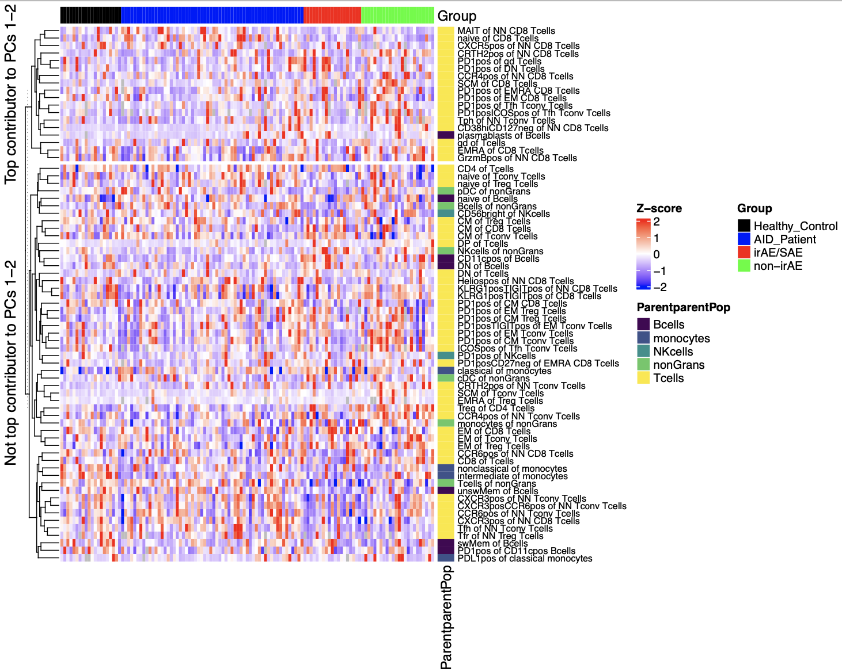
Certain features contribute more to variation (baseline)

Slide 12
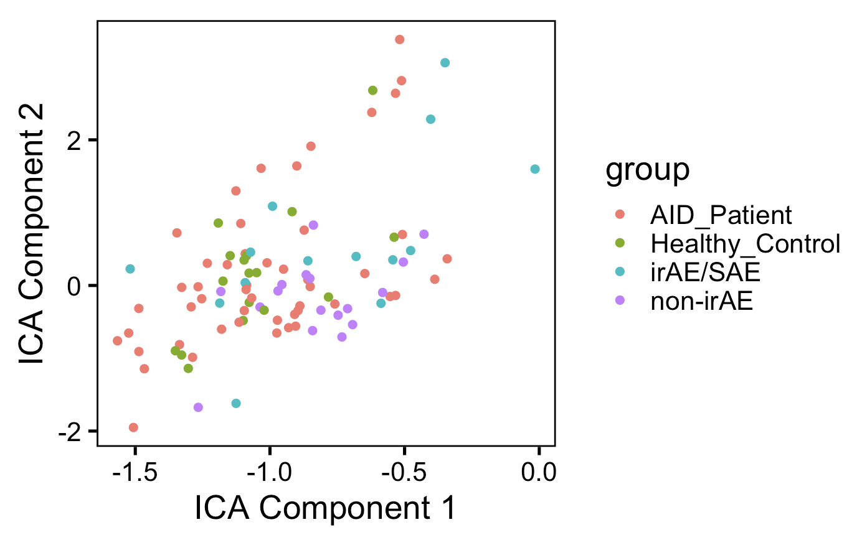
ICA doesn’t appear better at distinguishing unique immunotypes by group than PCA (baseline data)
Notes:
ICA vs. PCA: ICA decomposes data into independent components/sources, separates mixed signals, ICA components are independent not necessarily orthogonal vs. PCA orthogonal PCs i.e. maximally variant

Slide 13
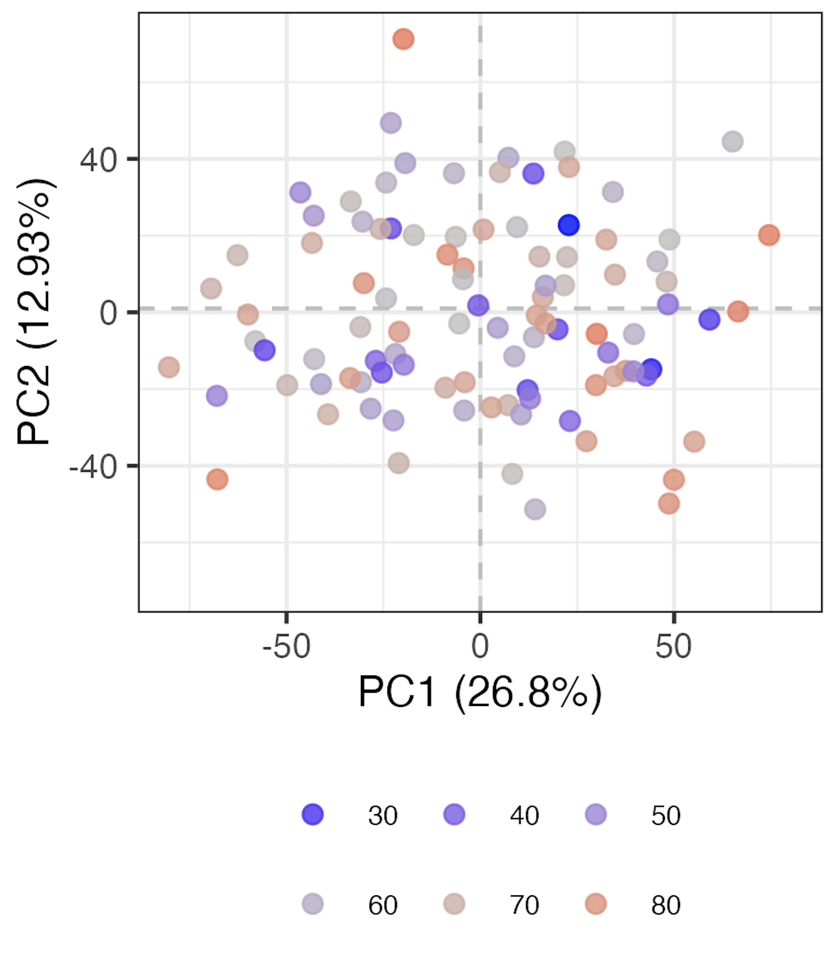
Confirmation that regressing age out worked (baseline samples)
Age

