Slide 1
Weekly meeting
10 31 2024
Ty Bottorff

Slide 2
Outline
Follow ups from NCI irAE meeting

Slide 3
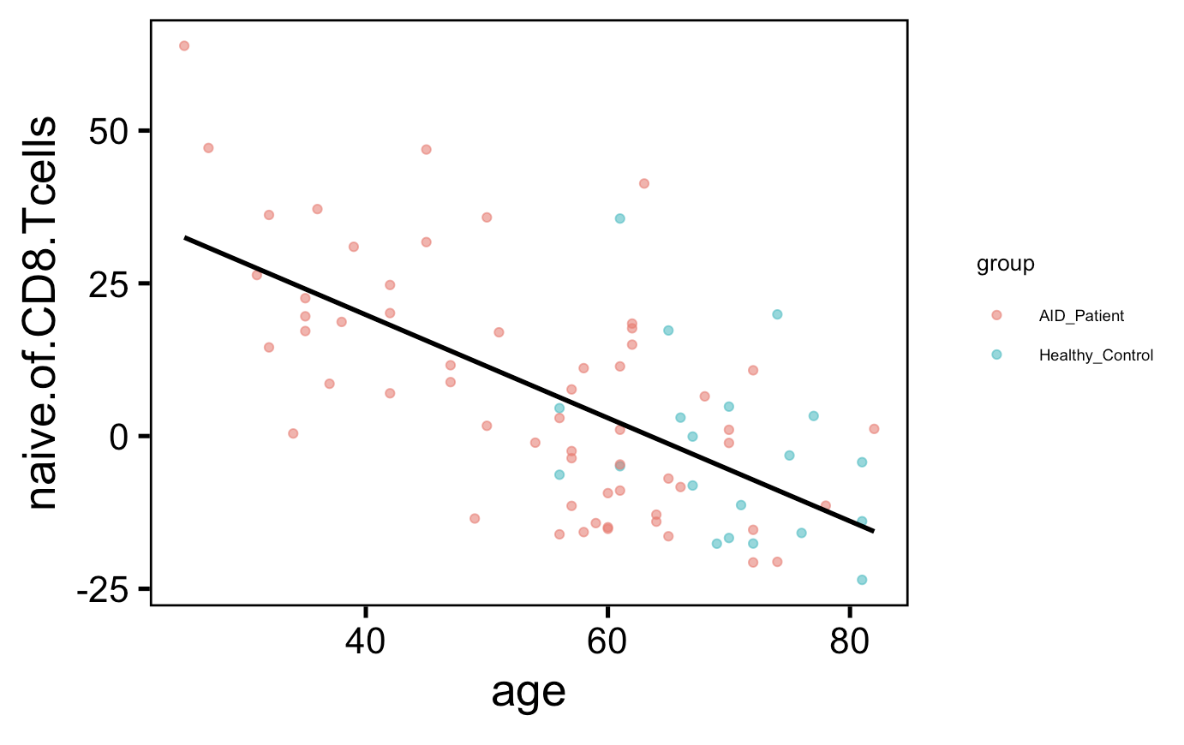
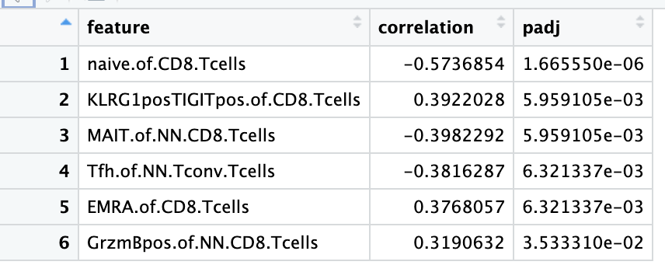
Several features associate strongly with age in baseline non-cancer samples
Notes:
Batch corrected, so y-axis and correlations with age here are with residuals from LM with batch as factor
None of these features had significantly different frequencies by irAE group (baseline)

Slide 4
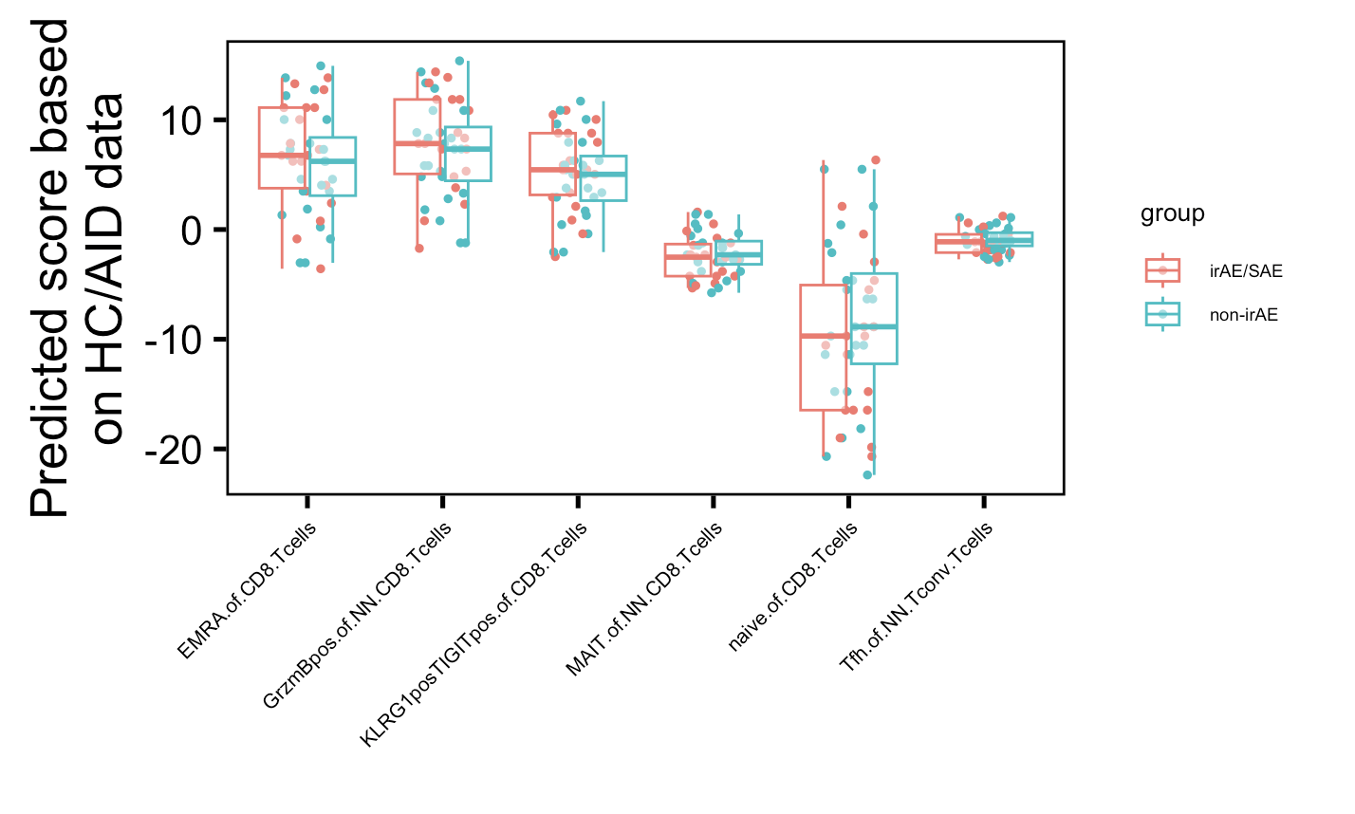
Predicted feature values based on age similar between irAE groups
Notes:
Using model relationship between age and feature freqs in HC+AID groups to predict feature freqs based on age

Slide 5
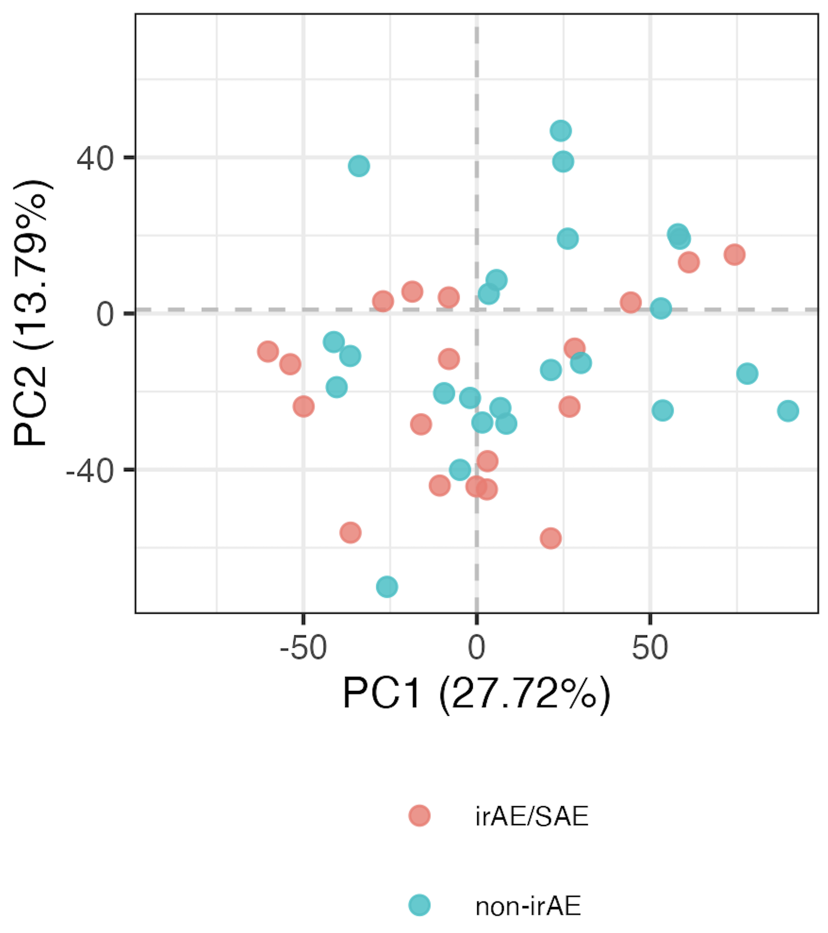
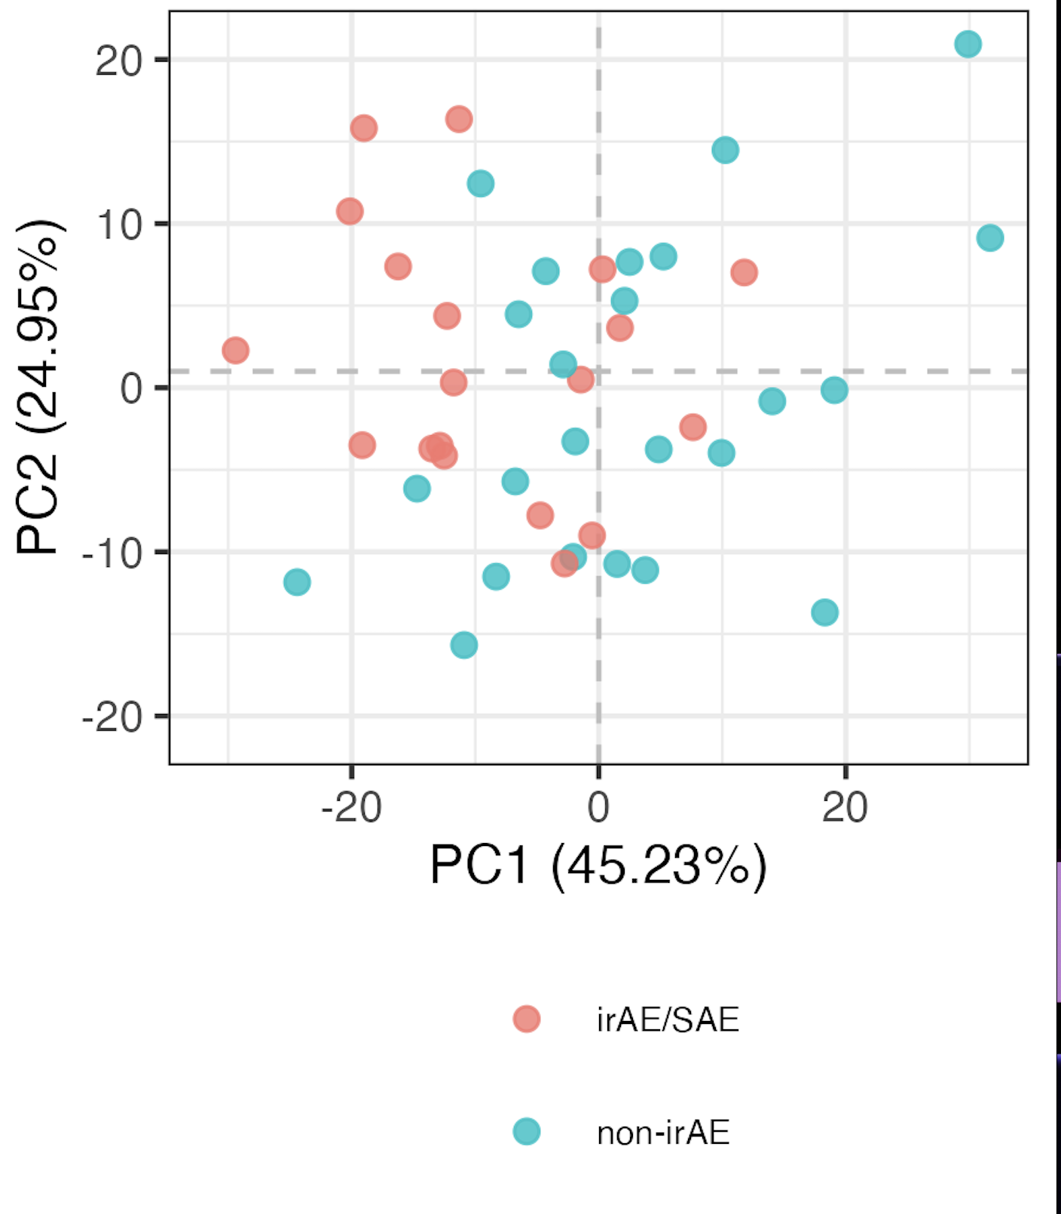
Using top features only doesn’t really help distinguish baseline irAE and non-irAE immunotypes
All features
Top 6 features
Notes:
Both batch corrected residuals, top features chosen by lowest pval in irAE vs. non-irAE residual comparison

Slide 6
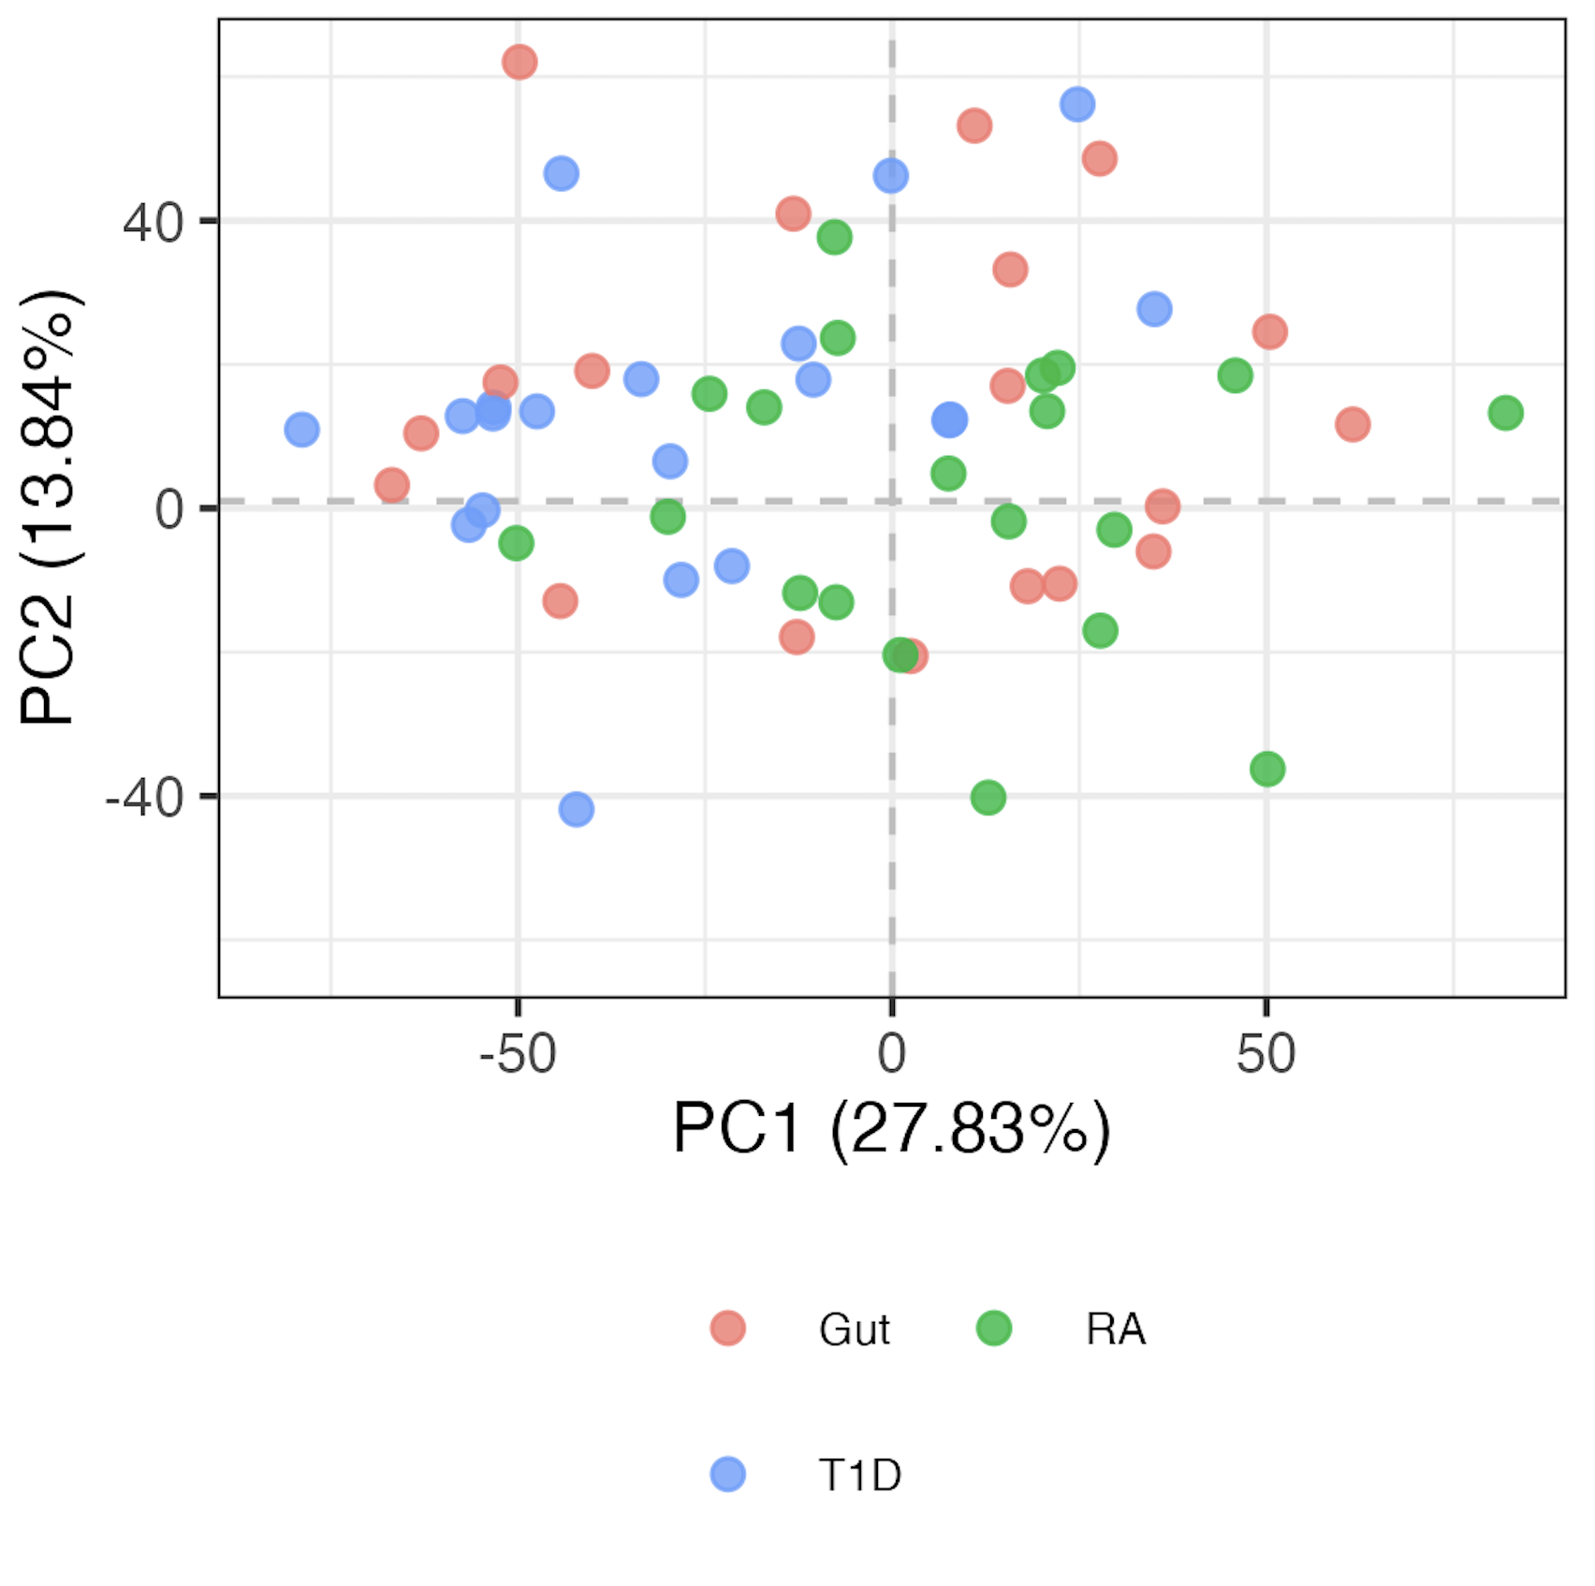
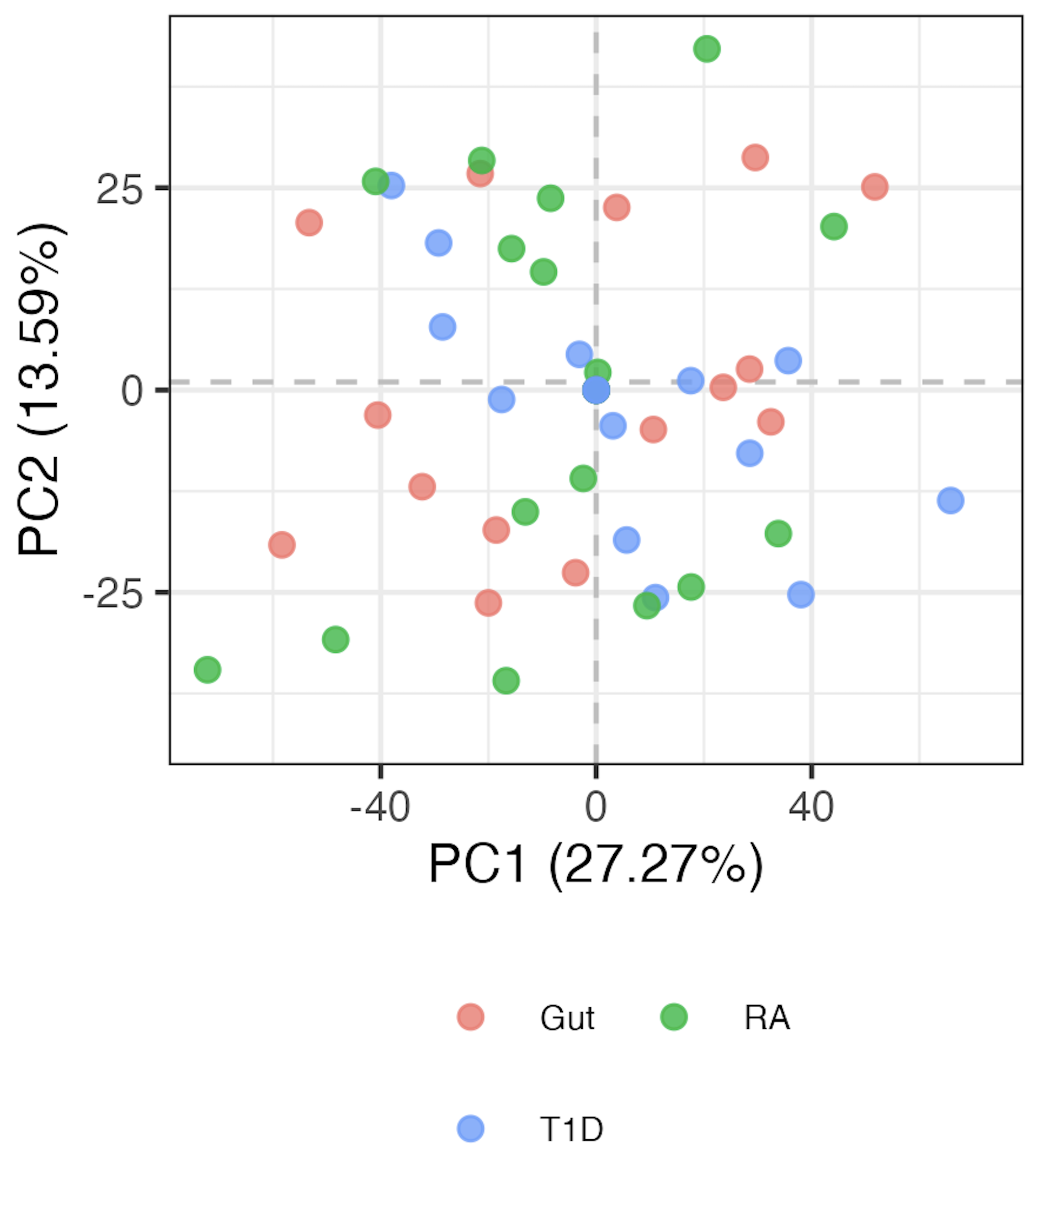
Age contributes to differences in immunotypes b/w T1D and RA groups
Only batch regressed out
Age and batch regressed out
Projecting cancer data onto this PCA doesn’t separate irAE groups
Average ages:
T1D: 42
RA: 66
Notes:
LOGIT TRANSFORMED FREQS, batch regressed out, so residuals

Slide 7
Conclusions
immune “age” similar between irAE groups (baseline)?
baseline irAE immunotypes do not appear distinct based on skin or thyroid irAEs (data not shown)
baseline cancer subtype immunotypes similar whether or not age regressed out (data not shown)
removed public MT SNVs, results don’t really change (emailed data)

Slide 8
Next steps
NCI irAE: IMPACD
follow ups from ITN
are there both CD127⁺ and CD127⁻ progenitors to more terminal DP populations? Compare CD127 expression between progenitor clusters 2 and 4 in Erin’s T1DAL analyses?
connecting MT SNV count and clonality: need sc data, but would expect less unique clonotypes in more terminal cells (by pseudotime) in HC+T1D scRNAseq/scTCRseq?
continue helping Shubham w/ figures/captions

