Slide 1
Weekly meeting
7 25 2024
Ty Bottorff

Slide 2
Outline

Slide 3
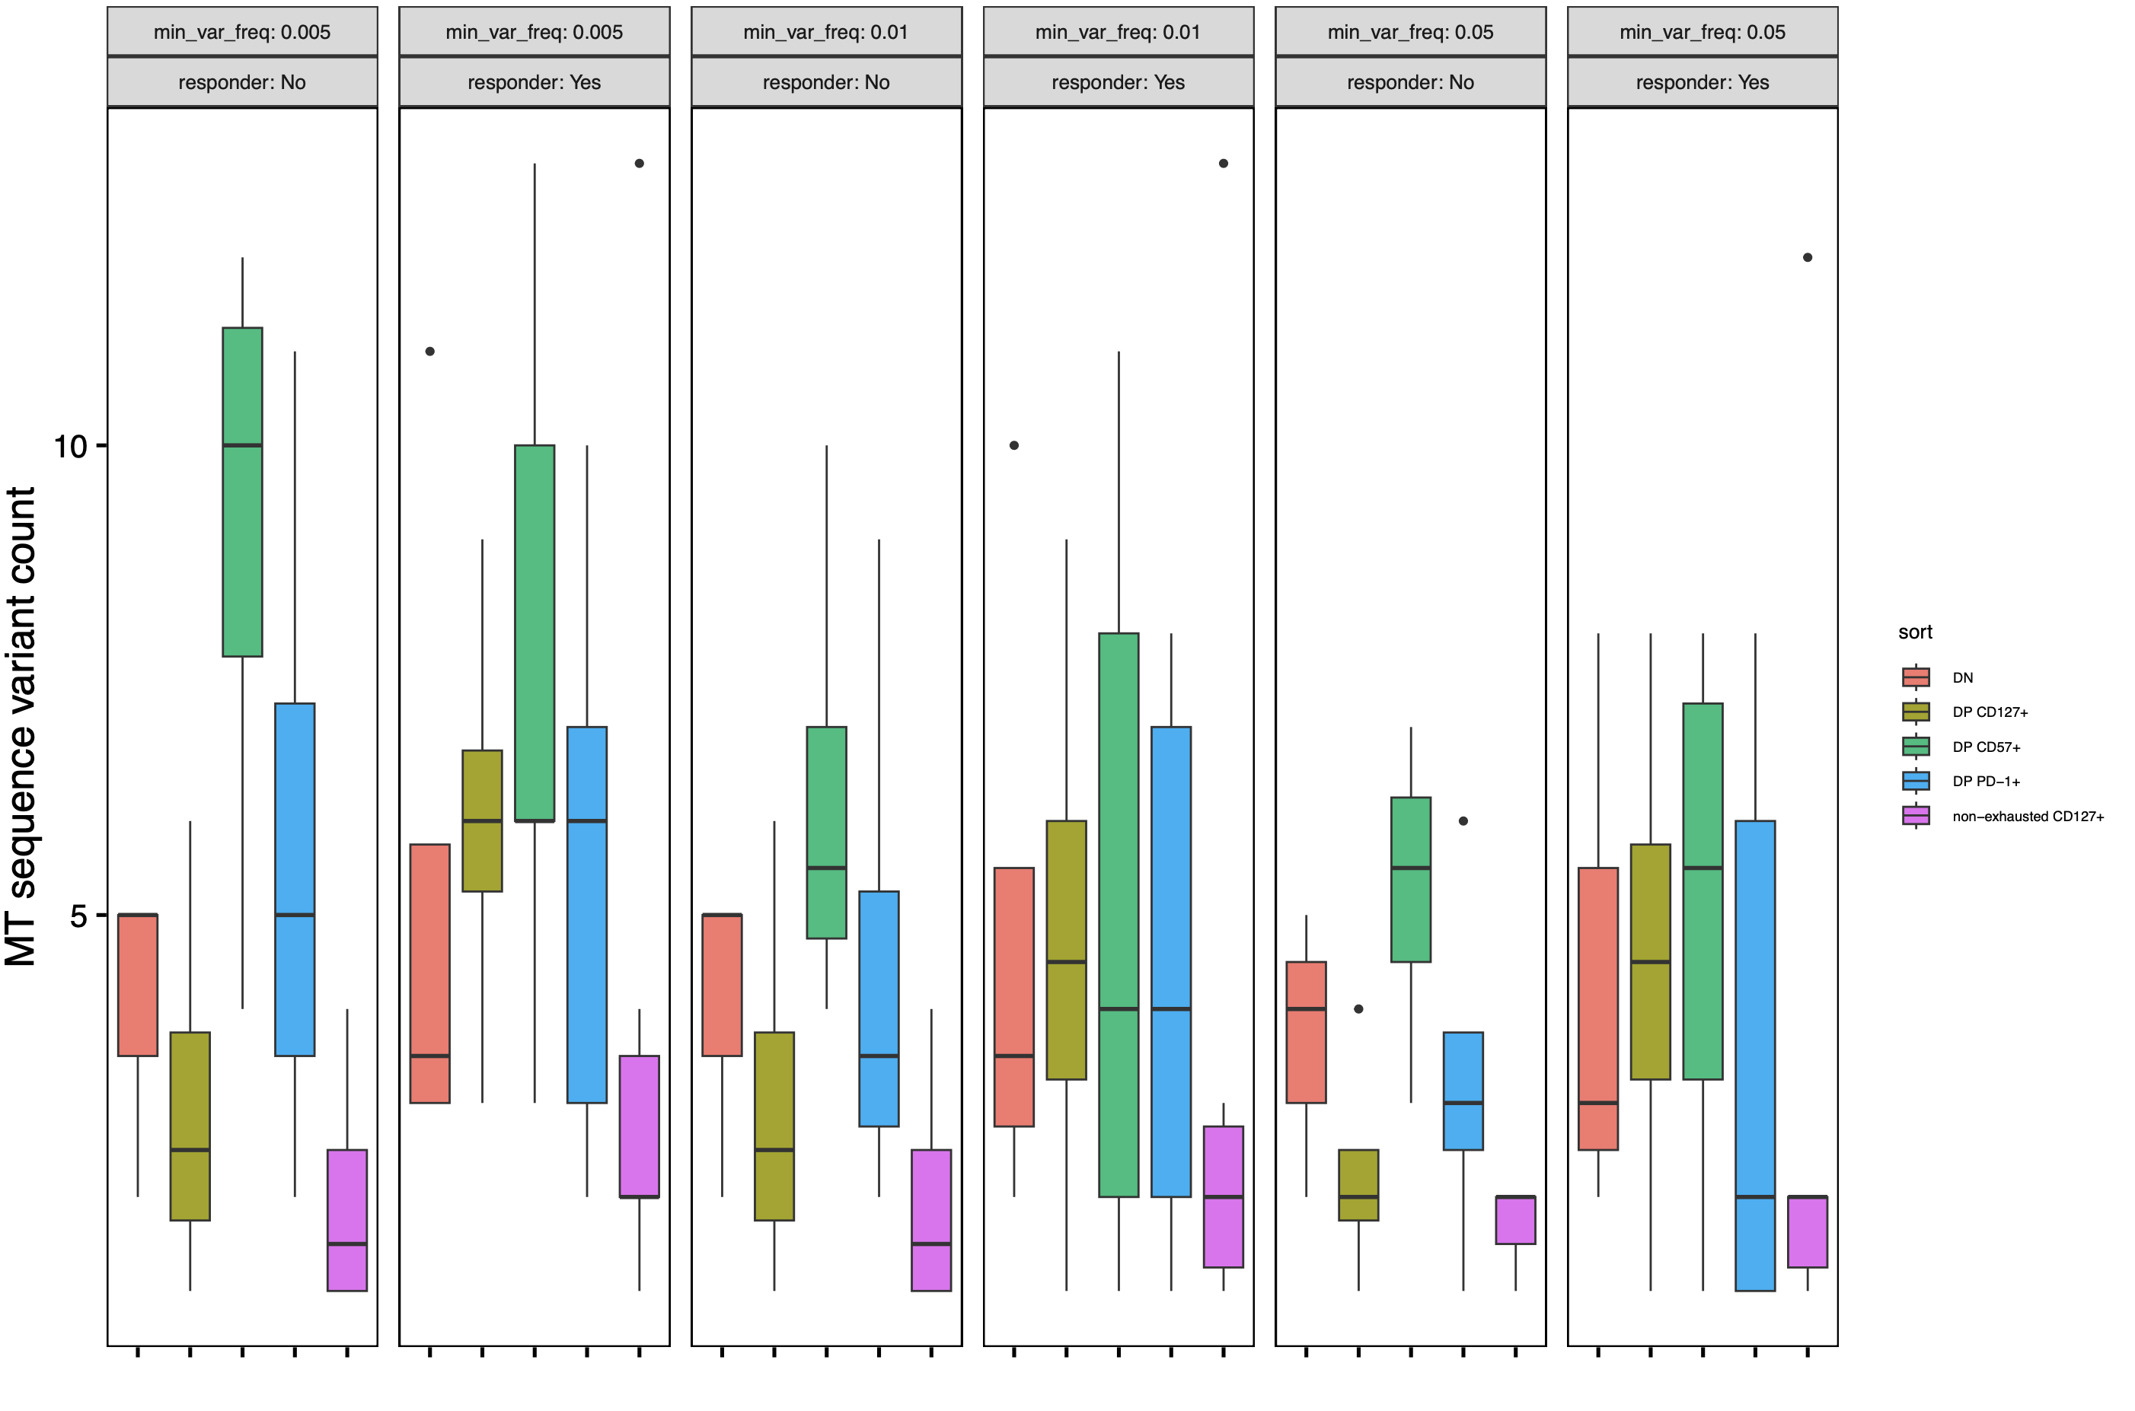
Across most min_var_freq params, see more variants in DP CD127⁺ sort and fewer variants in DP CD57⁺ in R vs. NR

Slide 4
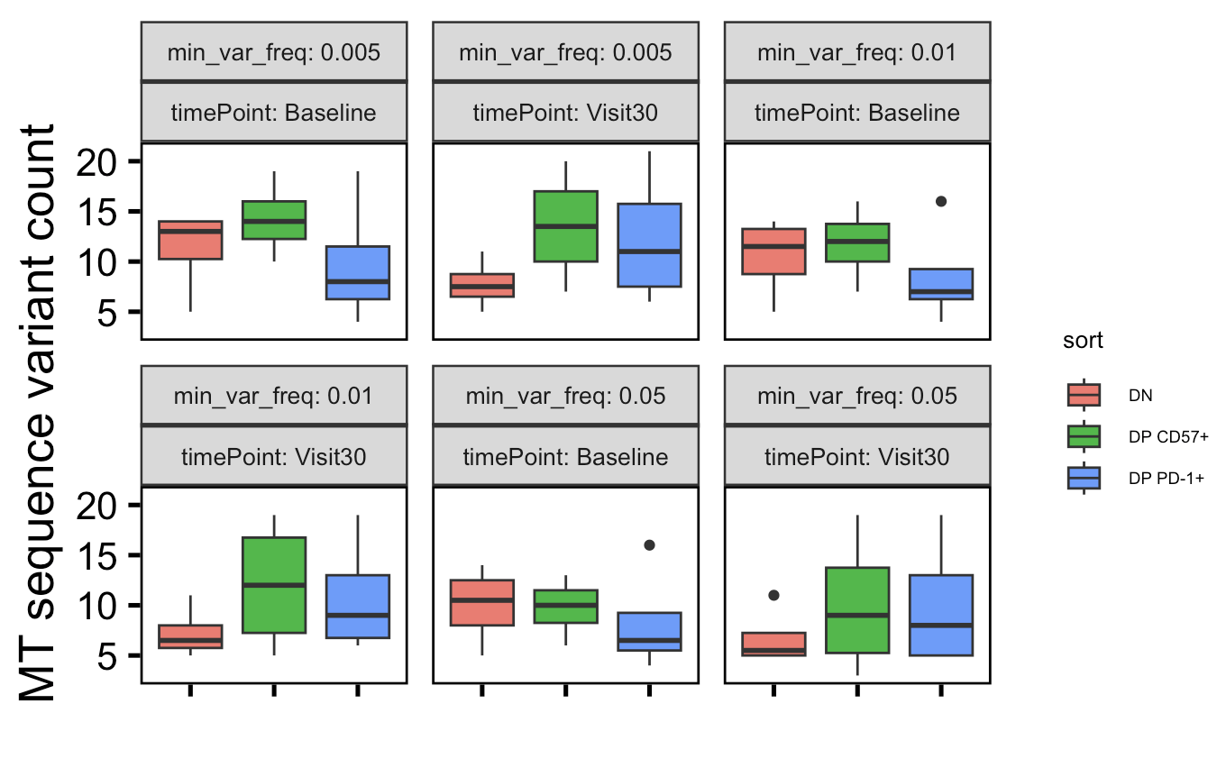
DP CD57⁺ variants already high at baseline, DP PD-1⁺ variants increase over time, DN variants decrease over time…
Notes:
Expectation from Long lab: increased vars over time in PD-1+ and maybe CD57 already high at baseline

Slide 5
Conclusions

Slide 6
Next steps

