Slide 1
Weekly meeting
12 7 2023
Ty Bottorff

Slide 2
Outline

Slide 3
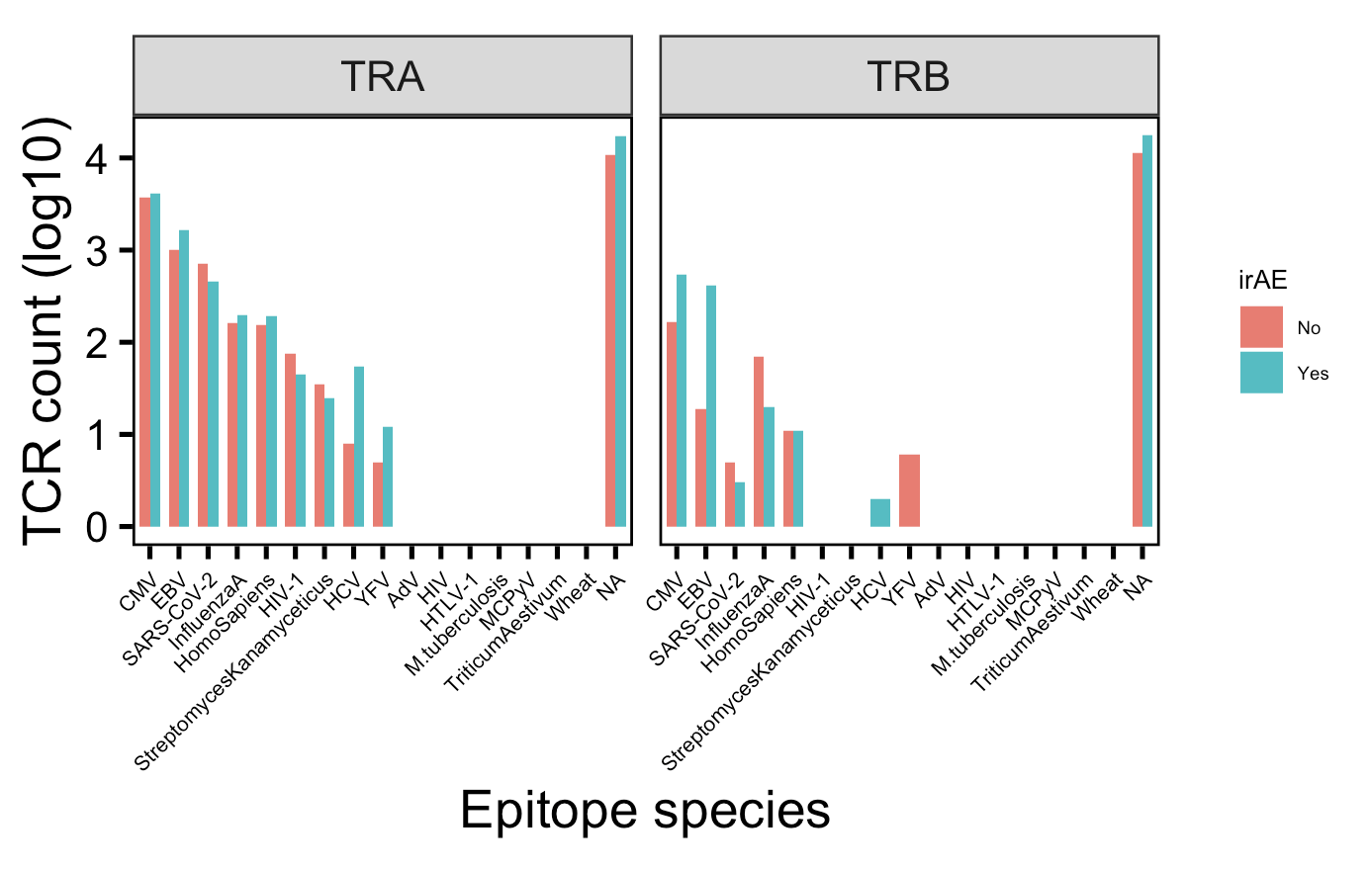
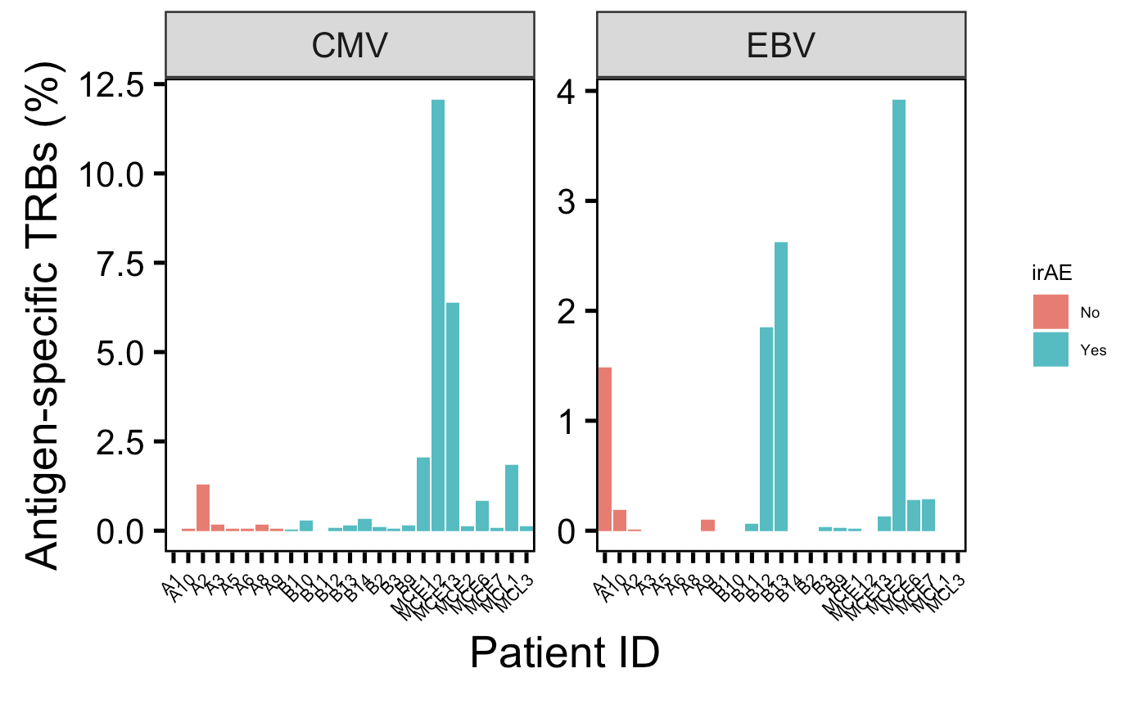
There are many more TRBs specific for CMV and EBV in those developing irAEs, mostly driven by a few patients
Notes:
Perhaps related to connection between infections before autoimmune development? Or just bystanders?
VDJdb mostly MHC class I (80k, 4k class II)

Slide 4
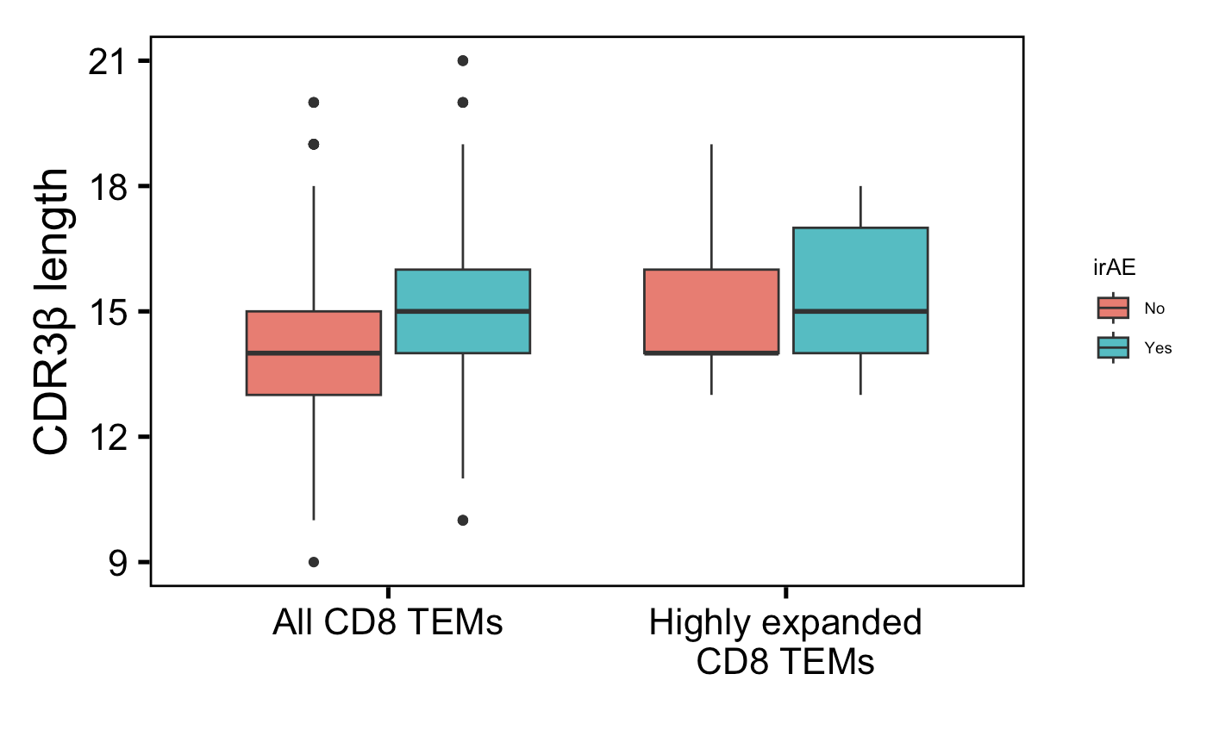
Solid conclusion #1 from myocarditis dataset: CD8 TEM CDRBs longer in those developing irAEs
**
**
n = 278
n = 816
n = 50
n = 306
Wilcoxon rank sum test. ****, p <1e-4; **, p <1e-2; *; p <0.05
Notes:
Downsampled

Slide 5
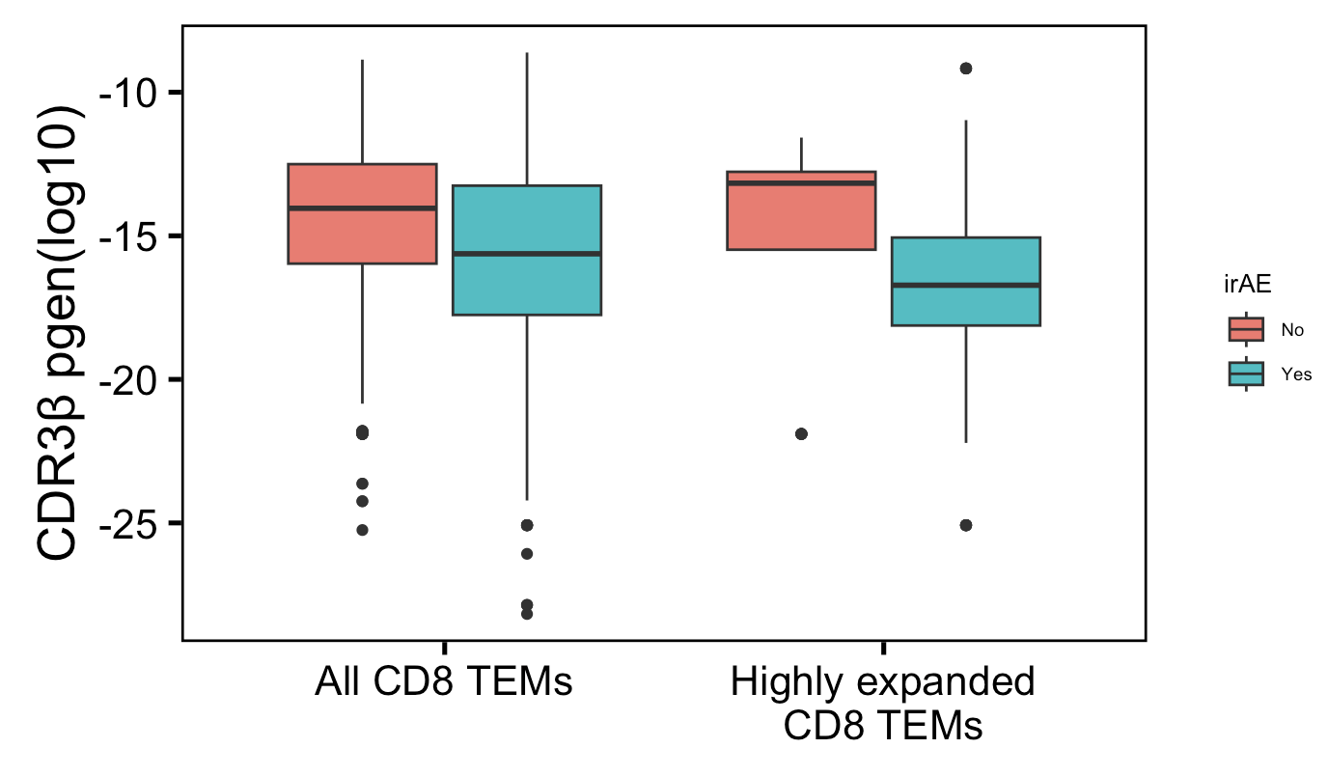
Solid conclusion #1 from myocarditis dataset: CD8 TEM TRBs less germline-like in those developing irAEs
****
****
n = 278
n = 816
n = 50
n = 306
Wilcoxon rank sum test. ****, p <1e-4; **, p <1e-2; *; p <0.05
Notes:
Downsampled

Slide 6
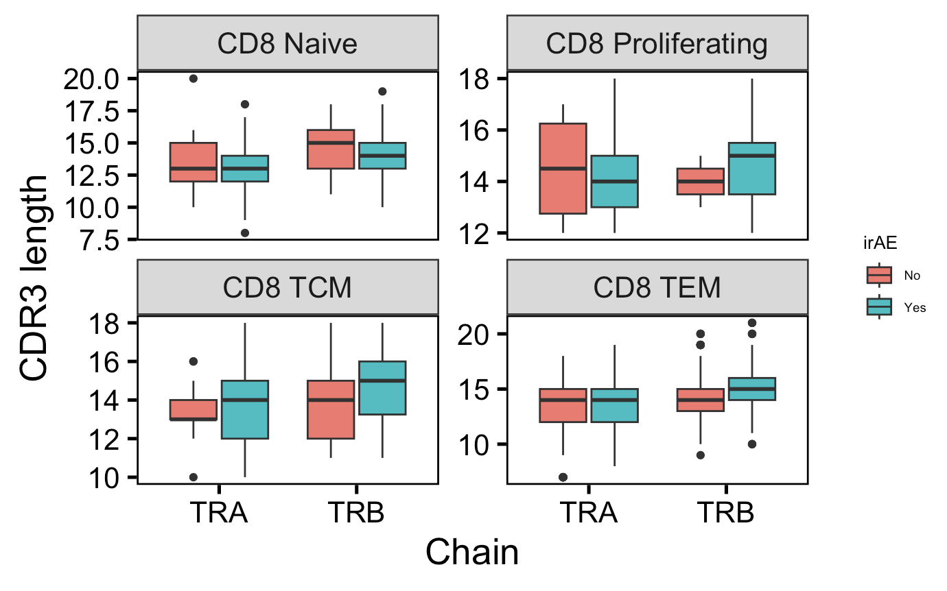
Somewhat solid conclusion #1 from myocarditis dataset: CD8 TCM CDR3Bs longer in those developing irAEs
CD8 TCM TRB pval = 0.08
n = 29
n = 46
Notes:
Downsampled

Slide 7
Unanswered questions from myocarditis dataset
Antigen specificities

Slide 8
Conclusions

Slide 9
Next steps

