Slide 1

Sampling Site sheet
Key: site_id + collection_site
Lot sheet
Key: Lot_ID
Species sheet
Key: shipment_id
Individual sheet
Key: Individual_ID
Match ID sheet
Key: species_valid_name+ site_id + match_id
Shipments only sheet
Key: Species_valid_name
Extractions sheet
Key: Extraction_ID
Key: Plate_ID
F-key: Individual_ID
Key: Shipping_ID
Key: Plate_ID
Shipping sheet
Library Info sheet
Sequence Info sheet
Key: Library_ID
Key: Sequence-run_ID
F-key: Library_ID
Library Contents sheet
Sequence Contents sheet
Key: Ex-Lib_ID
F-key: Library_ID
F-key: Extraction_ID
Key: Sequence_ID
F-key: Sequence-run_ID
F-key: Library_ID

Slide 2
Species sheet
Key: Species_valid_name
Lot sheet
Key: Lot_ID
F-key: Species_valid_name
Individual sheet
Key: Individual_ID
F-key: Lot_ID
Extractions sheet
Key: Extraction_ID
Key: Plate_ID
F-key: Individual_ID
Key: Shipping_ID
Key: Plate_ID
Shipping sheet
Library Info sheet
Sequence Info sheet
Key: Library_ID
Key: Sequence-run_ID
F-key: Library_ID
Library Contents sheet
Sequence Contents sheet
Key: Ex-Lib_ID
F-key: Library_ID
F-key: Extraction_ID
Key: Sequence_ID
F-key: Sequence-run_ID
F-key: Library_ID

Slide 3
Species sheet
Key: Species_valid_name
Lot sheet
Key: Lot_ID
F-key: Species_valid_name
Individual sheet
Key: Individual_ID
F-key: Lot_ID
Extractions sheet
Key: Extraction_ID
Key: Plate_ID
F-key: Individual_ID
Key: Shipping_ID
Key: Plate_ID
Shipping sheet
Library Info sheet
Sequence Info sheet
Key: Library_ID
F-key: Plate_ID
Key: Sequence-run_ID
F-key: Library_ID
Library Contents sheet
Sequence Contents sheet
Key: Ex-Lib_ID
F-key: Library_ID
F-key: Extraction_ID
Key: Sequence_ID
F-key: Sequence-run_ID
F-key: Ex-Lib_ID

Slide 4
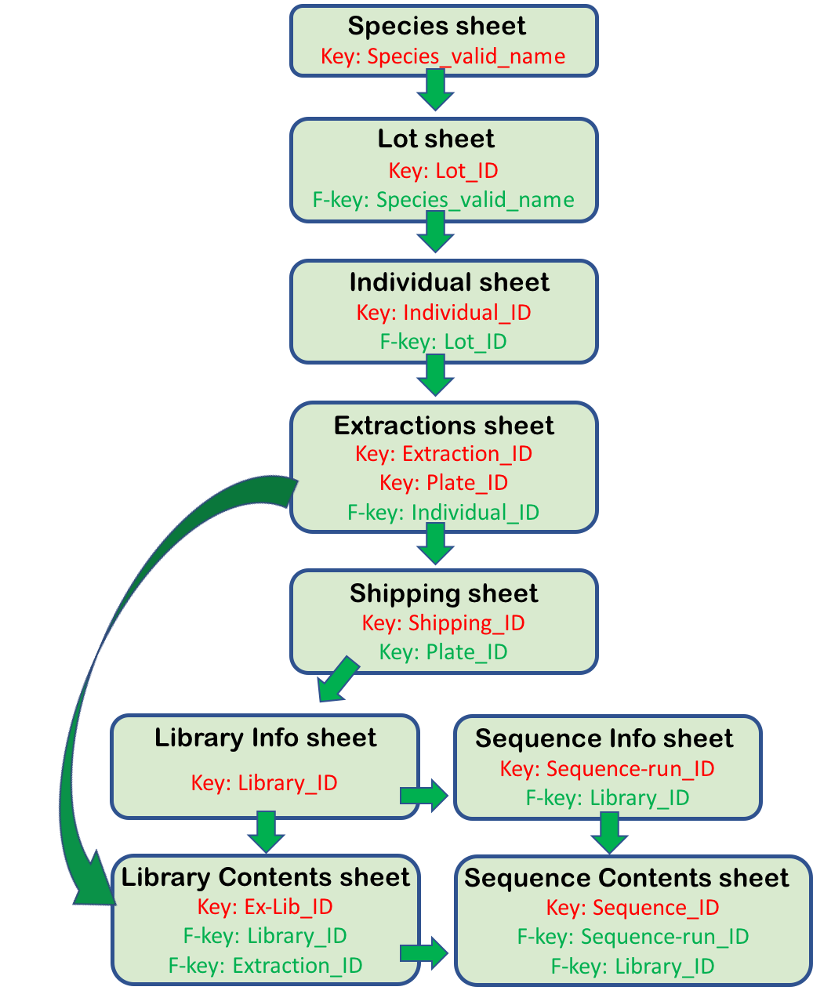
DATABASE
Figure 1. The PPP Database. Diagram showing all sheets and relationship between them. Each sheet contains a single “Primary Key” (except for Extractions_sheet) in red that is used to unique identify each record in this sheet. Sheets may also contain “Foreign Keys” in green that is/are used as a link to other sheets where the current Foreign Key appears as the Primary Key. Please refer to the README-DATABASE document for more details.
Eric Garcia Dec 19, 2019

Slide 5

DATABASE
Figure 1. The PPP Database. Diagram showing all sheets and relationship between them. Each sheet contains a single “Primary Key” (except for Extractions_sheet) in red that is used to unique identify each record in this sheet. Sheets may also contains one or more “Foreign Key(s)” in green that is/are used as a link to other sheets where the current Foreign Key appears as the Primary Key. Please refer to the README-DATABASE document for more details.
Eric Garcia Dec 19, 2019

Slide 6
DATABASE
Figure 1. The PPP Database. Diagram showing all sheets and relationship between them. Each sheet contains a single “Primary Key” in red that is used to unique identify each record in this sheet. Sheets may also contains one or more “Foreign Key(s)” in green that is/are used as a link to other sheets where the current Foreign Key appears as the Primary Key. Please refer to the README-DATABASE document for more details
Eric Garcia Dec 19, 2019

Slide 7
README - DATABASE

Slide 8
PIRE Progress Report – Collections and Extractions
Eric Garcia - Jan 23, 2019

