Slide 1
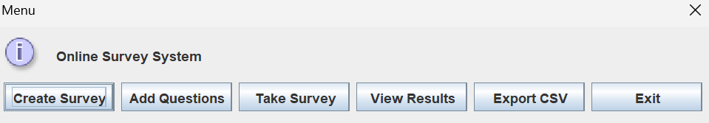
Online Survey System
A basic survey application that lets a user create a survey, add open ended questions, collect anonymous responses, view saved results, and export data to CSV.
Main menu
Create Survey
Add Questions
Take Survey
View Results
Export CSV

Slide 2
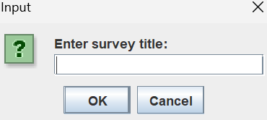
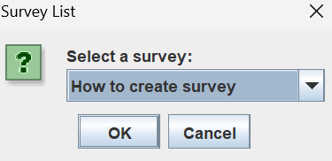
Problem, Users, and Features
Manual feedback collection is slow and hard to organize.
This system is useful for instructors, student groups, and small organizations.
The current version focuses on the most important survey tasks only.
Create Survey window
Current implemented features
Create a survey title
Add open ended questions
Take the survey anonymously
View saved responses
Export results to CSV
Survey selection window

Slide 3
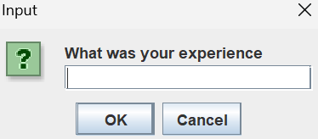
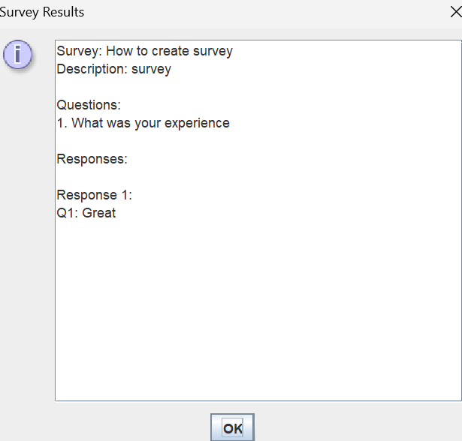
Completed Use Cases in the Demo
Use Case 1: Create a survey and save its title.
Use Case 2:
Add open ended questions to the survey.
Use Case 3:
Take the survey and submit an anonymous response.
Use Case 4:
View stored results and export them to CSV.
Response entry screen
Results window with saved answer

Slide 4
What Was Simplified to Keep Coding Basic
No login system or account management
No advanced user roles
Anonymous responses only
Only the core workflow is included in the current version
The current system uses open ended questions only
Why this helps
Easier database design
Less code to debug
More realistic final deliverable
Not yet added
Multiple choice options
Yes or no question types

Slide 5
Plan for the Rest of the Semester
Finish polishing the current survey workflow.
Improve usability and test the saved data flow.
Keep the project focused on stability instead of too many extra features.
If time allows, add multiple choice and yes or no question types after the core features are reliable.
Final goal
A clean and working Online Survey System that can create a survey, collect responses, show results, and export data.

