Slide 1
TalTech ITI8612 · Machine Learning · Final Project · 2026
Water Quality Compliance Estimator
A Probabilistic Risk Model for Estonian Open Water-Quality Data
Anton Sokolov
Supervisor: TalTech course staff
Live application:
https://h2oatlas.ee
Source: github.com/h2oatlas/water-quality-ee · Data: vtiav.sm.ee
Notes:
Hi, I'm Anton Sokolov. My final project for the Machine Learning course is a **probabilistic risk estimator for water-quality compliance** in Estonia. The data comes from Terviseamet's open XML feed; the goal is a binary classifier that decides whether a single laboratory probe matches the official health norm. The model is already in production at **h2oatlas.ee**, where it runs alongside the official label as a second opinion. I'll spend the next five minutes on data, methodology, results, and what we learned.

Slide 2
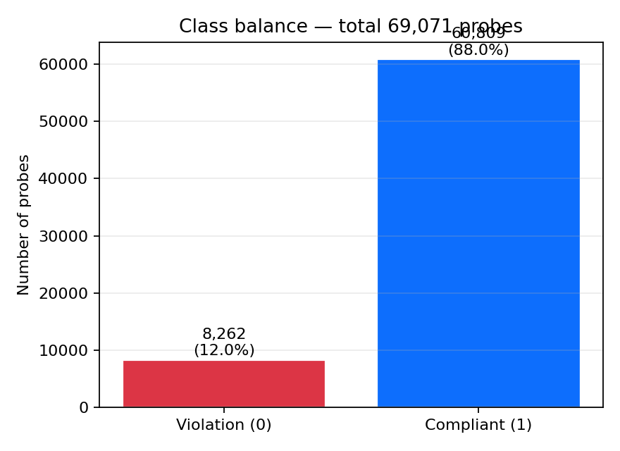
Problem & Data
Binary classification of laboratory probes against Estonian health norms
• Source: Terviseamet open data (vtiav.sm.ee), XML, 2021–2026
• 4 domains: bathing, public water-supply, pools/SPA, drinking sources
• 69 071 probes; ~70 engineered features
• Class imbalance: 86.9% compliant vs 13.1% violation
• Priority metric: Recall on class 0 (violation)
• False negative ≫ False positive (E. coli, microbial risk)
Water Quality Compliance Estimator · TalTech ITI8612 · h2oatlas.ee
2 / 7
Notes:
We pulled probes from four domains — bathing waters, public water-supply, swimming pools and SPAs, and drinking-water sources — for the years 2021 to 2026. After cleaning and de-duplication we have just over **69 000 probes**. The class balance is heavily skewed: about **87% pass, 13% violate**. The priority metric for us is **recall on the violation class**: a false negative means we tell the user "the water is fine" when in fact it is not, which is a much worse failure than a false alarm. One subtle data issue worth noting: Terviseamet renames the same physical site between yearly XML files, so we introduced a normalised `location_key` to avoid double-counting.

Slide 3
Methodology
Pipeline · feature engineering · 4 models · calibration · threshold tuning
XML load+parse
data_loader.py
Dedup location_key
normalize_location()
Feature engineering
ratio + time + missing
Split 80/20 + TS-CV
stratified + temporal
Models LR · RF · GB · LightGBM
class_weight balanced
Calibrate + threshold
isotonic + PR tuning
→
→
→
→
→
Key choices
• No SMOTE — keeps probability calibration interpretable
• Threshold optimised for Recall(viol.) at Precision ≥ 0.7
• County encoding is fit on train only (no leakage)
• Time-Series CV (n=5) confirms metrics survive temporal drift
Water Quality Compliance Estimator · TalTech ITI8612 · h2oatlas.ee
3 / 7
Notes:
The pipeline is six numbered notebooks. Feature engineering produces 70 columns: raw measurements, ratio-to-norm features, missing-value indicators, month and season, plus one-hot domain and county — fitted on train only to avoid leakage. We compared four classifiers: Logistic Regression as a baseline, Random Forest, Gradient Boosting, and LightGBM. We deliberately did **not** use SMOTE; instead we relied on `class_weight="balanced"` and threshold tuning on the precision-recall curve, which keeps the calibrated probabilities meaningful. We validated both with a random 80/20 split and a five-fold time-series cross-validation, and the metrics agreed within a few points, so the model isn't simply memorising the calendar year.

Slide 4
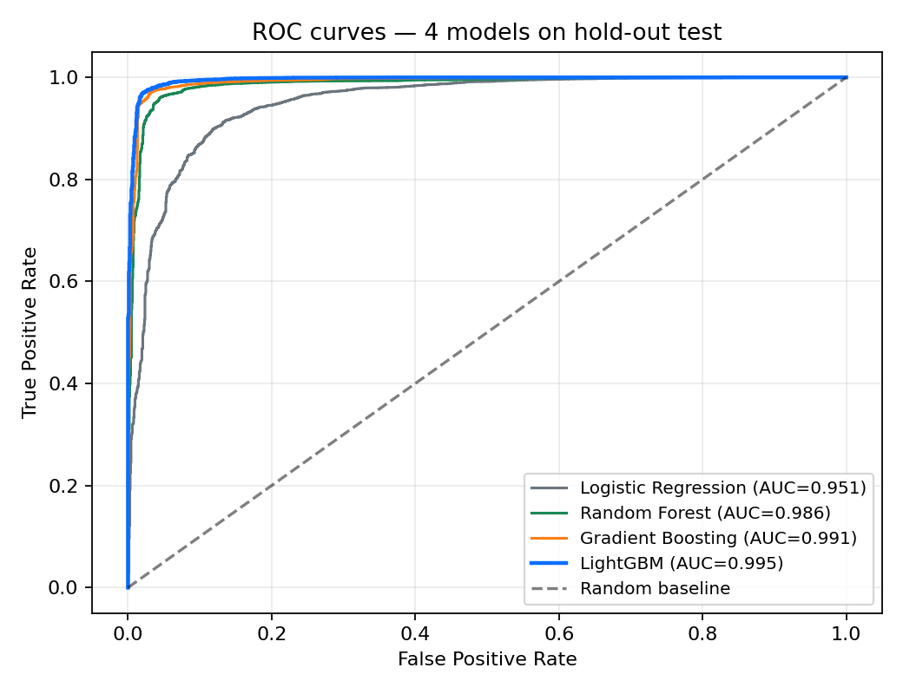
Results — Model Comparison
Hold-out test set (13 815 probes) · class-0 priority
Model | ROC-AUC | Recall (viol.) | Precision (viol.) | F1 (viol.)
Logistic Regression | 0.951 | 0.866 | 0.576 | 0.692
Random Forest | 0.986 | 0.921 | 0.845 | 0.881
Gradient Boosting | 0.992 | 0.962 | 0.834 | 0.893
LightGBM | 0.995 | 0.951 | 0.900 | 0.925
LightGBM — best AUC + best F1
• Recall 0.95 / Precision 0.90 at default threshold
• Threshold can slide along the PR curve at inference time
• GB reaches 0.96 recall at lower precision — alternative
Water Quality Compliance Estimator · TalTech ITI8612 · h2oatlas.ee
4 / 7
Notes:
LightGBM came out on top: ROC-AUC of **0.995**, F1 on the violation class of **0.92**. Recall at the default threshold is 0.95; if we tighten the threshold, Gradient Boosting is competitive and even gives a slightly higher recall, but at lower precision. The honest reading is that **LightGBM gives the best precision–recall trade-off**, and the threshold lets us slide along that curve without retraining. The Logistic Regression baseline is far below — that gap shows the problem really does benefit from non-linear models and feature interactions.

Slide 5
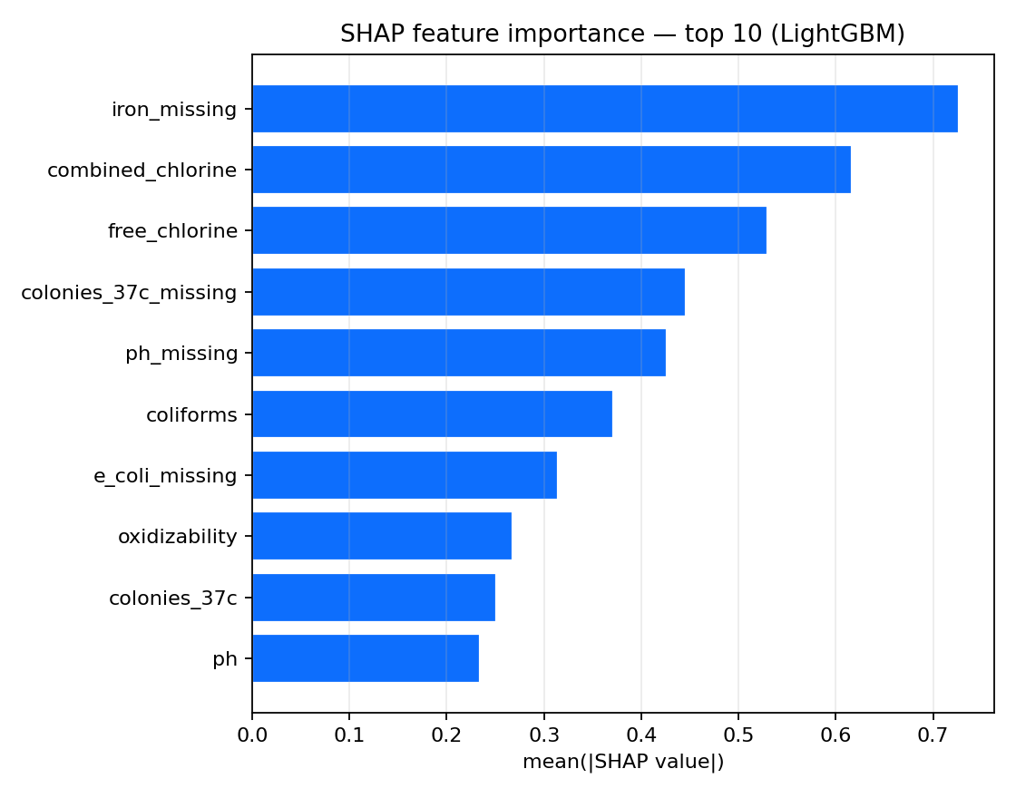
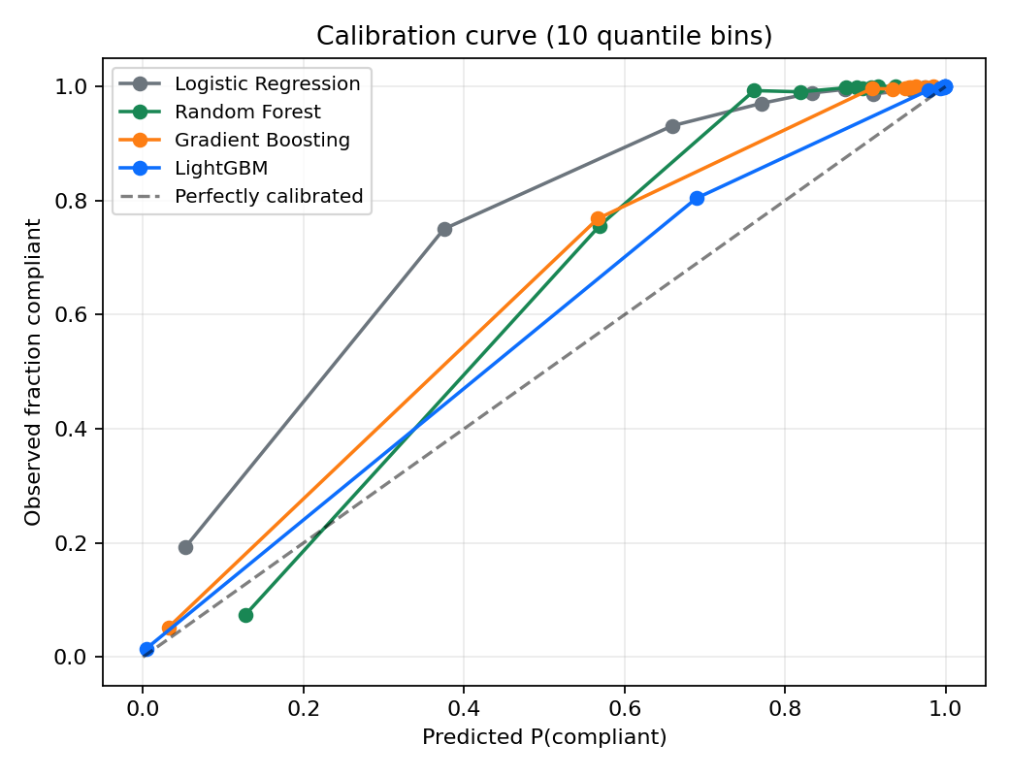
Interpretation — SHAP & Calibration
What drives the prediction · how trustworthy are the probabilities
• Top-5: iron_missing · combined_chlorine · free_chlorine · colonies_37c_missing · ph_missing
• Missing-value indicators encode probe type → baseline risk
• All 4 models track the ideal diagonal closely — probabilities are trustworthy
Water Quality Compliance Estimator · TalTech ITI8612 · h2oatlas.ee
5 / 7
Notes:
SHAP analysis on a 800-sample slice ranks **iron-missing, combined chlorine, free chlorine, colonies-at-37C-missing, and pH-missing** as the top five drivers. The headline here is that the **missing-value indicators dominate**. That sounds counter-intuitive, but it isn't: which parameters are measured at all tells the model a lot about the *type* of probe — pool chemistry, drinking water, or open bathing water — and that type carries a different baseline risk. Raw chemistry features like coliforms, pH, and oxidisability follow. The right-hand calibration plot shows that all four models track the ideal diagonal closely, so the predicted probabilities are trustworthy enough to expose on the public map.

Slide 6
Limitations & Production
What the model can't do · how it ships to citizens
Three honest limitations
• Target = function of input → AUC > 0.99 reflects task structure
• Model does not measure unmeasured contaminants
• Phase-10 audit: 3.1% probes labelled violation with all params in norm
• Pool chlorine norms were wrong — fix lifted agreement +9 pp
[ insert h2oatlas.ee screenshot ]
save as submission/figures/h2oatlas_screenshot.png
Production: h2oatlas.ee
2 196 locations · 2 layers (official + model risk) · 3 languages · disclaimer that the service does not replace official assessment.
Water Quality Compliance Estimator · TalTech ITI8612 · h2oatlas.ee
6 / 7
Notes:
Three honest limitations. **First**, the target label is largely a function of the same input parameters, so an AUC above 0.99 partly reflects the **structure of the task**, not a unique prediction ability. **Second**, our Phase-10 audit found about 3% of probes where the official verdict is "violation" but no published parameter exceeds the norm — there is data we don't see. **Third**, while validating, we found that our pool-water chlorine norms were wrong; correcting them lifted the model's agreement with the official label by 9 points. The production map at h2oatlas.ee carries this disclaimer prominently: it does not replace official assessment.

Slide 7
Lessons Learned
Direct response to the supervisor's note: scope, data quality, imbalance
"Data processing, handling imbalanced classes, and comparing multiple models may take more time than originally expected."
— supervisor feedback
1. Progressive scope
Started with 2 domains (supluskoha + veevärk). Expanded to 4 only after the pipeline stabilised.
2. Data-quality audit (Phase 10)
Added only after the first model surprised us — caught a real bug in pool chlorine norms (+9 pp agreement).
3. Imbalance handling
class_weight='balanced' + threshold tuning, NOT SMOTE — keeps probabilities calibrated and interpretable on the public map.
Thank you — questions welcome.
Water Quality Compliance Estimator · TalTech ITI8612 · h2oatlas.ee
7 / 7
Notes:
Our supervisor warned us that data work, class imbalance, and multi-model comparison would take longer than we'd planned. He was right. Three things we'd do exactly the same again. **One**, we scoped progressively — two domains first, four only after the pipeline stabilised. **Two**, we added a data-quality audit phase only after the first model surprised us — and that audit caught real bugs. **Three**, we kept the imbalance handling conservative: weights and thresholds, not synthetic oversampling, so the calibrated probabilities you see on the map actually mean what they say. Thank you — happy to take questions.

