Slide 1
HW3 Sharing
ANTSlab 資管碩二 陳廷易 r06725035

Slide 2
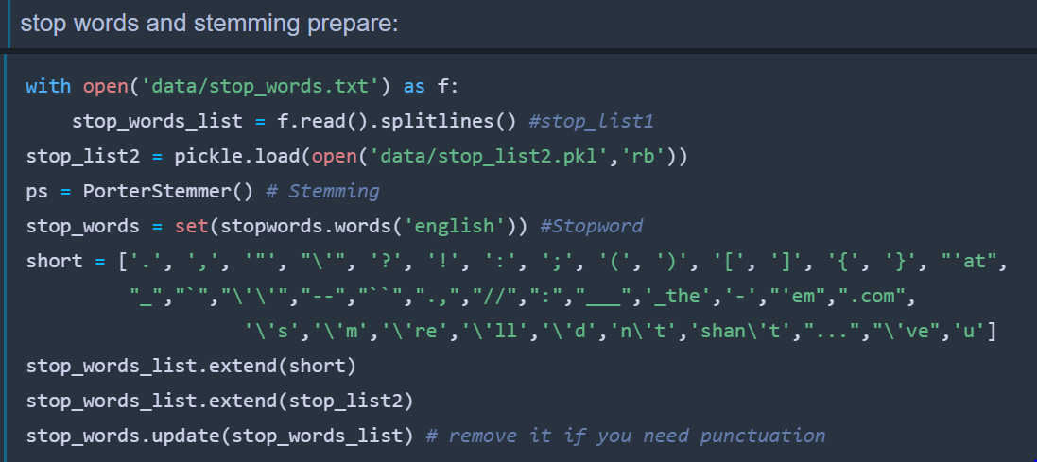
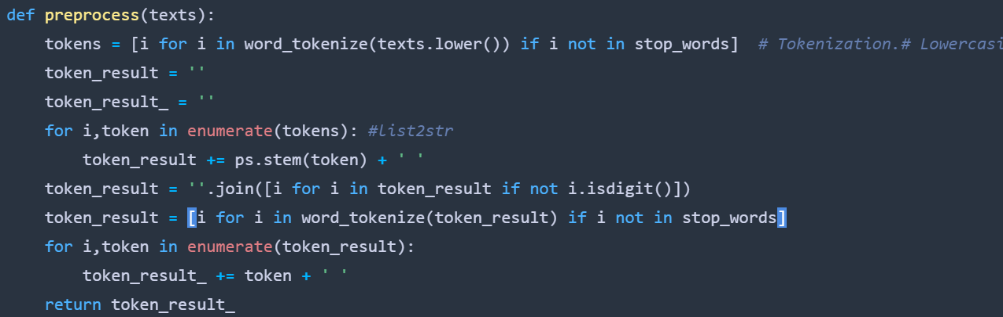
Preprocessing
Convert to lower case
Porter stemming
Filter out numbers, symbols and stop words

Slide 3
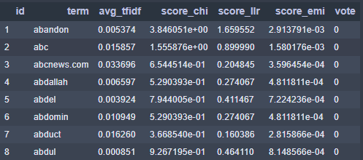

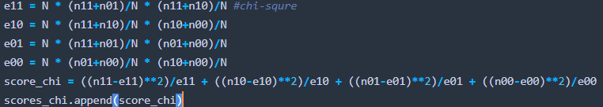
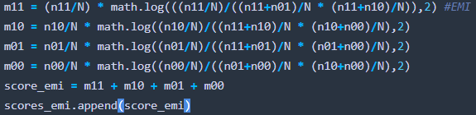
Feature Selection
Likelihood Ratios
Chi-Square
Expected Mutual Information
Average score of each class
Average TF-IDF scores of terms across documents
Notes:
LLR跟EMI表現很像
希望可以有鑑別力

Slide 4
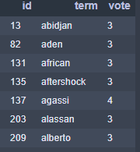

Select 500 terms for models
Calculate every score’s mean and standard deviation
Pick different threshold of each score
Voting: make term dictionary size under 500

Slide 5
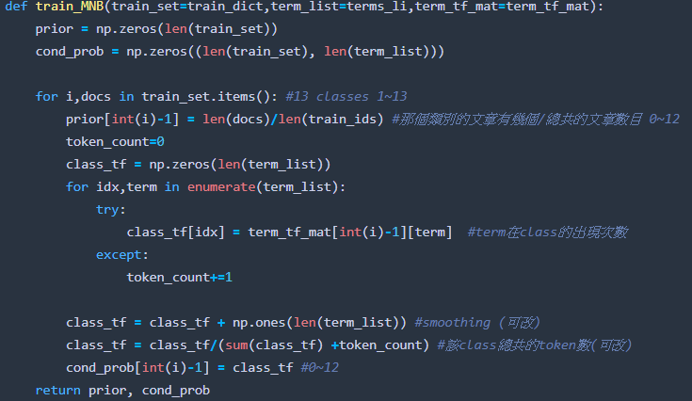
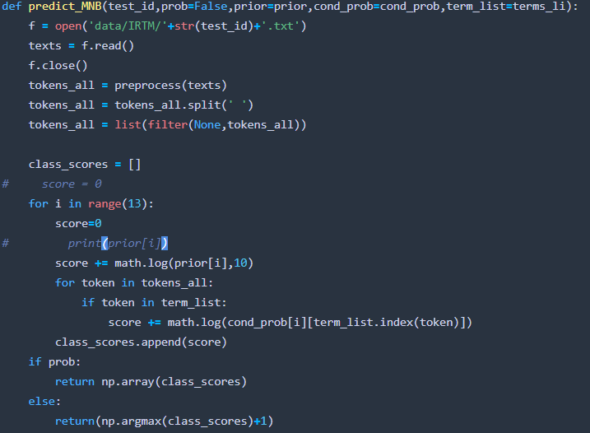
Multinomial Naïve Bayes Classifier

Slide 6
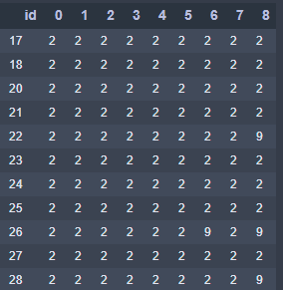
Models Voting
Final result

