Slide 1
Radar image reconstruction with raw ADC data
TingYing Chu

Slide 2
Outline
Radar data processing
Literature review
Possible future works
Timetable

Slide 3
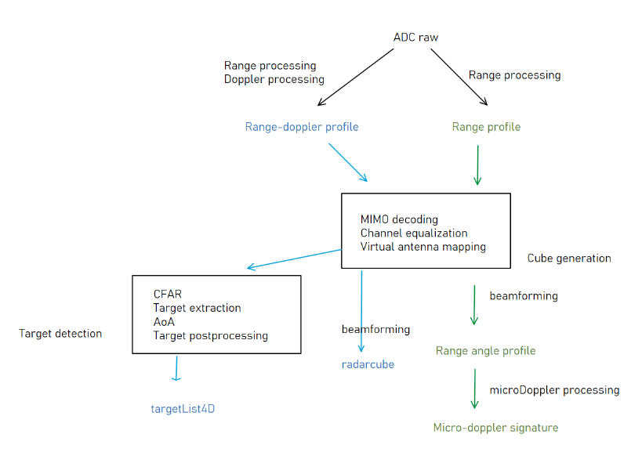
Radar data processing
processing steps
Data processing pipeline
Input: ADC raw signal (4D)
Output: Object detection information
Range
Doppler
Azimuth
elevation
py-core code
Understanding the code with the pipeline
Ran the code on PC
Still setting the environment to run the code on the server

Slide 4
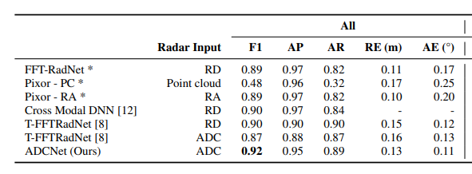
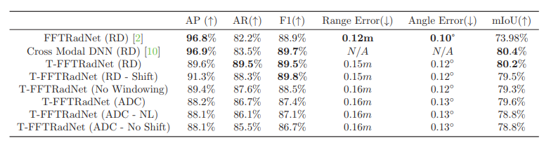
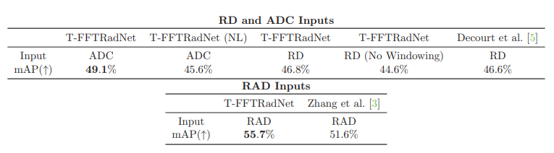
Literature review
End-to-end model with raw ADC radar data
ADCNet experiment on HD radar data
Models
ADCNet (2023):
Outperform T-FFTRadNet
Better performance on High Definition (HD) radar
T-FFTRadNet (2023)
Better performance on Low Definition (LD) radar
Public raw ADC Dataset (road)
RADIal: HD radar data; Currently unavailable
RADDet: LD radar data
T-FFTRadNet experiment on HD radar data
T-FFTRadNet experiment on LD radar data

Slide 5
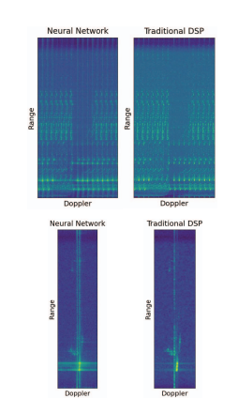
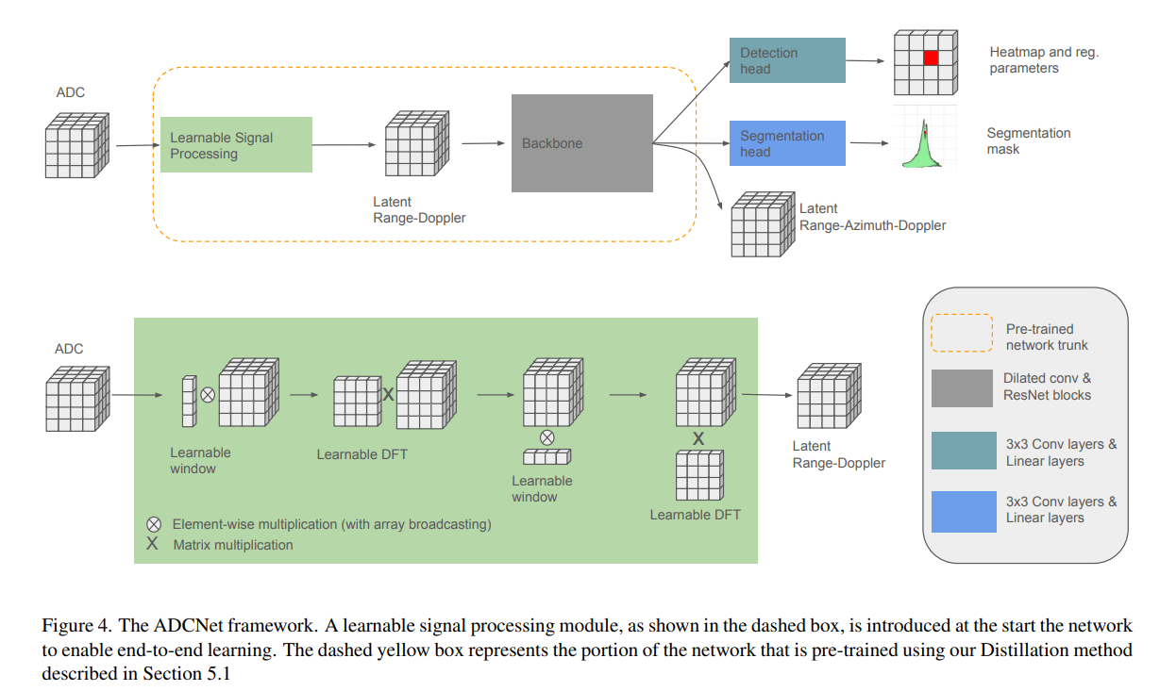
Possible future works
Based on ADCNet
Idea: Utilizing the technique of pre-training ADC to RAD via distillation
Use our py-core to create RAD cube
ADCNet use SDK algorithm for estimating AoA
The paper mentioned that future work is having advanced algorithm (such as IAA, MUSIC)
Possible direction
First, apply ADCNet on our dataset
Second, adjust the model via changing the algorithm for creating RAD cube
Third, try different backbone model

Slide 6
Timetable
Gantt chart
Task | April |  |  |  | May |  |  |  | June |  |  |  | July |  |  |  | August |  |  |  | September |  |  |  | October
Understanding py-core code and data processing pipeline; Testing code with imec server
Literature review and problem definition
Data collection
Model selection and implementation
Evaluation and Fine-tuning
Visualization and interpretability
Thesis writing

Slide 7
Appendix
Radar data pre-processing

Slide 8
Radar data pre-processing
Cube generation
Raw ADC
Range processing
Applies an FFT over the sampling (4th ) dimension
Doppler processing
Applies a 2nd FFT on the chirp loop (1st ) dimension
MIMO decoding & Equalization
Antenna mapping
Map the physical to virtual
Beamforming
applying FFT over the vertical and horizontal antenna dimensions, one can get elevation (vertical angle) and azimuth (horizontal angle)
Chirp dimension
Transmit antenna dimension
Receive antenna dimension
Sampling dimension
Velocity dimension
Transmit antenna dimension
Receive antenna dimension
Range dimension
Range processing
Antenna mapping
Chirp dimension
Transmit antenna dimension
Receive antenna dimension
Range dimension
Velocity dimension
Vertical antenna dimension
Horizontal antenna dimension
Range dimension
Beamforming
Doppler processing
Velocity dimension
Elevation dimension
Azimuth antenna dimension
Range dimension

Slide 9
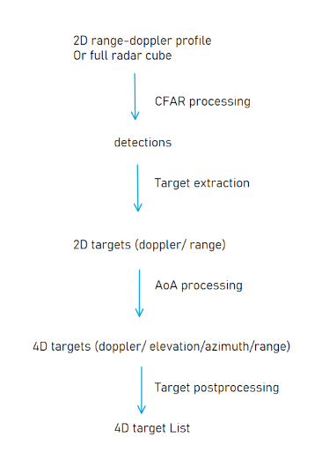
Radar data pre-processing
Target detection steps
CFAR processing
Detect targets in radar data cube (with threshold)
(2D) target extraction
Grouped detections with a multi-dimensional centroiding algorithm
AoA processing
Azimuth and elevation estimations for targets (using techniques, MUSIC algorithm, that more accurate than FFT)
(4D) target post-processing
Single-target: reject weakest targets and keep the most prominent target
Multiple-target: group detected targets based on distance
Multi-target tracking
Estimate the tracks of the targets

Slide 10
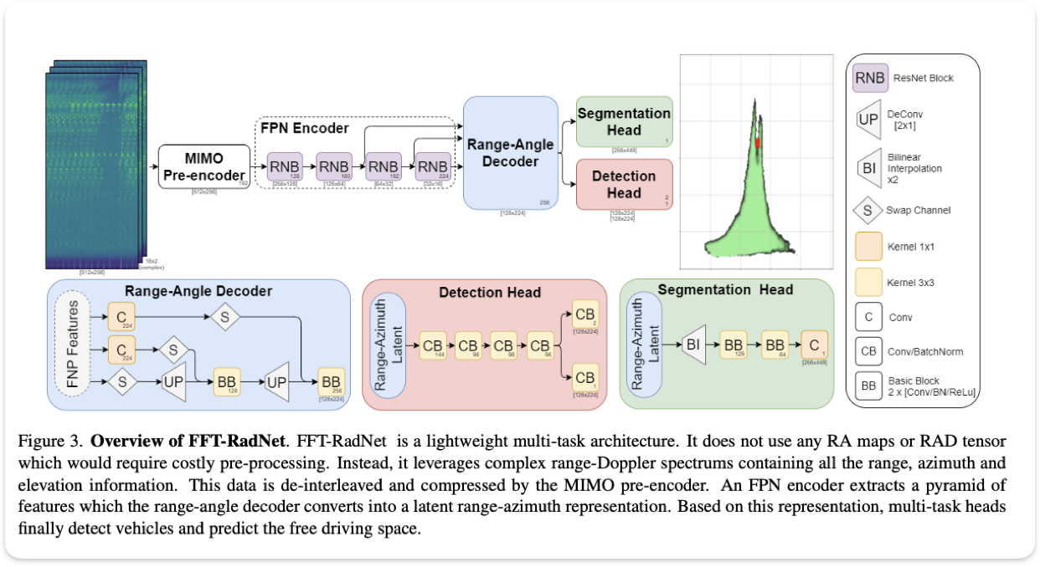
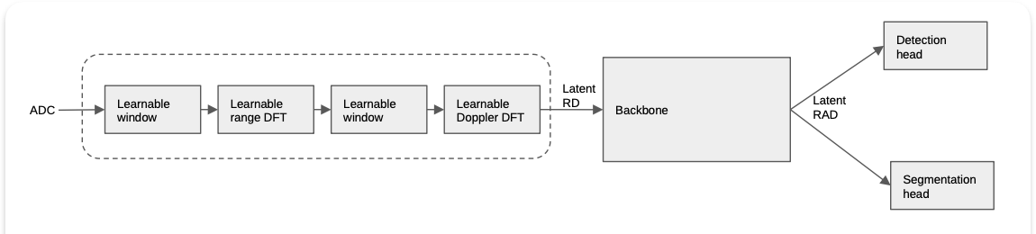
Deep Learning Model
ADCNet: End-to-end perception with raw radar ADC data
FFT-RadNet
Structure: MIMO pre-encoder+ encoder-decoder
ADCNet
Structure: trainable DSP module (as pre-encoder) + encoder-decoder (FFT-RadNet)
Loss function
Detection head: focal loss + smooth L1 loss
Segmentation head: Binary cross-entropy loss
FFT-RadNet architecture
ADCNet architecture

Slide 11
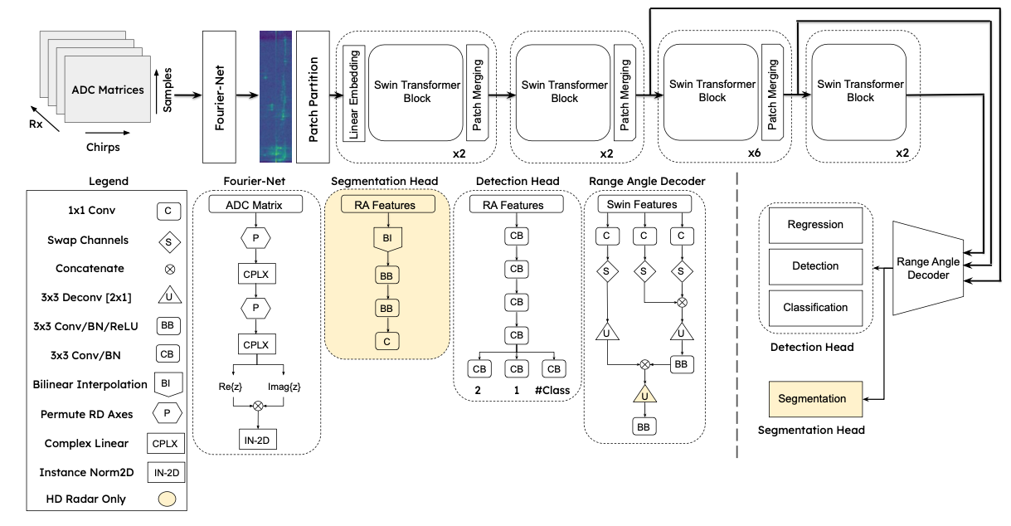
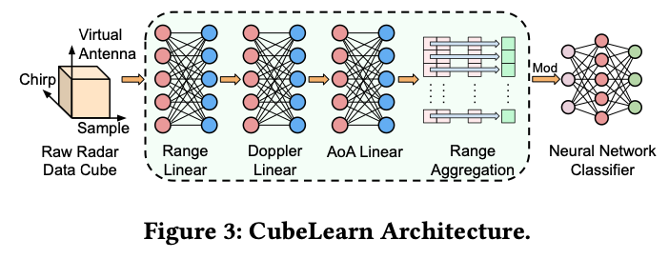
Deep Learning Model
T-FFTRadNet: Object Detection with Swin Transformers from Raw ADC Radar Signals
FFT-RadNet
Structure: MIMO pre-encoder+ encoder-decoder
T-FFTRadNet
Structure: transformation layer (as pre-encoder) + hierarchical Swin Transformer (as encoder) + encoder (FFT-RadNet)
Loss function
Detection head: focal loss + smooth L1 loss
Segmentation head: Binary cross-entropy loss
T-FFTRadNet: Detection head (LD Radar): focal loss + smooth L1 loss + pixel-wise cross-entropy loss
FFT-RadNet architecture
T-FFTRadNet architecture
Transformation layer

