Slide 1
FFT-RadNet vs. conventional data preprocessing
TingYing Chu

Slide 2
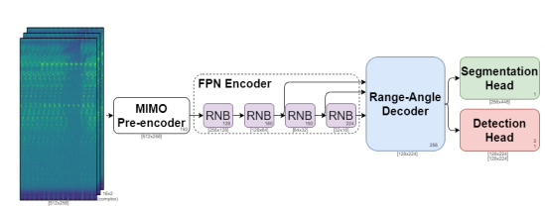
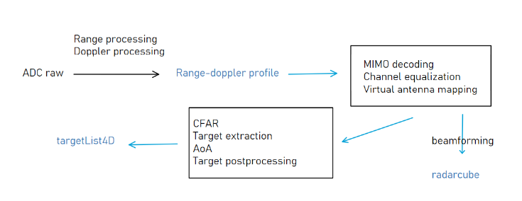
FFT-RadNet
RD cube
Model structure
MIMO Pre-encoder:
Reorganizing and compressing the RD cube
Feature Pyramidal Network (FPN) encoder:
Feature extraction
Range-Angle decoder:
Building a range-azimuth latent representation
Detection head:
Localizing vehicles in range-azimuth coordinates
Predicting range and azimuth values
Segmentation head:
Predicting the free driving space

Slide 3
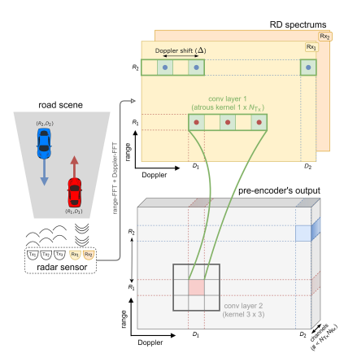
FFT-RadNet
MIMO pre-encoder
MIMO pre-encoder
Performs reorganization of the input tensor (range-doppler profile)
The pre-encoder organize and compress signatures in fewer than NTx·NRx output channels
First layer: A convolution layer (gathering Tx and Rx information)
Second layer: Second convolution layer (learns how to combine these channels and compresses the signal)
The role of the MIMO pre-encoder is to transform RD spectrum into a representation that is compact and still allows the prediction of azimuth angles along with other information
Notes:
For each receiver, its signature will be visible NTx times, one per transmitter. More specifically,
First layer: first a suitably-defined Atrous convolution layer that gathers Tx and Rx information at the right positions.
Second layer: A second convolution layer, with a 3×3 kernel, learns how to combine these channels and compresses the signal.

Slide 4
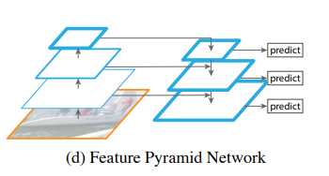
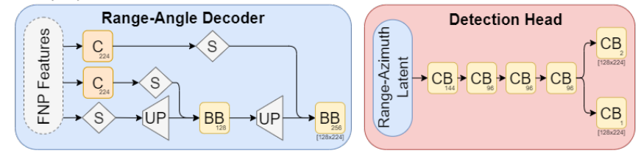
FFT-RadNet
FPN Encoder & Range-Angle decoder
FPN encoder
Using a pyramidal structure to learn multi-scale features
The role of FPN encoder is to extract feature maps from processed RD spectrum
Range-angle decoder
Aims to expand the input feature maps to higher resolution representations
This expansion is achieved through multiple deconvolution layers (output is combined with previous feature maps to preserve spatial details)
The role of range-angle decoder is to output RA latent representation
Output from 2nd ResNet Block
Output from 3rd ResNet Block
Notes:
Our FPN architecture uses 4 blocks composed of 3, 6, 6 and 3 residual layers [14] respectively
The channel dimensions are in fact chosen to encode at best the azimuth angle over the entire distance range (i.e., high resolution and narrow field of view at far range, low resolution and wider field of view at near range).
High resolution and narrow field of view at far range: At far distances, where objects are relatively distant from the radar sensor, it's crucial to have high resolution to accurately detect and distinguish objects, especially when the angular difference between objects may be small. Additionally, a narrow field of view helps focus the radar beam, allowing for more precise measurements over longer distances.
Low resolution and wider field of view at near range: Conversely, at closer distances, where objects are nearer to the radar sensor, the angular difference between objects tends to be larger. In this case, a wider field of view can cover a larger area, enabling the radar to capture more objects within its range. However, since objects are closer, the resolution requirements may not be as stringent as at far ranges.

Slide 5
FFT-RadNet
Detection Head
Detection Head
Classification pathways: predict the probability each “pixel” (range-azimuth coordinates) as occupied or not by a vehicle
Regression pathways: finely predicts the range and azimuth values corresponding to the detected object
Segmentation Head
Classification : predict the probability each “pixel” to be drivable
Notes:
The deconvolution layers upscale only the range axis, producing feature maps that are concatenated with those from the previous pyramid level. A final block of two Conv-BatchNorm-ReLU layers is applied, generating the final range-azimuth latent representation.

Slide 6
FFT-RadNet
model implementation
Original dataset: RADIal dataset (currently not available, requesting data from authors)
Current solution: Using our MATLAB code (MATLAB-RADAR-AUTOMOTIVE) to simulate the input data
Input data
Creating targets
Using targets to generate data
Take the RD cube before data going into MIMO processing
Output data
Using targets to calculate the ground truth (labels)
Questions for input data:
The input tensor dimension is 512*256,*32 (BR, BD, 2*NRx)
Notes:
Study the code for understanding the dimension of the input and output data
The author pre-processed their labels data, need to check how to match with our ground truth

Slide 7
Next steps
model implementation
This week:
Finish generating input and output data, matching with the model dimension and the paper explanation
Input: Match the dimension and the structure of RD cube
Output: Implement labels pre-processing
Nest week:
Training and evaluating the model with our simulation dataset
Compare the result with paper
Notes:
Study the code for understanding the dimension of the input and output data
The author pre-processed their labels data, need to check how to match with our ground truth

Slide 8
Timetable
Gantt chart
Task | April |  |  |  | May |  |  |  | June |  |  |  | July |  |  |  | August |  |  |  | September |  |  |  | October
Understanding py-core code and data processing pipeline; Testing code with imec server
FFT-RadNet implementation
Data preparation
Literature review
Model selection and implementation
Evaluation and Fine-tuning
Visualization and interpretability
Thesis writing

Slide 9
Appendix
ADCNet & FFTRadNet

Slide 10
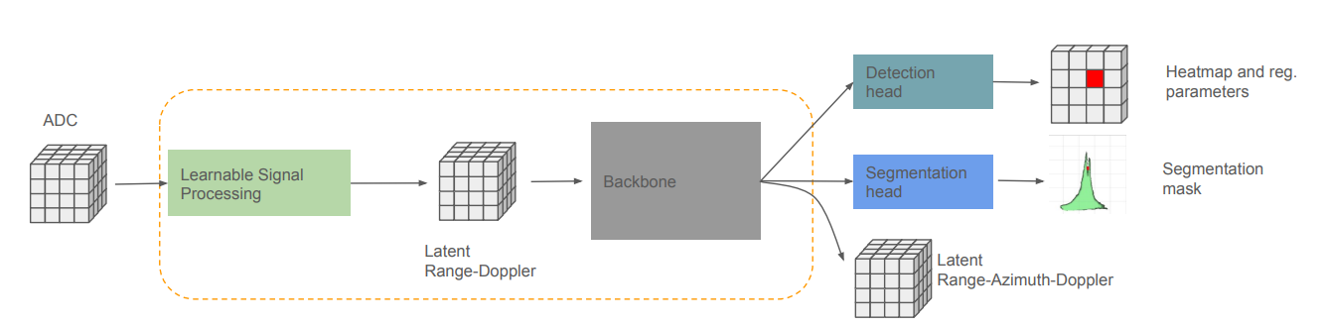
ADCNet
Backbone: FFT-RadNet

Slide 11
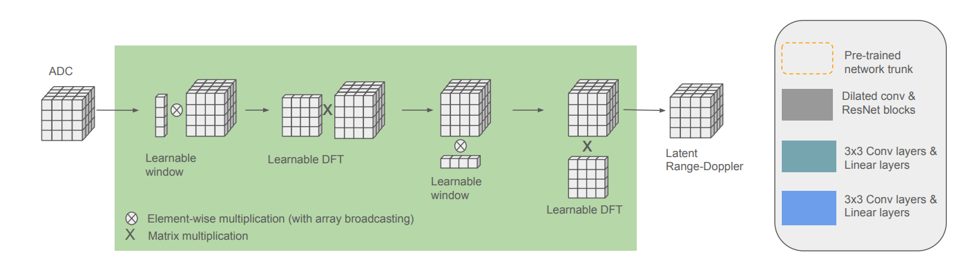
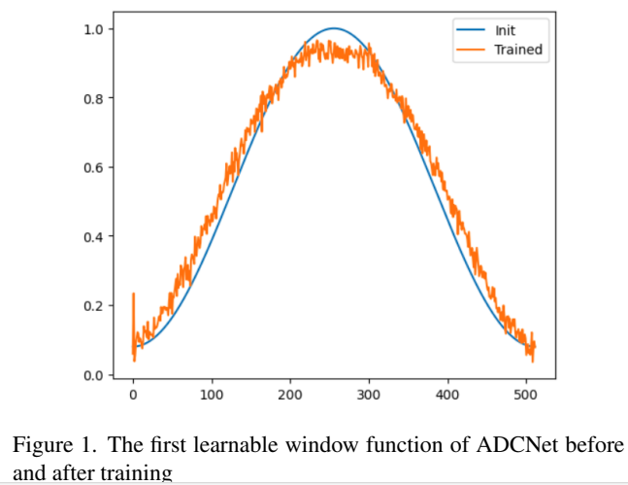
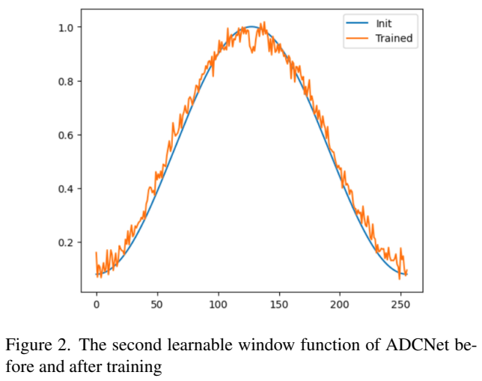
ADCNet
Learnable window
Learnable DFT

Slide 12
Range and Doppler processing: range-doppler profile
Windowing function

Slide 13
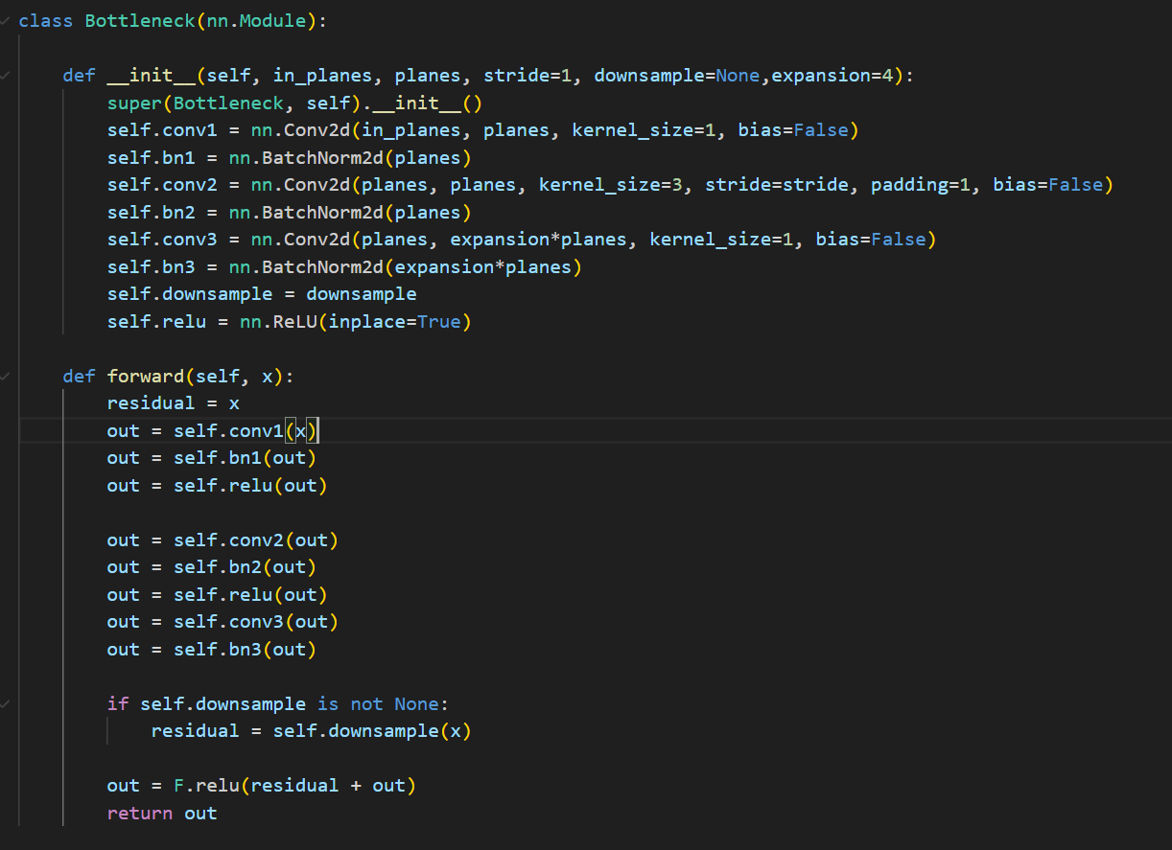
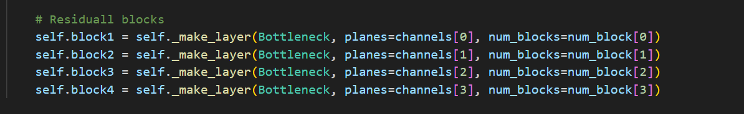
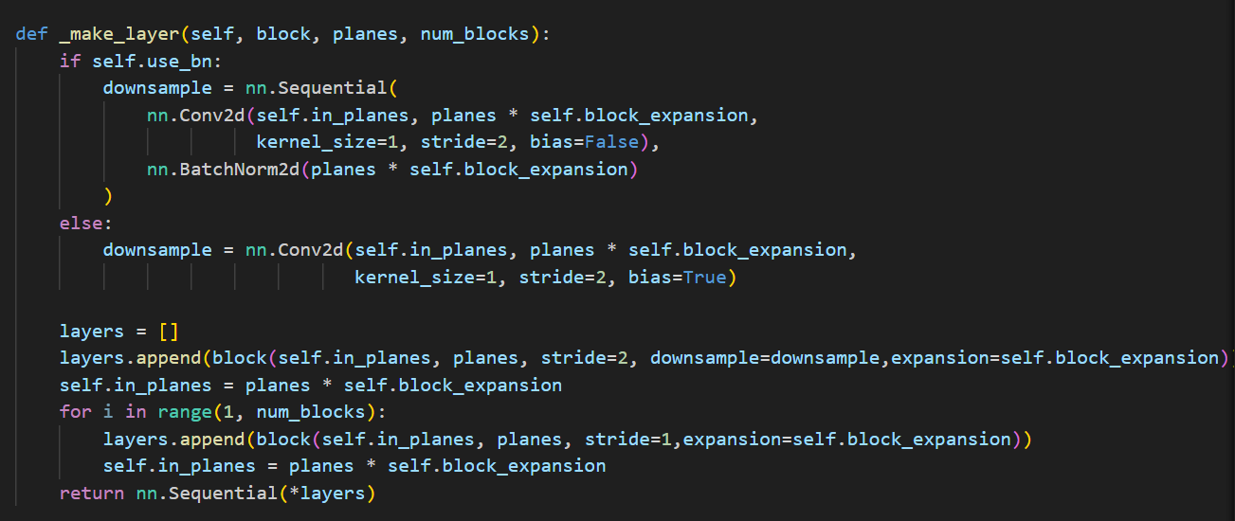
FFT-RadNet

