Slide 1
Radar image reconstruction with raw ADC data
TingYing Chu – Report 04

Slide 2
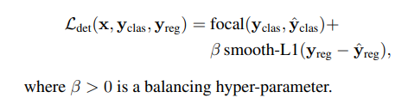
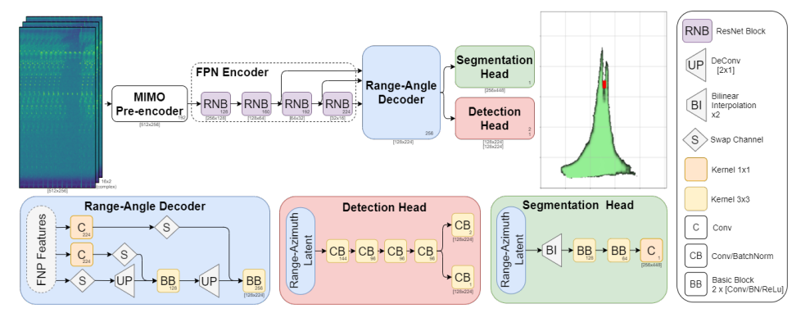
FFT-RadNet
model implementation
Dataset
Original dataset: RADIal dataset (currently not available)
Implementation dataset: Using our MATLAB code (MATLAB-RADAR-AUTOMOTIVE) to simulate the input data
Model:
Input data: RD cube
Output data
Binary classification: each “pixel” (RA map) as occupied or not by a vehicle
Regression: finely predicts the range and azimuth values corresponding to the detected object.
Loss function
Notes:
Study the code for understanding the dimension of the input and output data
The author pre-processed their labels data, need to check how to match with our ground truth

Slide 3
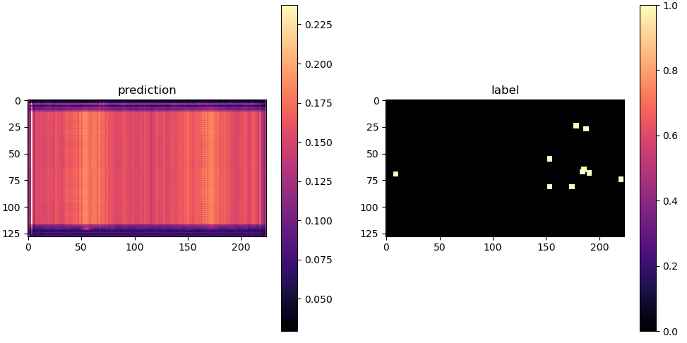
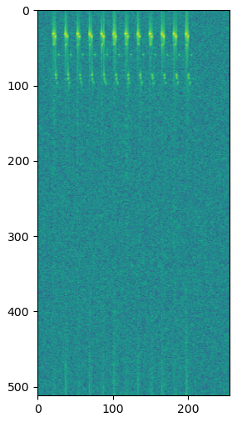
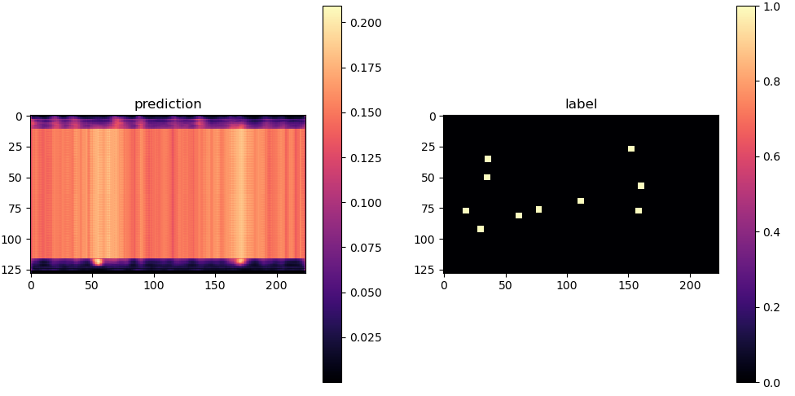
FFT-RadNet
Epoch = 10
model implementation
Training (Pre-trained model not available)
Epoch:100, batch size:4, train: 350 samples
Adjustment
Increase dataset: 100 -> 500 samples
Changing number of targets
Changing expand target (pixel) size
Prediction
No targets being predicted
Total loss: 2559 (classification+ regression loss)
Input: RD spectrum
range
range
angle
angle
Epoch = 90
range
range
angle
angle
Detection head Output:
softmax (prob.)
Ground truth
Label =1 if Probability > 0.5
Notes:
Study the code for understanding the dimension of the input and output data
The author pre-processed their labels data, need to check how to match with our ground truth

Slide 4
FFT-RadNet
Implementation problem
Dataset
Original dataset not available (RadIal dataset) -> found the original dataset (28th May)
MATLAB simulation data
Not sure about the size of RadIal dataset
Input: Difficult to check if the setting is correct (MIMO setting)
We adjust the number of Rx (from 16 to 2) to shorten the simulation time
Output: Not sure about the number of targets in each sample
Model:
Pre-trained model not accessible (harder to reproduce the same accuracy with small MATLAB simulation dataset )
possible solution: T-FFTRadNet
Notes:
Study the code for understanding the dimension of the input and output data
The author pre-processed their labels data, need to check how to match with our ground truth

Slide 5
Next-step
Next: Implementation
Data preparation
Train RadIal dataset (if this accessible dataset is the correct dataset)
Train FFTRadNet (not sure how much time is needed, because of no pre-trained mode;)
Input option 1: Fine-tuning the model on RD matrices (MATLAB simulation data)
Input option 2: Testing the model with raw ADC data (might not have ready-to-use ground truth label)
After FFTRadNet, try to implement T-FFTRadNet
T-FFTRadNet has pre-trained model for RD matrices and raw ADC
T-FFTRadNet’s GitHub code based on FFTRadNet’s GitHub code
Using pre-trained model (check point) with MATLAB simulation data -> solve the problem of not knowing how many training data is needed to train FFTRadNet
Schedule meeting with my professor (RWTH)
Notes:
Study the code for understanding the dimension of the input and output data
The author pre-processed their labels data, need to check how to match with our ground truth

Slide 6
Appendix

Slide 7
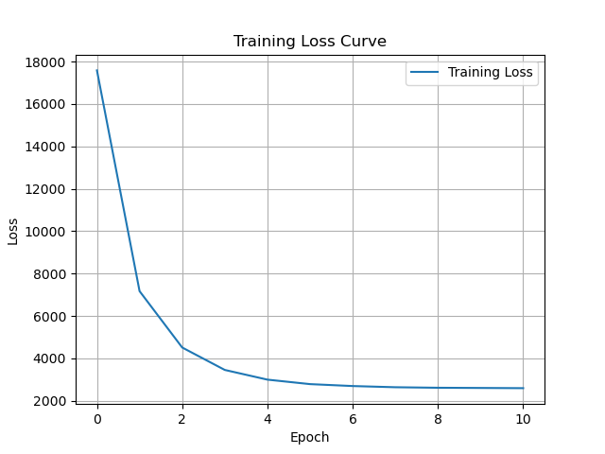
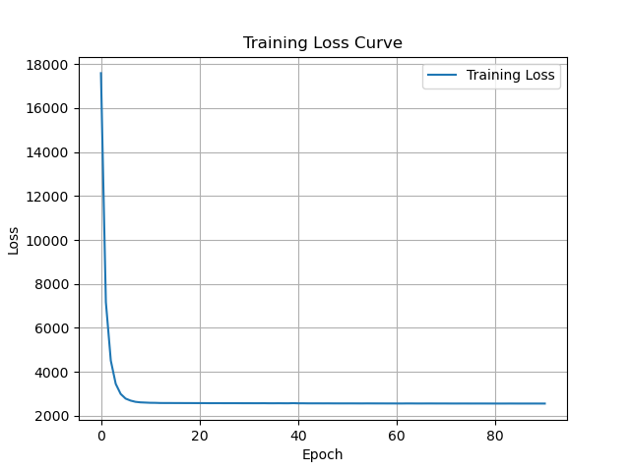
FFT-RadNet
Training Loss
Notes:
Study the code for understanding the dimension of the input and output data
The author pre-processed their labels data, need to check how to match with our ground truth

Slide 8
T-FFTRadNet
T-FFTRadNet
RadIal: use raw ADC, RD matrices
RADDet: use raw ADC, RD matrices. RAD cube (processed raw ADC to get RD and RAD )
Advantage: pre-trained model available
RADDet Dataset (Low definition)
The sensor is composed of 2 Tx and 4 Rx, where the transmitters produce 64 chirps each sampled 256 times producing inputs of shape (256,64,Tx ·Rx) where a virtual array has been formed
Available data: RAD cube
RadIal dataset
The HD radar sensor is composed of 12 transmitters (Tx) and 16 receivers (Rx), in which each Tx produces 256 chirps, each sampled with 512 points. The inputs to the model are either ADC, or RD matrices in which the complex components of the I/Q data are appended as additional channels for the Swin Transformer, producing inputs of shape (512,256,2Rx)
Notes:
Study the code for understanding the dimension of the input and output data
The author pre-processed their labels data, need to check how to match with our ground truth

Slide 9
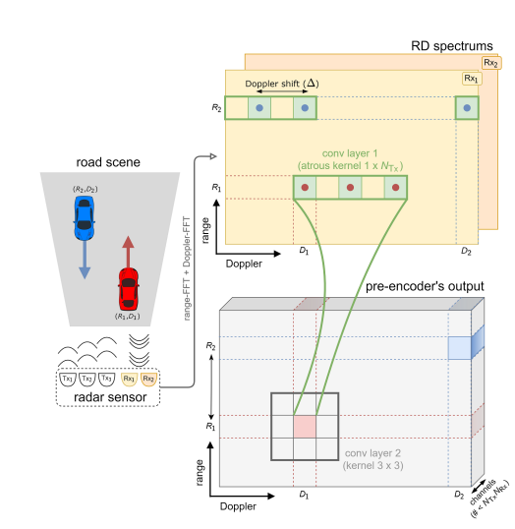
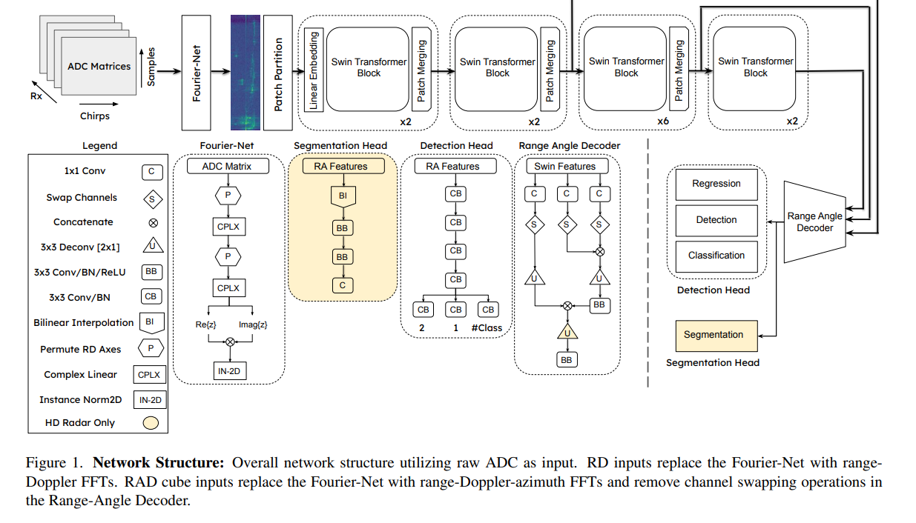
T-FFTRadNet
To deal with the special MIMO setting
Notes:
Study the code for understanding the dimension of the input and output data
The author pre-processed their labels data, need to check how to match with our ground truth

