Slide 1
Radar image reconstruction with raw ADC data
TingYing Chu – Report 05

Slide 2
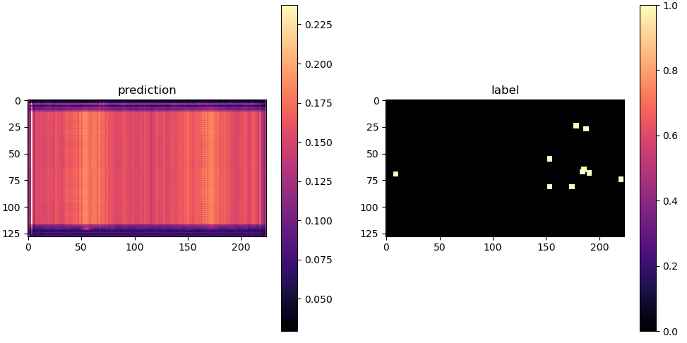
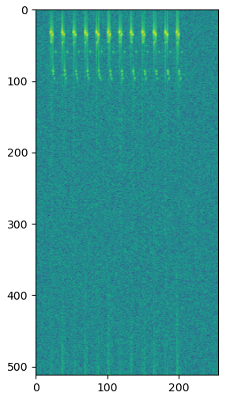
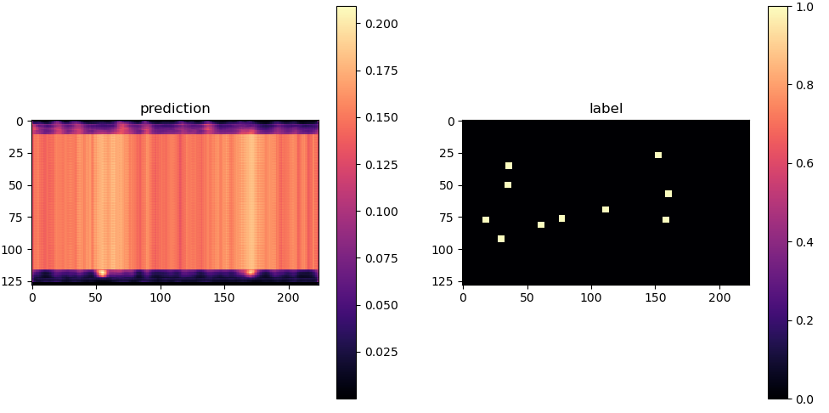
FFT-RadNet
Epoch = 10
Previous MIMO setting
Training (Pre-trained model not available)
Epoch:100, batch size:4, train: 350 samples
Adjustment
Increase dataset: 100 -> 500 samples
Changing number of targets
Changing expand target (pixel) size
Prediction
No targets being predicted
Total loss: 2559 (classification+ regression loss)
Input: RD spectrum
range
range
angle
angle
Epoch = 90
range
range
angle
angle
Detection head Output:
softmax (prob.)
Ground truth
Label =1 if Probability > 0.5
Notes:
Study the code for understanding the dimension of the input and output data
The author pre-processed their labels data, need to check how to match with our ground truth

Slide 3
RadIal dataset
FFTRadNet and T-FFTRadNet used RadIal dataset
Downloaded from valeo.ai [1]
No raw ADC data available
RD data are unusable
All the input data (numpy arrary) are the same (the arrays are identical) -> checking via randomly pick 50 inputs and check each pair of data
Still can’t use the RadIal’s dataset to train the FFTRadNet
Current Solution
Continue using MATLAB simulation RD cube (Updated the MATLAB radar setting, current implementation)
Tried to generate RD cube via the targets file (labels.csv) from RadIal dataset
Tried to find the correct label for the only input data -> Can compare the MATLAB generate input with the RadIal dataset input
[1] valeo.ai | valeo.ai research page (valeoai.github.io)
Notes:
Study the code for understanding the dimension of the input and output data
The author pre-processed their labels data, need to check how to match with our ground truth

Slide 4
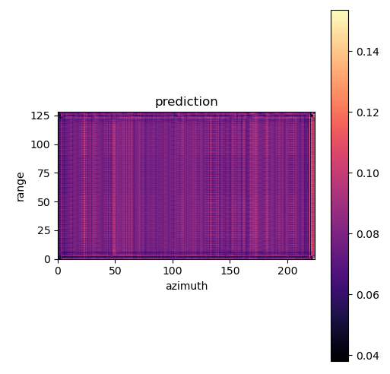
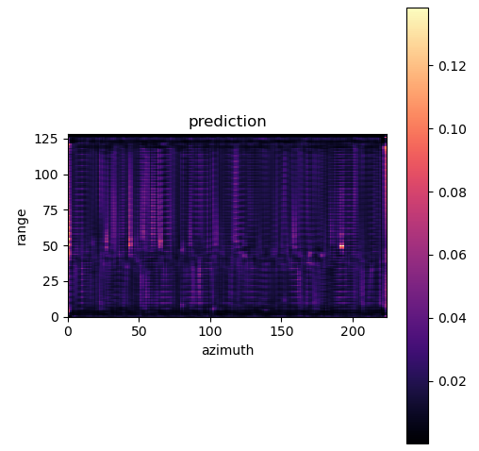
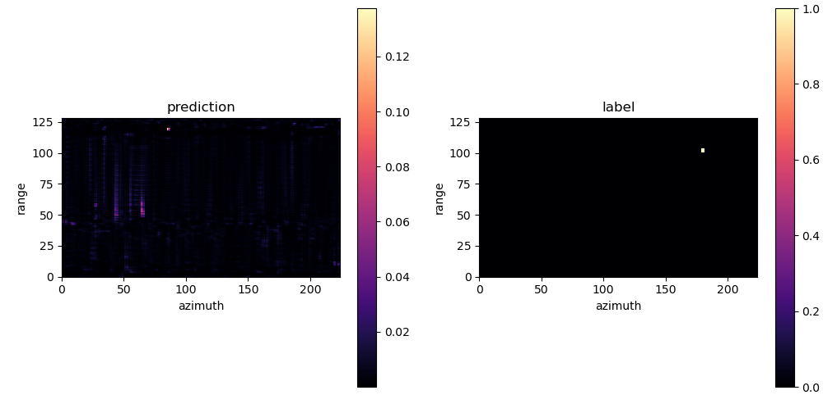
FFT-RadNet
Epoch = 20
Epoch = 100
model implementation
Dataset: MATLAB simulation data
Training (Pre-trained model not available)
Epoch:300, batch size:4, train: 350 samples
Not changing other parameters
Prediction
Have prediction, but not correct
No True positive prediction -> Unable to evaluate model with F1 score
Total loss: 4.37 (classification+ regression loss)
Epoch = 300
Detection head Output: softmax (prob.)
Ground truth
Notes:
Study the code for understanding the dimension of the input and output data
The author pre-processed their labels data, need to check how to match with our ground truth

Slide 5
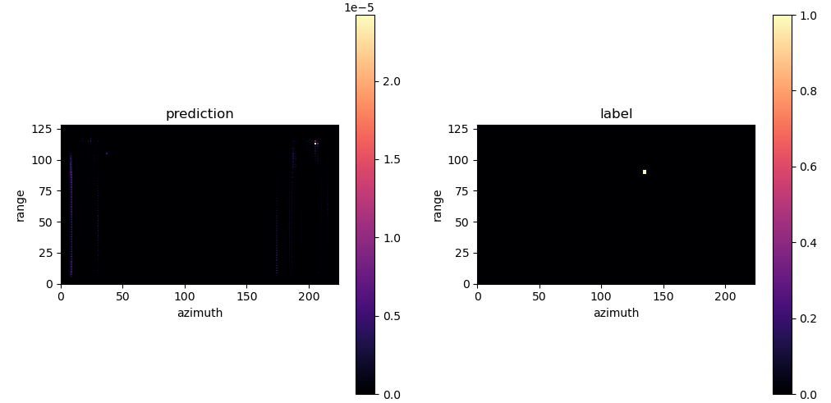
T-FFTRadNet
model implementation
Dataset: MATLAB simulation data
Use Pre-trained model
Prediction
Have prediction, but not correct
No True positive prediction -> Unable to evaluate model with F1 score
Detection head Output: softmax (prob.)
Ground truth
Notes:
Study the code for understanding the dimension of the input and output data
The author pre-processed their labels data, need to check how to match with our ground truth

Slide 6
Next step
Hichem suggestion: use MATLAB simulation data, increase the number of targets
Train on FFTRadNet
After FFTRadNet works, replace the encoder layer with complex layer to avoid concatenate the real and img part
Option1: Train the FFTRadNet with RD input to reach paper’s performance
Data
Use MATLAB simulation data, increase dataset (FFTRadNet trained on around 6k samples)
Use RadIal’s targets file and MATLAB to simulate RD cube
Model
Use Optuna to train the FFTRadNet
Option2: Train the T-FFTRadNet with raw ADC data
Data
Use MATLAB simulation data
Use real data
Model
Use Optuna to train the T-FFTRadNet
Research on how to implement the pre-train and distillation technique which are used in ADCNet (No public code)
Schedule meeting with my professor (RWTH)
Notes:
Study the code for understanding the dimension of the input and output data
The author pre-processed their labels data, need to check how to match with our ground truth

Slide 7
Appendix

Slide 8
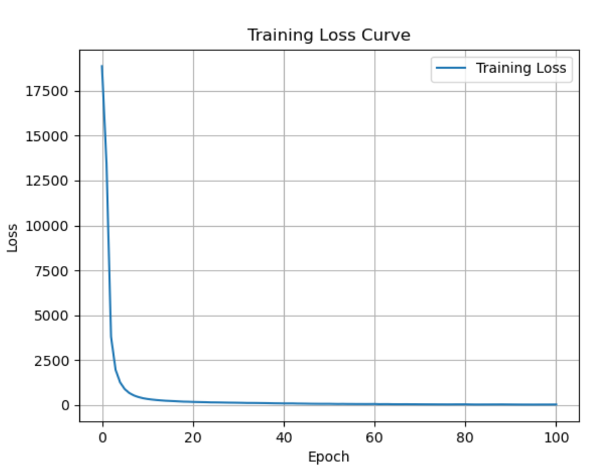
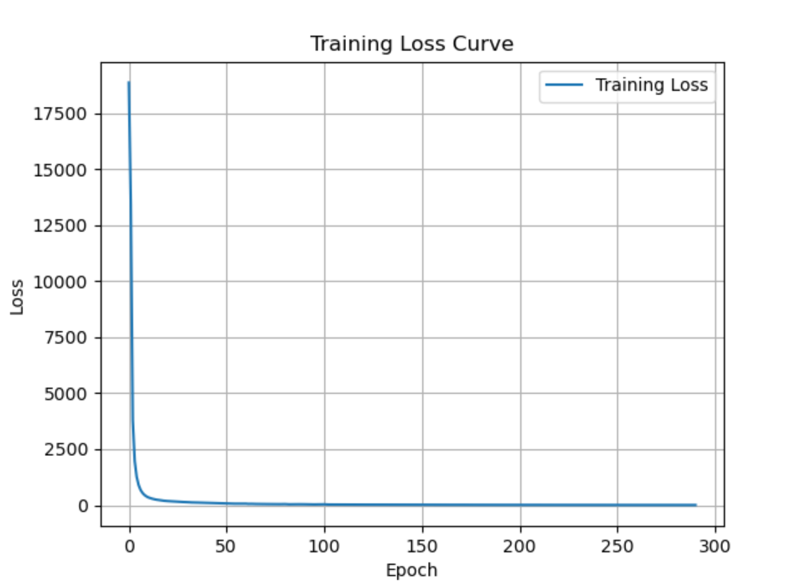
FFT-RadNet
Training Loss
Notes:
Study the code for understanding the dimension of the input and output data
The author pre-processed their labels data, need to check how to match with our ground truth

Slide 9
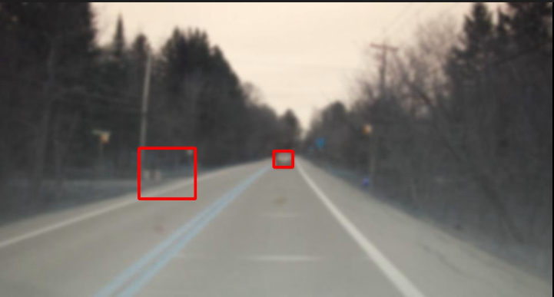
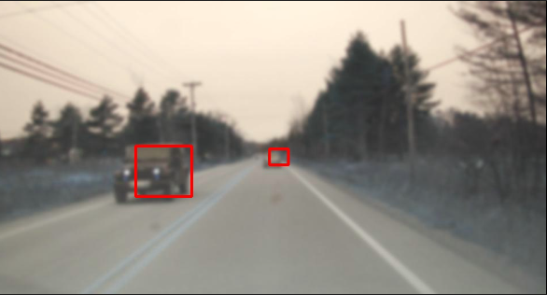
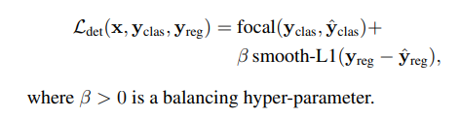
T-FFTRadNet prediction
Lowest loss (overall)
Lowest loss (having two targets)
Loss = classification loss + regression loss

Slide 10
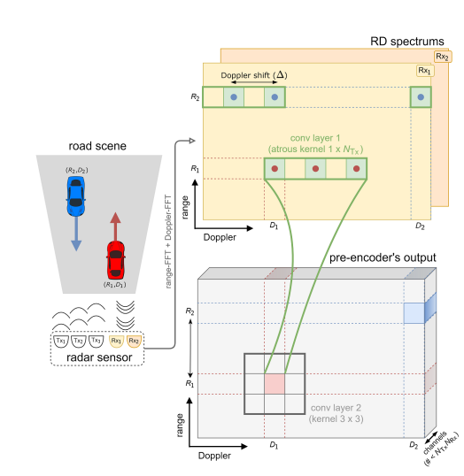
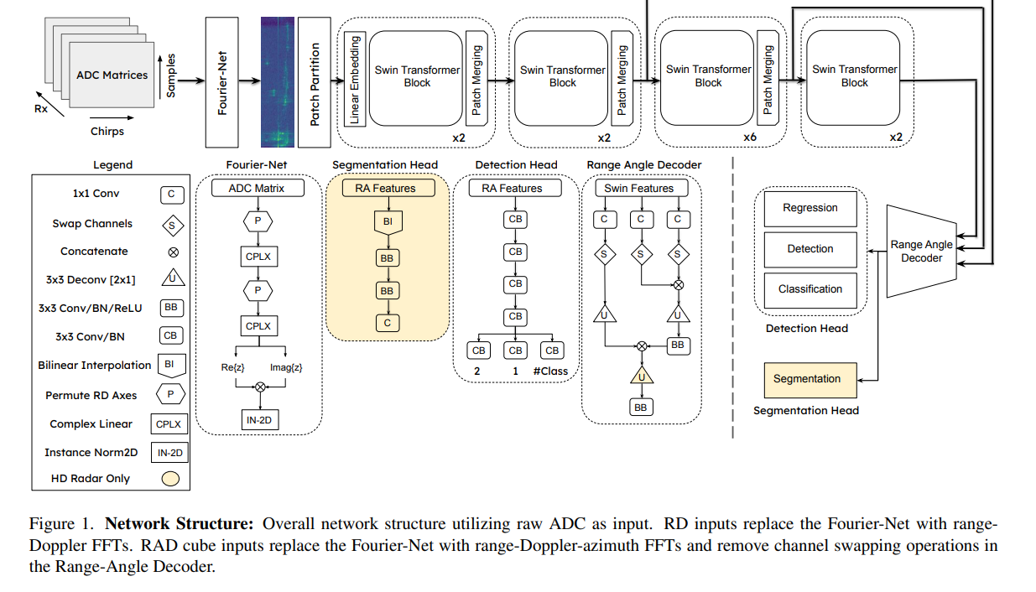
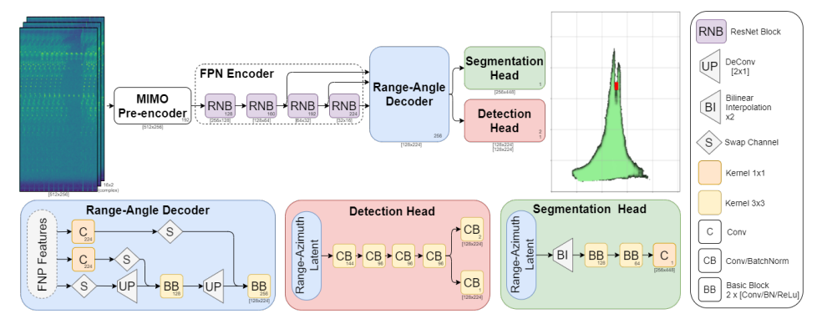
T-FFTRadNet
To deal with the special MIMO setting
Notes:
Study the code for understanding the dimension of the input and output data
The author pre-processed their labels data, need to check how to match with our ground truth

Slide 11
FFT-RadNet
model implementation
Dataset
Original dataset: RADIal dataset (currently not available)
Implementation dataset: Using our MATLAB code (MATLAB-RADAR-AUTOMOTIVE) to simulate the input data
Model:
Input data: RD cube
Output data
Binary classification: each “pixel” (RA map) as occupied or not by a vehicle
Regression: finely predicts the range and azimuth values corresponding to the detected object.
Loss function
Notes:
Study the code for understanding the dimension of the input and output data
The author pre-processed their labels data, need to check how to match with our ground truth

Slide 12
T-FFTRadNet
T-FFTRadNet
RadIal: use raw ADC, RD matrices
RADDet: use raw ADC, RD matrices. RAD cube (processed raw ADC to get RD and RAD )
Advantage: pre-trained model available
RADDet Dataset (Low definition)
The sensor is composed of 2 Tx and 4 Rx, where the transmitters produce 64 chirps each sampled 256 times producing inputs of shape (256,64,Tx ·Rx) where a virtual array has been formed
Available data: RAD cube
RadIal dataset
The HD radar sensor is composed of 12 transmitters (Tx) and 16 receivers (Rx), in which each Tx produces 256 chirps, each sampled with 512 points. The inputs to the model are either ADC, or RD matrices in which the complex components of the I/Q data are appended as additional channels for the Swin Transformer, producing inputs of shape (512,256,2Rx)
Notes:
Study the code for understanding the dimension of the input and output data
The author pre-processed their labels data, need to check how to match with our ground truth

