Slide 1
Radar image reconstruction with raw ADC data
TingYing Chu – Report 06

Slide 2
MATLAB simulation dataset
Parameter setting
Number of Tx: 12, Number of Rx: 16
Number of targets: 1, 3
Dataset size: 500 samples
Generation steps
Randomly generate 1 or 3 targets per sample
Use the randomly generated targets to generate RD cube
Two dataset for the FFTRadNet
One target dataset
Multi-targets dataset (3 targets)
Notes:
Study the code for understanding the dimension of the input and output data
The author pre-processed their labels data, need to check how to match with our ground truth

Slide 3
FFTRadNet model
Implementation setting
Parameter setting
Number of epoch: 300, 500
Batch size: 4
Train-validation-test dataset: 70%-15%-15%
Dataloader: no shuffle
Result
The prediction result at previous meeting is not accurate
The code for plotting misplace, so that the result is plotting by the model that is still updating the weights
Adjust the plotting code to ensure the result comes from the final model
Notes:
Study the code for understanding the dimension of the input and output data
The author pre-processed their labels data, need to check how to match with our ground truth

Slide 4
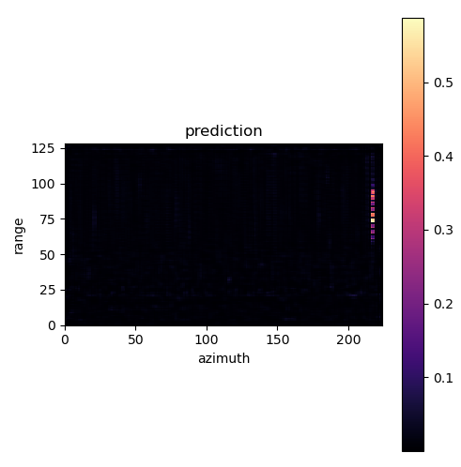
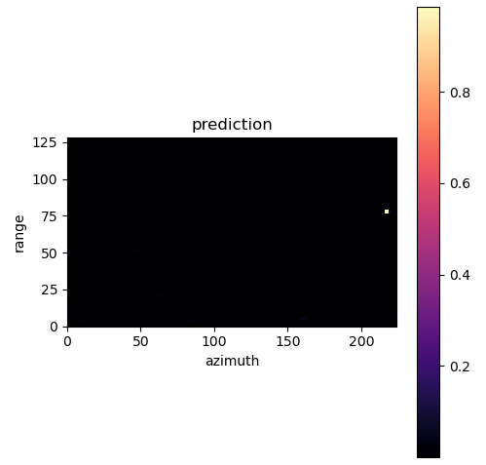
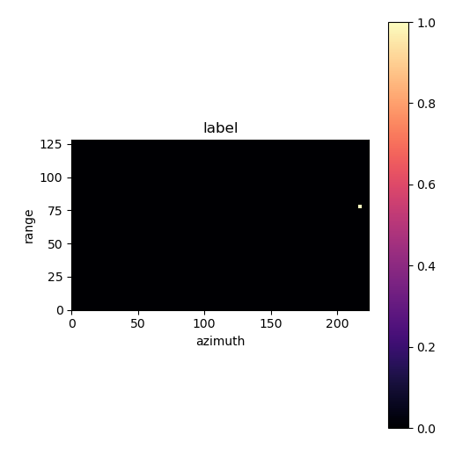
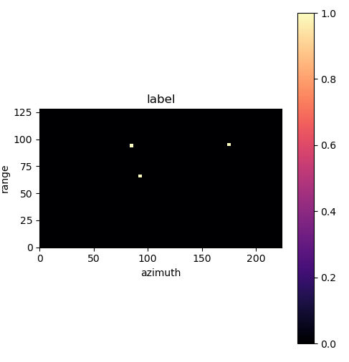
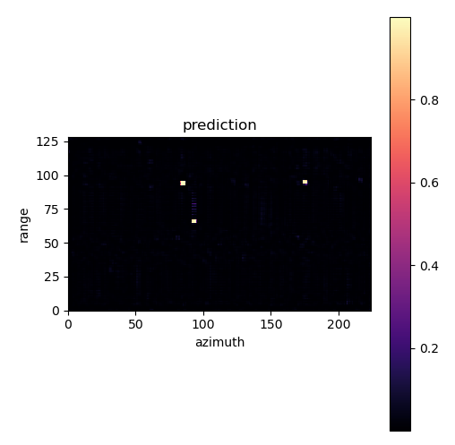
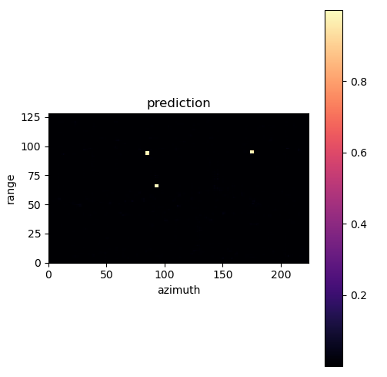
FFT-RadNet
Epoch=150
Epoch=499
Model training prediction
Number of target = 1
Number of target = 3
Notes:
Study the code for understanding the dimension of the input and output data
The author pre-processed their labels data, need to check how to match with our ground truth

Slide 5
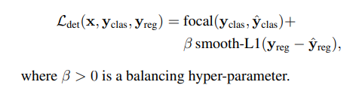
FFT-RadNet
Model training prediction
Evaluation score
Calculated with the same training dataset
Can’t calculate scores for validation dataset -> unable to check overfitting (explain in next slide)
 | Number of target = 3 |  | Number of target = 1
 | epoch:499 | Epoch:150 | epoch:499 | epoch:150
mAP | 0.964 | 0.543 | 0.867 | 0.435
mAR | 0.992 | 0.739 | 0.957 | 0.546
F1 score | 0.978 | 0.626 | 0.910 | 0.484
Loss (detection loss+ regression loss) | 1.6098 | 18.6216 | 4.9607 | 24.7359
Detection loss
regression loss
Notes:
Study the code for understanding the dimension of the input and output data
The author pre-processed their labels data, need to check how to match with our ground truth

Slide 6
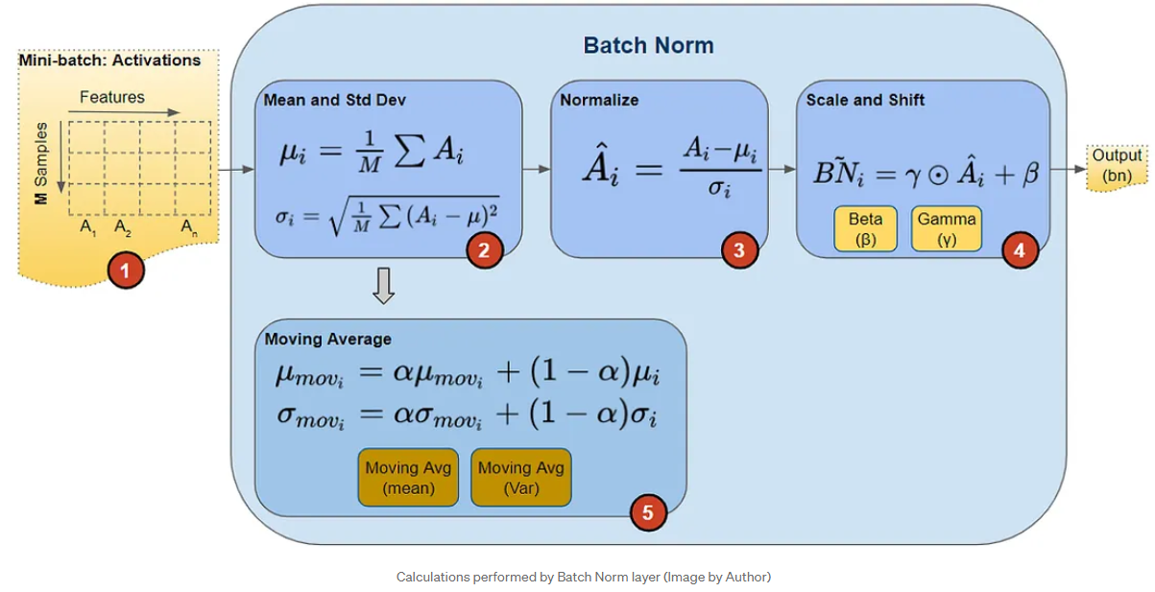
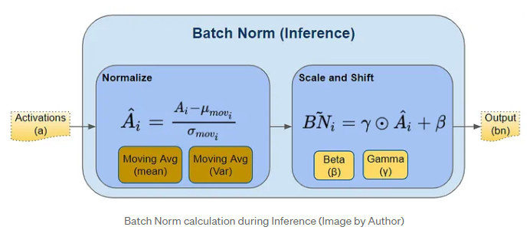
FFT-RadNet
Model evaluation
Evaluation mode (nn.Module.eval())
Create a consistent environment for model inference
BatchNorm2d and Dropout behave differently on evaluation and training mode
BatchNorm2d
Training mode: use batch statistic
Evaluation mode: uses the running estimates (mean and variance) that it computed during it's training phase
No evaluation score on train dataset with eval() & validation dataset without eval() -> unable to reproduce the performance on train dataset
Tried solutions: BatchNorm layer: set running_stat=False (evaluation mode use batch statistic), shuffle training dataset, adjusting momentum value (more weights on new statistic, ex, 0.5) -> these methods didn’t solve the issue
momentum
Notes:
Study the code for understanding the dimension of the input and output data
The author pre-processed their labels data, need to check how to match with our ground truth

Slide 7
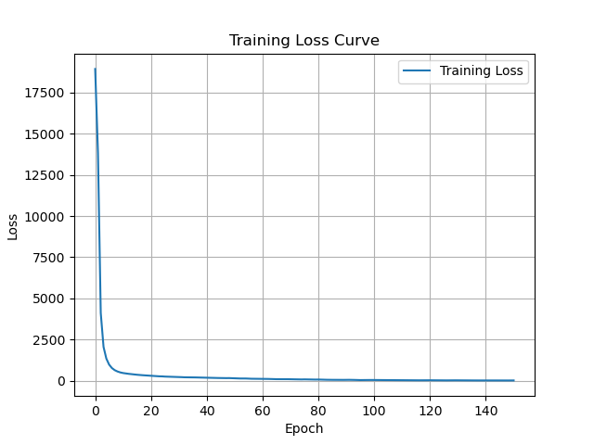
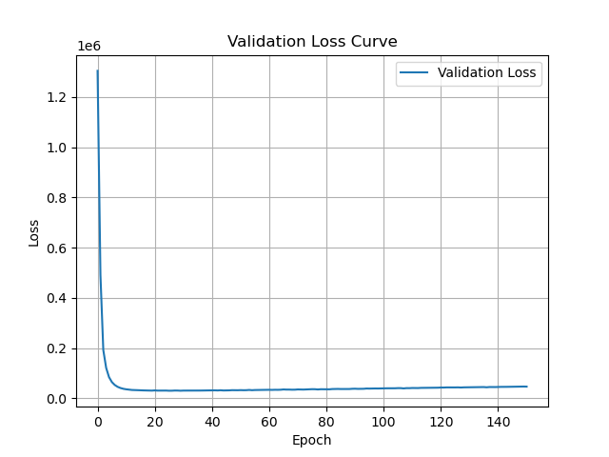

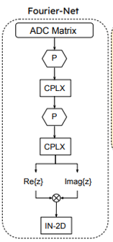

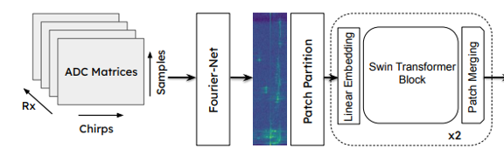
Next step
Increase the batch size, from 4 to 16 or more
The author trained with sequential dataset, but we use random dataset -> might need bigger batch size
Implement the complex layer
Three target: starting loss 17k
One target: starting loss 1200k
Epoch 150: loss 24.73
Epoch 500: loss under 10
T-FFTRadNet
Complex layer
Camera image for the RADIal dataset input
Notes:
Study the code for understanding the dimension of the input and output data
The author pre-processed their labels data, need to check how to match with our ground truth

Slide 8
Appendix

Slide 9
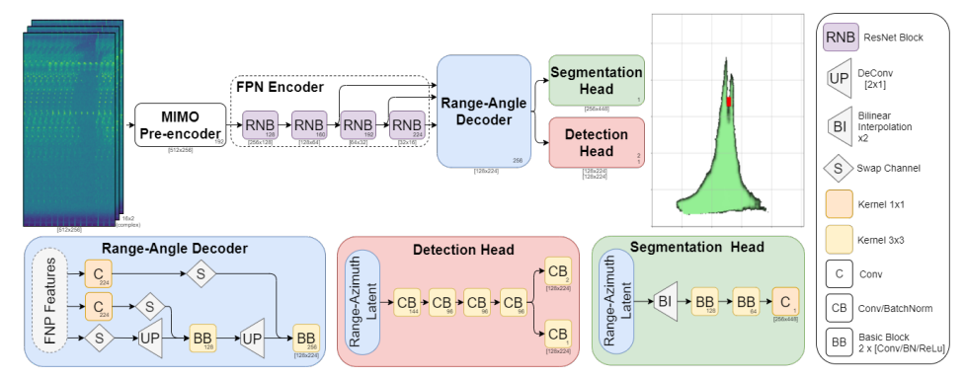
FFT-RadNet
model implementation
Dataset
Original dataset: RADIal dataset (currently not available)
Implementation dataset: Using our MATLAB code (MATLAB-RADAR-AUTOMOTIVE) to simulate the input data
Model:
Input data: RD cube
Output data
Binary classification: each “pixel” (RA map) as occupied or not by a vehicle
Regression: finely predicts the range and azimuth values corresponding to the detected object.
Loss function
Notes:
Study the code for understanding the dimension of the input and output data
The author pre-processed their labels data, need to check how to match with our ground truth

Slide 10
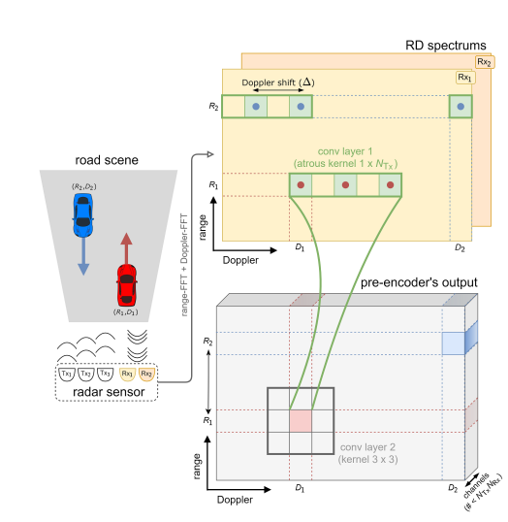
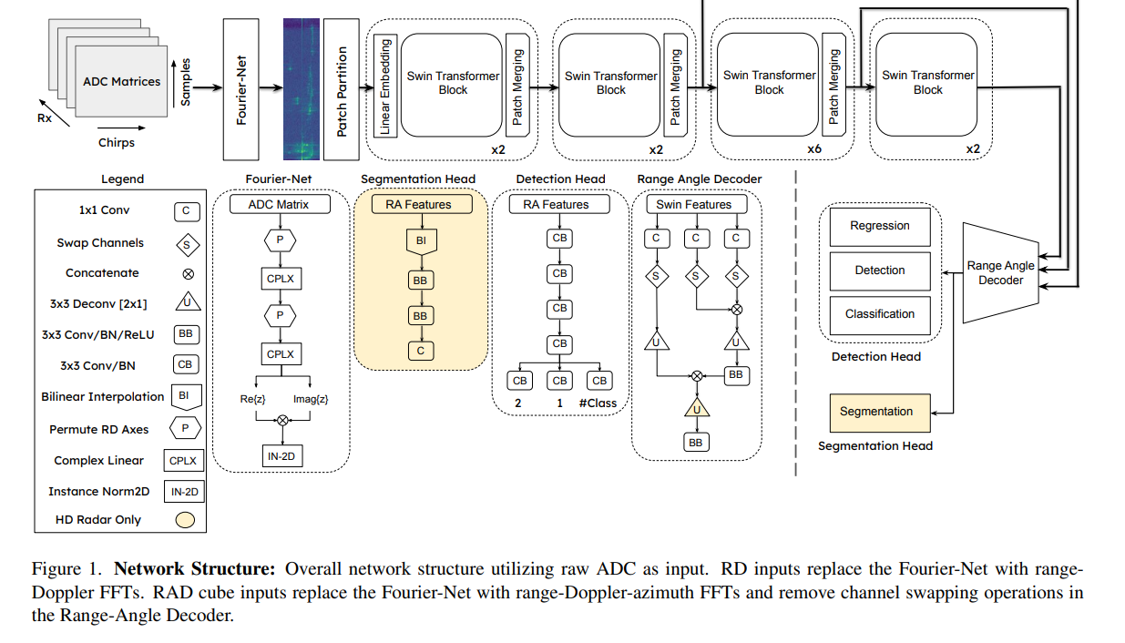
T-FFTRadNet
To deal with the special MIMO setting
Notes:
Study the code for understanding the dimension of the input and output data
The author pre-processed their labels data, need to check how to match with our ground truth

