Slide 1
RADIal Dataset
TingYing Chu

Slide 2
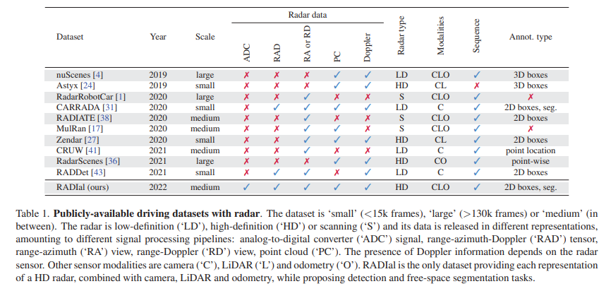
RADIal Dataset
introduction
GitHub link with dataset explanation: GitHub - valeoai/RADIal
A collection of 2-hour of raw data from synchronized automotive-grade sensors (camera, laser, High Definition radar) in various environments (citystreet, highway, countryside road) and comes with GPS and vehicle’s CAN traces
Contains 91 sequences of about 1-4 minutes, for a total of 2 hours. This amounts to approximately 25k synchronized frames in total, out of which 8,252 are labelled
with 9,550 vehicles
High-definition radar is composed of NRx=16 receiving antennas and NTx= 12 transmitting antennas, leading to NRx·NTx= 192 virtual antennas.

Slide 3
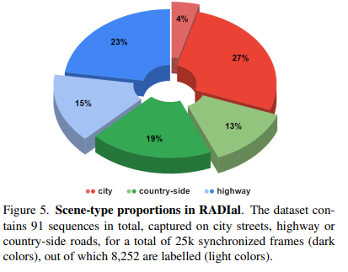
RADIal Dataset
Data related to our work
Dataset structure:
The ADC radar data saved in a binary file. There are 4 files in total, one file for each radar chip, each chip containing 4 Rx antennas
The log file that provides the timestamp of each individual sensor event
Labels:
Out of the 25,000 synchronized frames, 8,252 frames are labelled. Labels for vehicles are stored in a separated csv file
Labels related to our research target
numSample
[radar_X_m, radar_Y_m, radar_R_m, radar_A_deg, radar_D, radar_P_db]: 2D coordinates (bird' eyes view) of the vehicle in the radar coordinates system either in cartesian (X,Y) or polar (R,A) coordinates. radar_D is the Doppler value and radar_P_db is the power of the reflected signal
dataset: name of sequence it belongs to
dataset_index: frame index in the current sequence
Difficult: either 0 or 1

Slide 4
RADIal Dataset
Vehicle detection labels
Steps to generate the labels
First generated automatically using supervision from the camera and laser scanner.
A RetinaNet model was used to extract object proposals from the camera.
Then, these proposals were validated when both radar and LiDAR agree on the object position from their respective point cloud.
Finally, manual verification was conducted to reject or validate the labels.
The freespace annotation was done fully automatically on the camera images.

