Slide 1
Radar image reconstruction with raw ADC data
TingYing Chu – Report 07

Slide 2
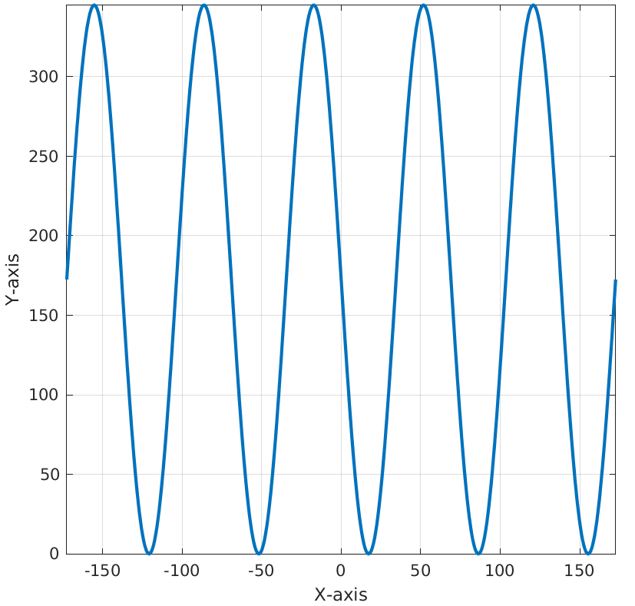
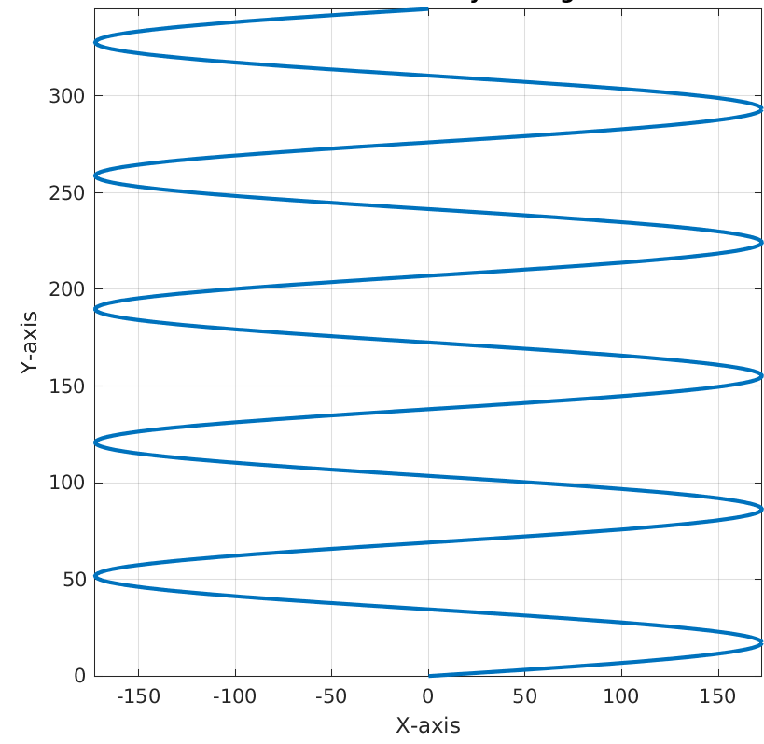
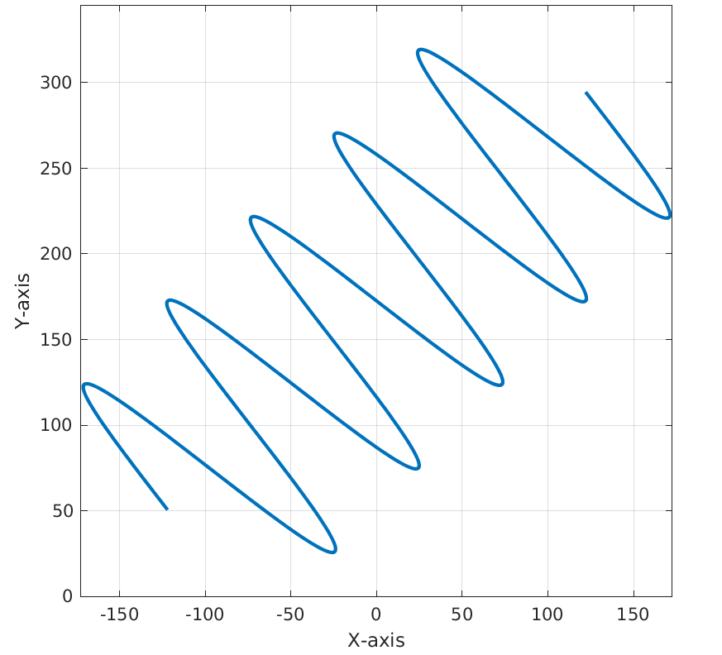
MATLAB simulation dataset
No limitation on range values, 3 different sequential targets’ trace
Sequential data
Motives: Can’t reproduce model’s training result with eval() (BatchNorm2d layer)
Tried increase batch size to have stable statistic values -> didn’t help -> might result from randomly generated targets
Goal: Generating sequential data to mimic RADIal dataset
Parameter setting
Number of Tx: 12, Number of Rx: 16
Number of targets: 3
Dataset size: 500 samples
Generation steps
Generate paths for targets
Use the generated targets to generate RD cube
Notes:
Study the code for understanding the dimension of the input and output data
The author pre-processed their labels data, need to check how to match with our ground truth

Slide 3
FFTRadNet model
Implementation setting
Parameter setting
Number of epoch: 500
Batch size: 4
Train-validation-test dataset: 70%-15%-15%
Dataset loading setting
Split the dataset in order (paper: split the dataset in a way that frames from a same sequence can’t appear in different sets)
Shuffle the training dataset (same as paper’s setting)
No shuffling on validation and test dataset
Notes:
Study the code for understanding the dimension of the input and output data
The author pre-processed their labels data, need to check how to match with our ground truth

Slide 4
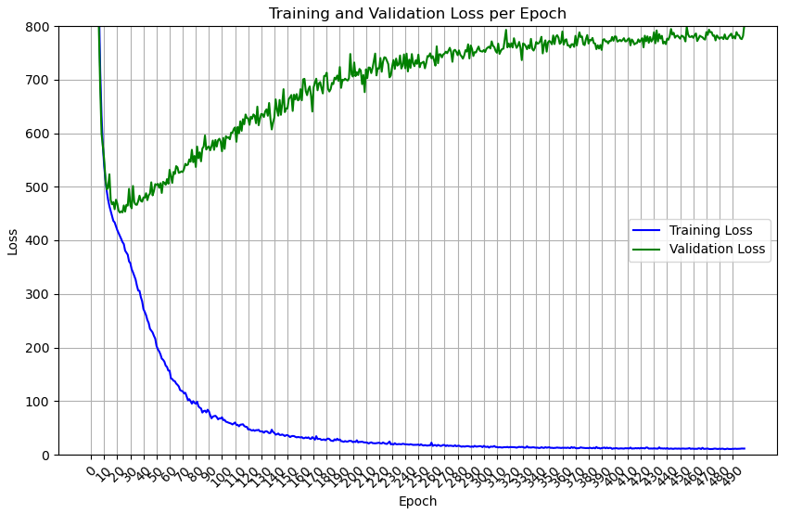
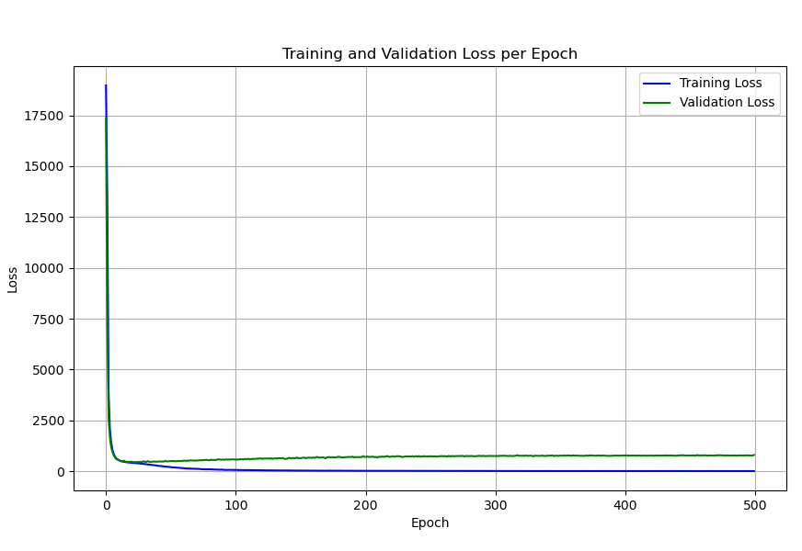
Implementation result - FFT-RadNet
Sequential data
AP:mean(TP/(TP+FP)), AR:mean(TP/(TP+FN))
F1 score: (AP*AR)/((AP+AR)/2)
Summary
Solve eval() mode issue for training dataset
Model overfitting the data after epoch 20
The model evaluation score at epoch 20 still low
No evaluation score for validation and test dataset
mAP/mAR/F1 score | epoch:499 | Epoch:20
Train | 0.803/0.902/0.849 | 0.393/0.515/0.446
validation | 0.0/0.0/nan | 0.0/0.0/nan
Test | 0.0/0.0/nan | 0.0/0.0/nan
Notes:
Study the code for understanding the dimension of the input and output data
The author pre-processed their labels data, need to check how to match with our ground truth

Slide 5
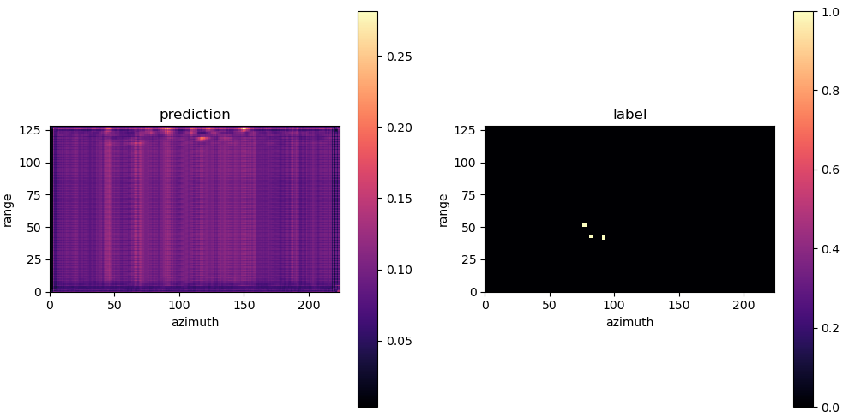

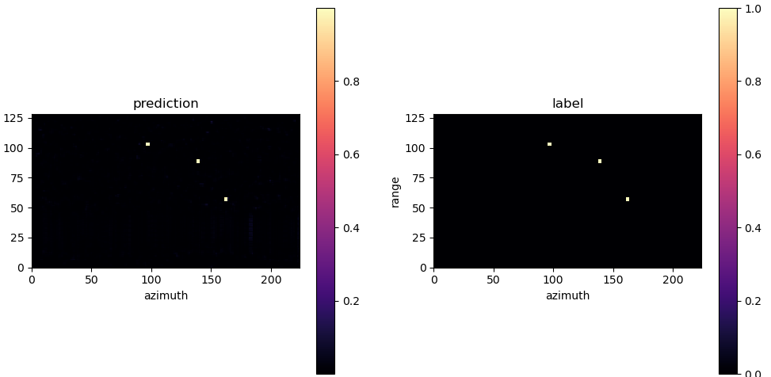
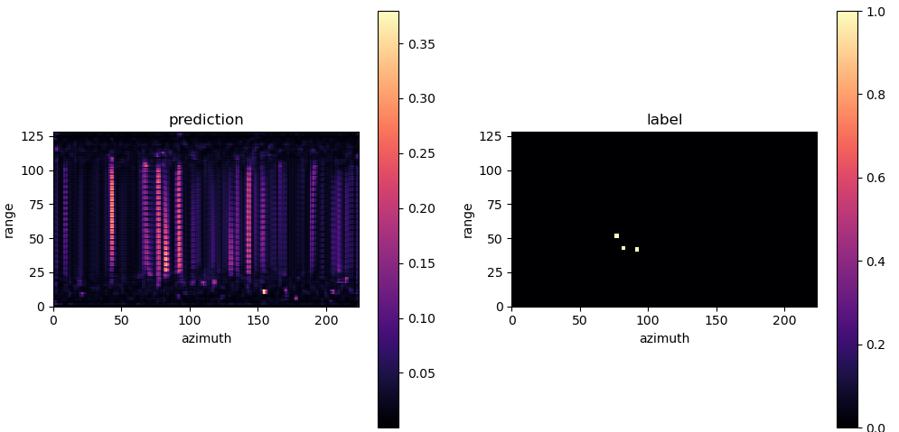
Implementation result - FFT-RadNet
Sequential data – training dataset prediction
epoch=20
epoch=20
epoch=499
epoch=499
batch = 15
batch = 5
Notes:
Study the code for understanding the dimension of the input and output data
The author pre-processed their labels data, need to check how to match with our ground truth

Slide 6
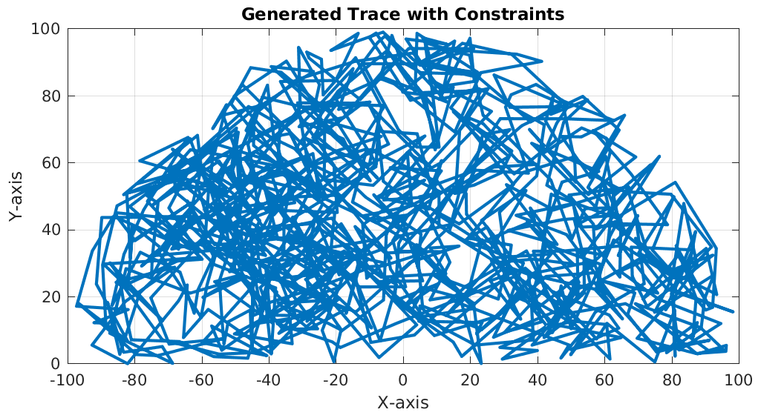
Next steps
Dataset
Generate more samples, increase the dataset size (RADIal: 8252 labelled samples)
10 times of the model parameter
Increase to 2000 (or more) samples
Decrease number of Rx (to save time for data generation and model training), paper’s setting: Nrx=16
Optional: Limit simulated range values, match paper’s settings (5<=range<=100)
Model: Hyperparameter tuning
Number of layers
Batch size
Optional: the probability to recognize as objects (paper sets 0.05)
Need to solve GPU capacity issue (discuss with Ruoyo)
Tried highest batch size: 8 (Nrx=16), 16 (Nrx=2)
Targets’ trace: Limit the range values
Notes:
Hichem feedback:
Dataset
More samples is good
Do not decrease the number of Rx
Limit the range values (5<=range<=100)
Model
Tuning number of layers and batch size
Evaluation
Plot the probability distribution of the detection head
Calculate the score with different threshold
Plot the object detection with different threshold
Check the probability around the target
Check: automatically check the threshold
Feedback from andre
Dataset
Check the distribution of the velocity and range values, whether the targets cover the whole values range

Slide 7
Appendix
Notes:
Study the code for understanding the dimension of the input and output data
The author pre-processed their labels data, need to check how to match with our ground truth

Slide 8
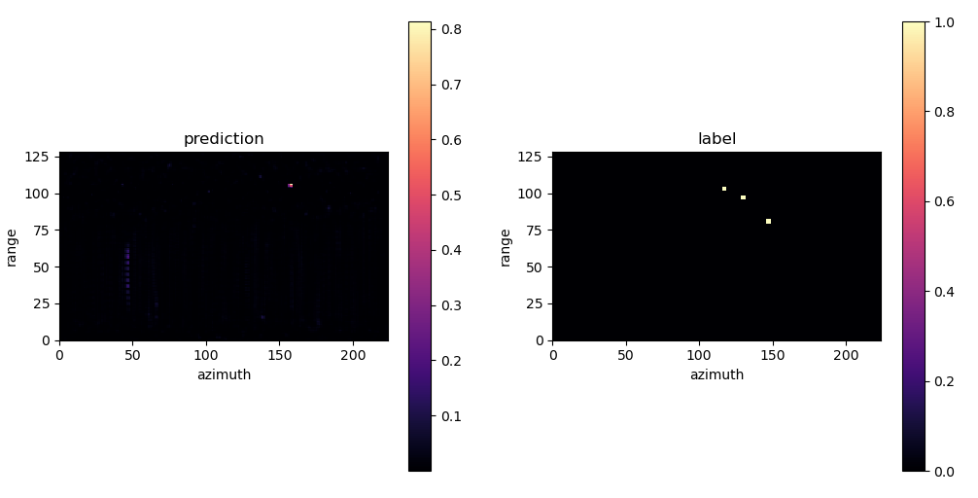

Implementation result - FFT-RadNet
Sequential data – test dataset prediction
epoch=20
epoch=499
Notes:
Study the code for understanding the dimension of the input and output data
The author pre-processed their labels data, need to check how to match with our ground truth

Slide 9
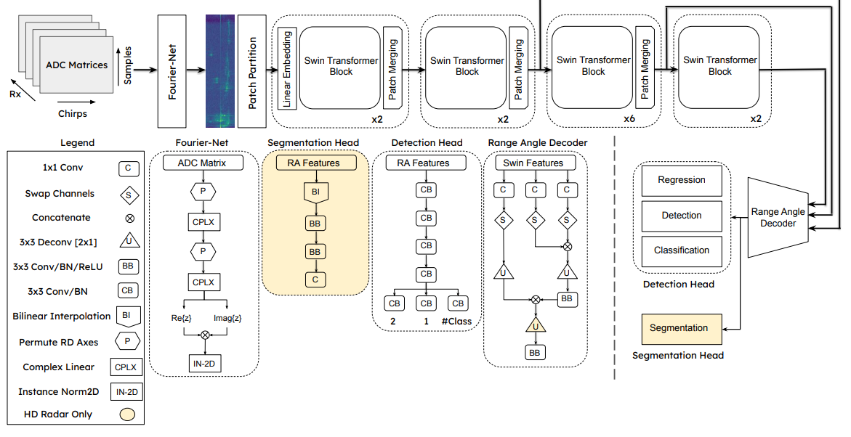
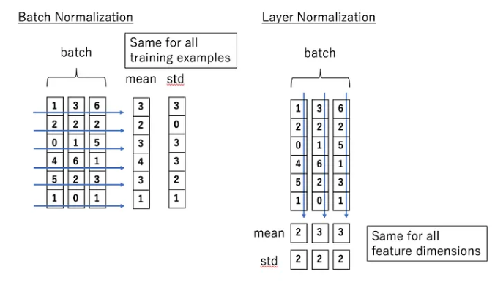
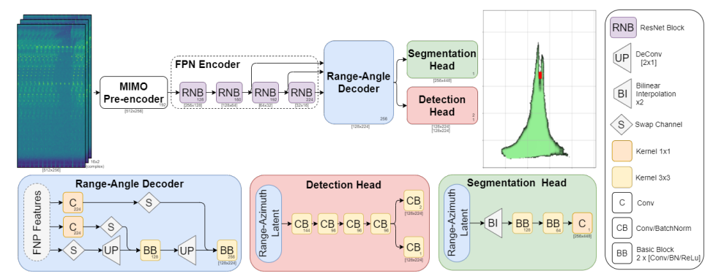
FFT-RadNet vs T_FFTRadNet
LayerNorm
Normalization
BatchNorm
normalizes each feature within a batch of samples
LayerNorm
normalizes all features within each sample-> use in transformer (NLP) since the sentence length differ, shouldn’t normalize samples
BatchNorm
Column: sample features
Row: batch
Notes:
Study the code for understanding the dimension of the input and output data
The author pre-processed their labels data, need to check how to match with our ground truth

Slide 10
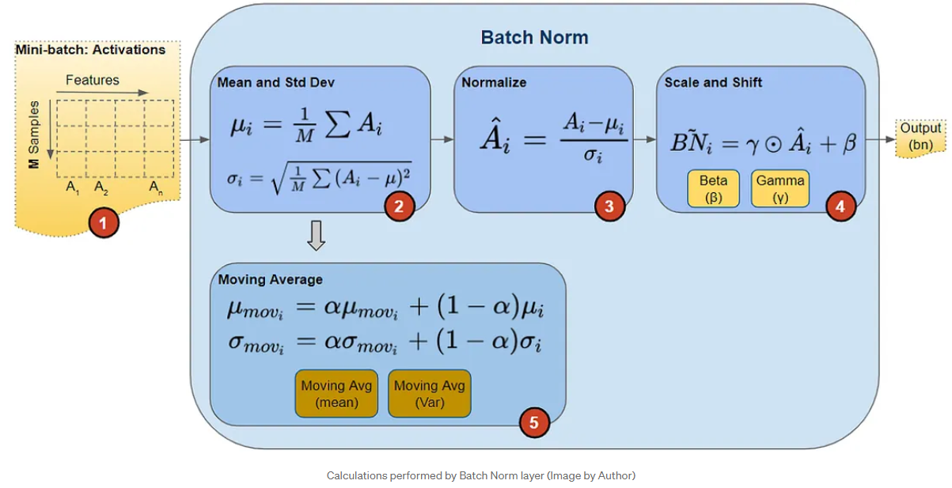
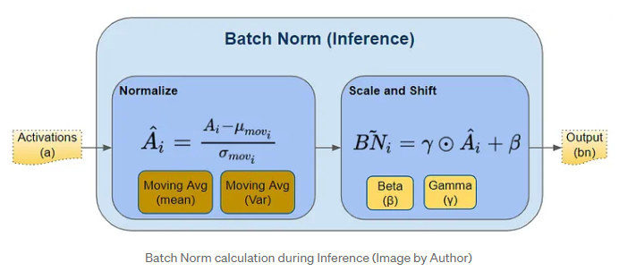
FFT-RadNet
Model evaluation
Evaluation mode (nn.Module.eval())
Create a consistent environment for model inference
BatchNorm2d and Dropout behave differently on evaluation and training mode
BatchNorm2d
Training mode: use batch statistic
Evaluation mode: uses the running estimates (mean and variance) that it computed during it's training phase
Implementation issue
Poor evaluation score on validation dataset
Unable to reproduce the performance on train dataset
momentum
Notes:
Study the code for understanding the dimension of the input and output data
The author pre-processed their labels data, need to check how to match with our ground truth

