Slide 1
EDA Project
By Deepti Gottipati

Slide 2
Project Overview
Hacker News website
(https://news.ycombinator.com/)
What it does
The hacker new website shows the articles on deeply interesting stuff.
The website shows via ranking the most popular links.
For each link/article the source, the source of the article on one line.
And below each article it gives the points received by the last user, the last user name of the user who voted on it, the time since the last vote and the total overall comments for the article.
How to get the data?
The hacker news website can be scraped using Beautiful Soup. I wrote some sample code to pull the data (though without pagination)
The website can also be scraped using Kimono labs API, which was used in this case for easy pagination.

Slide 3
Data Exploration (ACES)
A -- Assemble the data frame (Find data, import into Pandas)
First data set import to Pandas –- Related to articles and their ranking.
Id
article_info.href
article_info.text
Source
Points
last_updated_user_info.href
last_updated_user_info.text
comments.href
comments.text
Second data input to Pandas –- Related to commented users
username.href
username.text
commentedlink.href
commentedlink.text

Slide 4
Data Exploration (ACES)
C -- Clean the data frame (Identify and limit columns, rows, indices, dates, etc.)
Data Cleanup done
Cleaned comments.txt (eg: 35 comments) to number_of_comments (eg:35)
Cleaned source from (lekkertech.net) to lekkertech.net
Cleaned points from (eg: 175 points) to numeric value (eg: 175
Checked for empty /zero comments, but left them there as is

Slide 5
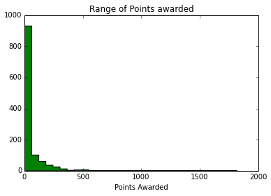
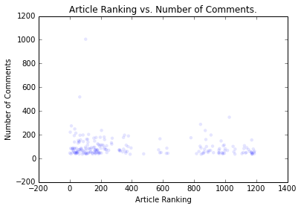
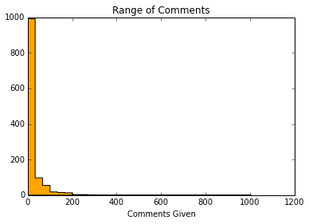
Data Exploration (ACES)
E -- Explore global properties Visualize!
Basic plots and stats appropriate to the data set
Range of points awarded by individual readers
Most of the points are <500, except a few outliers with >1000 points
Range of Comments given to the articles
Most of the comments are <200 per articles, except a few outliers with >800 points
Article Ranking versus Number of Comments

Slide 6
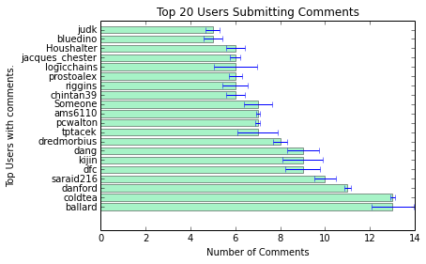
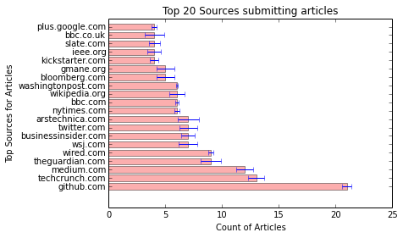
Data Exploration (ACES)
S -- Subset comparison
Top 20 sources submitting articles
Top 20 users submitting articles

Slide 7
Appendix A: HackerNewsScraper.py
https://www.dropbox.com/sh/lj9kh688z3lbngg/m38RP2ad4R/HackerNewsScraper.py

Slide 8
Appendix B: pythonnotebook file
http://nbviewer.ipython.org/urls/dl.dropbox.com/sh/lj9kh688z3lbngg/uAQ4zM3cHP/Hacker_News_Scraper_EDA.ipynb?create=1

