Slide 1
Historical GDP by Countries and Regions
From the World Bank Data Set

Slide 2
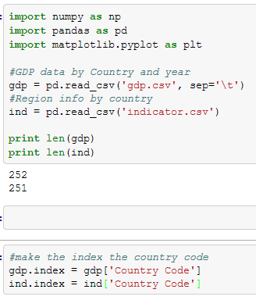
Gathering Data
Import GDP data from gdp.csv into gdp dataframe
Import indicator data into ind dataframe
Check import
Make country codes indices of each df

Slide 3
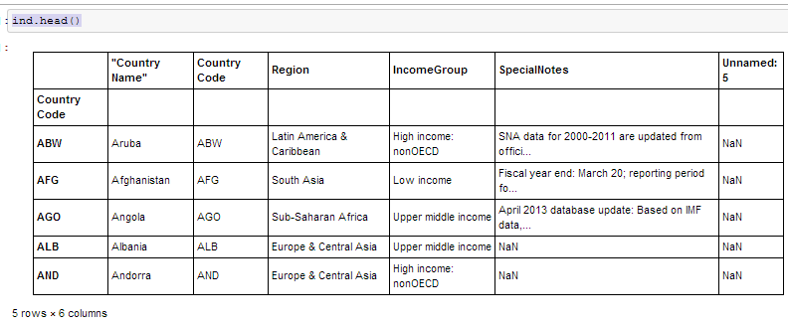
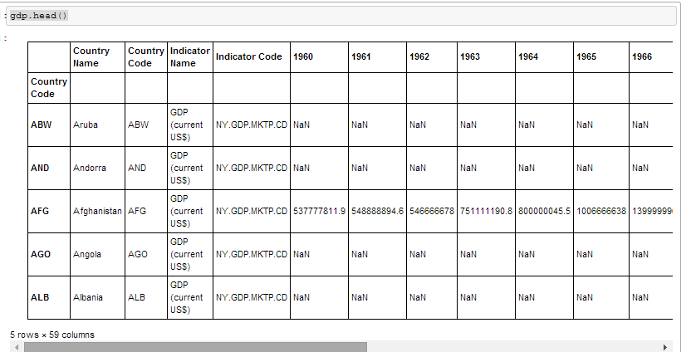
Data Sets
Country Info and Region
GDP Data Needs Region Info

Slide 4
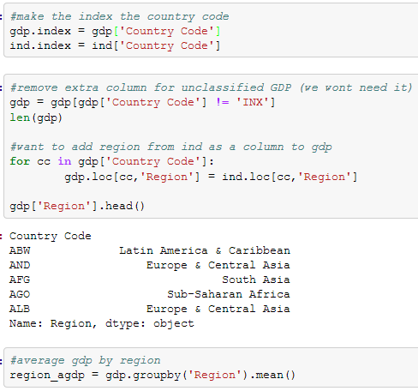
Remove unnecessary row from gdp df to easily match
For loop to create new ‘Region’ column in gdp
Check that it works (finally)
New df grouped by region with average GDPs for every year

Slide 5
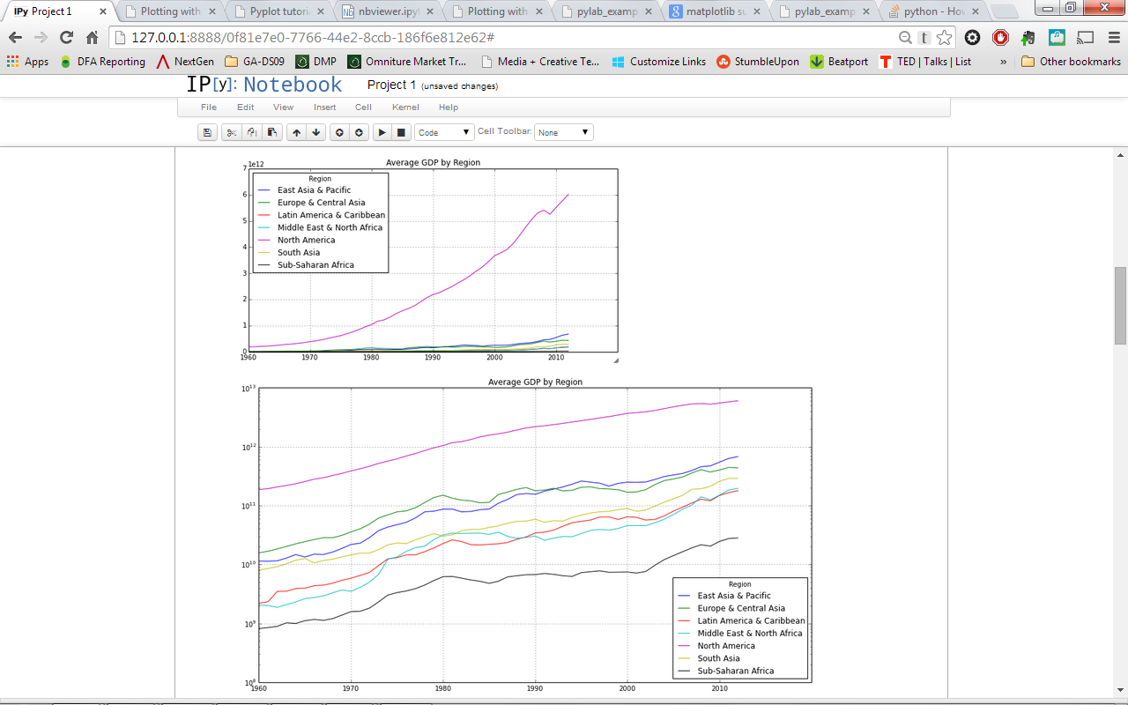
Plots of average performance by region
North America’s average GDP is off the charts
Log(y) scale makes it easier to see
East Asia surpassed Europe around 1992

Slide 6
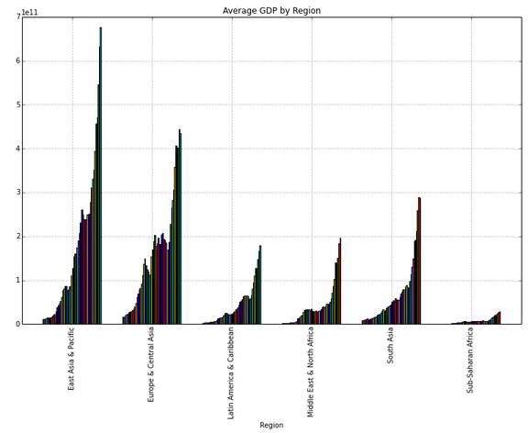
GDP over time by Region

Slide 7
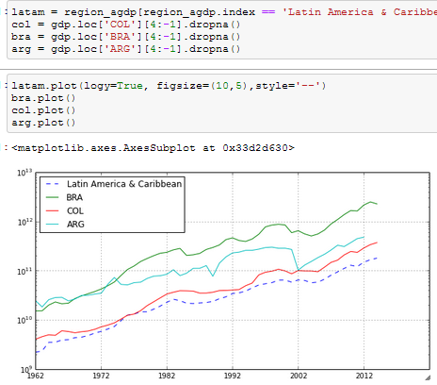
How 3 Countries Compare to Average

Slide 8
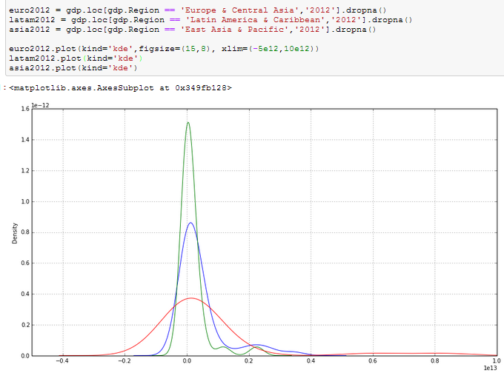
Density Plot

Slide 9
Next Steps
Consider GDP per capita since population may play a big role in region’s performance
Look at other indicators such as primary school completion rate to find potential correlations

