Slide 1
Project 01 – GADS
Study of Diamonds
Ryan Talbot

Slide 2
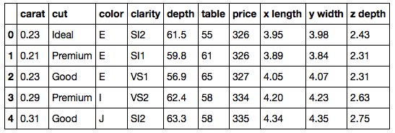
Data Collection
Source: diamonds.csv
A collection of about 50k diamonds with various characteristics about each diamond
Website: http://vincentarelbundock.github.io/Rdatasets/datasets.html

Slide 3
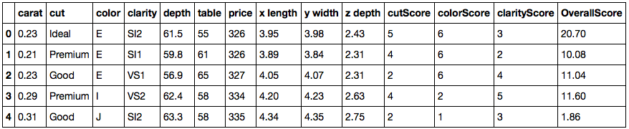
Cleaning the Data
Create a score for non-numeric features
The cut, color and clarity were categorized using a score of 1 – 5, 7 or 8, respectively
Creating an overall quality score
The carat was multiplied by the cut score, clarity score and color score

Slide 4
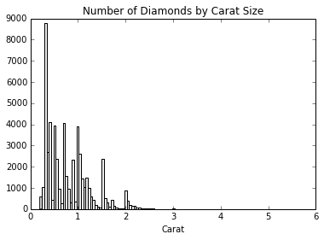
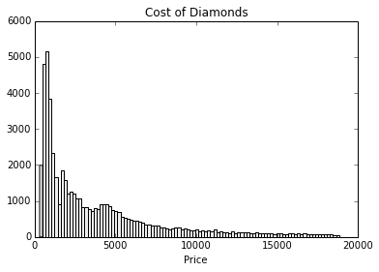
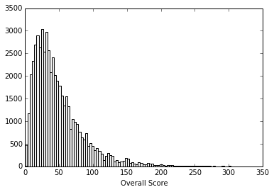
Visualize the Data - Histograms

Slide 5
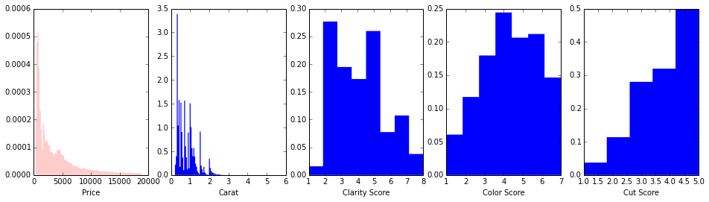
Comparison

Slide 6
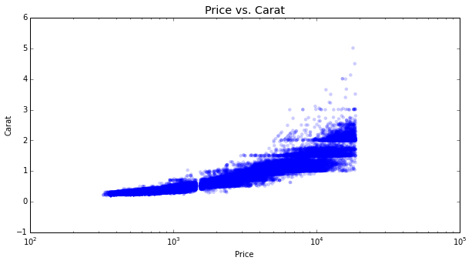
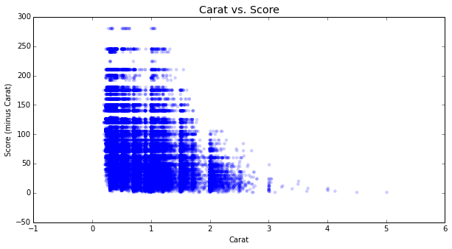
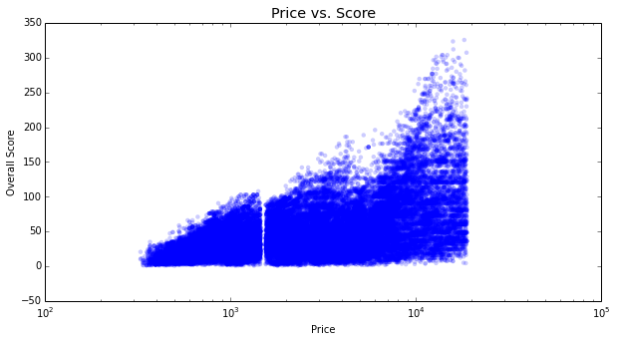
Scatter Plots

Slide 7
Observations
Clarity seems to be the least common quality
High carat diamonds typically are not great quality

