Slide 1
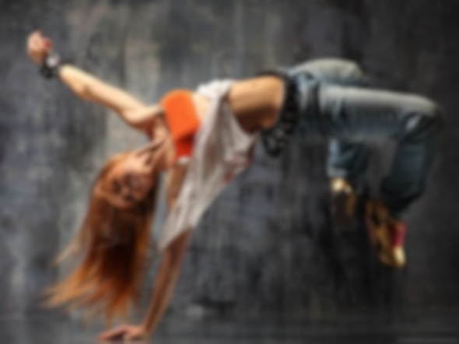
Dance Forms Classifier
By Deepti Gottipati

Slide 2
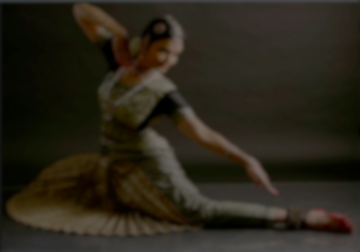
Dance Forms Classifier
Idea:
To write a classifier that would categorize different dance forms.
To be able to piece out the words that distinctly identify the dance forms.
Maybe also to look for commonalities in dance forms.
Classifier/Libraries Used:
TF-IDF (Term Frequency, Inverse Document Frequency) Classifier
Naïve Bayes Classifier
NLTK Library
Dance Forms Explorations:
Dance Forms Explored – 8
hiphop, bellydance, flamenco, kathak, hula, salsa, tango, bharatanatyam
Training Files – 18
hiphop-3, bellydance – 3, flamenco-3, kathak-5, hula -1, salsa-1, tango-1, bharatanatyam-1
Test Files – 8
One file for each of the 8 dance forms
Classify Files - 8
One file for each of the 8 dance forms

Slide 3
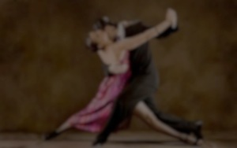
Data Acquisition and Cleaning
Data Acquisition
Started with wikipedia pages for a couple of dance forms
Extended it to a google seach ot any documents that talk about that dance form.
Data Cleaning and Processing
Load Training and test data from files (eg: hiphop.txt, hula.txt etc)
Tokenize document into words
No word limit – Read all of the document
Clean words (remove unwanted characters)
Check for stop words: If word isn’t a stop word add to the list.
Porter’s Stemmer – To remove like words
Eg: dancing danced dance – danc
Loving, loved, love – love

Slide 4
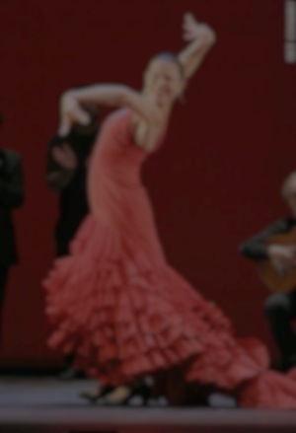
TF-IDF Algorithm
Freq(F) and Max Global Freq(MGF) Terms
Term Document Freq (TDF) and IDF
 | Kathak3 MGF=3 | flamenco3 MGF=10 | Hiphop3 MGF=2 | Hula MGF=4
Foot | F=2 | F=4 | F=0 | F=1
Flamenco | F=0 | F=10 | F=0 | F=0
Ball | F=1 | F=0 | F=0 | F=0
Guitarist | F=0 | F=4 | F=0 | F=0
Step | F=3 | F=6 | F=2 | F=4
Stomp | F=1 | F=6 | F=0 | F=0
 | TDF | N=# of Doc | [N/TDF] | IDF=Log[N/TDF]
Foot | 3 | 4 | 1.33 | 0.285
Flamenco | 1 | 4 | 4 | 1.386
Ball | 1 | 4 | 4 | 1.386
Guitarist | 1 | 4 | 4 | 1.386
Step | 4 | 4 | 1 | 0
Stomp | 2 | 4 | 2 | 0.693
 | Kathak3 MGF=3 | Flamenco3 MGF=10 | Hiphop3 MGF=2 | Hula MGF=4
Foot | (2/3)*0.285 =0.19 | (4/10)*0.285 =0.114 | (0/2)*0.285 =0 | (1/4)*0.285 =0.071
Flamenco | (0/3)* 1.386 =0 | (10/10)* 1.386 =1.386 | (0/2)*1.386 =0 | (0/4)*1.386 =0
Ball | (1/3)*1.386 =0.462 | (0/10)*1.386 =0 | (0/2)*1.386 =0 | (0/4)*1.386 =0
Guitarist | (0/3)*1.386 =0 | (4/10)*1.386 =0.554 | (0/2)*1.386 =0 | (0/4)*1.386 =0
Step | (3/3)*0 =0 | (6/10)*0 =0 | (2/2)*0 =0 | (4/4)*0 =0
Stomp | (1/3)*0.693 =0.231 | (6/10)*0.693 =0.416 | (0/2)*0.693 =0 | (0/4)*0.693 =0
kathak3 | flamenco3 | hiphop3 | hula
0.19+ 0.462 + 0.231 = 0.883 | 0.114 + 1.386 + 0.554 + 0.416 = 2.47 | 0 | 0.071
sum of column TF-IDF values
TF-IDF = (F/MGF)* IDF

Slide 5
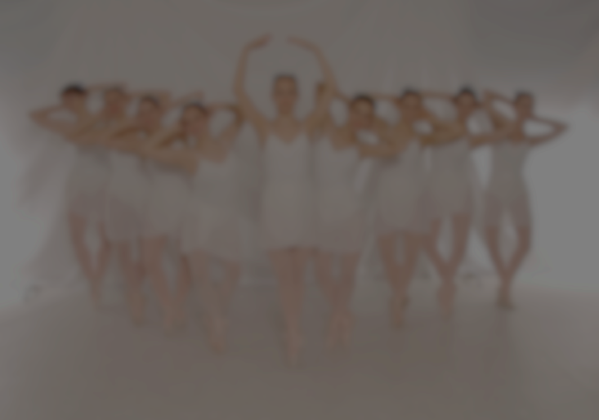
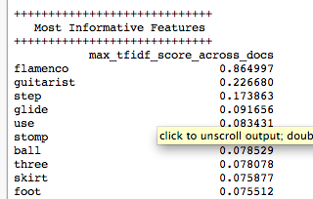
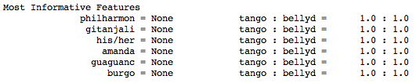
Most Informative Features
 | kathak3 | flamenco3 | hiphop3 | hula
Foot | 0.19 | 0.114 | 0 | 0.071
Flamenco | 0 | 1.386 | 0 | 0
Ball | 0.462 | 0 | 0 | 0
Guitarist | 0 | 0.554 | 0 | 0
Step | 0 | 0 | 0 | 0
Stomp | 0.231 | 0.416 | 0 | 0
Most Informative Features
Flamenco | 1.386
Guitarist | 0.554
Ball | 0.462
Stomp | 0.416
Foot | 0.19
Step | 0
TF-IDF Classifier
Naïve Bayes Classifier

Slide 6
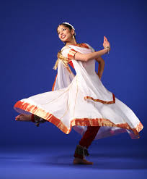
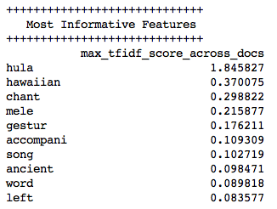
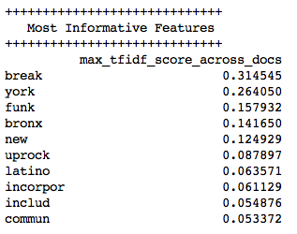
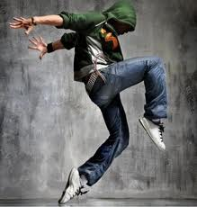
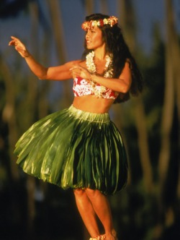
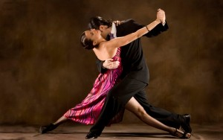
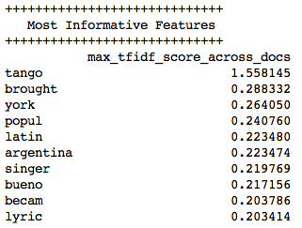
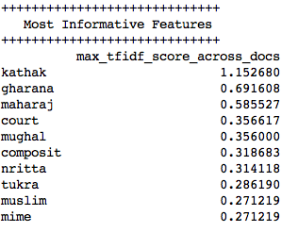
Match the Informative Features with Dance Forms

Slide 7
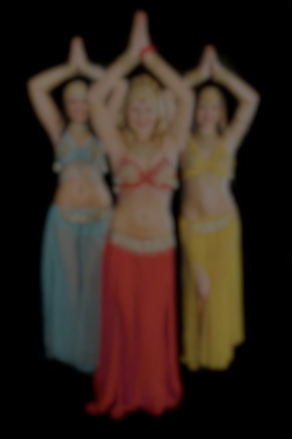

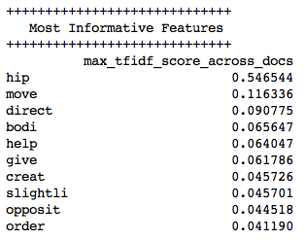

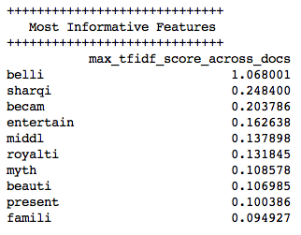
Missteps!
Different words for the dance form – hip hop, hiphop, hip-hop
Highest match for the word hip in the hiphop file.
Interesting enough, hip is also one of the most informative feature in belly dance – as its less about the belly and more about the hip!
Tried with another classification file.
This works! →

Slide 8
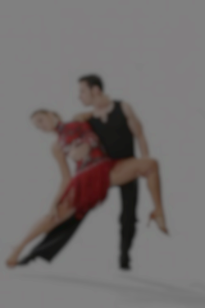
Next Steps
Fix the missteps
A list of different name representations for the dance forms
Try bi-grams : eg: bharata natyam, hip hop,
Extend the algorithm to more dance forms
More dance styles – similar and dissimilar
to see if the algorithm can distinguish between two dances of similar origin but different subtleties
Create a web interface via flask
Highlight the countries on a map to show the origins of the dance forms.

Slide 9
Questions?
Thank You

Slide 10
Appendix A: Classifier Files
Dance Classifier:
https://www.dropbox.com/s/6c34txhu3xz8psz/Dance_Classifier-TF_TDF.ipynb
Dance Data Zip Files:
https://www.dropbox.com/s/lwnndjl7bydcx6o/dance_data.zip

Slide 11

Appendix B: TF-IDF Classifier..
term frequency tf(t,d) –
Raw frequency of a term in a document, i.e. the number of times that term t occurs in document d.
Augmented frequency, to prevent a bias towards longer documents, e.g. raw frequency divided by the maximum raw frequency of any term in the document
inverse document frequency (idf) –
measure of how much information the word provides, that is, whether the term is common or rare across all documents.
It is the logarithmically scaled fraction of the documents that contain the word, obtained by dividing the total number of documents by the number of documents containing the term, and then taking the logarithm of that quotient.

Slide 12

Appendix C: TF-IDF Calculation
Tf-idf Calculation:
A numerical statistic that is intended to reflect how important a word is to a document in a collection or corpus.
Used as weighing factor in information retrieval and text mining
Increases proportionally to the number of times a word appears in the document, but is offset by the frequency of the word in the corpus, which helps control for the fact that some words are generally more common than others.
Meaning of TF-Idf Value :
A high weight in tf–idf is reached by a high term frequency (in the given document) and a low document frequency of the term in the whole collection of documents! the weight’s hence tend to filter out common terms.
Since the ratio inside the tf idf’s log function is always greater than or equal to 1, the value of idf (and tf-idf) is greater than or equal to 0.
As a term appears in more documents, the ratio inside the logarithm approaches 1, bringing the idf and tf-idf closer to 0

Slide 13
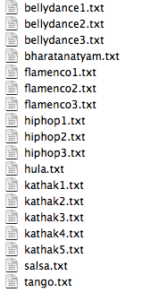
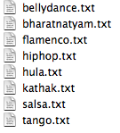
Appendix D: Dance Classification data sets
Training Files
Test Files

Slide 14
Appendix E: References
https://www.cs.rutgers.edu/~mlittman/courses/ml03/iCML03/papers/ramos.pdf
http://en.wikipedia.org/wiki/Tf–idf

