Slide 1
A Two-Part Study:
What are People Feeling About Crimea?
A Study Using Naïve Bayes Classifier (Using Multinomial and Bernouli)
and
A Study of the Relationship between
Emotion About Crimea vs. Distance from Crimea

Slide 2
What are People Feeling About Crimea?
A Study Using Naïve Bayes Classifier (Using Multinomial and Bernouli)

Slide 3
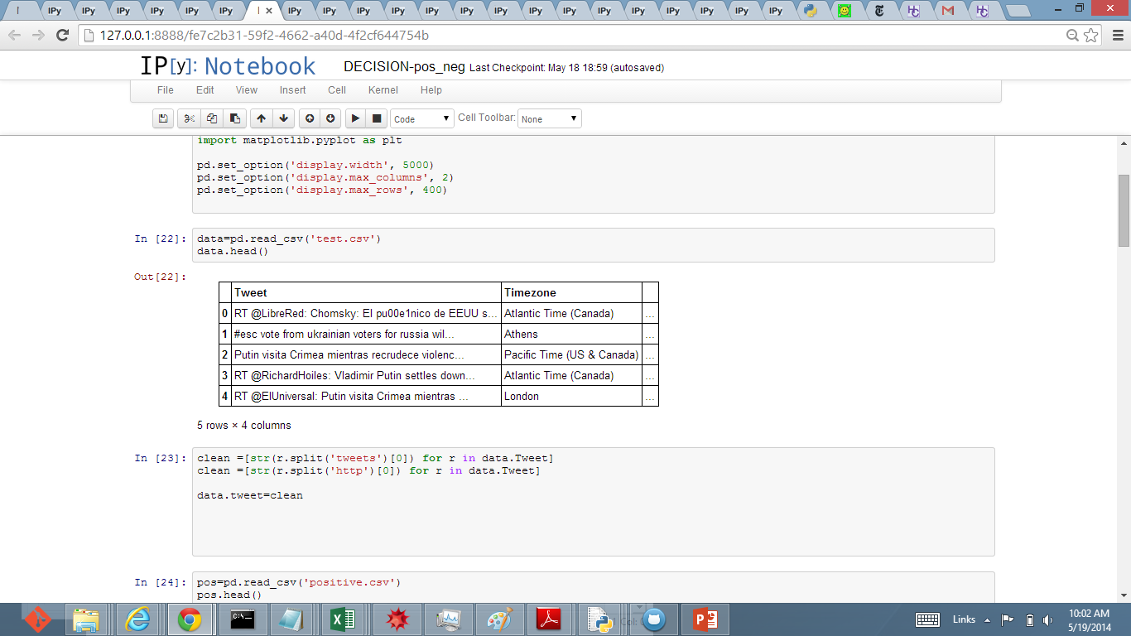
(Using Tweepy Api, I pull Tweets with keyword: “Crimea”, as well as City (timezone)) Analyzing Data: My 1st Step is to in read in the Data:

Slide 4
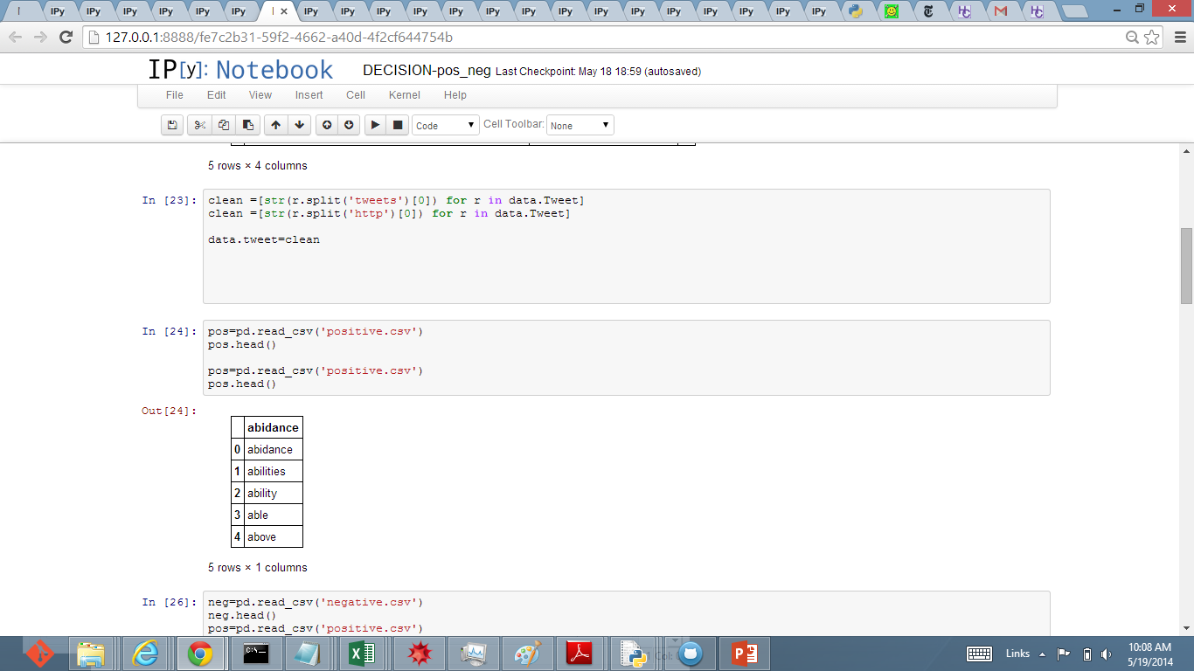
My goal here is to determine the “tone” or “emotion” of the Tweet. In order to analyze the tone, I will read in a positive and a negative library: (approx. 3000 adj /nouns)

Slide 5
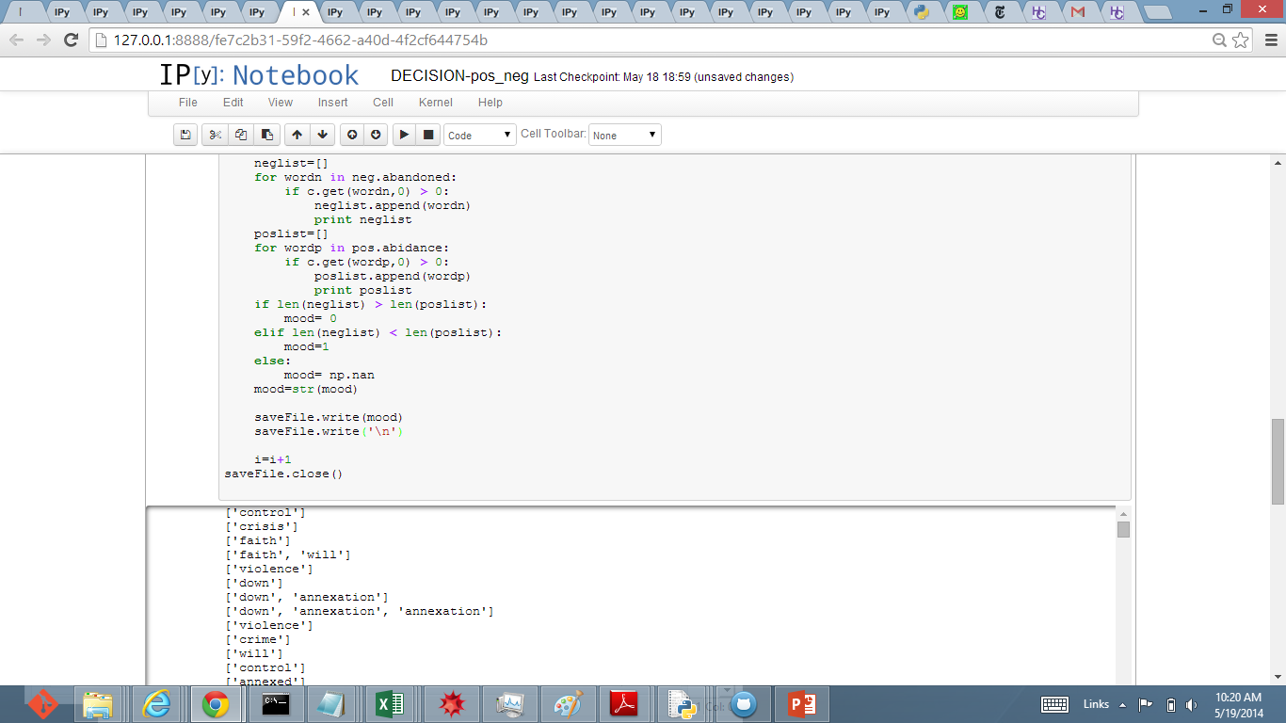
Using an inner and outer loop, I compare each word of Tweet and compare with positive and negative lists. I determine the tweet as Positive or Negative by comparing the pos. and neg. Count.

Slide 6
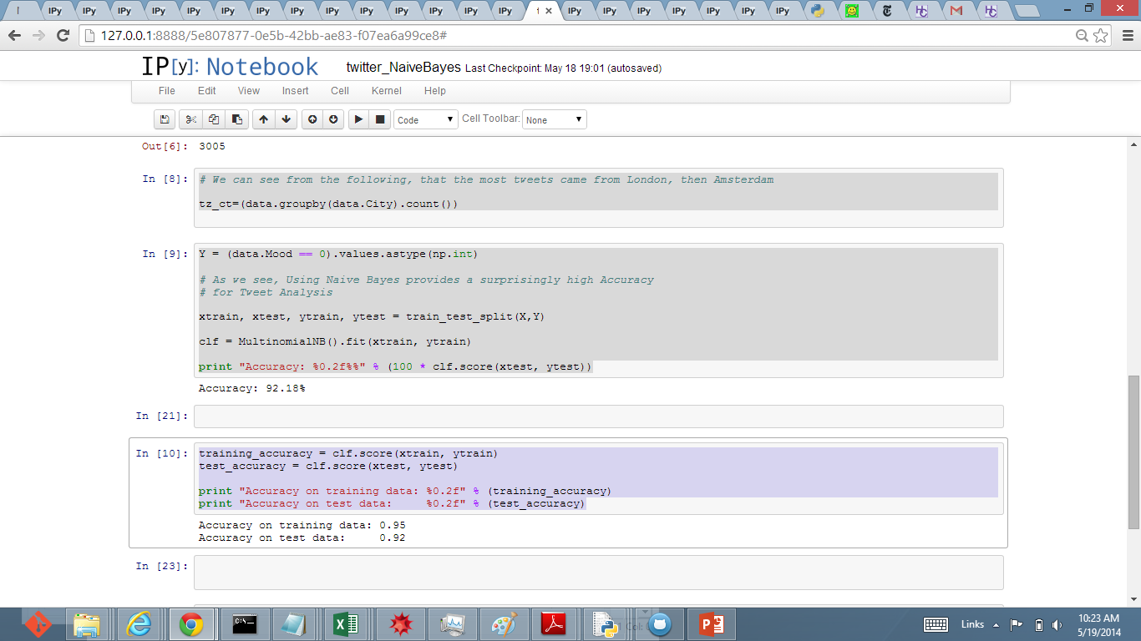
Next, I used the MultiNomial NB classifier to predict the mood (positive or negative), based on text of Tweet. As we can see: the accuracy on the training data was quite high: 95% Which begs the question…

Slide 7
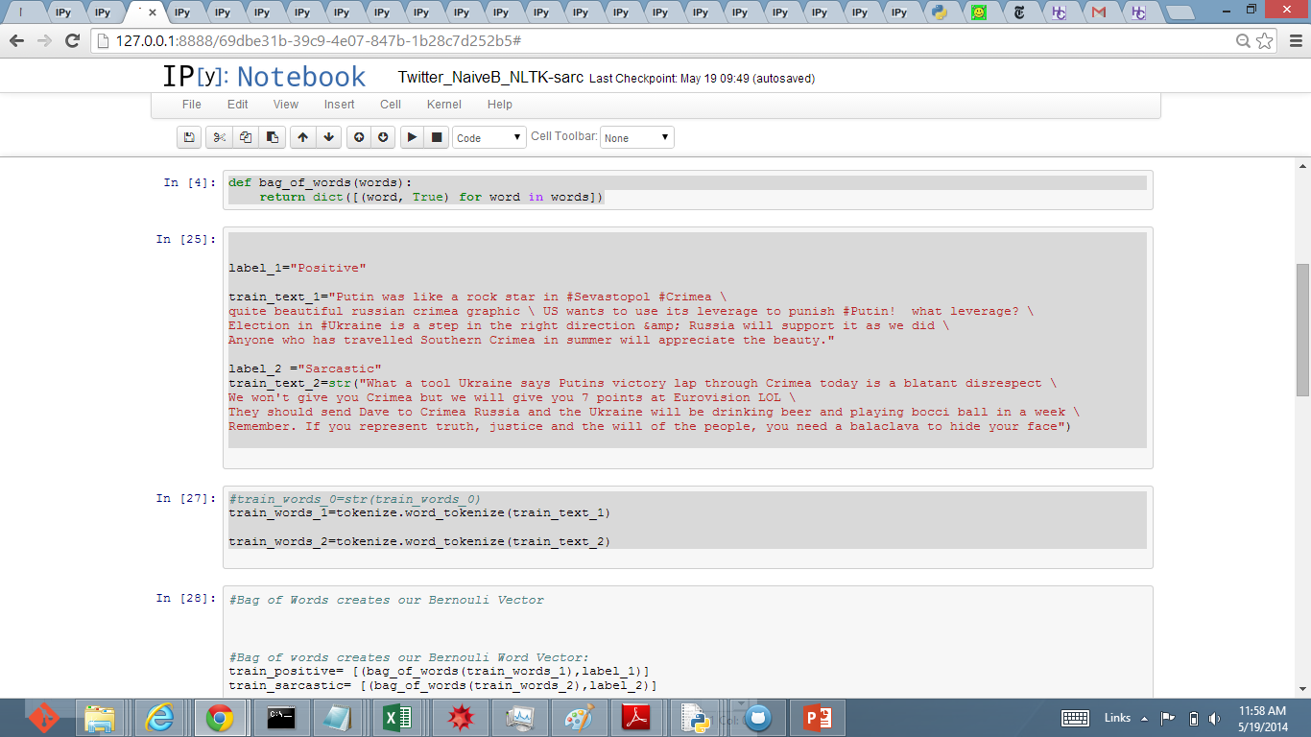
However, are ‘Positive’ Tweets really Positive? …..Or are they Sarcastic? To determine this: I used the Bag_of_Words Bernouli Vector and NLTK Naïve Bayes.

Slide 8
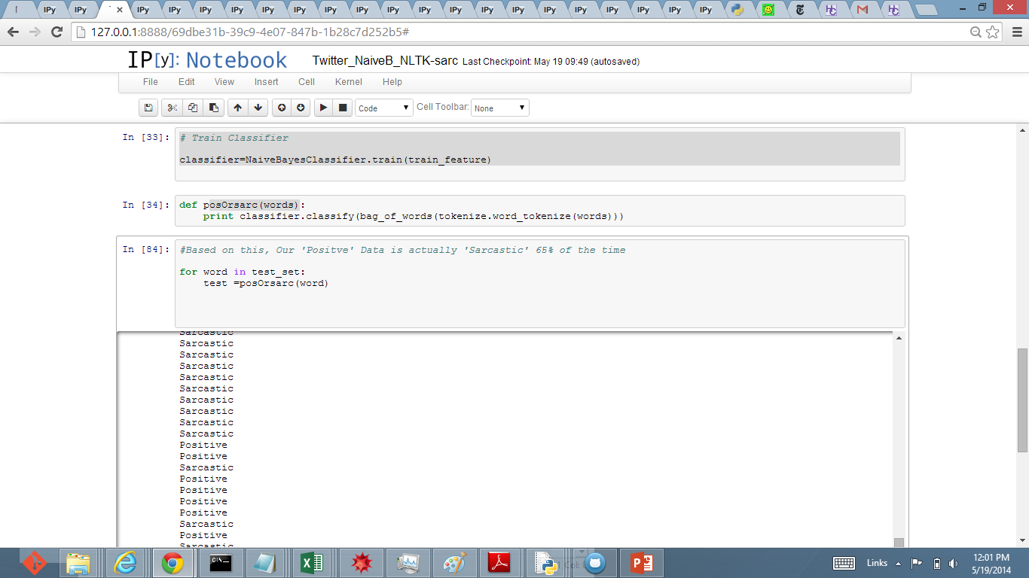
According to NLTK, the probability that a Positive Tweet is actually Sarcastic is : 65%

Slide 9
A Study of the Relationship between
Emotion About Crimea vs. Distance from Crimea

Slide 10
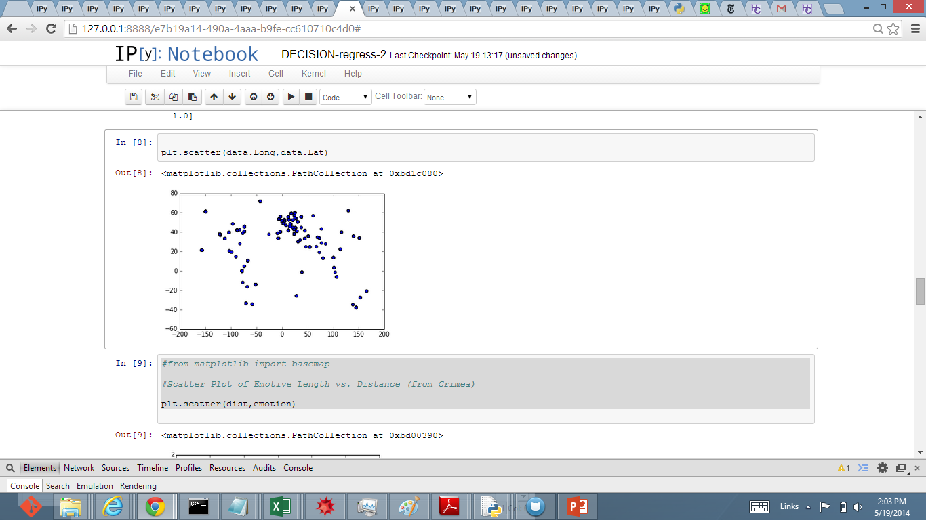
In order to create a plot of Distance vs. Emtotion:
I get the Distance: via Distance Formula & Longitudinal and Latitudinal Distance
Using the earlier emotion ‘count’: I assign an “emotive score” from neg to pos.

Slide 11
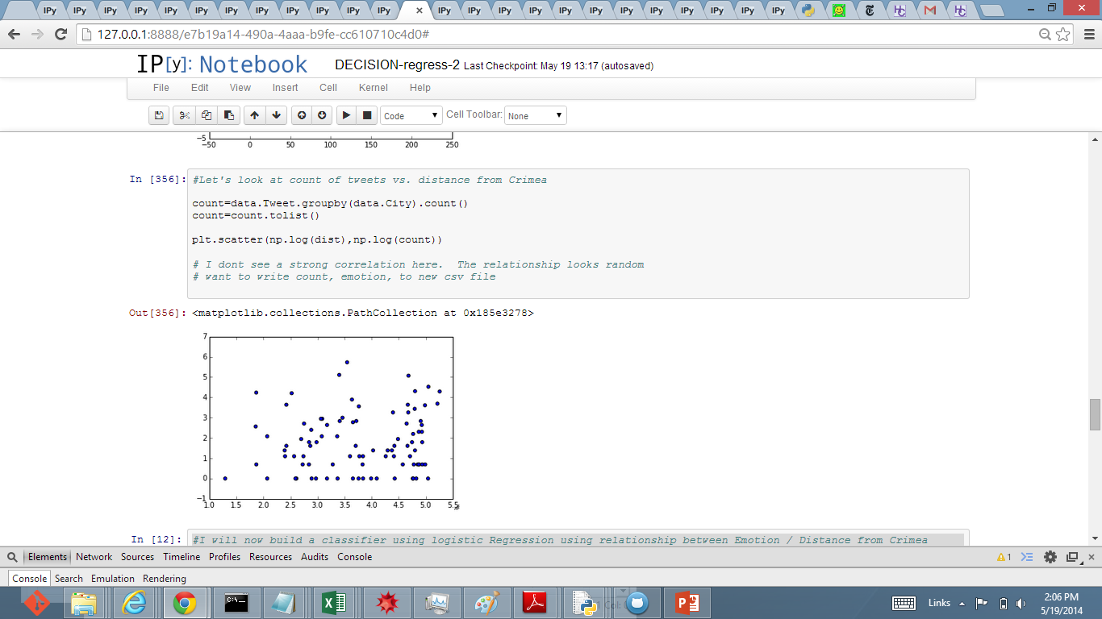
And # of Tweets (grouped by City) vs. Distance

