Slide 1
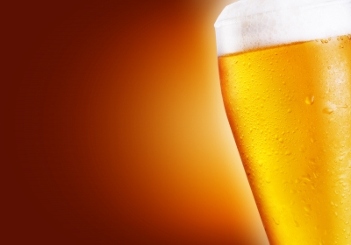
Beer in America in 3 Slides
Radu Stancut
General Assembly
GADS9

Slide 2

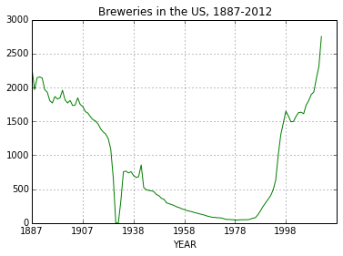
Breweries Through Time
Two key moments: 1920-32 and After 1980

Slide 3
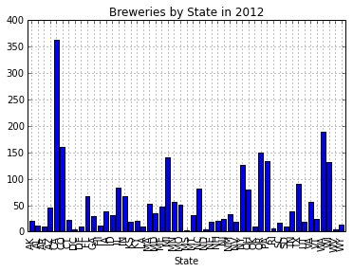
Overview by State
CA alone had more breweries in 2012 than entire USA from 1950-1991

Slide 4
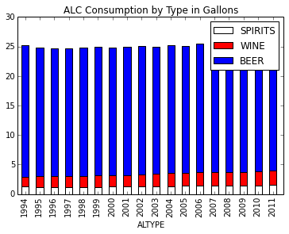
Per Capita Consumption by Year
If Americans aren’t consuming more beer per year, how is it that so many breweries have sprung up?

Slide 5
Resources
http://www.beerinstitute.org/assets/uploads/Brewers_Almanac-_20131.xlsx
http://commons.wikimedia.org/wiki/Main_Page

