Slide 1
Project 2: Classification of Chicago Public Elementary Schools
Presented by: Anastasia Dukes
Data source: 2013-14 Chicago Public Schools, Elementary School Progress Report
May 19, 2014.

Slide 2
Data set and relevance
I chose to work with data from the 2013-14 Chicago public elementary school progress report, available here: https://data.cityofchicago.org/Education/Chicago-Public-Schools-Elementary-School-Progress-/tj8h-mnuv
I made this selection because I regularly analyze New York City public school progress report data at work and I wanted to experiment with data from a different district

Slide 3
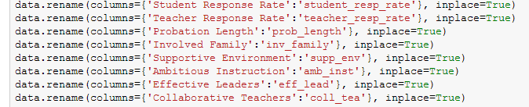
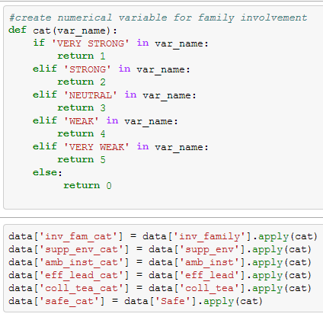
ACES framework for Visual Data Exploration
Acquire: 2013-14 Chicago elementary school progress report data sourced from the city of Chicago data portal via csv data file
Clean:
features were renamed to python-friendly names
several features had to be transformed from categorical to numerical values in order to be included in the model (i.e. from ‘very strong’ to ‘very weak’ to a numerical scale of 1 to 5)

Slide 4
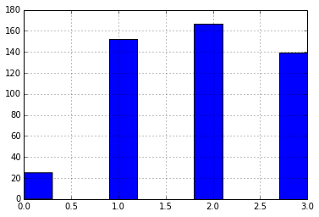
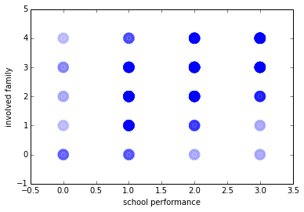
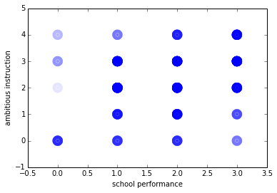
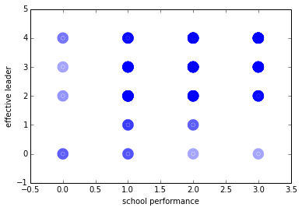
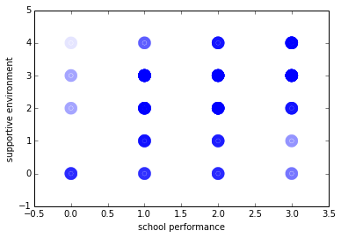
ACES framework for Visual Data Exploration continued
Explore:
Plotted y (school performance) as a histogram to confirm scores were evenly distributed
Plotted features along with school performance to visually see the strength of the relationships
Involved family
Ambitious instruction
Effective leader
Supportive environment

Slide 5
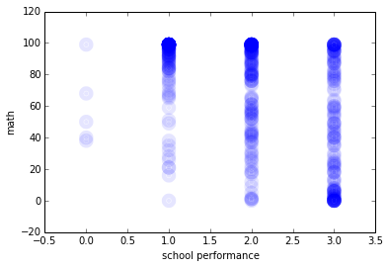
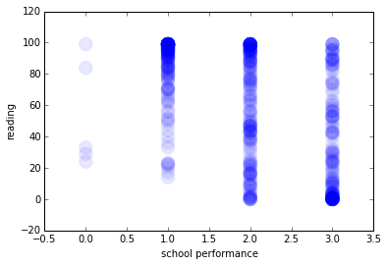
ACES framework for Visual Data Exploration continued
Explore (continued):
Math & reading growth scores were not clearly related to school performance
Subset:
Tested the following features:
Involved family: the entire staff builds strong external relationships
Ambitious instruction: classes are challenging and engaging
Effective leader: principals and teachers work together to implement a shared vision
Supportive environment: the school is safe, demanding, and supportive
Collaborative teachers: teachers collaborate to promote professional growth
Safety: students feel safe in and around the school

Slide 6
Classification challenge and algorithm
Decided to use logistic regression to classify “strong” schools (aka schools rated level 1)

Slide 7
Accuracy rates and feature details
Classification report
precision recall f1-score support
False 0.74 0.88 0.80 243
True 0.60 0.35 0.44 119
avg / total 0.69 0.71 0.69 362
Confusion matrix
[[215 28]
[ 77 42]]
Training set accuracy: 0.710
Test set accuracy: 0.719
Coefficients:
Safety and ambitious instruction were the most influential feature
Leadership was the least influential feature
Feature | Ambitious instruction | Effective leader | Collaborative teachers | Safety
Coefficient | 0.764 | 0.069 | -0.290 | -0.984
Code for classification and feature improvement in separate file

