Slide 1
Nonlinear ABS Control
Tim Coon
MAE5803
20 April, 2017

Slide 2
Outline
Introduction
Problem description
Mathematical model
Second-order to first-order because velocity control
Slip variable to analyze and define optimal performance
Phase diagram
First stage: constant brake torque
Second stage: nonlinear gain on velocity (s/b on wheel speed?)
Third stage: control to optimal slip condition

Slide 3
Single-Wheel Braking Model

Slide 4
Longitudinal Tire Slip, Dimensionless

Slide 5
Friction Model From Empirical Data

Slide 6
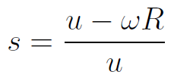

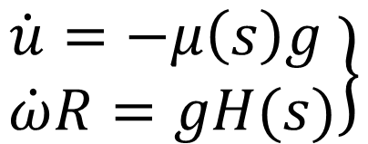
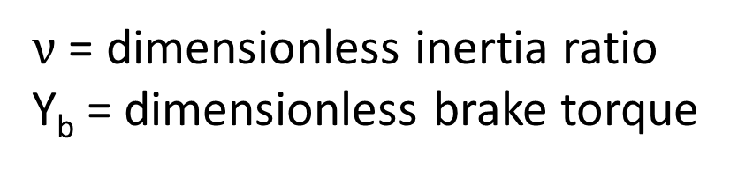

Equations of Motion
$$\left.\begin{matrix}\dot{u}=−μ\left(s\right)g \\ \dot{ω}R=gH(s)\end{matrix}\right\}$$
Control Laws:
Constant Torque
Proportional Feedback
Switching Control
Adaptive Control
$$0≤ωR≤u$$
$$H\left(s\right)= \text{ν}μ(s) −Y_{b}$$
Control Input
$\text{ν}$ = dimensionless inertia ratio
Y_{b} = dimensionless brake torque

Slide 7

Phase Portraits
$$h_{b}\left(s^{∗}\right)=0$$

Slide 8
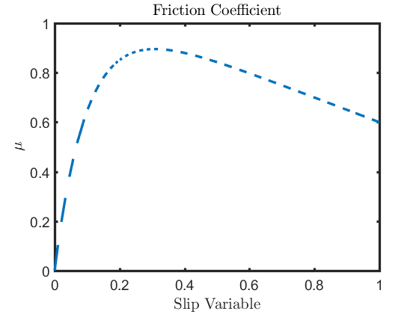


Optimal Braking
$$μ\left(s\right)=c_{1}\left(1−e^{−c_{2}s}\right)−c_{3}s$$
$$μ_{max}$$
$$s_{d}$$

Slide 9
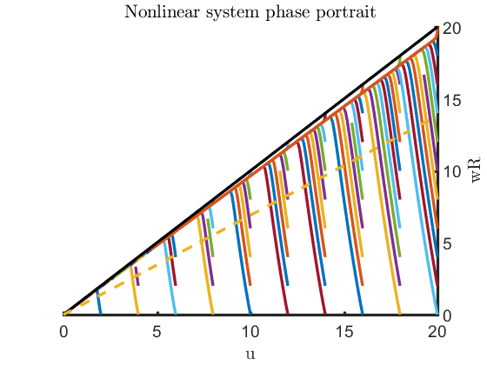
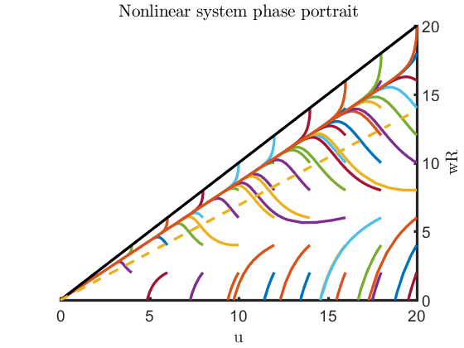
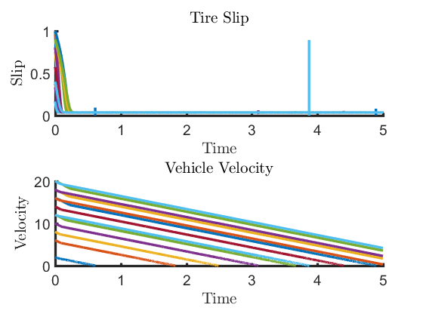
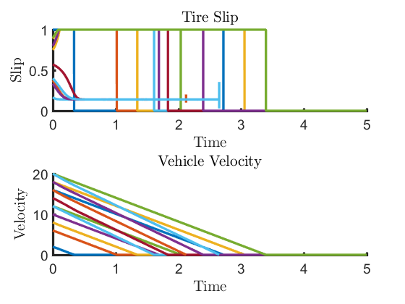

Constant Torque
Y_{b} = 5
Y_{b} = 12
$$ωR=\left(1−s\right)u$$

Slide 10
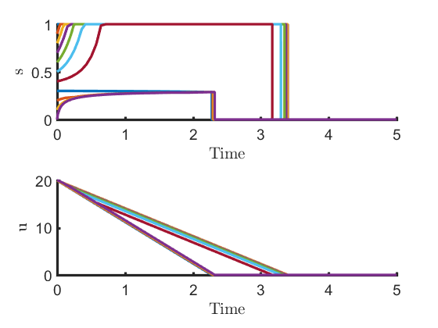
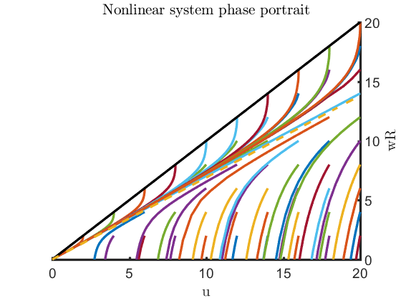

Constant Torque, Max Friction
$$Y_{b_{d}}=\left(1+\text{ν}−s_{d}\right)μ_{\left(s_{d}\right)}$$

Slide 11
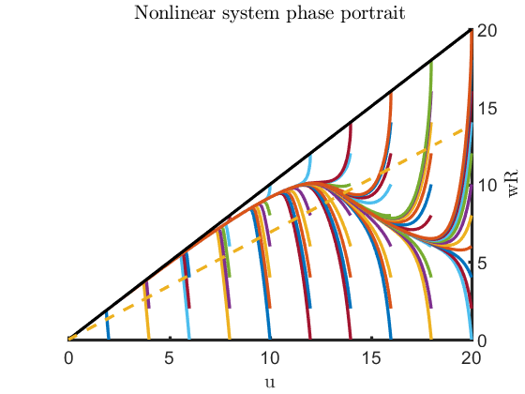
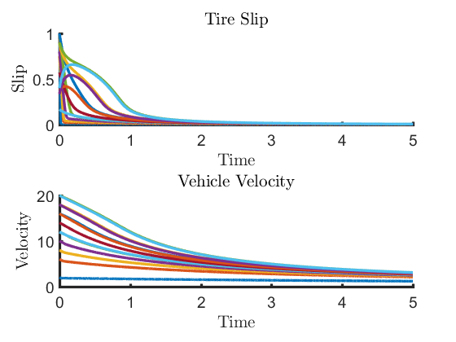

Proportional Feedback
$$Y_{b}=k_{p}ωR$$
$$k_{p}=0.1u$$

Slide 12
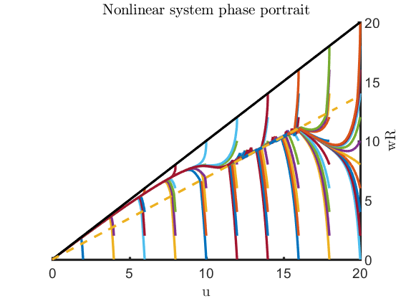
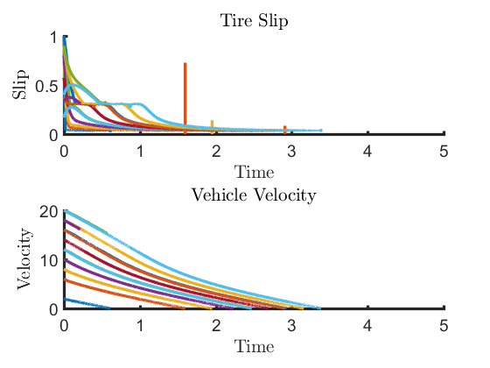
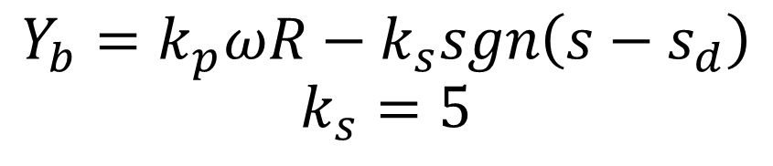
Switching Control
$$Y_{b}=k_{p}ωR−k_{s}sgn\left(s−s_{d}\right)$$
$$k_{s}=5$$
Maintain Optimal Tire Slip for Max Braking

Slide 13
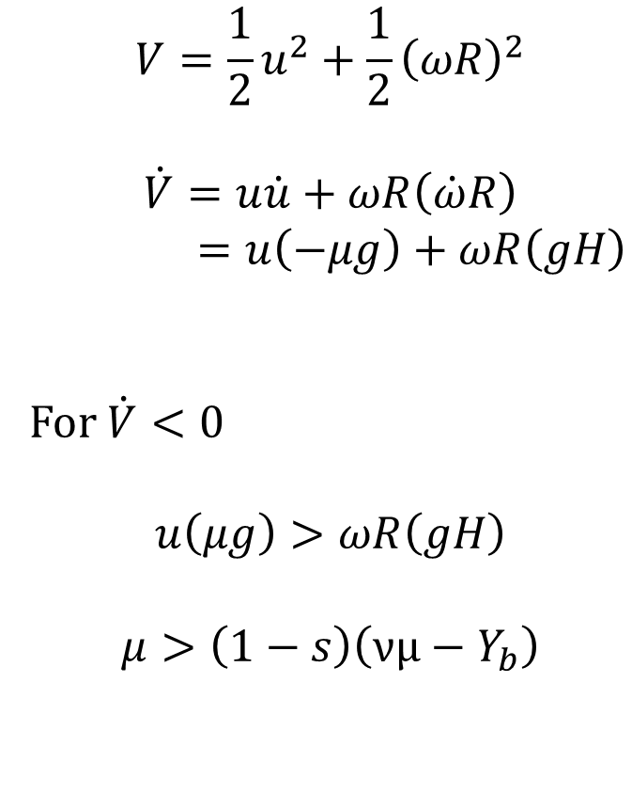

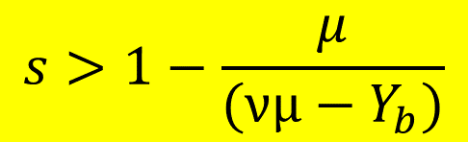

Lyapunov Analysis
$$V=\frac{1}{2}u^{2}+\frac{1}{2}{\left(ωR\right)}^{2}$$
$$\dot{V}=u\dot{u}+ωR\left(\dot{ω}R\right)$$ $=u\left(−μg\right)+ωR\left(gH\right)$
For $\dot{V}<0$
$$u\left(μg\right)>ωR\left(gH\right)$$
$$μ>\left(1−s\right)\left(\text{ν}μ−Y_{b}\right)$$
Candidate Lyapunov function, notice the kinetic energies of the car and the wheel are independent of each other.
In order to have $\dot{V}$ negative definite, the relation must hold for all time.
$$s>1−\frac{μ}{(\text{ν}μ−Y_{b})}$$
$$\frac{ωR}{u}=1−s$$

Slide 14


Adaptive Control (Future Work)
Add an uncertain scaling factor, θ, to the friction coefficient and add adaptation law. This will account for some of the uncertainty in the surface conditions.
An interesting question arising from this scenario is, will the adaptation law update the estimated dynamics quickly enough to be effective?
$$\left.\begin{matrix}\dot{u}=−θμ\left(s\right)g \\ \dot{ω}R=gH(s)\end{matrix}\right\}$$
$$0≤ωR≤u$$

Slide 15
References
Olson, B. J., S. W. Shaw, and G. Stépán. "Nonlinear dynamics of vehicle traction." Vehicle System Dynamics 40.6 (2003): 377-399.
Adcox, John. "Adaptive and Robust Braking-Traction Control Systems." (2014).

