Slide 1
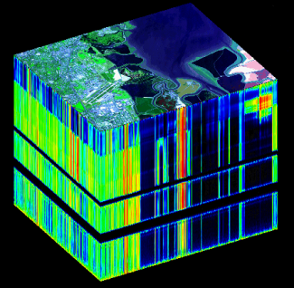
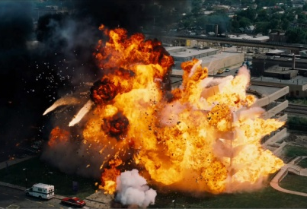
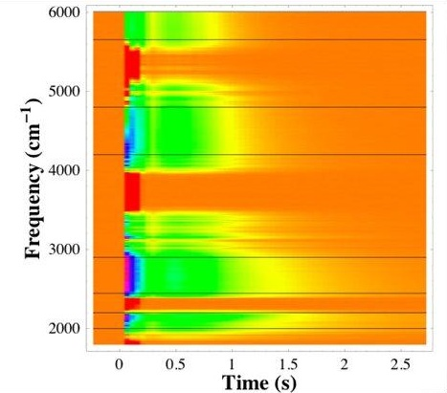
SPATIAL RESOLUTION
SPECTRAL RESOLUTION
TEMPORAL RESOLUTION
Frequency (cm⁻¹)
Time (s)

Slide 2
SPATIAL RESOLUTION
SPECTRAL RESOLUTION
TEMPORAL RESOLUTION

