Slide 1

Building a Killer UX
Brad Tilton
Sr. Implementation Specialist
Cloud Sherpas
Jake Gillespie
Sr. Implementation Specialist
Cloud Sherpas
A ServiceNow Master Partner

Slide 2


Building a Killer UX
Learn how to go beyond the standard ServiceNow user interface using AngularJS and Bootstrap.
In this session you will start with a simple, custom, scoped ToDo app built on ServiceNow’s Fuji release.
You’ll use AngularJS and Bootstrap to add custom UI controls to create a one page app optimized for mobile where you can add new ToDos, complete ToDos, and perform other actions without refreshing or navigating away from the page.

Slide 3
Agenda
Introduction
Why Build a Custom Interface?
Intro to Bootstrap/AngularJS
Demo/Labs
Conclusion
Notes:
Template default agenda is set to have 5 items.
For fewer than 5 points: delete place holders that aren't used from the master ->slide master view.
For more than 5 points: Use the default Title and Content slide layout.

Slide 4
Demo

Slide 5

Speaker Intros – Brad Tilton
Title:
Senior Implementation and Training Specialist, Cloud Sherpas - ServiceNow Master Partner
Accomplishments:
6+ Years developing on the ServiceNow platform. Community MVP.
Education/Certifications:
ServiceNow Certified Instructor, Administrator, Implementation Specialist, and Developer. Author on
ServiceNow Community and Cloud Sherpas Blogs
Contact:
Brad.Tilton@CloudSherpas.com
twitter.com/bradtilton
linkedin.com/in/bradtilton

Slide 6
Speaker Intros – Jake Gillespie
Title:
Senior Implementation Specialist, Cloud Sherpas - ServiceNow Master Partner
Accomplishments:
4+ Years developing on the ServiceNow platform.
Education/Certifications:
ServiceNow Certified Instructor, Administrator, Implementation Specialist, and Developer. Bachelor degree
in Engineering Technology (Computer Systems).
Contact:
jake.gillespie@cloudsherpas.com

Slide 7
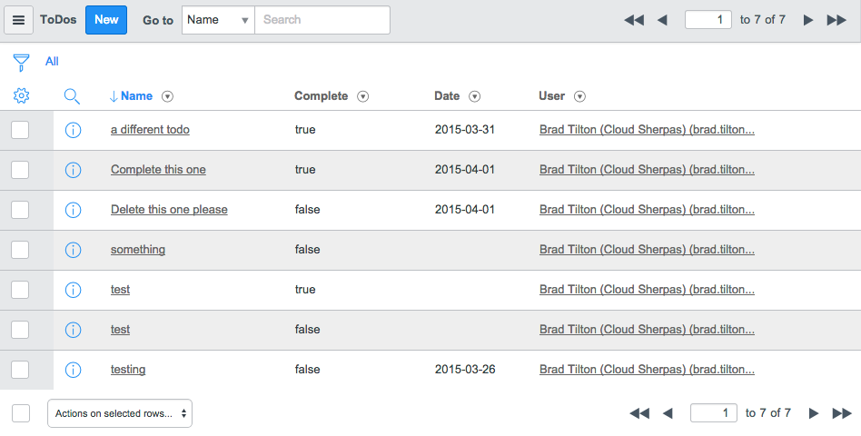
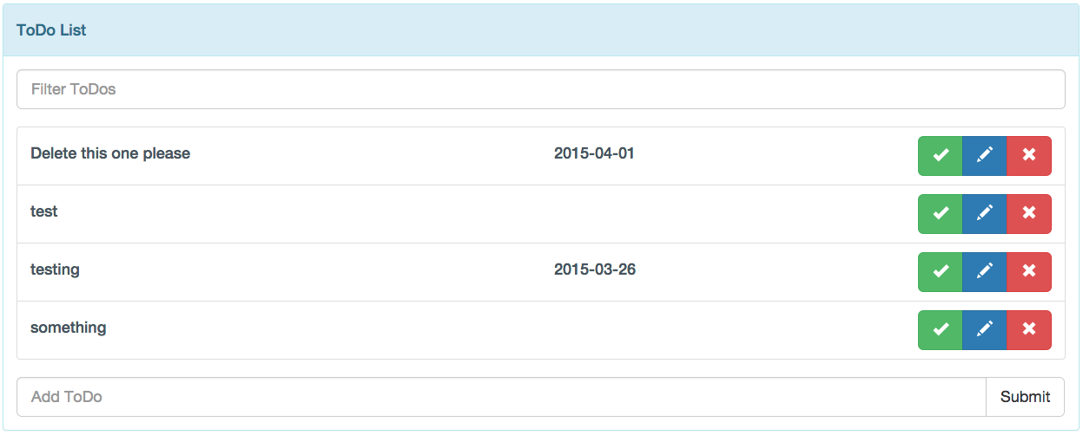
Why Build A Custom Interface
ServiceNow’s native interface is very powerful, but…
Using list editing and filters typically takes a bit of training
Excepting list editing, adding, deleting, and editing records requires leaving or refreshing the page and multiple clicks.
Screen can be busy
In our custom ToDo app, we want people to be able to…
Use it without any training
Manage all of their ToDos from one page like most other ToDo apps out there.
Clean interface

Slide 8
What is Bootstrap?
Bootstrap is the most popular HTML, CSS, and JavaScript framework for developing responsive, mobile-first web sites.
It contains HTML and CSS-based design templates for typography, forms, buttons, navigation and other interface components, as well as optional JavaScript extensions.
Reasons for programmers prefer Bootstrap
Easy to get started
Great grid system
Base styling for most HTML elements (Typography, Code, Tables, Forms, Buttons, Images, Icons)
Extensive list of components
Bundled Javascript plugins
Optimized for mobile

Slide 9
What is AngularJS?
AngularJS is a structural framework for dynamic web apps. It lets you use HTML as your template language and lets you extend HTML's syntax to express your application's components clearly and succinctly. Angular's data binding and dependency injection eliminate much of the code you would otherwise have to write.

Slide 10
Why should we use Bootstrap and Angular?
Bootstrap
We’ll build the entire app without doing any specific styling. We can get a good looking app just by using base bootstrap
ServiceNow’s forms and lists have been rebuilt in Fuji using bootstrap, so while we want a cleaner interface, it will still feel similar to the default interface.
By using Bootstrap 3, our app will be optimized for mobile right out of the gate.
Angular
Allows us to cut down on the amount of code we need compared to other front end frameworks.
We can manipulate the data on the page and post to the DB easily without the user having to refresh or navigate away.

Slide 11
Workshop
https://killerux-XXX.lab.service-now.com/ admin/Knowledge15

Slide 12
Conclusion
What kind of applications would you build based on your experience in this workshop?
Timecarding
ESS Portal
Etc…
Resources and Useful Links
Bootstrap
AngularJS
App Start on Share
Various blogs

Slide 13
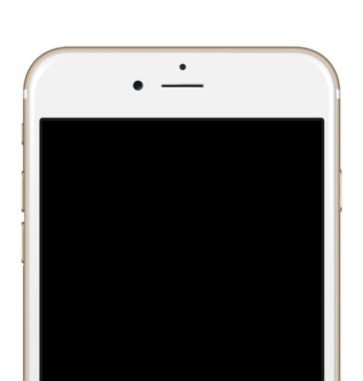
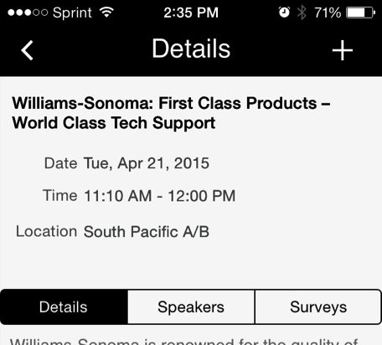

How Did We Do?
Your feedback on this session helps us deliver great content.
Please take a moment to complete a session survey in the Knowledge15 app or use the survey forms at the back of the room.
Get Presentations
As a Knowledge15 attendee, you have exclusive access to breakout and lab session content from the event.
Go to knowledge.servicenow.com
Log into the community
Click on View Now button
knowledge.servicenow.com
Thank You
Brad Tilton
Sr. Implementation Specialist
Cloud Sherpas
Brad.Tilton@CloudSherpas.com
Jake Gillespie
Sr. Implementation Specialist
Cloud Sherpas
Jake.Gillespie@CloudSherpas.com

