Slide 1


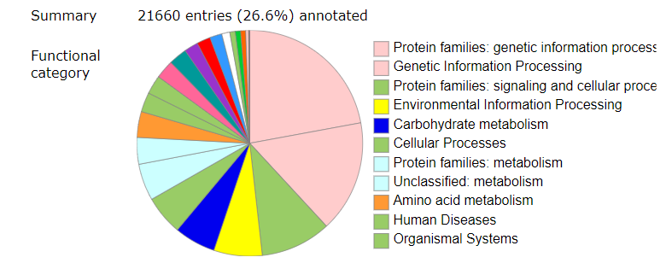
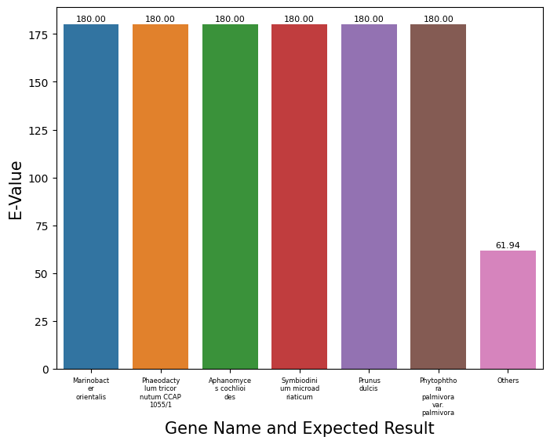
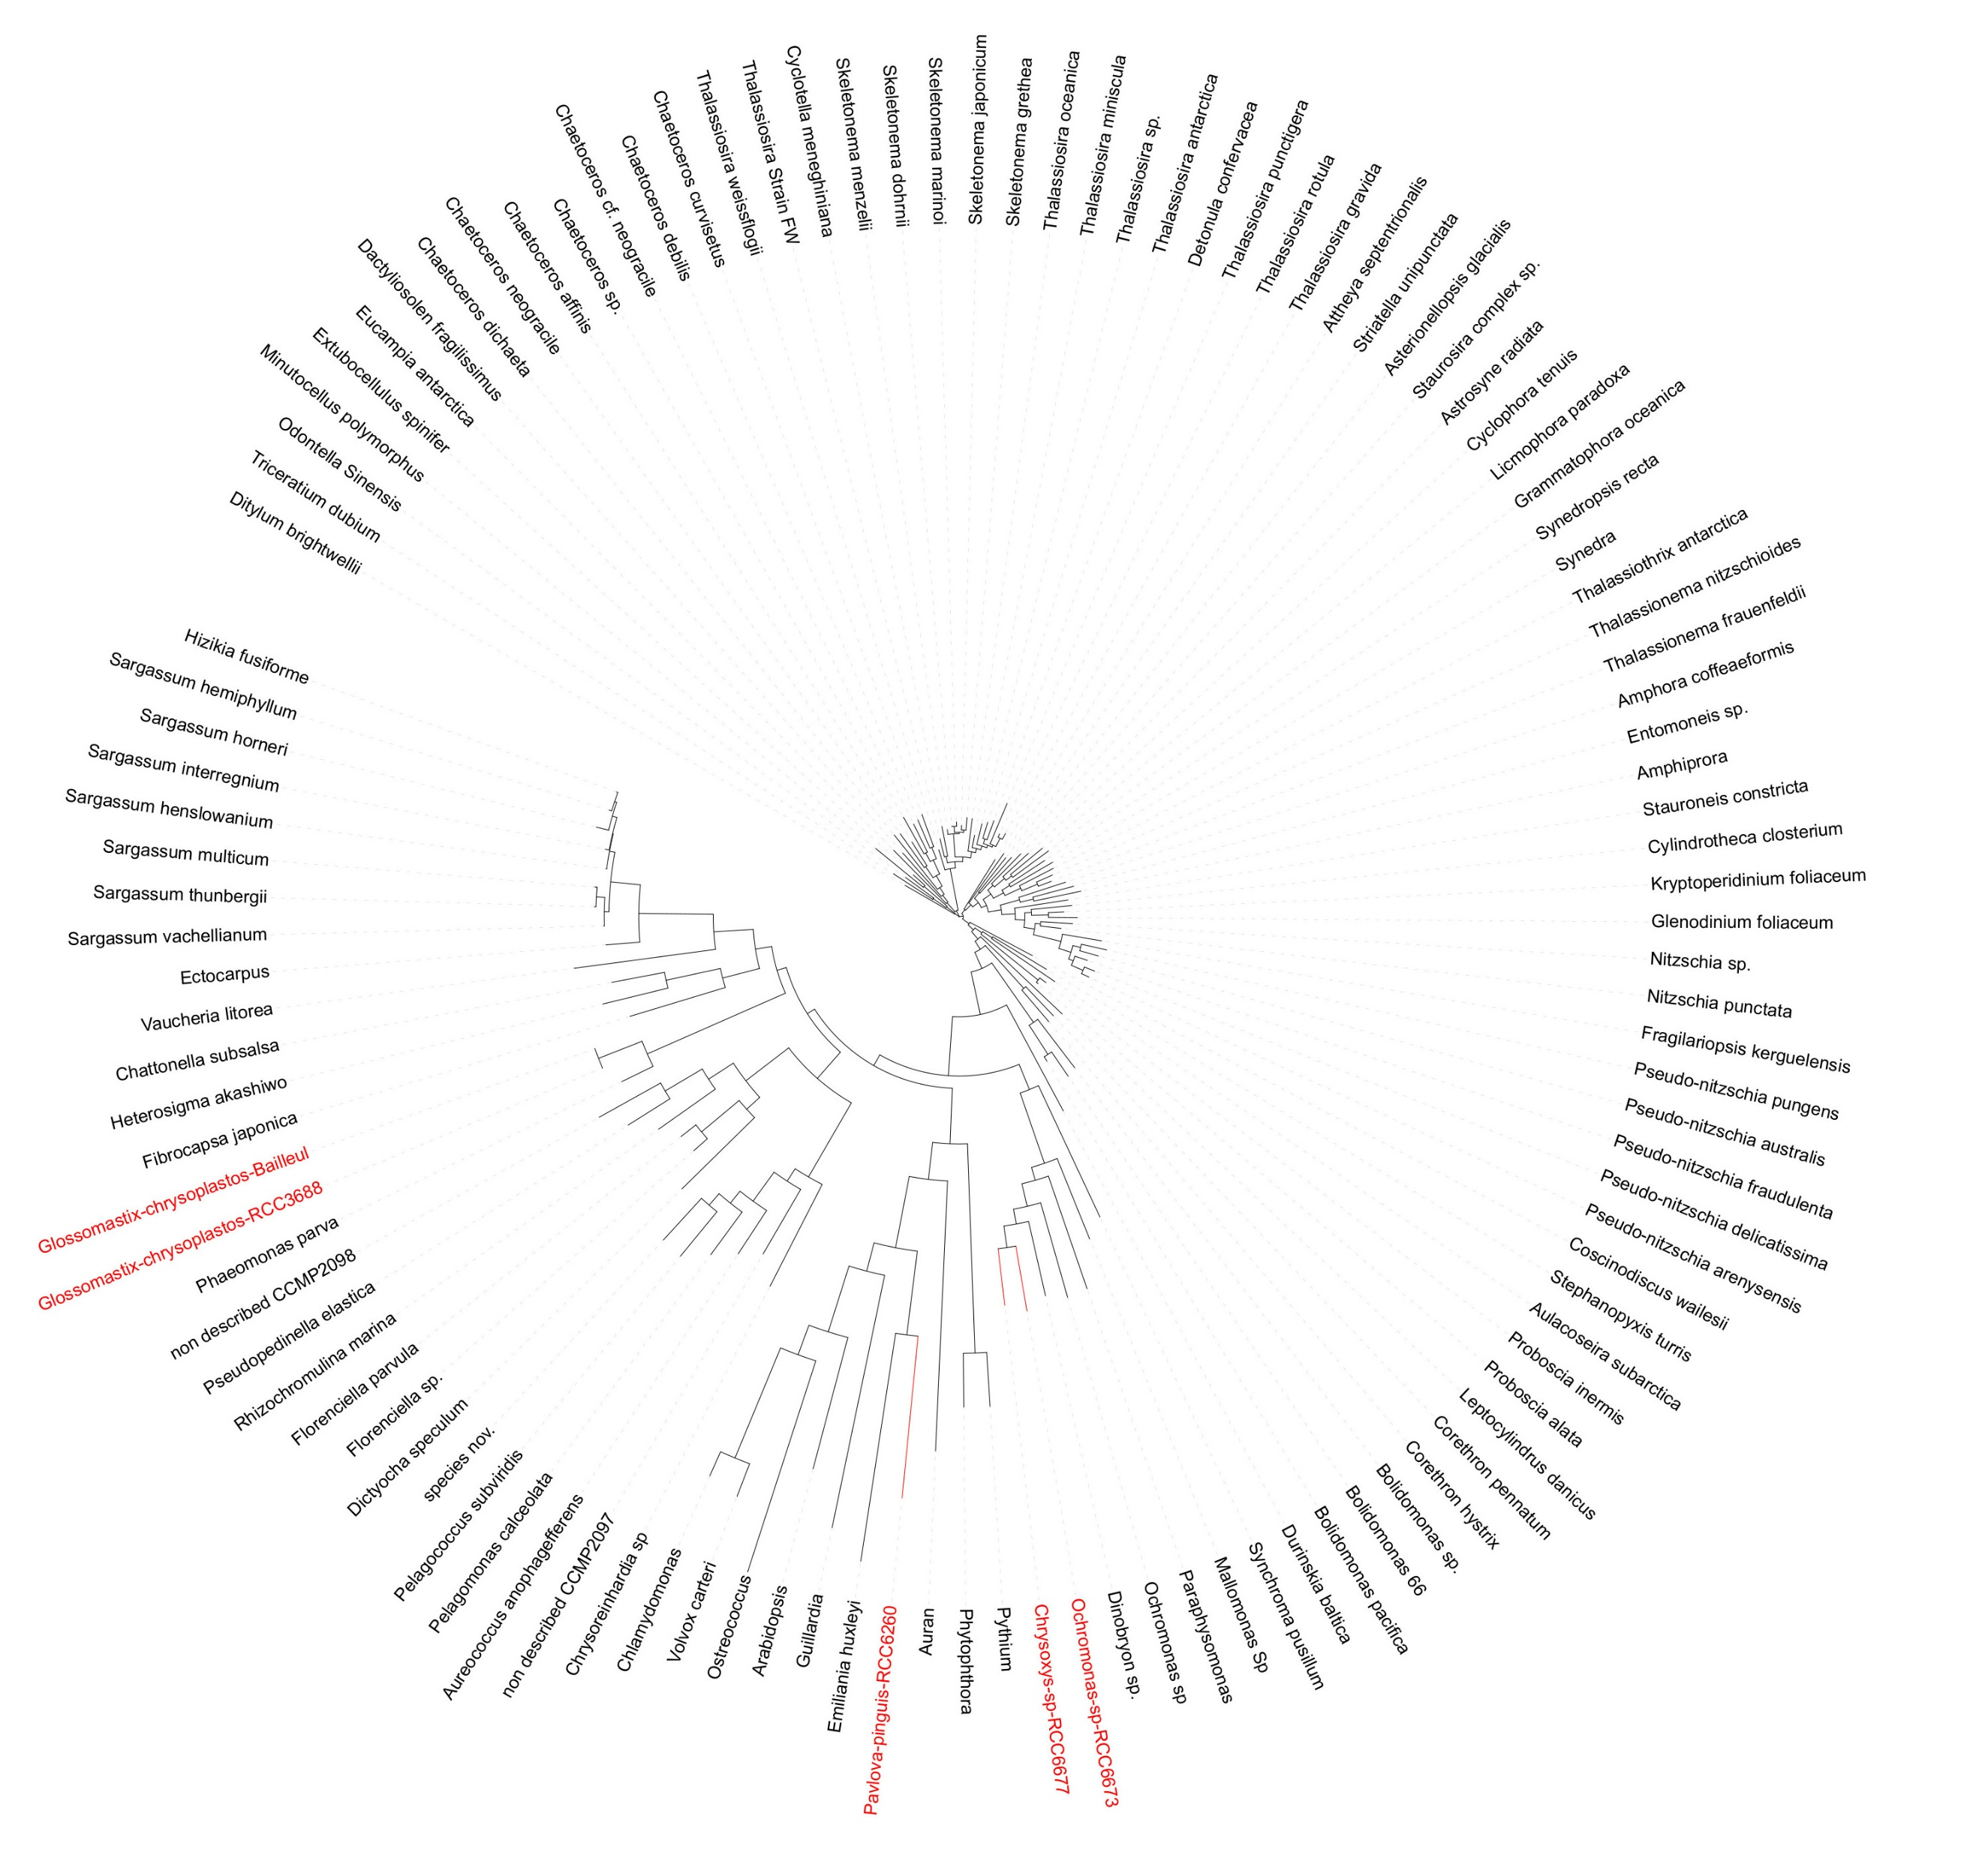
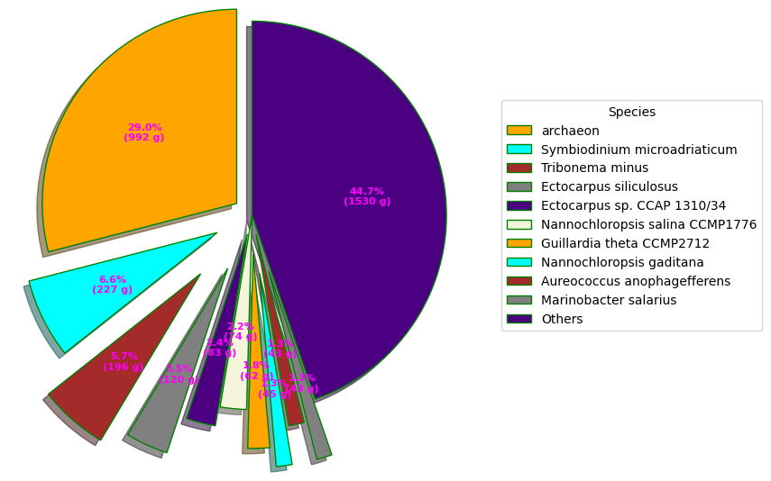
De Novo Assembly and Analysis of the Transcriptome for:
5 Unknown Ochrophyta Species
Tyler Desharnais, Advisor: Dr. Xiaoyu Zhang
Department: Computer Science, California State University: San Marcos, San Marcos, CA
INTRODUCTION
RESULTS
De Novo Assembly of a transcriptome is assembling RNA from new. As there are no current assemblies of any of the 5 species, the species had to be assembled from scratch.
Here we will assemble the five unknown Ochrophyte species using Quality Control and Trimming tools such as FastQC, TrimGlore, etc. We will use the Trinity assembler to assemble the RNA.
We will then run analysis of the assemblies through BUSCO, Trinity Stats, Blastx for database queries, BlastKoala and Trinotate for annotation, MAFFT for alignment and ITOL for the final Phylogenetic tree.
Fig. 2. BlastKoala results for Chrysoxys
Fig. 1. Top Species Hits and corresponding E-values for Chrysoxys
METHOD
Tools Used
Pipeline for tools used:
FastQC (Quality Control)
TrimGlore, Rcorrector, Unfix_Remove (Quality Control)
Trinity and RNASpades (Assembly)
BUSCO
Blastx, Blastp
Trinotate (Annotation data)
7. BlastKoala, GhostKoala (Annotation Data)
8. MAFFT (Multigene Alignment )
9. Interactive Tree of Life (Phylogenetic Tree)
Fig. 3. Phylogenetic Tree for all Ochrophyte species
Fig. 4. Table for BUSCO and Assembly analysis for the 5 different species
Fig. 4. Top Blastx Hits for Chrysoxys
Species | Trinity - GC | RnaSp. - GC | Trinity – Avg Contig Length (longest isoform) | RnaSpades – Avg. Contig Length (longest isoform) | Trinity – total genes assembled | RnaSpades – total genes assembled | BUSCO (Complete BUSCOS) from Trinity
Glossomastix-Chrysoplastos –RCC3688 | 63.23 % | 62.70 % | 1304.89 | 894.90 | 19975 | 31738 | 94 %
Glossomastix-Chrysoplastos – Baillieu | 63.79 % | 63.92 % | 1331.99 | 1144.31 | 16777 | 20269 | 89 %
Pavlova-Pinguis- RCC6260 | 58.45 % | 35.35 % | 546.21 | 188.71 | 40889 | 826141 | 50 %
Ochromonas-sp-RCC6673 | 49.08 % | 48.59 % | 1102.35 | 819.29 | 29161 | 43071 | 91 %
Chrysoxys-sp-RCC6677 | 51.33 % | 51.12 % | 1025.07 | 996.86 | 47124 | 46302 | 89 %
ACKNOWLEDGEMENTS
CONCLUSION
REFERENCES
Special Thanks to Dr. Xiaoyu Zhang for all of his help on this project and mentoring me during this process. I look forward to working with him in the future. Thank you to the Summer Scholars program for allowing me the opportunity to do research. And thank you to Genentech for sponsoring me on this journey and allowing me to accomplish this research. I’m eternally grateful.
From our research, we have concluded the 5 species we have discovered are not apart of the previous known Ochrophyte Multigene Tree. Further analysis is required to determine species characteristics.
Babraham Bioinformatics - FastQC a quality control tool for high throughput sequence data. (n.d.). Retrieved August 7, 2022, from https://www.bioinformatics.babraham.ac.uk/projects/fastqc/
Ochrophyta. Ochrophyta - an overview | ScienceDirect Topics. (n.d.). Retrieved August 7, 2022, from https://www.sciencedirect.com/topics/agricultural-and-biological-sciences/ochrophyta
Multiple alignment program for amino acid or nucleotide sequences. MAFFT. (n.d.). Retrieved August 7, 2022, from https://mafft.cbrc.jp/alignment/software/
Letunic, I. (n.d.). Welcome to iTOL V6. iTOL. Retrieved August 7, 2022, from https://itol.embl.de/
N;, F. T. M. A. C. (n.d.). Exploring pavlova pinguis chemical diversity: A potentially novel source of high value compounds. Scientific reports. Retrieved August 7, 2022, from https://pubmed.ncbi.nlm.nih.gov/31941962/

