Slide 1
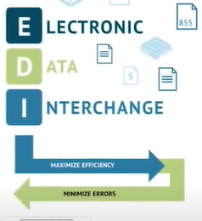
E- commerce

Slide 2
Electronic Data Interchange (EDI)
In traditional B2B transaction the purchaser-
Generates the purchase order
Prints it, and
Mail or fax the printed purchase order to the vendor
The vendor then
Prepare the invoice,
Prints it, and
Mail or fax the invoice to the purchaser. Upon receipt the invoice, the purchaser then has to input the invoice into his system to process and finalize the procurement.
With EDI, paper document are eliminated and human intervention is minimized. In the same transactions, the purchaser simply inputs the procurement details into his computer system, which sends it straight to the vendors own system. The invoice is automatically created in the vendors computer system and sends it send it straight back to the purchasers system for processing.

Slide 3
Electronic Data Interchange (EDI)
Electronic Data Interchange (EDI) is the electronic exchange of documents (business information) using a standard electronic format.
A process which allows transferring business documents in an organization internally, between its various departments or externally with suppliers, customers, or any companies (business partners) electronically.
Companies use EDI system to exchanges business information automatically as paperless transactions. A Specified format is set by both the parties to facilitate transmission of information.
EDI replaces the traditional business communication.
Many business documents can be exchanged using EDI, but the two most common are purchase orders and invoices.

Slide 4
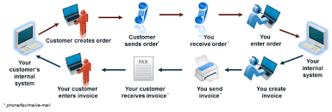
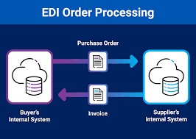
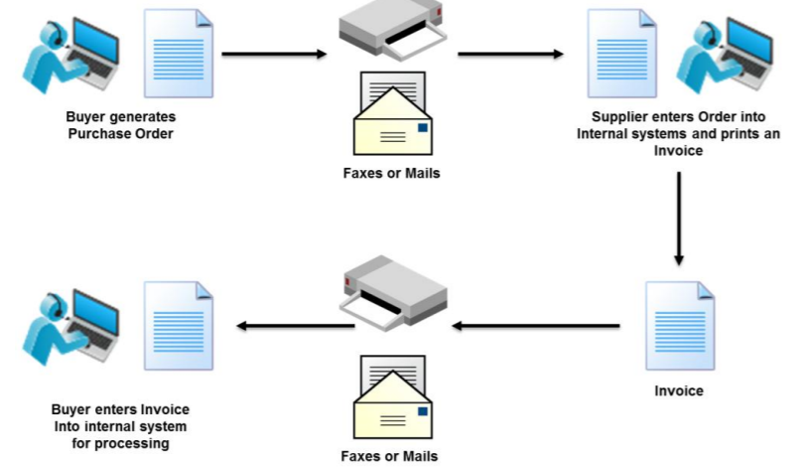
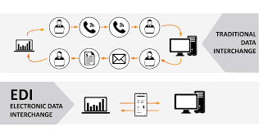

Slide 5
EDI Documents
Invoices
Purchase orders
Shipping Requests
Acknowledgement
Business Correspondence letters
Financial information letters
Steps in an EDI System
Following are the steps in an EDI System.
A program generates a file that contains the processed document.
The document is converted into an agreed standard format.
The file containing the document is sent electronically on the network.
The trading partner receives the file.
An acknowledgement document is generated and sent to the originating organization.

Slide 6
Business documents-
These are any of the documents that are typically exchanged between businesses. The most common documents exchanged via EDI are purchase order, invoices and advance ship notices. There are many other documents such as bill of lading, customs documents, inventory documents, shipping status documents and payment documents.
Business partners-
The exchange of EDI document is typically between two different companies, referred to as business partners or trading partners. For example, Company A may buy goods from Company B. Company A sends orders to Company B. Company A and Company B are business partners.

Slide 7
Advantages of an EDI System
Greater Accuracy and Fewer Manual Errors.
Reduction in data entry errors. − Chances of errors are much less while using a computer for data entry.
Shorter processing life cycle − Orders can be processed as soon as they are entered into the system. It reduces the processing time of the transfer documents.
Electronic form of data − It is quite easy to transfer or share the data, as it is present in electronic format.
Reduction in paperwork − As a lot of paper documents are replaced with electronic documents, there is a huge reduction in paperwork.
Cost Effective − As time is saved and orders are processed very effectively, EDI proves to be highly cost effective. Increased Efficiency, Decreased Costs.
Standard Means of communication − EDI enforces standards on the content of data and its format which leads to clearer communication.

Slide 8
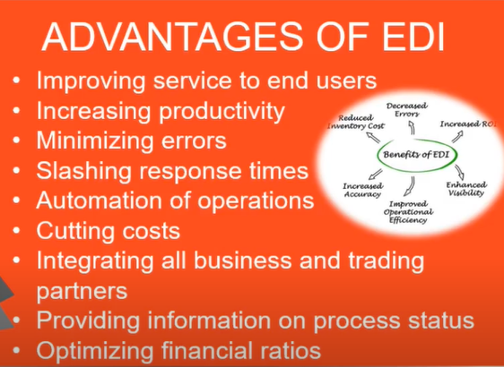

Slide 9
A Traditional Document Exchange of a Purchase Order | An EDI Document Exchange of a Purchase Order
This process normally takes between three to five days. | This process normally occurs overnight and can take less than an hour.
Buyer makes a buying decision, creates the purchase order and prints it. | Buyer makes a buying decision, creates the purchase order but does not print it.
Buyer mails the purchase order to the supplier. | EDI software creates an electronic version of the purchase order and transmits it automatically to the supplier.
Supplier receives the purchase order and enters it into the order entry system. | Supplier's order entry system receives the purchase order and updates the system immediately on receipt.
Buyer calls supplier to determine if purchase order has been received, or supplier mails buyer an acknowledgment of the order. | Supplier's order entry system creates an acknowledgment an transmits it back to confirm receipt.

Slide 10
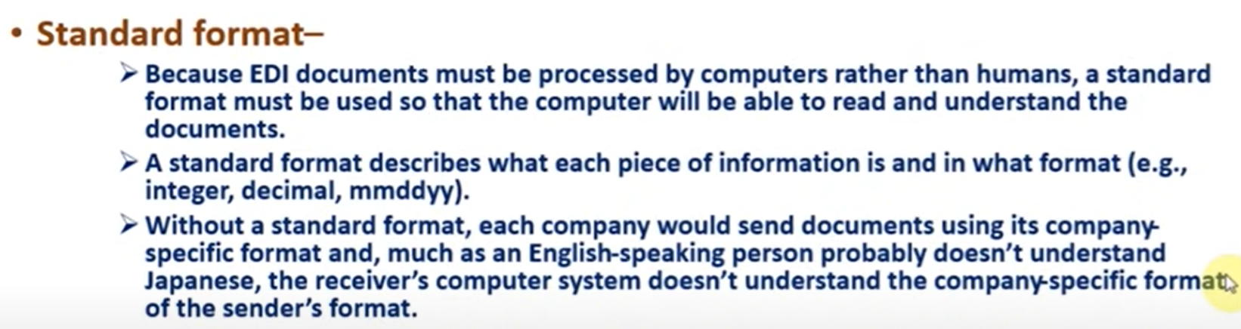

Slide 11
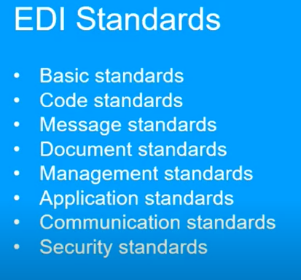

Slide 12
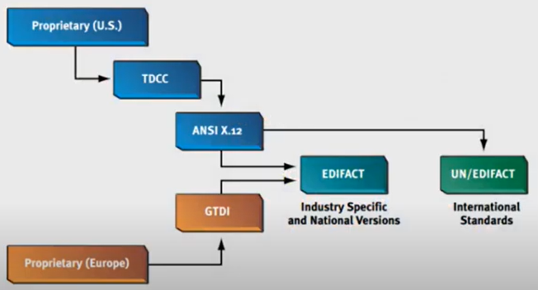
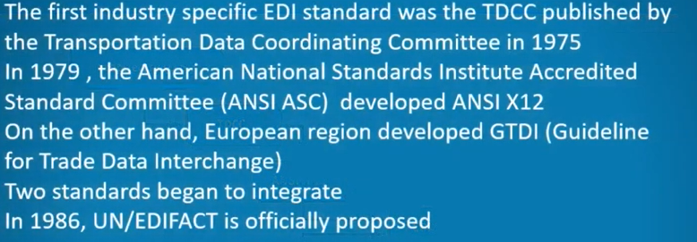

Slide 13
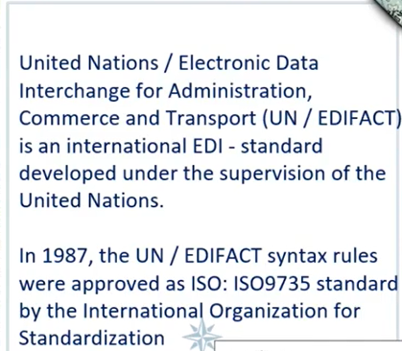

Slide 14
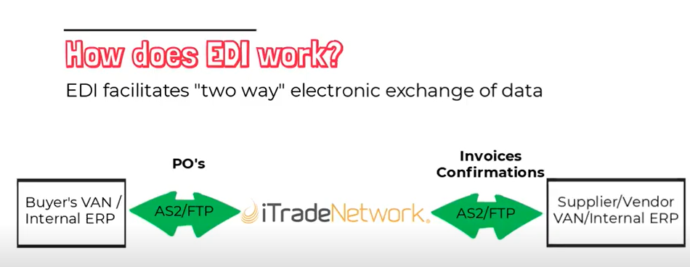

Slide 15
Value Added Network (VAN)
A VAN is a private network provider that focuses on offering network services such as secure email, message encryption and management reporting. Their goal is to facilitate EDI (electronic data interchange) among online companies, providing a convenient way for ecommerce businesses to securely communicate and share data.

Slide 16
Enterprise Resource Planning (ERP)
It's a business process management software that manages and integrates a company's financials, supply chain, operations, commerce, reporting, manufacturing, and human resource activities.
Enterprise resource planning (ERP) refers to a type of software that organizations use to manage day-to-day business activities such as accounting, procurement, project management, risk management and compliance, and supply chain operations. A complete ERP suite also includes enterprise performance management, software that helps plan, budget, predict, and report on an organization’s financial results.

Slide 17
Internet Based EDI
Communication of EDI messages via the Internet.
Internet based EDI (web based EDI) use internet communication technology to exchange EDI data between trading partners. It is simply a communications pathway, where EDI data is passed between trading partners using Internet protocols. Internet EDI is done via a variety of protocols, such as file transfer protocol (FTP), secure file transfer protocol with SFTP (SSH File Transfer Protocol) or FTPS (FTP over SSL) and AS2 (applicability statement 2).
It is often referred to as EDI INT, meaning EDI over internet.
Internet Based EDI from Traditional EDI
Internet based EDI data sharing uses the same formatting and same codes as traditional EDI, but instead of sending the information through a variety of methods, the information is sent over the internet. Using internet instead of a VAN can cut communication costs by over 50 percent.

Slide 18
