Slide 1
Frequency Divider
Tyler Edwards & Michael Cheng

Slide 2
Overview
Our circuit divides the clock frequency by 2, then 4
By 2 - Switches outputs from 1 to 0 every 2 clock cycles
By 4 - Switches outputs from 1 to 0 every 2 clock cycles

Slide 3
1st Step - Design + FSM Diagram

Slide 4
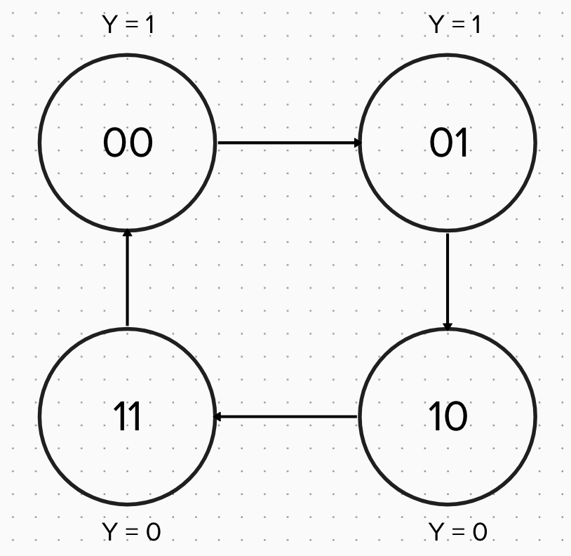
FSM State Diagram

Slide 5
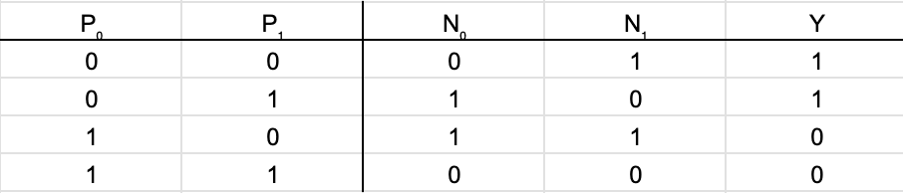
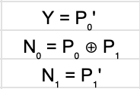
Equations & Tables
State Table
State Equations

Slide 6
2nd Step - Logisim Schematic

Slide 7
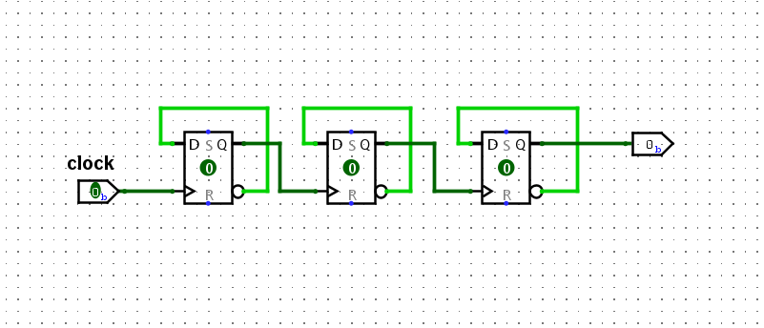
Logic Simulator Schematic

Slide 8
3rd Step - Test Outputs in Verilog

Slide 9
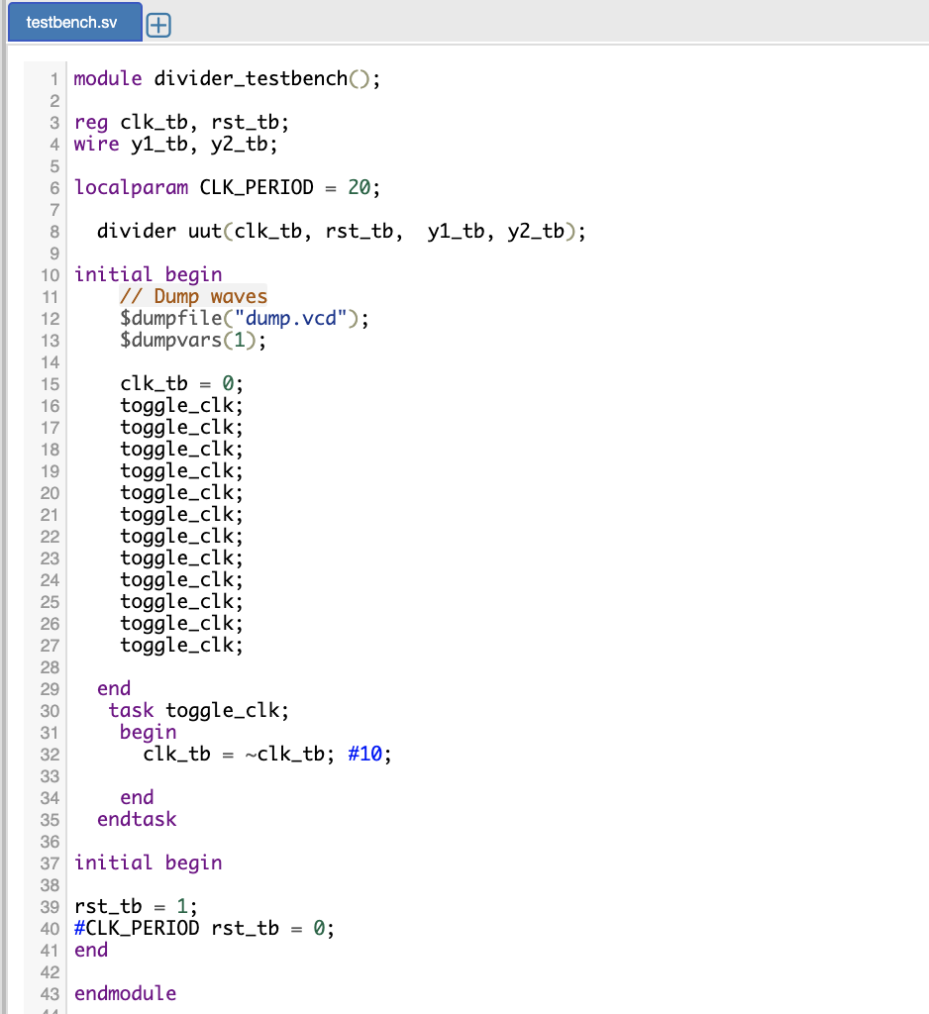
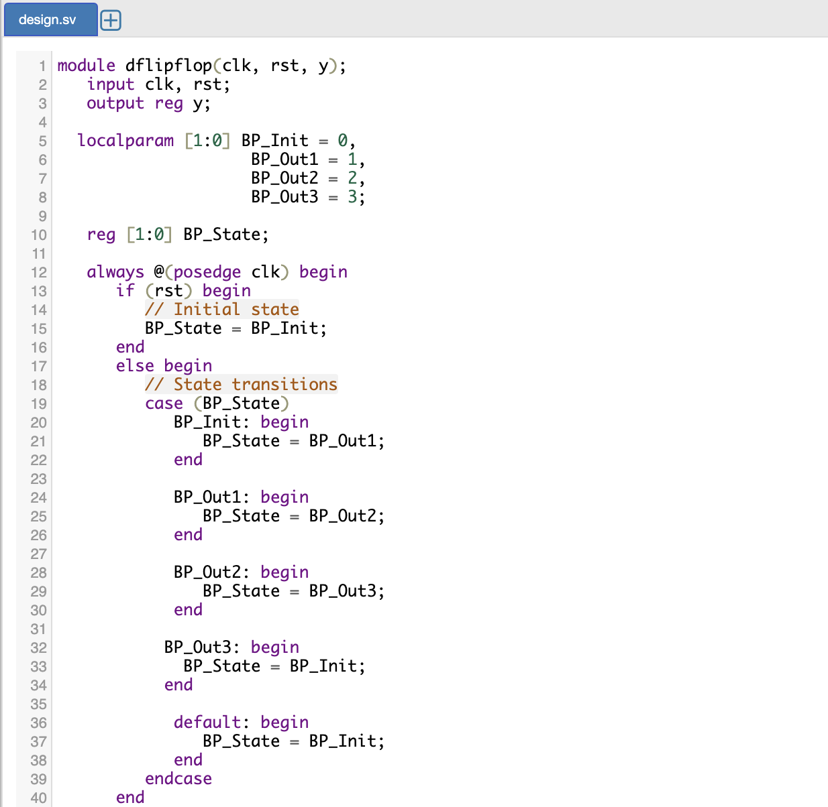
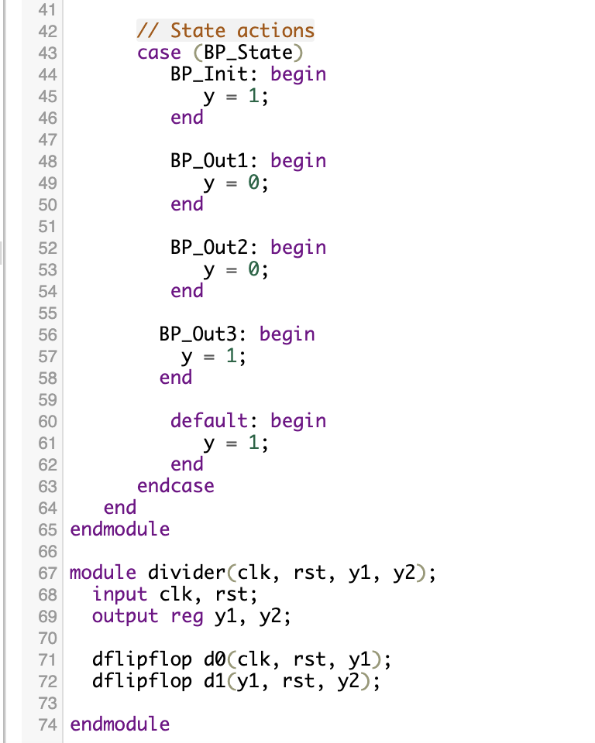
Verilog Model & Testbench
https://www.edaplayground.com/x/7YbV

Slide 10
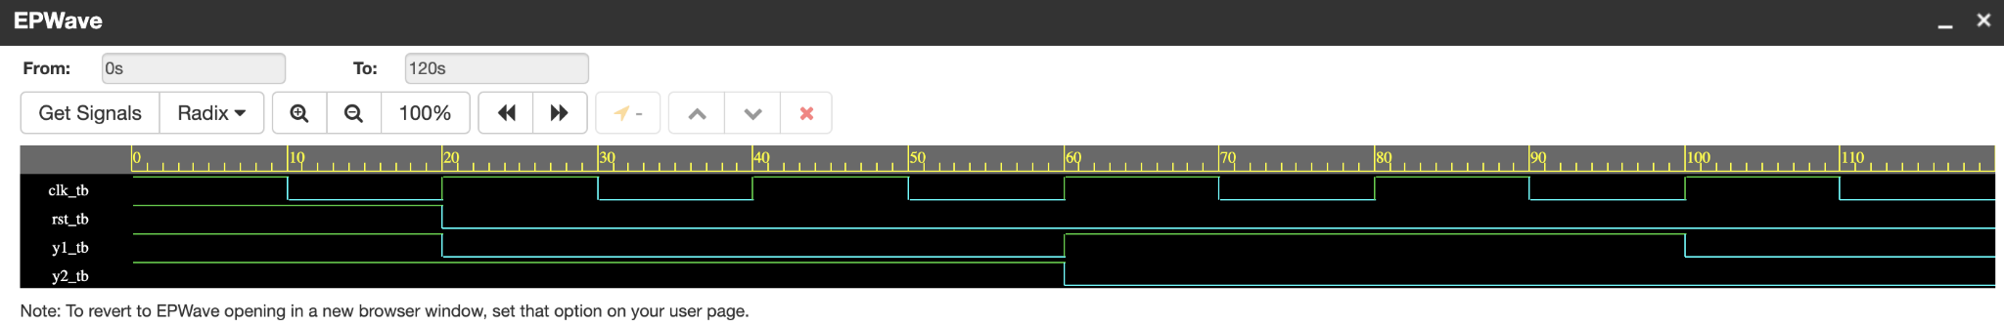
Waveforms

Slide 11
4th Step - Build the Physical Circuit

Slide 12
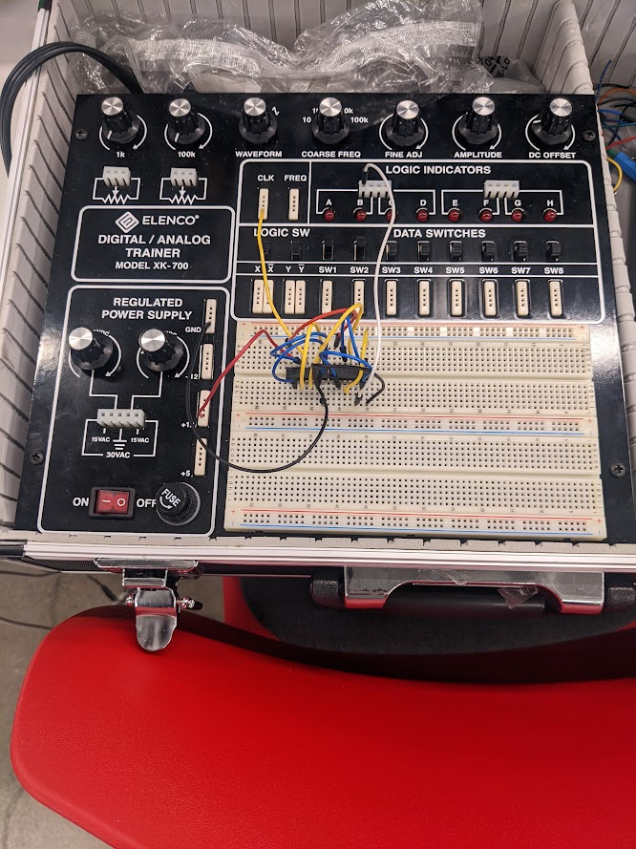
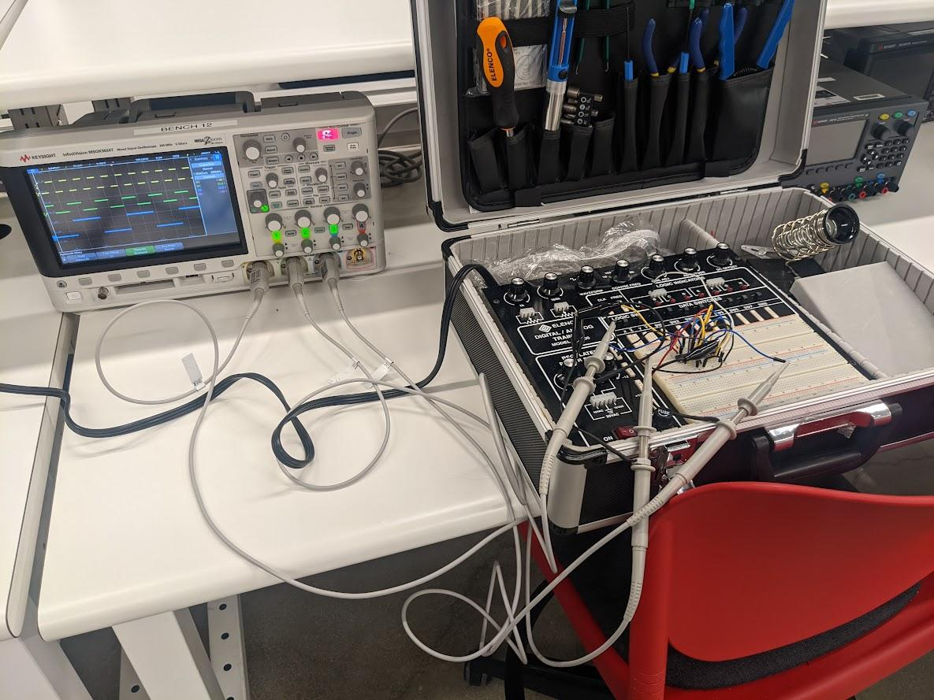
Final Breadboard
We used two 7474 ICs

Slide 13
Thank you! :)

