Slide 1
MA5851 – Data Science Master Class 1
Assessment 3- Web Crawler and NLP System
Tye Galloway

Slide 2
Project Overview
Understand the problem statement
NLP Tasks
Share the results
Scrape the appropriate data
Exploratory data analysis

Slide 3
GitHub Repository
Munzner, T. (2015). Visualization analysis and design. Boca Raton, FL: A K Peters/CRC Press.

Slide 4
Limitations of the Web-Crawler
Dashboard layout
Visual encodings
Knaflic, C. N. (2015). Storytelling with data: a data visualization guide for business professionals. Hoboken, New Jersey: John Wiley & Sons, Inc.

Slide 5
The Harvested Data

Slide 6
NLP Task 1: Topic Modelling
Visualisation Intent
Domain assumptions
Data abstractions
Munzner, T. (2015). Visualization analysis and design. Boca Raton, FL: A K Peters/CRC Press.

Slide 7
NLP Task 2: Sentiment Analysis
Task abstractions
Interactions
Visual encodings
Effectiveness of communication of the visualisation intent
Knaflic, C. N. (2015). Storytelling with data: a data visualization guide for business professionals. Hoboken, New Jersey: John Wiley & Sons, Inc.

Slide 8
Results

Slide 9
Visualisation 2 – Stacked Bar Chart
Visualisation Intent
Domain assumptions
Data abstractions

Slide 10
Visualisation 2 – Stacked Bar Chart
Task abstractions
Interactions
Visual encodings
Effectiveness of communication of the visualisation intent
Peebles, D., Ali, N. (2013). The effect of gestalt laws of perceptual organization on the comprehension of three-variable bar and line graphs (Vol 53). Human Factors.

Slide 11
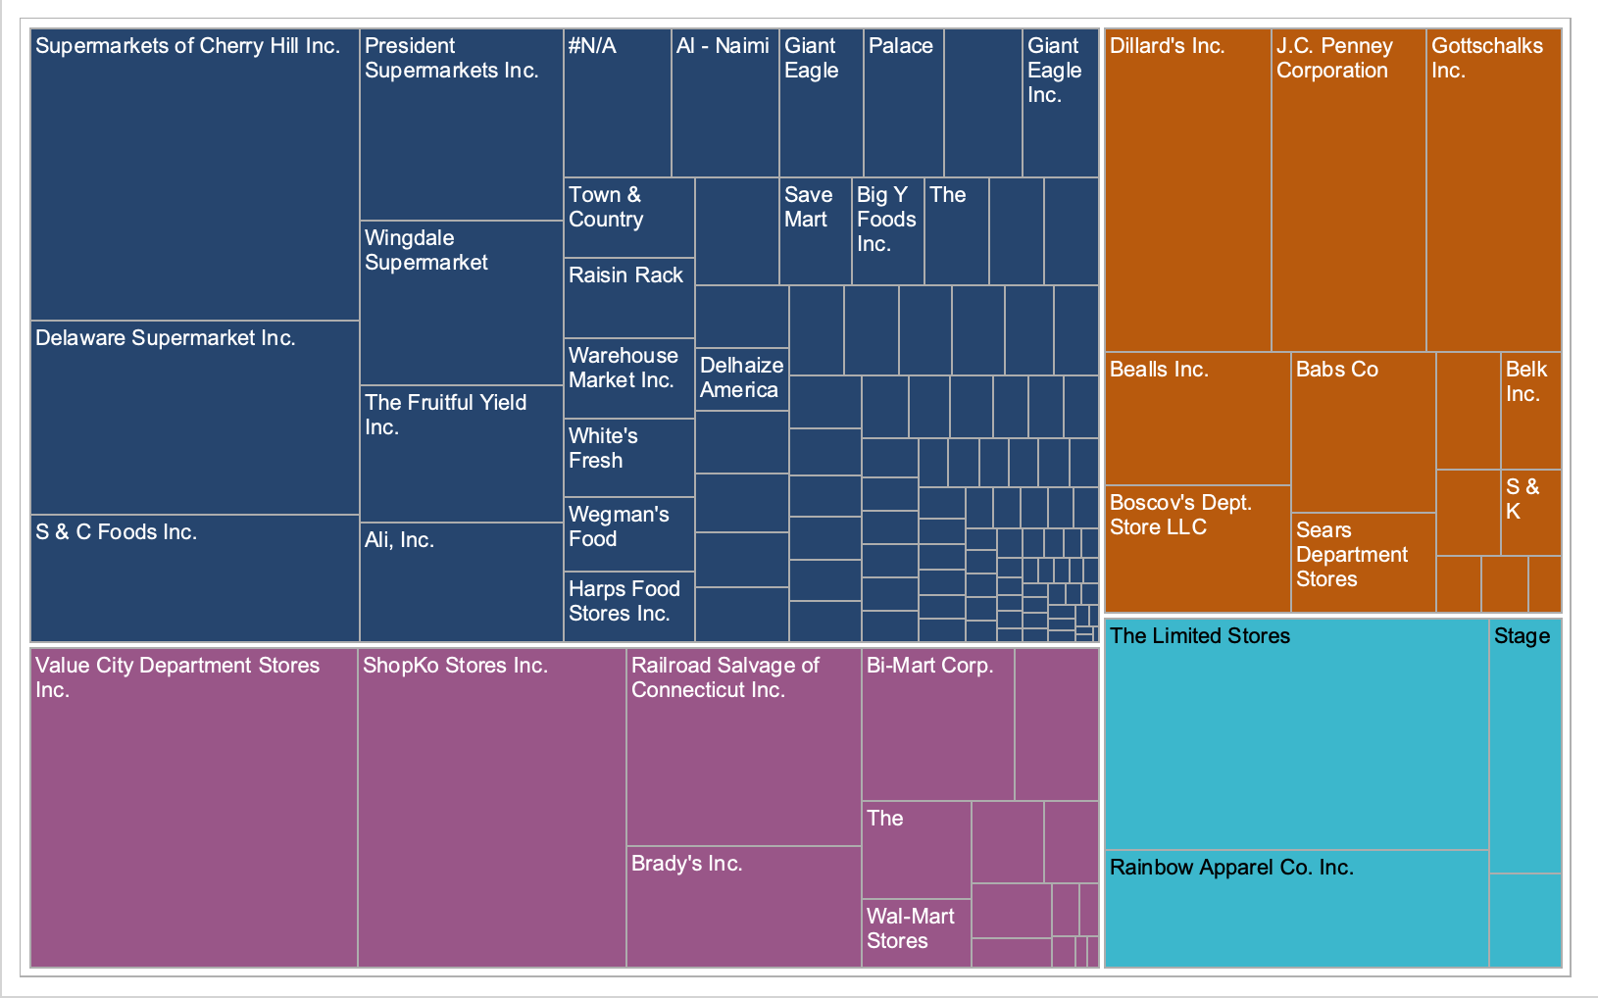
Visualisation 3 – Treemap
https://public.tableau.com/en-gb/gallery/retail-site-openings?tab=featured&topic=industry-retail-and-consumer-goods

Slide 12
Visualisation 3 – Treemap
Visualisation Intent
Domain assumptions
Data abstractions
Munzner, T. (2015). Visualization analysis and design. Boca Raton, FL: A K Peters/CRC Press.

Slide 13
Visualisation 3 – Treemap
Task abstractions
Interactions
Visual encodings
Effectiveness of communication of the visualisation intent
Bang, W. (2010). Gestalt principles part 1 (Vol 7). Nature methods.

Slide 14
Review of the Interactivity
Intent of the interaction between the visualisations
Task abstraction of the interactions
Visual encodings
Effectiveness of communication of the interaction intent
Jones, B. (2014). Communicating data with Tableau. Sebastopol, California: O'Reilly.

Slide 15
Overall Effectiveness
Effectiveness of the visual choices used to communicate the dashboard intent
Dashboard intent and the individual visualisation intents
Jones, B. (2014). Communicating data with Tableau. Sebastopol, California: O'Reilly.

Slide 16
Recommended Improvements
Dashboard design
Area map
Heer, J., Bostock, M., & Ogievetsky, V. (2010). A tour through the visualization zoo (Vol 53). Communications of the ACM.

Slide 17
References
Bang, W. (2010). Gestalt principles part 1 (Vol 7). Nature methods.
Donald, D. (2020). MA5830: Visualisation fundamentals; week 1 lecture notes. LearnJCU.
Donald, D. (2020). MA5830: Tableau basics; week 2 lecture notes. LearnJCU.
Donald, D. (2020). MA5830: Data representation and abstraction; week 3 lecture notes. LearnJCU.
Donald, D. (2020). MA5830: Visualising data; week 4 lecture notes. LearnJCU.
Heer, J., Bostock, M., & Ogievetsky, V. (2010). A tour through the visualization zoo (Vol 53). Communications of the ACM.
Jones, B. (2014). Communicating data with Tableau. Sebastopol, California: O'Reilly.
Knaflic, C. N. (2015). Storytelling with data: a data visualization guide for business professionals. Hoboken, New Jersey: John Wiley & Sons, Inc.
Munzner, T. (2015). Visualization analysis and design. Boca Raton, FL: A K Peters/CRC Press.
Peebles, D., Ali, N. (2013). The effect of gestalt laws of perceptual organization on the comprehension of three-variable bar and line graphs (Vol 53). Human Factors.
Tableau Software, http://www.tableau.com/, 2020
Source: https://public.tableau.com/en-gb/gallery/retail-site-openings?tab=featured&topic=industry-retail-and-consumer-goods

