Slide 1
Optimizations of Bilinear Reaction State Model & Second-Order Reaction through Ensemble Trajectories and Nlopt.jl
Tye Phoenix

Slide 2
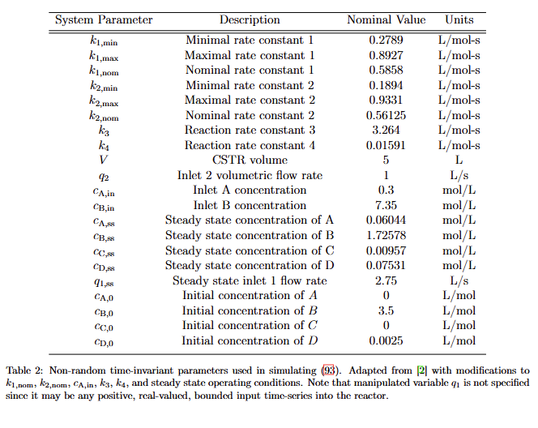
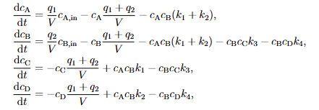
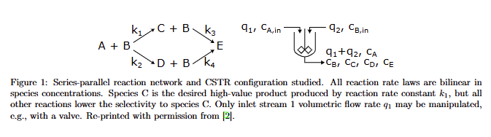
Bilinear Reaction Model

Slide 3
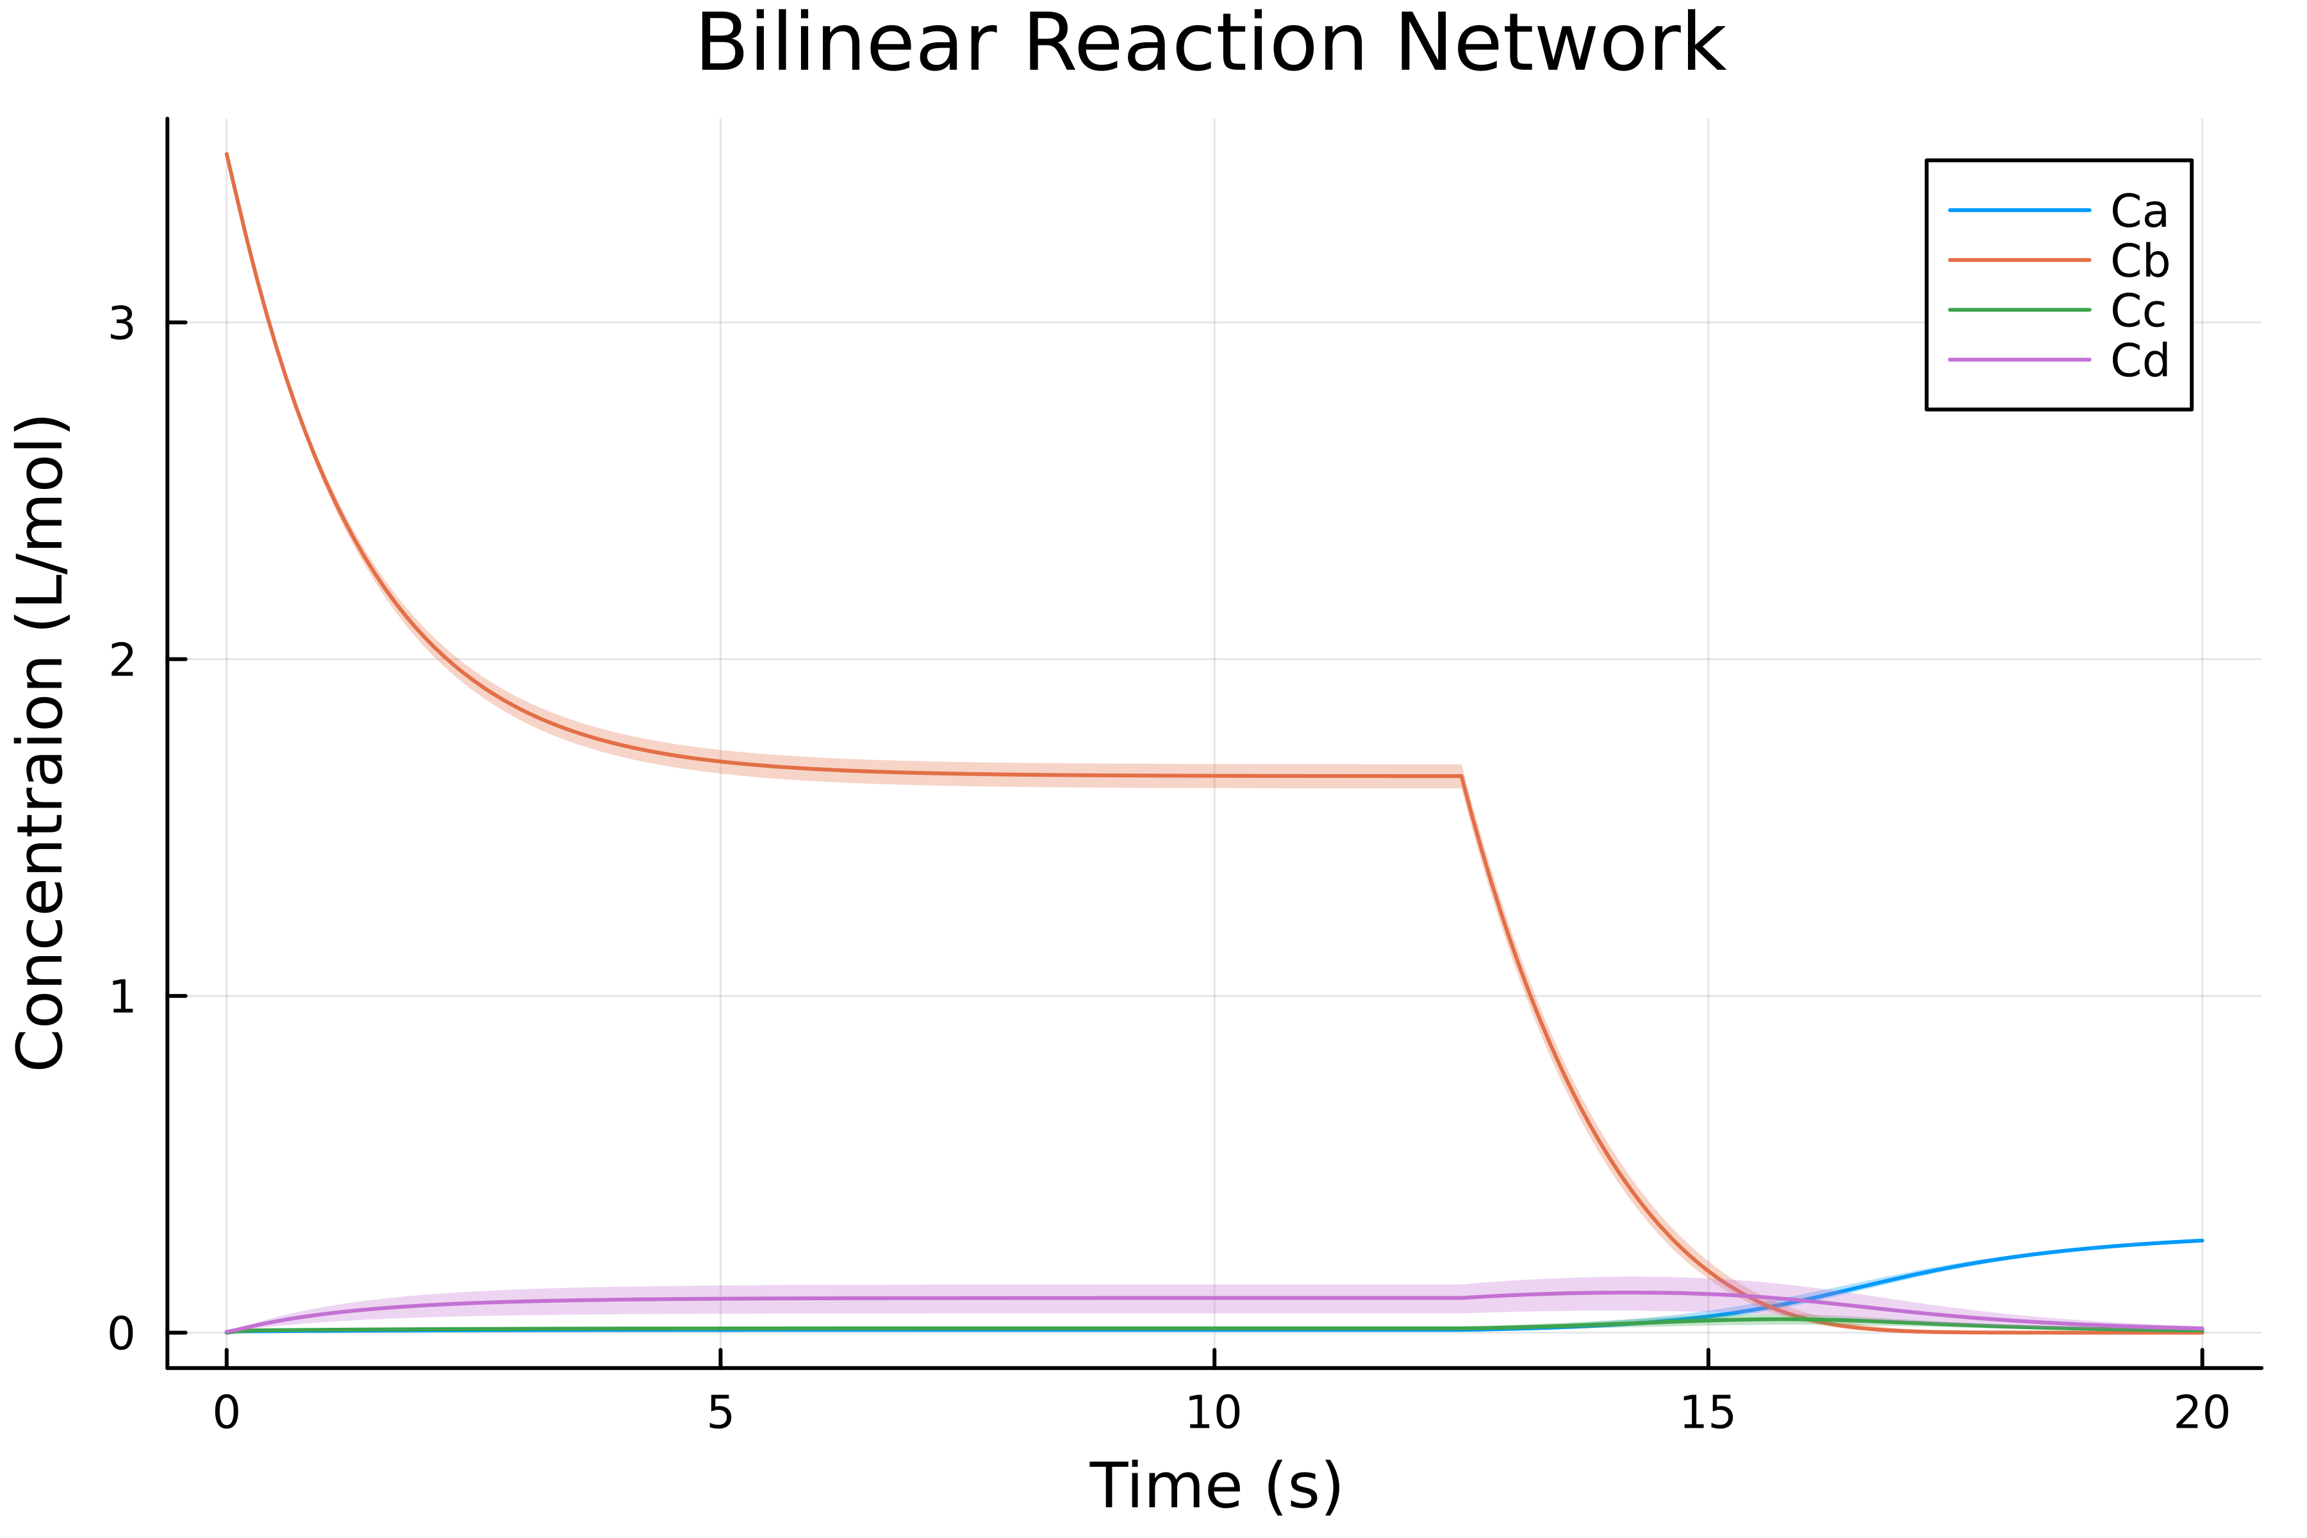
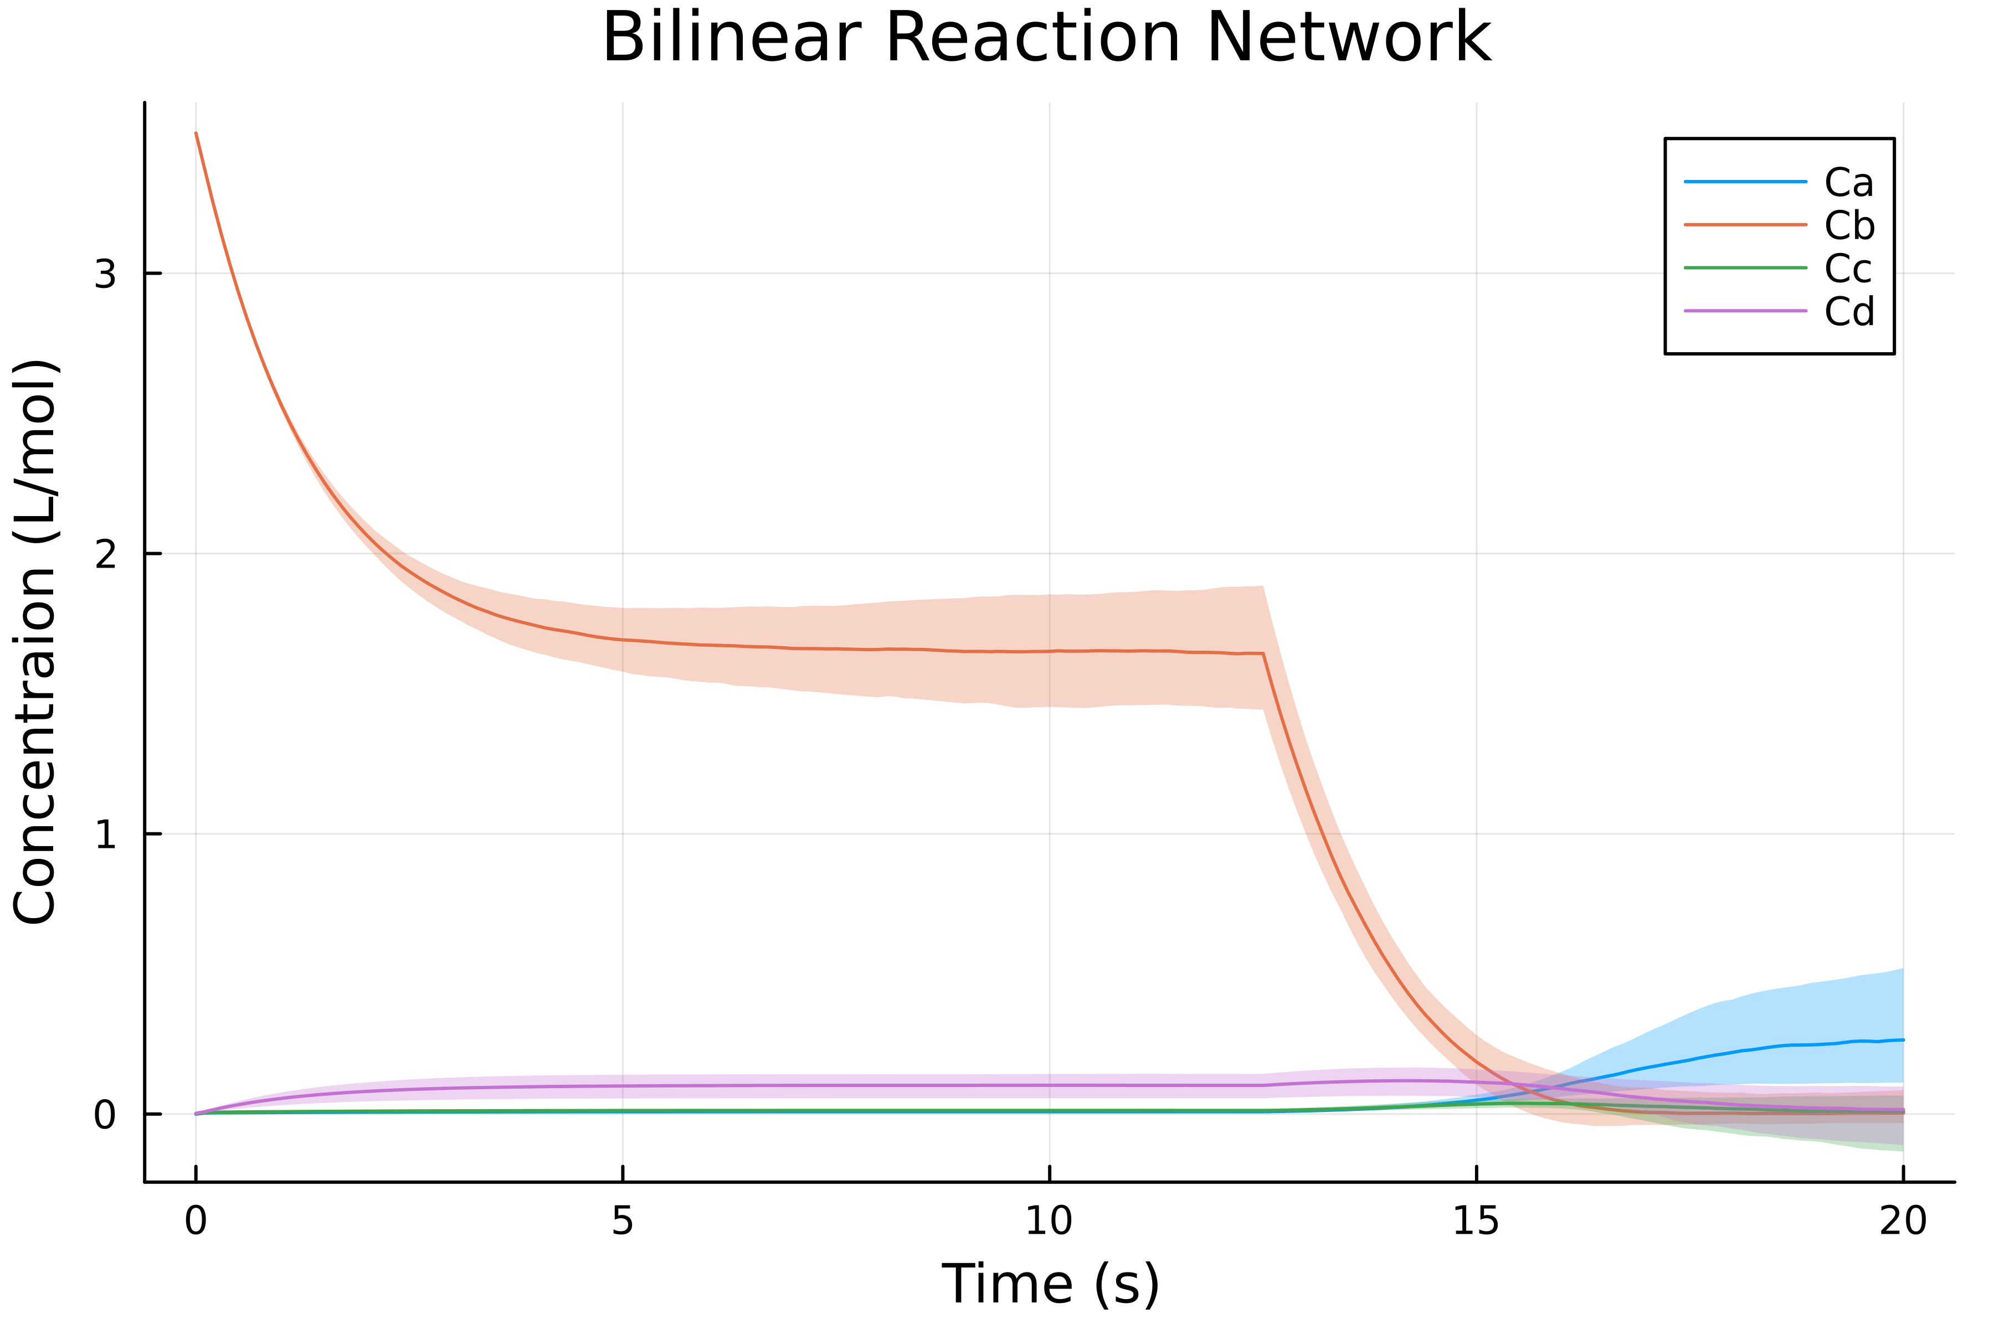
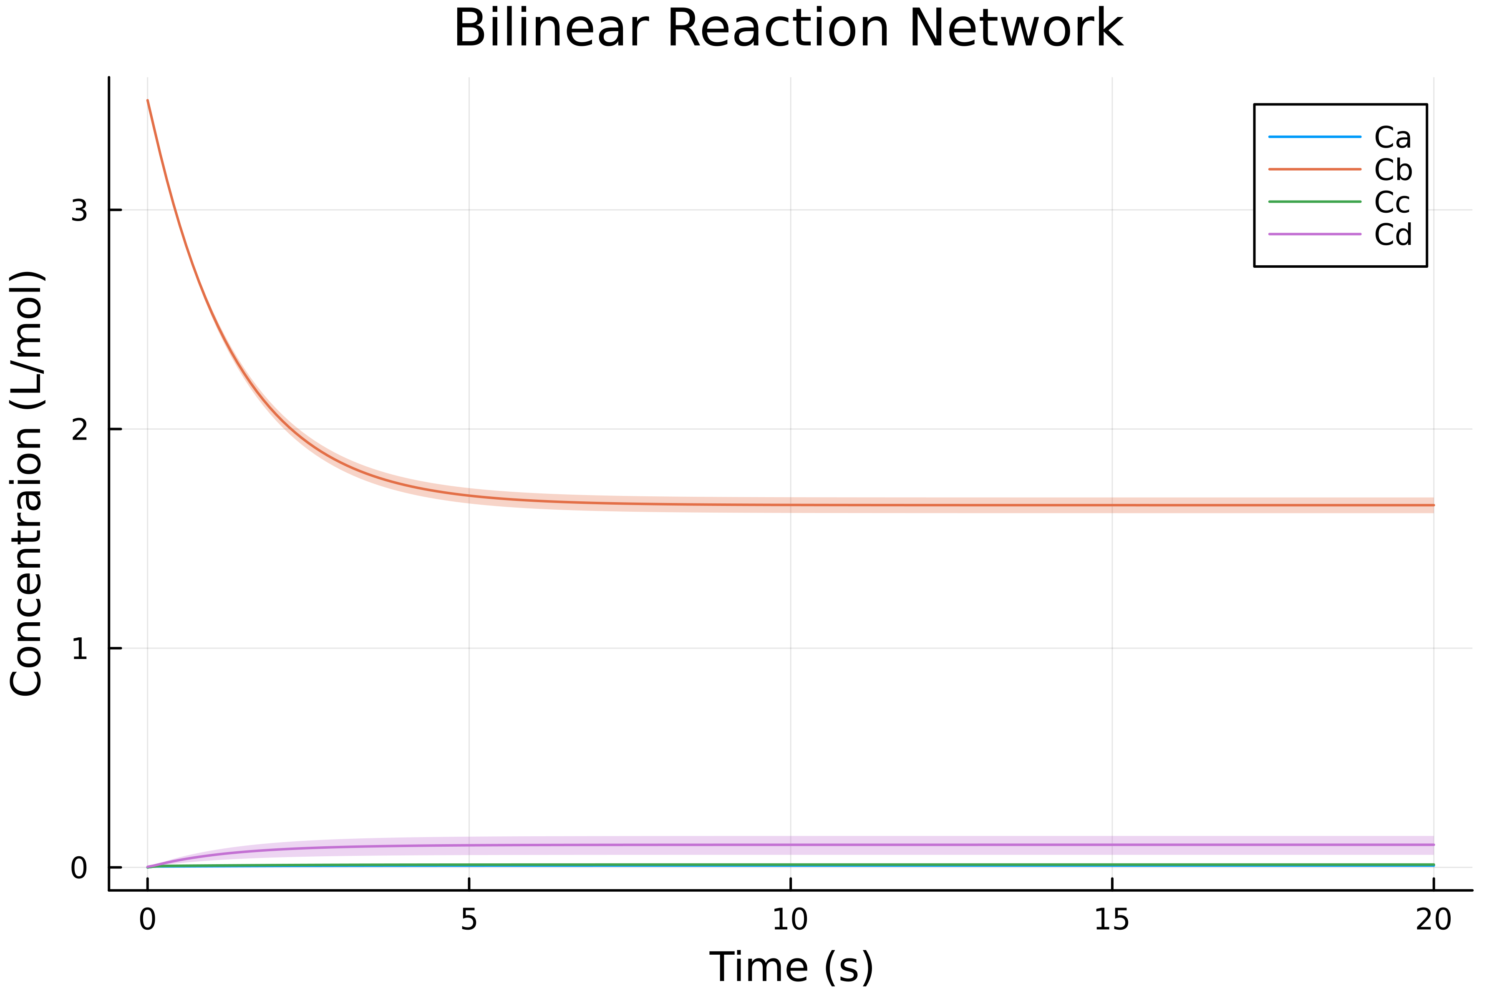
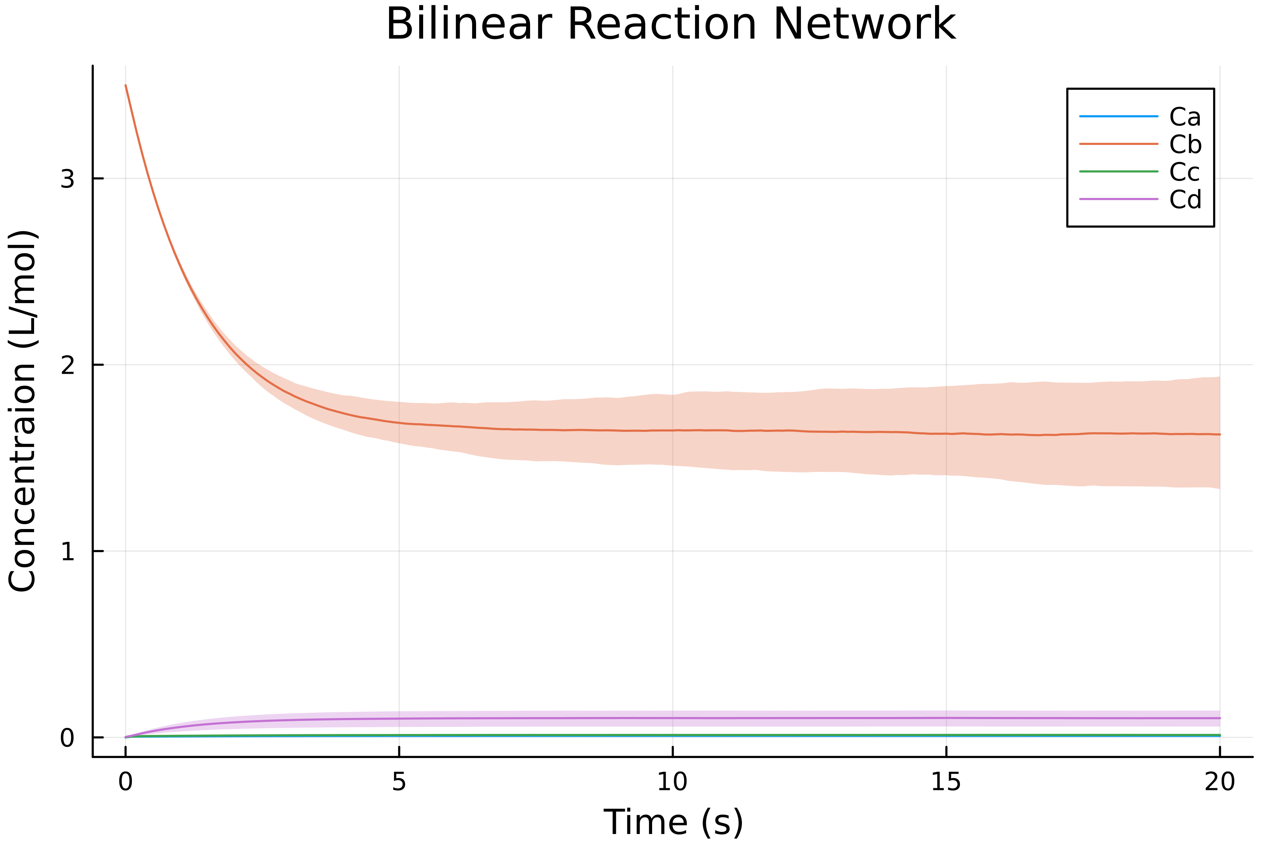
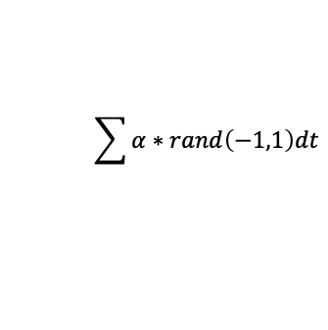
Broken Valve (2)
Both (2)
Discrete event @ t=12.5
Faulty Valve (2)
$$\sum{α∗rand\left(−1,1\right)dt}$$

Slide 4
Optimization
Found highest value at last time step in ensemble. Retrieved trajectory parameters by index.
Ca={k1: 2.789, k2: 2.265}
Cb={k1: 2.789, k2: 9.331}
Cc={k1: 8.620, k2: 2.265}
Cd={k1: 2.789, k2: 9.331}

Slide 5
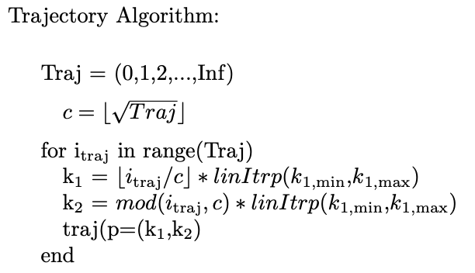
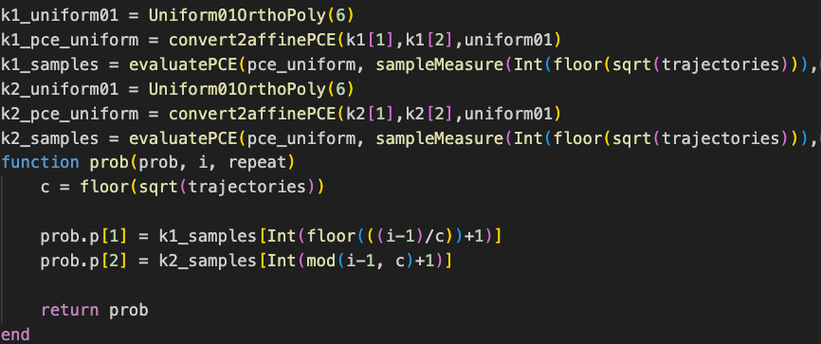
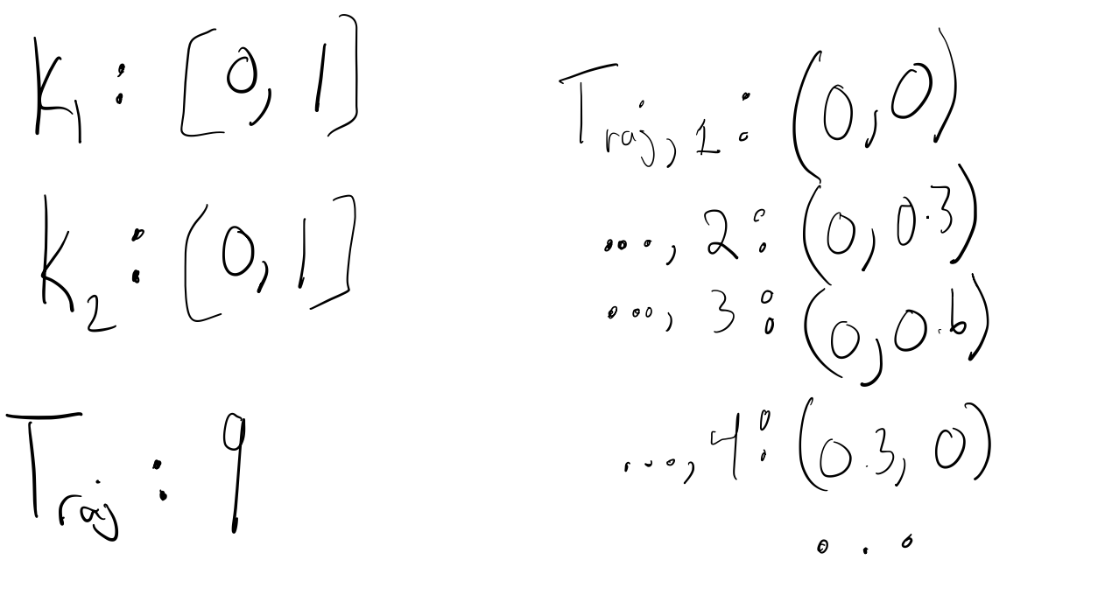
Trajectory State Machine & Maximize Algorithm through NLopt.jl

Slide 6
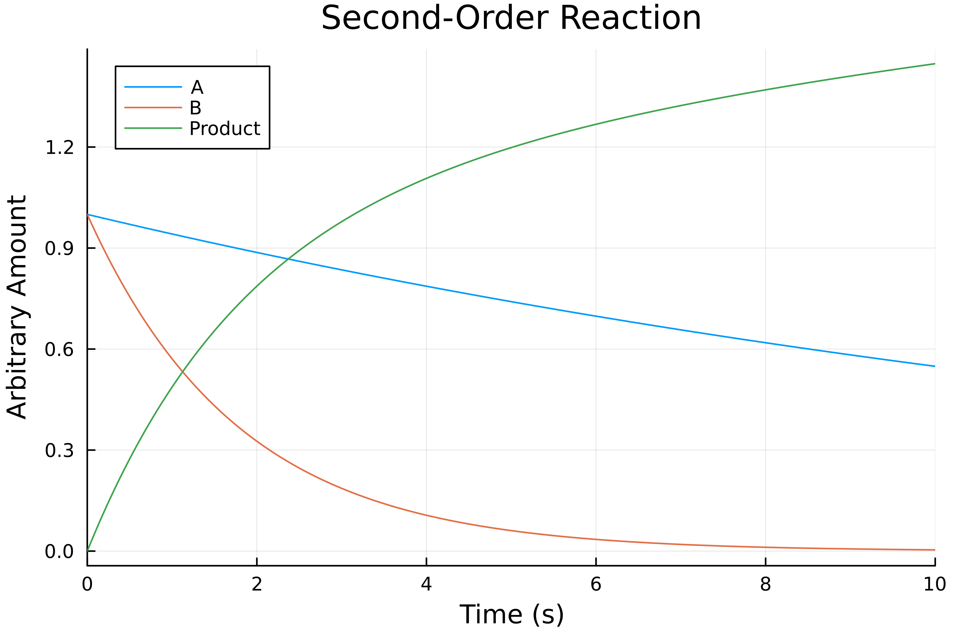
Second-Order Chemical Reaction
Variable | Definition | Value
R | Ratio of A:B to produce Product | 0.2
k | Reaction Constant | [0.1,0.9]

Slide 7
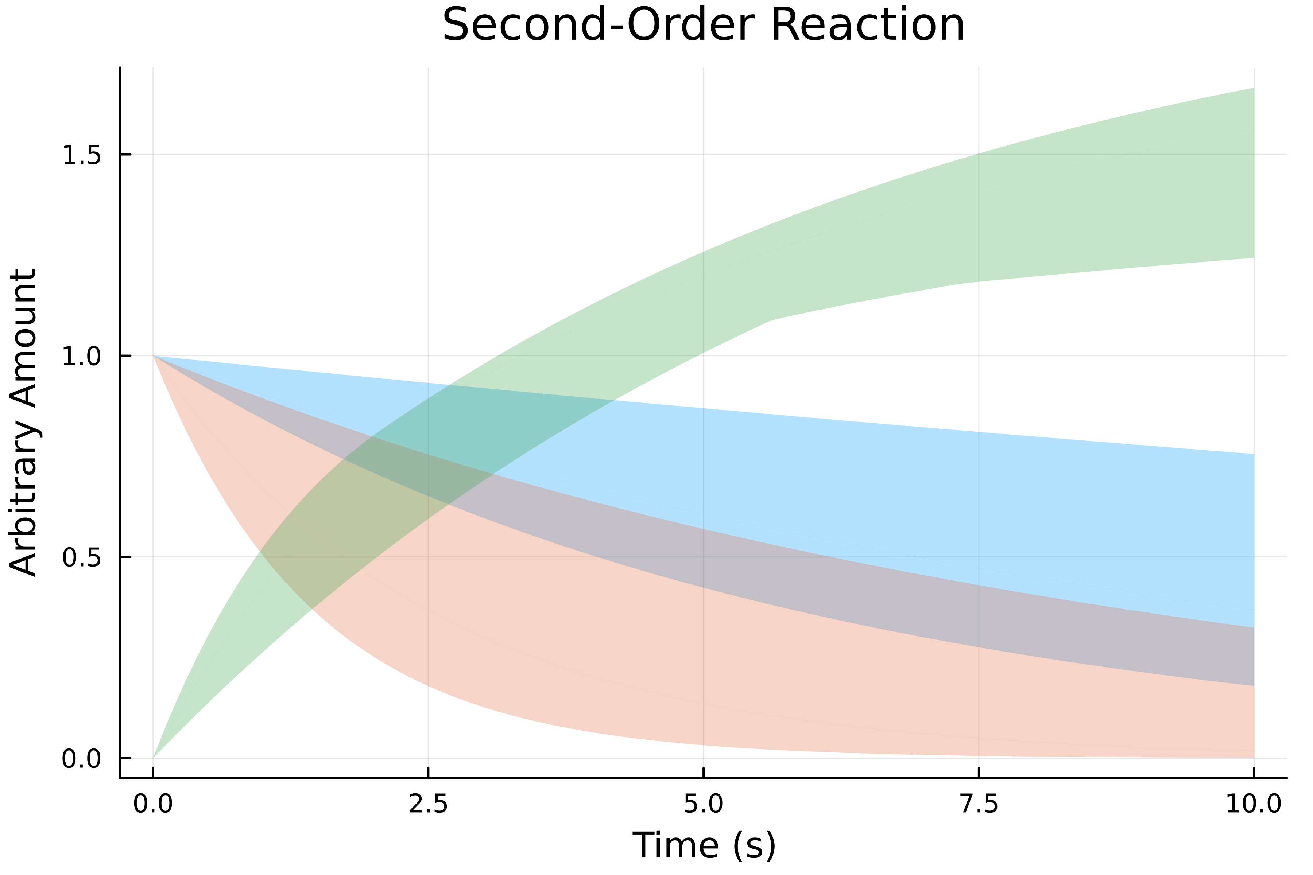
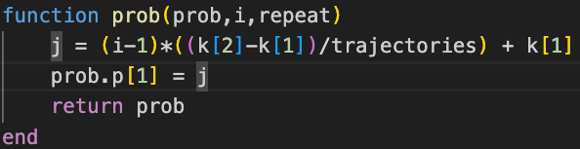
Reaction Ensemble
By plotting different trajectories due to different parameter values, we achieve an ensemble as shown below.

Slide 8
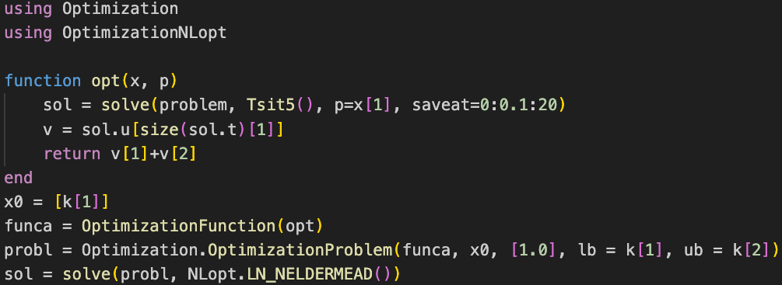
NLopt.jl Optimization
Use the solution to the ODEProblem to get the last ‘t’ value to get minimum amount of substrate at
the end of the simulation.
Returns the parameter as ’u’.
retcode: Success
u: [0.6613708585486165]
Final objective value: 0.3330058512256518

Slide 9
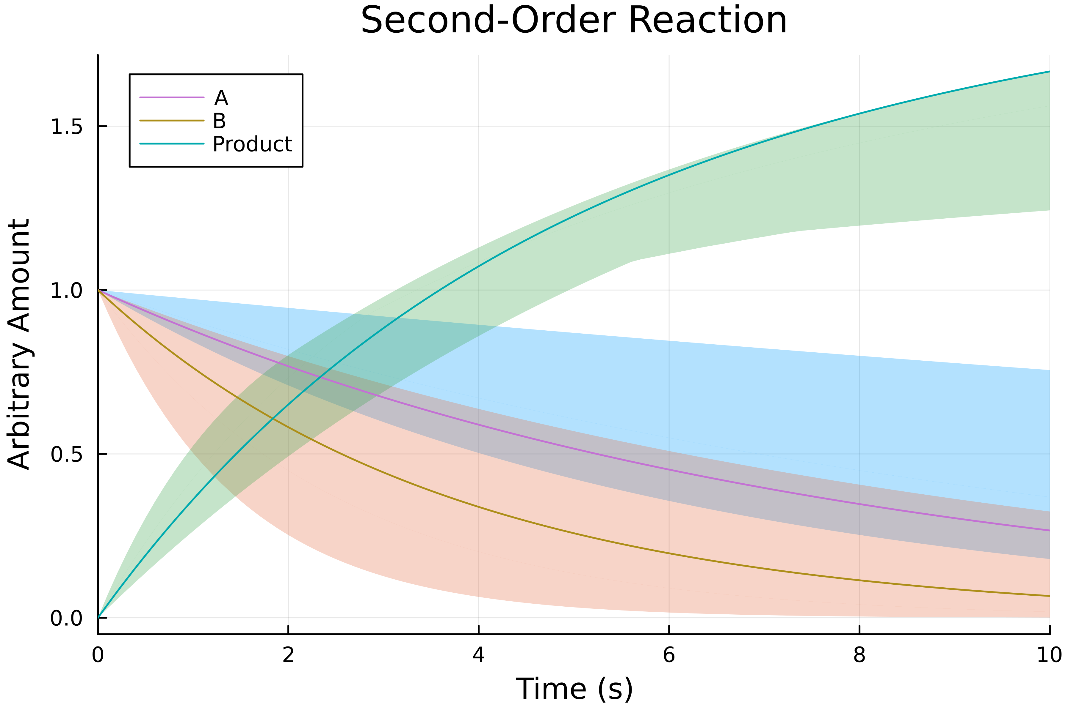
Optimization for Reaction
k ~ 0.66

Slide 10
Polynomial Chaos Sampling for Parametric Estimation
Tye Phoenix

Slide 11
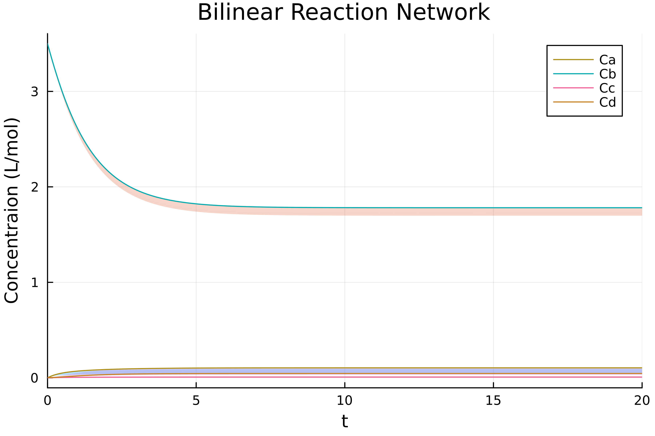
Single Tank Bilinear Reaction Network
*PolyChaos.jl’s algorithm seems to generate a randomly response? Different ensemble each iteration.

Slide 12

Second-Order Reaction
*Trajectory propagation algorithm runtime down from ~0.15 seconds to ~0.05 seconds! 3x as fast!

