Slide 1
EMODEPICTOR : Harnessing Emotions from Audio
Group 6: Soumya Shanigarapu, Tarun Kunkunuri, Teja Vineeth Reddy Yeramareddy

Slide 2
TABLE OF CONTENTS
01
02
03
04
05
06
Introduction
Dataset
Models
Data Analysis
Conclusion
Challenges & Limitations

Slide 3
01
Introduction

Slide 4
What’s SER and Importance?
Background:
Evolution of Communication: From vocal cues in history to global digital interactions.
Emotional Gap: Despite connectivity, digital communication lacks a personal touch.
Digital Age Challenge: Devices need to understand emotions for deeper connections.
Emergence of SER: Aiming to bridge the gap between human emotions and machine understanding.
Tool Utilization: RNNs, SVMs, and CNNs at the forefront for empathetic human-machine interactions.
Introduction to SER
Importance of Personalization: Personalizing digital experiences by understanding user emotions.
Technological Advances: Exploring emotions in speech with AI and machine learning.
Voice as an Indicator: The human voice as a powerful indicator of feelings.
SER Intersection: Operating at the intersection of linguistics, psychology, and computer science.
SER's Nuances
Beyond Transcription: Focusing on voice nuances beyond word transcription.
Nuances in Voice: Voice inflections, pace, and pauses convey a range of emotions.
Emotional State Representation: SER aims to paint a clearer picture of emotional states.

Slide 5
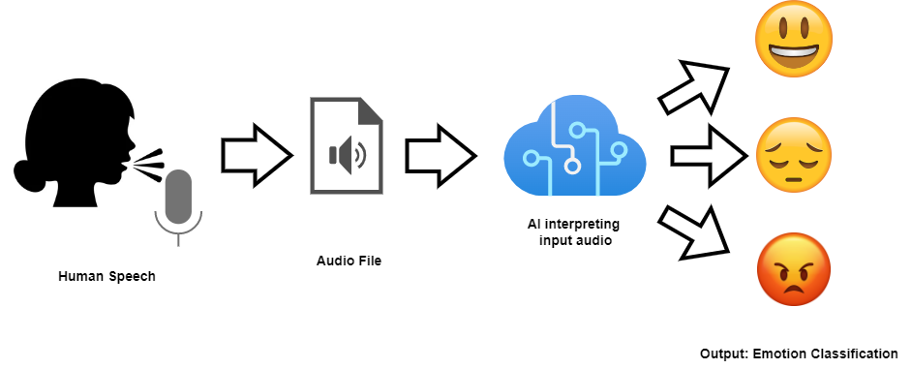
Project Objectives & Models
Models Used:
RNN, SVM, CNN: Introduction of Recurrent Neural Networks, Support Vector Machines, and Convolutional Neural Networks.
Strengths of Each Model: Unique strengths of RNN, SVM, and CNN models.
Project Aim:
Determining the best model for recognizing emotions from speech.

Slide 6
02
Dataset

Slide 7
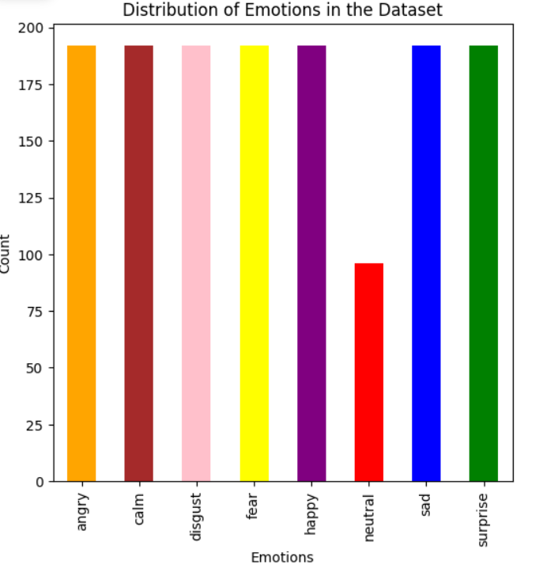
Dataset Description
Dataset Characteristics: RAVDESS
Source & Accessibility: Sourced from Kaggle, easily accessible. [Reference]
Volume: Over 1,400 audio clips.
Contributors: 24 professional actors provided speech and song recordings.
Diversity in Emotion: Spans emotions like neutral, calm, happy, sad, angry, fearful, disgusted, and surprised for versatile research.
Data Identification: Unique 7-part numerical identifier in each audio file for detailed insights, including conveyed emotion.
Emotional Categories: RAVDESS classifies emotions into eight distinct categories, enabling nuanced vocal emotion expression study.
Audio Features: Key features include pitch, intensity, and spectrogram data crucial for emotion recognition modeling.

Slide 8
03
Models

Slide 9
Flow of Our Project
Step 1
Step 2
Step 3
Step 4
Mount Google Drive
Audio Visualization
Dataset Connection
Visualizing Emotion Distribution
Step 5
Step 6
Step 7
Step 8
MFCC Feature Extraction
Model Training
Model Comparsion
Results

Slide 10
Models Selection
Convolutional Neural Network (CNN)
A deep learning model designed for recognizing patterns in data, particularly effective in extracting features from spectrogram data in audio.
Recurrent Neural Network (RNN)
A specialized model for sequential data, excelling in capturing temporal dependencies, making it suitable for analyzing emotional nuances over time in audio.
Support Vector Machine (SVM)
A machine learning algorithm known for its robustness in high-dimensional feature spaces, effective in binary and multiclass classification, and well-established in pattern recognition, making it suitable for emotion classification.

Slide 11
04
Data Analysis

Slide 12
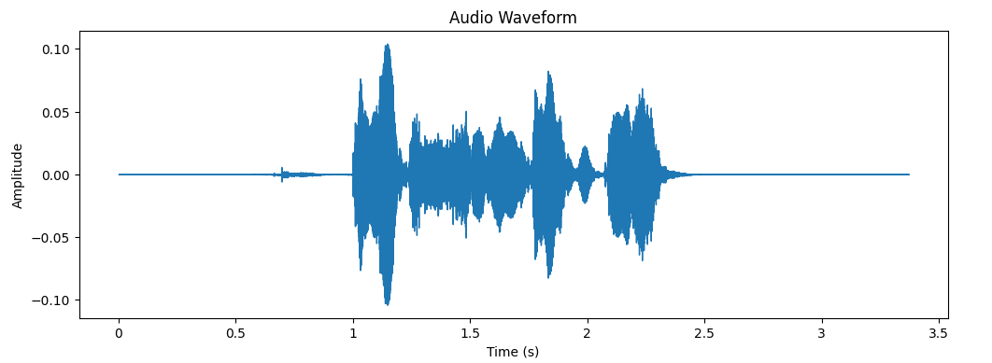
Audio Visualization
Audio Waveform Visualization: Capturing Amplitude Dynamics Over Time

Slide 13
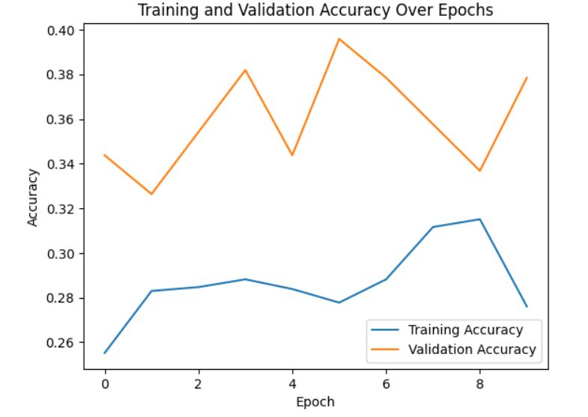
CNN Model:

Slide 14
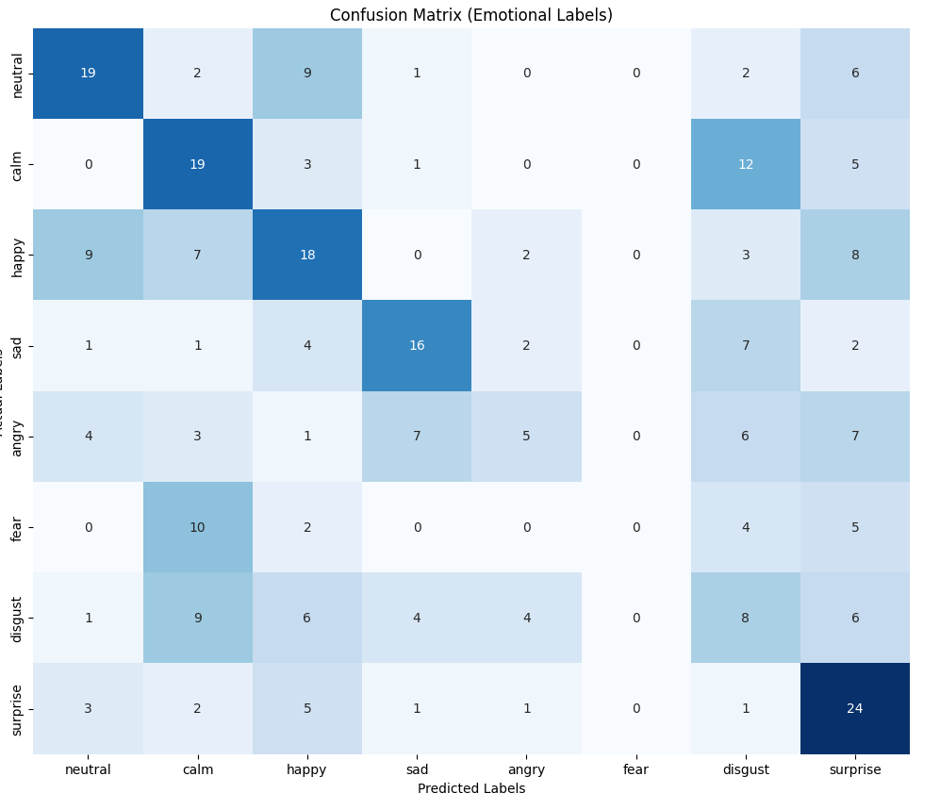
CNN Model:

Slide 15
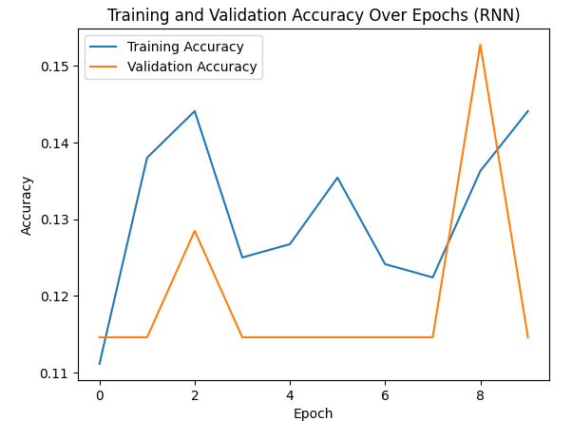
RNN Model:

Slide 16
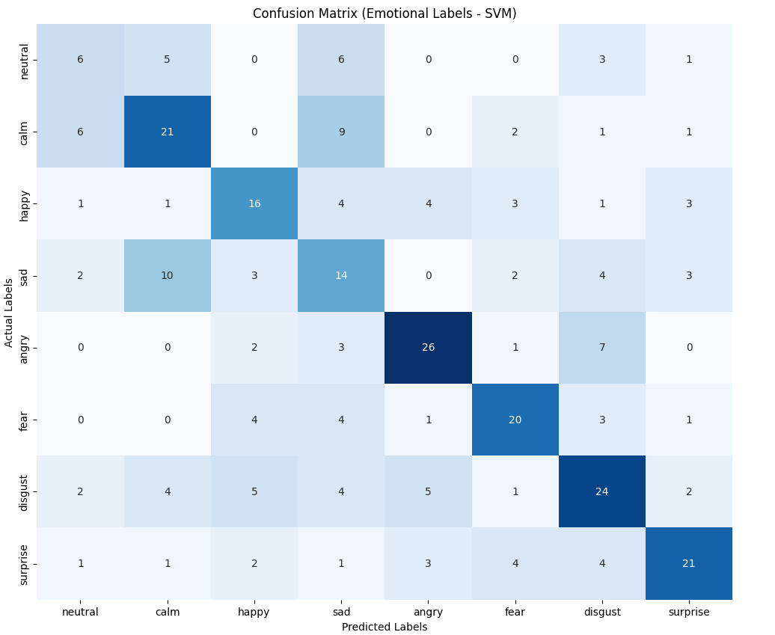
SVM Model:

Slide 17
05
Conclusion

Slide 18



THREE KEY TAKEAWAYS
SVM
RNN
CNN

Slide 19
06
Challenges & Limitations

Slide 20
Challenges:
Data Variability:
Varied emotional expressions and accents in real-world speech may pose challenges for model generalization.
Labeling Subjectivity:
Emotion annotation subjectivity can lead to variations in labeled data, impacting model training.
Limitations:
Data Size:
Limited dataset size may hinder the models' ability to capture the full spectrum of emotional expressions.
Computational Resources:
Complex models like CNN and RNN require substantial computational resources, potentially limiting scalability.

Slide 21
THANKS!

