Slide 1
NYC Flash Flood SOMs
Figures, Supplementary Figures, and Movies

Slide 2
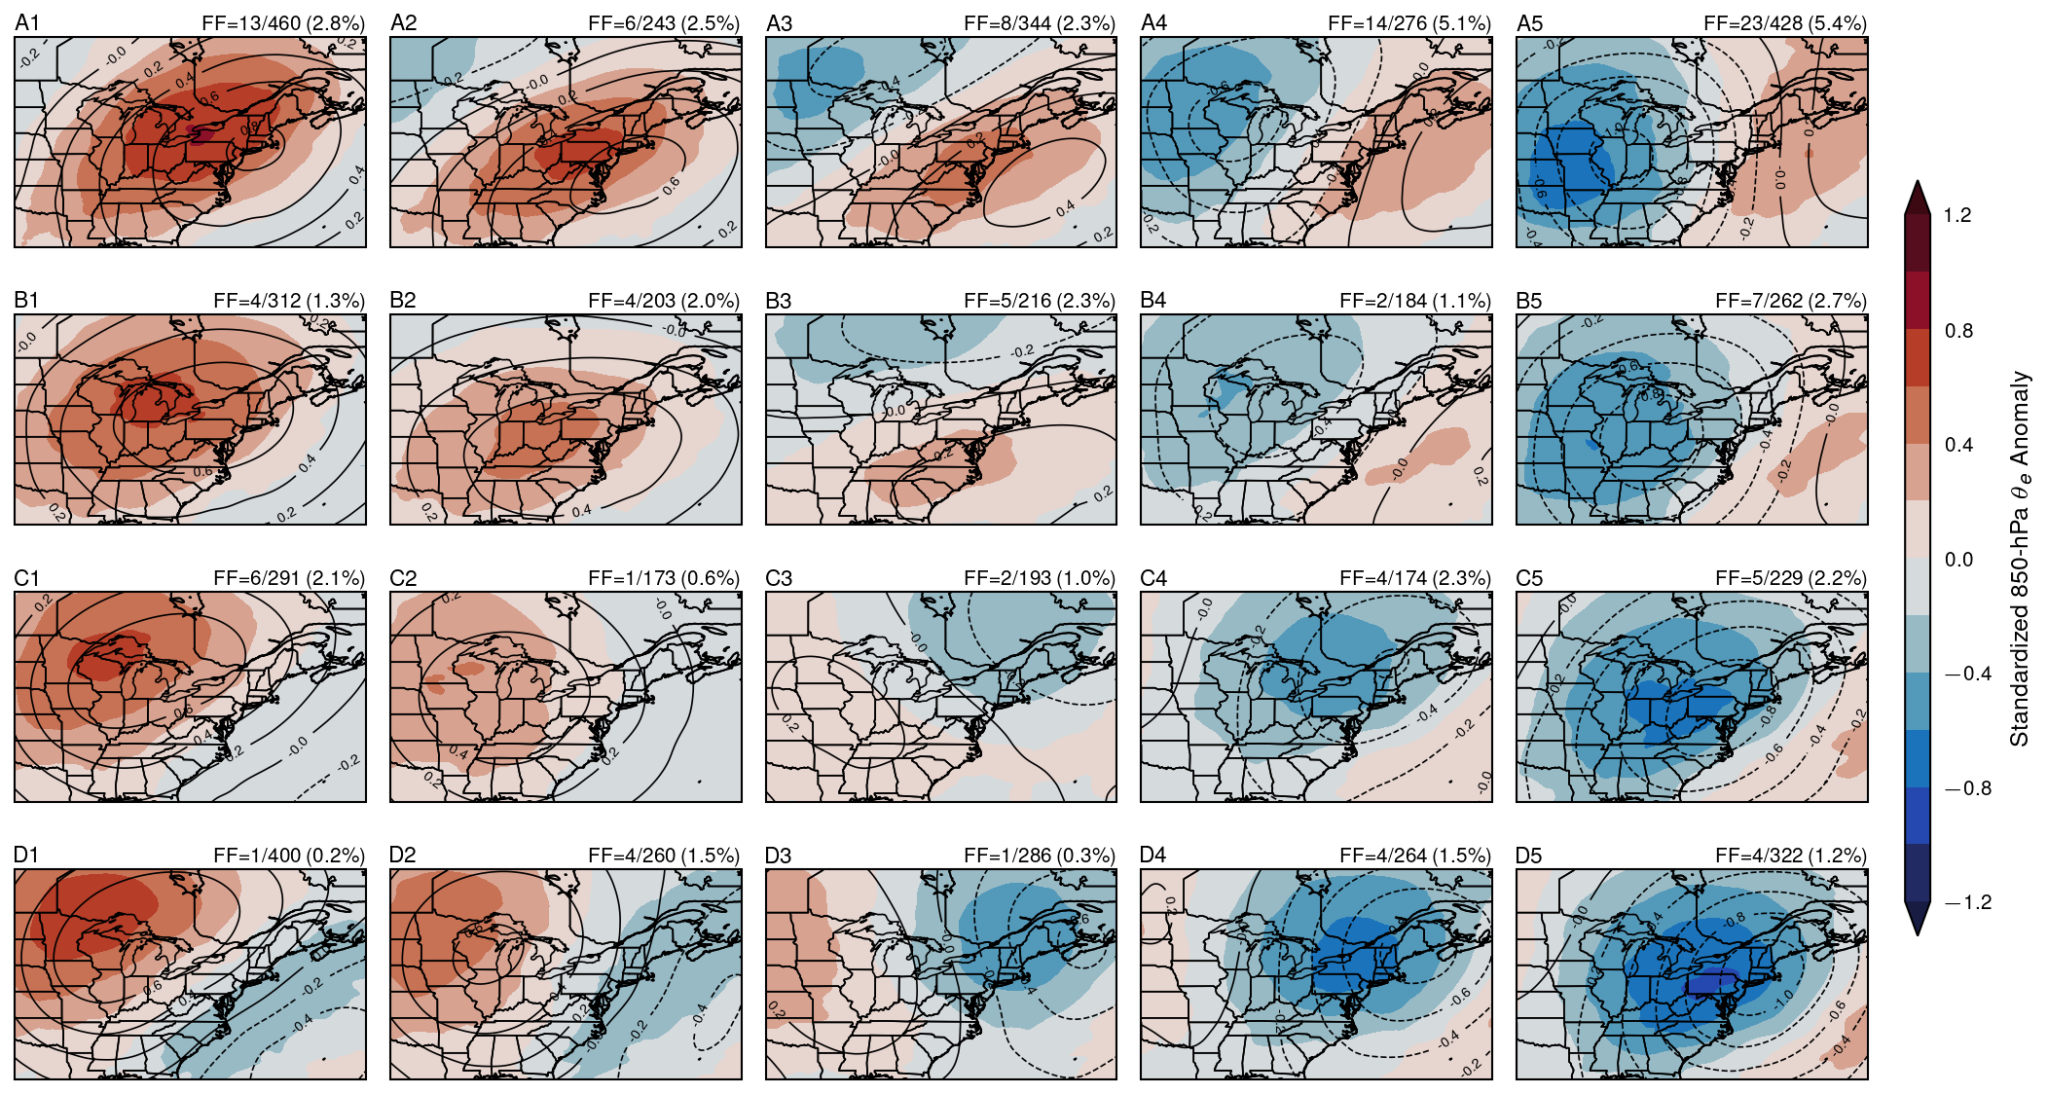
Figure 1
Figure 1. Self-organizing map (SOM) node weight patterns for the 5×4 all-days SOM trained on standardized 500-hPa geopotential height (Z500) and 850-hPa equivalent potential temperature (θe) anomalies over all warm-season days (May–October, 1996–2025). Contours show standardized Z500 anomaly (interval: 0.2σ; negative dashed); shading shows standardized 850-hPa θe anomaly. Nodes are labeled A1–E4 (columns A–E, rows 1–4 from top-left). Each panel annotates the flash flood (FF) risk as the number of FF days assigned to that node over the total number of days assigned (with percentage in parentheses).

Slide 3
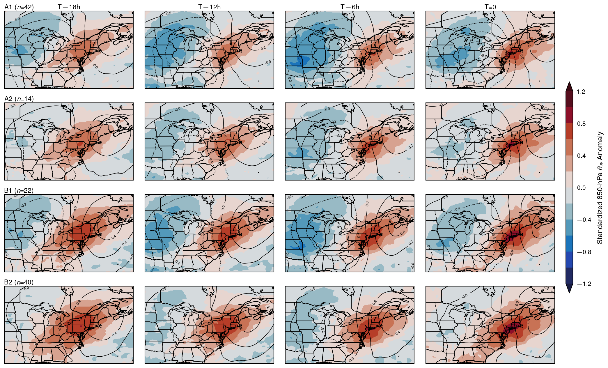
Figure 2
Figure 2. Evolution SOM (evSOM) node weight patterns at four key hours preceding flash flood episodes. The 2×2 evSOM was trained on 24-hour windows of standardized Z500 and 850-hPa θe anomalies centered on each of the 121 flash flood episodes (1996–2025). Each row corresponds to one evSOM node (A1, A2, B1, B2); each column shows a different hour offset (T−18h, T−12h, T−6h, T=0, where T=0 is the flash flood event time). Contours show standardized Z500 anomaly (interval: 0.2σ; negative dashed); shading shows standardized 850-hPa θe anomaly. Node labels include the number of episodes assigned (n).

Slide 4
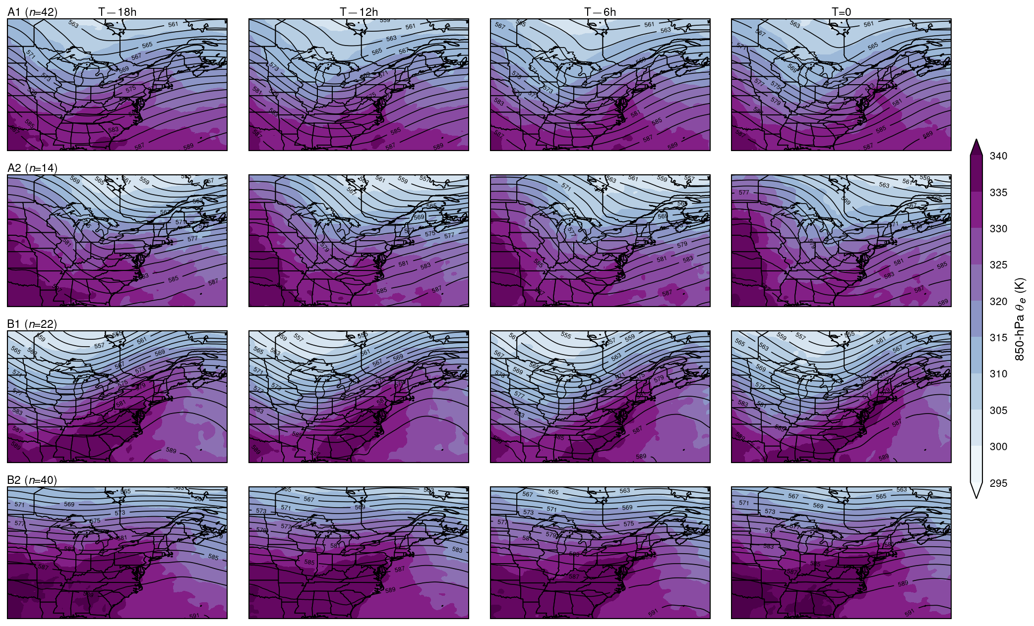
Figure 3
Figure 3. Composite mean synoptic fields at four key hours preceding flash flood episodes, grouped by evSOM node. Layout is identical to Figure 2. Contours show composite mean Z500 (interval: 2 dam); shading shows composite mean 850-hPa θe (K). Composites are computed by averaging ERA5 fields over all episodes assigned to each node at each hour offset. Node labels include the number of episodes in each composite (n).

Slide 5
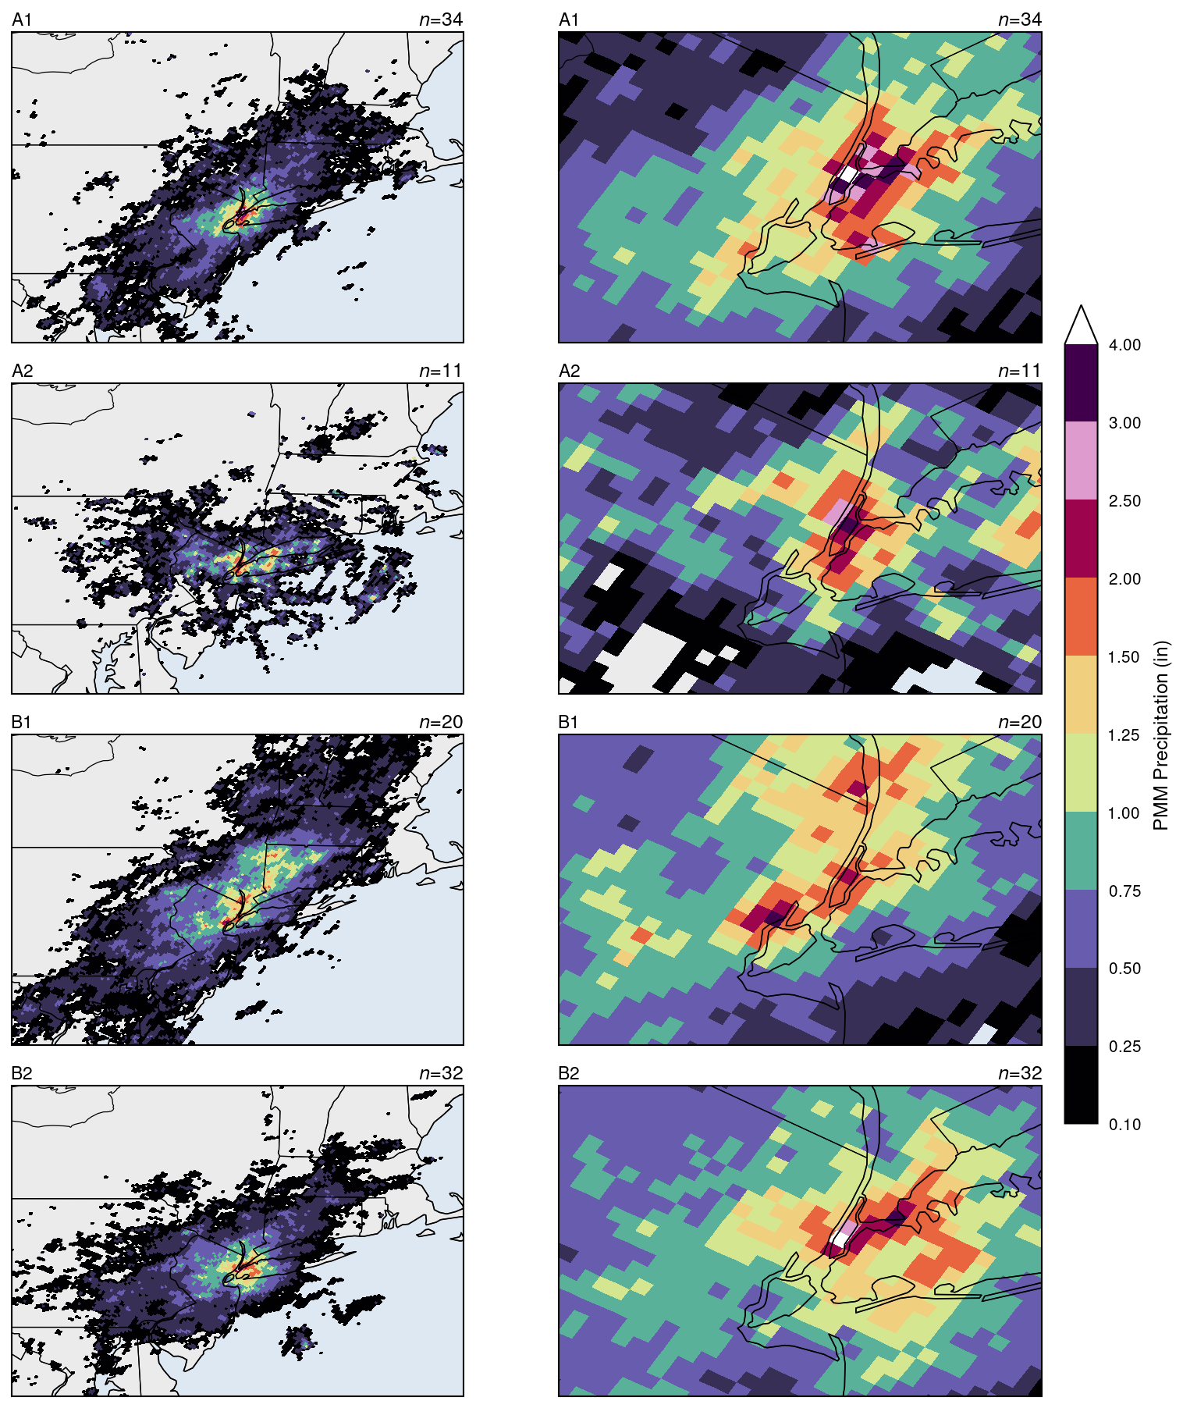
Figure 4
Figure 4. Stage IV radar-based precipitation composites for each evSOM node at T=0, shown at (left) regional scale (38.5–44°N, 78–70°W) and (right) NYC scale (40.3–41.2°N, 74.8–73.4°W). Precipitation is displayed using the probability-matched mean (PMM) technique applied to hourly Stage IV accumulations. Colors follow NWS precipitation thresholds (inches). Node labels show the number of episodes with Stage IV coverage (n). Note that n may differ between panels due to incomplete Stage IV coverage.

Slide 6
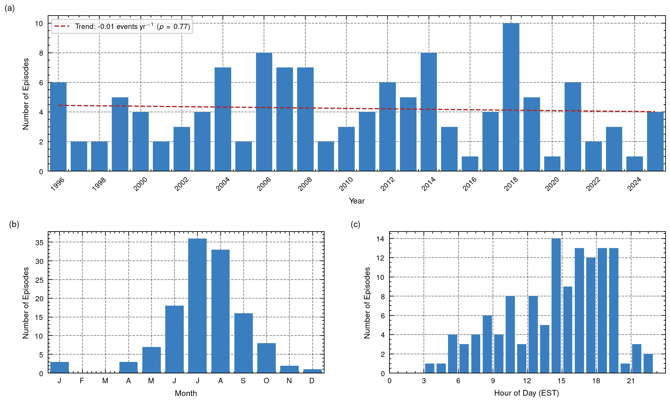
Figure S1
Figure S1. Temporal and diurnal distributions of the 127 flash flood episodes recorded in the study domain (1996–2025). (a) Annual counts with linear trend line (dashed). (b) Monthly distribution. (c) Diurnal distribution by hour of day (Eastern Standard Time). Episodes are derived from NOAA Storm Events Database flash flood reports for New York City, deduplicated by episode identifier and UTC calendar day. All seasons are included; the 118-episode warm-season subset used in the SOM analysis is described in the main text.

Slide 7
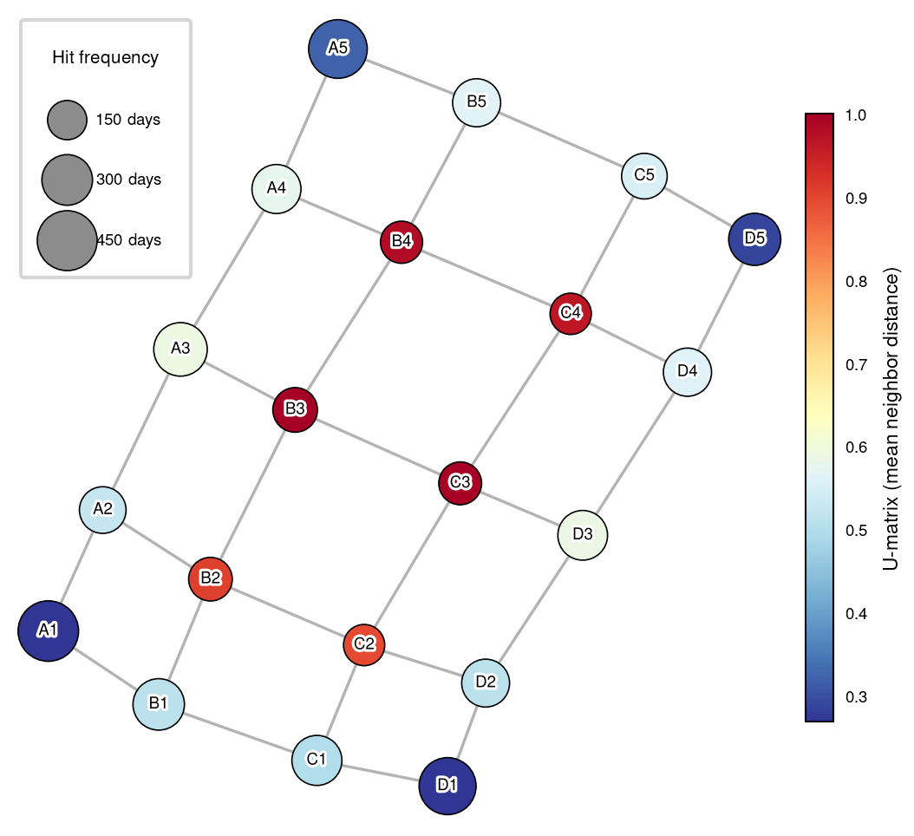
Figure S2
Figure S2. Sammon mapping (nonlinear multidimensional scaling) of the 5×4 all-days SOM. Each circle represents one SOM node; fill color indicates the U-matrix value (mean Euclidean distance to neighboring nodes in weight space, a measure of inter-node dissimilarity); circle size is proportional to hit frequency (number of days assigned to that node). Gray lines connect adjacent nodes in the original SOM grid. Node labels correspond to those in Figure 1.

Slide 8
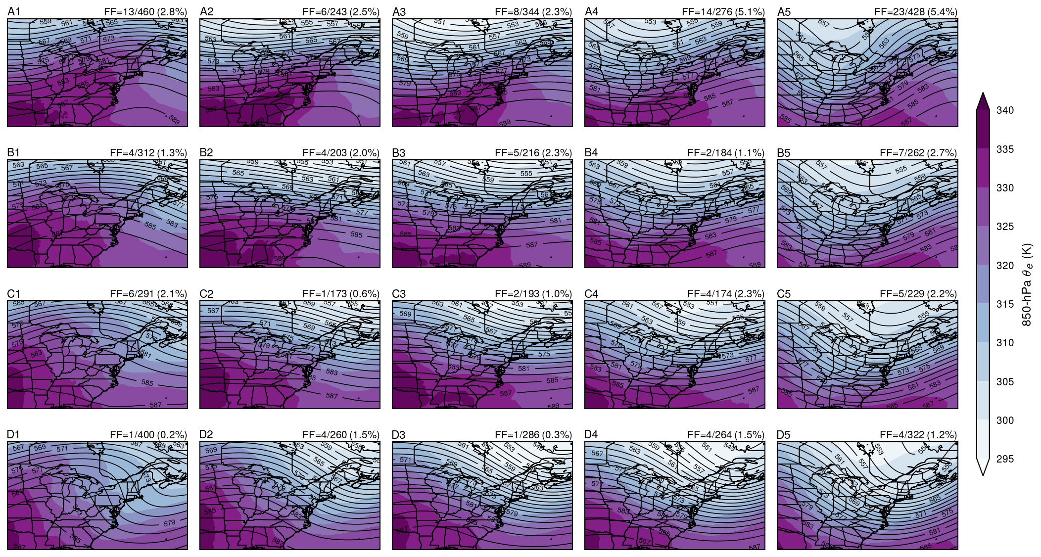
Figure S3
Figure S3. Composite mean synoptic fields for each node of the 5×4 all-days SOM, corresponding to the node weight patterns shown in Figure 1. Contours show composite mean Z500 (interval: 2 dam); shading shows composite mean 850-hPa θe (K). Composites are averaged over all warm-season days (May–October, 1996–2025) assigned to each node. Each panel annotates the flash flood (FF) risk as in Figure 1.

Slide 9
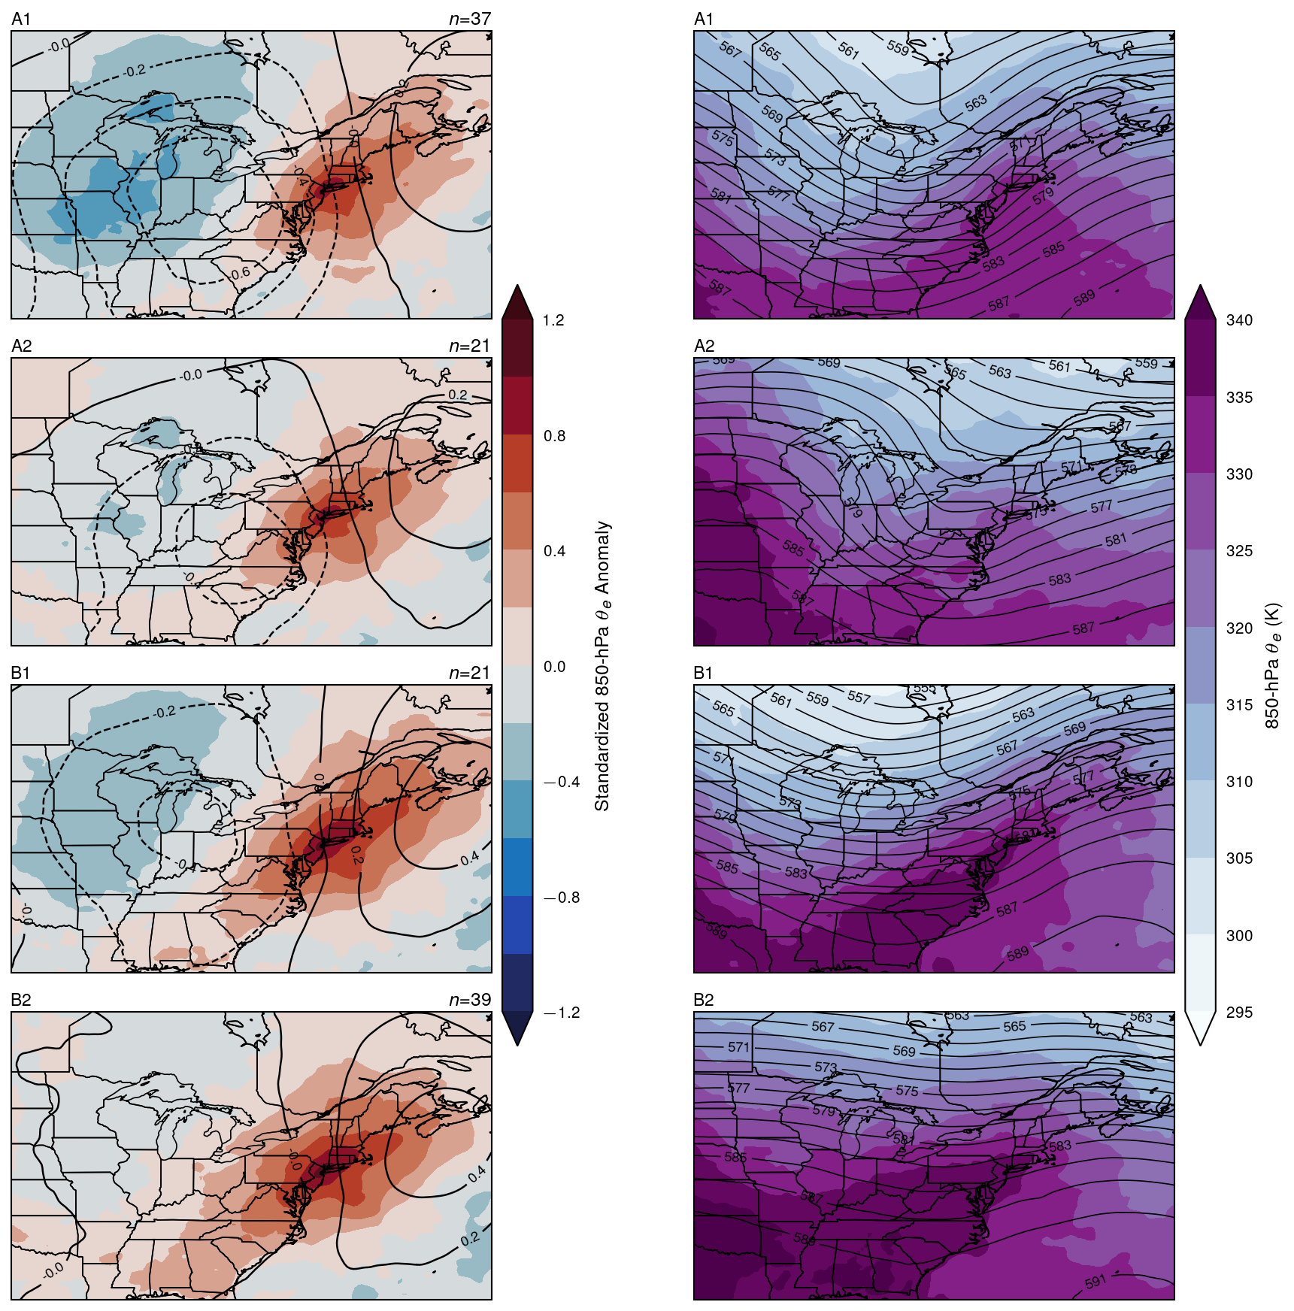
Figure S4
Figure S4. Node weight patterns (left) and raw composite mean fields (right) for the static 2×2 flash-flood-episode (FFE) SOM trained on standardized Z500 and 850-hPa θe anomalies at the time of each episode. Left panels: contours show standardized Z500 anomaly (interval: 0.2σ); shading shows standardized 850-hPa θe anomaly. Right panels: contours show composite mean Z500 (interval: 2 dam); shading shows composite mean 850-hPa θe (K), averaged over episodes assigned to each node. Node labels include the number of episodes assigned (n).

Slide 10
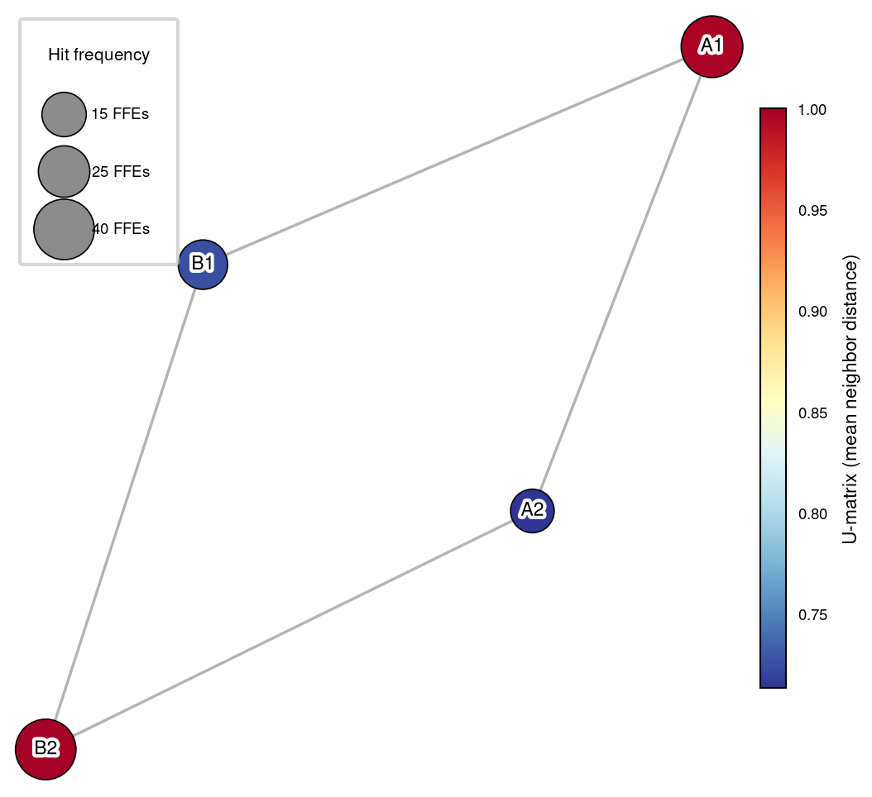
Figure S5
Figure S5. Sammon mapping of the 2×2 evolution SOM (evSOM). As in Figure S2, but for the evSOM trained on 24-hour windows of standardized Z500 and 850-hPa θe anomalies preceding each flash flood episode. Circle size is proportional to the number of episodes assigned to each node (n = 14–42 episodes).

Slide 11
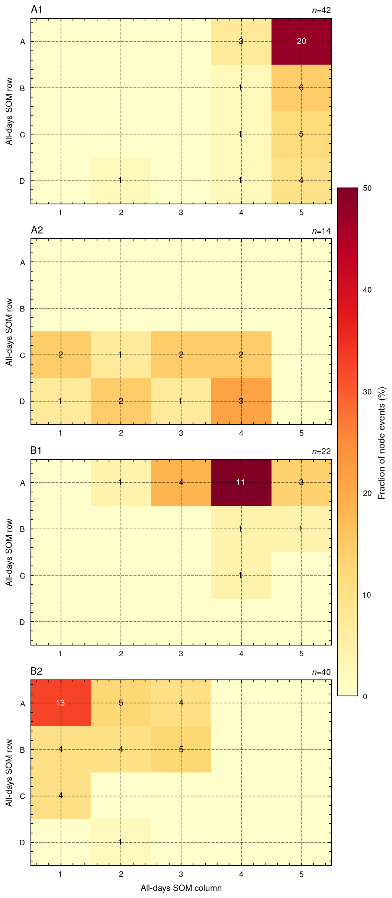
Figure S6
Figure S6. Mapping of evSOM nodes to all-days SOM nodes. Each panel corresponds to one evSOM node (A1, A2, B1, B2) and shows the percentage of flash flood episodes assigned to that evSOM node that fall into each node of the 5×4 all-days SOM (columns 1–5, rows A–D). Annotated values give episode counts. Color shading indicates the percentage, with darker orange-red tones denoting a higher concentration of episodes.

Slide 12
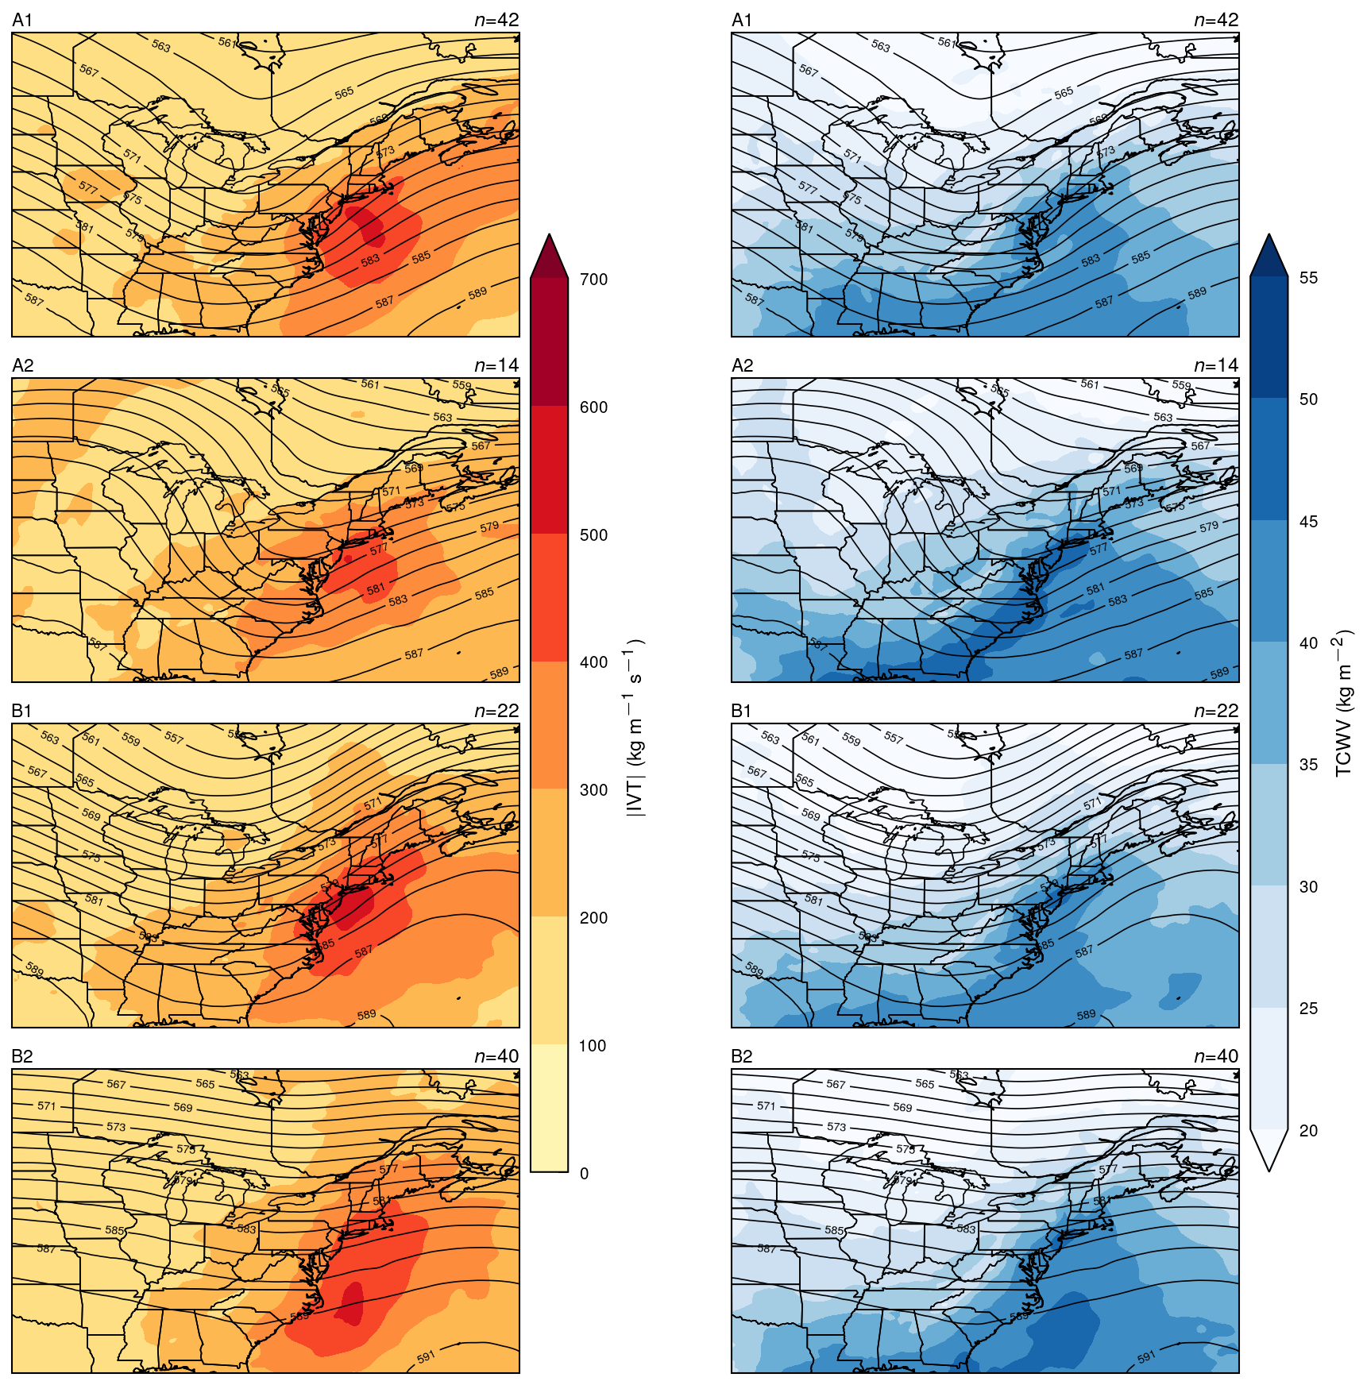
Figure S7
Figure S7. Composite mean integrated vapor transport (IVT; left) and total column water vapor (TCWV; right) at T=0 for each evSOM node. Left panels: shading shows composite mean IVT magnitude (kg m−1 s−1); contours show composite mean Z500 (interval: 2 dam). Right panels: shading shows composite mean TCWV (kg m−2); contours show composite mean Z500 (interval: 2 dam). Composites are averaged over episodes assigned to each node (n given in each panel).

Slide 13
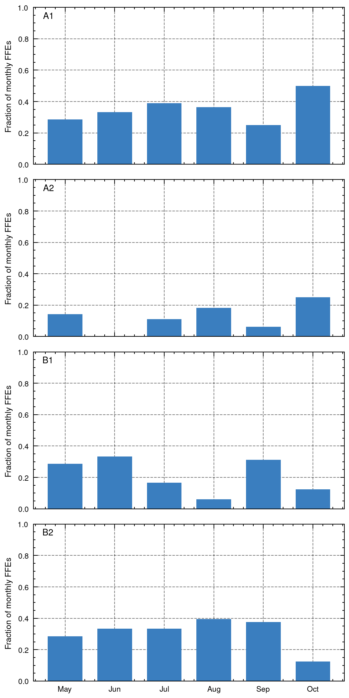
Figure S8
Figure S8. Monthly frequency distribution of flash flood episodes by evSOM node. Each panel shows the fraction of episodes assigned to that node within each calendar month (May–October), normalized by the total number of episodes in that month across all nodes. Node labels follow the convention of Figure 2.

Slide 14
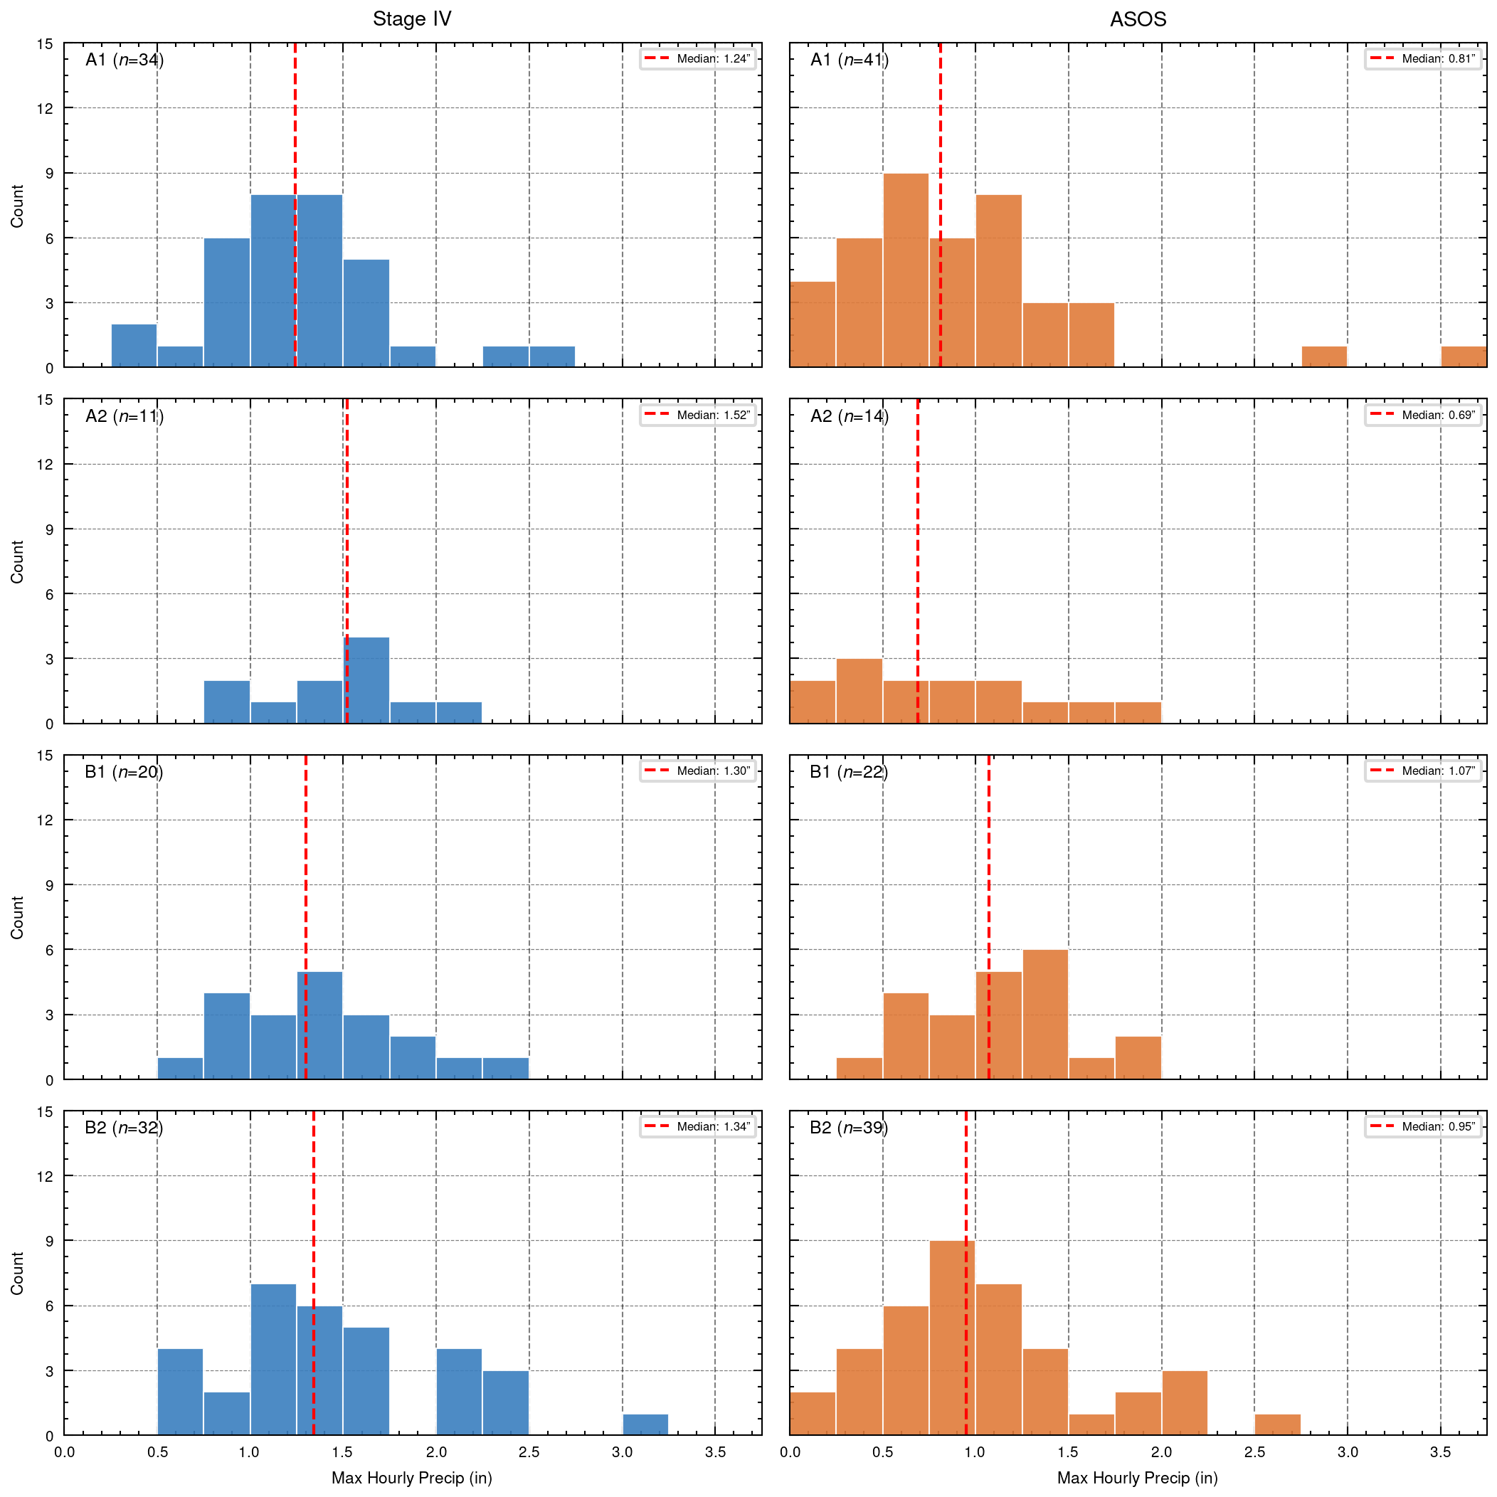
Figure S9
Figure S9. Per-node distributions of maximum hourly precipitation within ±6 hours of flash flood episode onset. Left column: Stage IV radar-based precipitation (inches) over the NYC domain (40.5–40.9°N, 74.3–73.7°W). Right column: maximum hourly ASOS gauge precipitation (inches) across JFK, LGA, Central Park, and EWR. Red dashed lines indicate the median. Node counts (n) reflect events with available data; 2025 events are excluded from Stage IV composites due to data availability.

Slide 15
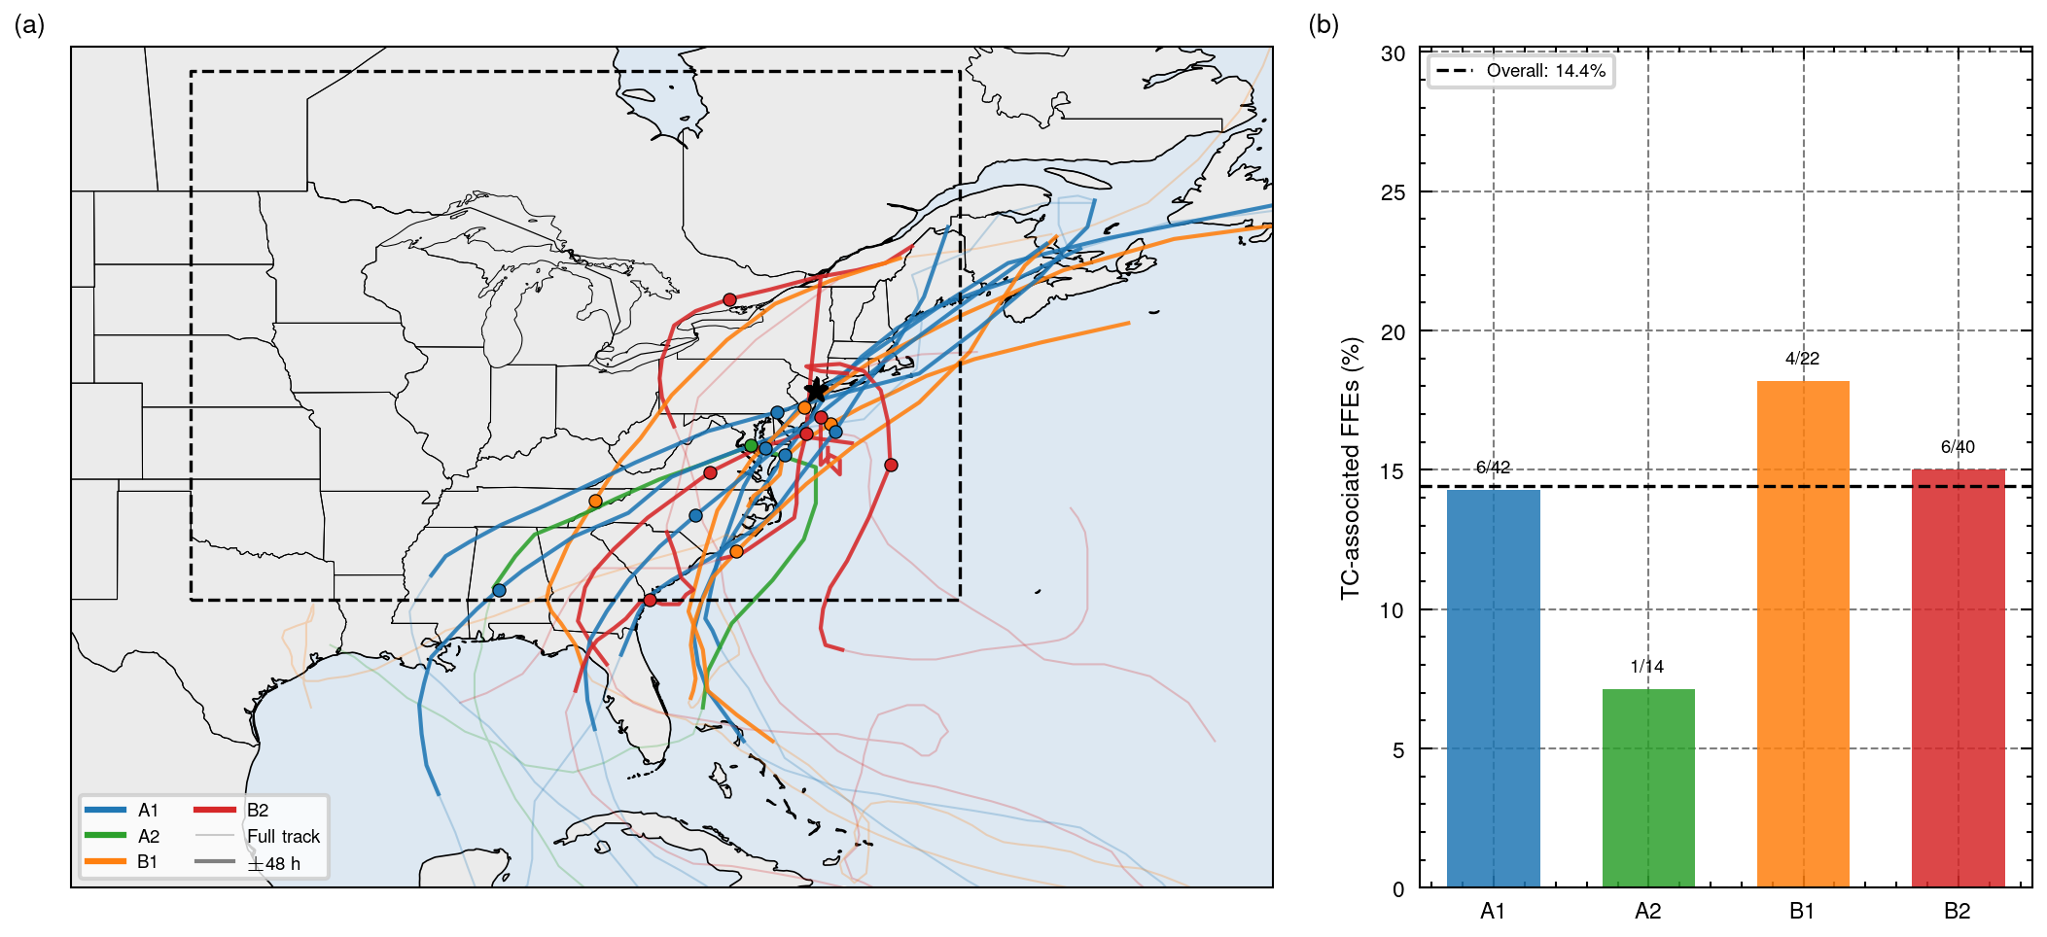
Figure S10
Figure S10. Tropical cyclone (TC) associations for flash flood episodes grouped by evSOM node. (a) IBTrACS TC tracks during TC-associated episodes, colored by evSOM node. Faint lines show the full track; bold lines show the ±48-hour window around the episode time; filled circles mark the TC position at T=0. The dashed rectangle indicates the TC-association domain (30–54°N, 100–60°W). The star marks New York City. (b) Percentage of TC-associated (colored) episodes per evSOM node. Annotated fractions give TC-associated count over total node count. The dashed horizontal line indicates the overall TC-association rate across all episodes.

Slide 16
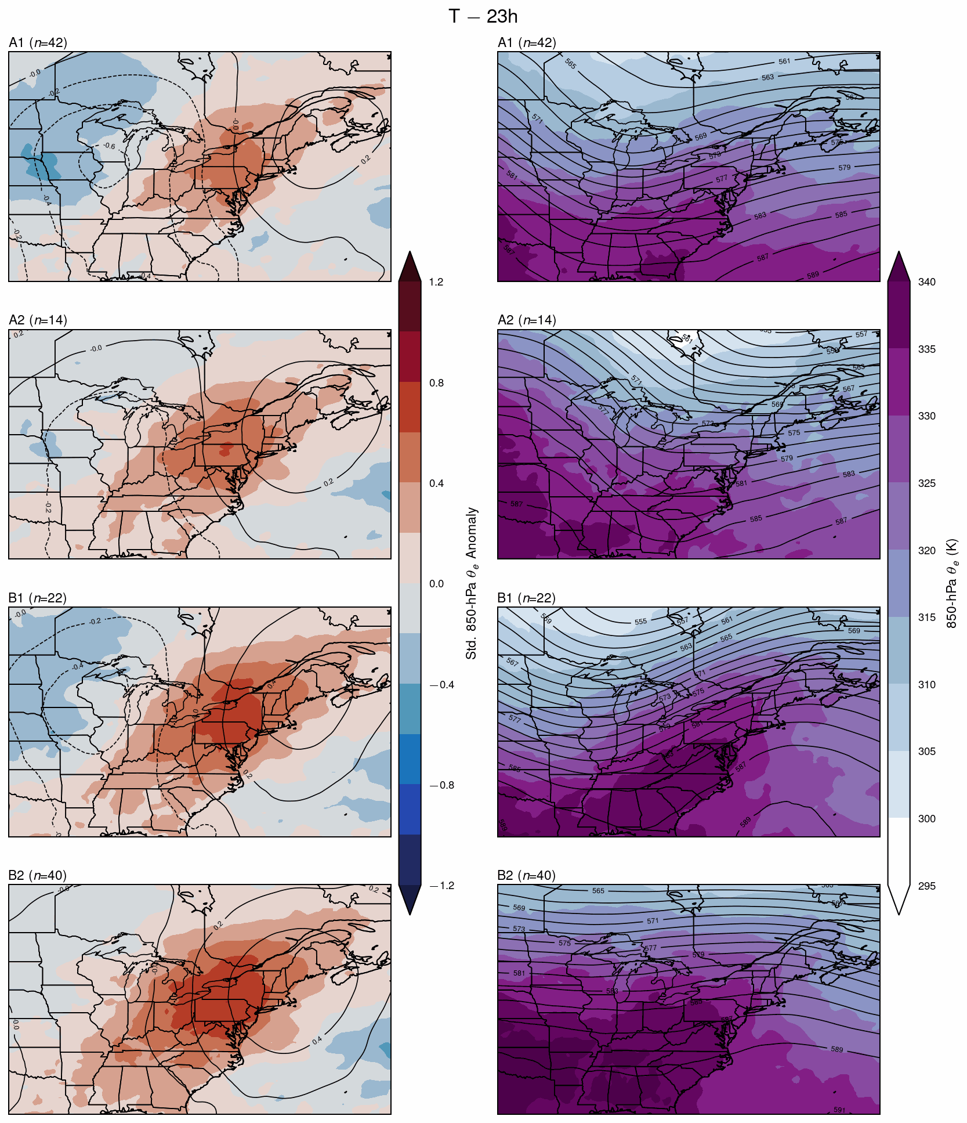
Movie S1 [animation — see .gif / .mp4]
Movie S1. Animation of evSOM node weight patterns from T−23h to T=0 (1-hour steps, 24 frames total). Each frame shows the 2×2 evSOM layout (nodes A1, A2, B1, B2) at one hour offset prior to flash flood episode time. Contours show standardized Z500 anomaly (interval: 0.2σ; negative dashed); shading shows standardized 850-hPa θe anomaly. Corresponds to the full temporal evolution of which Figure 2 shows four key snapshots.

