Slide 1

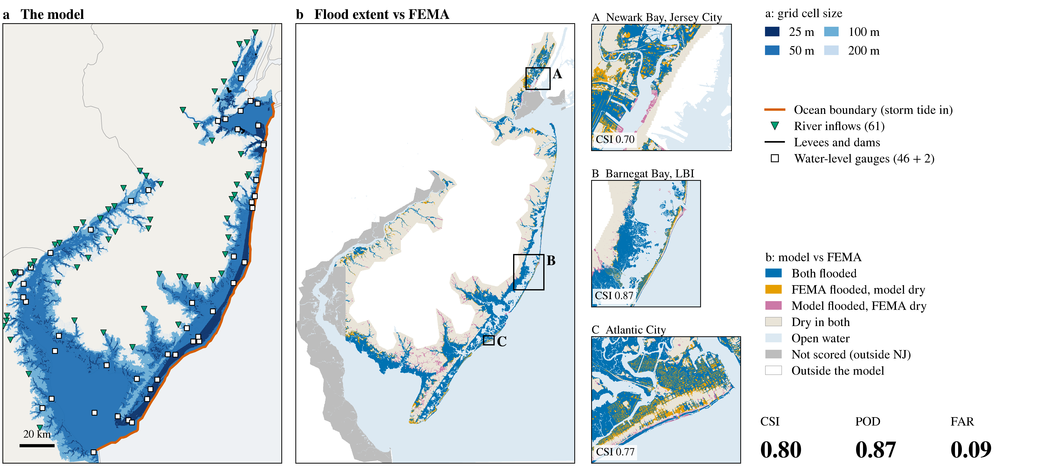
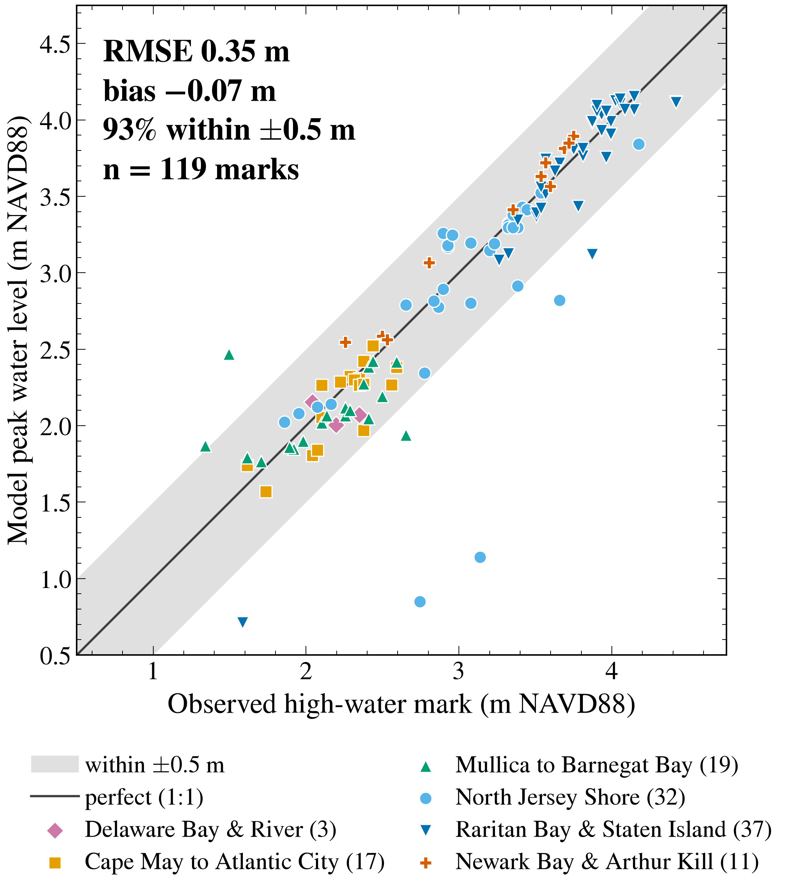
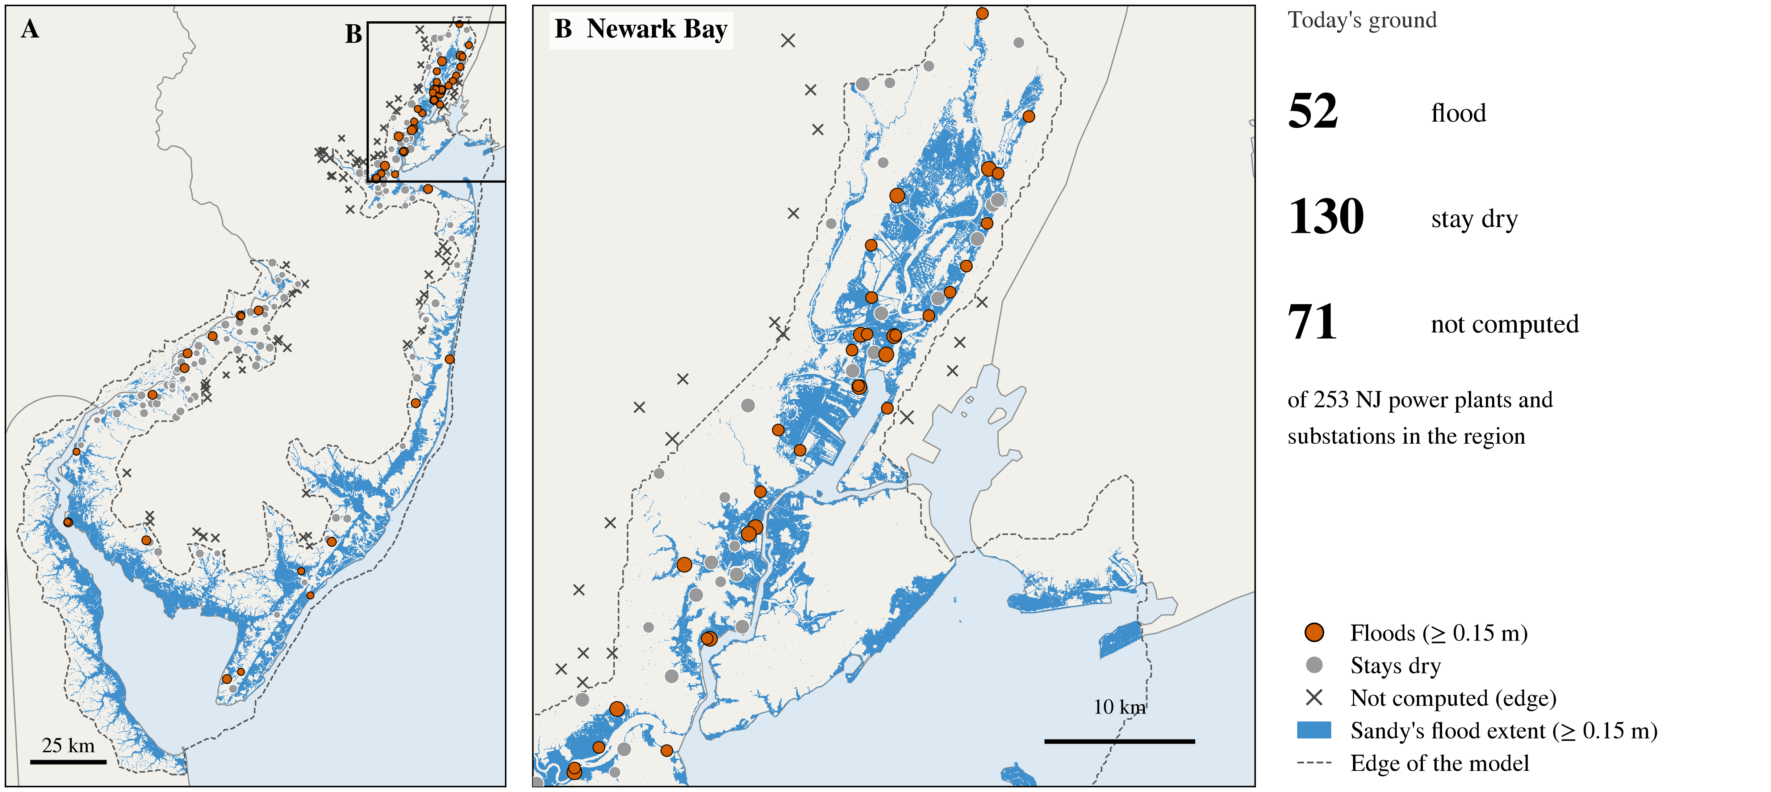
NJ-SFINCS: A compound flood model for coastal
New Jersey for power-grid and community risk
Tyler P. Janoski¹, Nithila Darmeshwaran¹, James B. Shope¹, Robert Mieth², Terence Ahn³
¹Department of Environmental Sciences, ²Department of Industrial and Systems Engineering,
³Department of Electrical and Computer Engineering, Rutgers University
Abstract
Results 1: Sandy test case
We present NJ-SFINCS, a high-resolution compound flood model for the New Jersey coast, built on the computationally efficient SFINCS flood model: it covers the coast from the Verrazzano Narrows to Cape May and extends up the Delaware Bay and River, with a maximum resolution of 25 m over a 3 m sub-grid topography. We test the model using Hurricane Sandy (2012): simulated peak water levels have an RMSE of 0.35 m relative to 119 USGS high-water marks, and NJ-SFINCS reproduces more than 86% of FEMA's mapped surge extent. Overlaying present-day substations and power plants, we find that nearly one-third of New Jersey assets in the domain (52 of 182) would flood if Sandy struck today's coast, while 1.2 m of sea-level rise alone would flood about 30 at high tide (still-water estimate); we also couple these flood depths with an impact model to estimate damage to individual buildings.
High-water marks: NJ-SFINCS's peak water levels are within 0.35 m (RMSE; bias −0.07 m) of 119 USGS marks; 93 % of the marks within ±0.5 m (Fig 2).
FEMA's surge map: NJ-SFINCS floods more than 86 % of the New Jersey land FEMA mapped as flooded by Sandy's surge (CSI 0.80, FAR 0.09; Fig 1b).
False alarms: 71 of the 113 km² the model floods and FEMA does not are rain ponds cut off from the sea; without rain, CSI is 0.82.
Introduction
New Jersey's coast is subject to several forms of flooding, including coastal (storm surge and waves), pluvial (rainfall), and fluvial (river). Hurricane Sandy (2012) is a prime example of how these sources combine to impact communities and the power grid (Blake et al. 2013; Suro et al. 2016). Planning for future storms and sea-level rise requires running many “what if” cases, and most coastal flood models are too slow to produce simulations efficiently. SFINCS is a fast flood model that uses simplified shallow-water equations, retaining the physics that matters for flooding (Leijnse et al. 2021). NJ-SFINCS applies SFINCS to the whole New Jersey coast, with surge, waves, rain, and rivers all included. We validate it against observations from Hurricane Sandy, then ask: if Sandy were to happen again today, what communities and power grid assets would flood?
NJ-SFINCS is the first SFINCS model to cover the New Jersey coast as a whole, from the Narrows to Cape May and up Delaware Bay.
Fig 1. NJ-SFINCS and its Sandy flood extent. (a) The model grid and its inputs. (b) Peak flood extent vs FEMA's mapped surge, New Jersey land only; insets at full 15 m with local CSI. Orange rows in C are building footprints, which the model treats as solid blocks. FEMA's map ends abruptly around Jersey City and Bayonne, so model flooding there scores as a false alarm.
Fig 2. Peak water at Sandy's high-water marks; grey band = ±0.5 m. The big misses are five marks behind Deal Lake and Wreck Pond, whose outlets the model holds shut (RMSE 0.24 m without them).
Results 2: Power grid and buildings
Delft-FIAT building-damage results — [to be added]
(figure here, about two-thirds of the box)
Sandy on today's ground and defences (preliminary): 52 of the 182 New Jersey power plants and substations in the model flood (≥ 0.15 m on any part of the site); 26 of them have water over at least half their ground.
Newark Bay: half of the flooded sites (26 of 52) are in Hudson, Bergen, Union and Essex counties.
Substations and big plants: 23 of the 27 flooded substations are high-voltage (230 kV and above). Four large gas-fired plants on the Hackensack, Arthur Kill and Raritan (Kearny, Linden, Sewaren, Sayreville) have water over two-thirds or more of their ground (68–87 %), a median 1.3–2.2 m deep.
1.2 m of sea-level rise, no storm: about 30 of the 182 sit in water at high tide (still-water estimate, preliminary).
[FIAT finding + number]
Methods
[FIAT bullet 1: finding + number]
[FIAT bullet 2: which flood map fed it, which buildings]
Model | NJ-SFINCS 1.1.0: SFINCS v2.3.3 (Leijnse et al. 2021) via HydroMT-SFINCS (Eilander et al. 2023)
Grid | ~4 million cells, 25–200 m; 3 m subgrid ground; building footprints; levees
Forcing | storm tide: USACE NACCS (Cialone et al. 2015); waves: SnapWave (Roelvink et al. 2025); wind: NACCS / ERA5; rain: NOAA AORC; rivers: USGS, 61 inflows
Speed | about 3 hours per 72-hour storm on one 64-core computer
Impact model | Delft-FIAT (Deltares); [inventory]
Fig 3. New Jersey power plants and substations in Sandy on today's ground (preliminary): a site counts as flooded if any part has ≥ 0.15 m; blue = flood extent as in Fig 1b. B = Newark Bay.
Fig 4. Building damage from Sandy's flood depths (Delft-FIAT). [caption: preliminary; flood map used]
Conclusions / Future Work
References
NJ-SFINCS is fast: a 72-hour storm in about 3 hours on one computer makes dozens of cases practical.
It reproduces Sandy (Experiment 1): 0.35 m RMSE at the marks; more than 86 % of FEMA's surge extent.
It turns floods into risk (Experiment 2): nearly one-third of New Jersey's power plants and substations in the model (52 of 182) would flood if Sandy struck today's coast, and the same depths feed building damage estimates. [add the impact number]
Future work: more storms and sea-level-rise cases on today's ground; building damage for each scenario; Model 2.0 with the Hudson waterfront and the Upper Bay; finer Cape May inlets, where the back bays read about 0.2 m low.
Blake, E.S., Kimberlain, T.B., Berg, R.J., Cangialosi, J.P., Beven, J.L. II (2013). Tropical Cyclone Report: Hurricane Sandy (AL182012). NOAA National Hurricane Center.
Cialone, M.A., et al. (2015). NACCS Coastal Storm Model Simulations: Waves and Water Levels. USACE ERDC/CHL TR-15-14.
Copernicus Climate Change Service (C3S). ERA5 hourly data on single levels. doi:10.24381/cds.adbb2d47.
Eilander, D., et al. (2023). A globally applicable framework for compound flood hazard modeling. Nat. Hazards Earth Syst. Sci. 23, 823–846. doi:10.5194/nhess-23-823-2023.
FEMA Modeling Task Force (MOTF) (2012). Hurricane Sandy storm-surge extent, final field-verified (11 Nov 2012).
Leijnse, T., van Ormondt, M., Nederhoff, K., van Dongeren, A. (2021). Modeling compound flooding in coastal systems using a computationally efficient reduced-physics solver. Coastal Engineering 163, 103796. doi:10.1016/j.coastaleng.2020.103796.
McCallum, B.E., Wicklein, S., Reiser, R.G., Busciolano, R., Morrison, J., Verdi, R.J., Painter, J.A., Frantz, E.R., Gotvald, A.J. (2013). Monitoring storm tide and flooding from Hurricane Sandy along the Atlantic coast of the United States, October 2012. USGS Open-File Report 2013-1043. doi:10.3133/ofr20131043.
Roelvink, D., et al. (2025). SnapWave: fast, implicit wave transformation from offshore to nearshore. Geosci. Model Dev. 18, 9469–9495. doi:10.5194/gmd-18-9469-2025.
Suro, T.P., Deetz, A., Hearn, P. (2016). Documentation and hydrologic analysis of Hurricane Sandy in New Jersey, October 29–30, 2012. USGS SIR 2016-5085. doi:10.3133/sir20165085.
Data & credits: USACE (NACCS / Coastal Hazards System, eHydro, National Levee Database, NCMP lidar) · NOAA (CO-OPS gauges, CUDEM, CORA, AORC, NOS surveys) · USGS (high-water marks and storm-tide sensors, discharge, 3DEP, CoNED) · ECMWF / Copernicus (ERA5) · FEMA (MOTF surge extent) · NJ OGIS / NJDEP (lidar DEM, building footprints) · USDA NRCS (SSURGO) · MRLC (NLCD) · GMRT (CC BY 4.0) · power plant and substation outlines © OpenStreetMap contributors (ODbL). Computing: Rutgers Amarel (OARC).
Experiment 1: Sandy test. Sandy (28–31 Oct 2012) on 2012 ground, all forcing on. Scored against 119 USGS high-water marks (median model peak water within 50 m of each mark) and FEMA's mapped surge extent on New Jersey land (flooded = peak depth ≥ 0.15 m; CSI = overlap of the two flooded areas, 1 = perfect).
Experiment 2: power grid and buildings. Today's New Jersey power plants and substations (OpenStreetMap outlines; 182 inside the model) in two cases: Sandy on today's ground and defences (post-2012 elevation surveys, levees and tide gates; 2012 sea level and buildings), and 1.2 m of sea-level rise at high tide (still water). A site floods if any part of it is under ≥ 0.15 m. Delft-FIAT turns the same depths into building damage.
Notes:
Draft v9 built 2026-11-13: two experiments, no stat tiles; red [ ... ] = stubs to fill (FIAT results, inventory).

