Slide 1
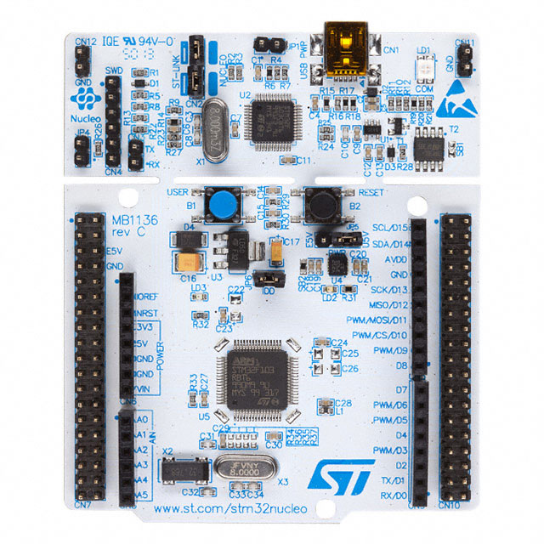
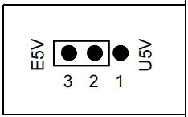
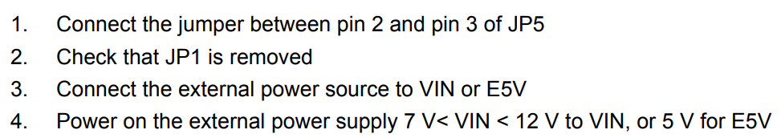
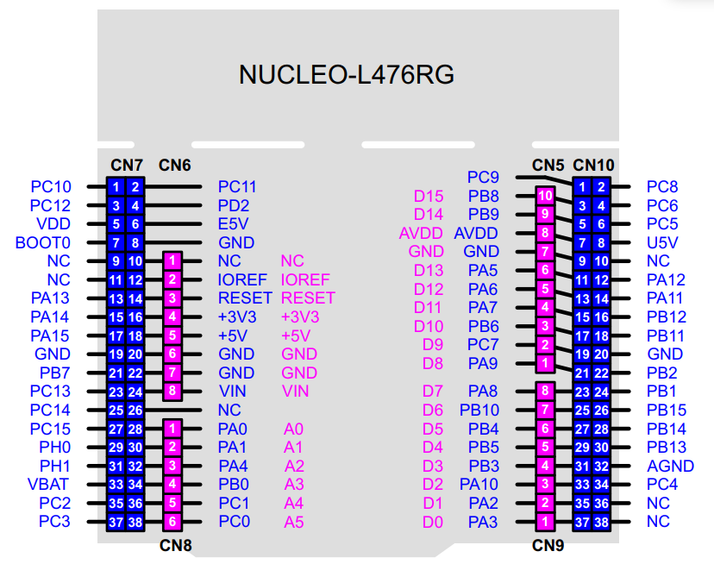
Configure jumpers as per section 6.3.2 of the STM32 Nucleo 64.pdf file. This allows us to accept power from the RPi
RPi --> MCU comm
MCU --> RPi comm
To servos (daisy chain)
+5 V supply, from RPi
Common ground, shared by all equipment

