Slide 1
Swipes for Advice

Slide 2
Objectives
Client server application
Client: Android phone application that keeps track of user activity in the form of “likes”, user corporate and academic achievement, and allows users to exchange chatroom messages.
Server: An online NoSQL database that saves and displays user information, past in-app behavior pictures, GPS location and chatroom conversations.

Slide 3
User flow
LinkedIn Integration
Profile Creation
Profile Stack
Matching
User-to-User Communication

Slide 4
System integration
Data collection (LinkedIn SDK)
Data sent to server for profile creation
Profiles pulled from database
User activity sent to server
Client-server interaction for chatroom

Slide 5
Applications
Networking
Connect people through a Mentor/Mentee relationship
Potentially free food
Mentee swipes a Mentor in the dining hall

Slide 6
Timeline
Sign in with LinkedIn
Make profile and pull from LinkedIn
Set up database and get profiles
a) Chat between 2 profiles b) Have profiles appear c) Matching & chatrooms

Slide 7
Obstacles
Database query delay
Recreating relational database query in noSQL
Server client interaction for chatroom (making sure it doesn’t lag)

Slide 8
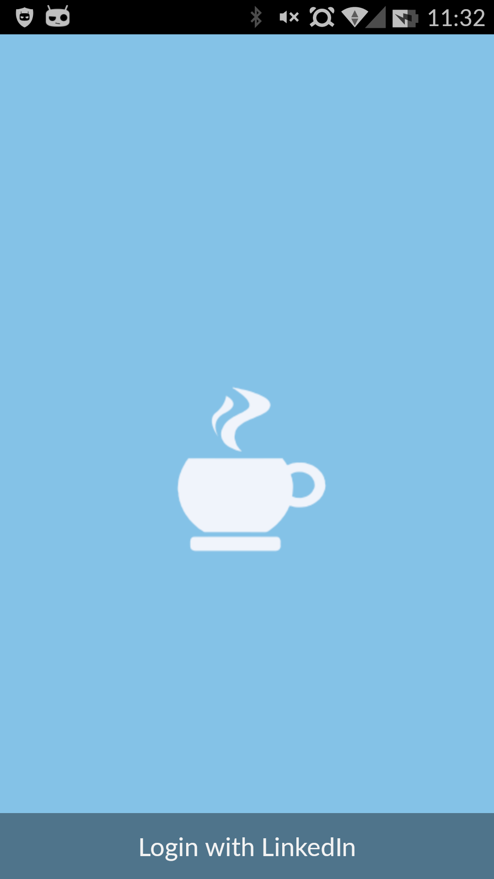

Slide 9
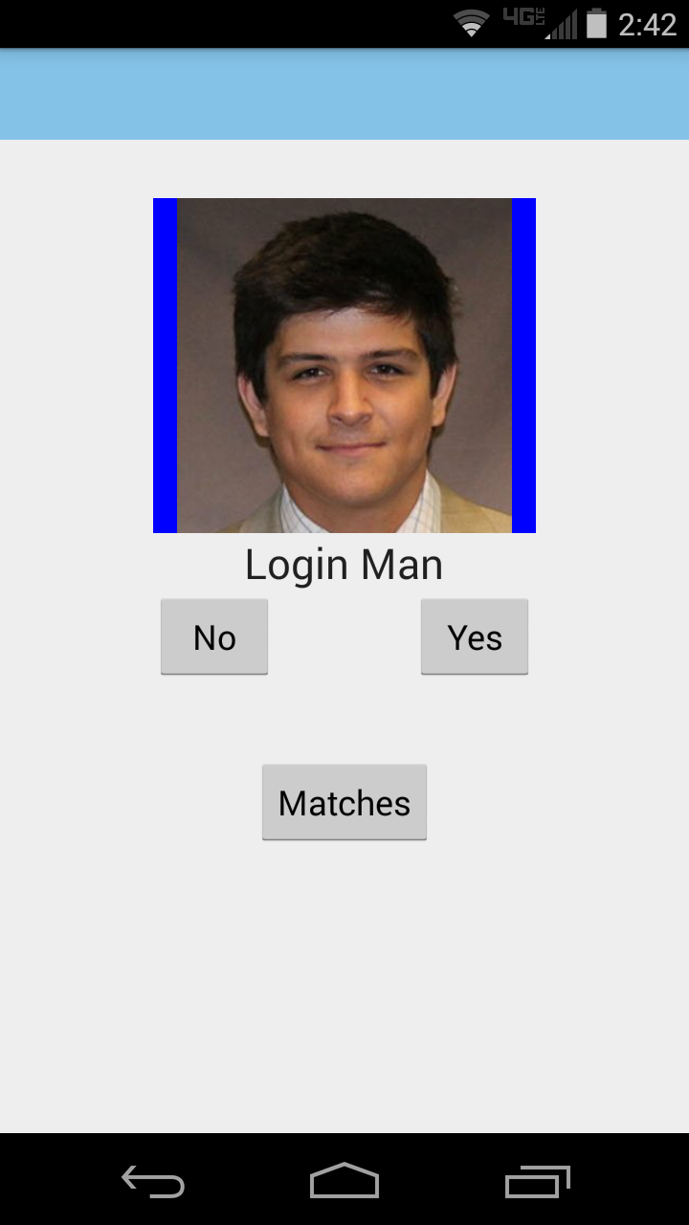

Slide 10
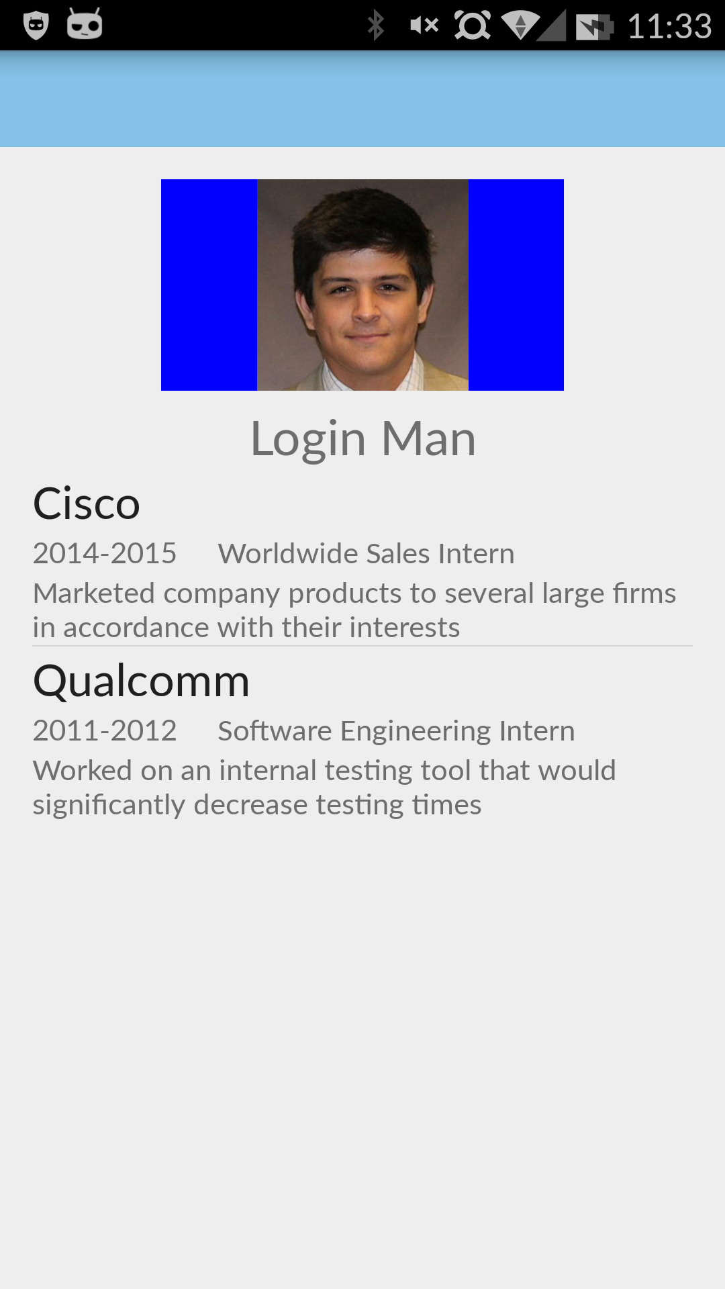

Slide 11
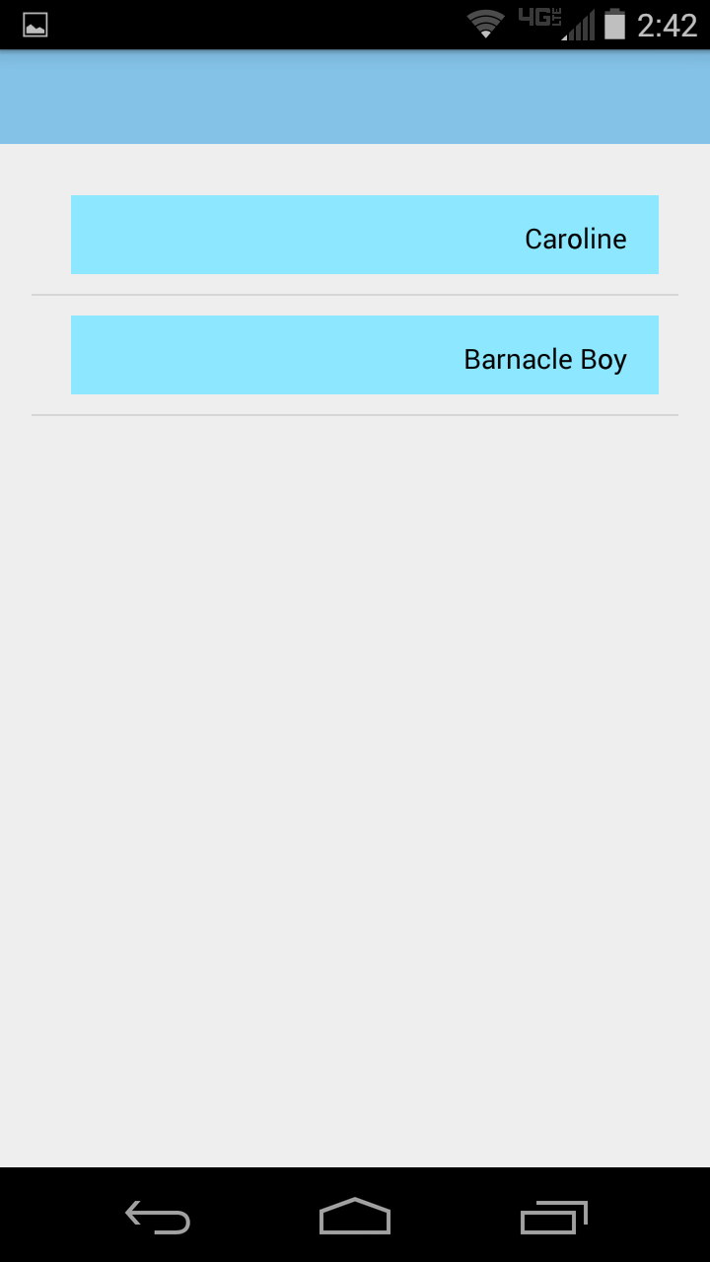

Slide 12
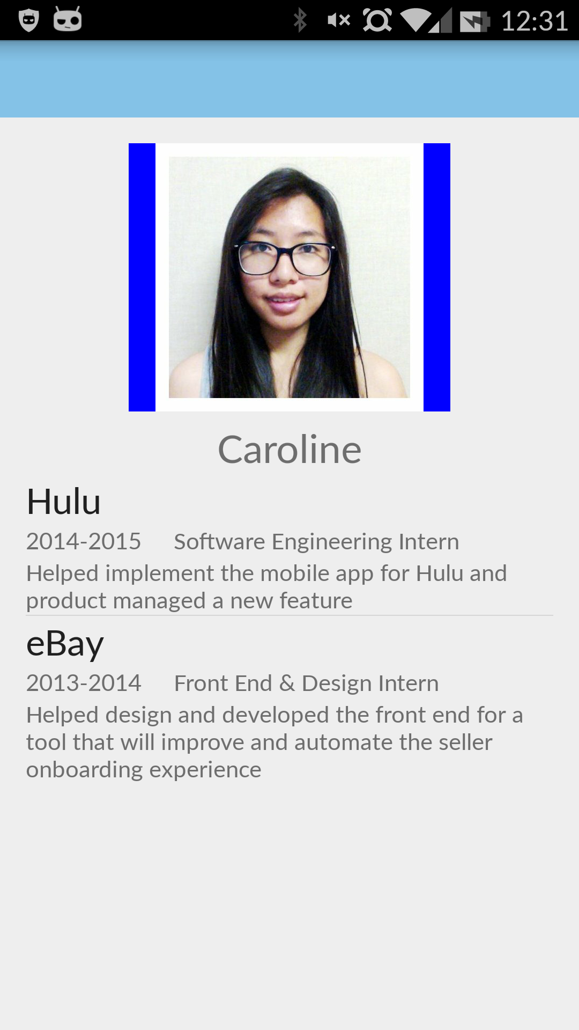

Slide 13
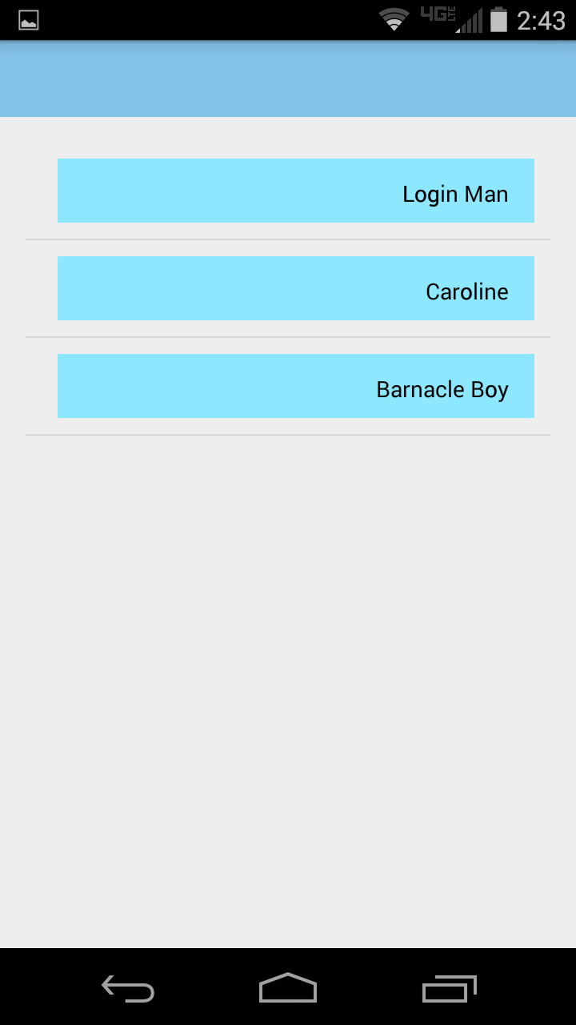

Slide 14
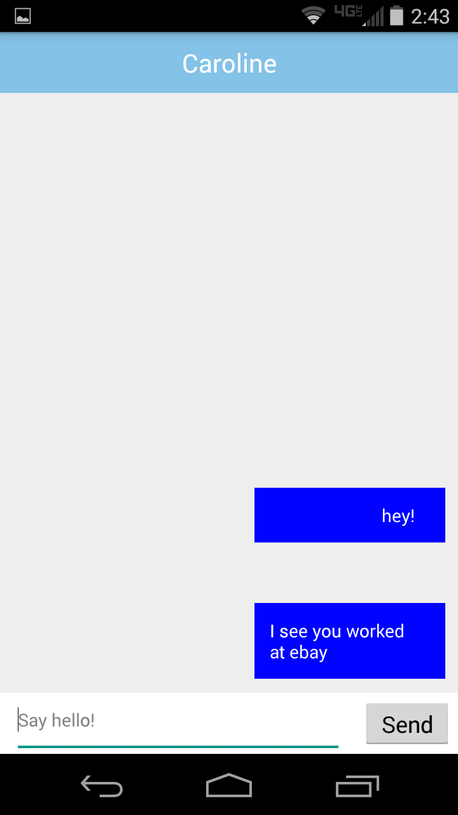

Slide 15
Future development
Improve matching algorithm
Use mutual likes
Improve local caching of data from database

Slide 16
Questions?

